Slide 1
Multiple time sampling for Monte Carlo ray-tracing instrument simulations
Mads Bertelsen, Peter Willendrup
ICANS 2026
PRESENTED BY Mads Bertelsen

Slide 2
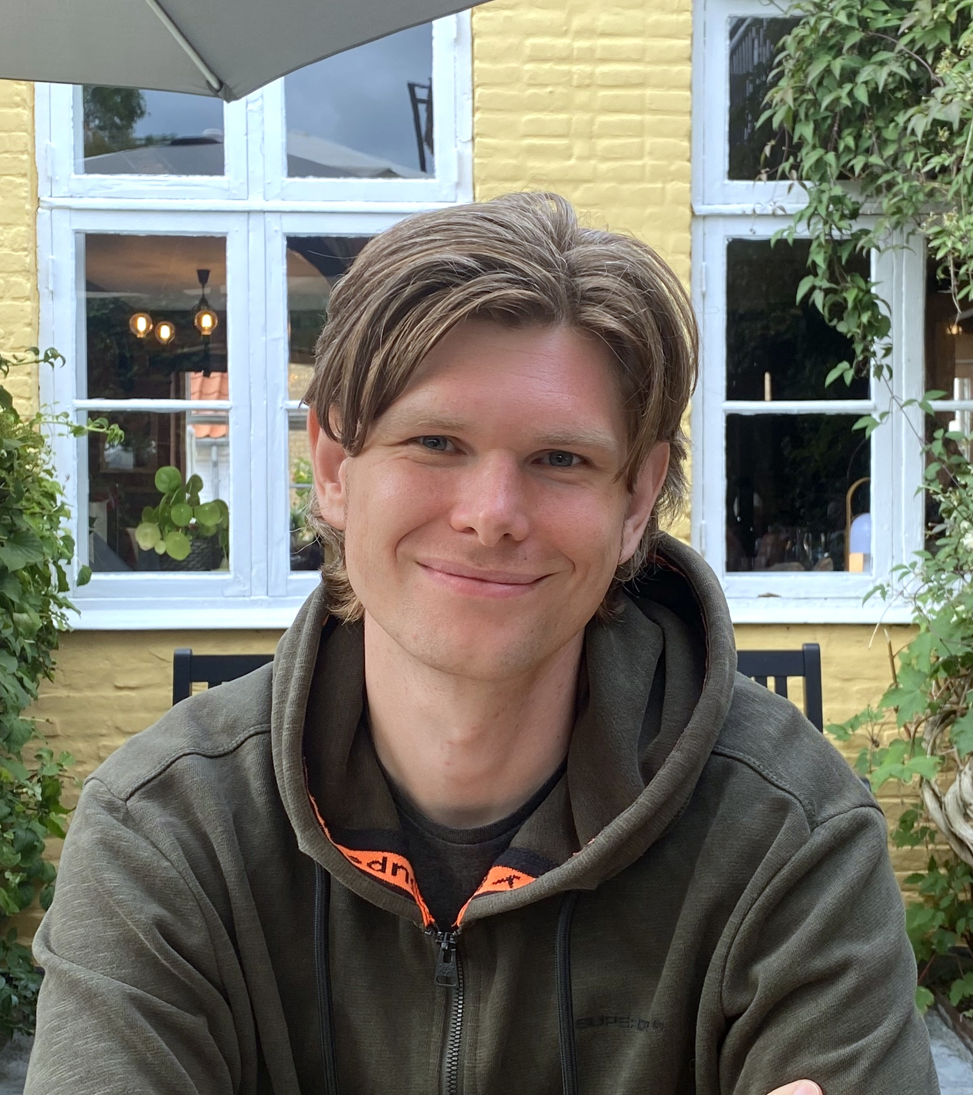
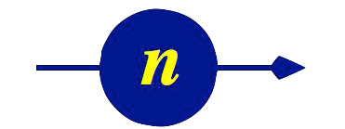
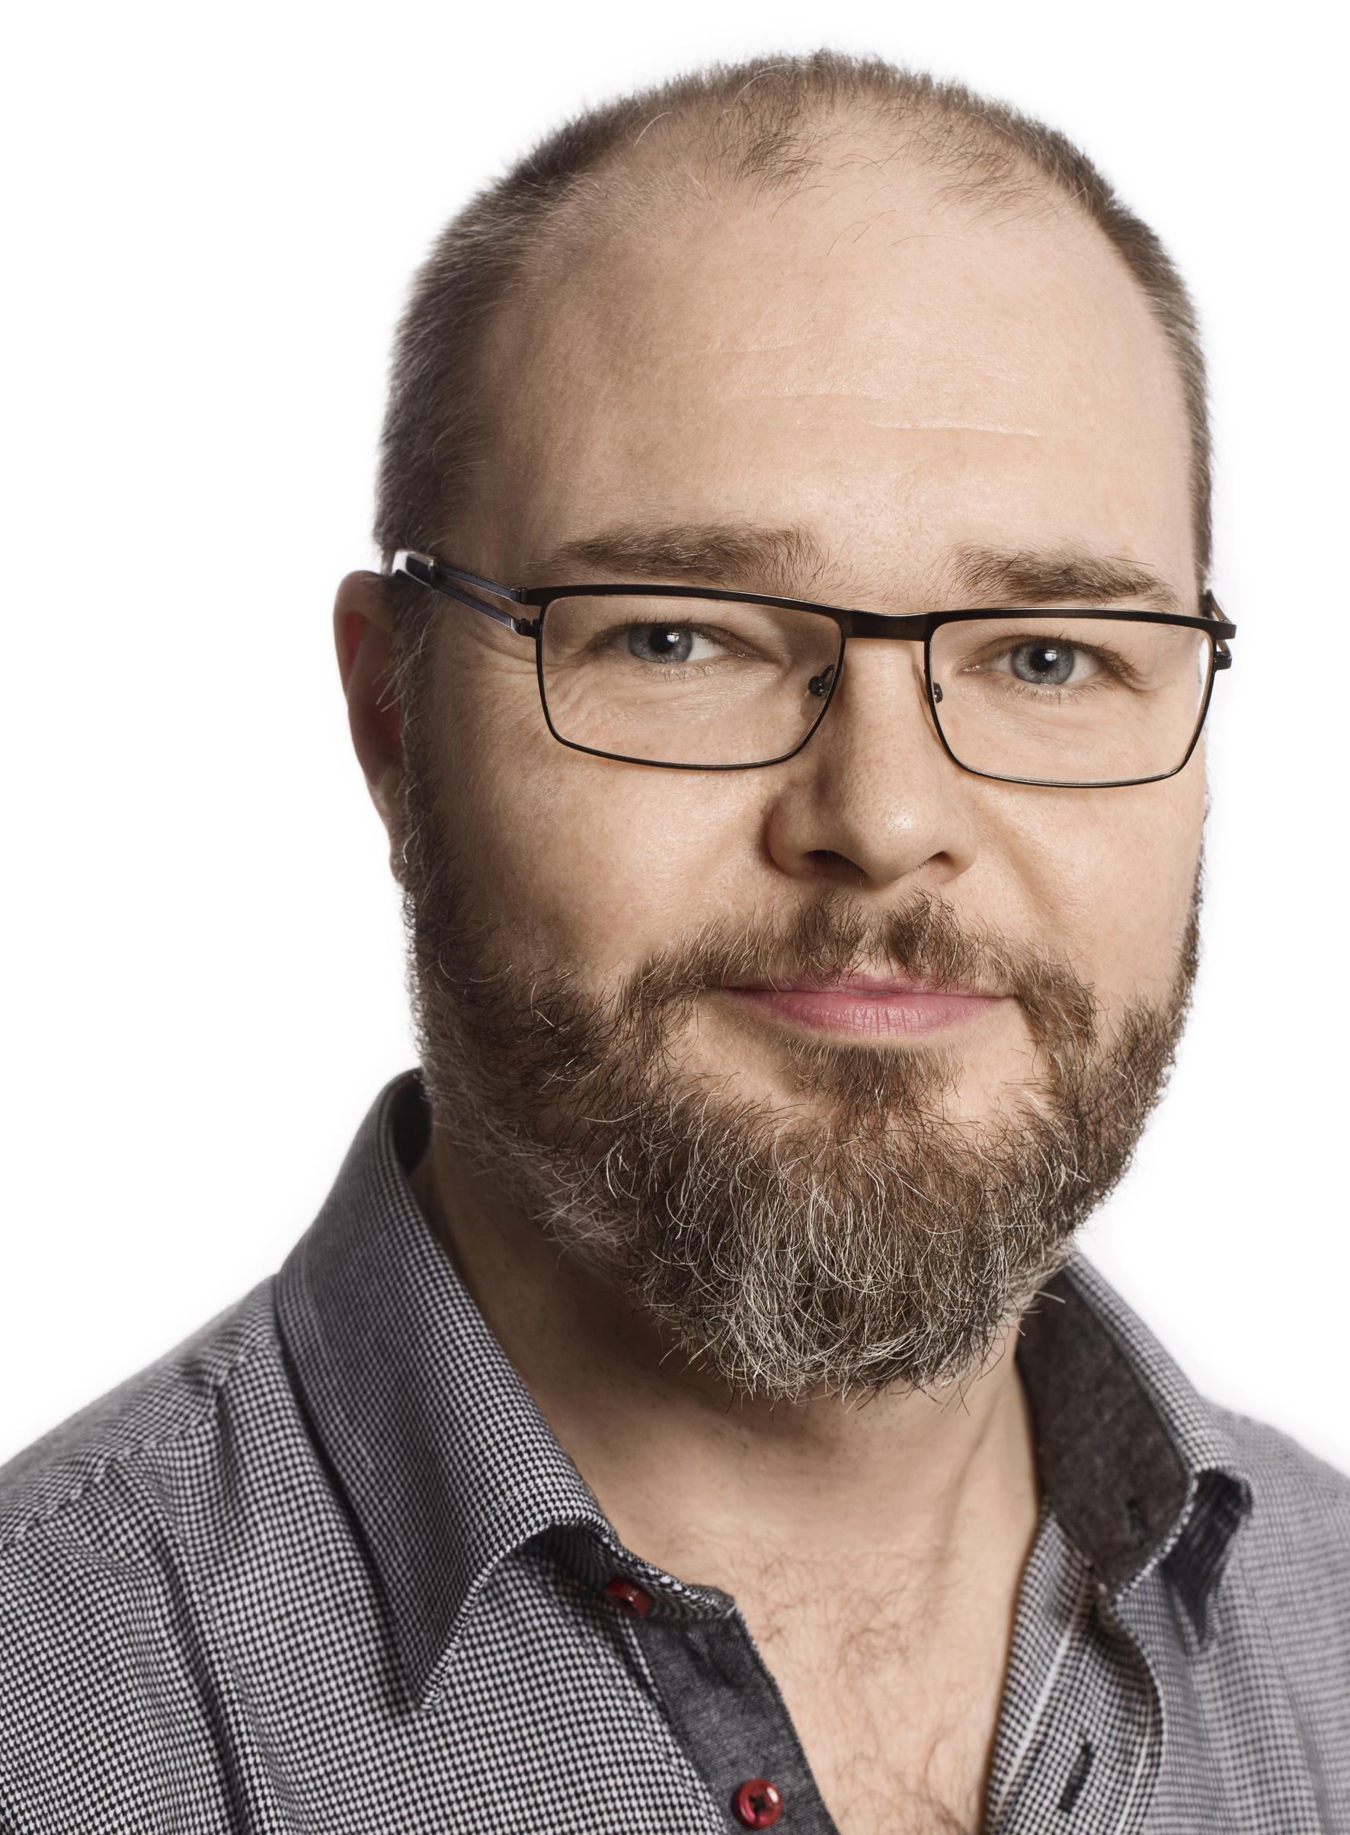
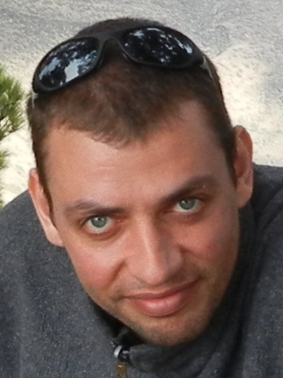

Instrument simulations
McStas team
McStas
Supported – continuously developed for 28 years
Modular – build instrument from large component library
Flexible – edit or create components locally
Peter Willendrup
Mads Bertelsen
Fast – a laptop is typically sufficient
Community driven – components & instruments contributed
Can always be improved
Add capabilities
User experience
Increase computational speed
Thomas Kittelmann
Torben
Nielsen

Slide 3
McStas optimization
Monte Carlo performance
We are often asked: “Can we simulate this in real time?”
Real source intensity
Single 2 MW ESS pulse: ~10¹⁰ thermalized neutrons entering the guide
Instruments with flux on sample ~10¹⁰ n/s/cm²
McStas speed
ESS instrument simulation on laptop: ~2 10⁵ rays per second
Just need 10⁵ laptops?
We need to improve! Today we present a new optimization trick

Slide 4
McStas optimization
Performance tricks
Limiting phase-space
Focusing
Weight – Reflection / Absorption
Weight – Sampling interesting events

Slide 5
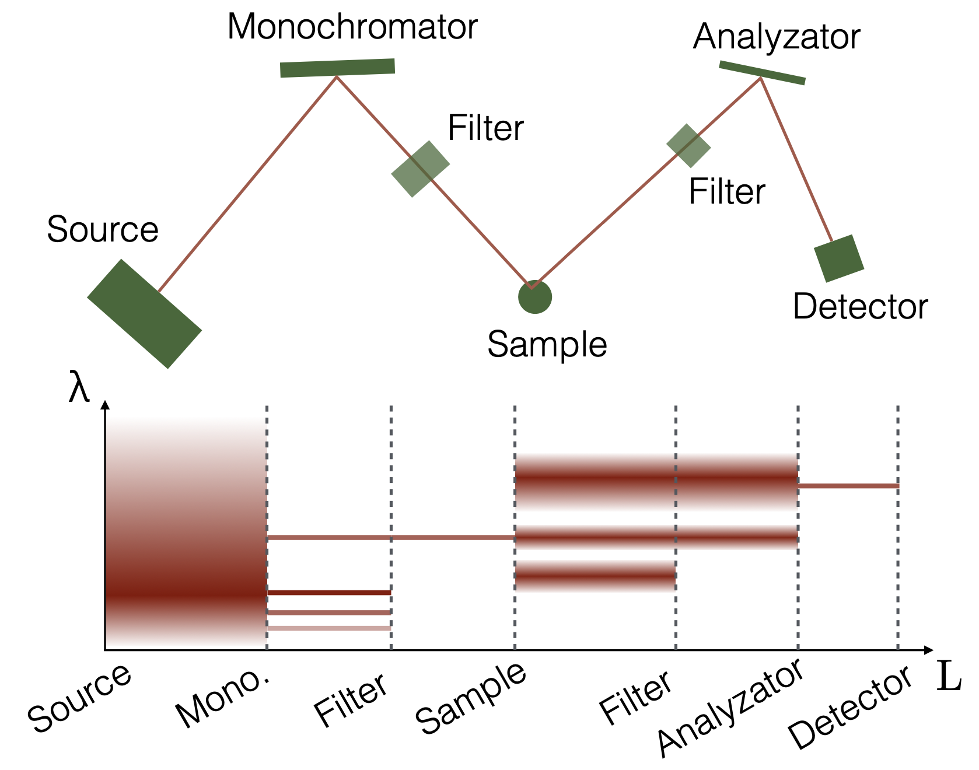
McStas optimization
Performance tricks
Limiting phase-space
Focusing
Weight – Reflection / Absorption
Weight – Sampling interesting events
Only start with these wavelengths

Slide 6
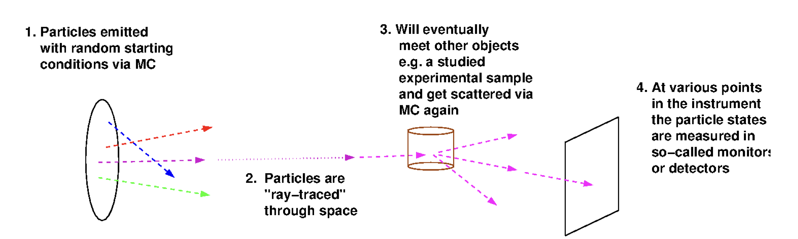
McStas optimization
Performance tricks
Limiting phase-space
Focusing
Weight – Reflection / Absorption
Weight – Sampling interesting events

Slide 7
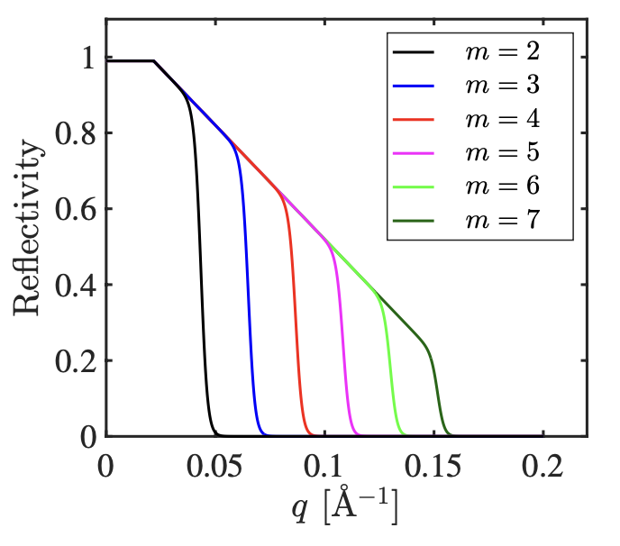
McStas optimization
Performance tricks
Limiting phase-space
Focusing
Weight – Reflection / Absorption
Weight – Sampling interesting events
Reduce ray weight p instead of removing the ray

Slide 8
McStas optimization
Reality – Low scattering probability
Performance tricks
Limiting phase-space
Focusing
Weight – Reflection / Absorption
Weight – Sampling interesting events
Sample
Detector

Slide 9
McStas optimization
Reality – Low scattering probability
Performance tricks
Simulation – Modified scattering probability
Limiting phase-space
Focusing
Weight – Reflection / Absorption
Weight – Sampling interesting events
Sample
Detector
Actual intensities recovered with weight transformation

Slide 10
McStas optimization
Performance tricks
Limiting phase-space
Focusing
Weight – Reflection / Absorption
Weight – Sampling interesting events
Even with these tricks, choppers are a problem

Slide 11
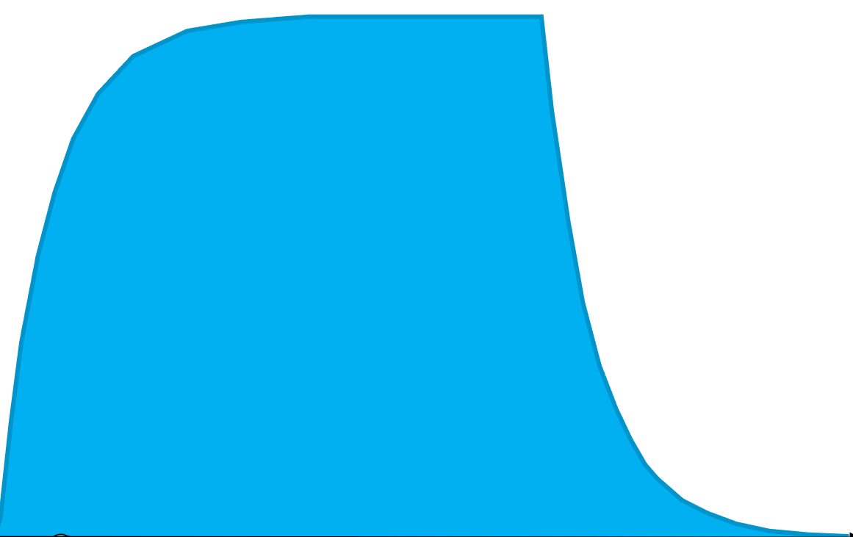
McStas optimization
Performance tricks
No solution for choppers

Slide 12
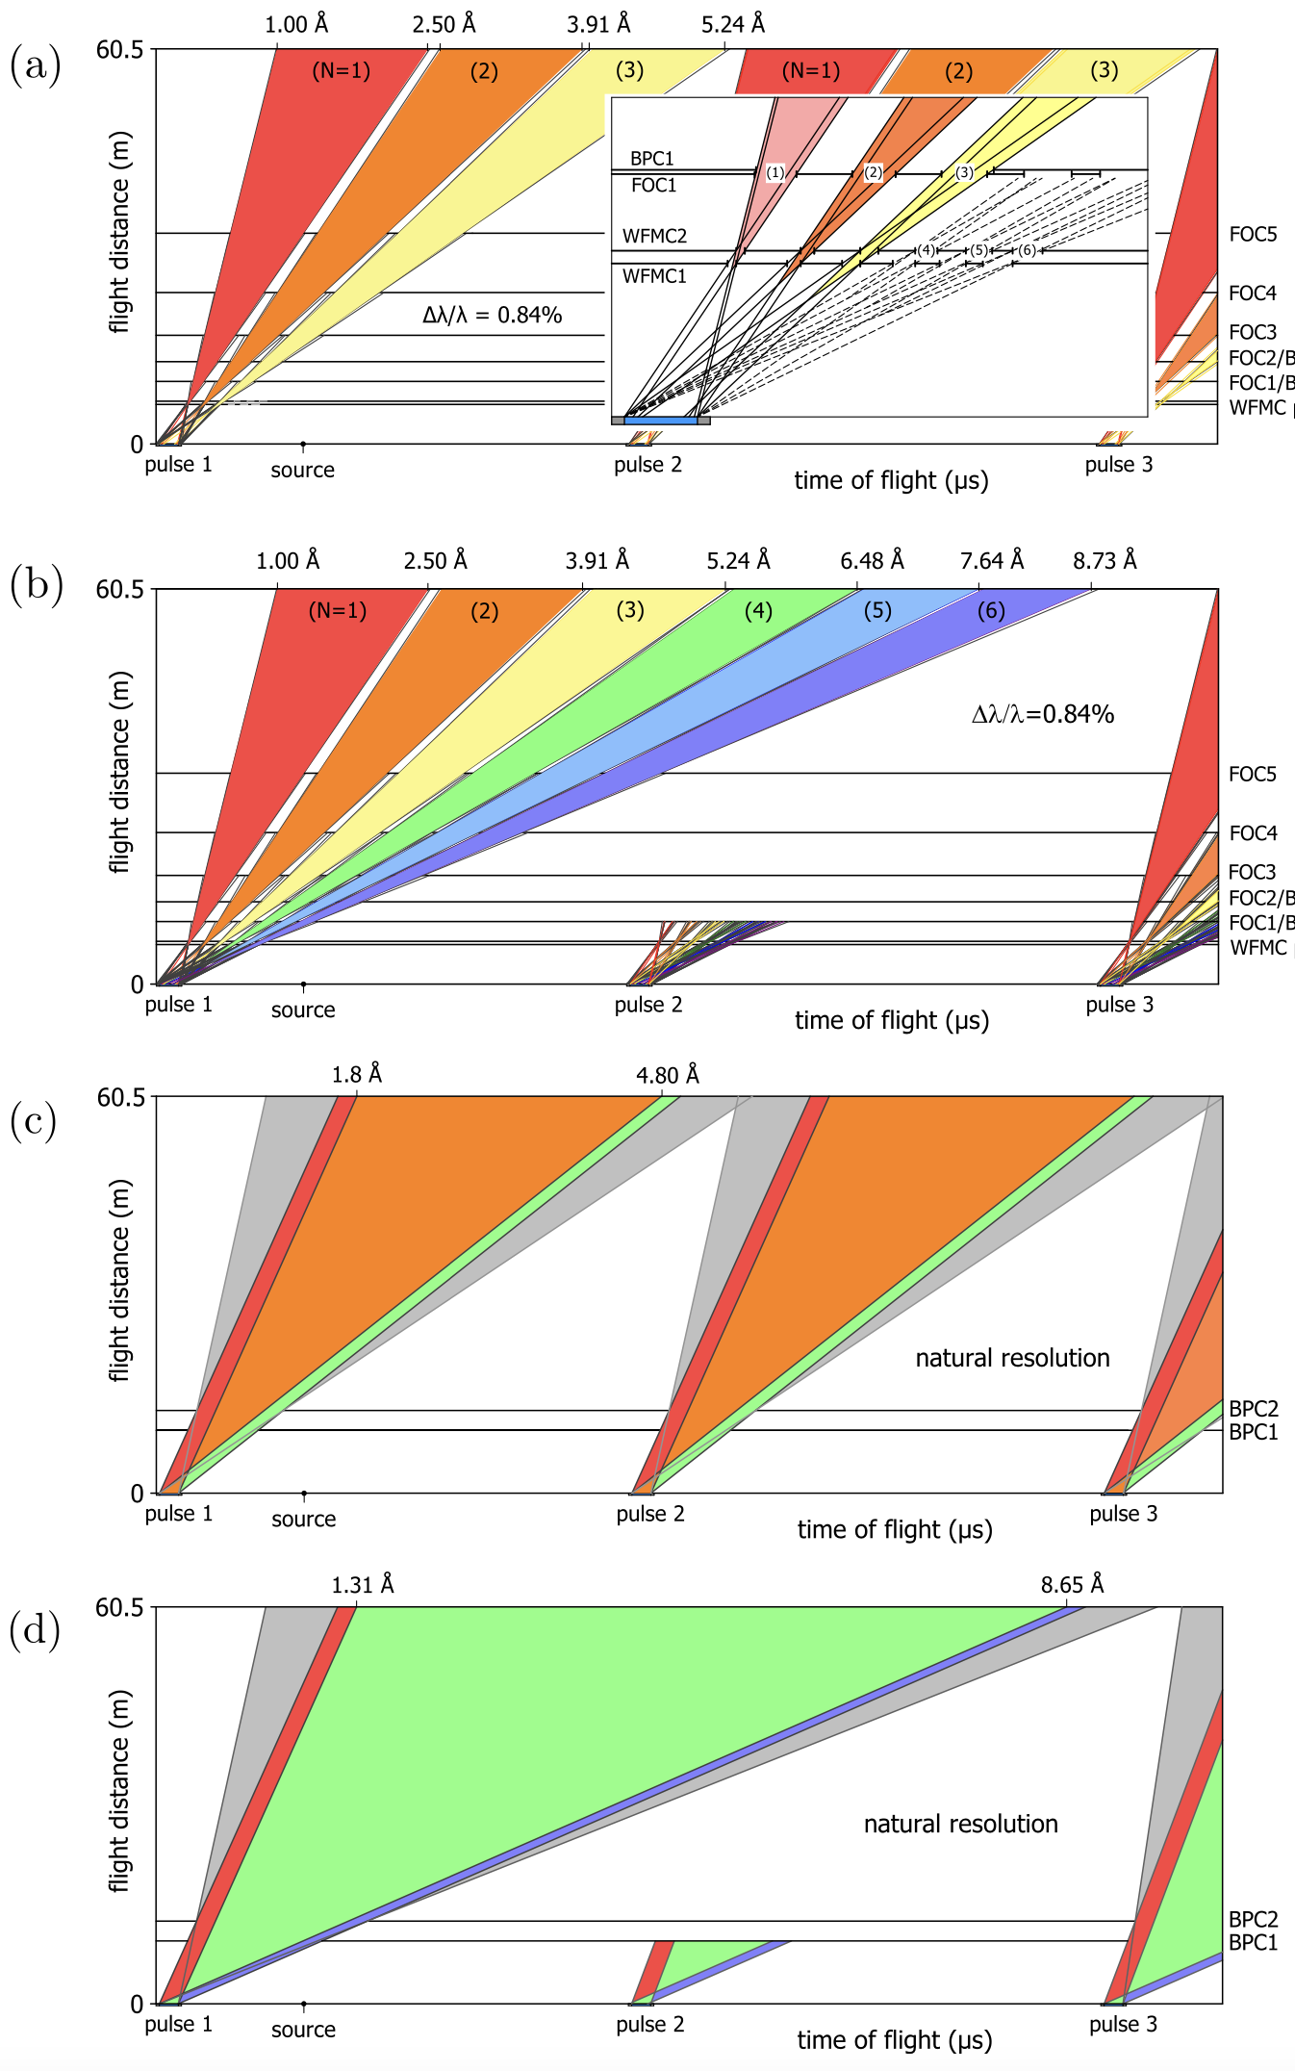
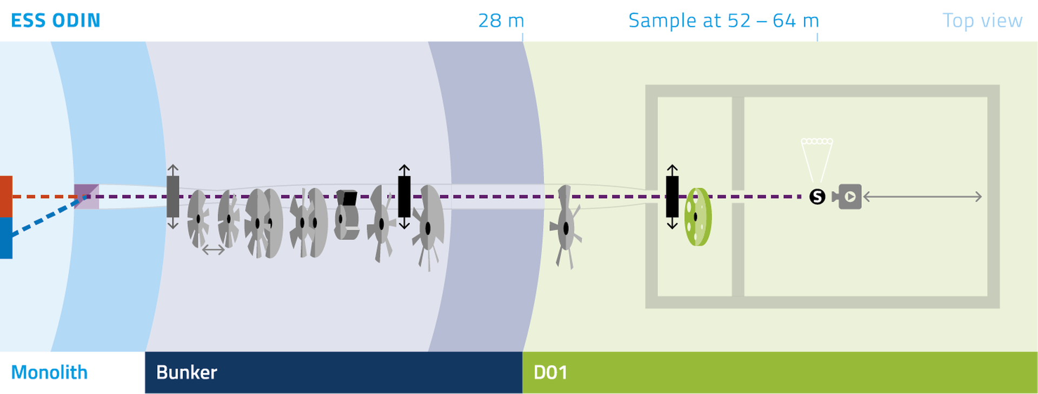
McStas optimization
ODIN as test case
ODIN as test case
Several chopper modes, including WFM
6 frame WFM mode
10 choppers

Slide 13
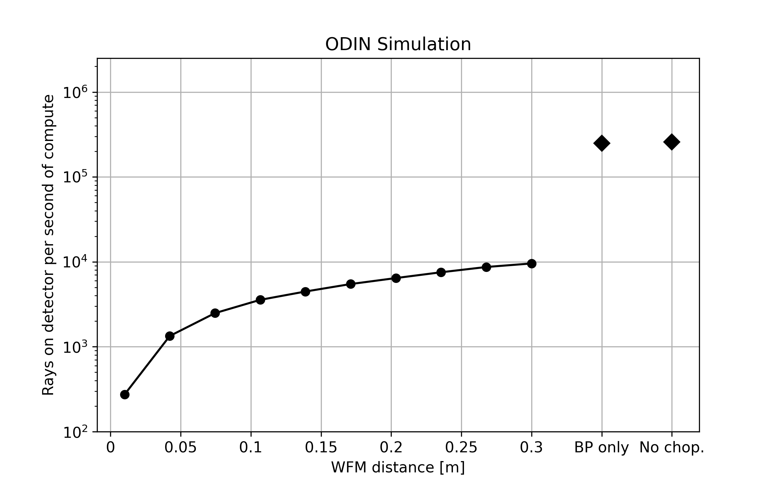
McStas optimization
Current performance on ODIN (no sample)
2.5 10⁵ rays/s without choppers
Same for band pass only
Wavelength range chosen well
WFM mode 10⁴ and down

Slide 14
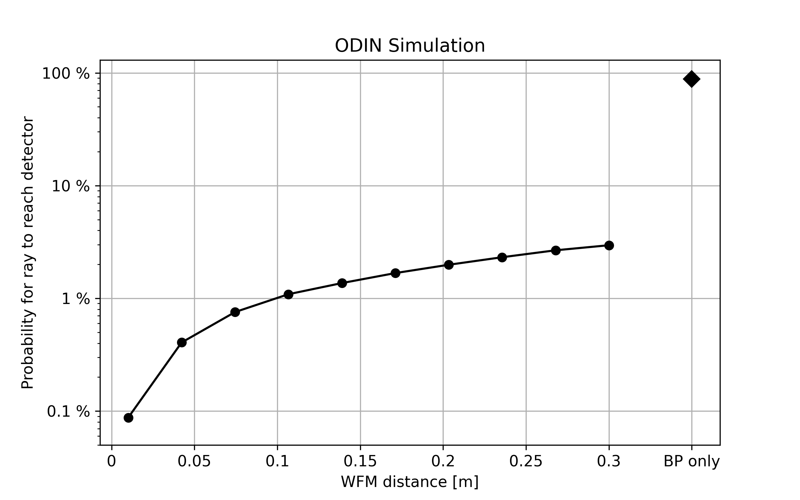
McStas optimization
Current performance on ODIN (no sample)
Normalized to no chopper case
Bandpass ~same number
WFM much lower
Many rays removed by choppers

Slide 15
McStas optimization
Multiple time sampling
Ray parameters
Position, Velocity, Weight, Time, Spin
Current McStas – one time sampled

Slide 16
McStas optimization
Multiple time sampling
Ray parameters
Position, Velocity, Weight, Time, Spin
Current McStas – one time sampled
Prototype – multiple times sampled from ESS Butterfly
and t_offset[100], p_t[100]

Slide 17
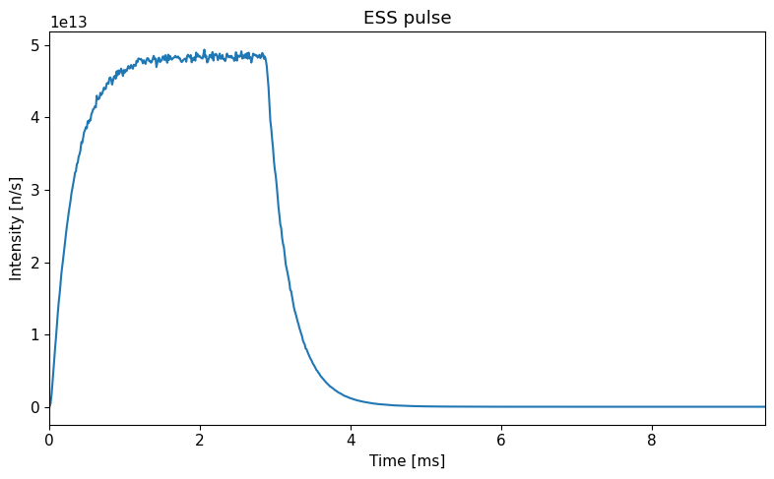
McStas optimization
Multiple time sampling
ESS pulse time sampling
Has to include tail
Makes sense to use more times

Slide 18
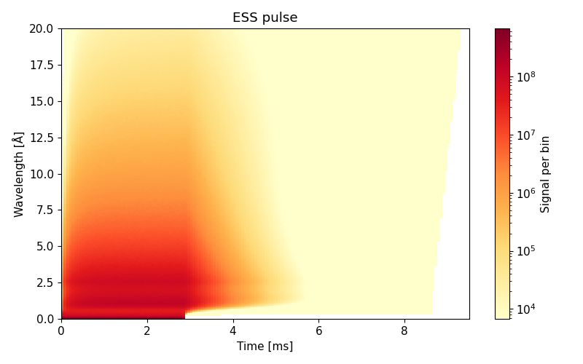
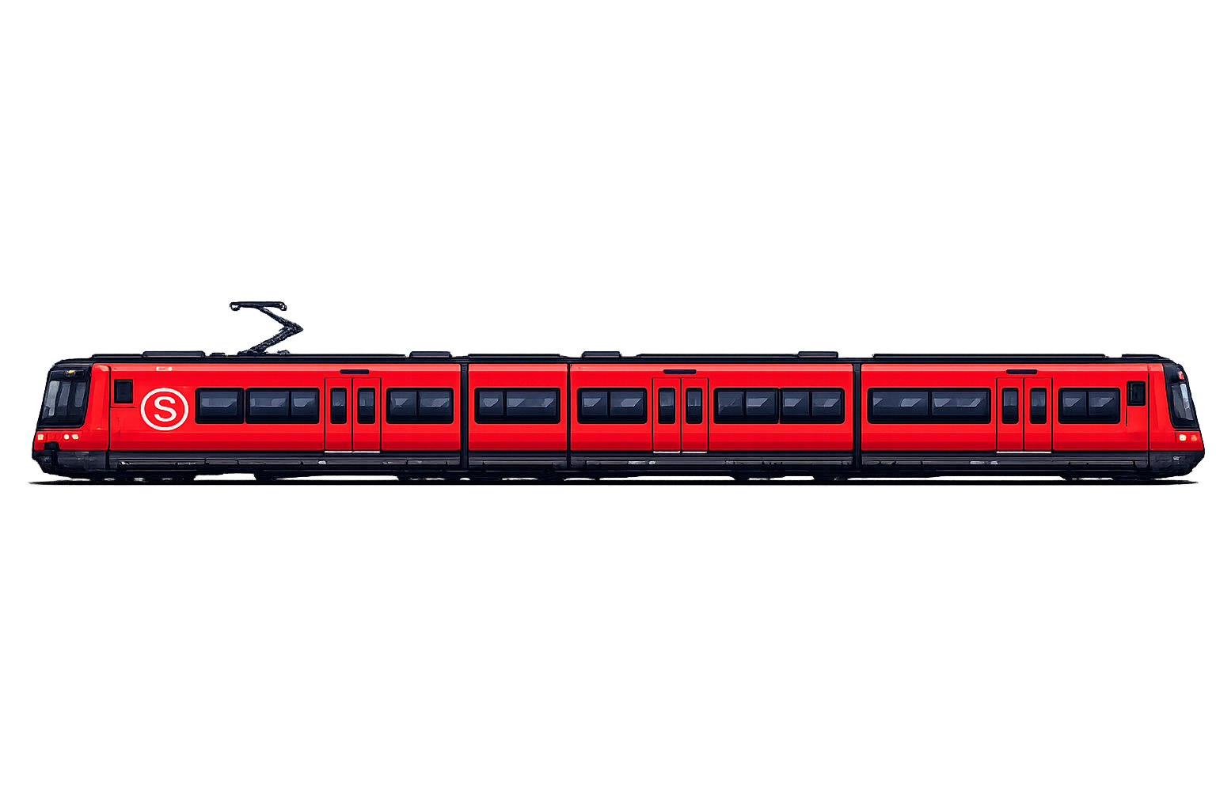
McStas optimization
Multiple time sampling
ESS pulse time sampling
Has to include tail
Makes sense to use more times
Sampling strategy
Step 1: position, direction, wavelength
Step 2: multiple time sampling
Number of time samples
Up to a given number, user parameter
Adaptive, given number on chosen monitor to avoid over-sampling

Slide 19
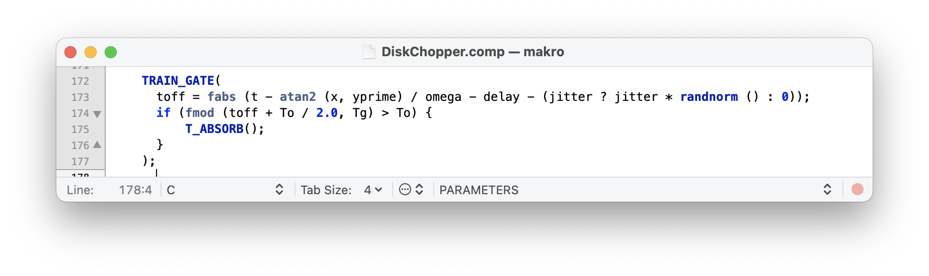
McStas optimization
Multiple time sampling
Code updates necessary
Components that ABSORB based on time (Choppers)
Components that read time (Monitors)
Components that unpack rays no longer support GROUP
Multi slit choppers: Go from DiskChopper GROUP to MultiDiskChopper
Need careful introduction to package

Slide 20
McStas optimization
Multiple time sampling performance
Return to ODIN performance

Slide 21
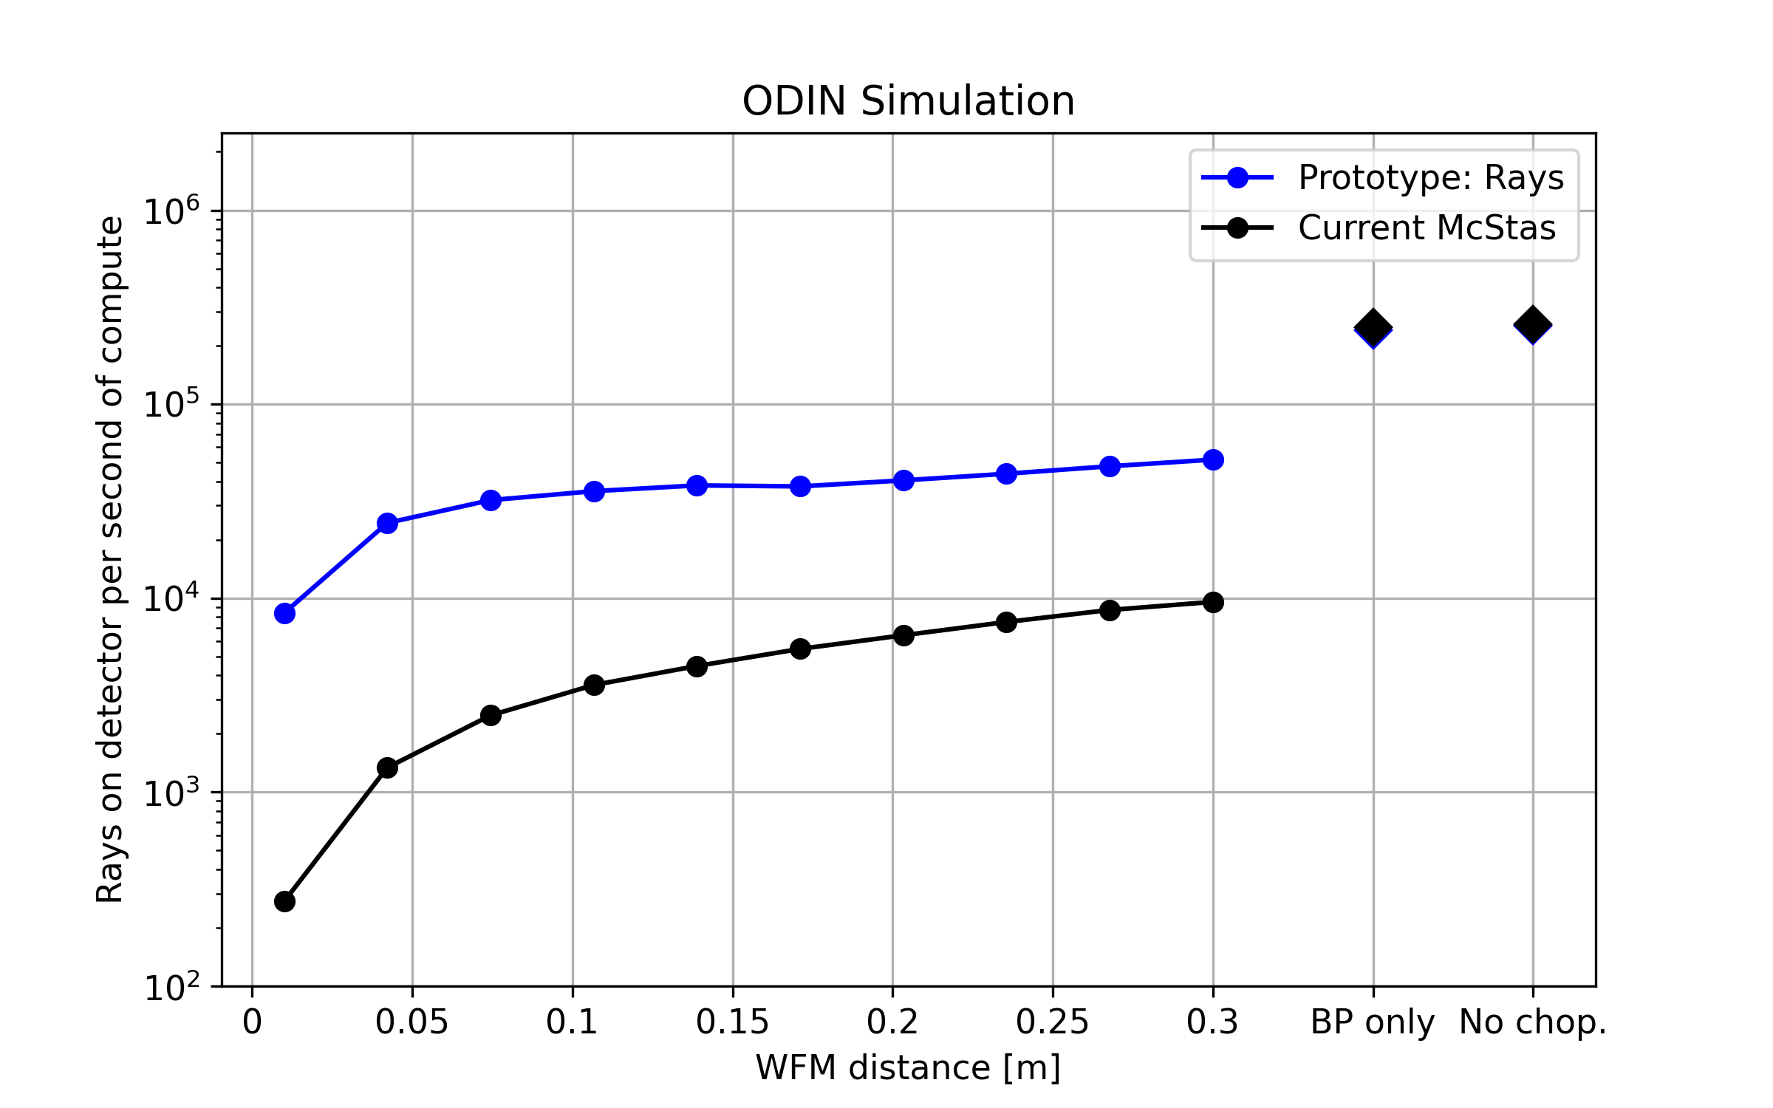
McStas optimization
Multiple time sampling performance
Return to ODIN performance
No choppers
Can get more time information
Only Band pass
Same as without choppers
WFM
Significantly improved performance

Slide 22
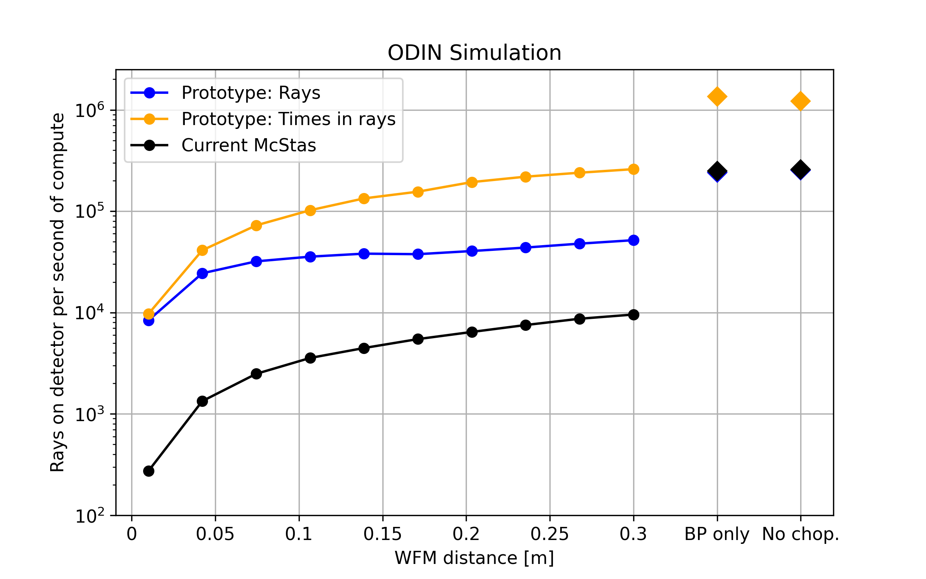
McStas optimization
Multiple time sampling performance
Return to ODIN performance
No choppers
Can get more time information
Only Band pass
Same as without choppers
WFM
Significantly improved performance

Slide 23
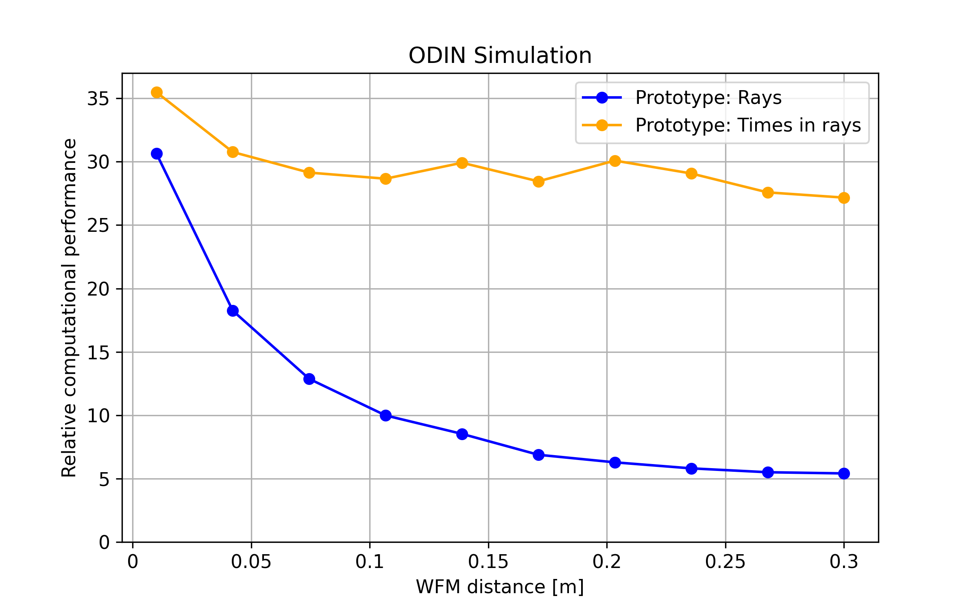
McStas optimization
Multiple time sampling performance
Return to ODIN performance
No choppers
Can get more time information
Only Band pass
Same as without choppers
WFM
Significantly improved performance
Gains between 5x and 35x

Slide 24
McStas optimization
Performance across ESS instruments
ODIN Case
White beam not using time information ~ 3% performance loss
Parked choppers or BP using time information ~ 3-5x gain
WFM mode ~ 5x-35x gain
Case | Expected performance gain
Single frame instruments | 2-5x (if time focusing used as baseline)
WFM or complex chopper solutions | Significant, like ODIN
Monochromating choppers | Large

Slide 25
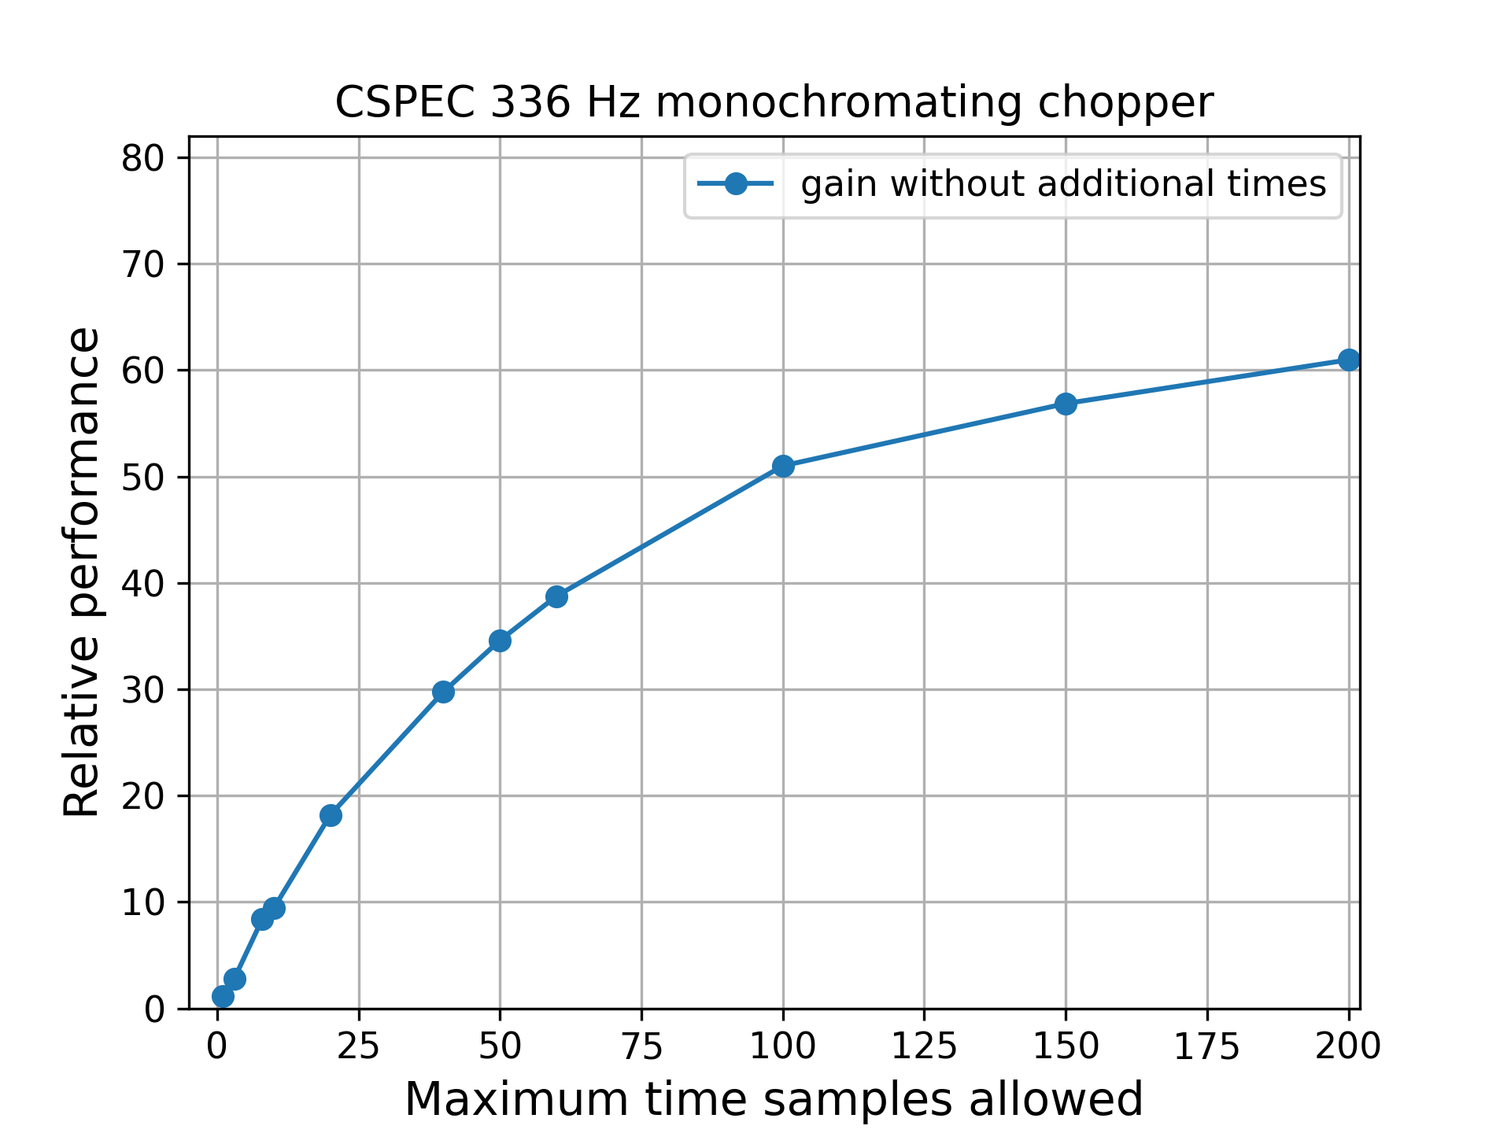
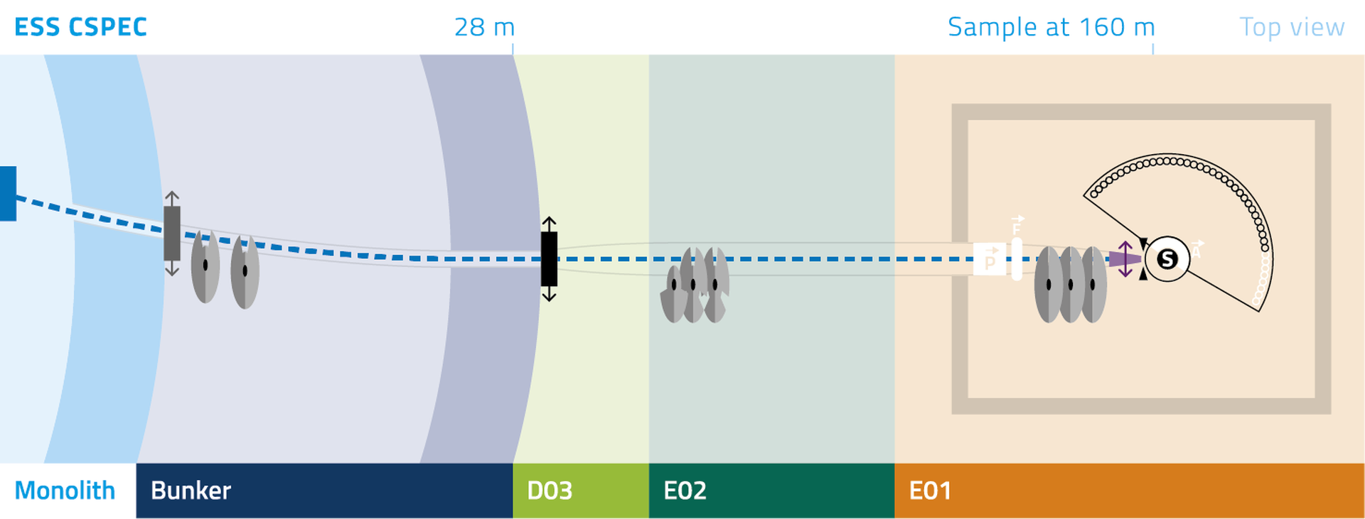
McStas optimization
Multiple time sampling performance

Slide 26
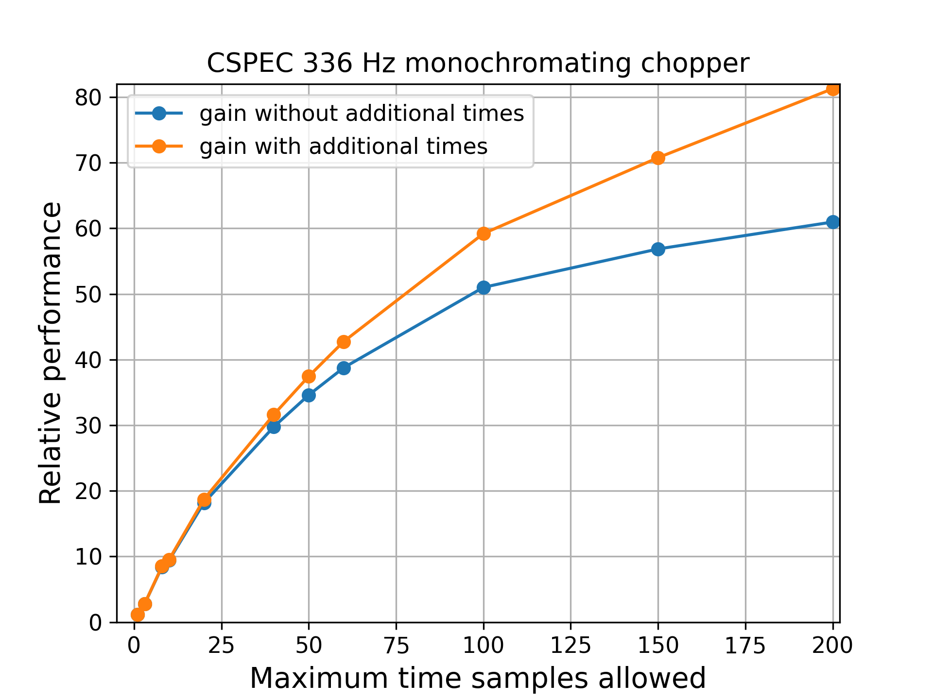
McStas optimization
Multiple time sampling performance

Slide 27
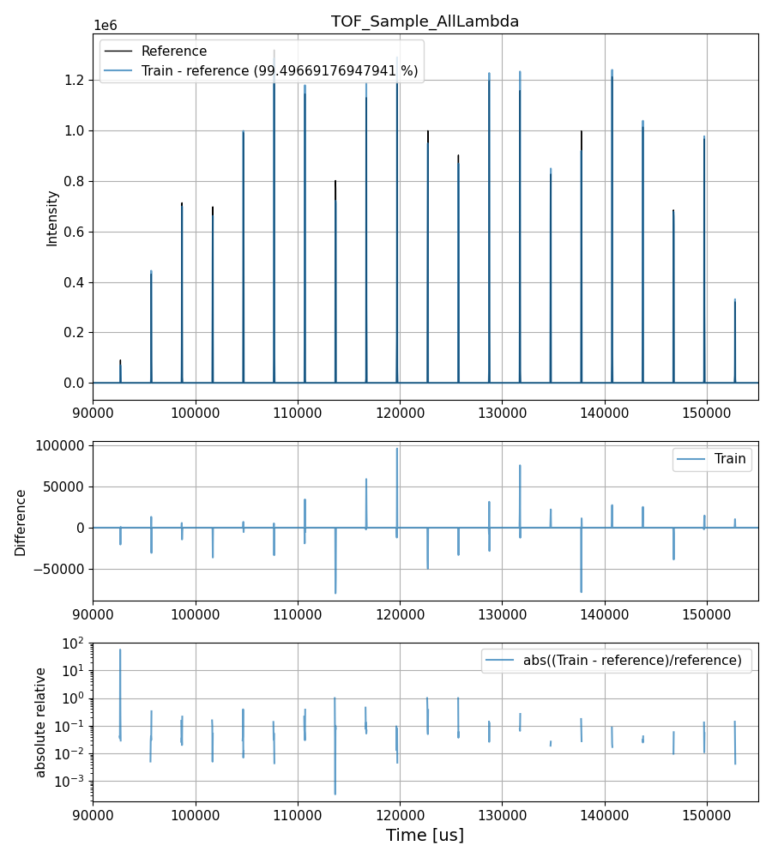
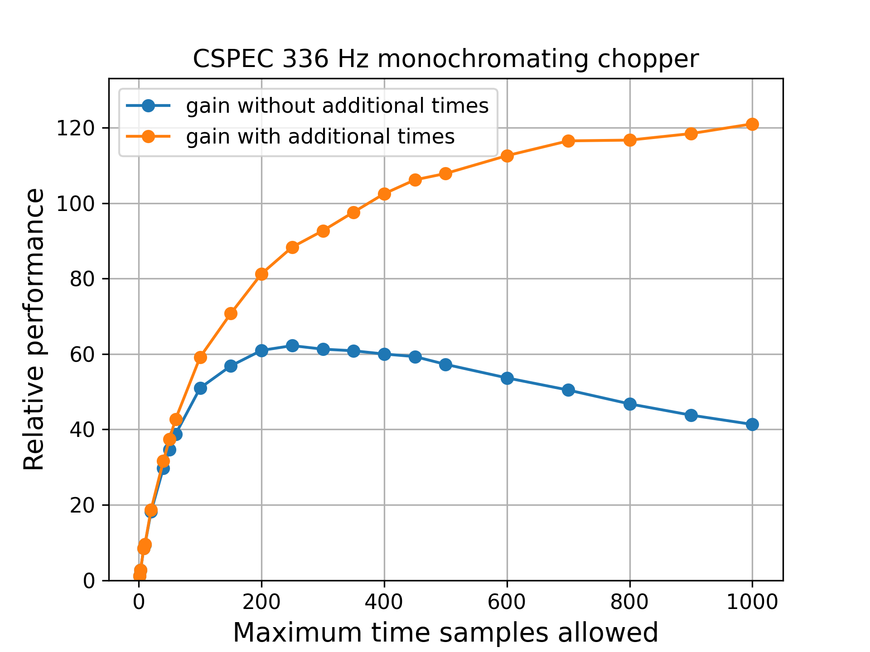
McStas optimization
Multiple time sampling performance
Example data at maximum 500 sampled times

Slide 28
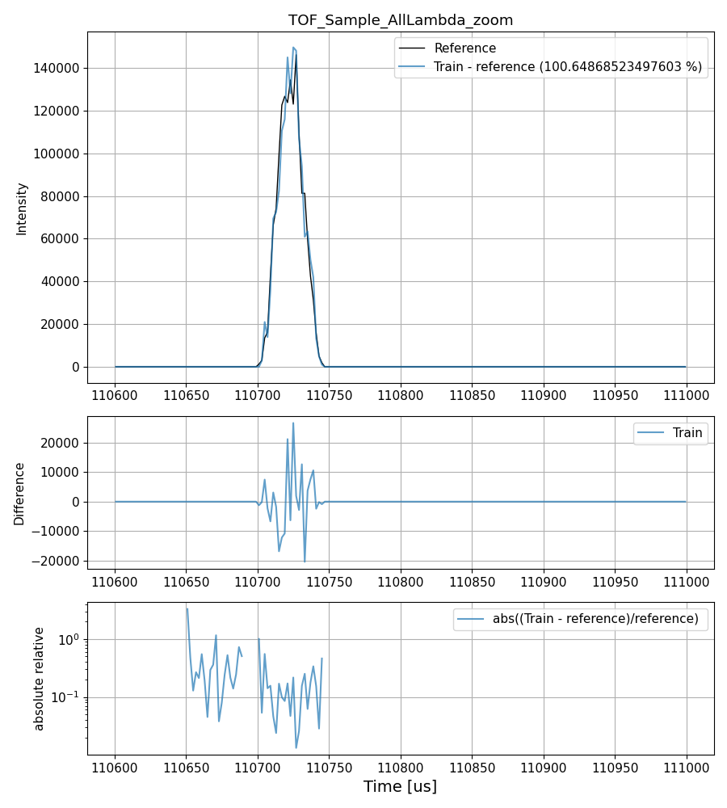
McStas optimization
Multiple time sampling performance
Example data at maximum 500 sampled times

Slide 29
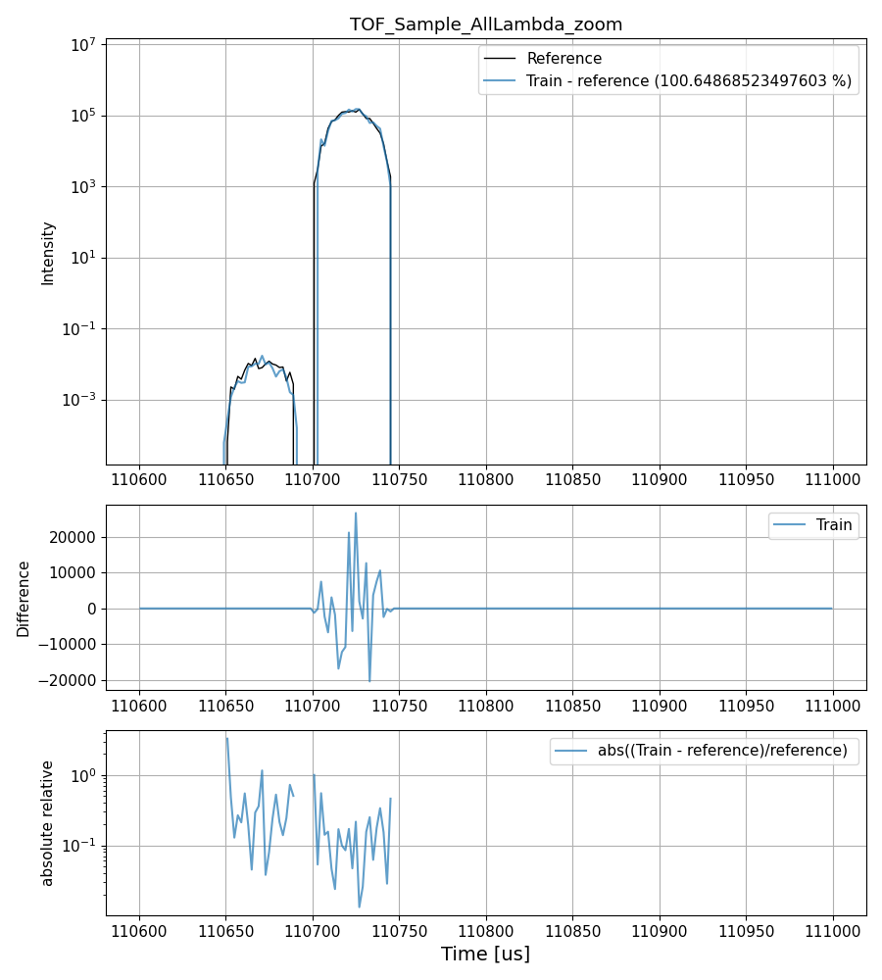
McStas optimization
Multiple time sampling performance
Example data at maximum 500 sampled times

Slide 30
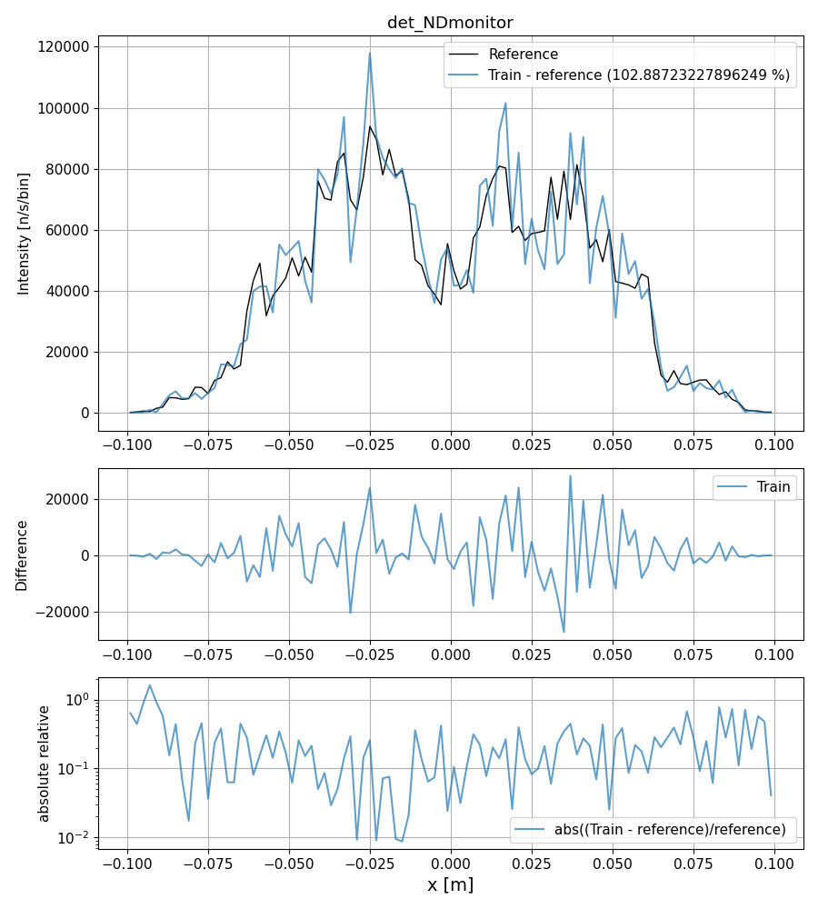
McStas optimization
2563 s vs 26 s
Multiple time sampling performance
Example data at maximum 500 sampled times

Slide 31
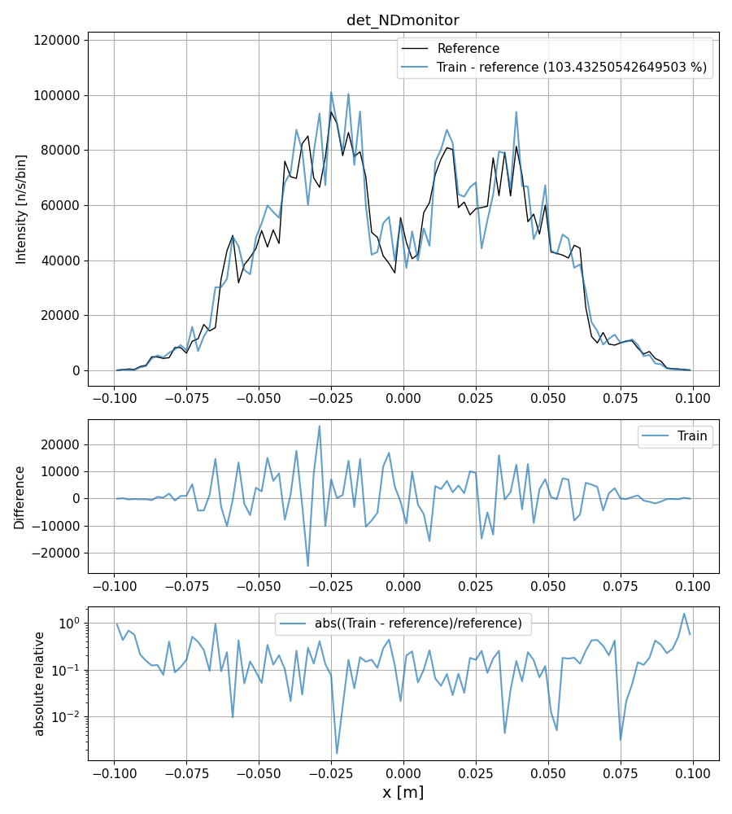
McStas optimization
2563 s vs 55 s
Multiple time sampling performance
Example data at maximum 500 sampled times

Slide 32
McStas optimization
Outlook
Some additional considerations necessary before release
Need to be carefully implemented to be backwards compatible
Components where time impacts position or velocity need to be marked
Doppler monochromator
Others?
Similar system would also be possible for spin

Slide 33
McStas optimization
Conclusion
Used to get % gains when optimizing, not gain factors
We see up to 120x gain at CSPEC (when time information used)
The gains are mainly where performance was problematic (high resolution)
Simulation performance flatter with changing resolution
These performance gains are independent on other speed ups
time focusing
Use of GPU’s
Probably relatively easy to implement in other packages

Slide 34
Thanks for your attention

