Slide 1
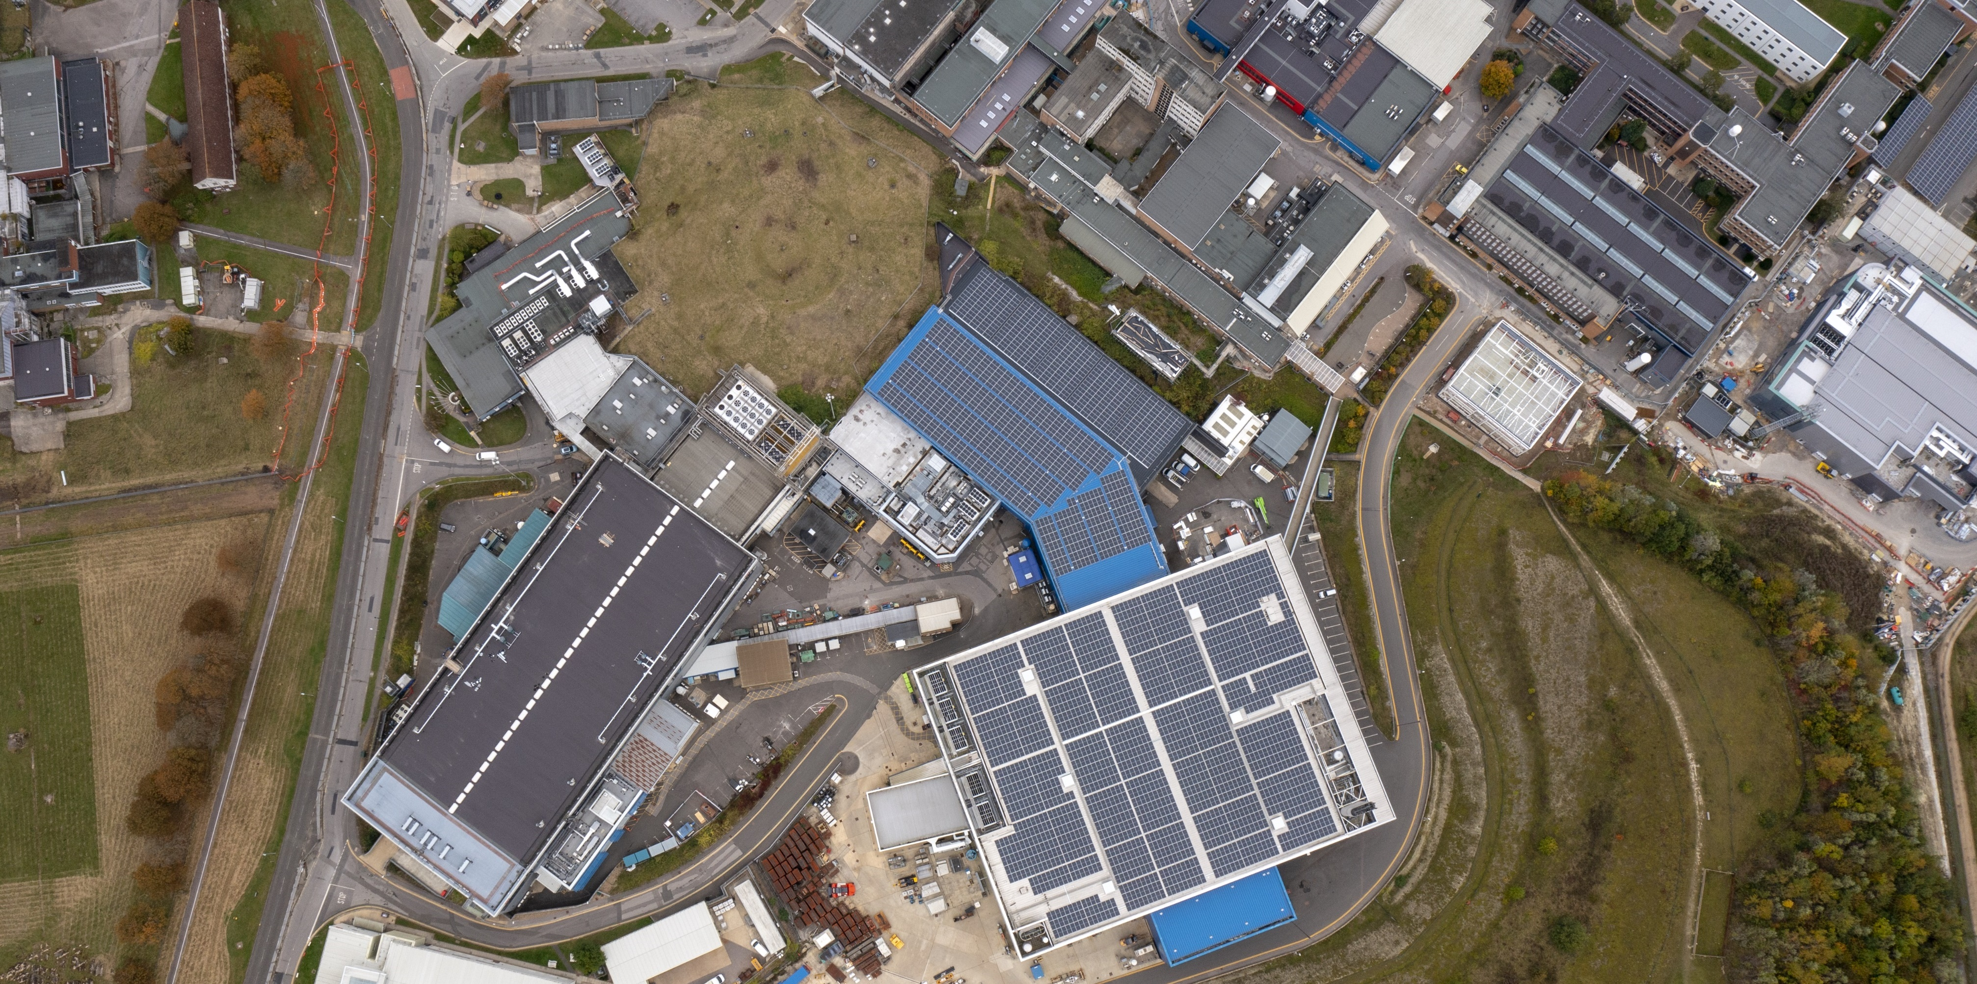
ISIS Neutron and Muon Source Update
Neutrons and muons to advance knowledge and improve lives
Matt North & Ste Gallimore, ICANSXXV, April’26

Slide 2
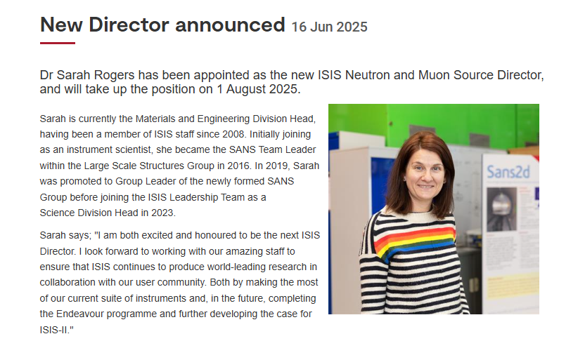
ISIS Director Announcement
Notes:
20 August 25

Slide 3
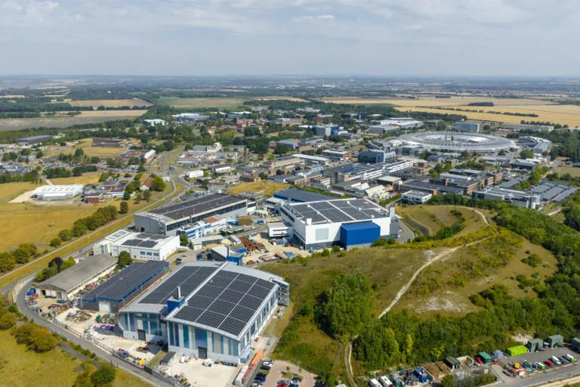
Notes:
Ariel View – ISIS at RAL
Accelerator driven neutron and muon source, two targets.
First neutrons in 1983, 40+yrs of operation.

Slide 4
Scientific Computing
Space Cluster
Diamond Light Source
Moderna
Rosalind Franklin Inst.
National Quantum Computing Centre
EPAC
Central Laser Facility
Notes:
Continues to attract huge amount of both public and private investment. Plan for steady investment of 1.5bn over the next 10 yrs.
National Labs
NQCC, RFI, Space Cluster, Moderna Innovation & Tech Centre, lots of growth of modern hi-tech lab space.
DLS-II, VULCAN 20-20

Slide 5






What is the ISIS Neutron and Muon Source?
ISIS’s mission is to enable research that advances knowledge and improves lives.
Annually, ISIS hosts around 3000 UK and international researchers from academia and industry. The research conducted at ISIS plays an important role in addressing global challenges, answering fundamental questions, and delivering scientific and socioeconomic impact.
^{A typical year at ISIS…}
35
instruments
hosting
1200 experiments
enabled by
600 staff
for…
3000
users
from
30
countries
generating
600
publications
Notes:
Typical Year – delivering 1200 experiments for 3000 users from across the globe.

Slide 6
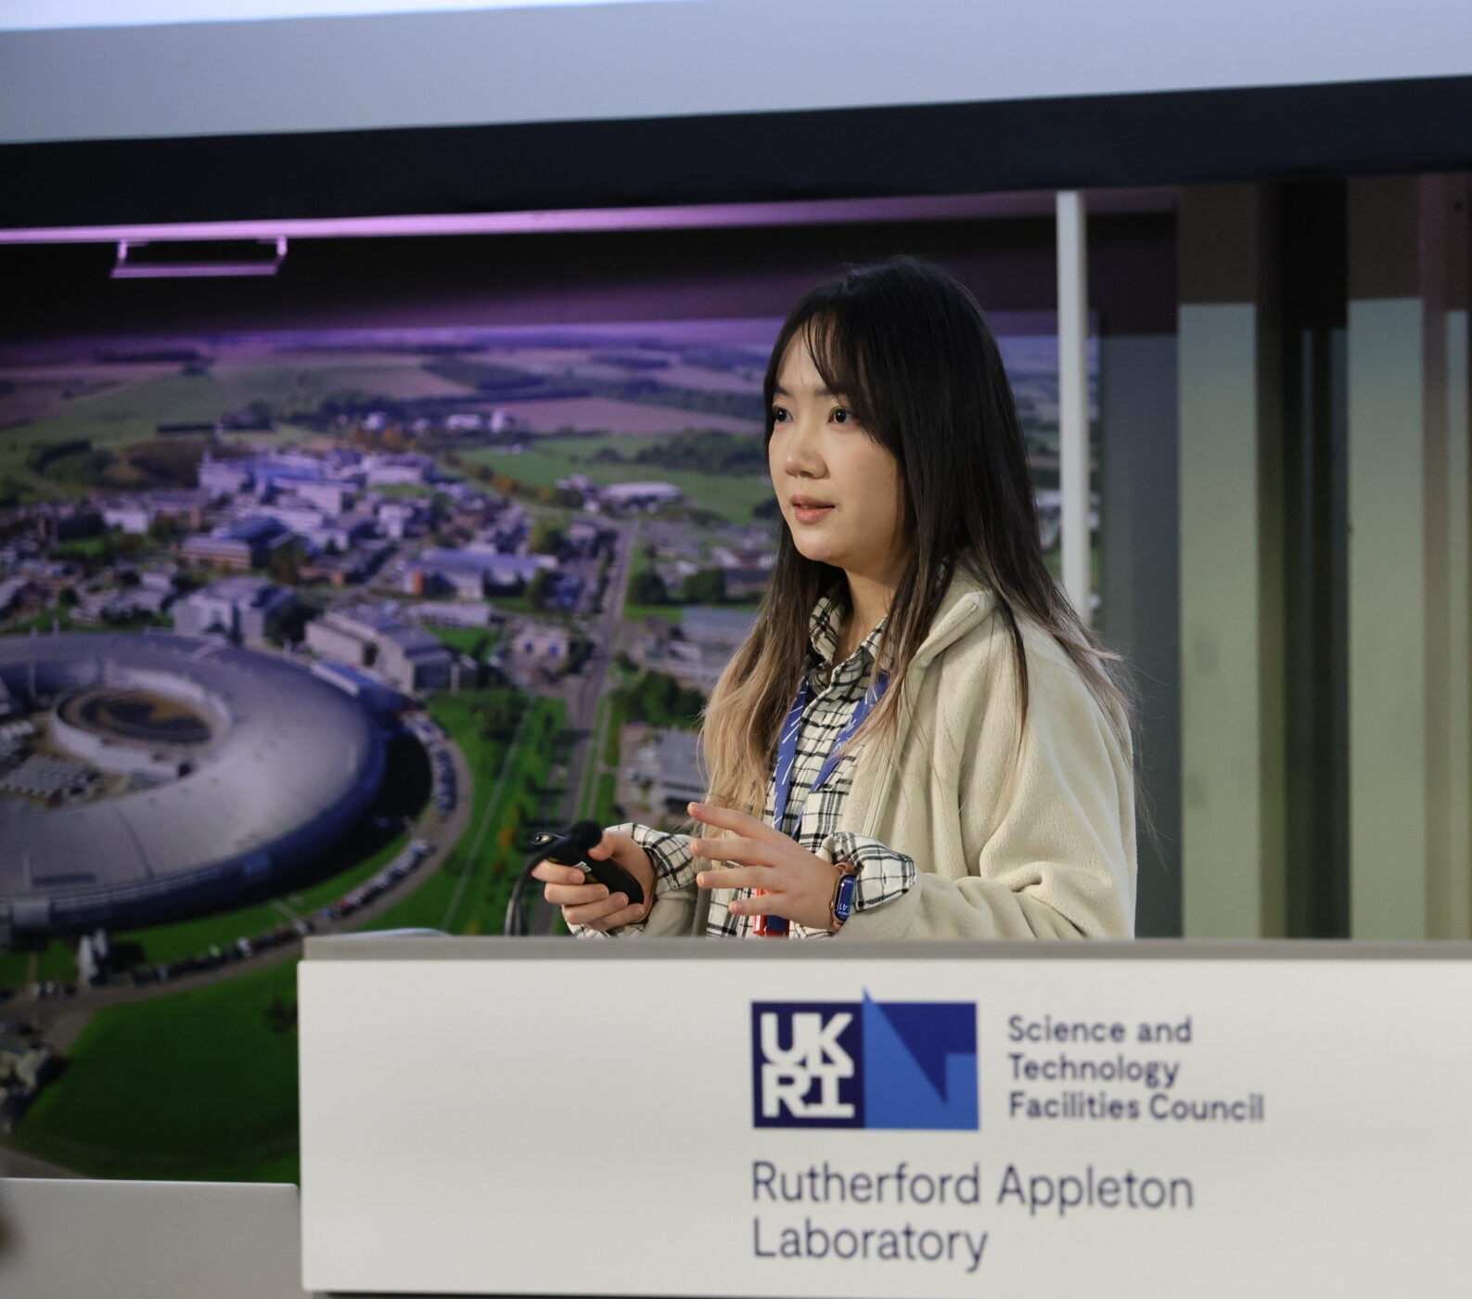


Neutrons provide insight into the synthesis of a potential hydrogen storage material
Neutron diffraction tracks the high‑pressure formation of a promising hydrogen‑storage material, offering new insight into metal‑hydride synthesis under industrially relevant conditions.
Background
Hydrogen storage remains a key challenge for a hydrogen economy. Metal hydrides, such as molybdenum hydride, offer an alternative to compressed H₂ gas by providing a framework for hydrogen atoms to sit.
The study was led by Zhongsheng Wei, a postdoctoral researcher supported by a UKRI International Science Partnerships Fund fellowship linking ISIS, Diamond and the Paul Scherrer Institute.
The value of ISIS
Using the Paris-Edinburgh press, and with the support of the ISIS Sample Environment team, the structure of the deuterated form of molybdenum hydride was studied on Pearl as it formed at pressures of over 6 GPa.
Neutron scattering is powerful for studying metal deuterides as it is sensitive to light elements such as deuterium, allowing for precise structural analysis, even in the presence of heavier elements.
Outcomes and impact
The experiments revealed the exact deuterium : molybdenum ratio and the location of deuterium atoms within the structure, providing insight into the interactions between these elements.
These results provide insight into the synthesis and structural properties of these materials, which could guide future studies on materials relevant to hydrogen‑storage.
Zhongsheng presenting her work at the 2026 ISIS Science Day
Learn more
Pearl
Notes:
Global challenges, using neutrons to advance knowledge and improve people’s lives – clean energy tech – investigating the use of new hydrogen storage materials for industrial applications.
Closes gap between experiment and industrial applications.
Post- Doc research using DLS, ISIS & PSI.
https://www.isis.stfc.ac.uk/science-highlights/neutrons-provide-a-unique-view-of-the-synthesis-of-a-potential-hydrogen-storage-material/

Slide 7
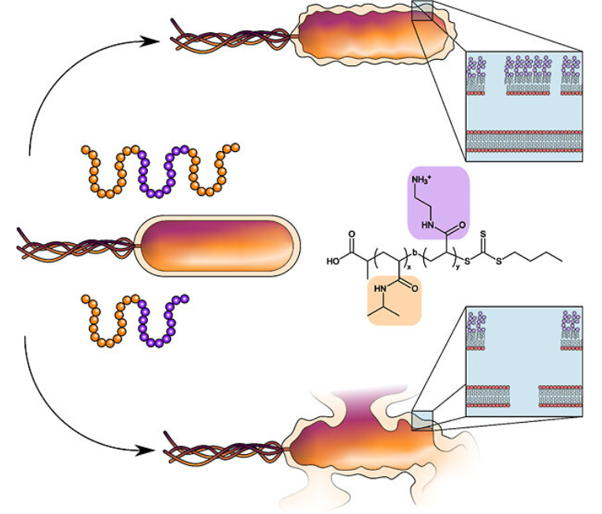

Tackling the toughest infections
Neutron reflectometry has provided molecular‑level information on how two synthetic antimicrobial compounds disrupt bacterial membranes, offering insight to support the development of new treatments for drug‑resistant infections.
Background
The shortage of effective treatments for multidrug‑resistant Gram‑negative bacteria is a serious threat to global health.
Using microscopy and neutron reflectometry, researchers from the Universities of Warwick and Sheffield, Monash University and ISIS examined the effects of two Synthetic Nanoengineered Antimicrobial Polymers (SNAPs) on the outer surface of bacteria that cause lung disease in cystic fibrosis patients.
The value of ISIS
Neutron reflectometry allowed the team to study how SNAPs interact with a model of the bacterial outer membrane, using isotopic contrast to reveal detailed structural changes.
The results confirmed two different mechanisms: the shorter diblock SNAP (a-D50) disrupts and breaks apart the membrane, causing cell lysis, while the longer triblock SNAP (a-T100-1) forms tiny pores that make the membrane leaky, leading to cell death without bursting.
Outcomes and impact
The results demonstrate that it is possible to design SNAPs that act through specific mechanisms to target and destroy bacterial cells, including those that are typically more difficult to treat.
The results will help researchers design new antimicrobials to tackle the antimicrobial resistance crisis.
A triblock SNAP forms pores that increase permeability and induce cell death (top), while a diblock SNAP causes membrane dissolution and lysis (bottom).
Learn more
OffSpec
Notes:
Global challenges, using neutrons to advance knowledge and improve people’s lives – working to beat drug resistance – leveraging the unique insight of neutron reflectometry to see how ‘SNAPS’ can disrupt the membrane of bacteria opening up new avenues for antimicrobial drug design.
https://www.isis.stfc.ac.uk/science-highlights/tackling-the-toughest-infections/

Slide 8
Key Technologies and Capabilities
Working in parallel to carry out obsolescence, operate effectively & develop for the future

Slide 9
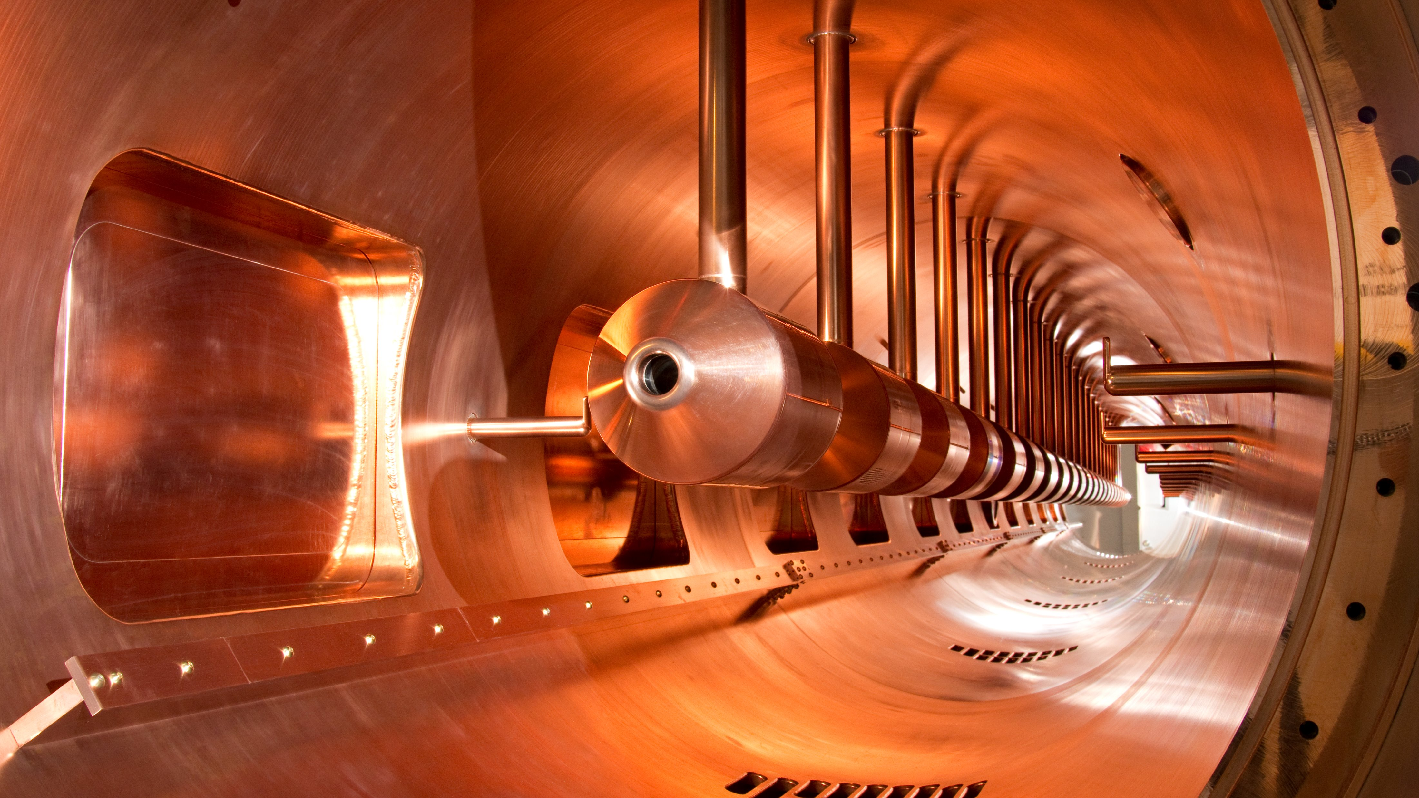
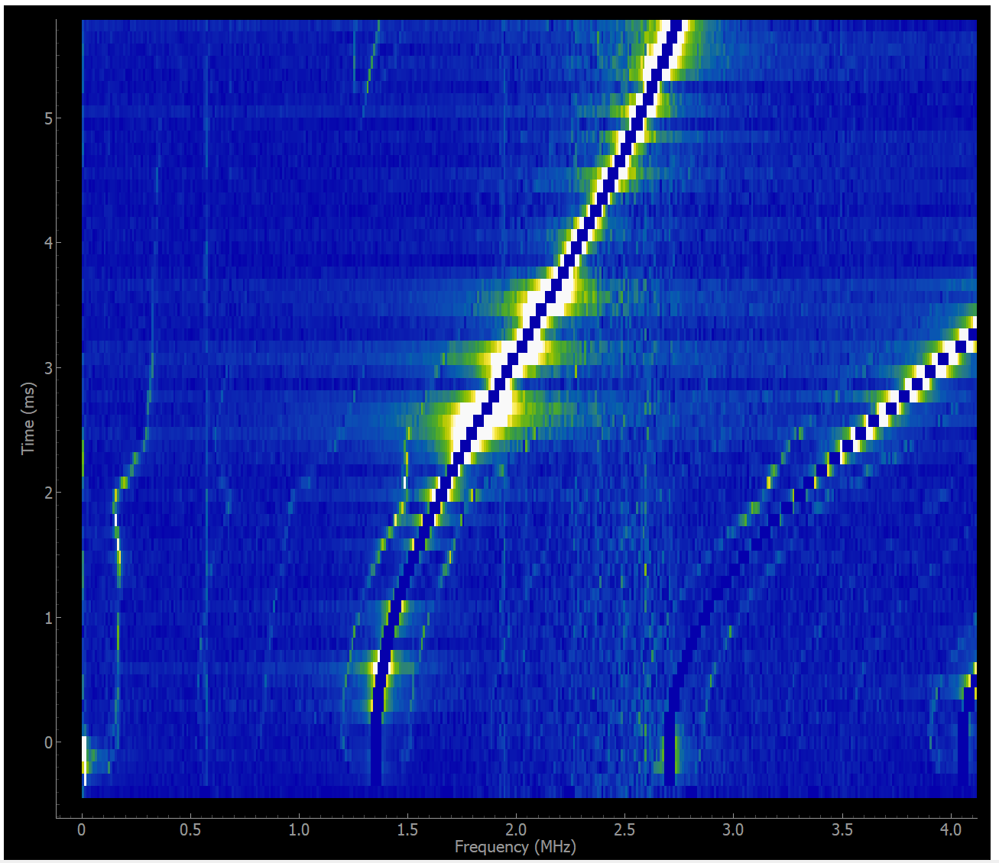
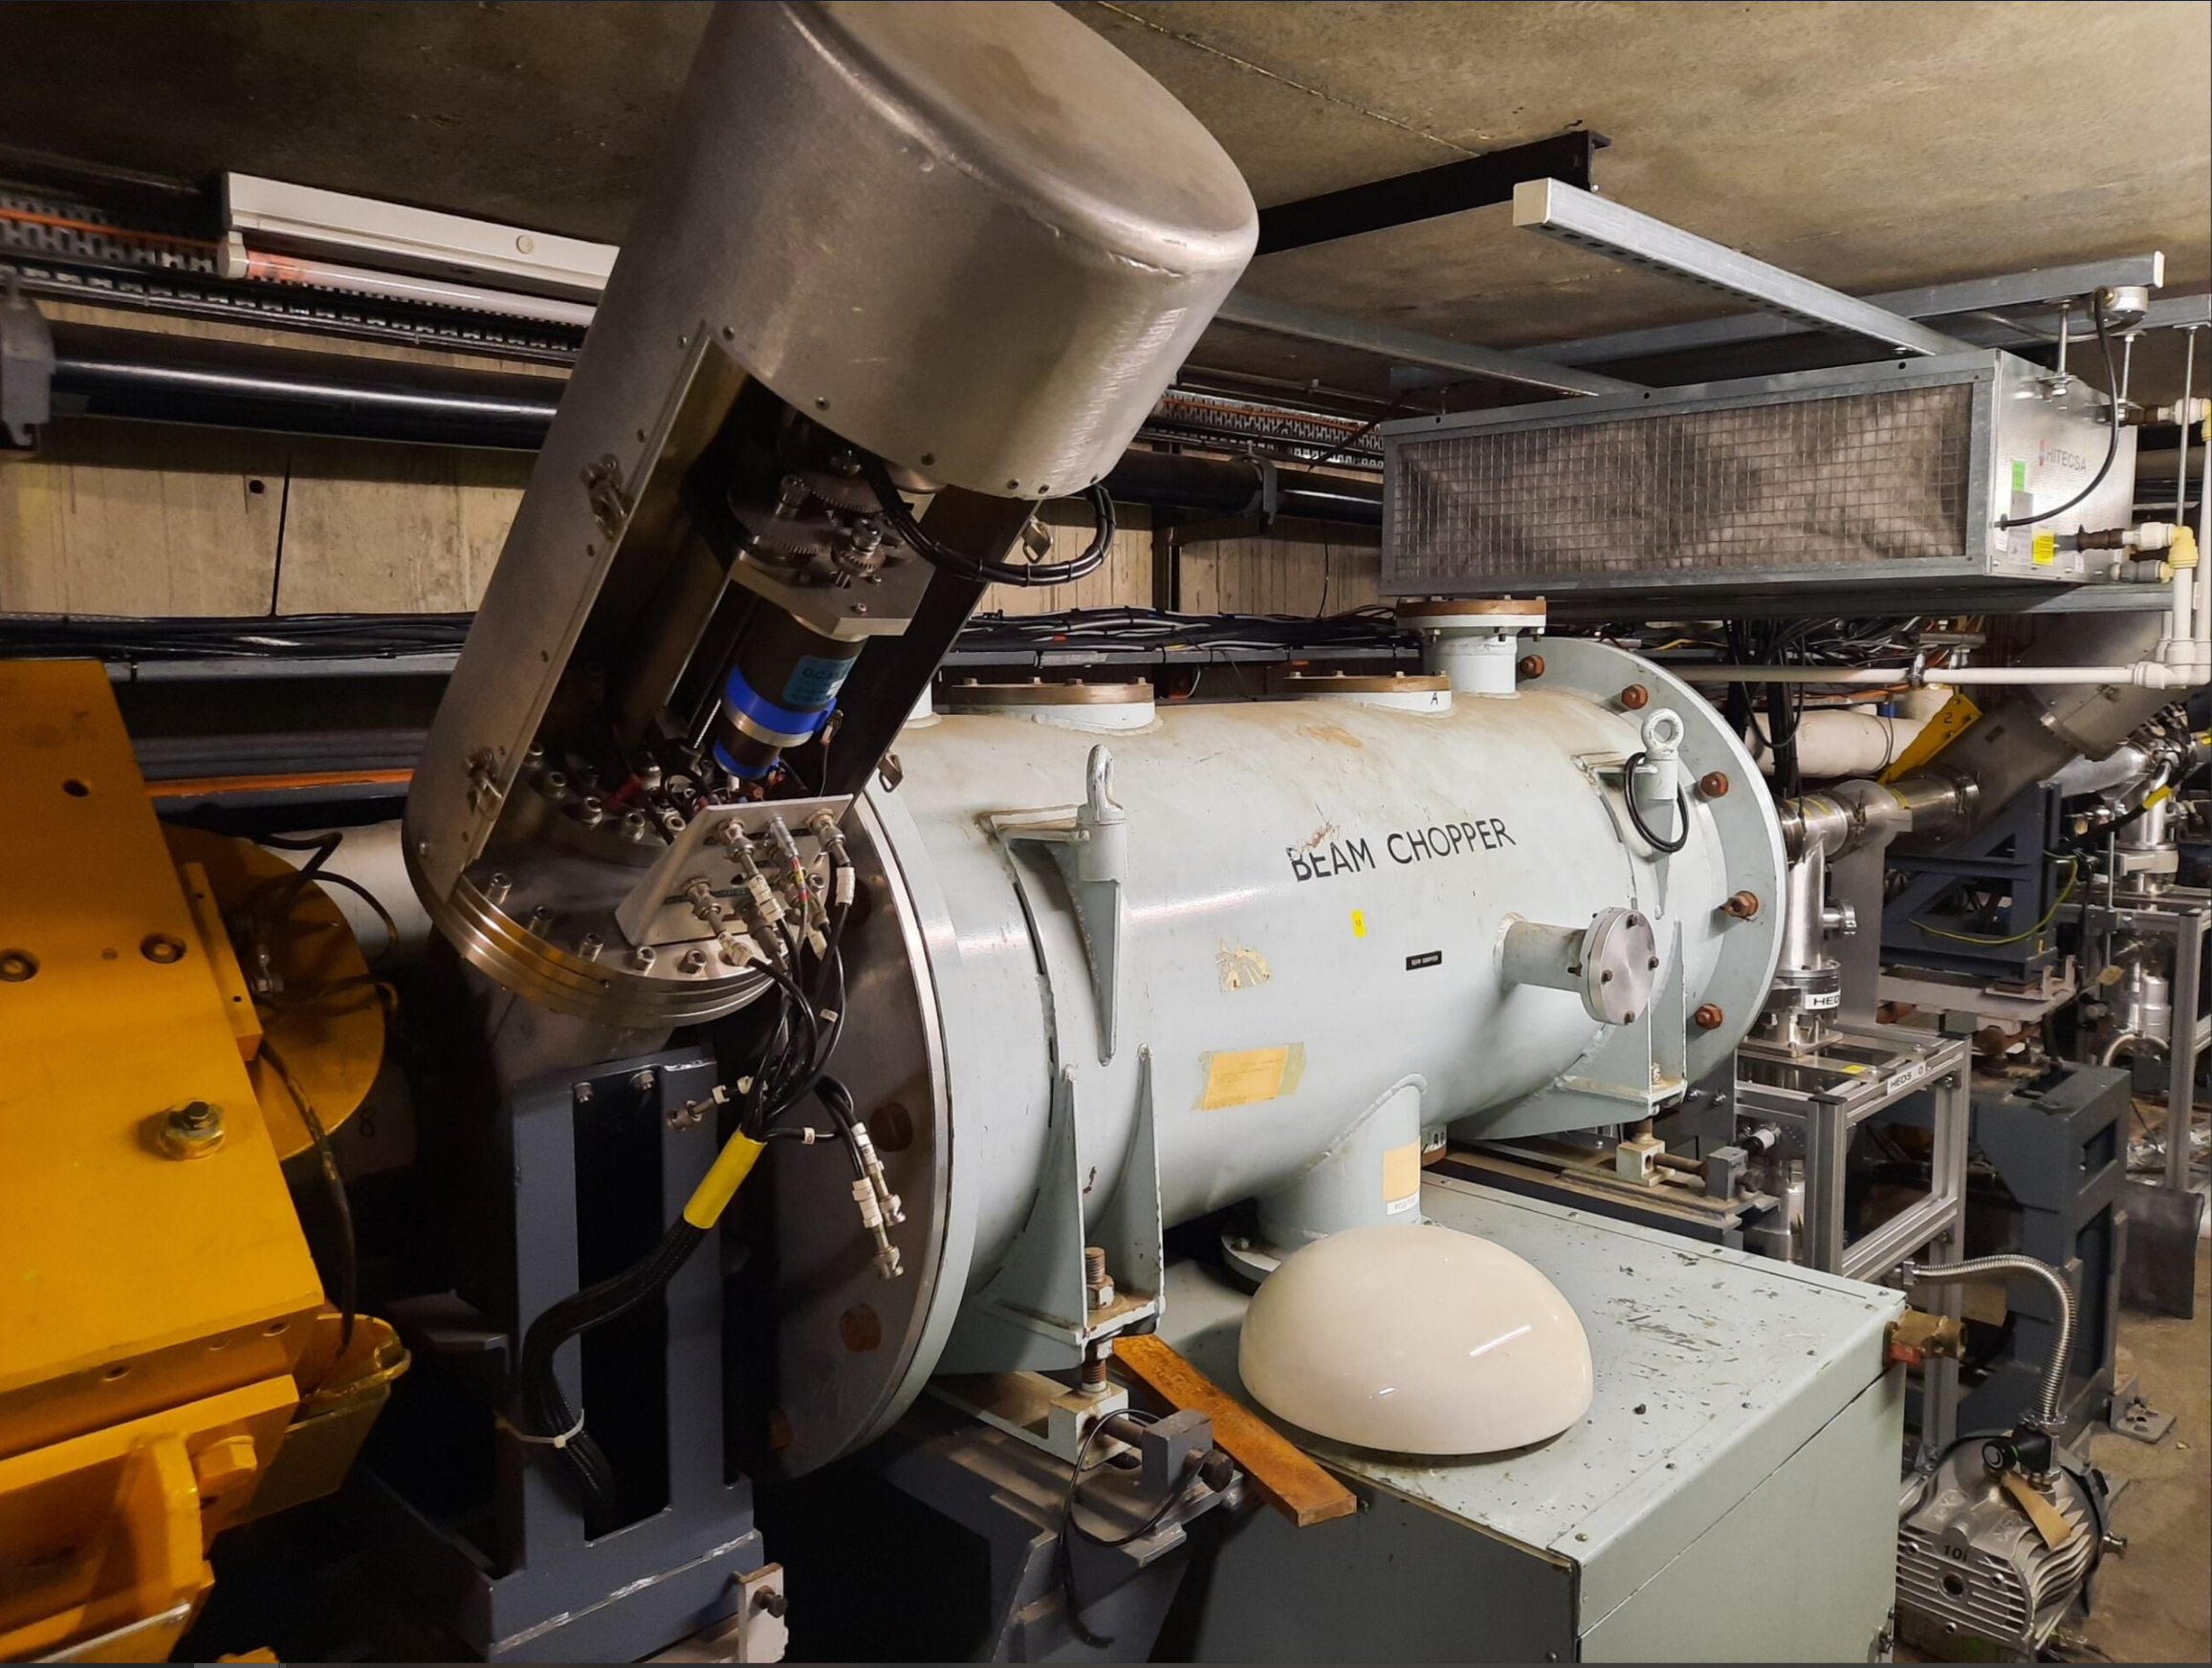
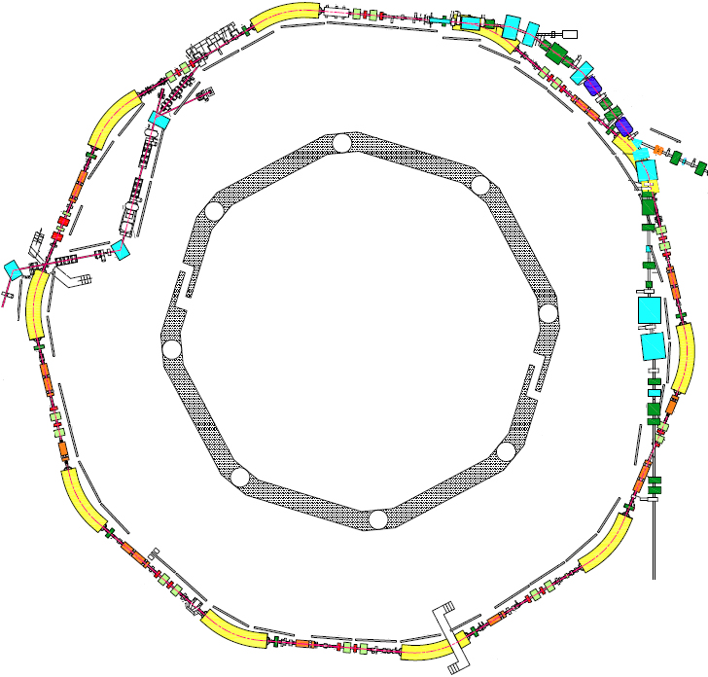
Accelerator
Operational sustainability
Environmental sustainability
Accelerator research and development: innovation
Development and retention of skills and knowledge
Beam Instabilities
Intensity Limitations
Extraction Kickers
Resistive wall
Collimators
RF cavities
RF shields
Q-kickers
Notes:
Since the 2021 long shutdown the focus has been primarily on improving operational sustainability, reducing beam loss (where there has been some notable success - regularly achieving RCS outputs in excess of 220uA) and increasing availability. There has been a rolling programme of obsolescence around RF valves and magnet power supplies, however we have still experience
Availability 90%
Beam current >220uA
Obsolescence plans for 5yr equipment
Reduce, reuse, recycle when operating the facility
Minimise activated material
Develop accelerator science and technology to enhance the ISIS facility and future facilities through collaboration and
Critical technologies
Extensive body of work to drive accelerator performance
Needs funding

Slide 10
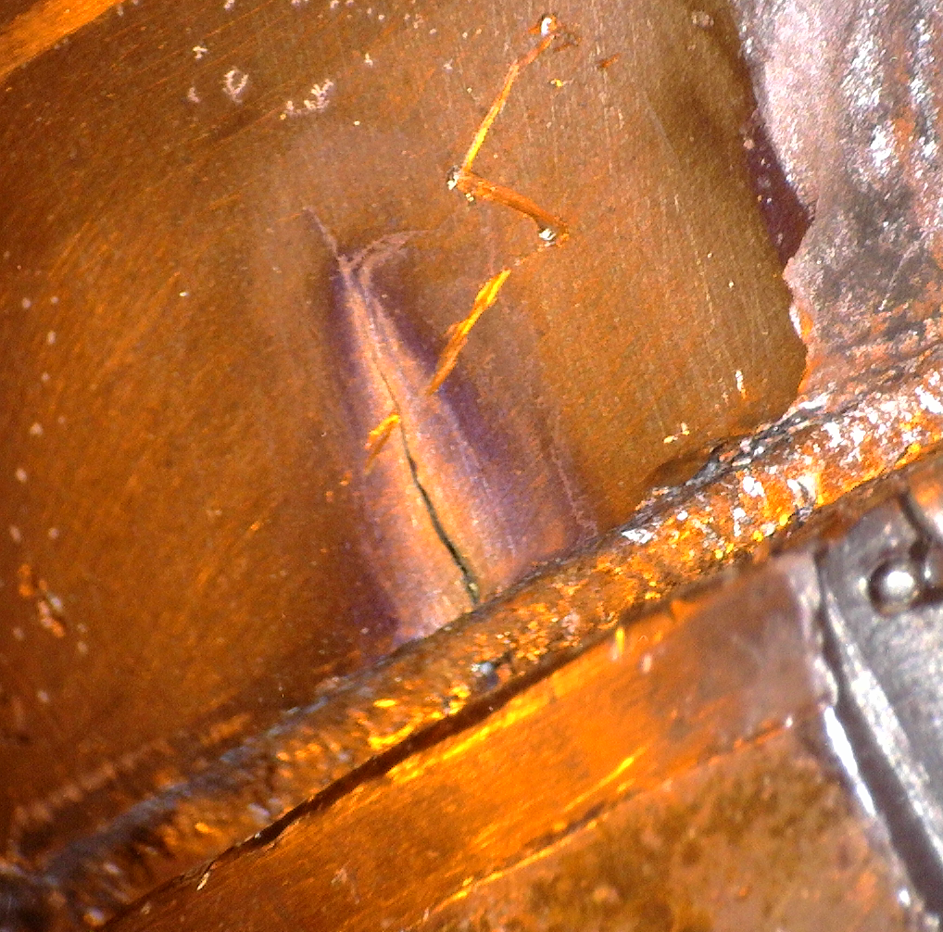
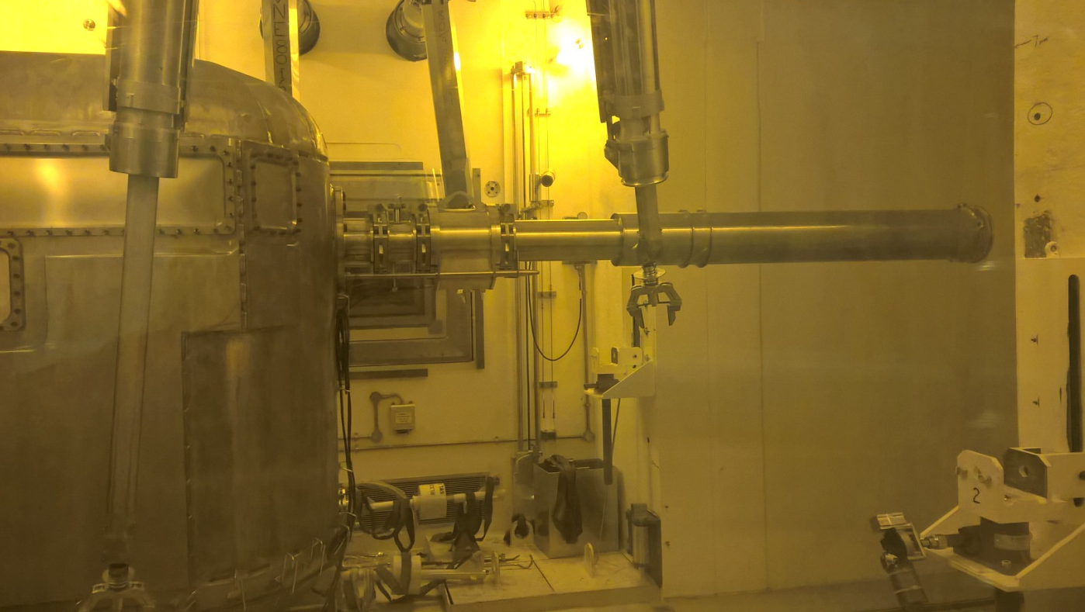
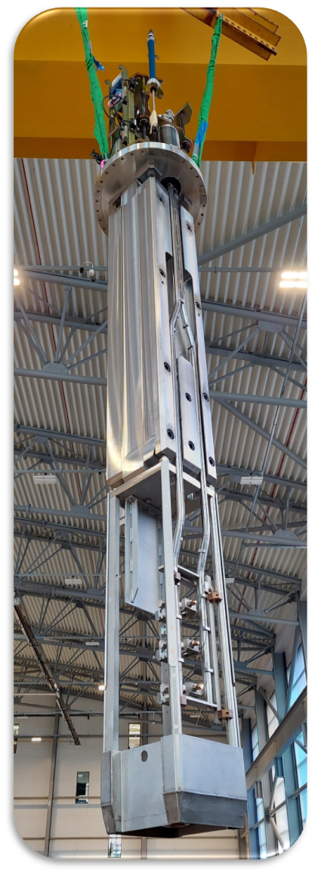
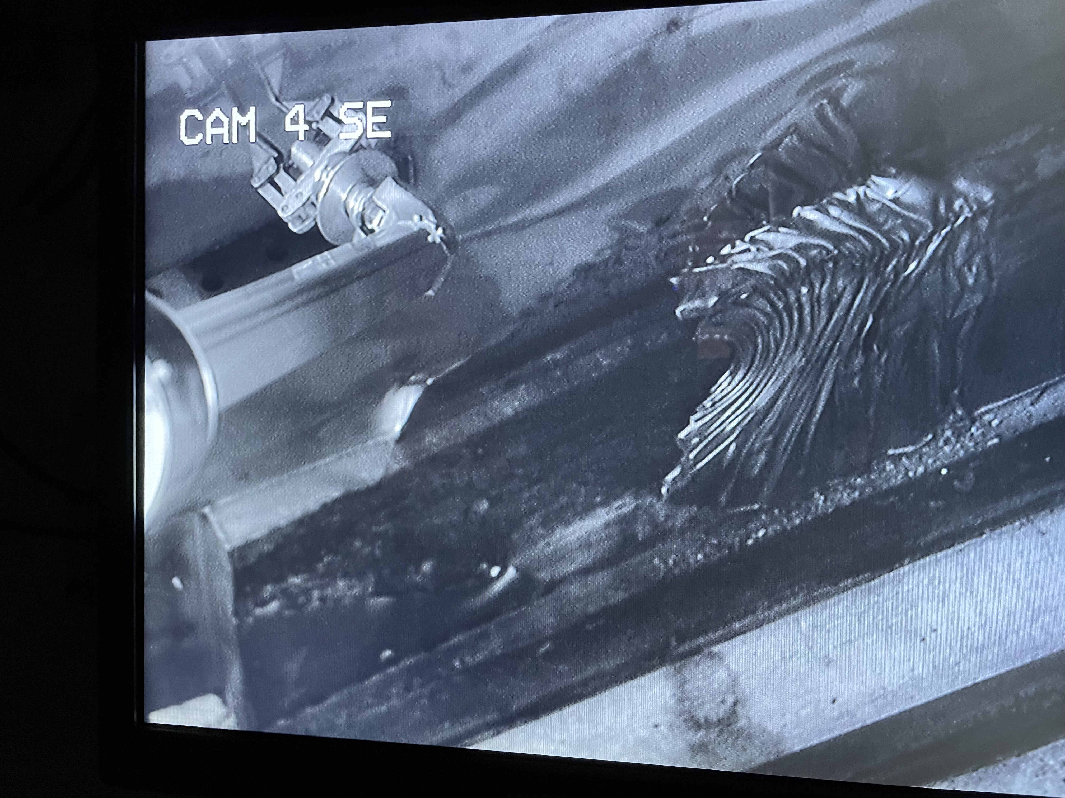
Target Stations
Maintain, operate and develop targets
For TS1 – continued to gain post TS1-project operating experience
For TS2 – proton beam window exchanged (2025)
Extensive work to optimise moderator performance and manufacture new ‘horned’ pre-moderator design
Next muon target assembly built
On site construction due to start later in 2026 for remote retrieval handling facility (RRHF)
Programme in progress of target PIE
Operational challenges TS1 trolley – quick recovery through large team effort

Slide 11
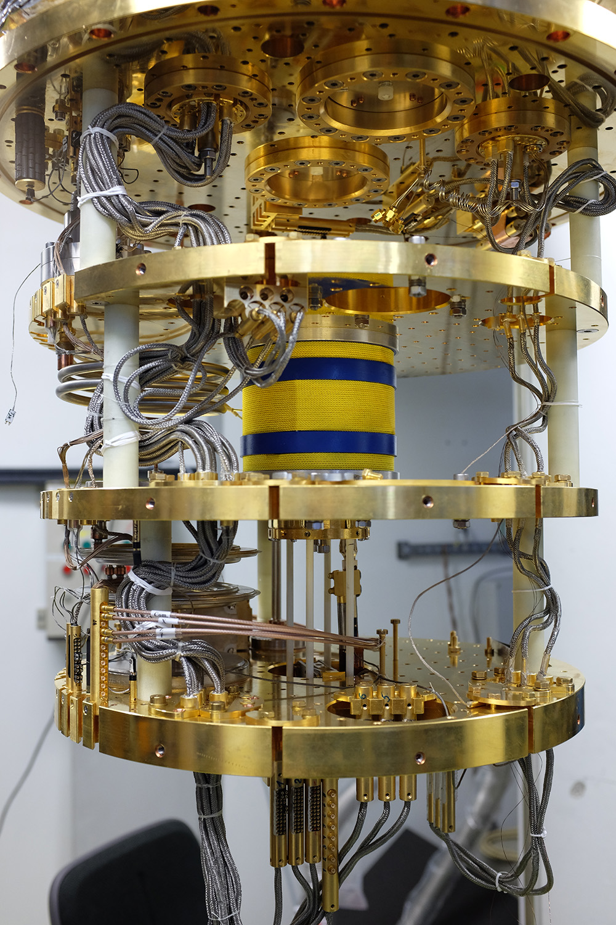
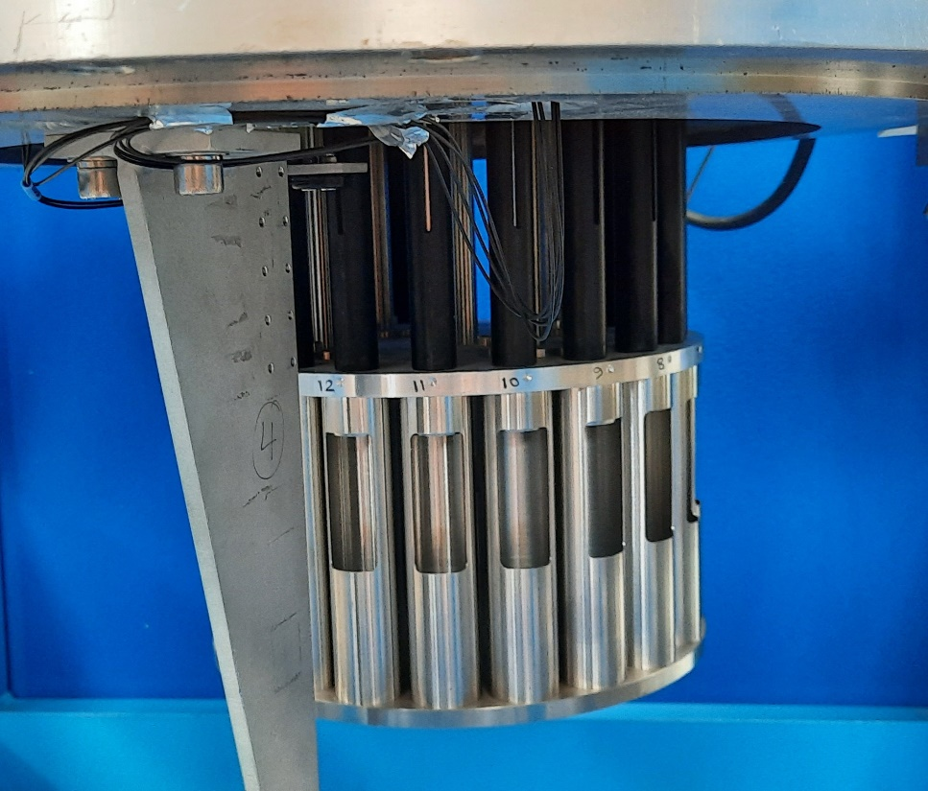
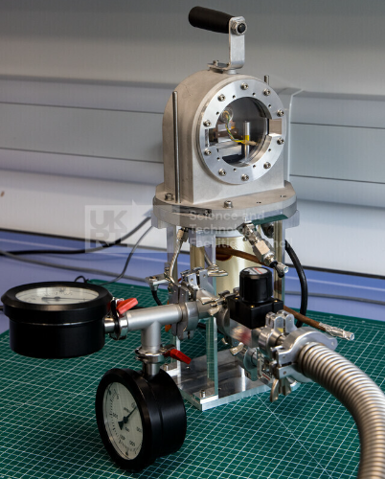
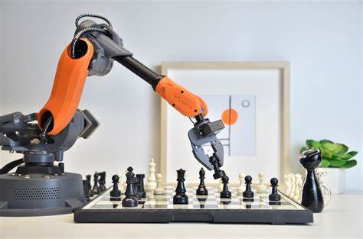
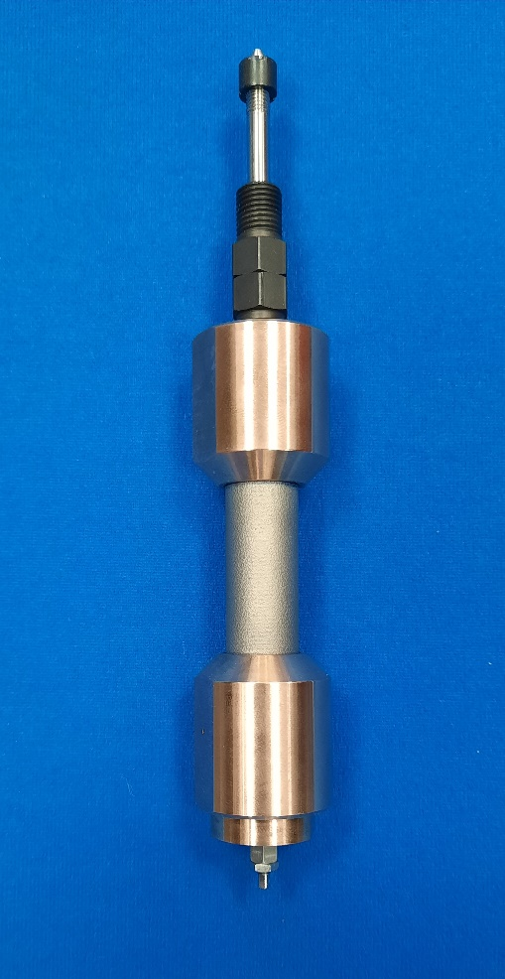
Sample Environment Future
Exploring the phase diagram
Realising the full potential of Endeavour instruments
Technical Research and Development
Rotating sample changer
Humidity control with 3D printed chamber
<10mK Dilution Fridge with fast sample exchange and integrated magnet
Robotics + Image recognition
Bulk metallic glass cell
Continue pushing to extremes with new technologies
Exploit automation to increase throughput
Exploration of new manufacturing techniques

Slide 12

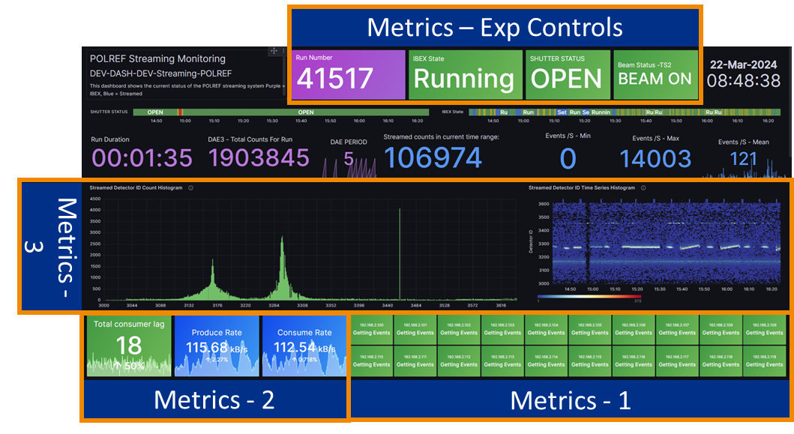



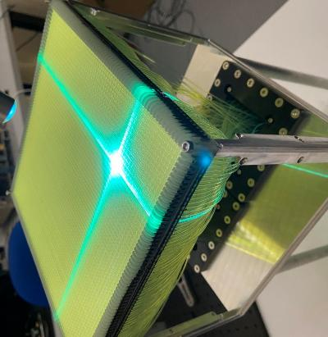
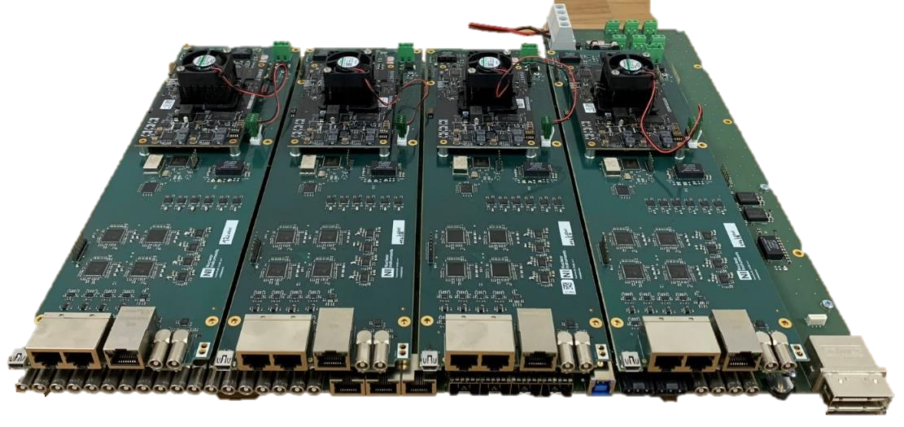
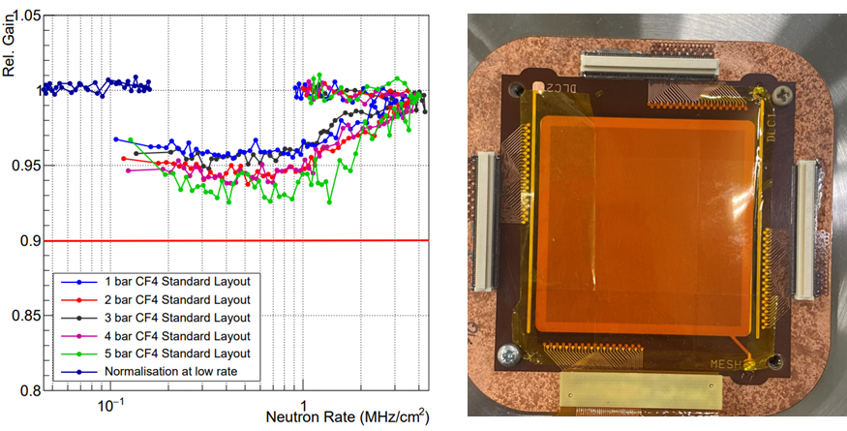
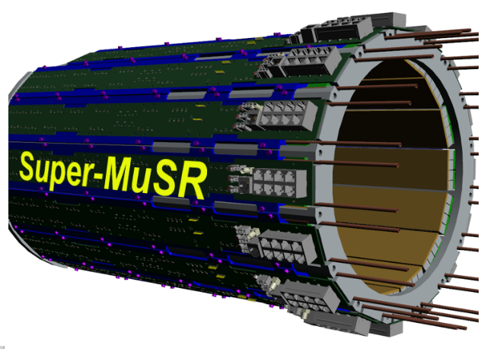
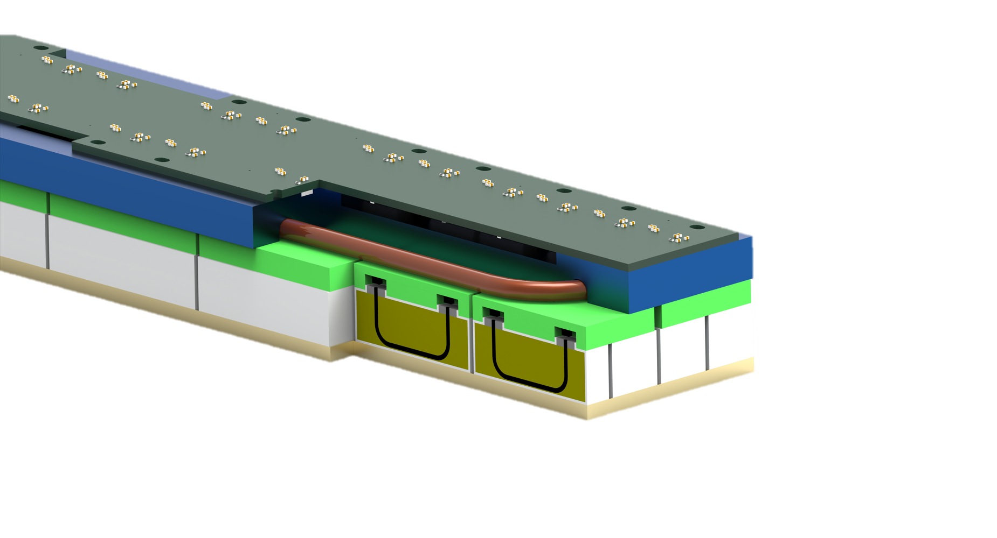

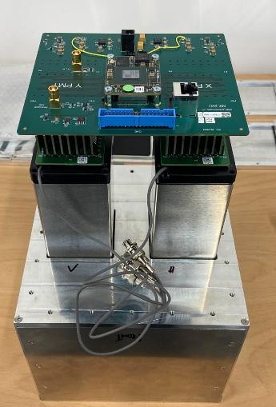
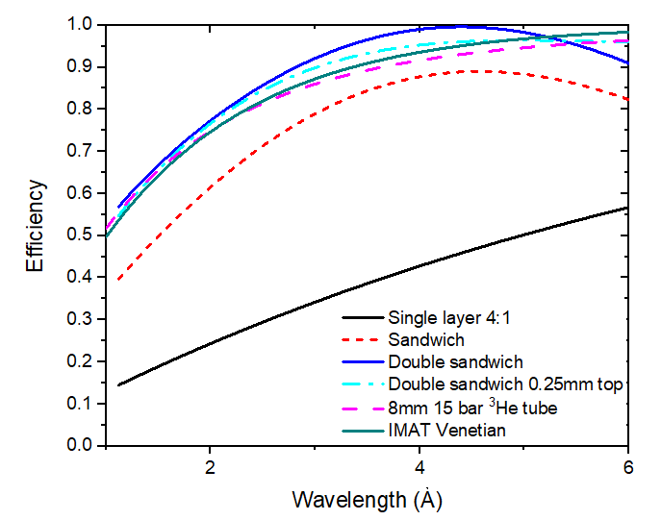
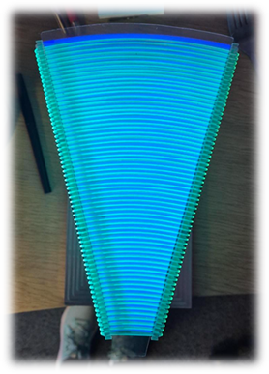
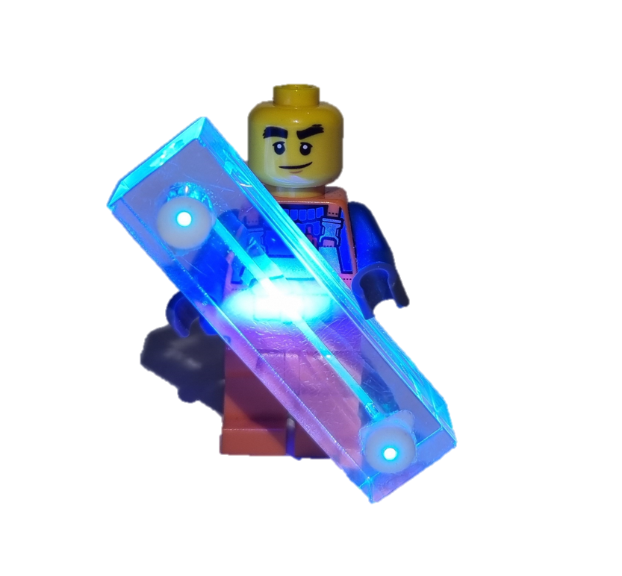
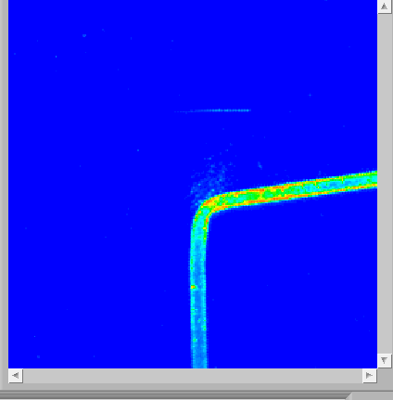
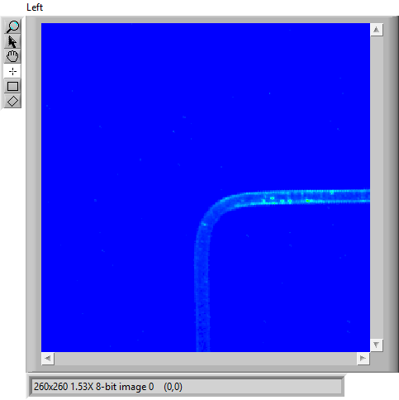
Detector Systems
uRWELL
50x50mm²
2x480 individual detector channels in a compact barrel
Notes:
Lots of detector system project delivery and technology development going on
Lego - modular construction etc.
SuperMUSR is a step change in performance and requires a step change in approach – SiPM sensors, new acquisition system employing digitisers, data streaming pipelines enabling detection and processing of factor 70 increase in count rate and unlocks a huge range of data insights for science and operations. First data streaming pipeline on ISIS (new for us).
WaveLengthShiftingFibres tech dev is focussing on increasing efficiency, rate, and resolution whilst reducing costs. The latest WLSF can match (or better) He3 tubes for efficiency. We have employed ML algorithms to increase resolution to 0.2mm. Work ongoing at the moment to reduce the scintillator and fibre. Improving performance while reducing cost. Lots of in-house R&D on this
More data requires more efficient ways of extracting insights and visualising. Electronics team deploy Grafana dashboards to monitor operational metrics for the detector system, including automating alerts. Future development will be in collab with accelerator on ML & AI models to move into predictive fault detection, high-level health status for systems, automated root cause analysis.
High rate detectors are a future focus for the group. mircoRwell sensors very high rate 100’s MHz (in collab with ESS), application in n, tomography reduced collection time by factor 40. Ongoing WLSF R&D to increase the rate capability, looking at novel scintillator nanomaterials and associated ML algos for efficient neutron signal discrimination.

Slide 13

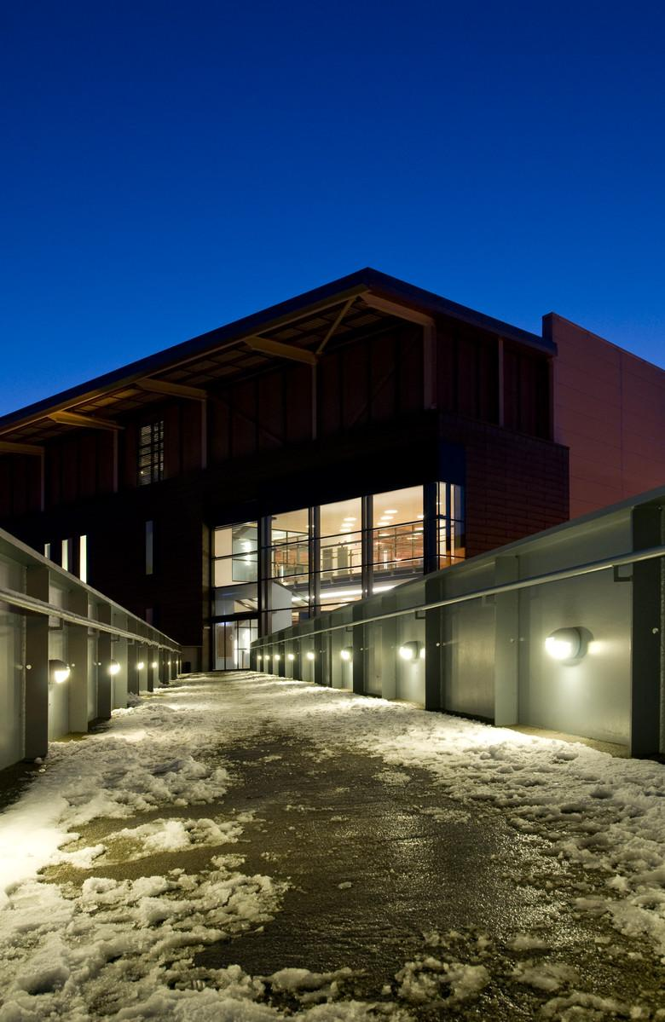






Experiment Controls
Operating IBEX on all Instruments
bluesky – Automated scanning solution integrated into IBEX for Reflectometry & Muon Instruments.
SuperMUSR – Raw digitised detector data, Kafka’esque streamed data pipeline.
MNeuData – Delivering on an ambition to revolutionise the instrument data ecosystem — enabling seamless, secure, and scalable data workflows that empower scientific operations and discovery.
Notes:
Completed the transition from our old control system to a new EPICS based system, called IBEX. IBEX no operating on all instruments (large programme of work that’s now complete)
Current developments:
BlueSky – Python library for experiment control and data collection. We integrated it into our IBEX control system for a number of sutomation applications across SANS, Reflectometry & Muons enabling highly efficient adaptive scanning; factor of 3 faster sample alignment on refl, automating the beamline alignment Looking closely at leveraging this in the future as part of developing the controls capability and in part delivering MNeuData
SuperMUSR – Our first streamed data pipeline
MNeuData – Programme that revolutionises instrument data (How do we build a data infrastructure to enable effective application of AI and ML across sci and eng operations) MNeuData Project: Will develop modern, standards-based data infrastructure and streaming across ISIS instruments. A 3–6-month proof-of-concept is proposed to trial architectural options at small scale.

Slide 14

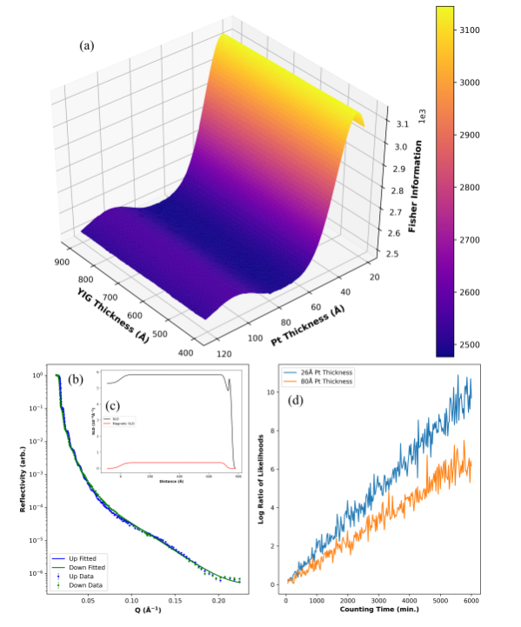
Scientific Software: Deploying Advanced Compute to optimise the facility
Goals:
Develop and maintain a wide range of core analysis and modelling
Easy to use software and flexible analysis and modelling workflows
Software that is implicitly trusted by users
Long-term sustainability and adaptability
Modular and interoperable design Hardware and software infrastructure to enable it all to be useable
Data Analysis and Interpretation:
Automated Data Processing
Spectral Noise Reduction
Experimental Design and Optimisation
Predictive Modelling
Parameter Optimization
Material Discovery and Characterisation
Complex System Modelling
Feature Identification
Real-time Monitoring and Control:
Adaptive Control Systems
Fault Detection
https://github.com/jfkcooper/HOGBEN
Notes:
In collaboration with SCD & the Ada Lovelace Centre continue to exploit rapid development of compute across the facility in a professional and sustainable way – being able to collaborate with users closely to meet immediate and long-term project needs. Leveraging machine learning looking to drive efficiencies
Breadth of areas where modern compute delivers an advantage – both science, engineering and operations
Example: HOGBEN code seeks to optimise reflectometry experiment design providing greater confidence in experiment parameters of interest leading to more efficient use of beam time.

Slide 15
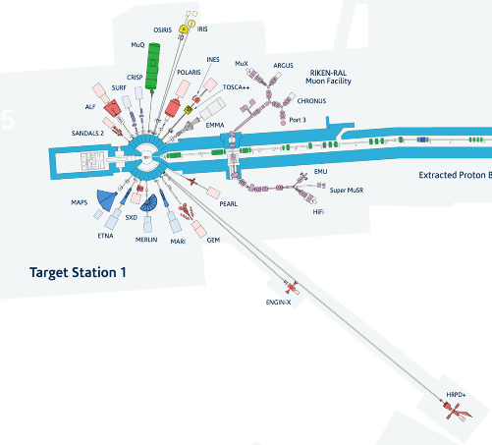
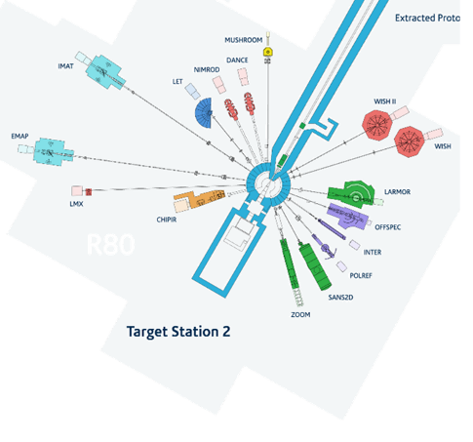
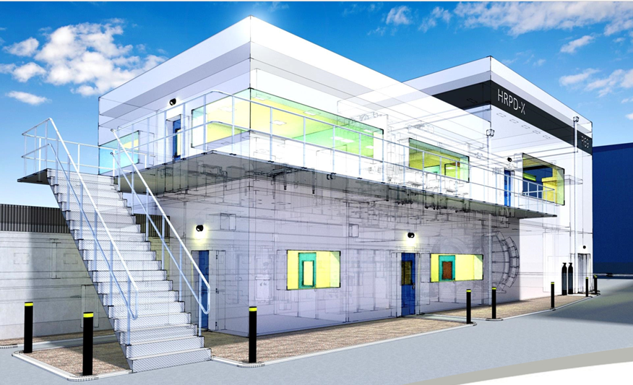
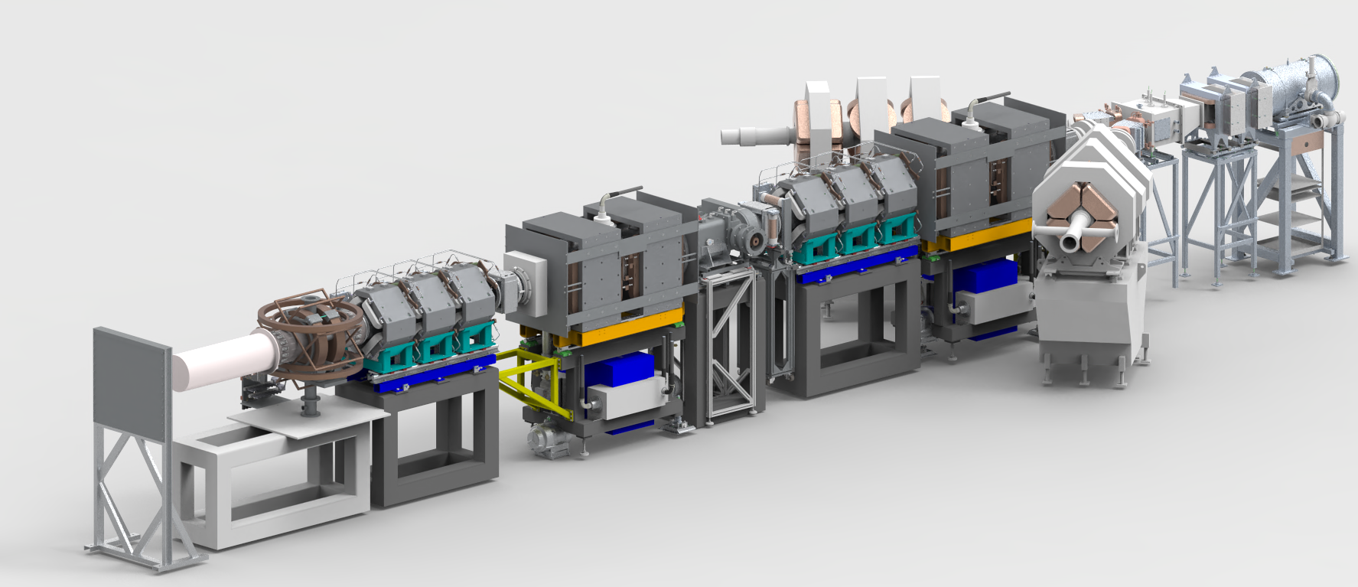

The Endeavour Programme
The £93 million Endeavour programme is delivering new and upgraded instruments, significantly boosting ISIS’s capacity and capability, delivering impact in key societal challenge areas: materials for the future, clean growth and life sciences.
5 major upgrades
4 new instruments
Learn more
Notes:
£90M 10-year programme to deliver major upgrades in TS1 and four new instruments in TS2 delivered all of which delivered over 3 phases.

Slide 16
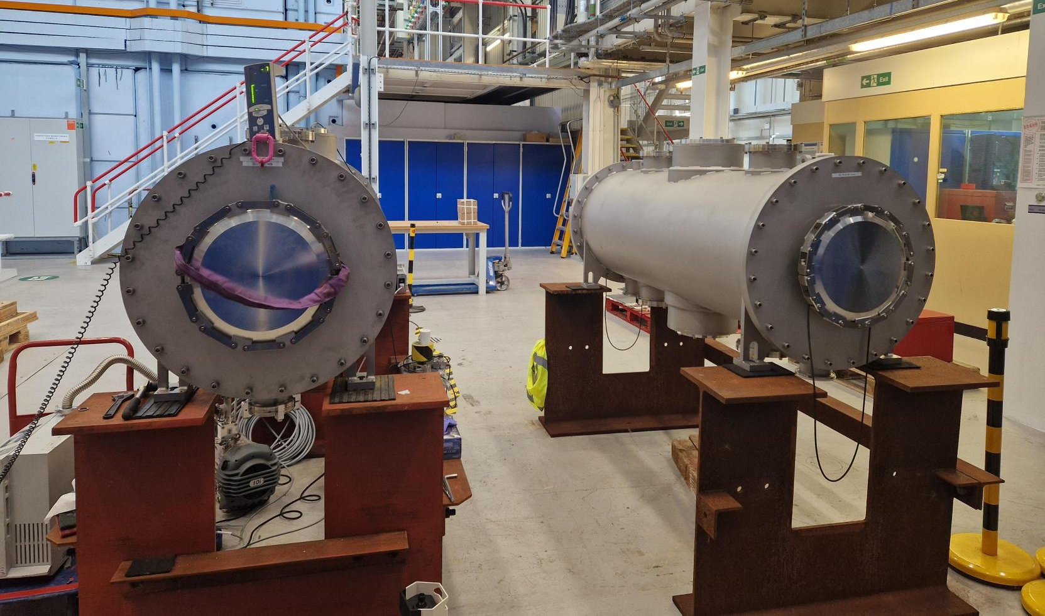
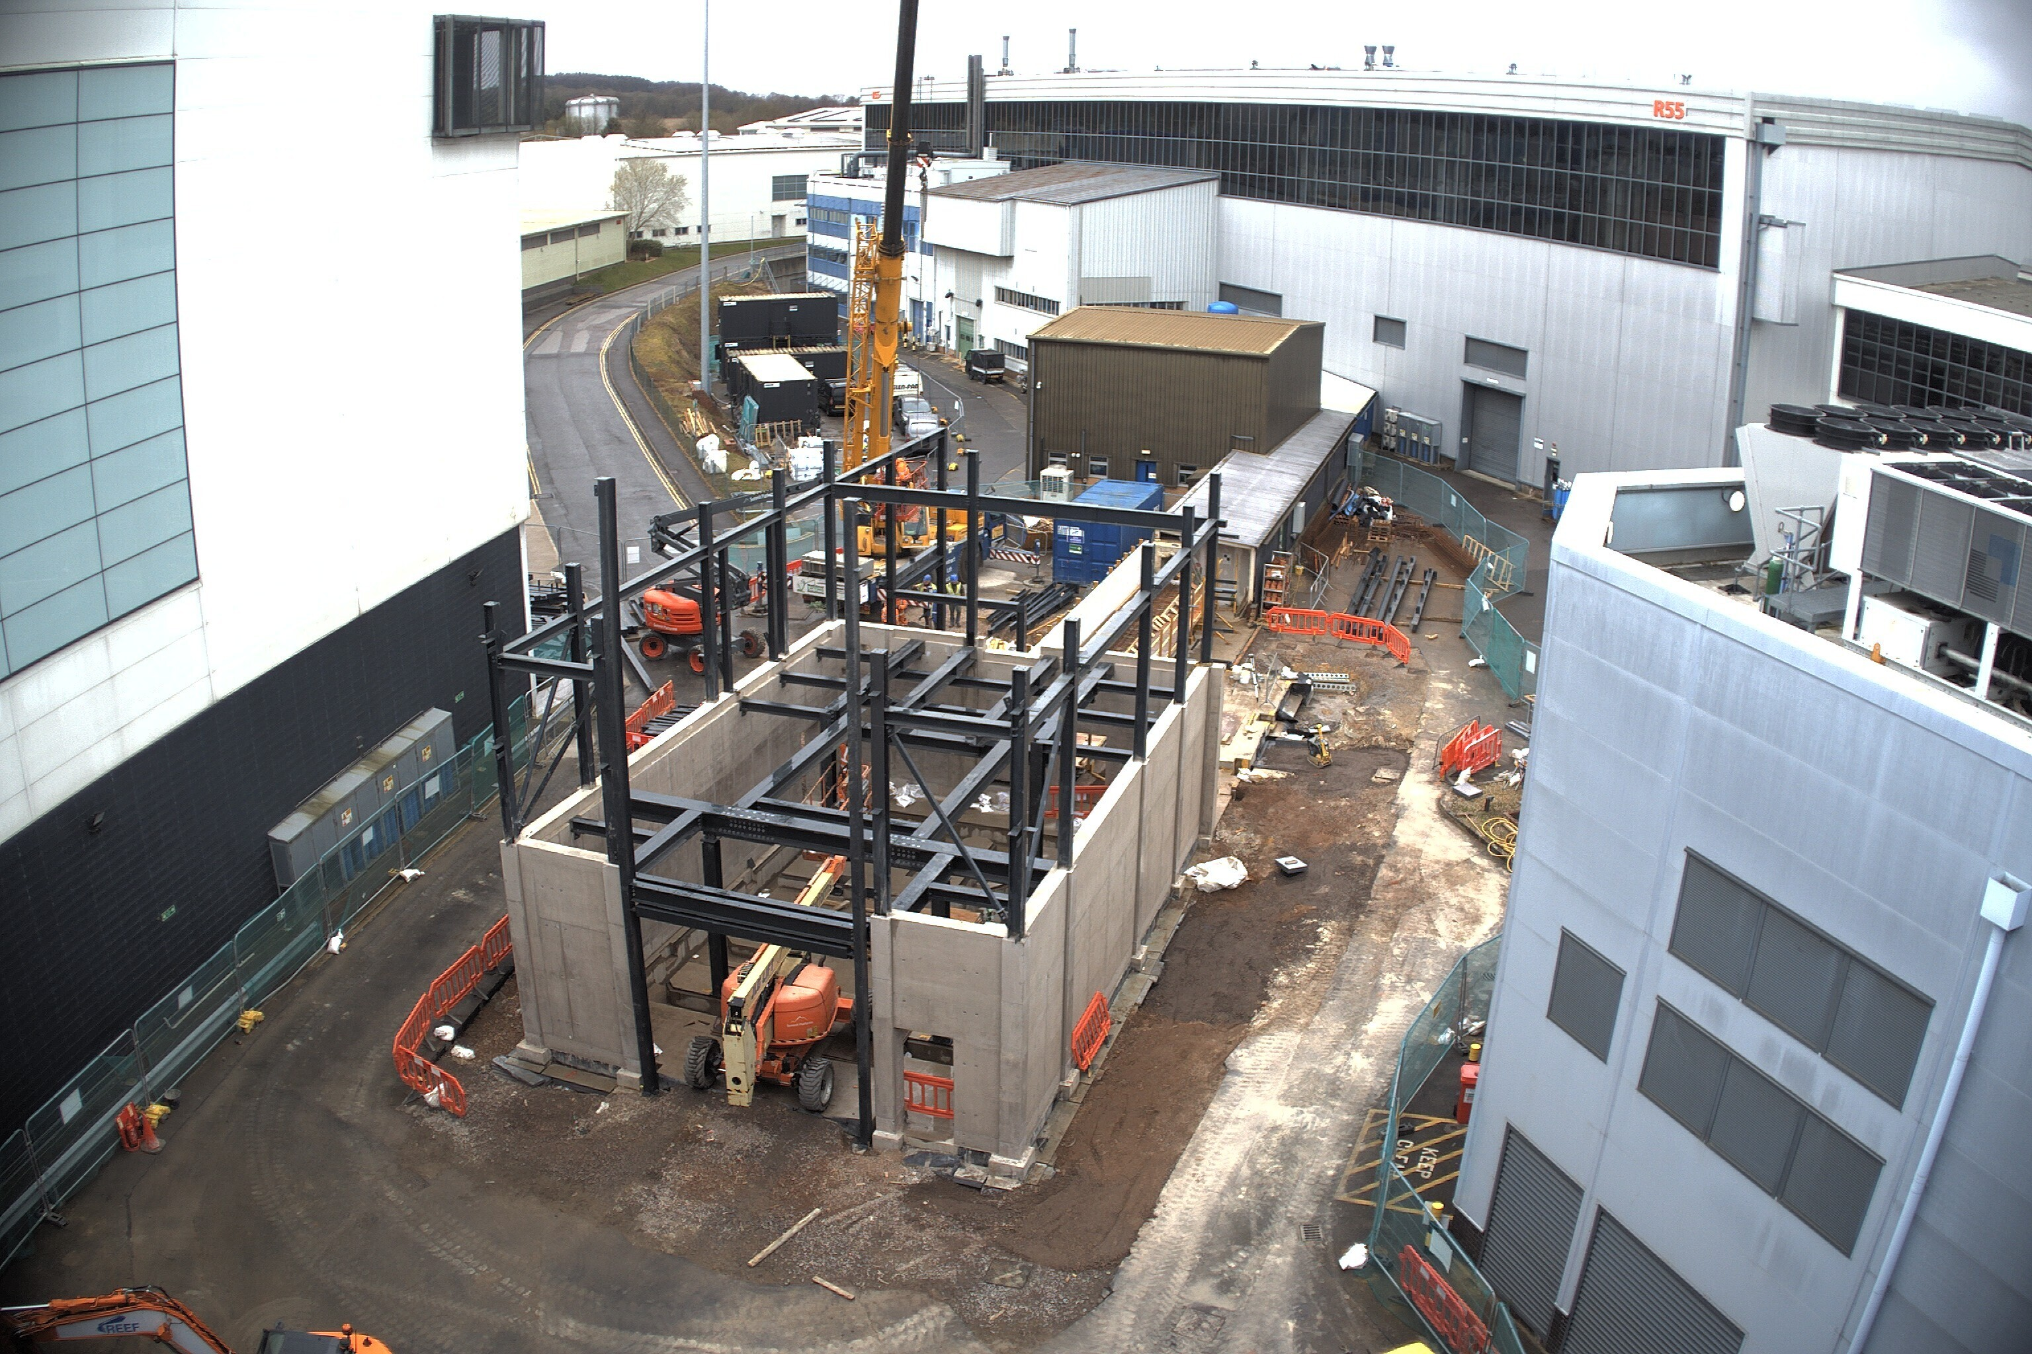
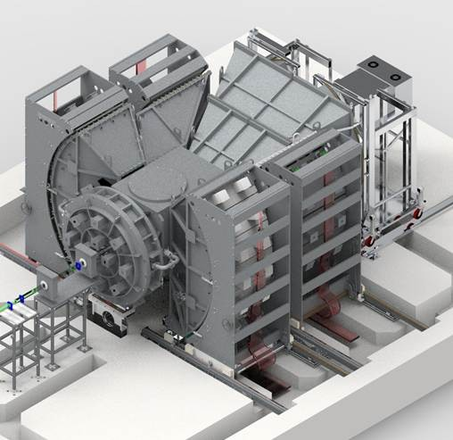
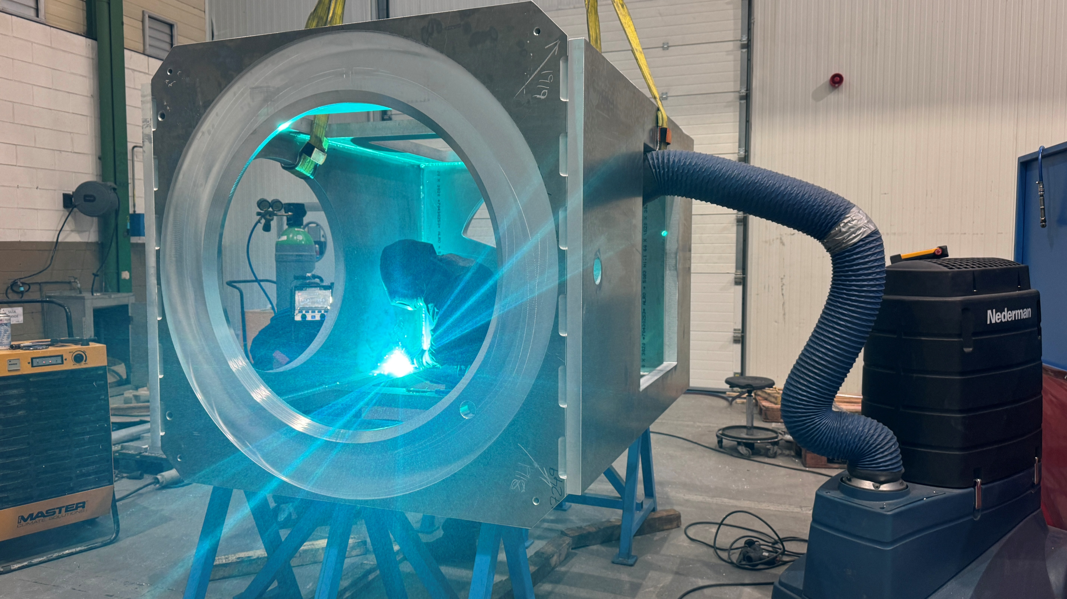
The Endeavour Programme
The £93 million Endeavour programme is delivering new and upgraded instruments, significantly boosting ISIS’s capacity and capability, delivering impact in key societal challenge areas: materials for the future, clean growth and life sciences.
Wish-II and Mushroom
ISIS staff are working with the technology team at STFC's Daresbury Laboratory to develop the primary parts of these instruments.
The Super MuSR pre-build is progressing, with many components soon to be delivered or on-site construction underway. The image shows the spin rotator vessels, which have undergone ceramic testing in preparation for install.
The new HRPD-X instrument building is taking shape. The next few months will see the delivery of key components, such as the detector supports, and the start of the pre-build.
Learn more
Notes:
HRPD – one of the first instruments built in early 80’s was completely demolished and is being rebuilt as HRPD-X
SuperMUSR – lots of work establishing and testing the performance of the data pipelines and detector manufacture is ramping up alongside instrument pre-build activities.

Slide 17
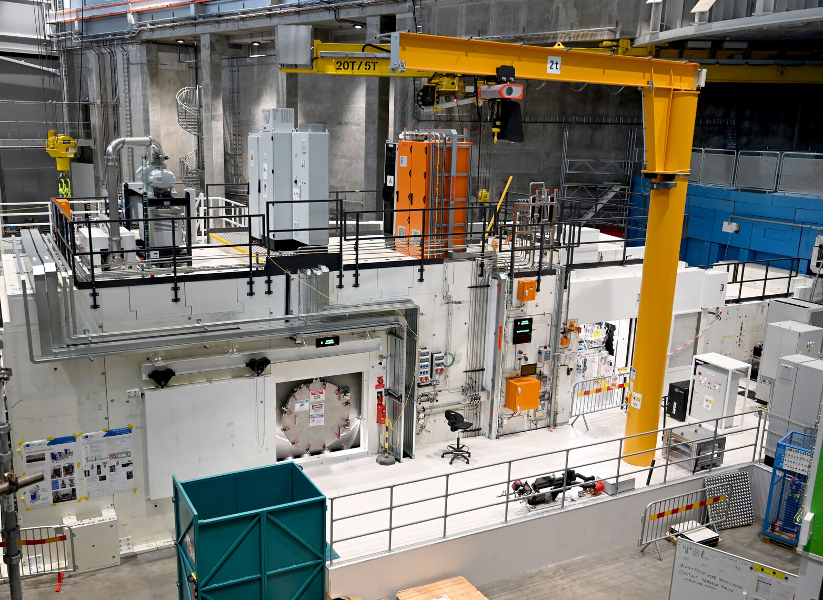
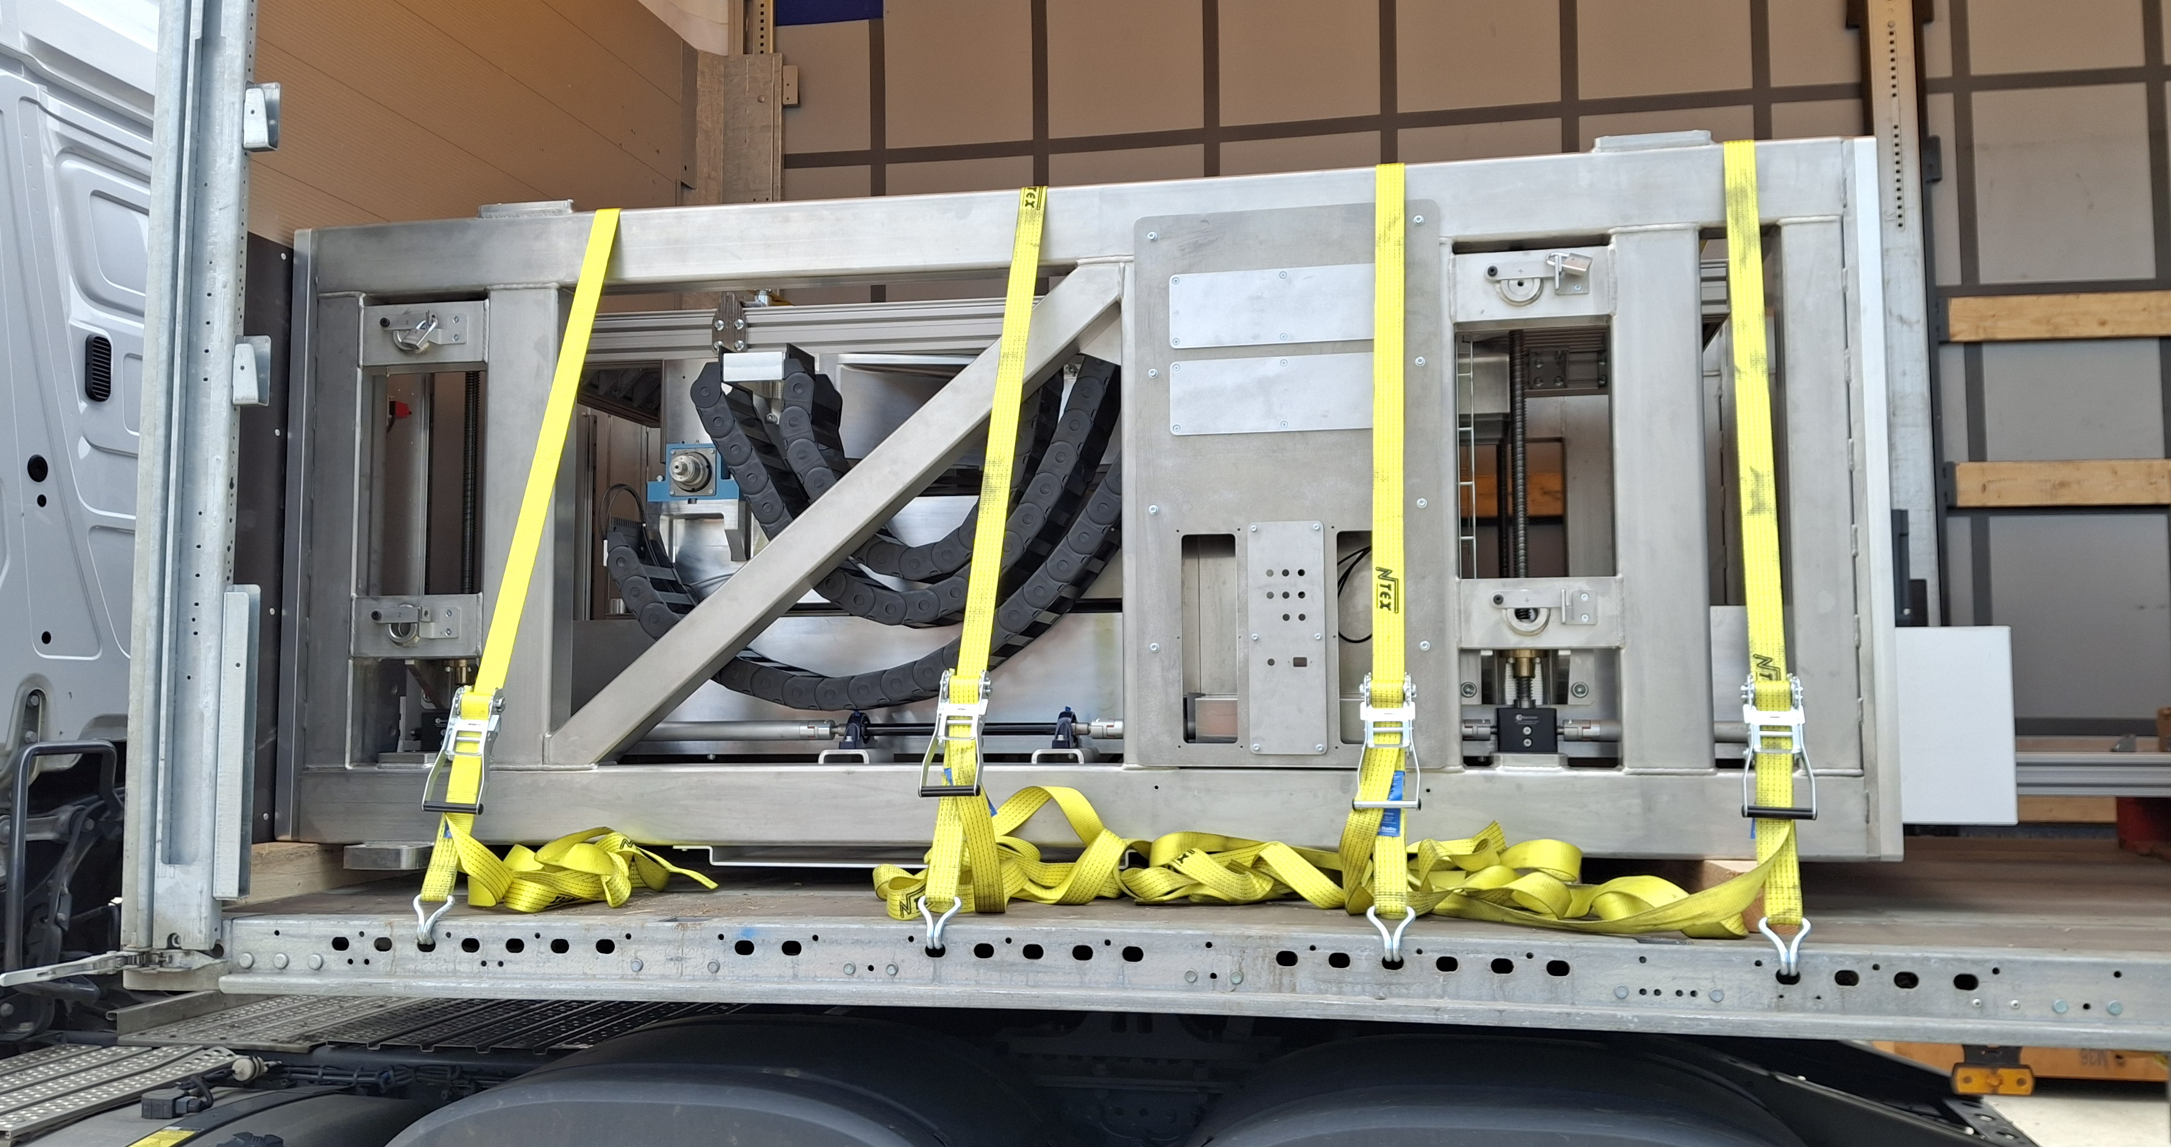
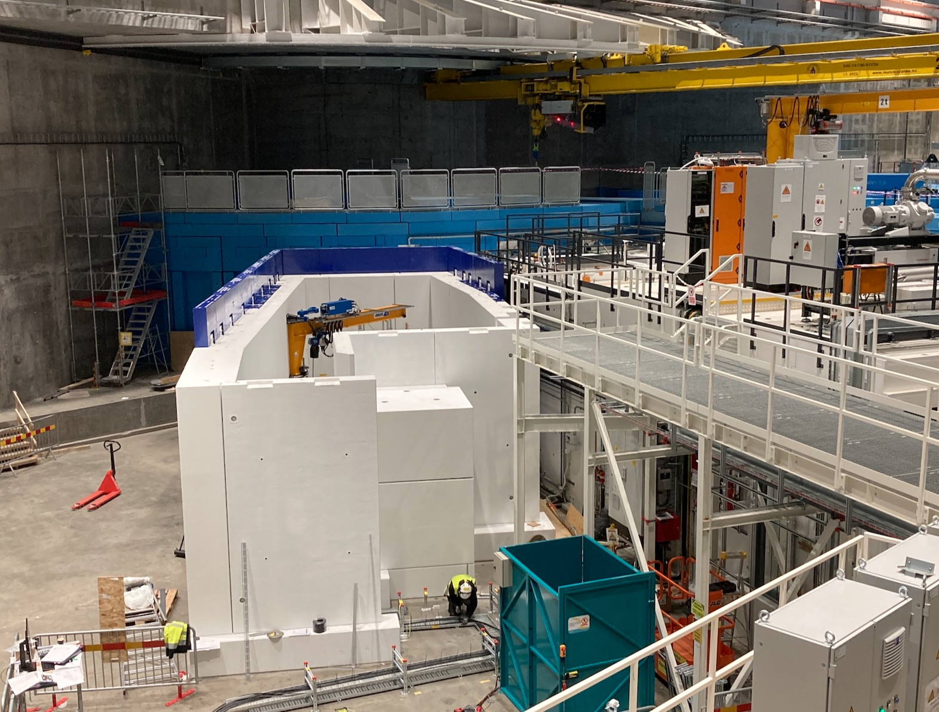

ESS instruments - LOKI & FREIA
Reference: https://ess.eu/article/2026/03/06/loki-ready-receive-neutrons
Learn more
Notes:
ISIS has contributed directly to the ESS project instrument suite.
LOKI is complete and installed at the ESS.
FREIA has been brought forwards compared to original plan and is due in 2027. Significant parts of the beamline have already been constructed in Sweden, Choppers are being commissioned. Last deliveries from UK in May this year

Slide 18
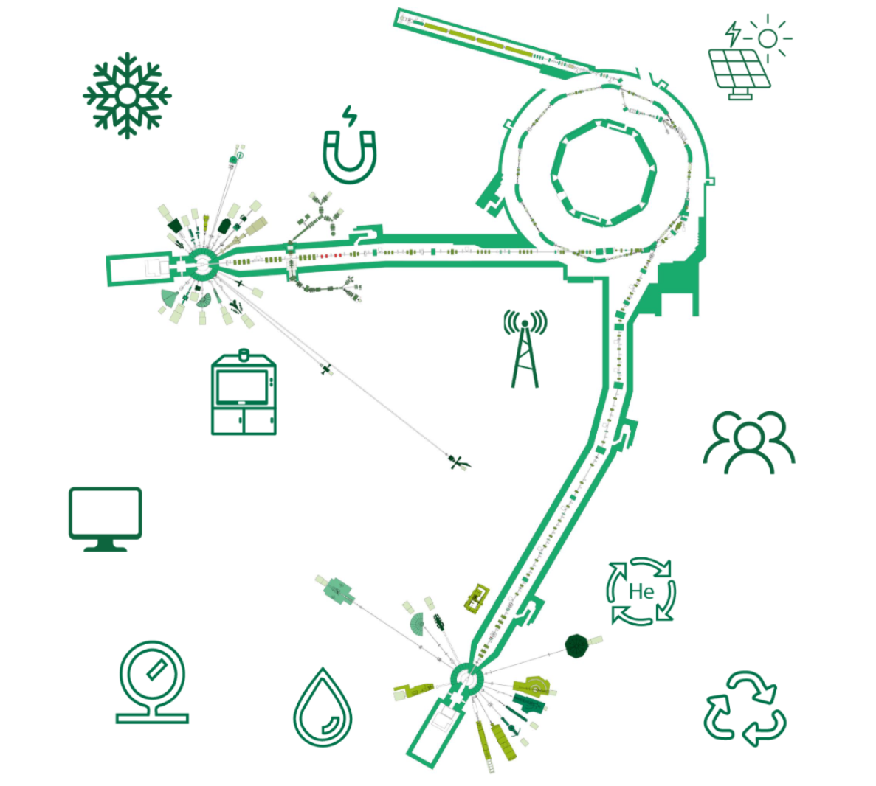

ISIS’s commitment to sustainability
A planned replacement of the RIKEN solenoid with a cryogen-free system could reduce electrical consumption by up to 2GWhrs p.a., saving of 424 tonnes of CO2e.
At ISIS, we strive to embed sustainability into how we operate, the science deliver and in our day-to-day work.
6000 solar panels generating >1 GWh p.a. and cutting carbon emissions.
An air blast cooler connected to the synchrotron main magnet has reduced electricity consumption by 56MWhrs p.a., saving 12 tonnes of CO2e.
The ISIS Sustainability Strategy recognises our responsibility to reduce environmental impact while maximising the contribution our research makes to global sustainability challenges.
Development of guidelines to improve environmental sustainability across the lifecycle of accelerator facilities.
Learn more
Advancing sustainable software by providing guidance on cloud and testing systems and embedding sustainability into major project planning.
A helium recovery system recovers over 90% of the helium used at ISIS.
Improved electricity and water metering.
In 2025, ISIS recycled 90% of radioactive waste. The approach is expected to save 51,600 tonnes of CO₂e over ISIS’ lifetime.
A new cooling system reduces ISIS’ water consumption by up to 80,000 bathtubs p.a.
Participation in a computer recycling scheme has helped dispose of over 10 tonnes of IT hardware more sustainably.
Notes:
High energy usage - No silver bullet to reduce our emissions, have to put sustainability up front in your strategy and exploit new technologies to deliver savings. Given the UK’s commitment to environmental sustainability we’re committed to take action on a number of fronts.
90% reuse on liquid He recovery

Slide 19
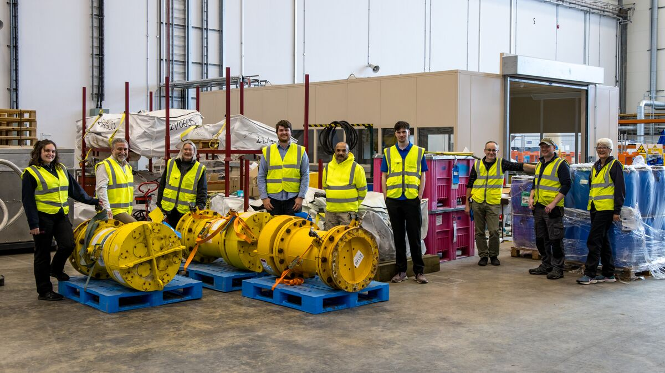

Recycling success at ISIS
Last year, ISIS reused or recycled 90% of its radioactive waste. The work was led by the Health Physics and Facility Safety Group.
​By necessity, ISIS operations generate between 100 - 200 tonnes of radioactive waste every year. It is mostly metal, and the vast majority is low activity waste.
By working with regulators to apply the UK Government’s 2023 radioactive waste policy, the team has increased recycling by treating waste to remove radioactive components, storing it safely on site until levels fall, and then sending the metal for recycling.
Over the remaining life of ISIS, this approach is expected to save 51,600 tonnes of CO₂e compared with using newly sourced metal.
The Health Physics and Facility Safety Group at ISIS
Learn more

Slide 20
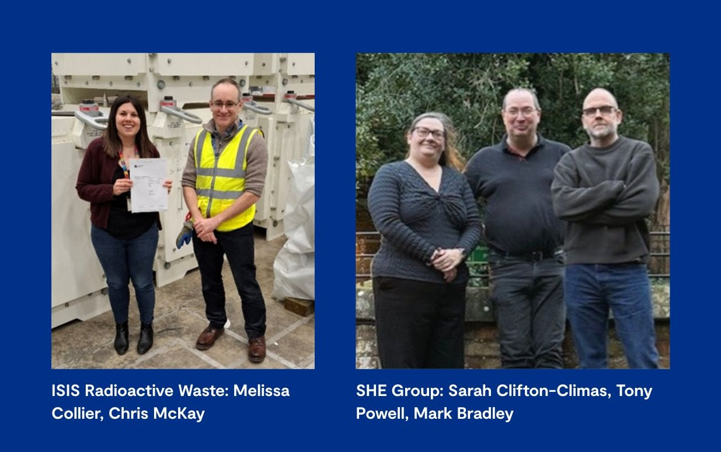
ISIS teams key to securing RAL’s new radioactive waste permit
The new permit removes previous limitations, allowing us to store radioactive waste until it can be safely disposed of through more environmentally friendly routes, such as recycling.
Our previous permit allowed us to store radioactive waste for a maximum of 15 years, limiting our ability to ‘decay store’ short-lived radionuclides.
The new permit will allow us to recycle around 80% of radioactive waste throughout the lifetime of ISIS operations.
It’s estimated this will save ~54,000 tonnes of carbon emissions, equivalent to 4.5 years of ISIS operation.
Many thanks to Steve Lilley (ISIS Neutronics Group), Chris McKay and Melissa Collier (ISIS Radioactive Waste Team) for their key contributions.

Slide 21
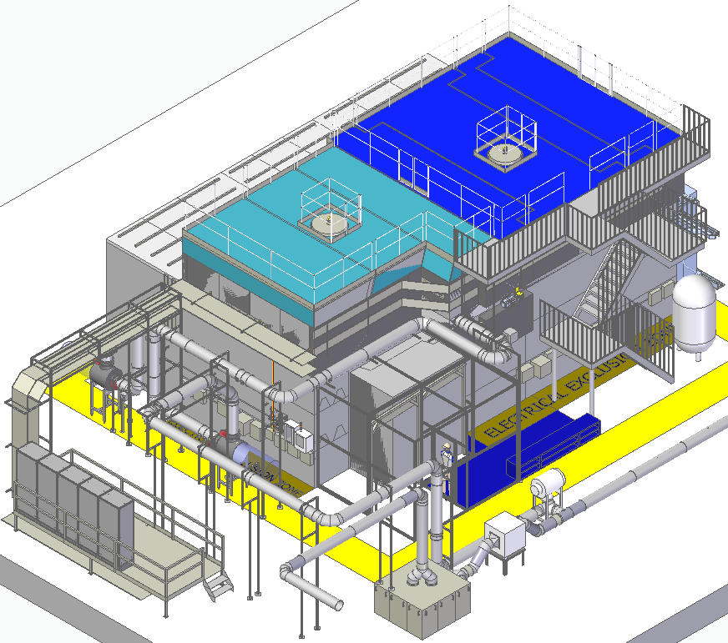
Investment in Remote Handling Capability
Allows waste sorting, size-reduction and segregation of HAW.
Provides PIE capabilities
Disconnected to operation of target station hot cells
Being provided as a 'turn-key' design by industrial partner
Notes:
Large science facilities needs investment in supporting infrastructures. RRHF is the latest, c. £20M investment.
Active waste is expensive up to ~£1M/tonne.
If you can reduce the volume then you can significantly reduce cost.
However, some items are very radioactive and in some cases are mixed with less active items, makes handling a challenge.
RRHF provides the remote handling capability to de-lid, sort, segregate and repackage our high active wastes.
Also provides the capability to perform PIE activities on targets and moderators to support ISIS increasing target system lifetimes
Currently in manufacture, operational in 2027

Slide 22
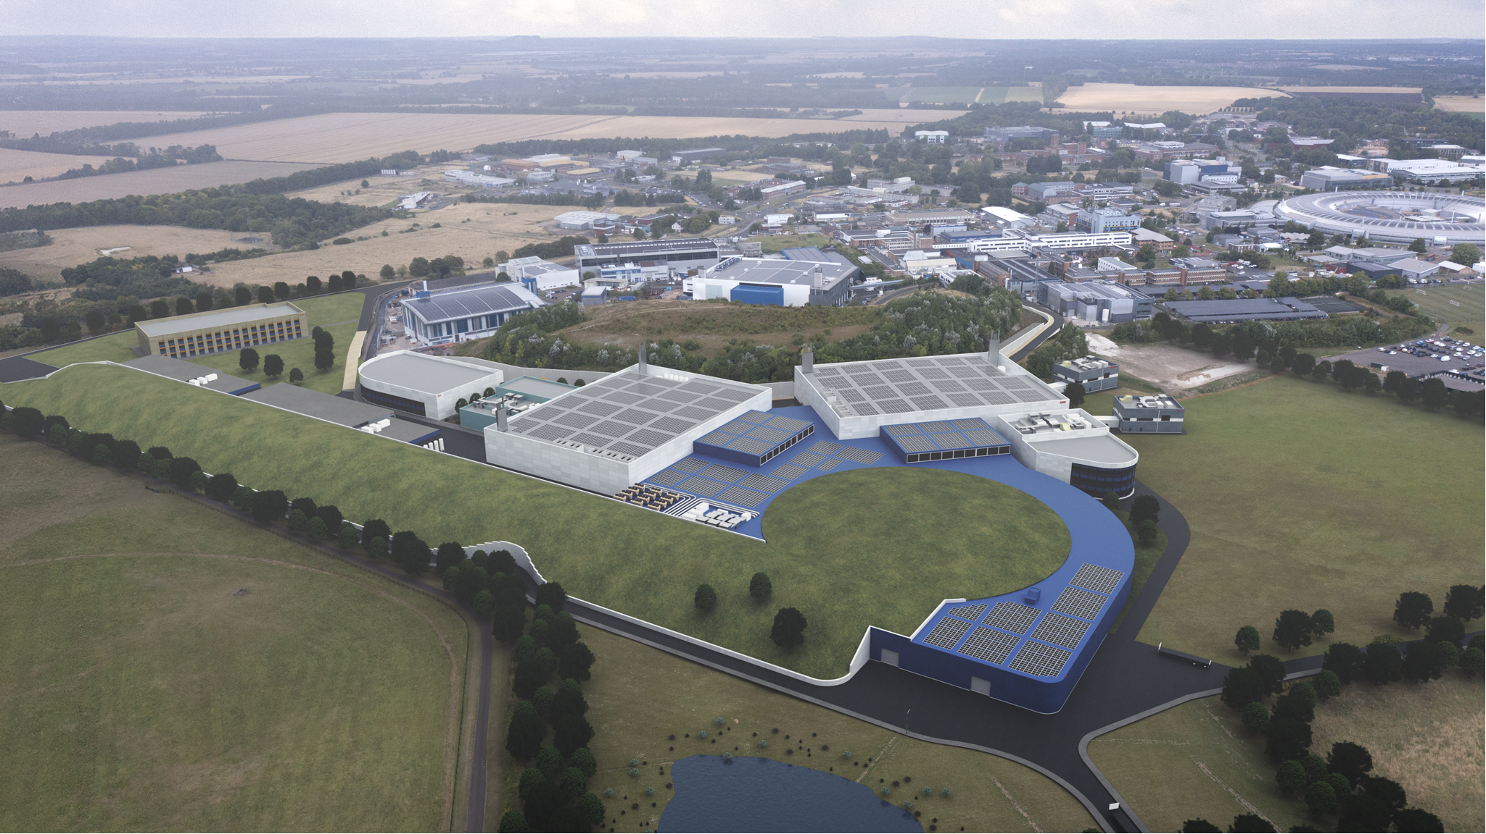

ISIS-II
On the timescale of 2040’s, ISIS will need significant refurbishment Scientific and technical possibilities will also have moved on
Initial feasibility work has been completed. Funding climate is very challenging at the moment and there is no funding available to progress further at this time.
ISIS-II remains important long-term ambition for ISIS.
Learn more
Notes:
QR takes you to the ISIS-II webpage

Slide 23
STFC staff contributions
Update on ISIS Targets: Analysis and Operating Experience - D. Wilcox
ISIS Neutron and Muon Source Target Station 2 Methane Moderator Test - T. More
ISIS II Neutron Targets Baseline Showcase - D. Wells Calvo
Self-Powered Neutron Detectors for ISIS - K. Gelborova
FETS–METS: A Test Stand for the Development of Moderator Systems - A. Chrysafi
Design and Deployment of a Remote Handling Cutting Rig for TS1 Cladding Obstruction Removal - M. Klaiber
Radiation shielding analysis for the ISIS Endeavour programme - S. Lilley
SHERPA: a Spectrometer for High Energy Resolution Polarization Analysis - G. Nilsen
A New Model for Radioactive Waste Management at ISIS - C. McKay
UKRI - STFC, ISIS Neutron Source, Target Station One - Recovery from a sticky position - D. Coates
Keeping an ‘Ion’ ISIS’ Challenging Wastes - M. Collier
The commissioning of a new ISIS Target Station 2 Solid Methane Moderator - M. Telkman
Post Irradiation examination (PIE) on ISIS TS2 targets - S. Gallimore
Monte Carlo Predictions of Radiation Damage in the ISIS TS1 Target and indirect Experimental Benchmarking - L. Quintieri

Slide 24
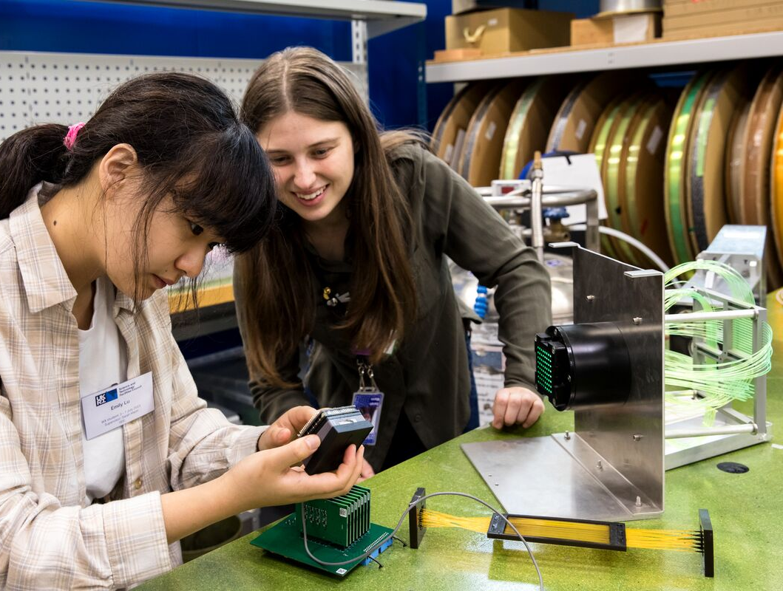
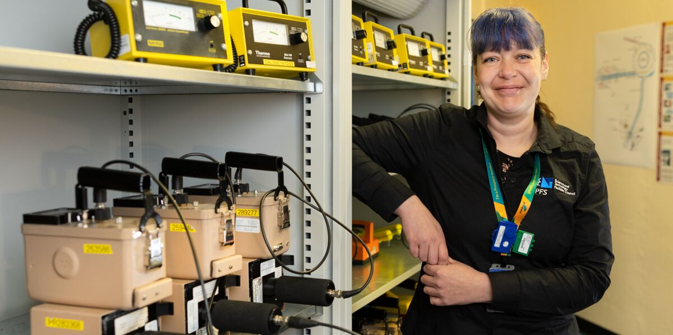









Slide 25











ISIS International partnerships
Sweden long-term agreement for Swedish access
Japan RIKEN – 30 year partnership
Canada UK ISPF funding aiming at long-term Canadian funding
Netherlands long-term collaboration
Italy long-term agreement for Italian access
India long-term agreement about to be signed
Malaysia, Indonesia ISPF funding to build partnerships
Brazil UK ISPF funding to build partnership
Notes:
Grow the UK user base
Support our long term international partners
Grow, sustainably the international user funding

Slide 26







PSI ISPF/SERI partnership with Diamond – multiple projects
ESS MoU for partnership working; a wide range of collaborative projects and instrument delivery
Julich MoU for partnership working in process
ILL MoU for partnership working; a range of collaborative projects
J-PARC MoU for partnership working; some collaborative projects
LENS active member of the League of Advanced European Neutron Sources
CSNS MoU for partnership working; some collaborative projects
Notes:
Position ISIS at the heart of neutron and muon infrastructure landscape

Slide 27

Getting the TS1 trolley back on track
During routine maintenance, the trolley in the TS1 target area came off its track. The complex repair involved teams across ISIS working together to carry out some challenging work in an inaccessible area.
During a routine moderator change, the 400-ton Target Station 1 trolley became stuck.
Fresh scraping marks revealed unexpected contact in the shield tunnel, traced to a protruding 80 mm diameter pin, which had torn the stainless-steel liner in the shield tunnel between the void vessel and the remote handling cell.
With the damaged area inaccessible due to radiation levels, the team relied on remote cameras, archive photos and the original 1980s drawings to understand the internal layout.
ISIS teams rapidly developed bespoke tools and a full‑scale replica to safely rehearse the repair work.
Despite limited access and tight timescales, the damaged wall was successfully removed and the trolley returned to its correct position in time for the next user cycle.
The repair work demonstrated the outstanding collaboration, engineering skill and perseverance of ISIS teams.

Slide 28


Slide 29


Slide 30
Sample Environment Future
Realising the full potential of Endeavour instruments
Technical Research and Development
Exploring the phase diagram
Continue pushing to extremes with new technologies, e.g. HTS based magnets, large dilution fridges
Develop equipment which combines parameters and enables new science, e.g. In-situ chemistry
Exploit automation to increase throughput on high-flux instruments
Use of new digital technologies
Exploration of new manufacturing techniques e.g. additive manufacture
Research into new materials
Rotating sample changer
Humidity control with 3D printed chamber
<10mK Dilution Fridge with fast sample exchange and integrated magnet
Robotics + Image recognition
Bulk metallic glass cell
Notes:
That is not an ISIS dil fridge, just an example.
BMG Cell uses a Null scattering alloy like TiZr but has low attenuation particularly at long wavelengths
In Situ Experiments
Vector fields
Humidity
Stress / Strain
Flow
Vibrations
High Voltage
Optical Access / Lasers
Polarisation

Slide 31

Target, reflector and Moderators (TRAMs)
Maintain, operate and develop targets for ISIS, ISIS-II
Exploring TS1 Water pre-moderator
Extensive work to optimise moderator performance
4 year program to deliver remote retrieval handling facility to enable PIE
σ
ε
Cut coupon from target material in RRHF
Cut and test experiential specimen at off site facility
Material data for use in design and analysis

