Slide 1
Keeping an “Ion” ISIS’ Challenging Wastes
Melissa Collier
ICANS XXV, Malmo
April 2026

Slide 2
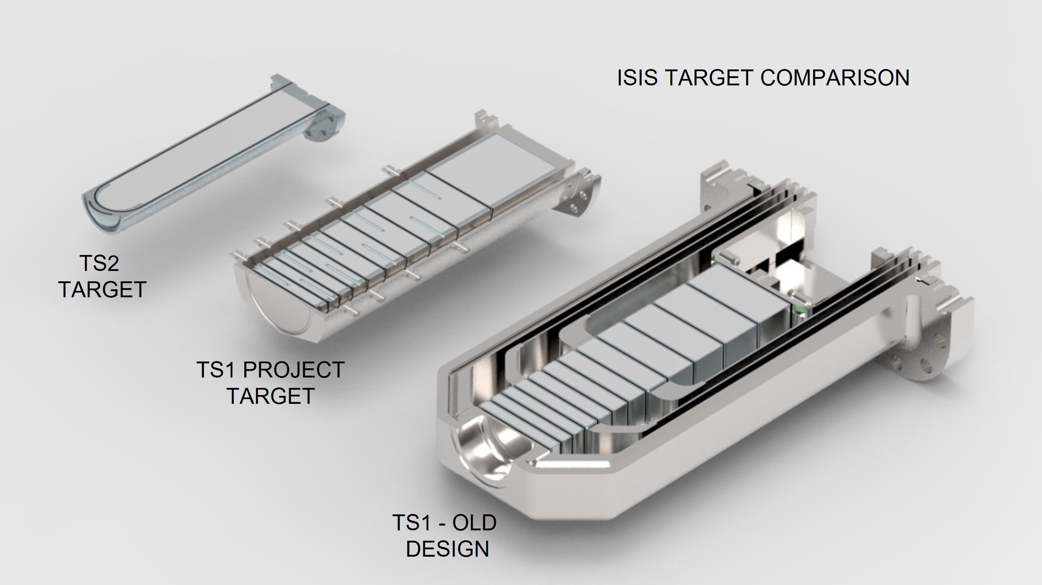
ISIS’ TRaM Circuits
Target Station 1 (TS1)
Target Station 2 (TS2)
Target cooling circuit (demin water).

Slide 3
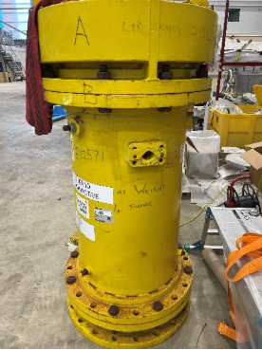
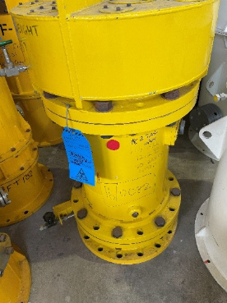
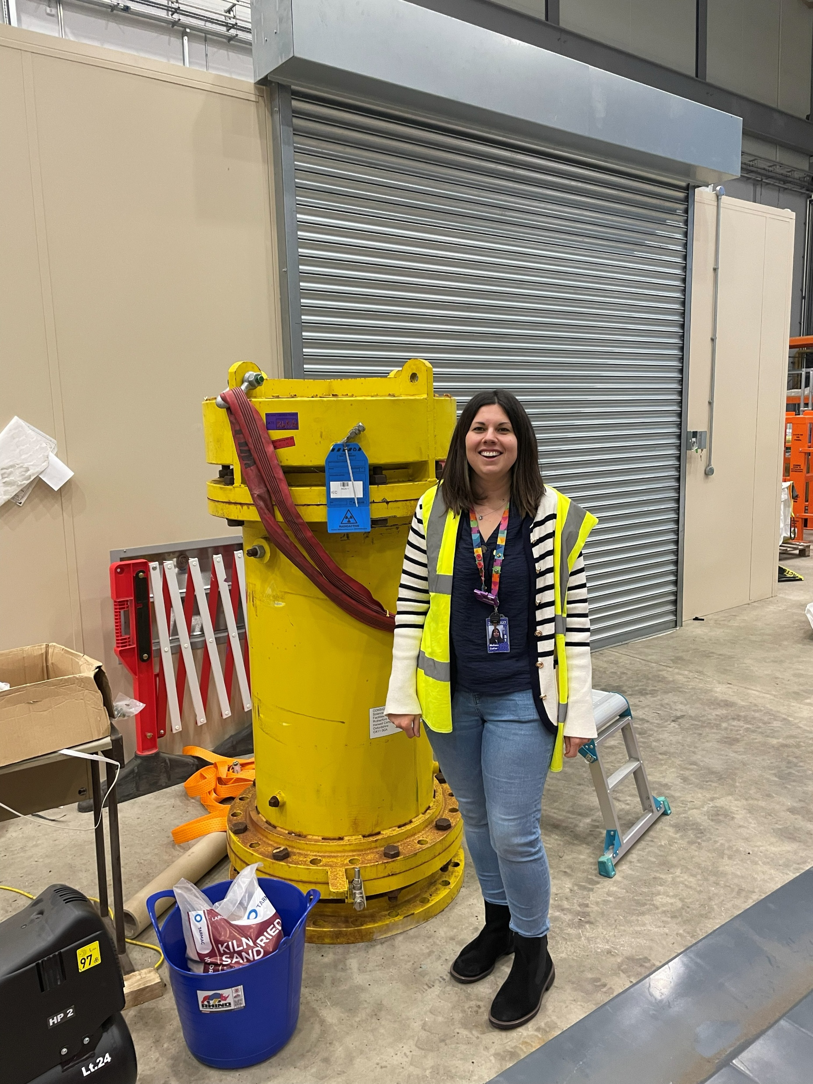
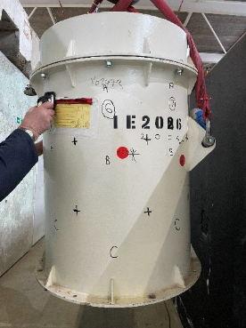
ISIS’ Ion Exchange Columns
Controls coolant chemistry in the TRaM circuits.
Shielded ion exchange columns (IECs).
Amberlite IRN77 (H+) and IRN78 (OH-).
20 IECs on the RAL radioactive waste inventory.
Problematic waste- not disposable.
Notes:
IRN77= H+ is a cation resin.
IRN78= OH- is an anion resin.

Slide 4
Legacy IECs
Legacy waste ~1990s-2010s.
Trial for characterisation, processing and disposal of 7x IECs offsite.
Initial characterisation- intermediate level waste (ILW).
Average activity concentration- 6.33E+05 Bq/g.
Alpha detected up to 840 Bq/g.
Average % contribution

Slide 5
Legacy IECs
Radionuclides (excluding H-3) and activity inconsistent across the IECs:
% contribution, IEC Y02261
(TS1 target plates IEC)
% contribution, IEC B02571
(TS1 target plates IEC)

Slide 6
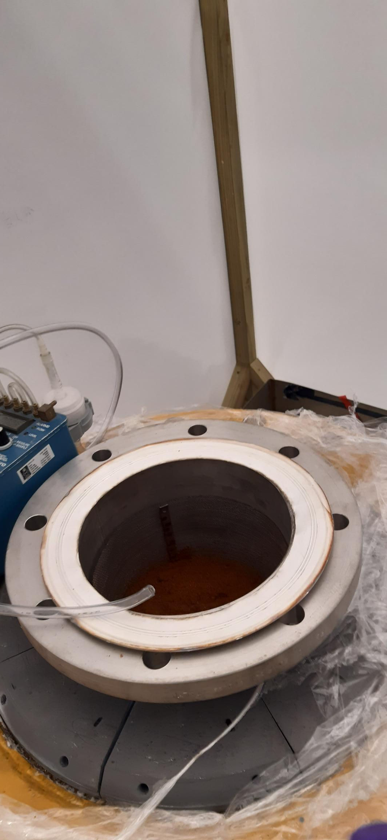
Legacy IECs
Further analysis on initial samples.
Alpha >Am-241 energy (ruled out Gd-148).
Further samples collected at different depths.
4 columns re-sampled without incident.
B02571 discharged gaseous H-3 (100-350 MBq/m3).
Did not dissipate after 24 hours.
Columns were returned to RAL.

Slide 7
IEC Characterisation Aims
Determine nuclides and activities in the columns.
Determine if isotopic fingerprint(s) can be developed.
Inform if treatment of resin is appropriate.
Determine if a disposal route is available.
Understand the physical characteristics of the resin.
Understand any non-radiological contaminants.
Determine how much water retained in the resins.

Slide 8
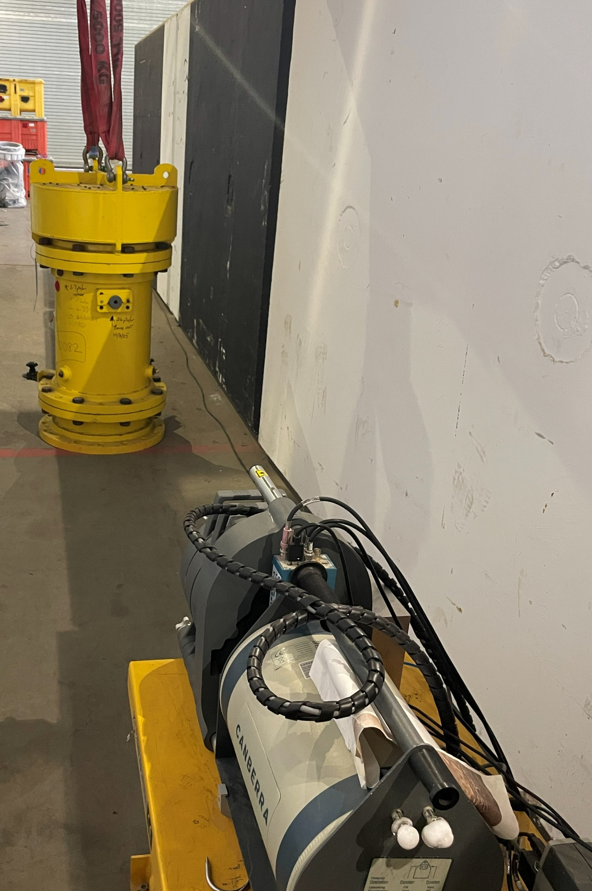
IEC Characterisation at RAL
Characterisation activities so far:
Characterisation plan developed.
External dose rate surveys (gridded).
In-situ HRGS (legacy and younger IECs).
21/0286 | 1 | 2 | 3 | 4
A- top | 6.80 | 6.50 | 8.40 | 8.40
B- middle | 2.50 | 3.30 | 3.30 | 3.40
C- bottom | 1.10 | 0.90 | 1.20 | 1.50
30 µSv/h plug open
21/0487 | 1 | 2 | 3 | 4 | 5 | 6 | 7 | 8
A- top | 38.9 | 36.0 | 32.8 | 36.0 | 28.2 | 29.0 | 38.7 | 39.0
B- middle | 55.5 | 50.1 | 52.6 | 63.6 | 86.2 | 115.0 | 87.1 | 60.5
C- bottom | 62.0 | 56.5 | 58.2 | 103.0 | 130.0 | 135.0 | 123.0 | 74.0
All contact dose rates measured in µSv/h.
Notes:
~600 uSv/h in 2021.

Slide 9
IEC Gamma Spectrometry
% contribution, IEC B02571
(TS1 target plates IEC)
% contribution, IEC 21/0286
(TS1 target plates IEC)
% contribution, IEC 21/0487
(TS2 target IEC)

Slide 10
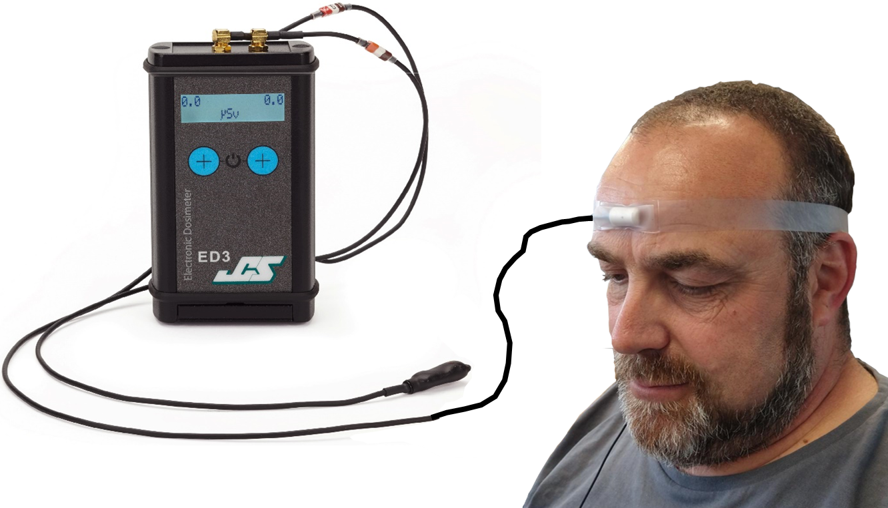
IEC Sampling at RAL
Sampling and analysis required..
Challenging from a radiation protection perspective…
(TS1 high H-3 and TS2 high gamma dose).
Potential dose rates- up to 140 mSv/h (hands) 2-3 mSv/h (body).
PPE/RPE required.
Sampling will be inside modular containment.
Extremity dosimeters- eyes and fingers.
H-3 in urine testing.
Selected IECs will be sampled.
Sampling scheduled- May 2026.
Proposed samples required.

Slide 11
Post Characterisation Plans
Best available technique (BAT) assessment:
Determine if any disposal routes available e.g. incineration.
Determine if treatment technically feasible and beneficial.
May need to consider TS1 and TS2 IECs differently…
Retrieve resin from IECs
Dispose of Columns
If treatment appropriate
If disposal route available
If geological disposal required
Treatment
Package for Transport
Condition (grout)
Package for Transport
Disposal
Package for Interim Storage
Disposal
Geological Disposal

Slide 12
Questions?

