Slide 1

BD-OT
Development of the DUMP-OT for MYRRHA phase I accelerator
Jorge Garcia Tortosa
Ot Dams
Fernando Sordo
Ulrich Dorda
Mario Perez
13 APRIL, 2026

Slide 2
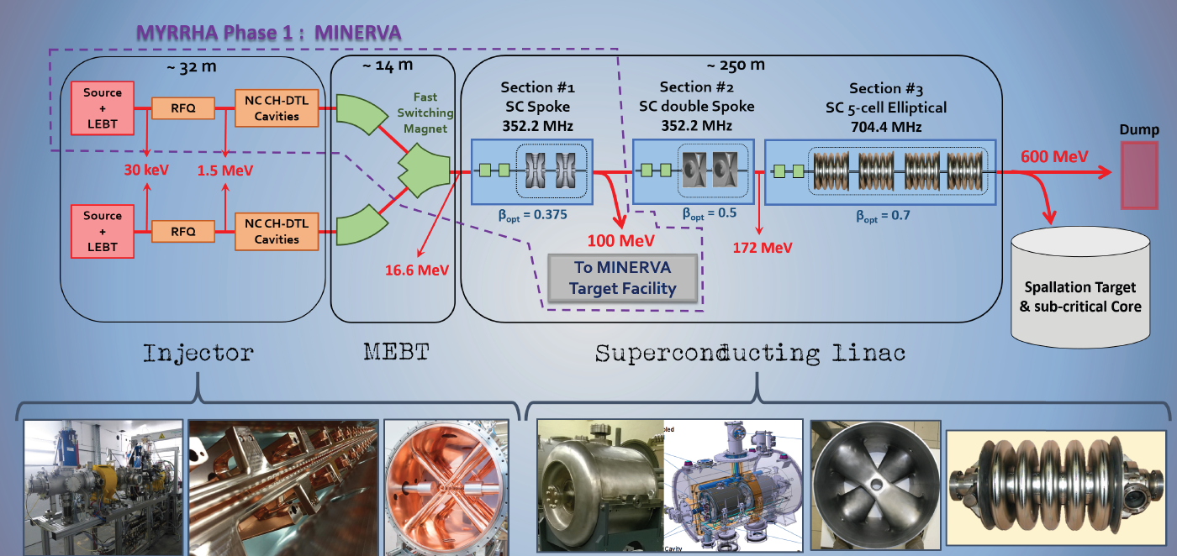
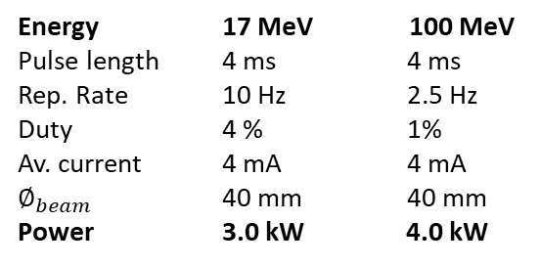
SCK-CEN: MYRRHA – Minerva
MYRRHA
Reactor powered by a particle accelerator
  Minerva
  1st phase: first part of overall accelerator – research facility
  Injector 17 MeV
  ADS 100 MeV
I1-DL
DUMP
TS-S03
DUMP
Same design concept for both Beam Dumps:
Dump-OT
Energy 17 MeV 100 MeV
Pulse length 4 ms 4 ms
Rep. Rate 10 Hz 2.5 Hz
Duty 4 % 1%
Av. current 4 mA 4 mA
$∅_{beam}$ 40 mm 40 mm
Power 3.0 kW 4.0 kW
Taking advantage of the
similar deposited power
2

Slide 3
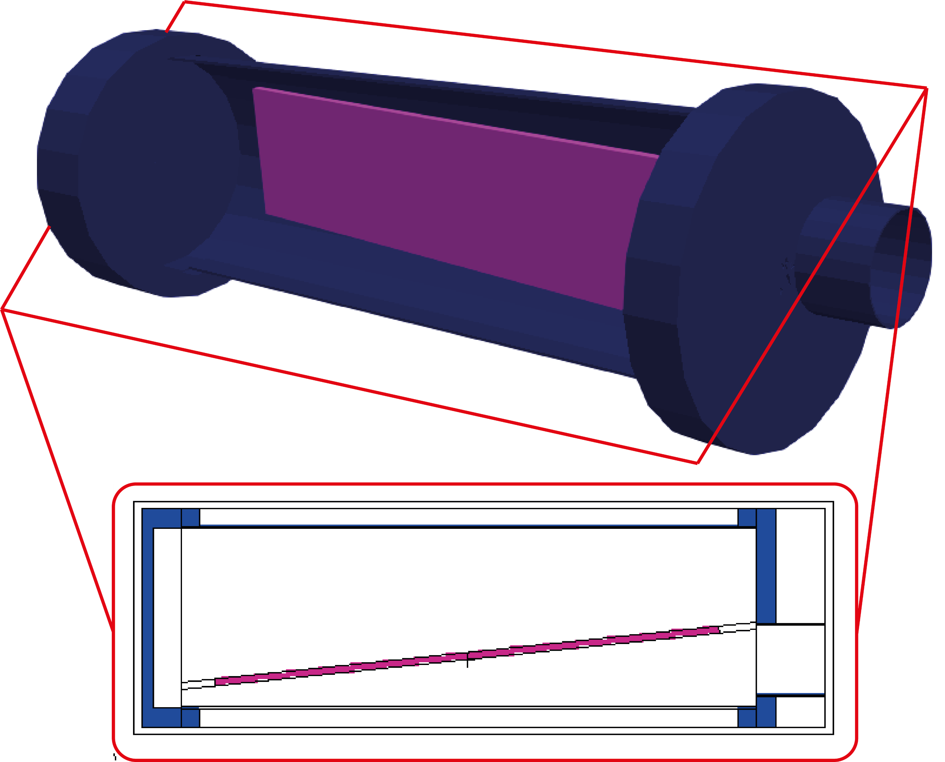
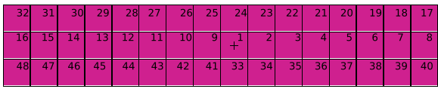
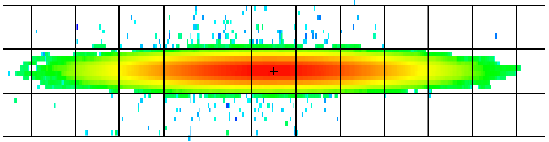


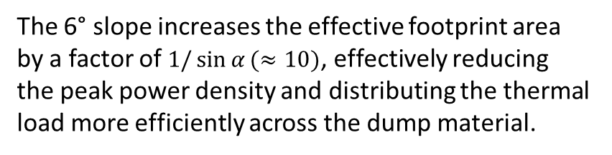

BD-OT: Operational Concept
BD-OT Basic Model
(Vessel + Dump material)
The 6° slope increases the effective footprint area by a factor of $1/\sin{α}(≈10)$, effectively reducing the peak power density and distributing the thermal load more efficiently across the dump material.
Dump material
Vacuum vessel
$$α=90°$$
(perpendicular)
$$α=6°$$
(tilted)
17/100 MeV
Proton Beam
$α=6°$slope
𝛼
17/100 MeV
Proton Beam
Bolt heads: “Mushrooms” (Independent square tiles that accommodate the heat deposited by the beam)
3

Slide 4
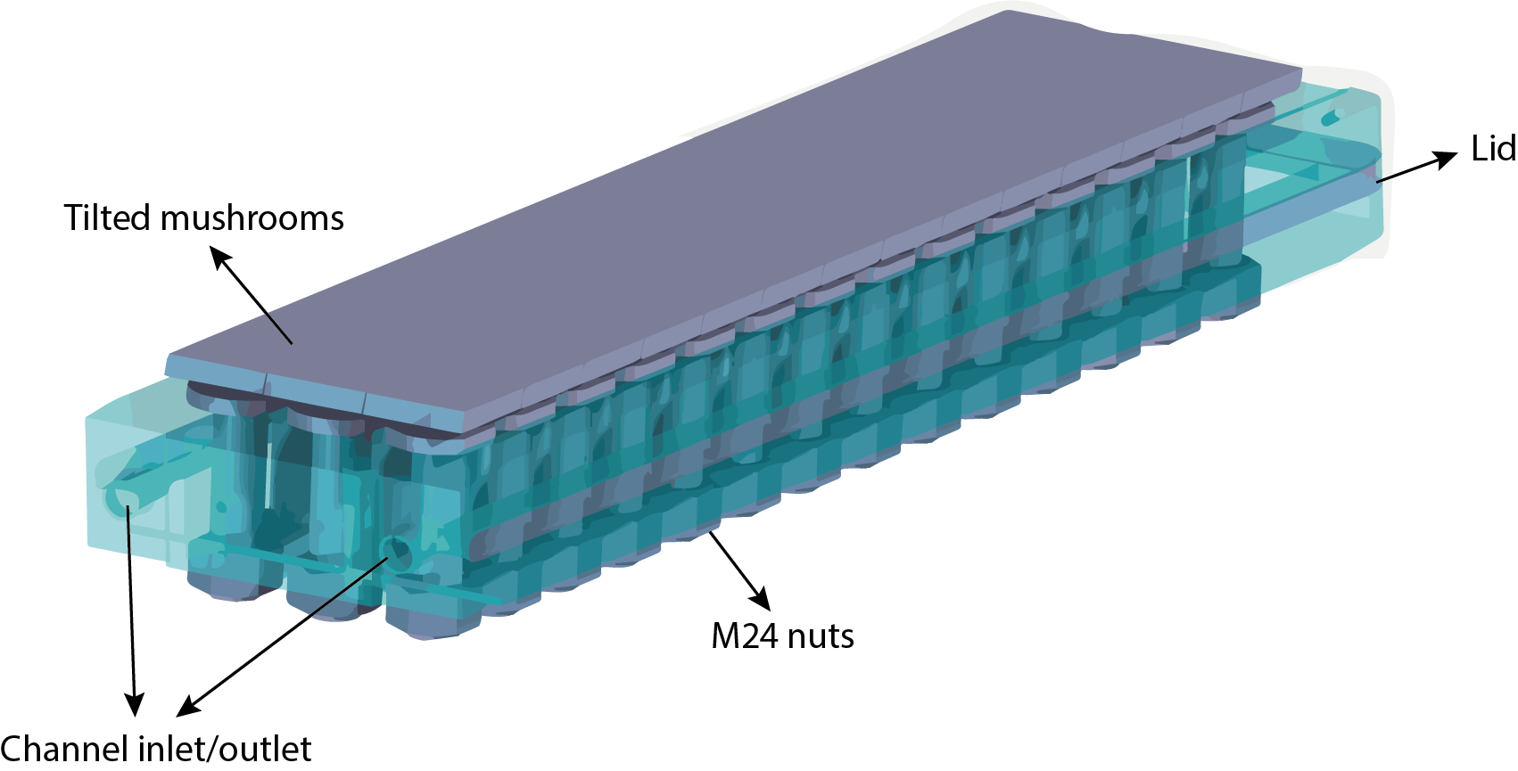
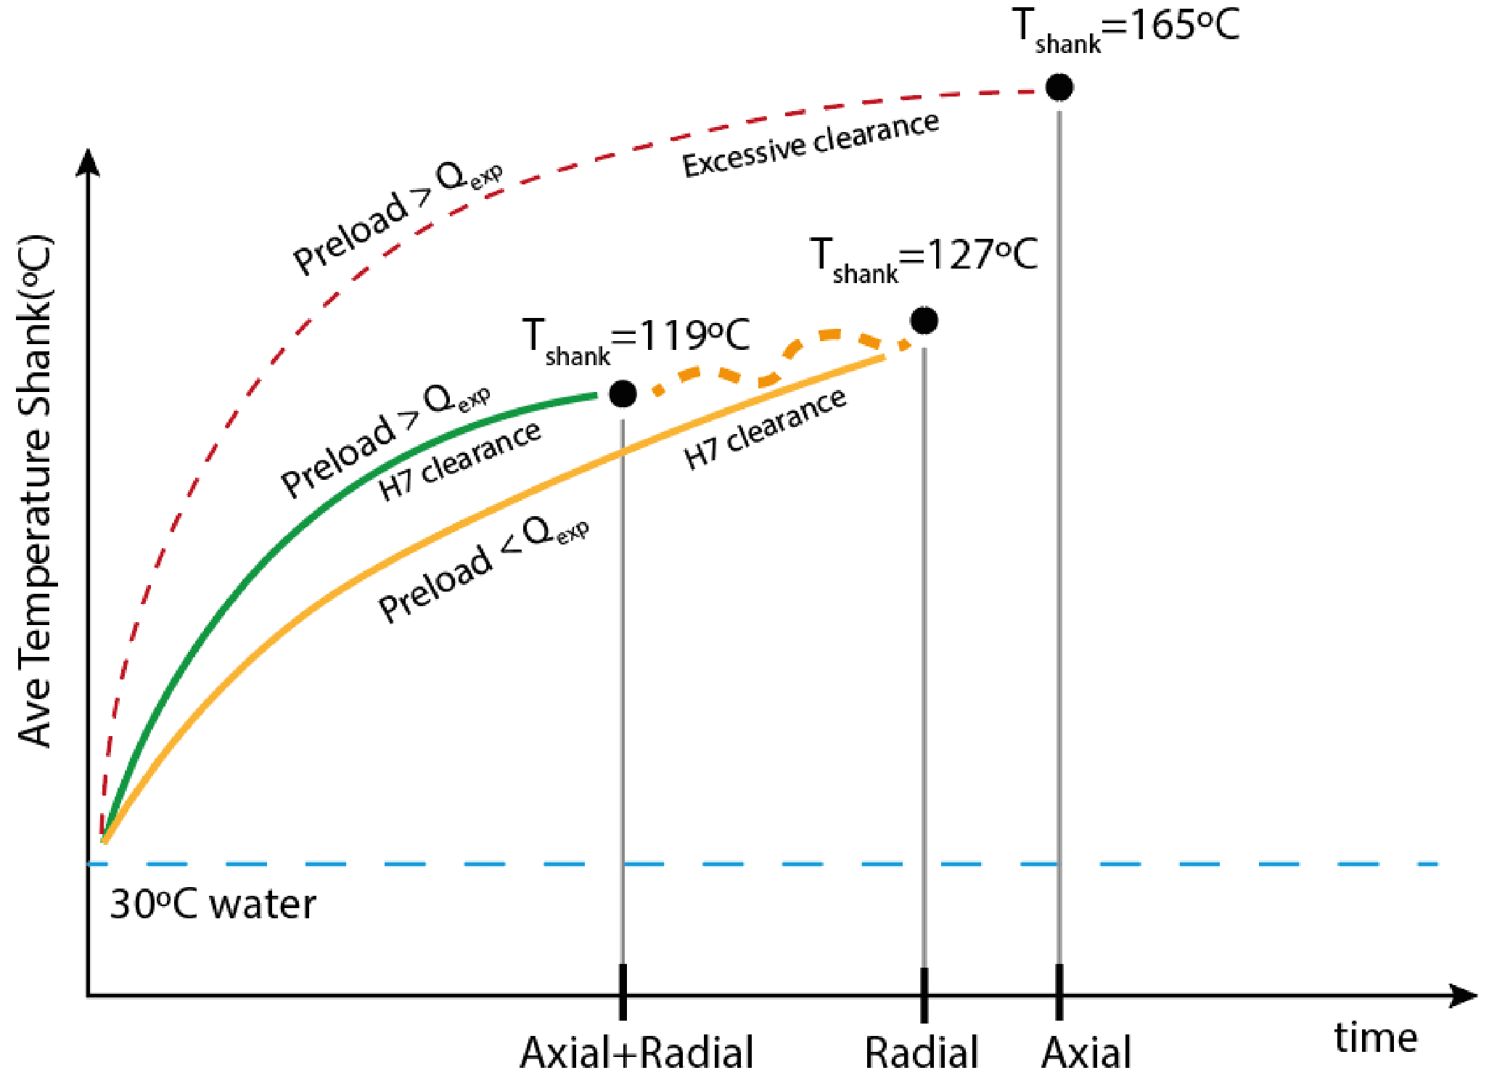
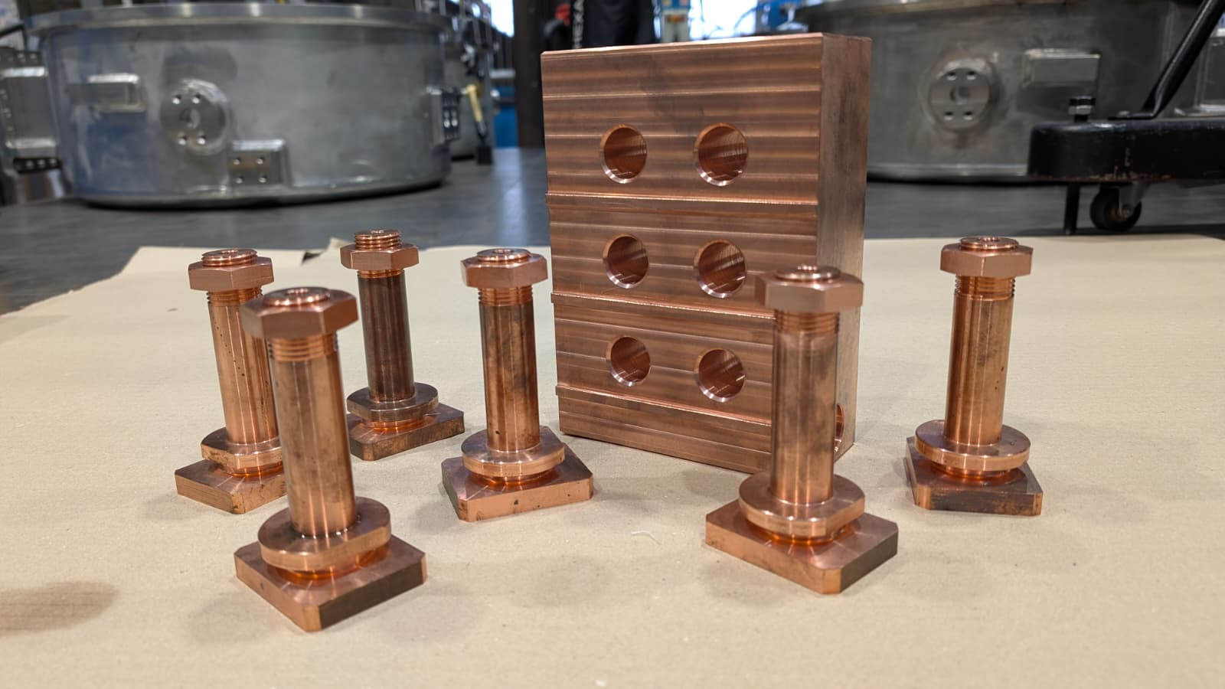
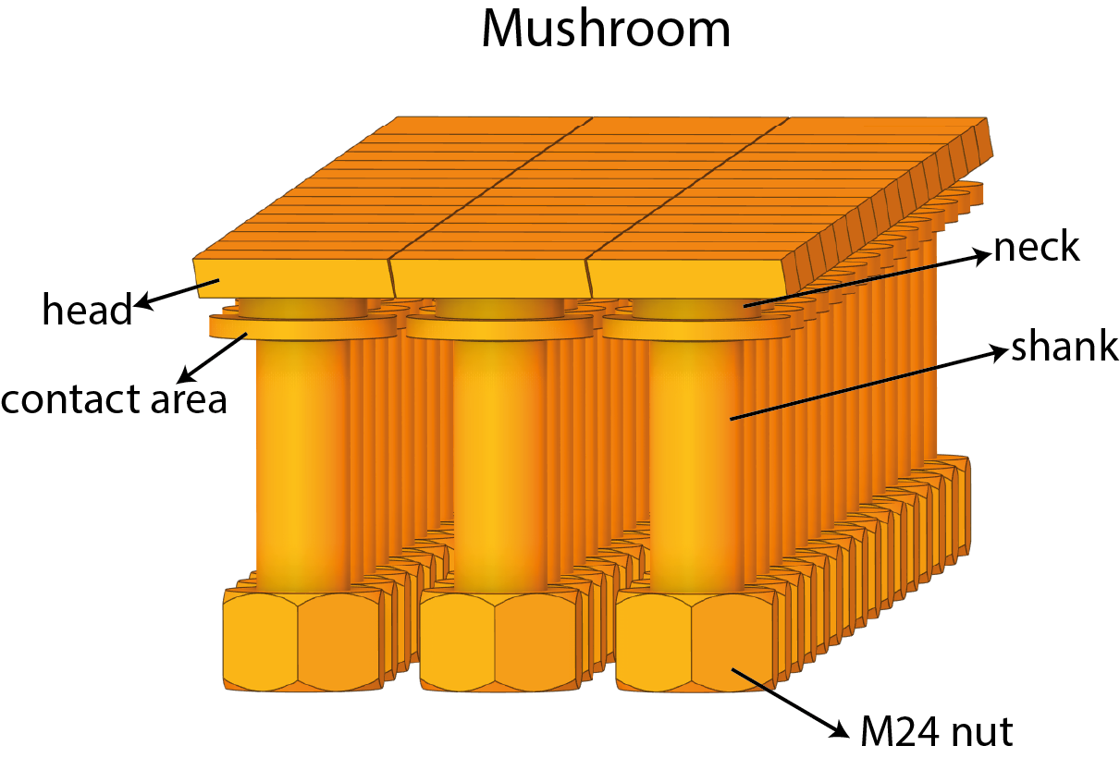
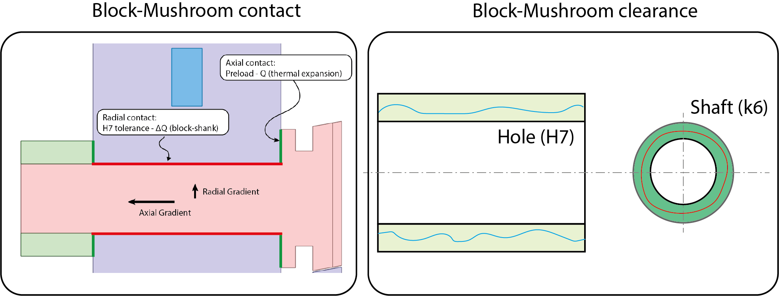
BD-OT: Operational Concept
BD-OT Dump Material
Contact behaviour
The behaviour of the component thermal mechanism approaches to a realistic model the higher the temperature in the mushrooms
Realistic model
Real Prototype
Conservative model
22°C water
operational concept
max
24.021 mm
min
24.002 mm
4

Slide 5
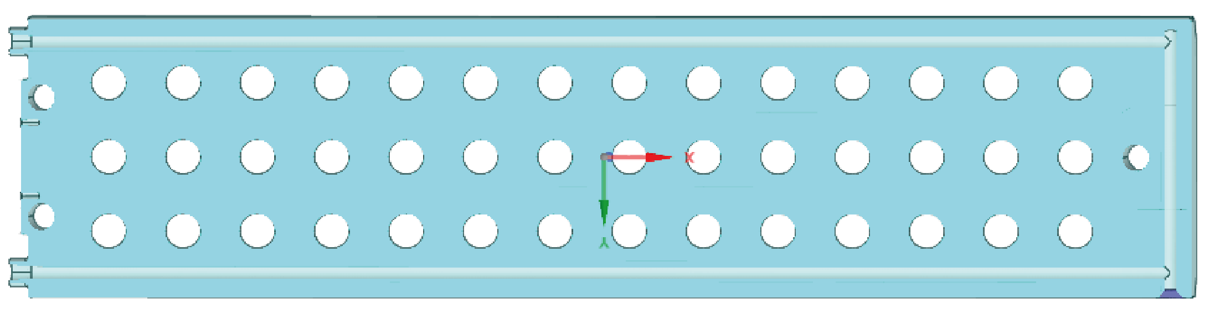








BD-OT: Cooling
BD-OT Dump Material
Channel characteristics
Cooling parameters
$$Ø_{channel}=14 mm$$
$$l_{channel}≈2000 mm$$
$${\dot{m}}_{water}=0.4 m/s$$
$$P_{op}=10 bar$$
$$T_{in}=22℃$$
($u<2.5 m/s$)
A’
A
Operational data
$$Re=\frac{ρud_{h}}{μ}≈35000$$
Dittus-Boelter
Drilled channels
$$h=9.25 kW/m^{2}K$$
$$Pr=\frac{μc_{p}}{k_{w}}≈7$$
conservative HTC used in the model:
$$h=5 kW/m^{2}K$$
Expected water bulk temperature increase:
$$∆T_{water}=\frac{P_{avg}}{\dot{m}c_{p}}≈2.4℃$$
(negligible impact)
Welded plug
5

Slide 6
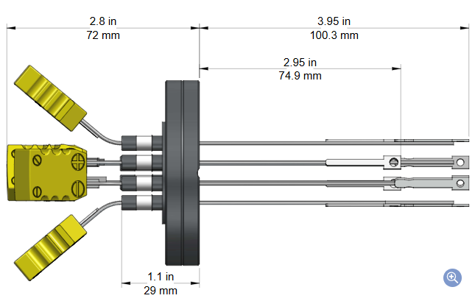
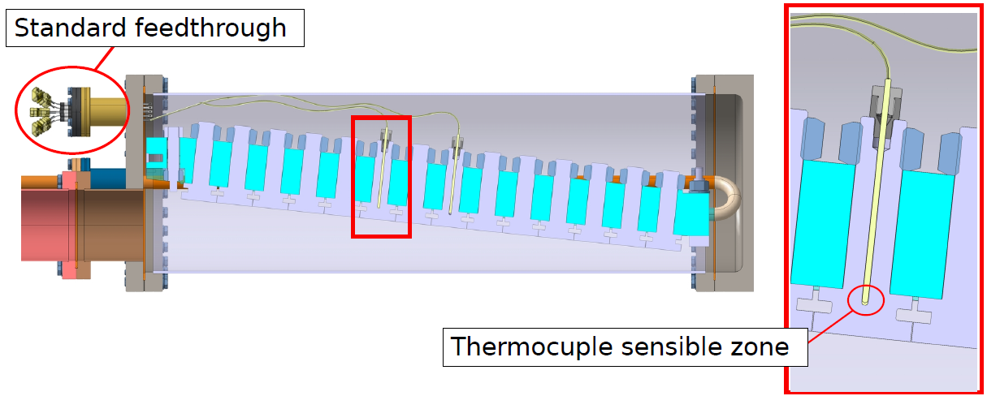
BD-OT: Monitoring
Mushrooms have a hole in the centre to accommodate a thermocouple. Number of thermocouples and their position (selected mushrooms to monitor) can be determined per convenience.
  10 thermocouples are introduced through standard feedthrough in the front flange.
  Four – Six central mushrooms are mandatory to monitor (beam impact – per thermal results).
  Thermocouples Type K of chromel(+)/alumel(-) insulated with alumina are a good option for the expected operation temperature range. More expensive Type N may be an option if reliability is a high priority.
  Mineral insulated cables shall be used inside the vacuum vessel.
Standard feedthrough
Thermocouple sensitive point
6

Slide 7
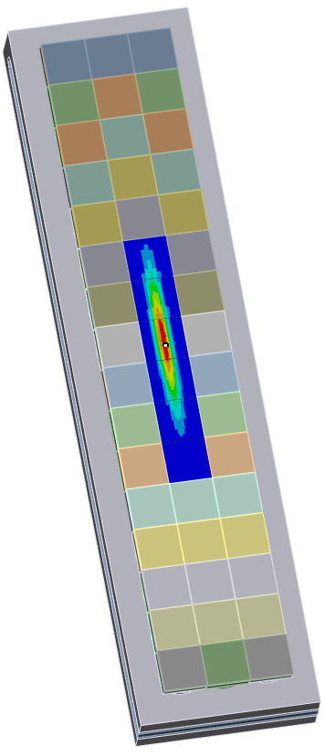
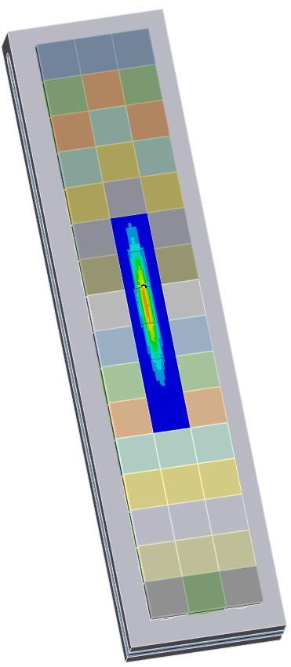
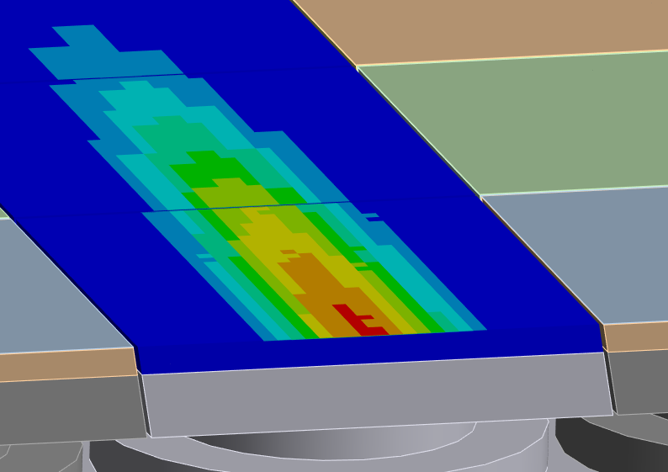
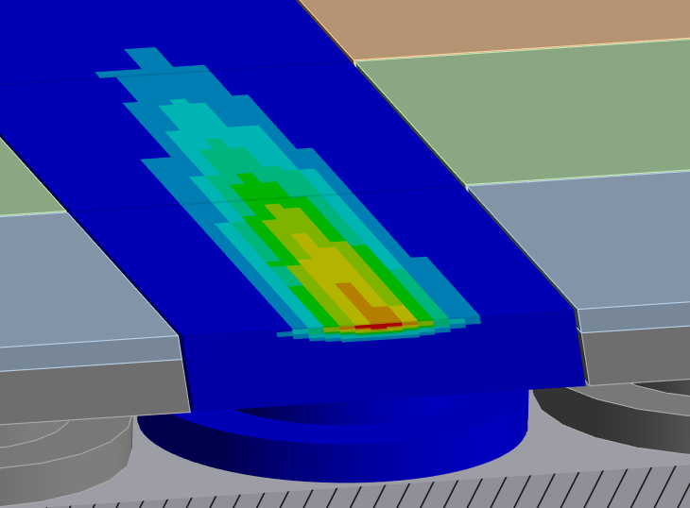
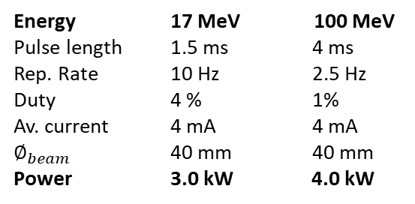

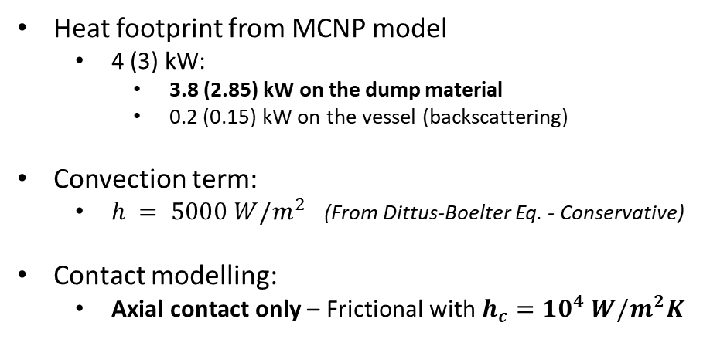
BD-OT: Conservative Model – Boundary conditions
I1-DL
DUMP
(17 MeV)
TS-S03
DUMP
(100 MeV)
I1-DL
DUMP
TS-S03
DUMP
Convection (water channel)
Energy 17 MeV 100 MeV
Pulse length 1.5 ms 4 ms
Rep. Rate 10 Hz 2.5 Hz
Duty 4 % 1%
Av. current 4 mA 4 mA
$∅_{beam}$ 40 mm 40 mm
Power 3.0 kW 4.0 kW
$h=5 kW/m^{2}K$ (per analysis)
Superficial footprint
Heat footprint from MCNP model
  4 (3) kW:
    3.8 (2.85) kW on the dump material
    0.2 (0.15) kW on the vessel (backscattering)
Convection term:
  $h = 5000 W/m^{2}$ (From Dittus-Boelter Eq. - Conservative)
Contact modelling:
  Axial contact only – Frictional with $h_{c}={10}^{4} W/m^{2}K$
Bragg peak ≈ 0.75 mm
(conductance)
*Conservative assumption from Yovanovich[1][2]
7

Slide 8
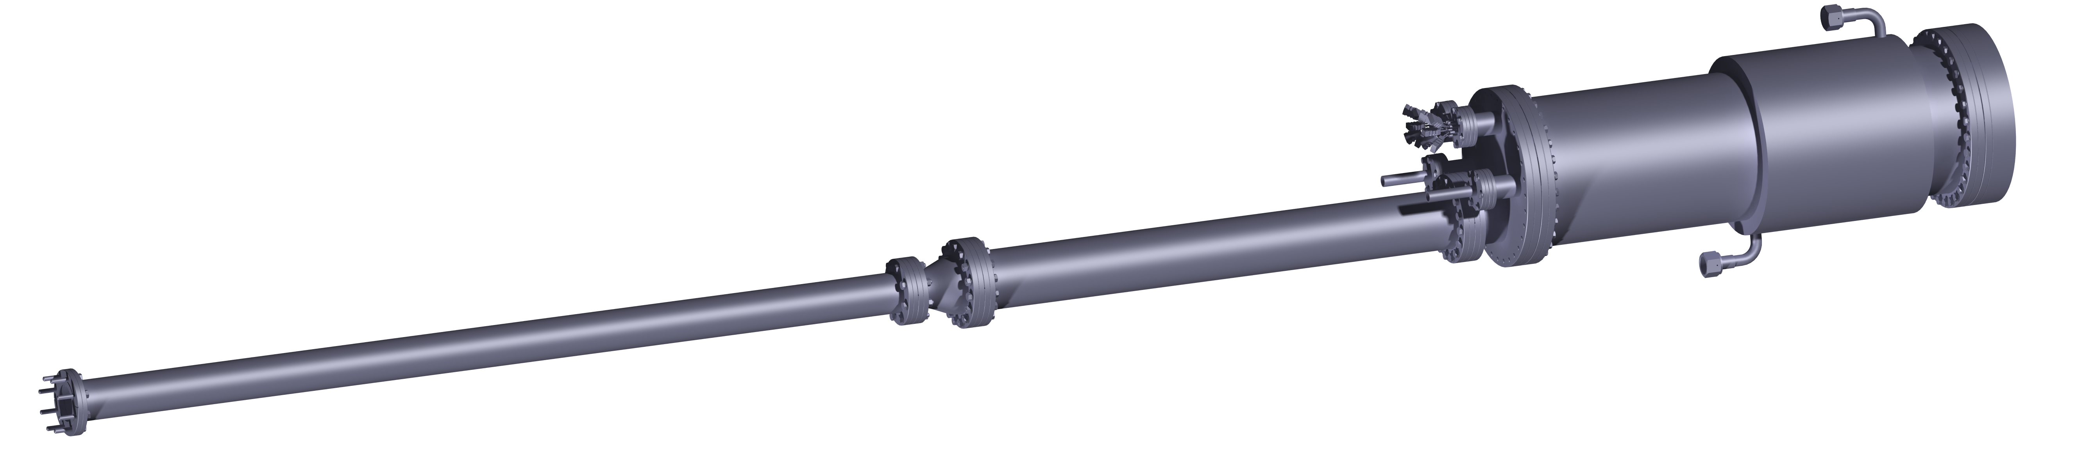
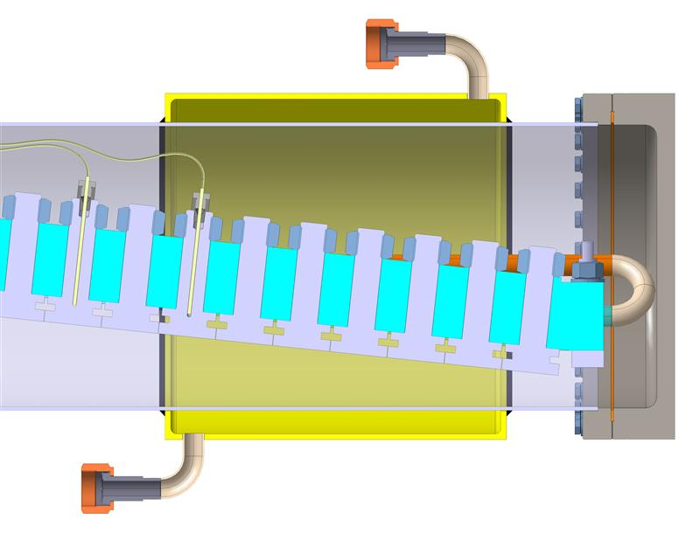
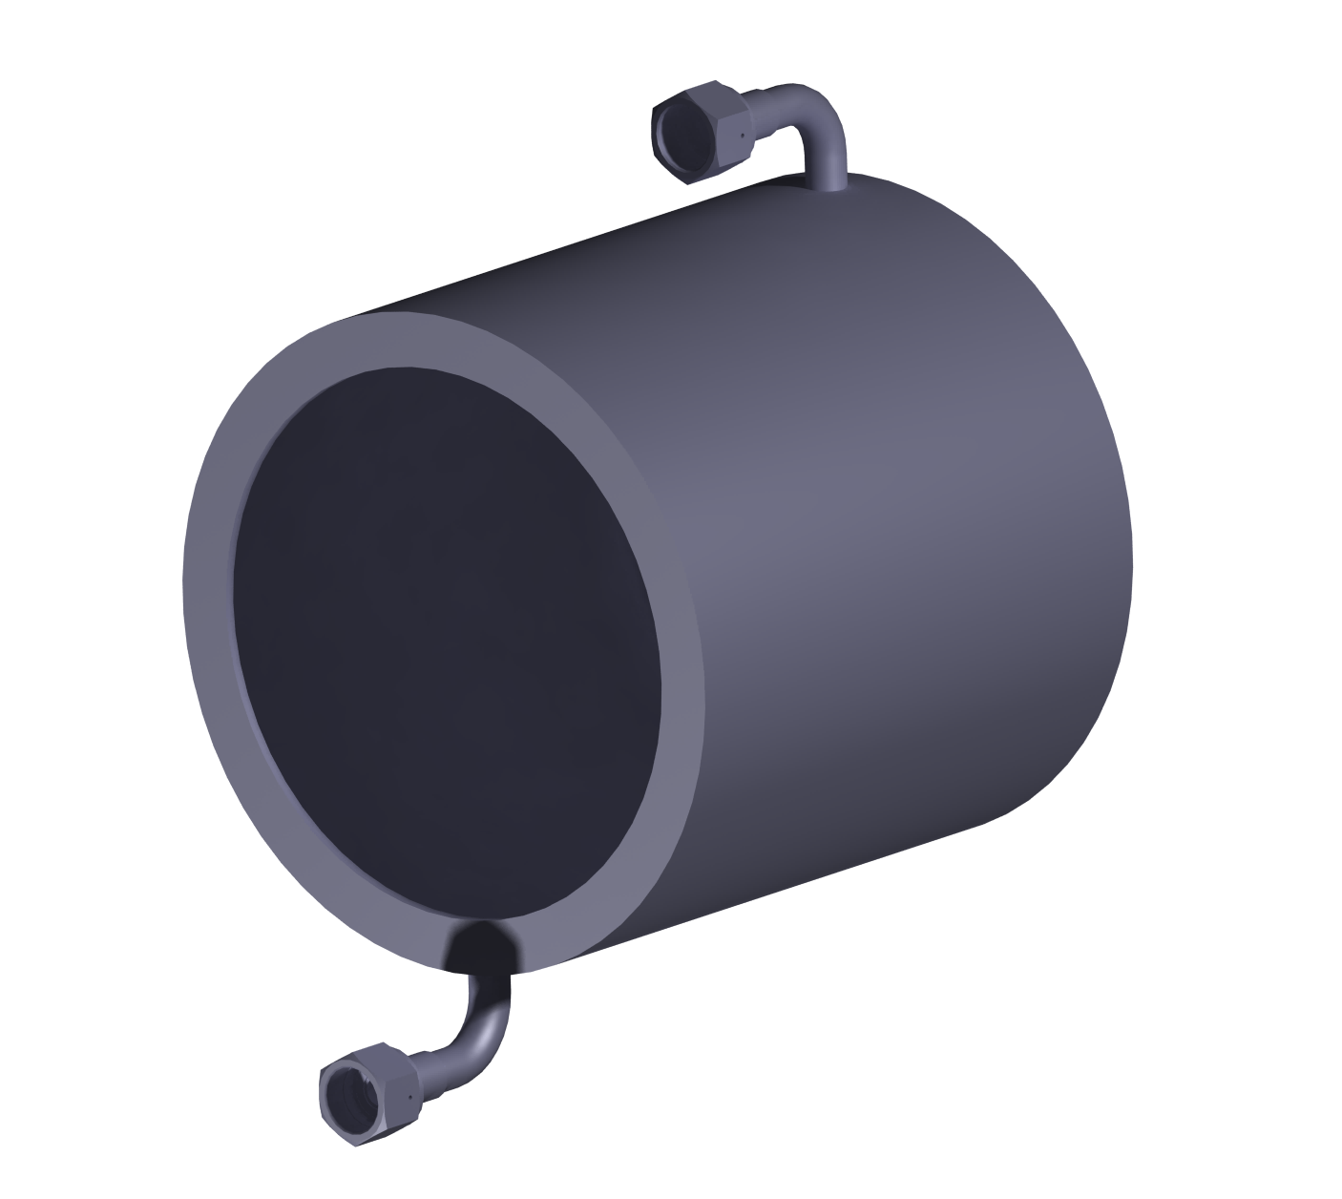
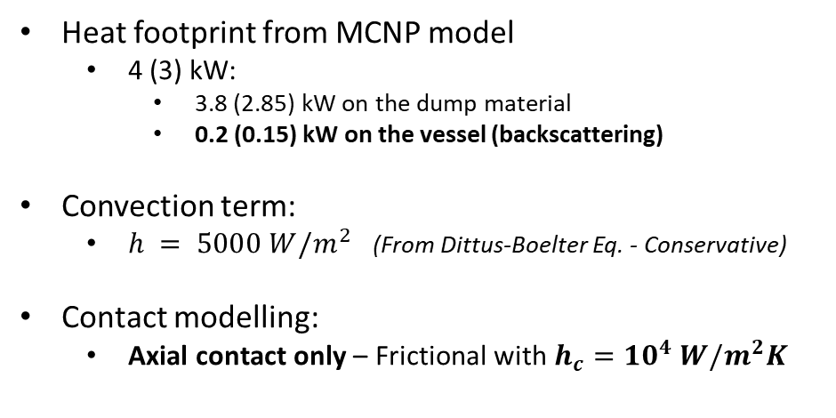
BD-OT: Conservative Model – Boundary conditions
I1-DL
DUMP
TS-S03
DUMP
Energy 17 MeV 100 MeV
Pulse length 1.5 ms 4 ms
Rep. Rate 10 Hz 2.5 Hz
Duty 4 % 1%
Av. current 4 mA 4 mA
$∅_{beam}$ 40 mm 40 mm
Power 3.0 kW 4.0 kW
Water
inlet
Water
inlet
Heat footprint from MCNP model
  4 (3) kW:
    3.8 (2.85) kW on the dump material
    0.2 (0.15) kW on the vessel (backscattering)
Convection term:
  $h = 5000 W/m^{2}$ (From Dittus-Boelter Eq. - Conservative)
Contact modelling:
  Axial contact only – Frictional with $h_{c}={10}^{4} W/m^{2}K$
Water
outlet
Water
outlet
Welded areas
(conductance)
*Conservative assumption from Yovanovich[1][2]
8

Slide 9
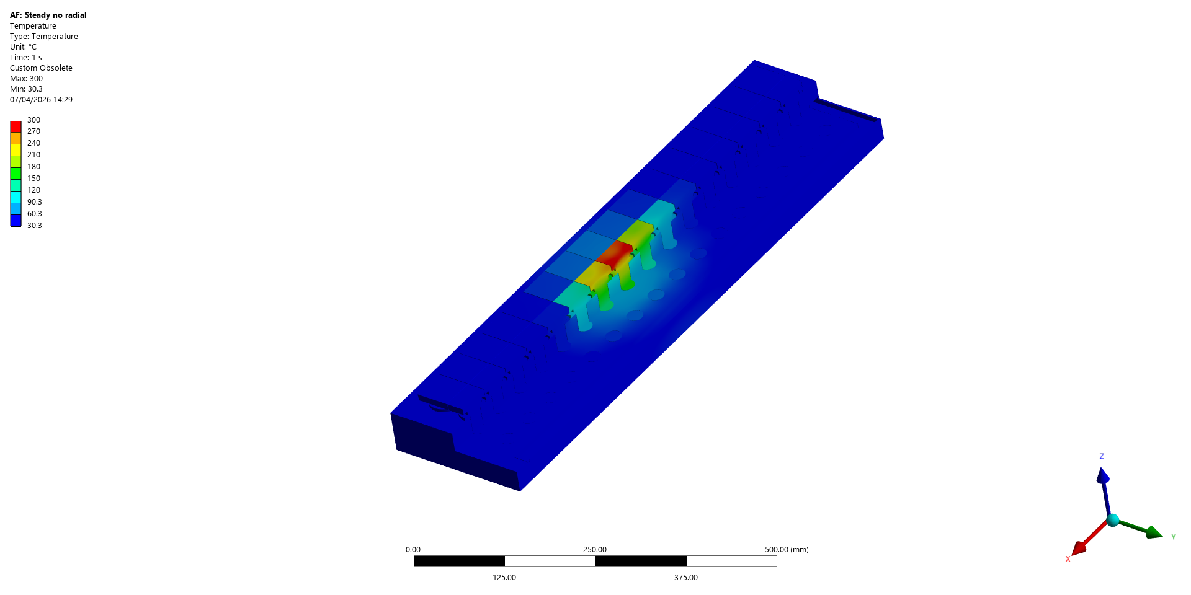
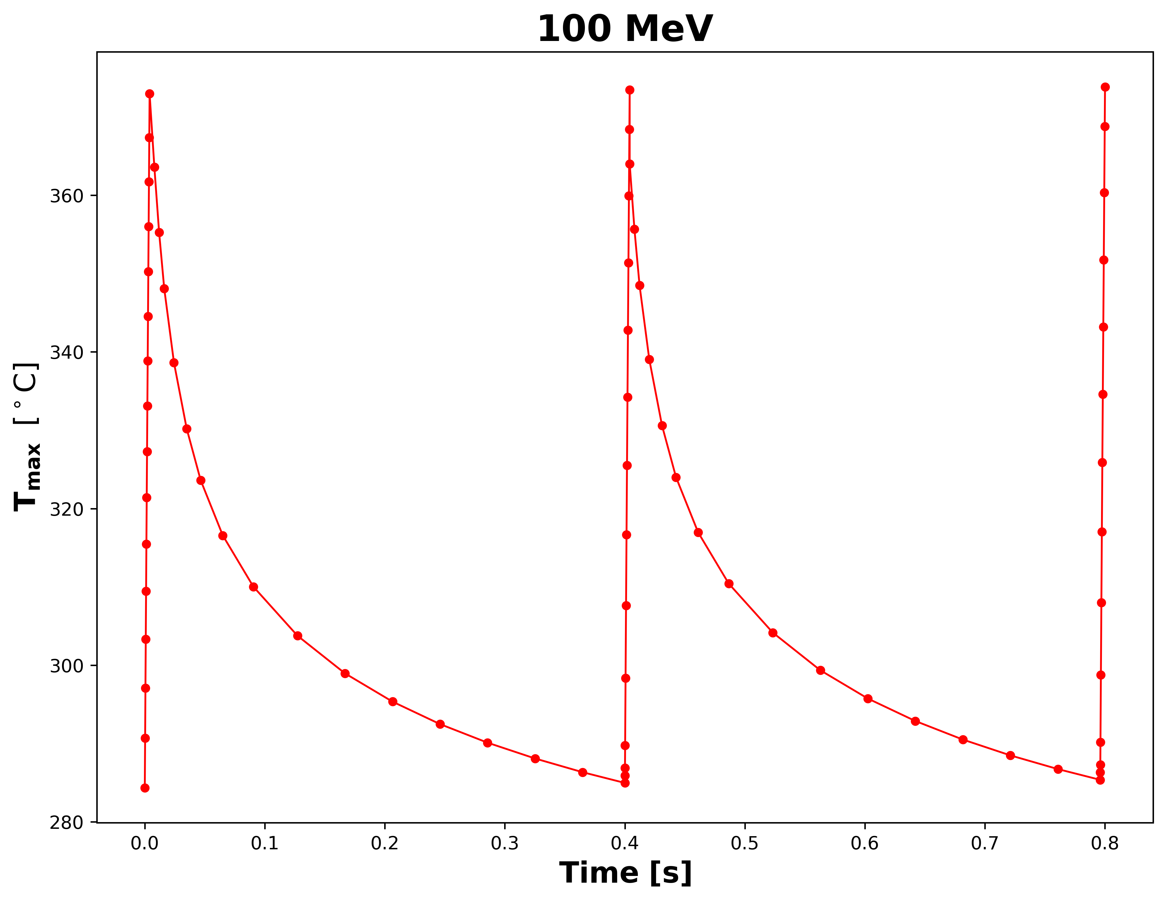





BD-OT: Conservative Model – Results: 100 MeV
100 MeV
3.3% of pulse time
Temperature
$$ΔT_{pulse}=89°C$$
Steady state
(°C)
MCNP vs Thermal
(energy balance check)
MCNP
$$3779 W$$
$$≈1\%$$
$$T_{max, steady}≈300℃≪350℃$$
$$T_{max}≈373℃>350℃$$
ANSYS
CuCrZr recommended upper temperature limit is 350°C [3].
9

Slide 10
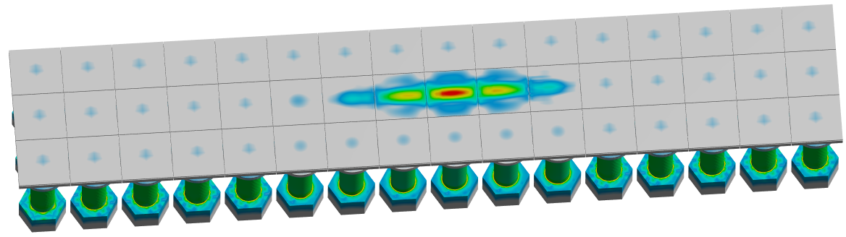
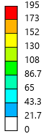
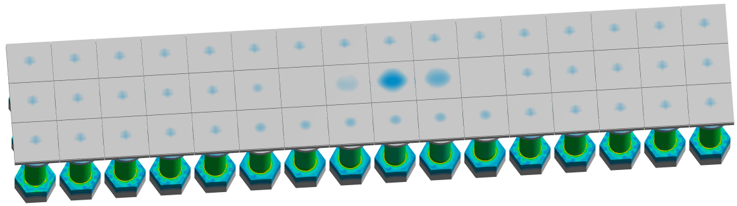
BD-OT: Conservative Model – Results: 100 MeV
After pulse
195 MPa
3.3% of pulse time
Eq. Stress
$$ΔT_{pulse}=89°C$$
Before pulse
(MPa)
$$∆σ≈170 MPa≈170 MPa$$
Secondary loads are critical for the Beam Dump operational life. Following the work of Heikkinen[4] on CuCrZr, fatigue strength for ultra high cycling $\left(>{10}^{10}\right)$ is 170 Mpa. Maximum stress range expected is near acceptable limits.
10

Slide 11
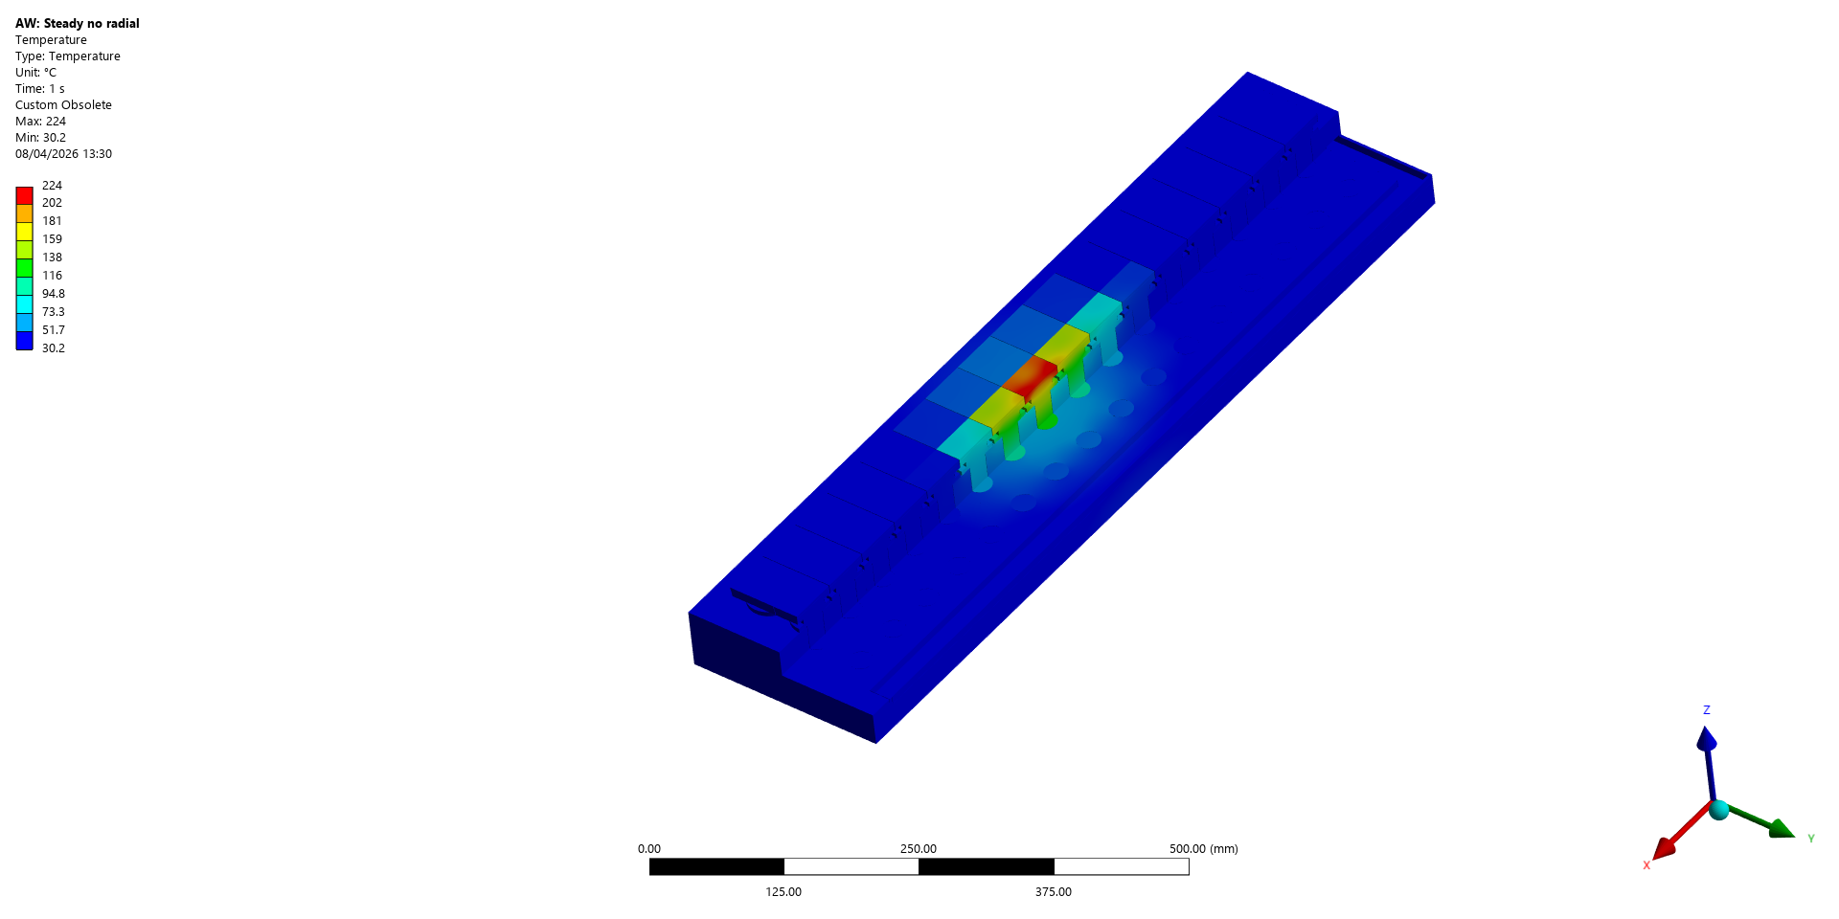
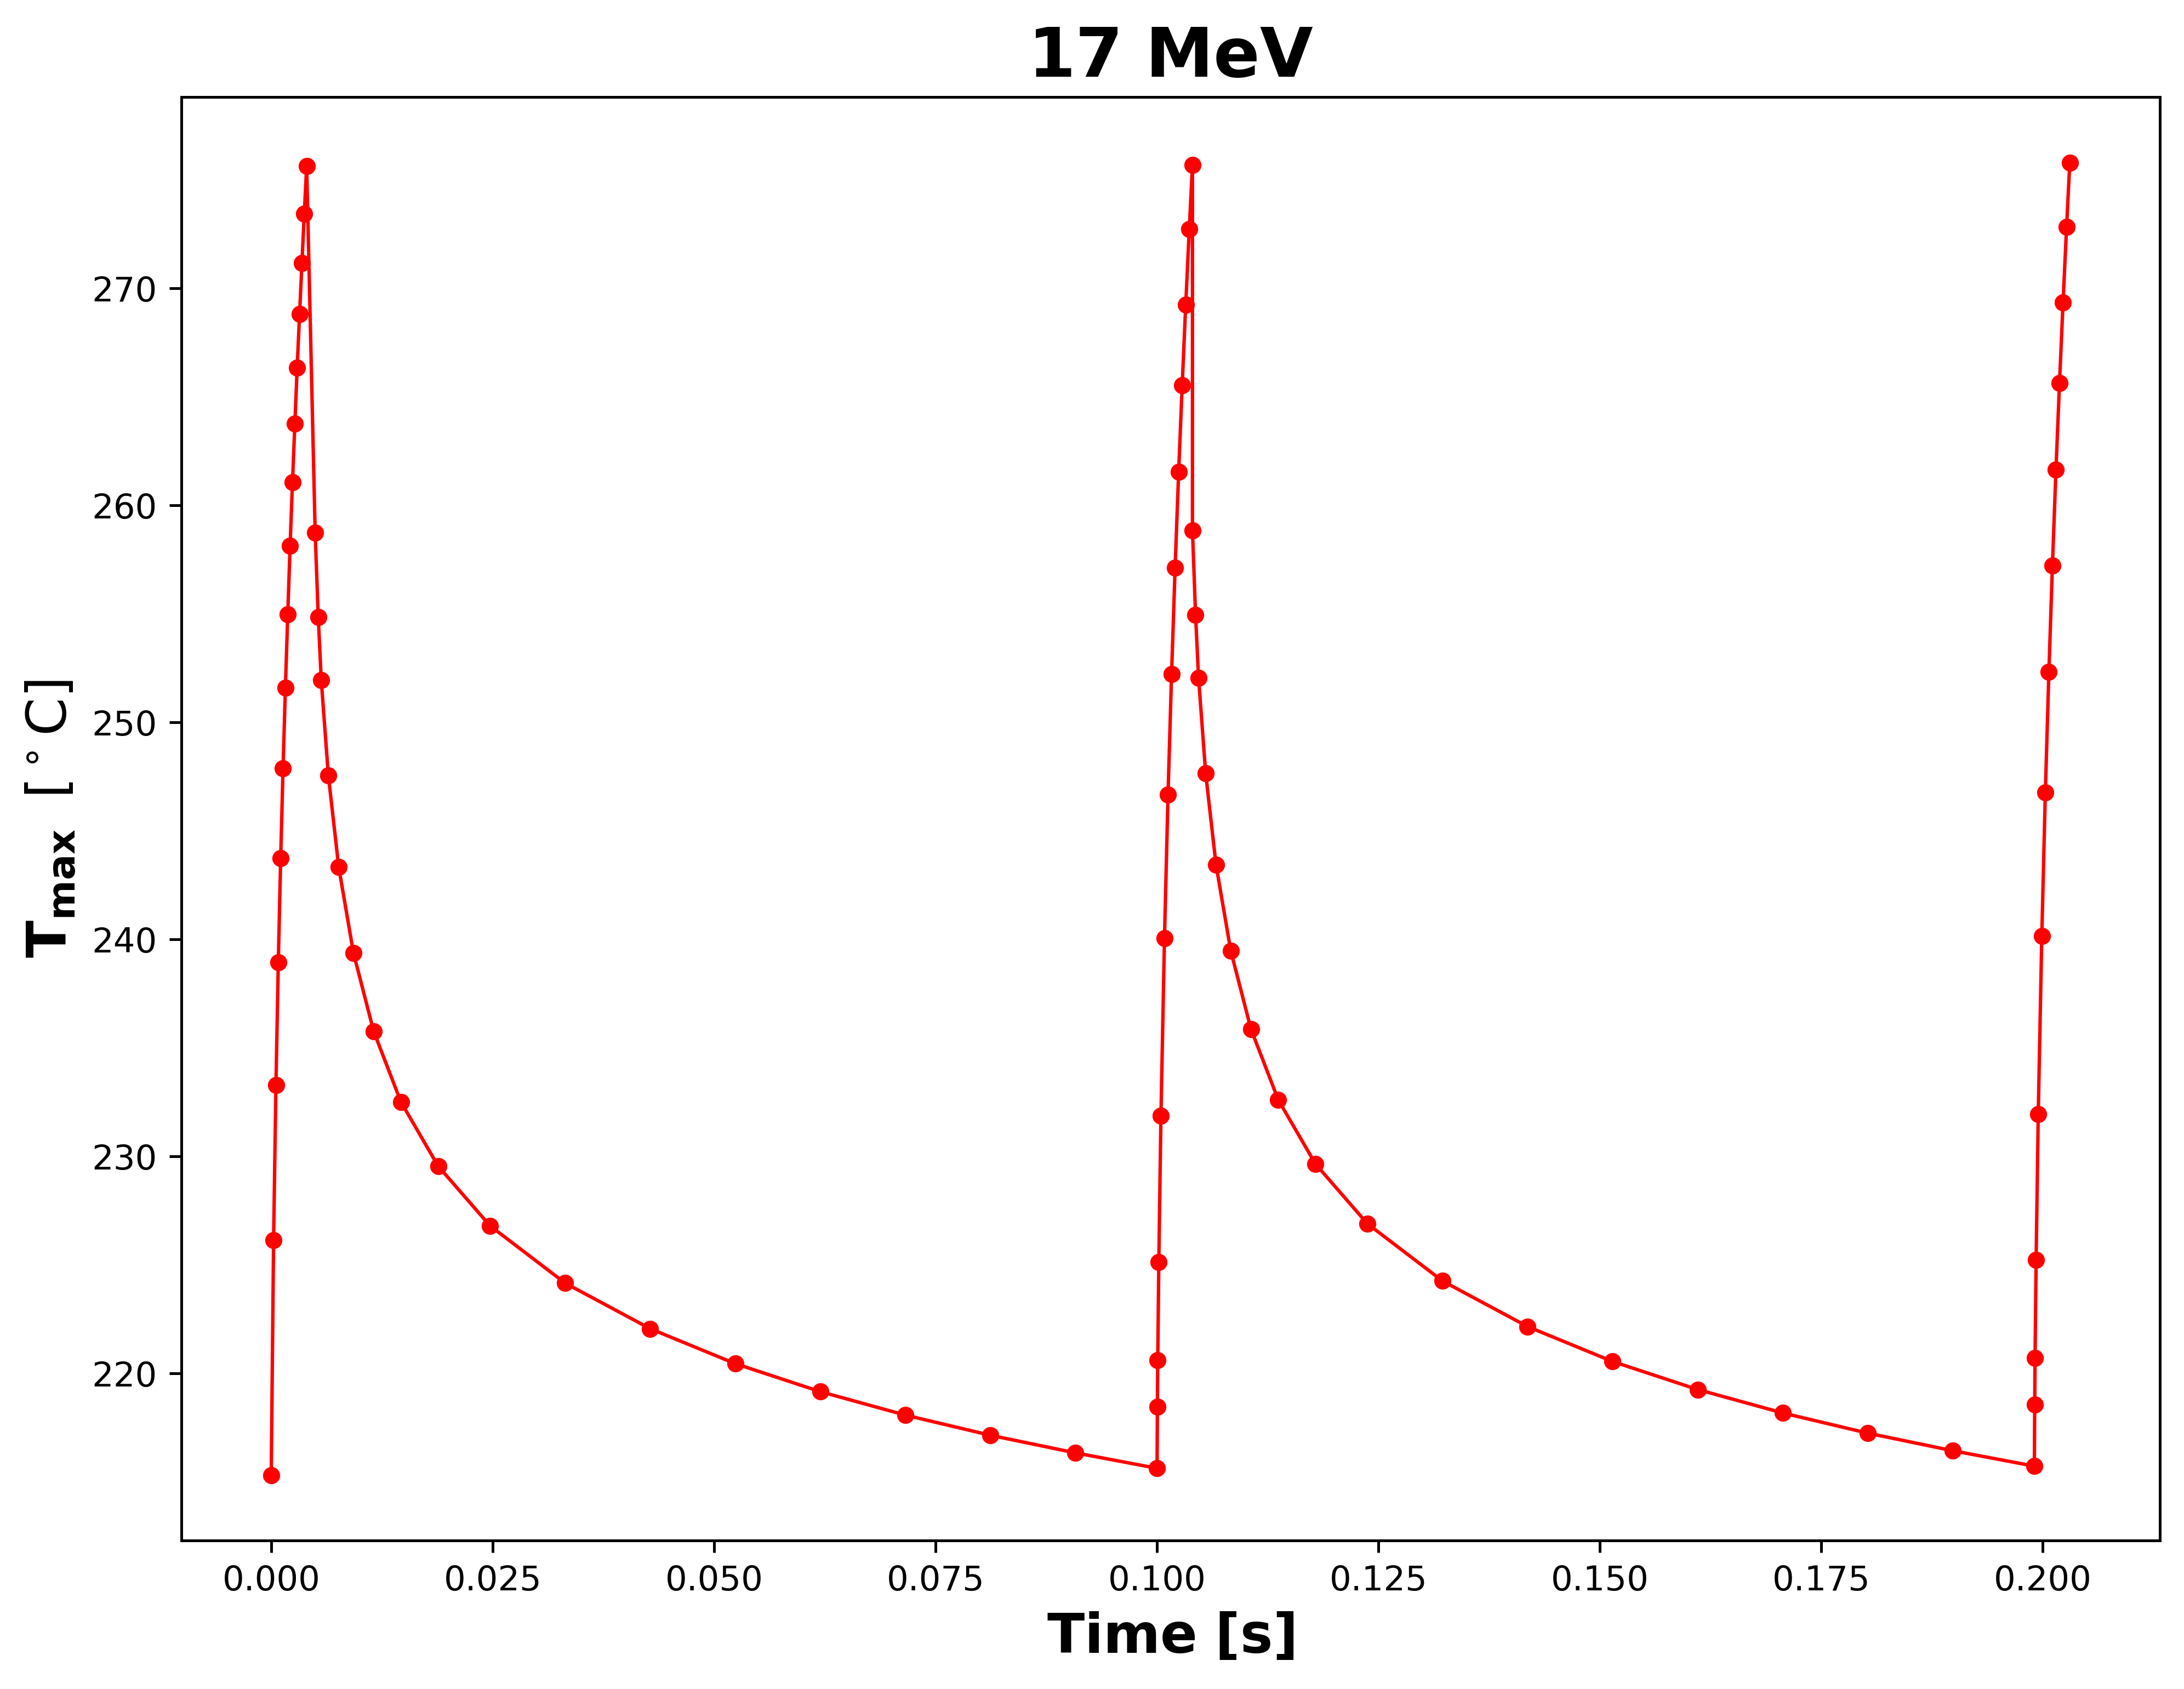





BD-OT: Conservative Model – Results: 17 MeV
17 MeV
Temperature
$$ΔT_{pulse}=60°C$$
Steady state
(°C)
MCNP vs Thermal
(energy balance check)
MCNP
$$2847 W$$
$$≈0.5 \%$$
$$T_{max, steady}≈225℃≪350℃$$
$$T_{max}≈275℃≪350℃$$
ANSYS
CuCrZr recommended upper temperature limit is 350°C [3].
11

Slide 12
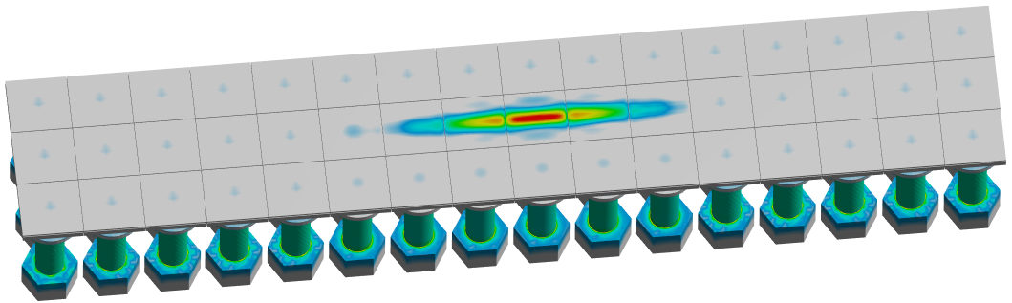

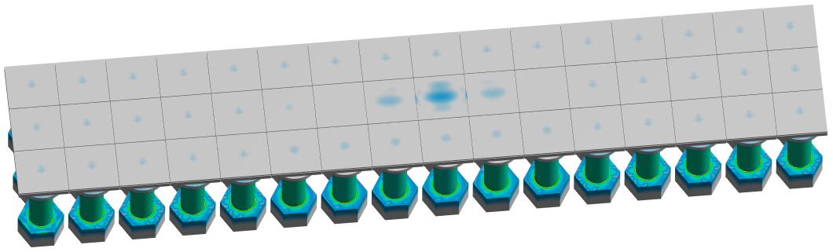

BD-OT: Conservative Model – Results: 17 MeV
After pulse
148 MPa
Eq. Stress
$$ΔT_{pulse}=60°C$$
Before pulse
(MPa)
$$∆σ≈130 MPa≪170 MPa$$
Secondary loads are critical for the Beam Dump operational life. Following the work of Heikkinen[4] on CuCrZr, fatigue strength for ultra high cycling $\left(>{10}^{10}\right)$ is 170 Mpa. Maximum stress range expected remains well below acceptable limits.
12

Slide 13
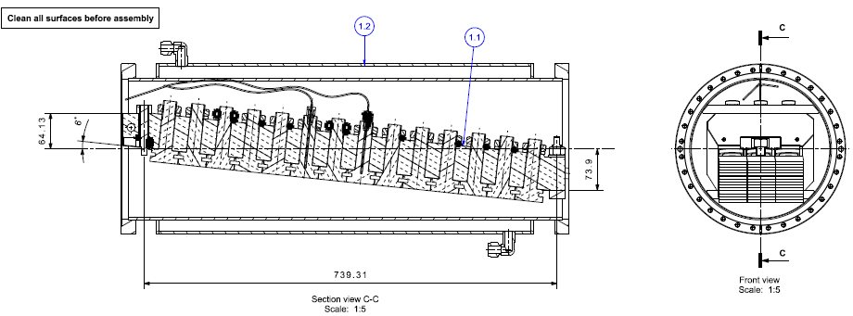
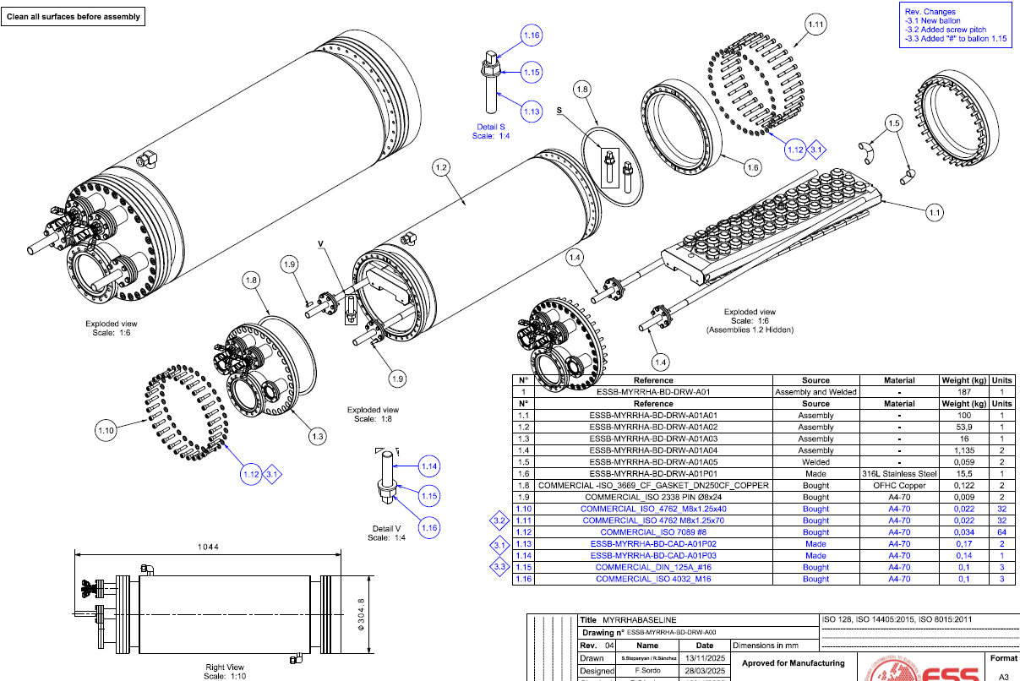
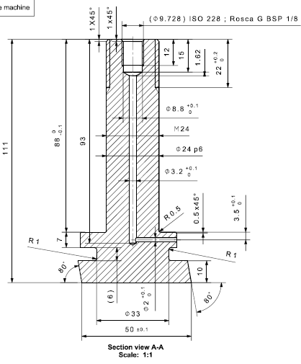
BD-OT: Assembly drawings
Assembly drawings already generated before manufacturing phase. Ready to generate accordingly detailed pieces drawings for BD manufacturing phase.
13

Slide 14
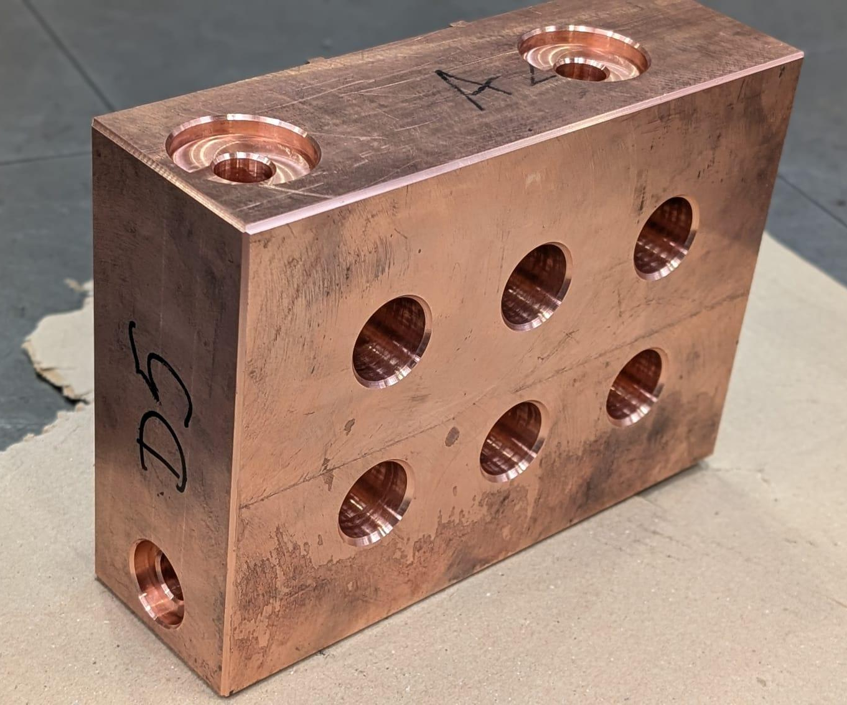
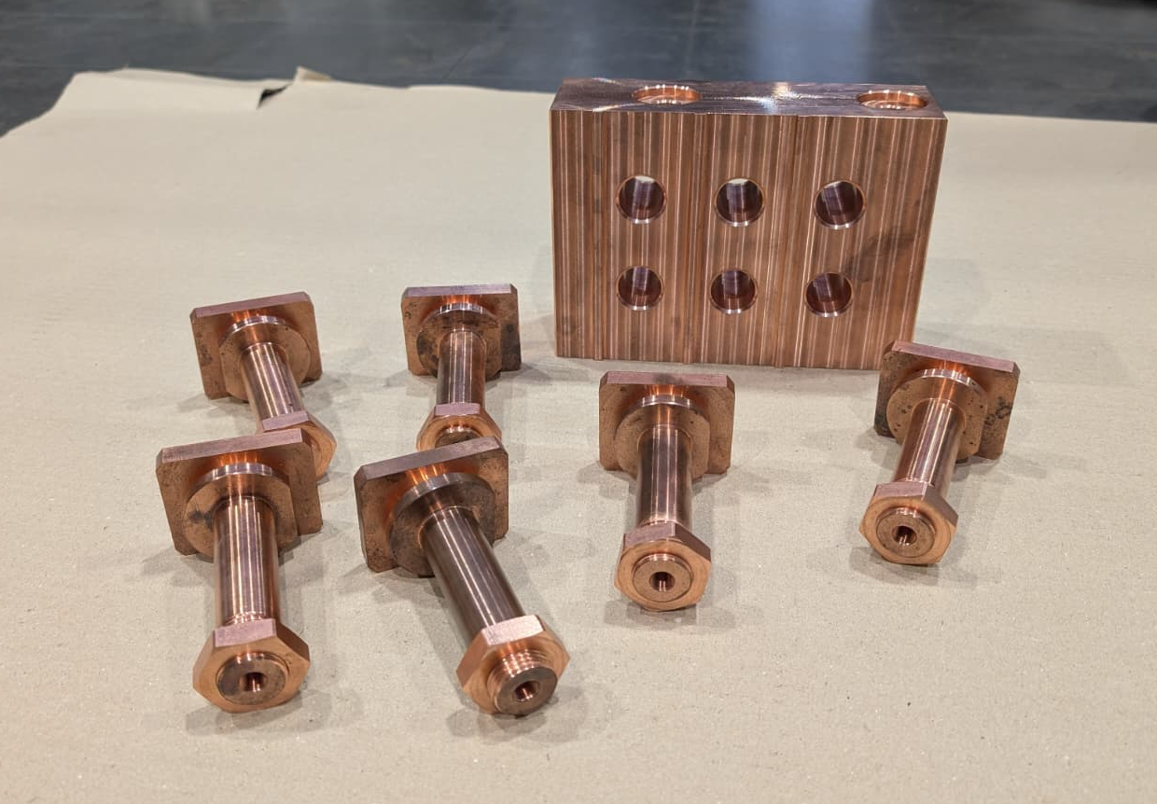
BD-OT: Prototype
Prototype is being manufactured. Cooled block and mushrooms have been machined without issues. Welds with Electron-Beam welding process still to be produced.
Water
inlet
Water
outlet
Cooled Block
mushroom
Thermocouple
hole
14

Slide 15
Conclusions
A Beam Dump concept has been presented for Minerva Facility for 17 & 100 MeV and 3 – 4 kW beam.
The design solution consists of independent CuCrZr bolts with a planar-squared head called “mushrooms” bolted to a cooled block. The heat transfer mechanism that governs is the contact between the bolt – which receives the beam impact – and the water-cooled block – which evacuates heat through cooling channels– . [The closer the heat transfer between components is to an ideal case (perfect contact → infinite thermal conductance), the more optimal the solution becomes.]
Thermal and mechanical results with a conservative model show good behaviour of the Beam Dumps under nominal conditions (SCK – Accelerator Team beam characteristics):
  For the Injector BD (17 MeV):
    Maximum temperatures below CuCrZr recommended limit (350°C).
    Fatigue is not expected due to secondary loads.
  For the Tuning BD (100 MeV):
    Maximum temperatures below CuCrZr recommended limit (350°C) except during brief beam pulse phases, which account for only 3% of the nominal operation time.
    Fatigue is not expected due to secondary loads.
Prototyping: The concept is already in a prototyping manufacturing phase. Assembly drawings have been produced, and a first prototype is being manufactured (cooled block sample + 6 mushrooms).
15

Slide 16
References
[1] Cooper, M.G.; Mikic, B.B.; Yovanovich, M.M. (1969), “Thermal Contact Conductance,” International Journal of Heat and Mass Transfer, 12, 279–300.
[2] Yovanovich, M.M. (1982), “Thermal Contact Correlations,” Progress in Astronautics and Aeronautics, Vol. 83, p. 83.
[3] Zhang et al. (2019), “Development of the material property handbook and database of CuCrZr,” Fusion Engineering and Design, 144, 148-153.
[4] S. Heikkinen (2010), “Thermally Induced Ultra High Cycle Fatigue of Copper Alloys of the High Gradient Accelerator Structures,” Aalto University.
16

