Slide 1
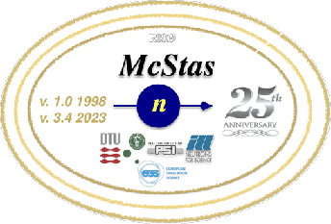
An overview of new developments in McStas
Peter Willendrup, ESS DMSC & DTU Physics
Mads BERTELSEN, ESS DMSC GregorY S. Tucker, ESS DMSC
Damian M. RodrigueS, ESS DMSc
Thomas Kittelmann, ESS DMSC

Slide 2

Agenda
Brief McStas intro
Presentation of “recent” i.e. 3.0-3.6.x features (not at since 2019) exemplified through
McStas effort toward ESS commissioning phase
Securing a improved / solid technical foundation:
conda-forge, continuous integration, release early/often
Support infrastructure
PR-template for user contributions
Issue-templates
Thanks / funding

Slide 3

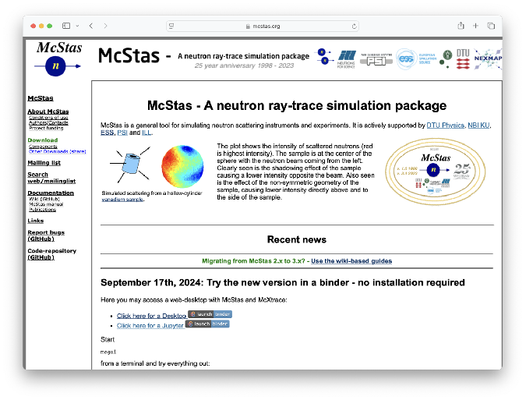
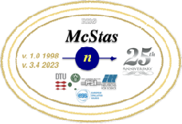



McStas Introduction
Flexible, general simulation utility for neutron scattering experiments.
Original design for Monte carlo Simulation of triple axis spectrometers
Developed at DTU Physics, ILL, PSI, Uni CPH, ESS DMSC
V. 1.0 by K Nielsen & K Lefmann (1998) RISØ
Currently ~6 people on joint McStas-McXtrace team but only 2 full time, based at ESS DMSC / DTU
GNU GPL v3 license
Open Source
Peter Kjær Willendrup peter.willendrup@ess.eu
Mads Bertelsen mads.bertelsen@ess.eu
Project website at
http://www.mcstas.org
mcstas-users@mcstas.org mailinglist

Slide 4
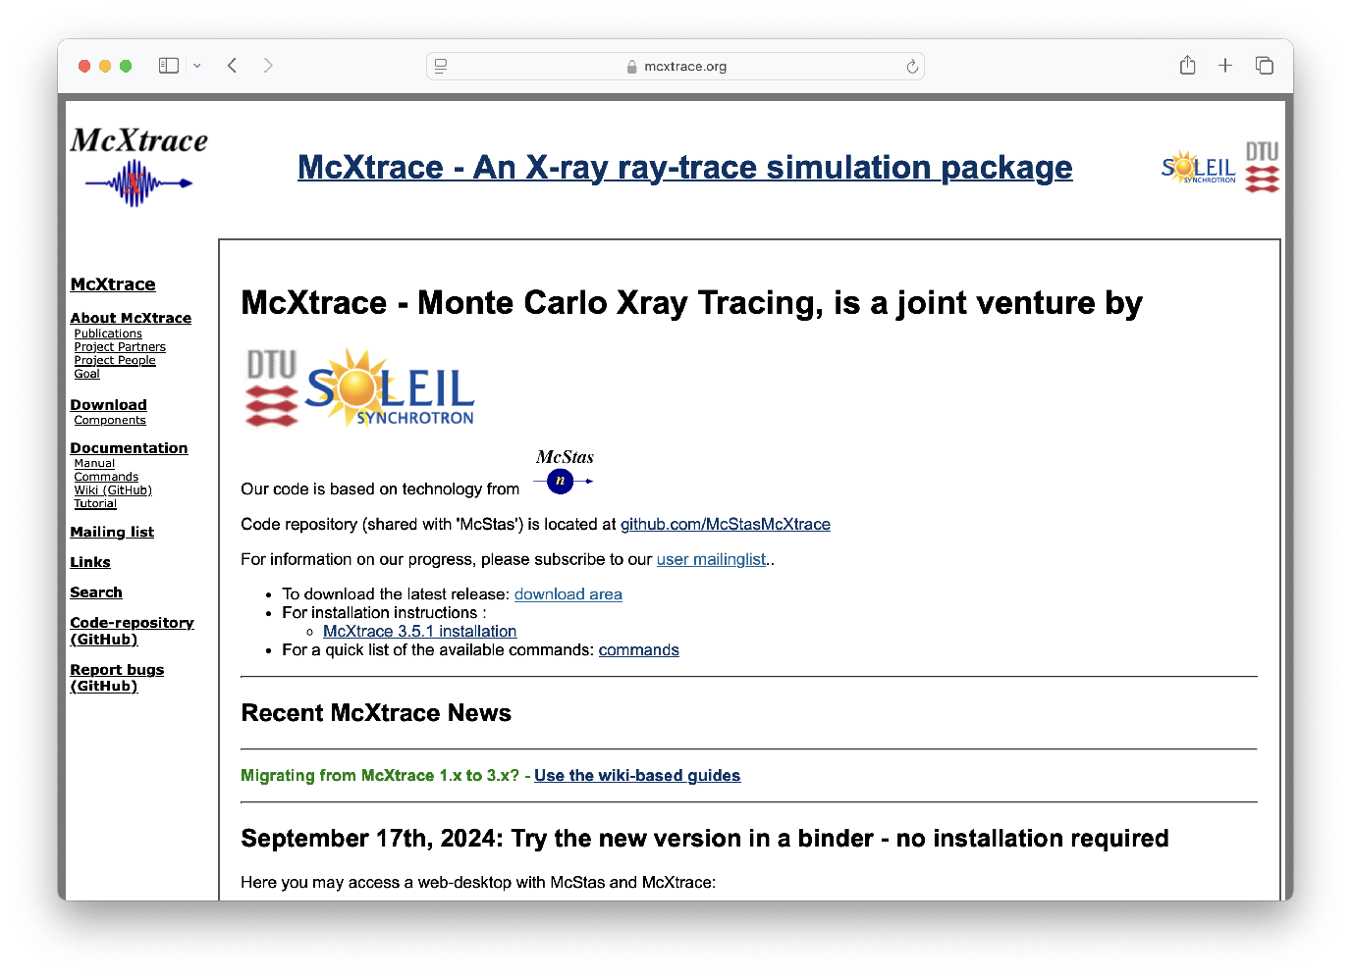




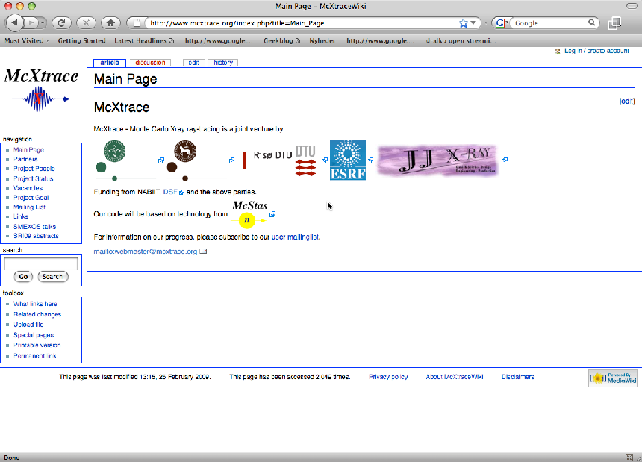




McXtrace - since jan 2009 similar for X-rays
mcxtrace-users@mcxtrace.org mailinglist
Project website at
http://www.mcxtrace.org
Original consortium
Synergy, knowledge transfer, shared infrastructure, repo etc.
4

Slide 5
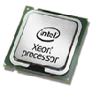
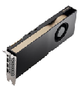
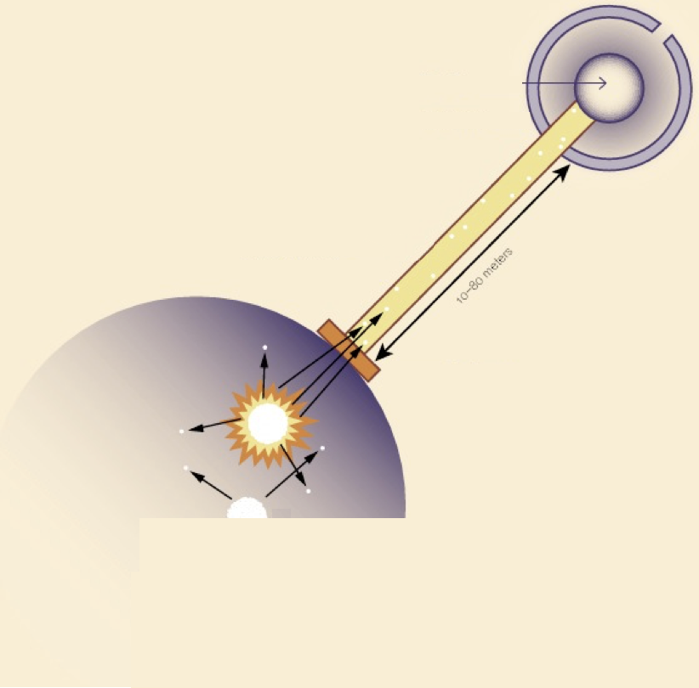
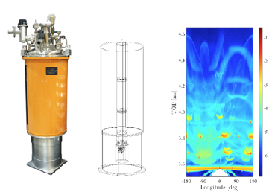
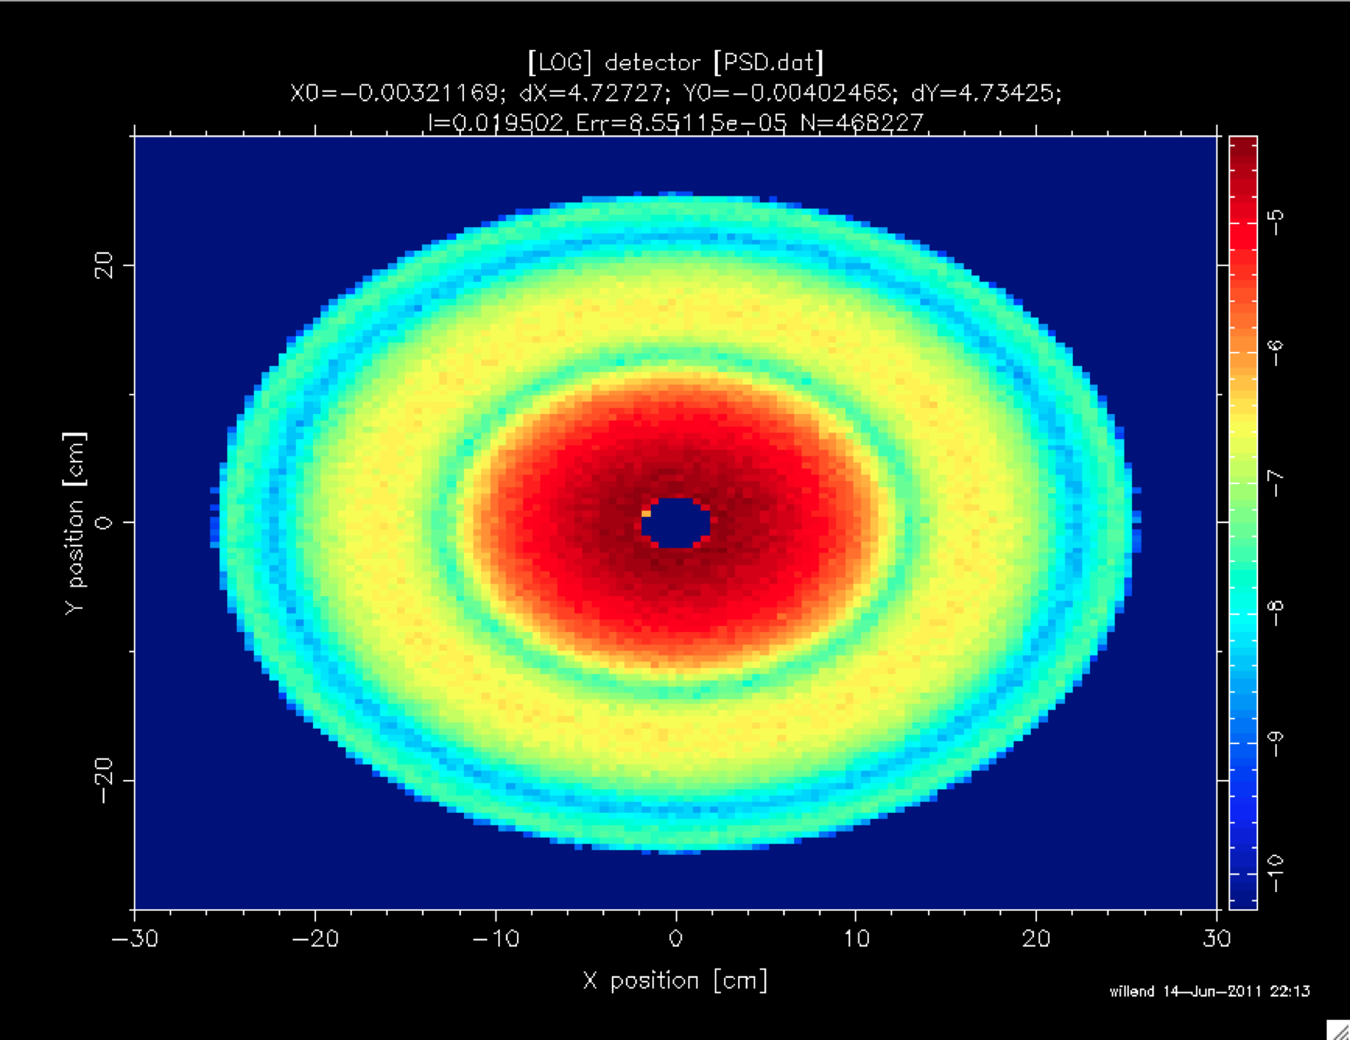
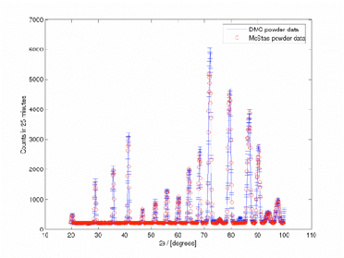

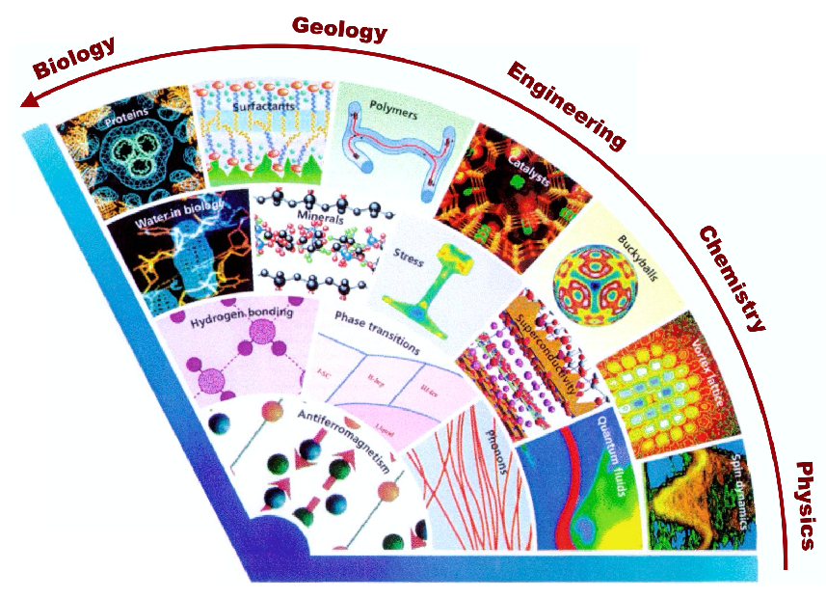
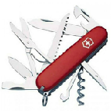
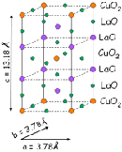

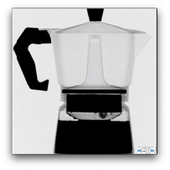
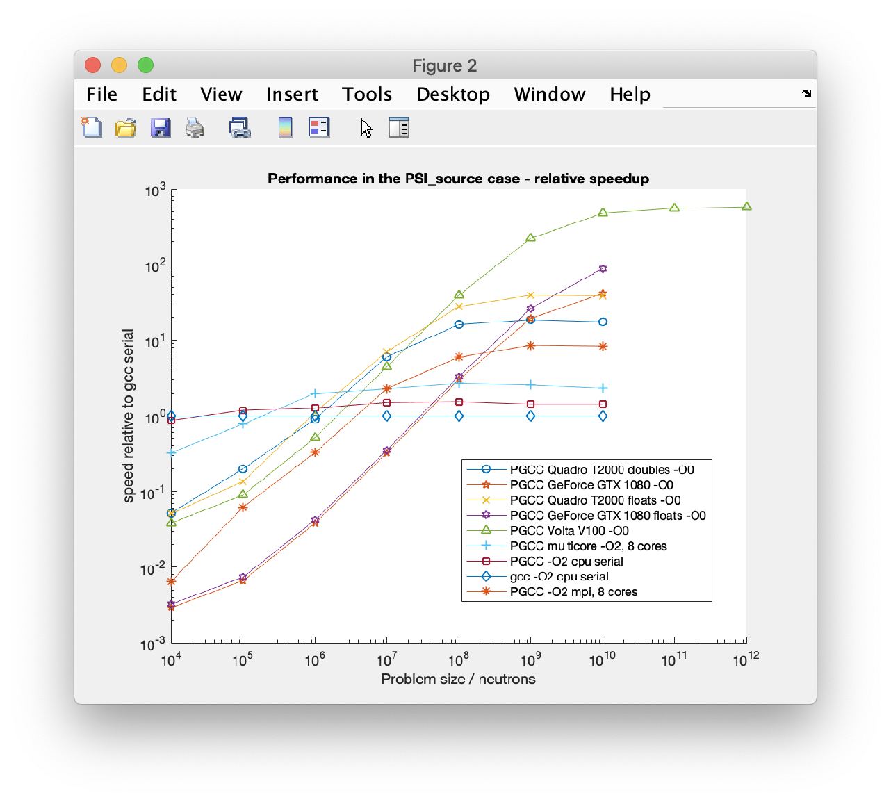

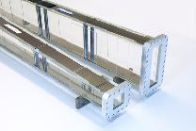
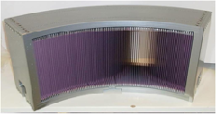
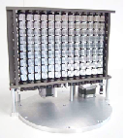
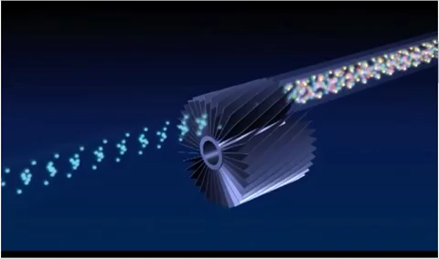
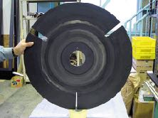
McStas: simulation toolkit for neutron scattering instruments, virtual experiments
Sample-environments - Union subsystem
+
Since 2020: McStas 3.x with support for MPI and multiple GPUs
Detectors
+
~600
Scientific model-samples
McStas 3.x acc. on NVIDIA GPUs - 1-3 orders of magnitude speedup wrt. single core performance. Talk to Peter for details
Neutron optics
Starts with a source of neutrons, be it a reactor- or spallation source
Neutron moderators is where starts

Slide 6


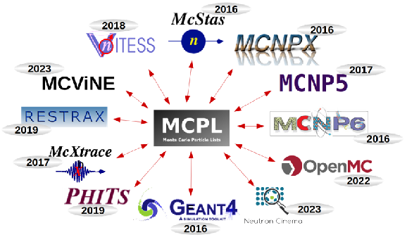
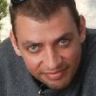


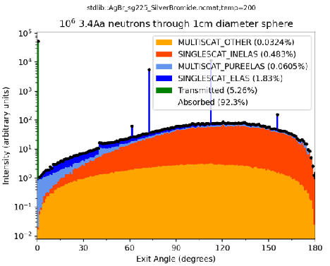
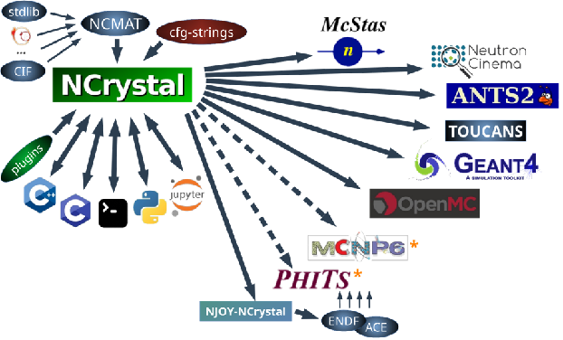





High McStas fidelity is achieved by interfaces to surrounding community codes, e.g.
conda-forge ensures coherence and interoperability
Benchmarked material cross-section database
Solutions for elastic and inelastic scattering
Uniform use (cfg strings) across client codes
Thomas Kittelmann thomas.kittelmann@ess.eu
Monte Carlo Particle List file format
Provides a well-defined interface between many Monte Carlo codes
Widely accepted standard format
See presentation from Thomas Kittelmann right before break!
Other important libraries
GNU Scientific Library (GSL)

Slide 7
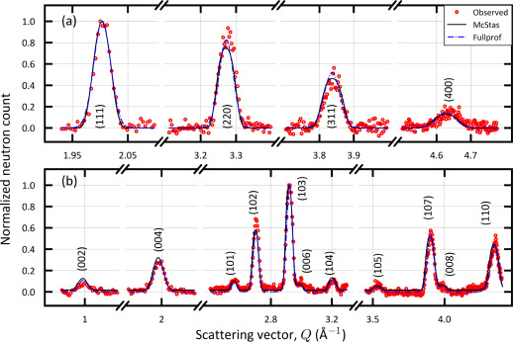
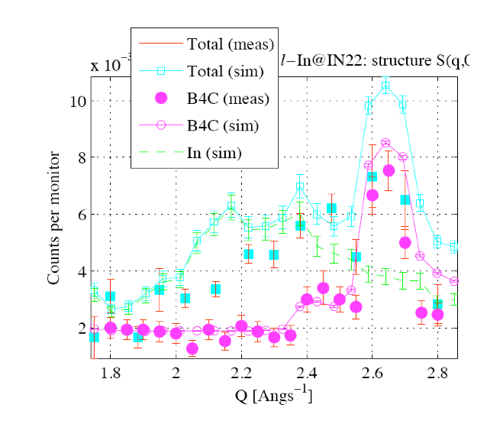
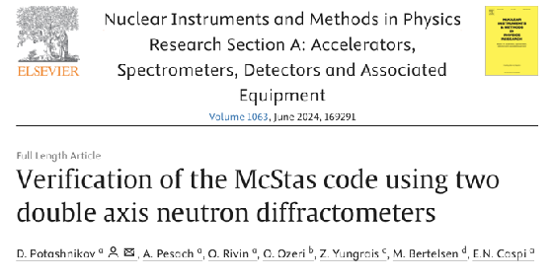
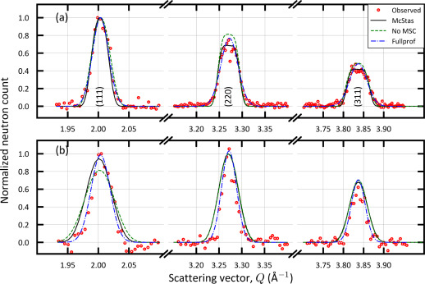
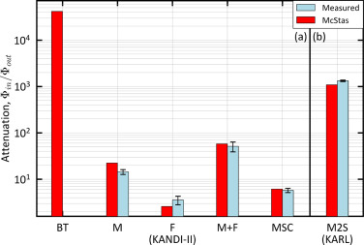
Reliability - cross comparisons
KANDI-II 2.47 Å wavelength
Much effort has gone into this
Here: simulations vs. exp. at powder diffract. DMC, PSI
The bottom line is
McStas agree very well with other packages (NISP, Vitess, SIMRES, MCViNE)
Experimental line shapes are within 5%
Absolute intensities are within 10%
Common understanding: McStas and similar codes are reliable
Si
Gr₂GaC
KARL Si sample
PG 2.421 Å
E. Farhi, P. Willendrup, from IN22 benchmark exp.
https://doi.org/10.1016/j.nima.2024.169291
Gold foil intensity measurements
Cu 0.98 Å
P. Willendrup et al., Physica B, 386, (2006), 1032.

Slide 8
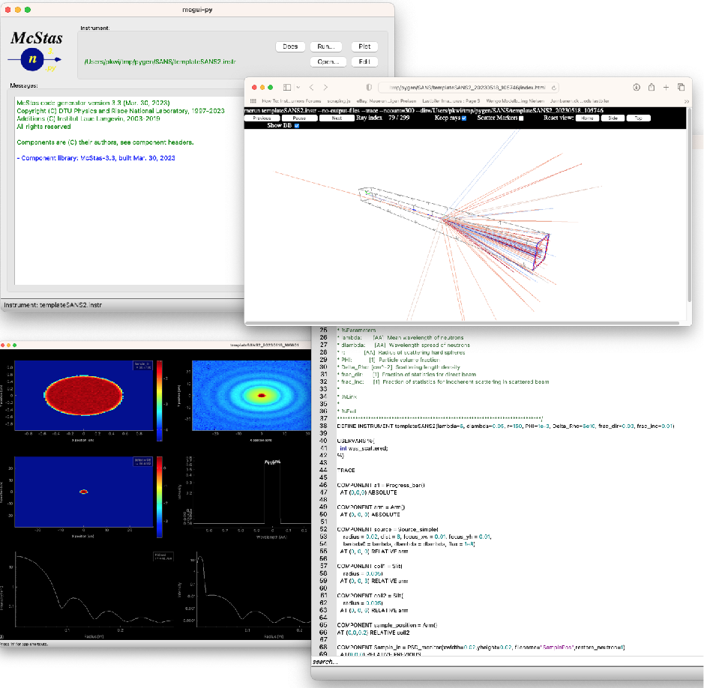
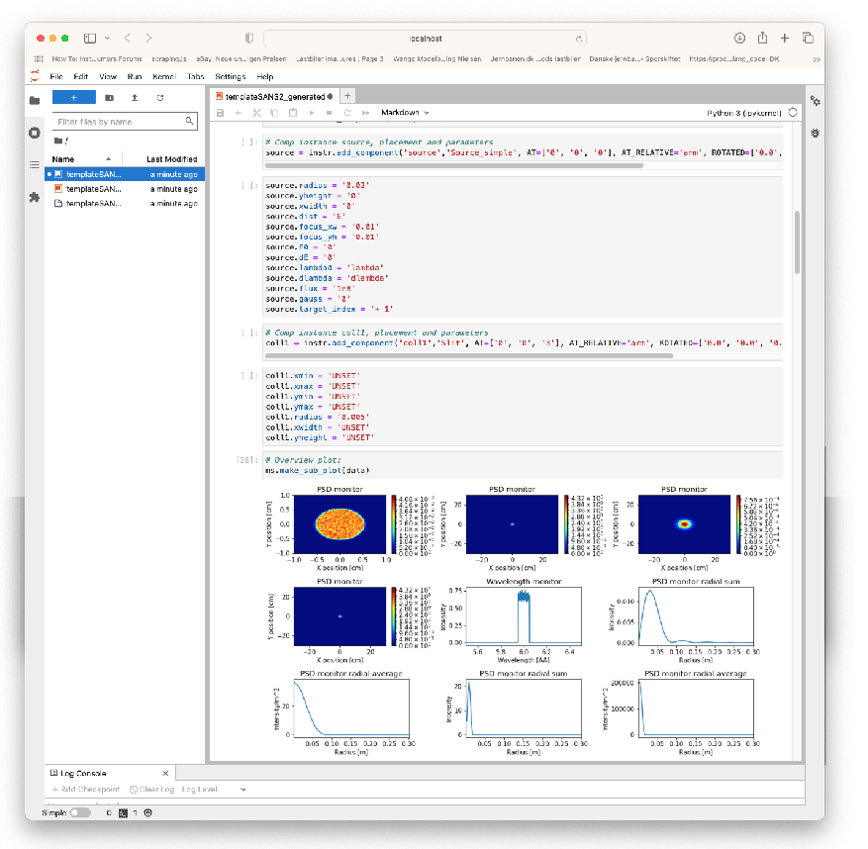
McStas: simulation toolkit for neutron scattering instruments, V.E.
… in .py / Jupyter notebooks using McStasscript
Work in GUI or fav. editor using DSL or …

Slide 9
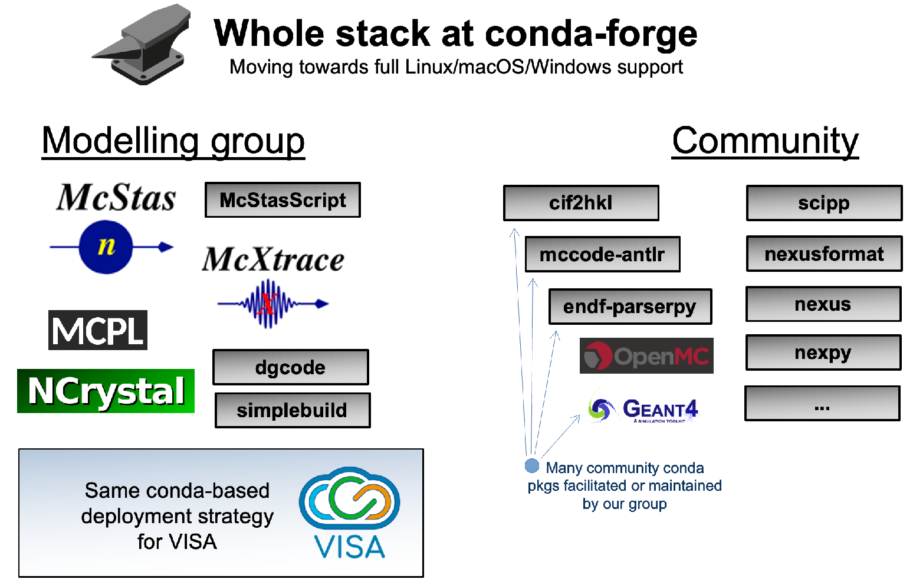

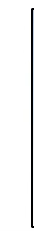



FULL
ESS DMSC Modelling Group “McCode++”
McStasToX
conda-forge also for deployment on and the esss.dk / DMSC cluster
( + )
( + .deb Linux packages for most, mccode.org and )
Peter Kjær Willendrup peter.willendrup@ess.eu
Mads Bertelsen mads.bertelsen@ess.eu
Thomas Kittelmann thomas.kittelmann@ess.eu
Damian Martin Rodriguez damian.rodriguez@ess.eu
Gregory Tucker gregory.tucker@ess.eu

Slide 10
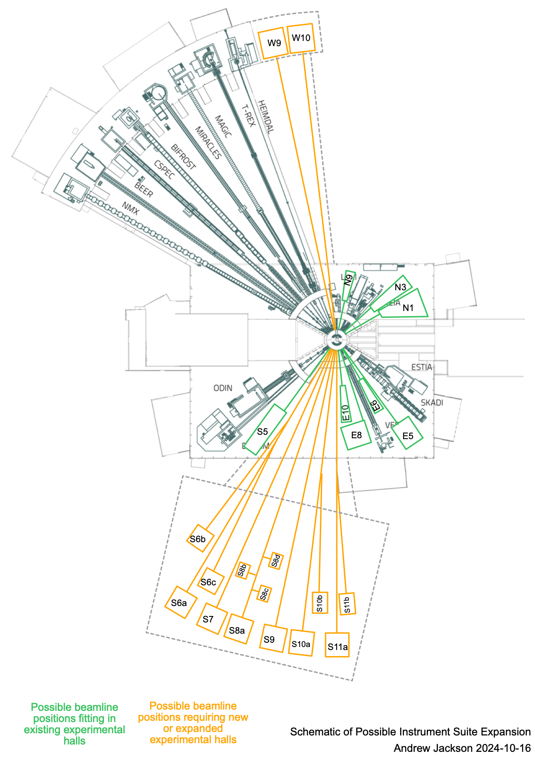
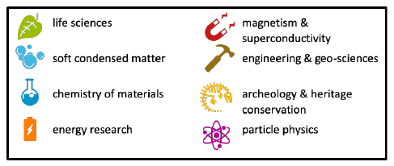
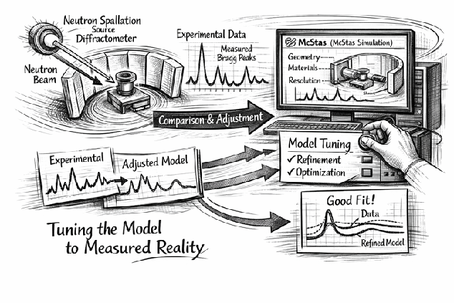
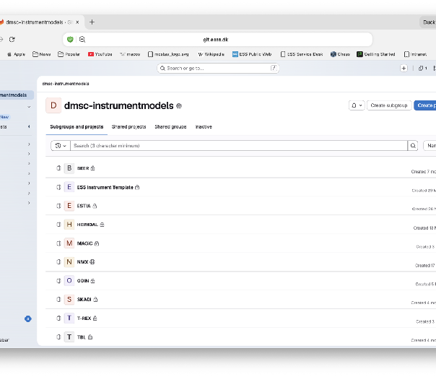
MC-raytracing instrument modelling is by now standard for instrument design (@ILL, @PSI, @ANSTO, @SAFARI @SNS, @ISIS, @J-PARC, @CSNS, @ESS…)
E.g. at ESS
All instruments modelled during design phase using McStas + Vitess + SIMRES
MCNP(x), FLUKA, Geant4 source term, shielding and detectors etc. requiring full energy range and/or non-neutron particle transport
Status of ESS McStas models: Transitioning to commissioning
Setting up dedicated repos at ESS DMSC
Simplification (parameters varied during design should become “frozen” etc.)
Aiming for similar
Look and feel
Naming of components and variables, concepts
DMSC “modelling” group in close collaboration with IDS group
Commissioning….
Goal:
Validated, well understood, workable model
Common tool for Modellers, IDS and instrument team
One main source
Branch off to do specific tasks

Slide 11
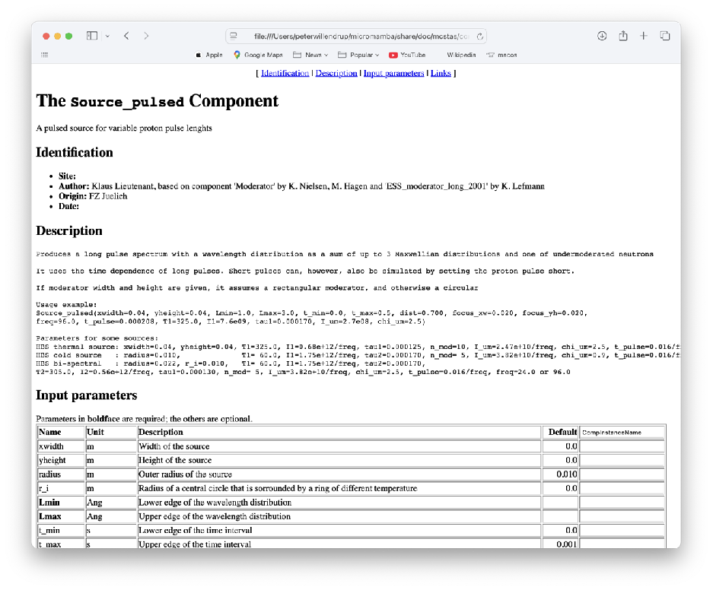
How will the source perform during ramp-up?
The model available in McStas corresponds to the “asymptotic expected behaviour” of the butterfly source
Anything beyond that will require work from the target group. I have proposed they create MCPL input files corresponding to “logical steps” during ramp-up of proton energy and accelerator power
Until such a suite of input files exist, your guess is as good as mine ;-)
In the meantime, one might try using
(Iill not change spectrum shape - and time-profiles remain the same…)
Use the “generic pulsed source” contributed by Klaus Lieutenant
Keep an eye open for incoming developments in collab. with ESS Spallation Physics Group

Slide 12
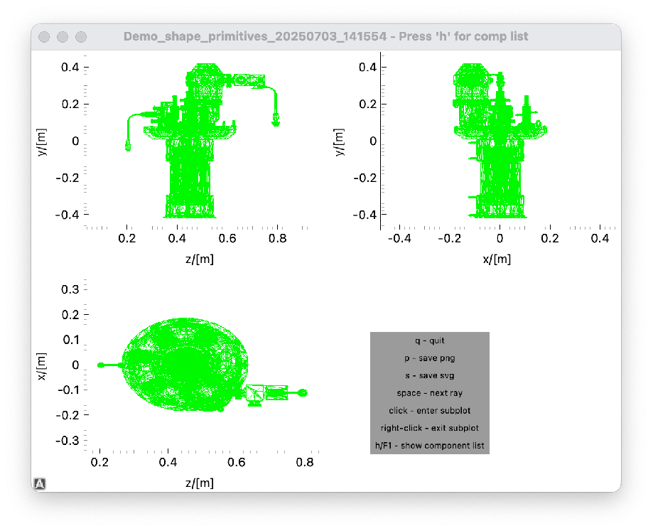
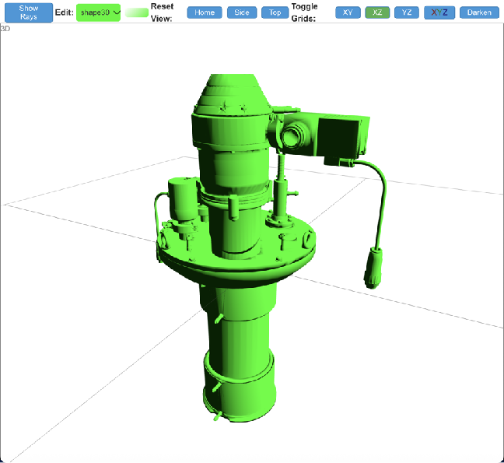
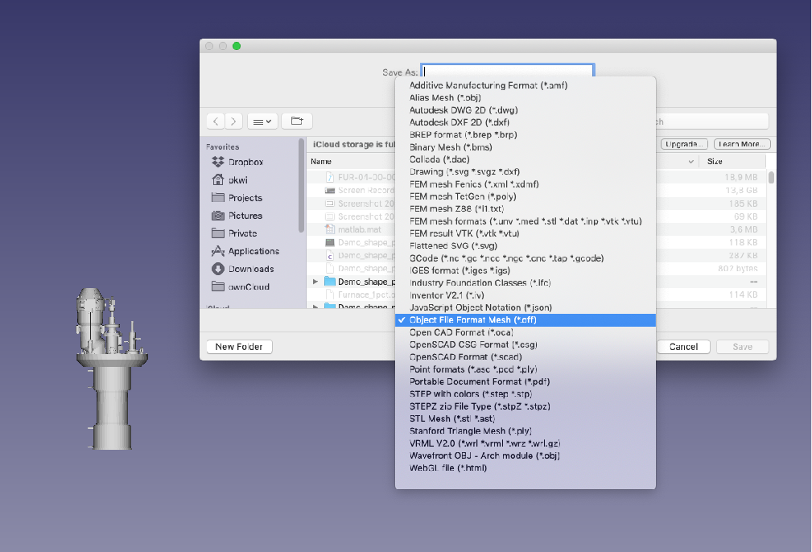
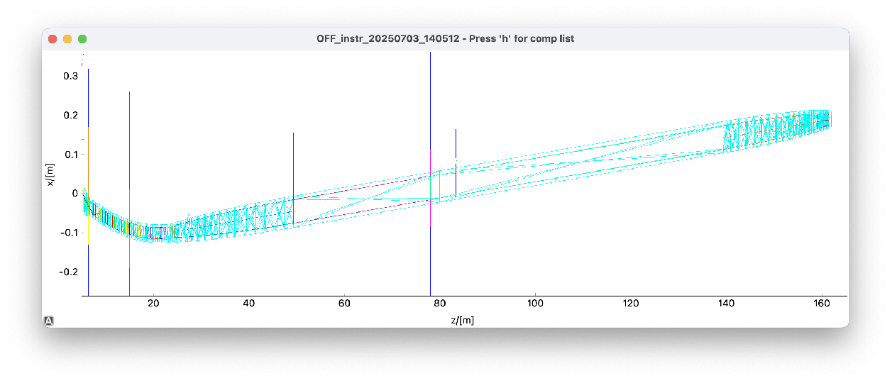
CAD / geometry validation help - 1
Import CAD data into McStas:
Use e.g. Shape.comp in McStas, import CAD from the engineer
Check that McStas model and what was ordered / built agrees
Caveat: We support OFF format only ;-)
A possible route:
Catia/Solidworks/etc -> STL -> OFF via FreeCAD
ILL cryo-furnace in mcdisplay
BIFROST guide assembly from CAD (CYAN) imported alongside McStas guide elements

Slide 13
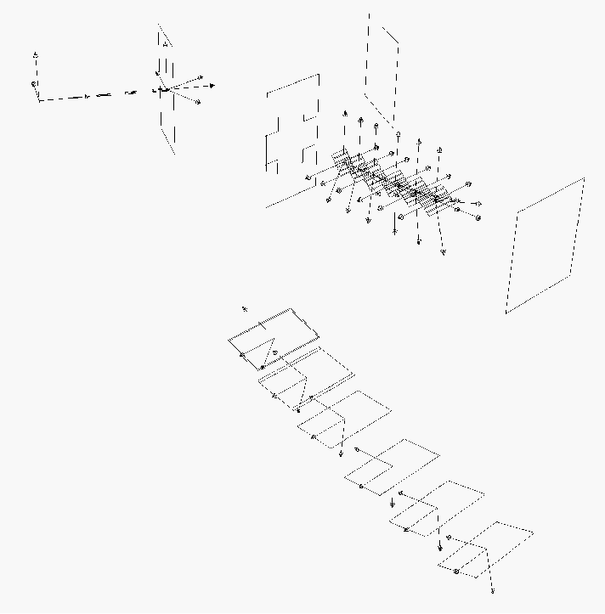
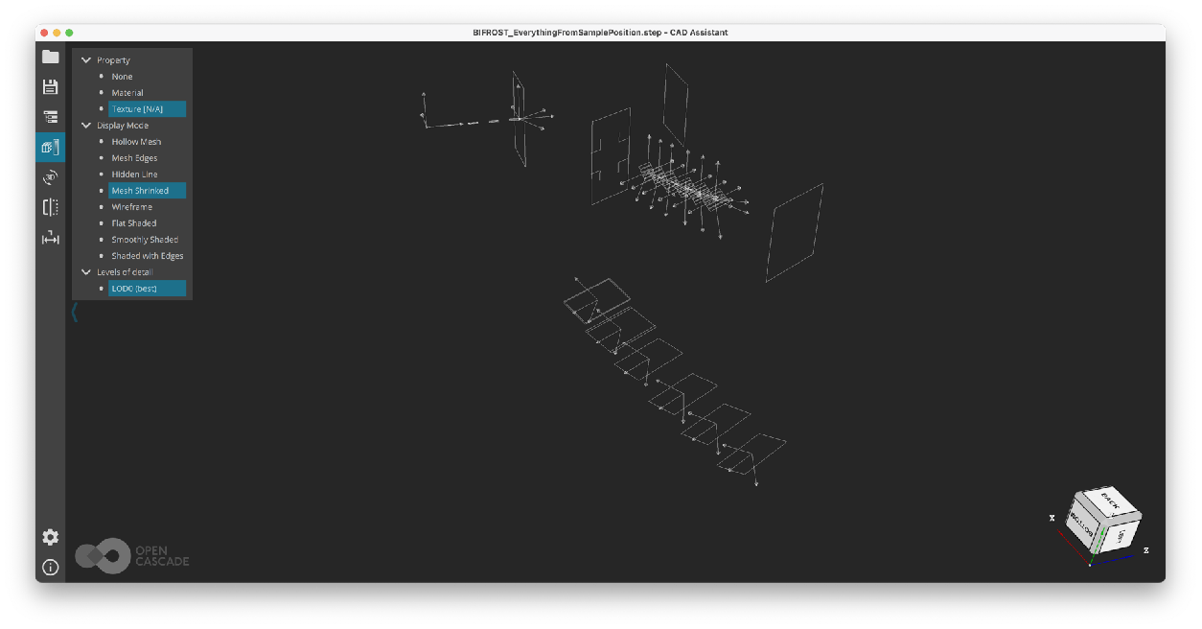
CAD / geometry validation help - 2
Import McStas visualisation data into CAD
mcdisplay-cad from Greg Tucker depends on CadQuery* / OpenCASCADE and exports many different formats - Choose between STEP, STL, VRML, GLTF, VTKJS, and OpenCASCADE Technology XML
Comp geometry data only - rays are ignored
Should work with the engineer’s favourite geometry tool!
Gregory Tucker gregory.tucker@ess.eu
Here used to visualise sample-detector path on BIFROST - model from Milan Klausz
* to use with a standard McStas install, please inject cadquery via e.g. micromamba install cadquery

Slide 14
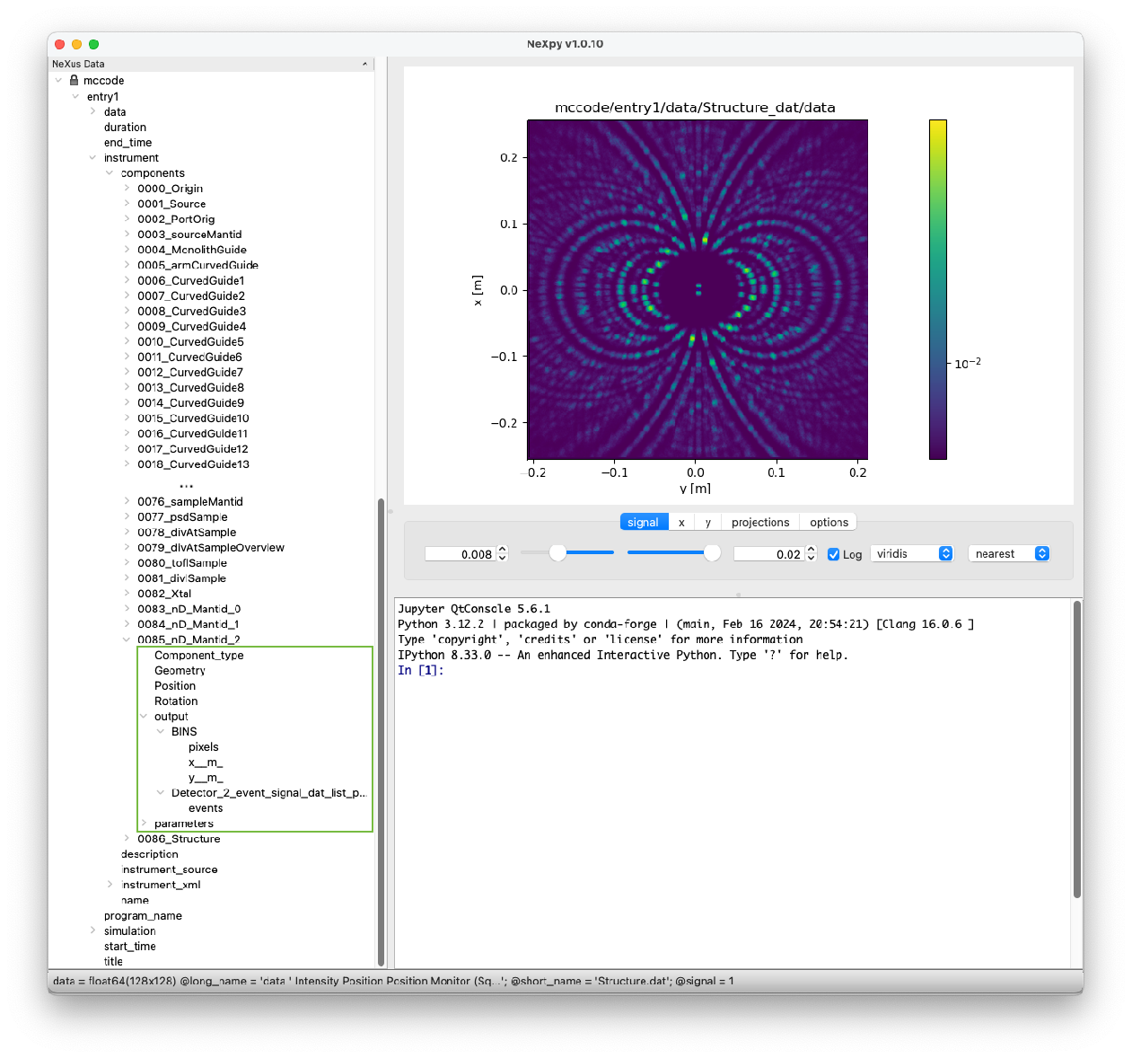
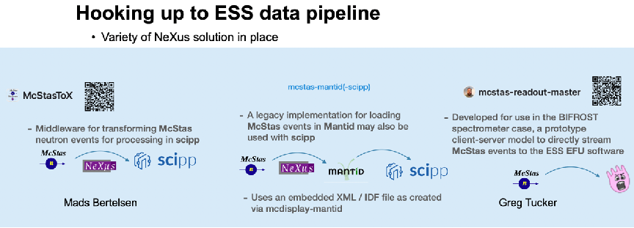


“Richer NeXus format”
All component AT / ROTATED data
All component param=value info (currently as text from instr file)
Monitor_nD geometry data included
Monitor_nD binning / pixellation arrays

Slide 15

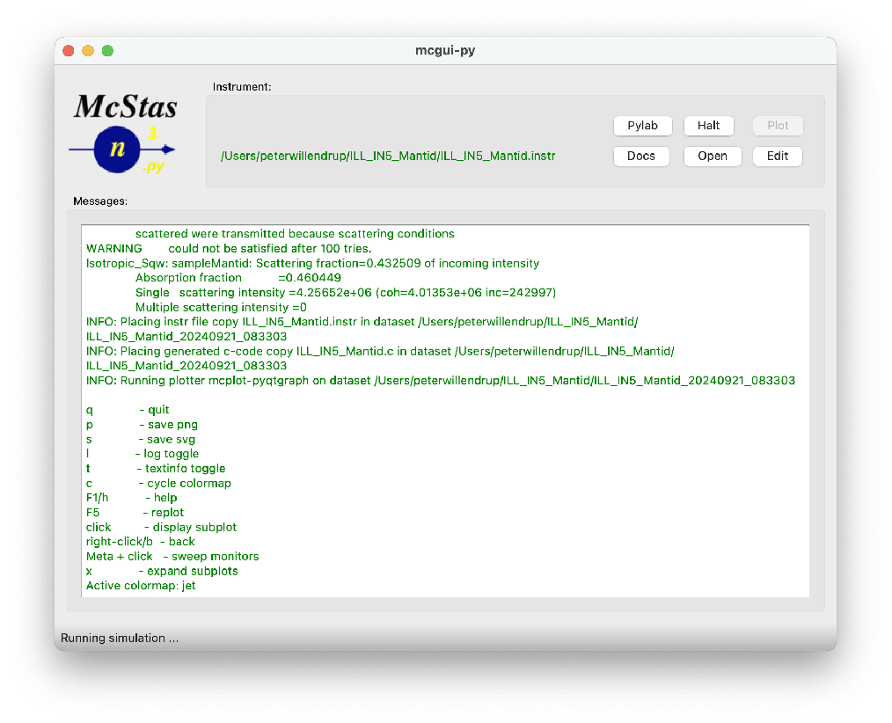
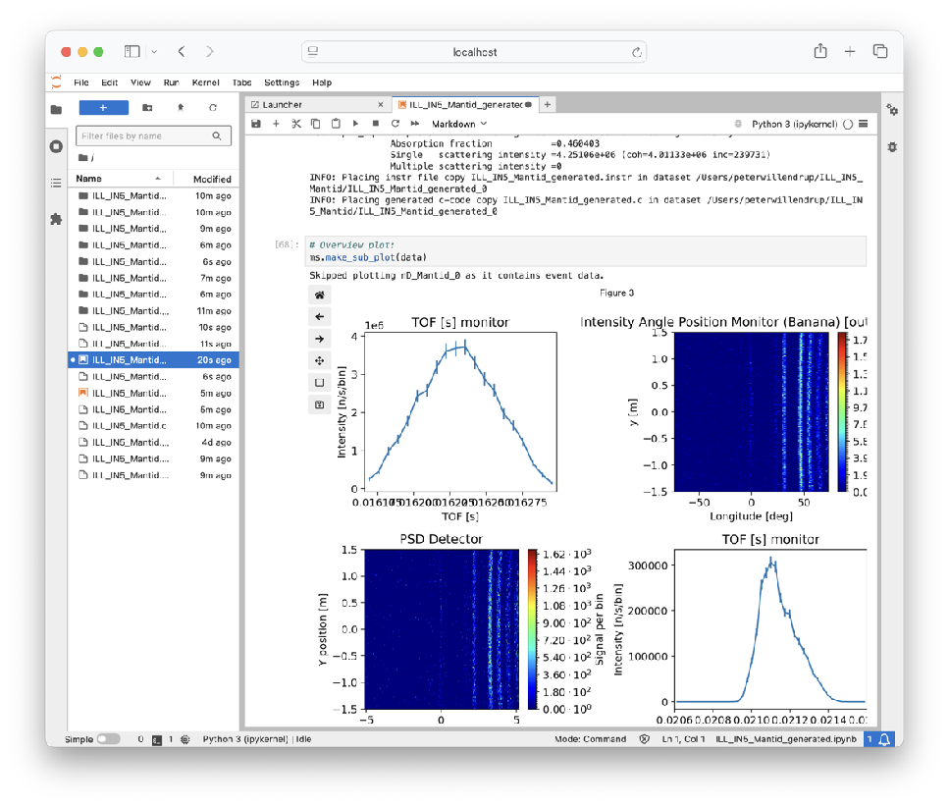
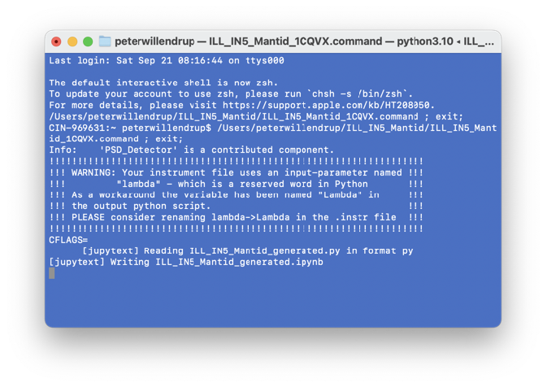
Easier access to data interpretation - 1
McStas to McStasScript / Jupyter

Slide 16



Easier access to data interpretation - 2
Via NeXus to nexpy
Enables easy access to fitting etc.

Slide 17


New stuff in the series 3.5.x and 3.6.x
Common release and versioning for McStas & McXtrace - no more 2.x and 1.x
We are now on conda-forge!
Forms support basis for Windows, macOS and non-Debian Linux
Lots of work from SOLEIL toward official Debian packages
CI (GitHub + conda) in place
Usability:
One-click transfer to McStasScript/Jupyter
Easy access to NeXus output through e.g. nexpy or silx
3D rendering modernised
mctest / mcviewtest tools
Various component / instr contributions
LOTS of work on many layers + infrastructure -> solid basis for future work:
Used for preparing the ESS data pipeline
More emphasis on “in-experiment” and data-analysis features
Further modernisation
Project:
Historical “yearly release” -> release often, release early mode(conda-forge is the basis)
PR-only, “production grade” main branch
Plan to extend McStas/McXtrace collaboration
Even more emphasis on testing at different levels

Slide 18

New stuff in the series 3.5.x and 3.6.x
Common release and versioning for McStas & McXtrace - no more 2.x and 1.x
We are now on conda-forge!
Forms support basis for Windows, macOS and non-Debian Linux
Lots of work from SOLEIL toward official Debian packages
CI (GitHub + conda) in place
Usability:
One-click transfer to McStasScript/Jupyter
Easy access to NeXus output through e.g. nexpy or silx
3D rendering modernised
mctest / mcviewtest tools
Various component / instr contributions, some presented later today!
New, ~ “feature-complete” python/ANTLR4 code-generator mcstas-antlr from G S Tucker. install from e.g. conda-forge Want to know more? Talk to Greg
(base) laptop:~ user$ mctest --instr=BNL_H8 -n1e7 --testdir=$PWD --mpi=10
loading system configuration
Output of test will be placed in: /Users/user
ncount is: 1e7
mpi count is: 10
Testing: 3.6.13
Finding instruments in: /Users/user/micromamba/share/mcstas/resources/examples
Copying instruments to: /Users/user/mcstas-3.6.13_mpi_x_10_BNL_H8_Darwin
Compiling instruments [seconds]...
BNL_H8 : 6.52
BNL_H8_simple : 2.34
Running tests / getting status...
BNL_H8 : 5.08 [val: 9.60477e-10 / 9.84026e-10 = 98 %]
BNL_H8_simple : 2.13 [val: 9.53534e-10 / 9.84026e-10 = 97 %]
======================================
Overall test result:
SUCCESS

Slide 19


Better Quality Assurance of incoming McStas contributions
Have in essence handled much this task in alone since 2002
PW dealt with almost all user-support in the past 24 years (Lots of mcstas-users posts, personal emails, GitHub issues, …)
Experience: very few “component-developers” stay in the game
Very few “component-developers” touch (the distributed version of) their code ever again
- This means that PR/merge time is effectively my LAST chance
What to do going forward?
Insist contributor is part of the process via GitHub PR as long as possible. (Also: code can no longer be sent via email etc.)
Raise the bar for acceptance a bit (Includes checklist / reminders of what to do)
Teach use of relevant development tools and apply Continuous Integration (CI) tests
This will of course NOT mean that I / the other McCode dev’s will leave everything to you! Your PR and the repo are meant for collaboration!
ICANS XXV 2026 Malmö

Slide 20




Interface physics demo
McStas
Lots of other news… New components, new capabilities, new physics has also come in… Example: Interface physics in McStas union assemblies. Talk to Mads for details!
Mads Bertelsen mads.bertelsen@ess.eu
2025-07-10
PRESENTATION TITLE/FOOTER

Slide 21


Conclusion
( + )
Peter Kjær Willendrup peter.willendrup@ess.eu
Mads Bertelsen mads.bertelsen@ess.eu
Thomas Kittelmann thomas.kittelmann@ess.eu
Damian Martin Rodriguez damian.rodriguez@ess.eu
Gregory Tucker gregory.tucker@ess.eu
McStas is in great shape!
Lots of work on basic infrastructure, development tools, CI, packaging
Lots of new features e.g. for use in ESS commissioning
Please make good use of GitHub infrastructure (PRs and issues)
lightning talks during ICANS Tuesday poster session:
Nicolò Violini | Artificial Intelligence applied to Neutron simulations
Nicola Rizzi | Thick 3He detector component for time-of-flight energy resolution calculation
Gregory tucker | The case for mccode-antlr
Shuqi Xu | Quantitative data analysis of neutron imaging experiments using NCrystal
Gabriele Sala | 1) McStas to Mantid conversion, generation of the IDF and Nexus file. 2) Request for an update of Union_mesh component 3) Request to add on the McStas website a tab to upload sample environment templates
Peter Willendrup | A quick look at the PR template / contribution process
Thomas Kittelmann | Overview of MCPL + NCrystal in McStas
Mads Bertelsen | Union interface physics
You? | Bring maximum 1 slide - or just a theme for discussion!
McStas/McXtrace/AI summerschool in September, check mcstas.org website:
ICANS XXV 2026 Malmö

Slide 22

Backup Slides

Slide 23










Main McStas Funding sources

Slide 24





What constitutes a high-quality component contribution?
A piece of code that serves a well-defined purpose, generalised as far as possible
Comes with a(t least one) test (%Example pars=value Detector: what_I=to_expect)
Uses the standard physical units and parameter names of McStas (NOMENCLATURE)
Has the right type of code in the right %{ %} sections
Has sufficient, meaningful and complete documentation
Can be read and understood by others (and yourself later, weeks-months is enough to loose track) (Prefer simplicity over complexity in algorithms, doc strings etc. Think of your peer user.)
Is aligned with / flavoured and styled like other similar components (Please dig in comp and instr database, much to inspire from!)
Runs across platforms (ideally including on GPU)
Includes vetted / linted c-code and does not spit out lots of noise
Much of this is documented on the Wiki and you are reminded during the PR process
conda-forge and GitHub CI helps!

