Slide 1
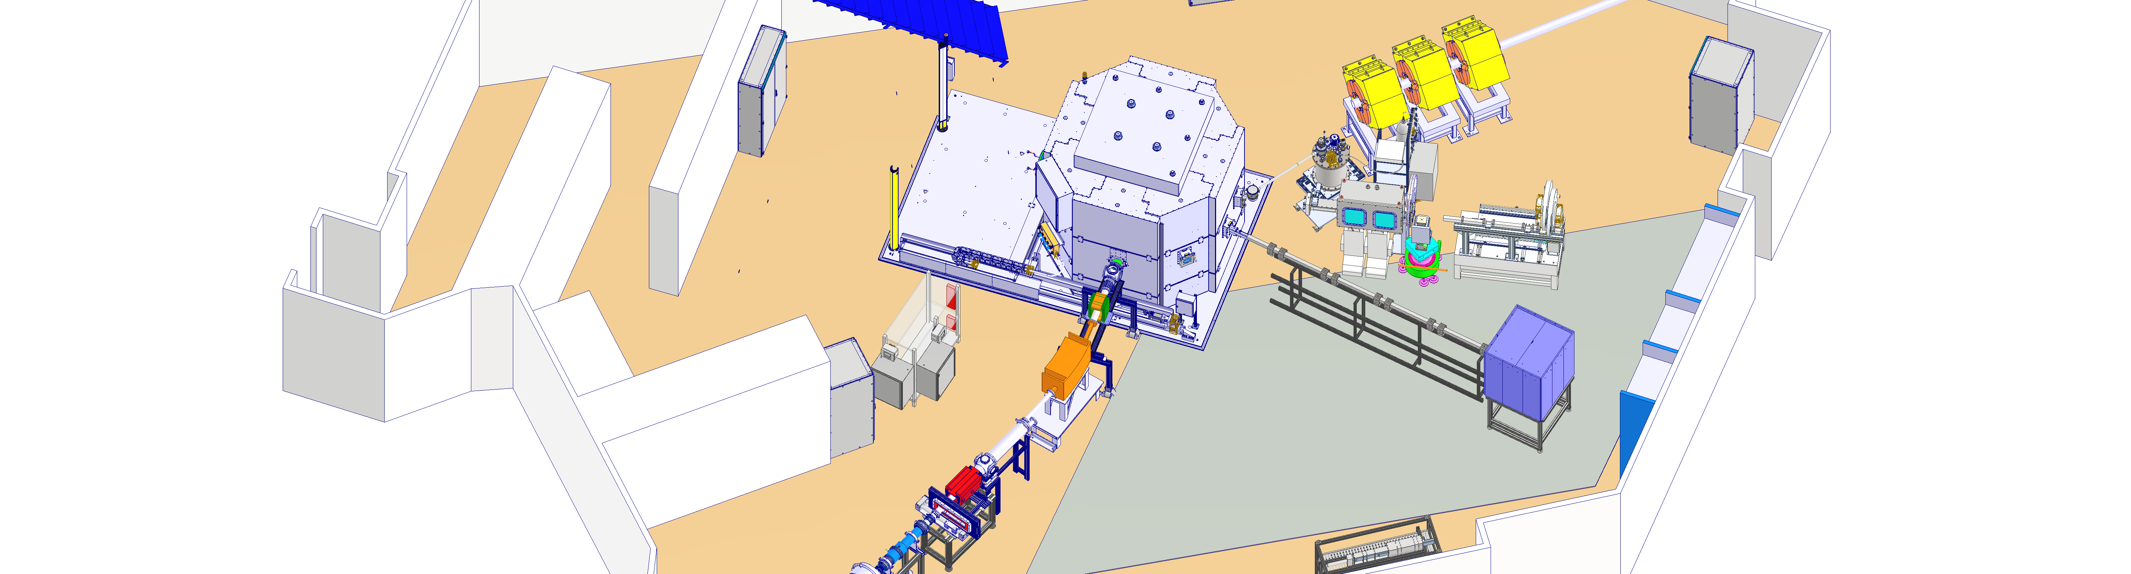
Radiological shielding performance of the HBS-prototype target station at Forschungszentrum Jülich
Jingjing Li | HBS
ICANS XXV, Malmö, Sweden (13-17 April 2026)

Slide 2
Outline
  Motivation and requirements
  Experimental setup & measurements
  Monte Carlo simulation
  Validation: measurement vs. simulation
  Conclusion and future work

Slide 3
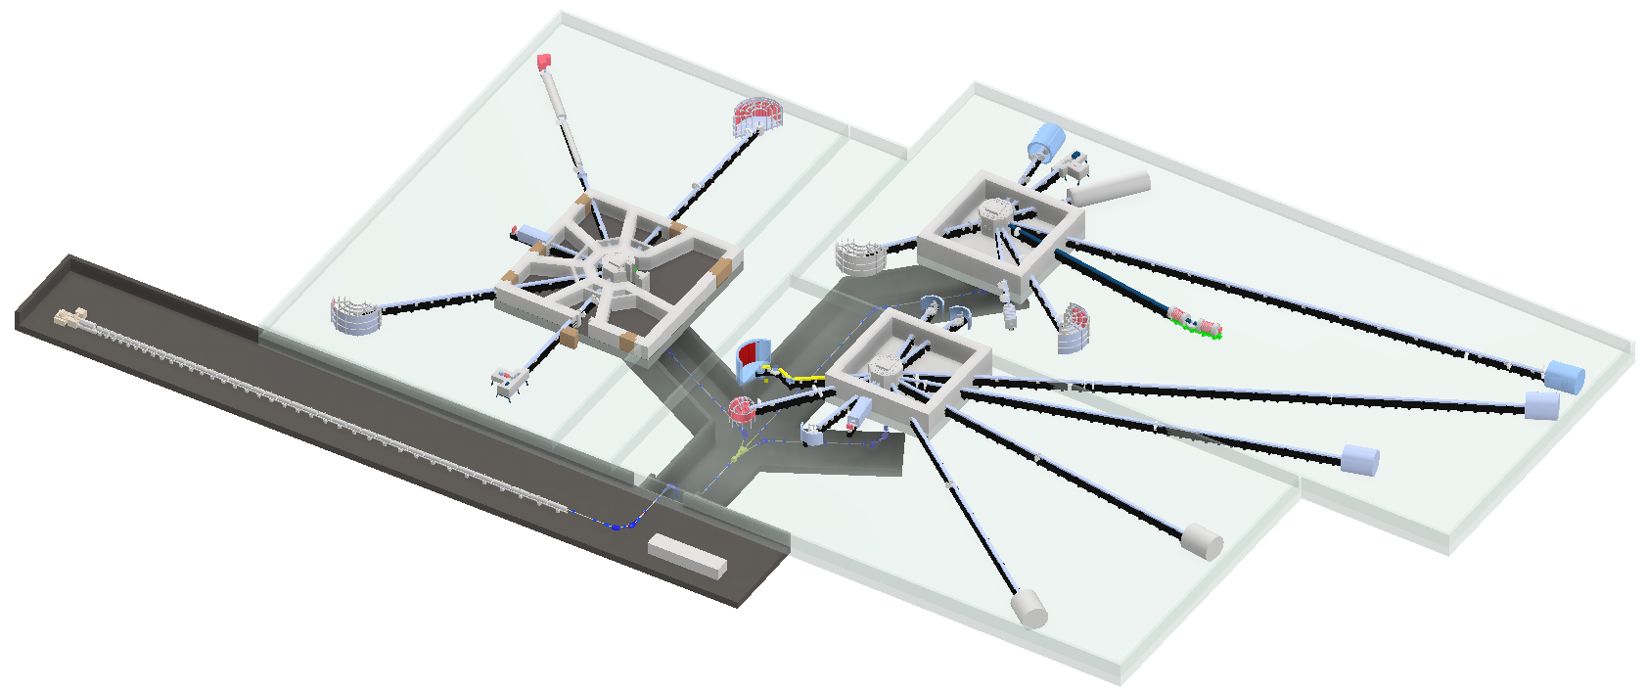
HBS, a High-Current Accelerator-driven Neutron Source (HiCANS)
High current linear accelerator
  100 mA, 70 MeV pulsed proton beam
  Variable frequency
Several target stations
96 Hz
  Optimize pulse structure (length, rep. rate)
  Optimize thermal spectrum
96 Hz
Every beam port serves only 1 Instrument
  Optimize neutron source spectrum
  Optimize geometry
  Integrate neutron optics with beam port
24 Hz
Small shielding
  Neutron guide close to cold source
  Chopper at <2 m from target

Slide 4
Shielding requirement
Shielding: TMR shielding + Bunker
Requirement
During operation: the upper limit of neutron and photon dose rate at the outer surface of the instrument hall is 10 𝜇𝑆𝑣/ℎ.
After shutdown: minimize residual dose rates in source room for maintenance.
Key challenge
Reliable prediction of neutron dose rates
Objective
Experimental validation of the TMR shielding
Quantify agreement and identify dominant uncertainties

Slide 5
The development of the shielding concept in the HBS project
Biological shield and Bunker
Based on CAD model in TDR
2023
Benchmark
Dose rate measurement on JULIC platform
2023
Further development
Multi-objective Genetic Algorithm
2024
Multilayered shield
Preliminary optimization in CDR
2020

Slide 6
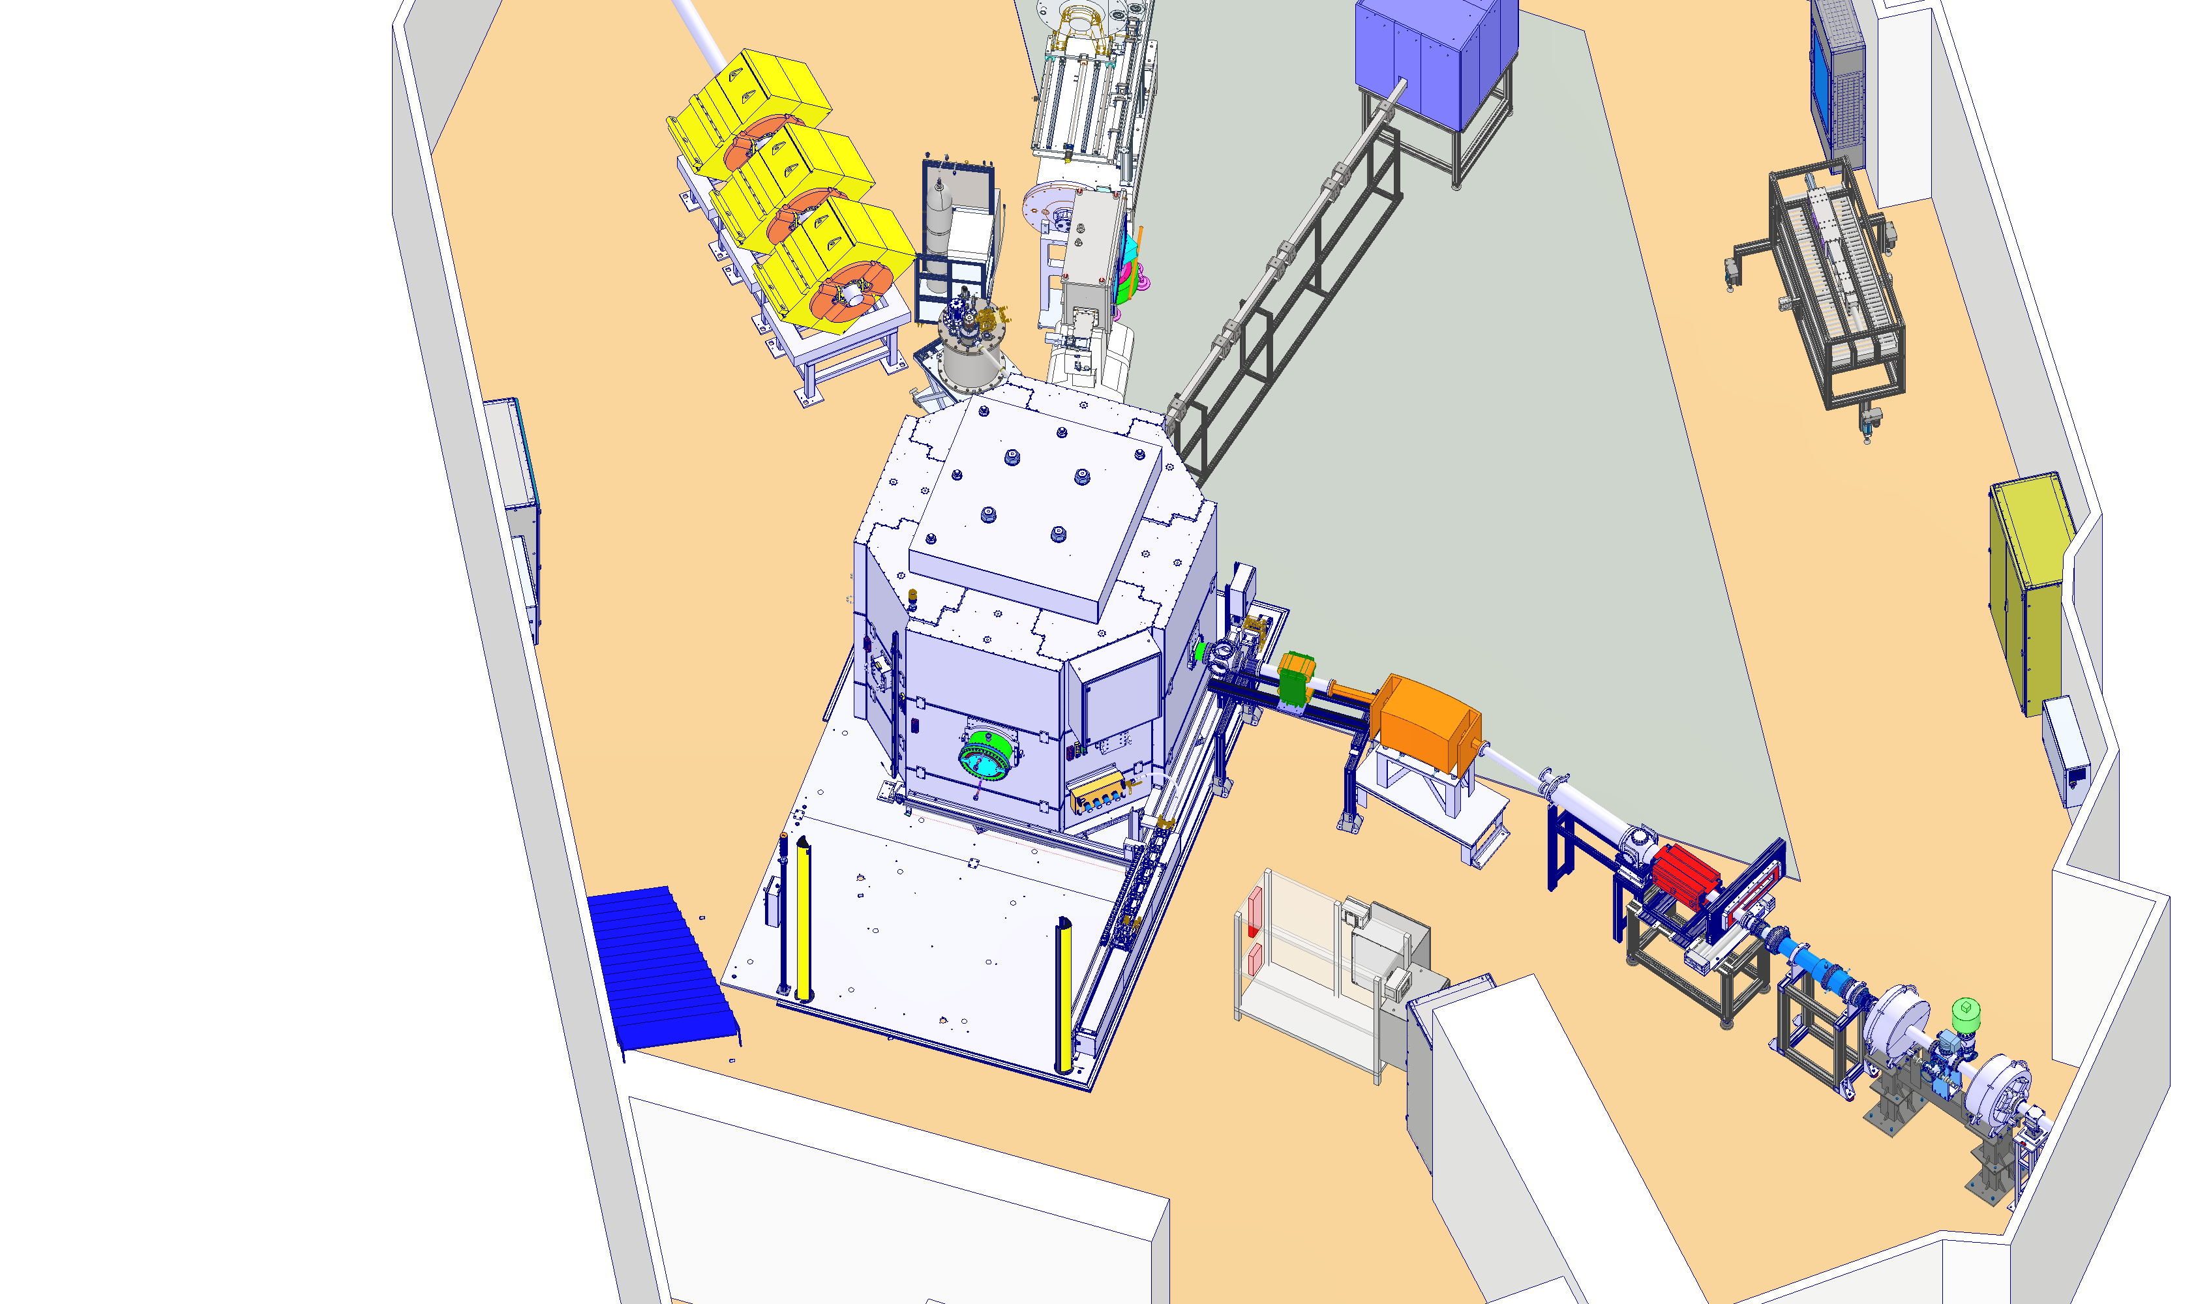
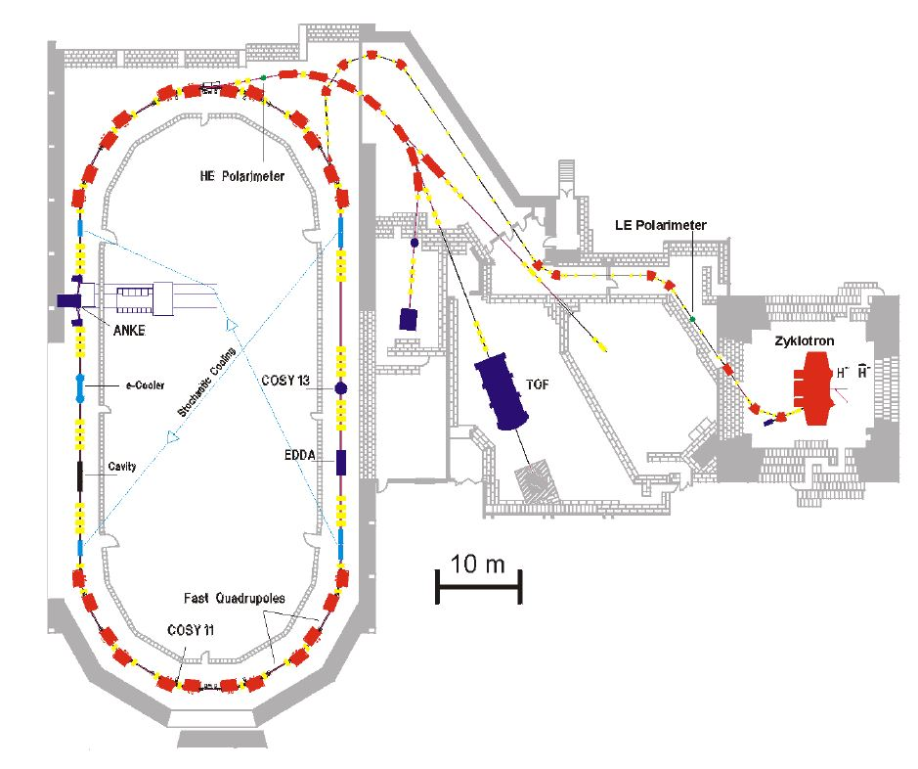
The HBS Jülich Light Ion Cyclotron (JULIC) Neutron Platform
Big Karl experimental hall
Detector housing
COSY synchrotron
Neutron guide
JULIC cyclotron
Quadrupole
magnets
Beamline from JULIC

Slide 7
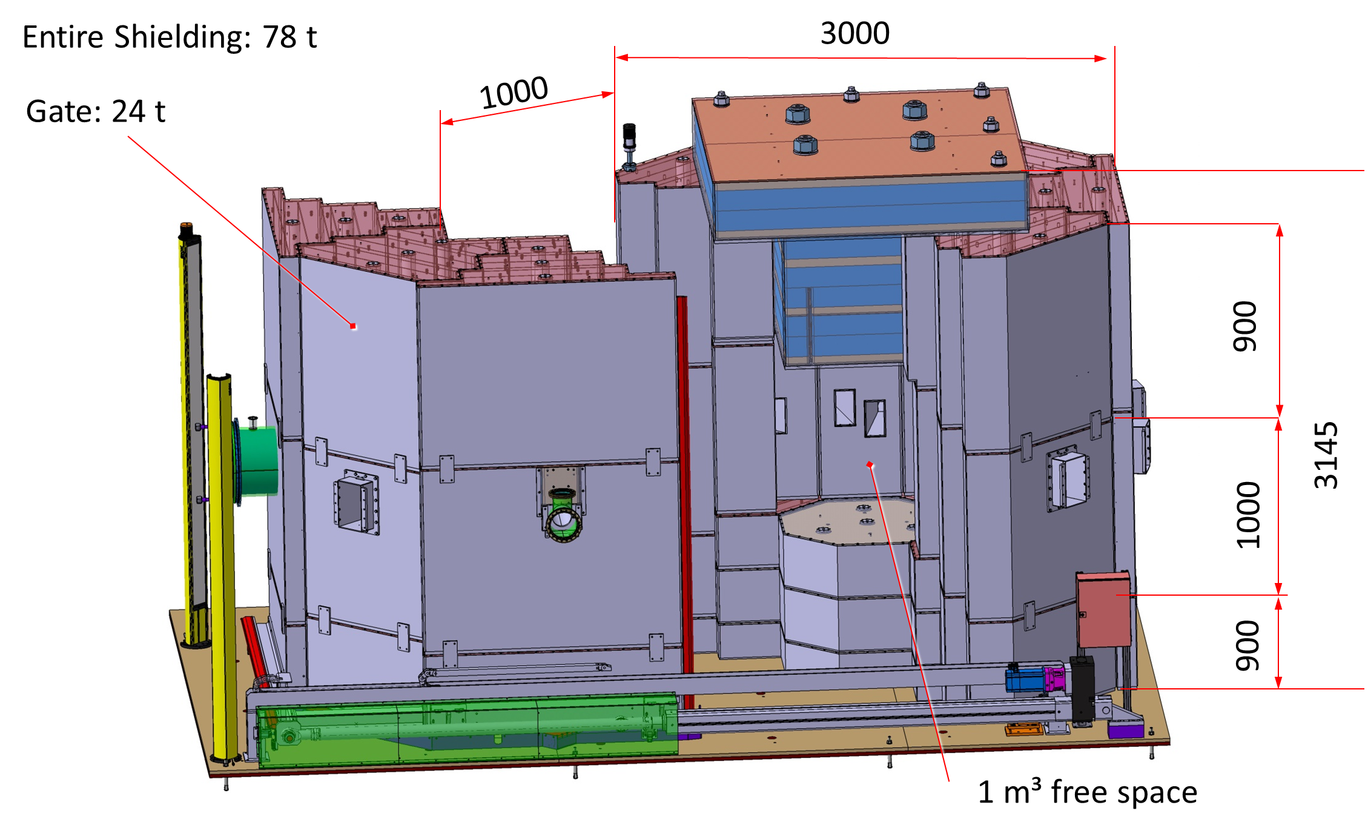
Prototype target station
 | Prototype | HBS
Particle type | Proton | Proton
Energy | 45 MeV | 70 MeV
Peak current | ∼ 10 µA | 100 mA
Duty cycle | ∼ 4 % | 1.6 %
Average power | < 18 W | 100 kW
Neutron yield | 10¹⁰ s⁻¹ | 10¹⁵ s⁻¹
Shielding mass | ∼ 78 tons | ∼ 120 tons

Slide 8
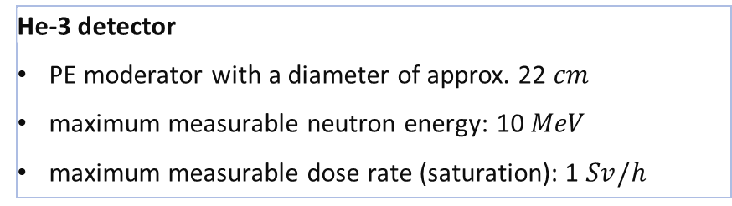
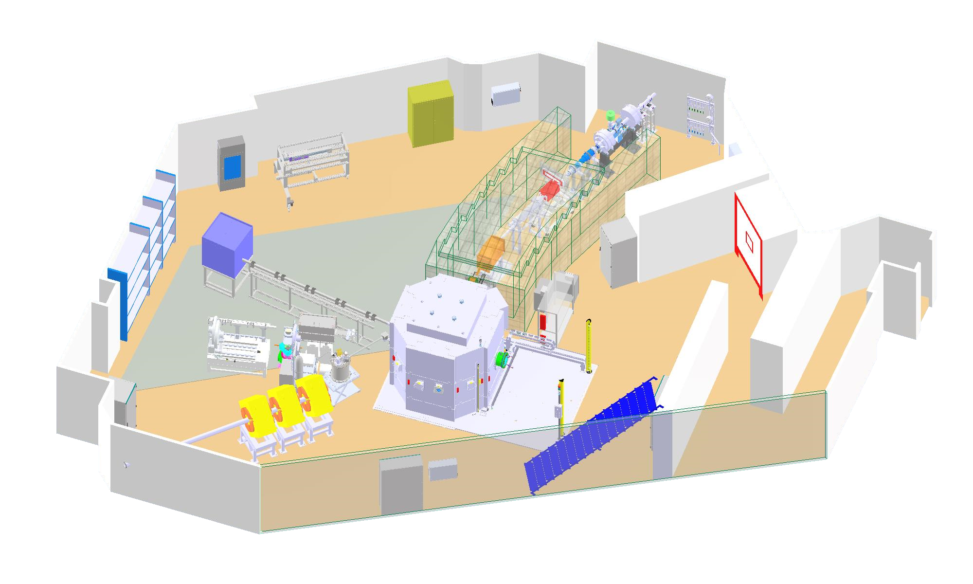
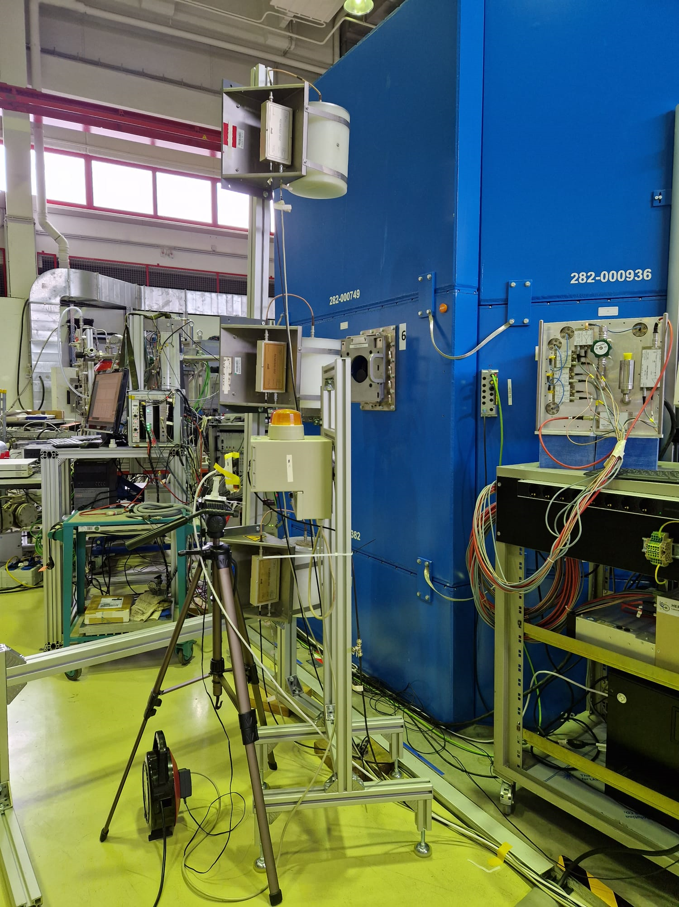

Experimental setup
Measurement
Neutron monitors are used.
Neutron dose rate measured at multiple positions (vertical and horizontal).
Proton beam line
Fast neutron imaging
Concrete wall
diffractometer
Reflectometer
Thermal neutron imaging

Slide 9
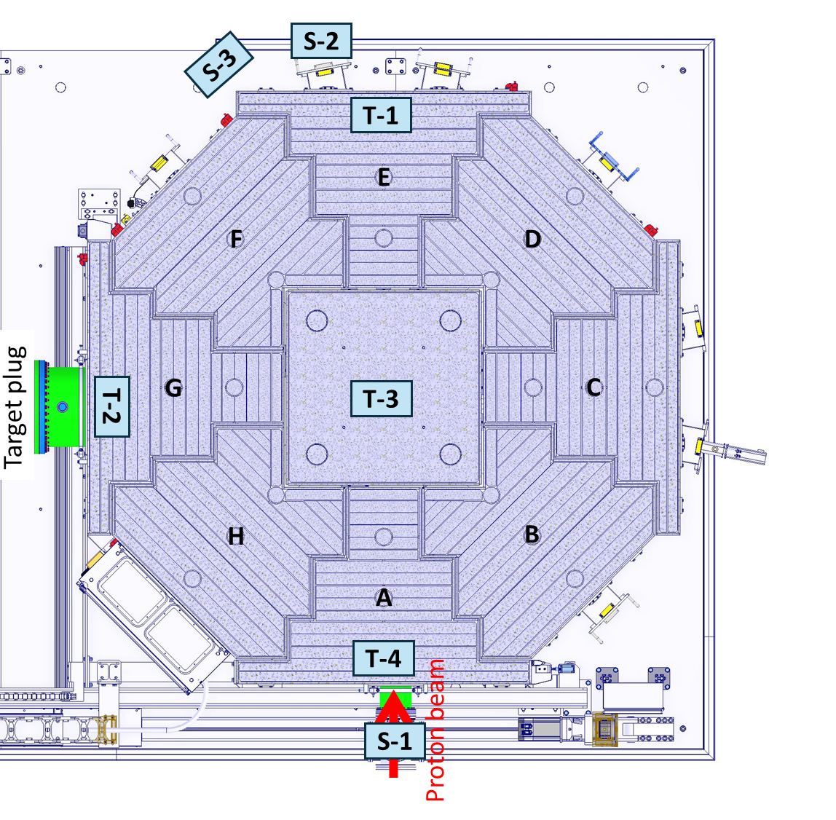
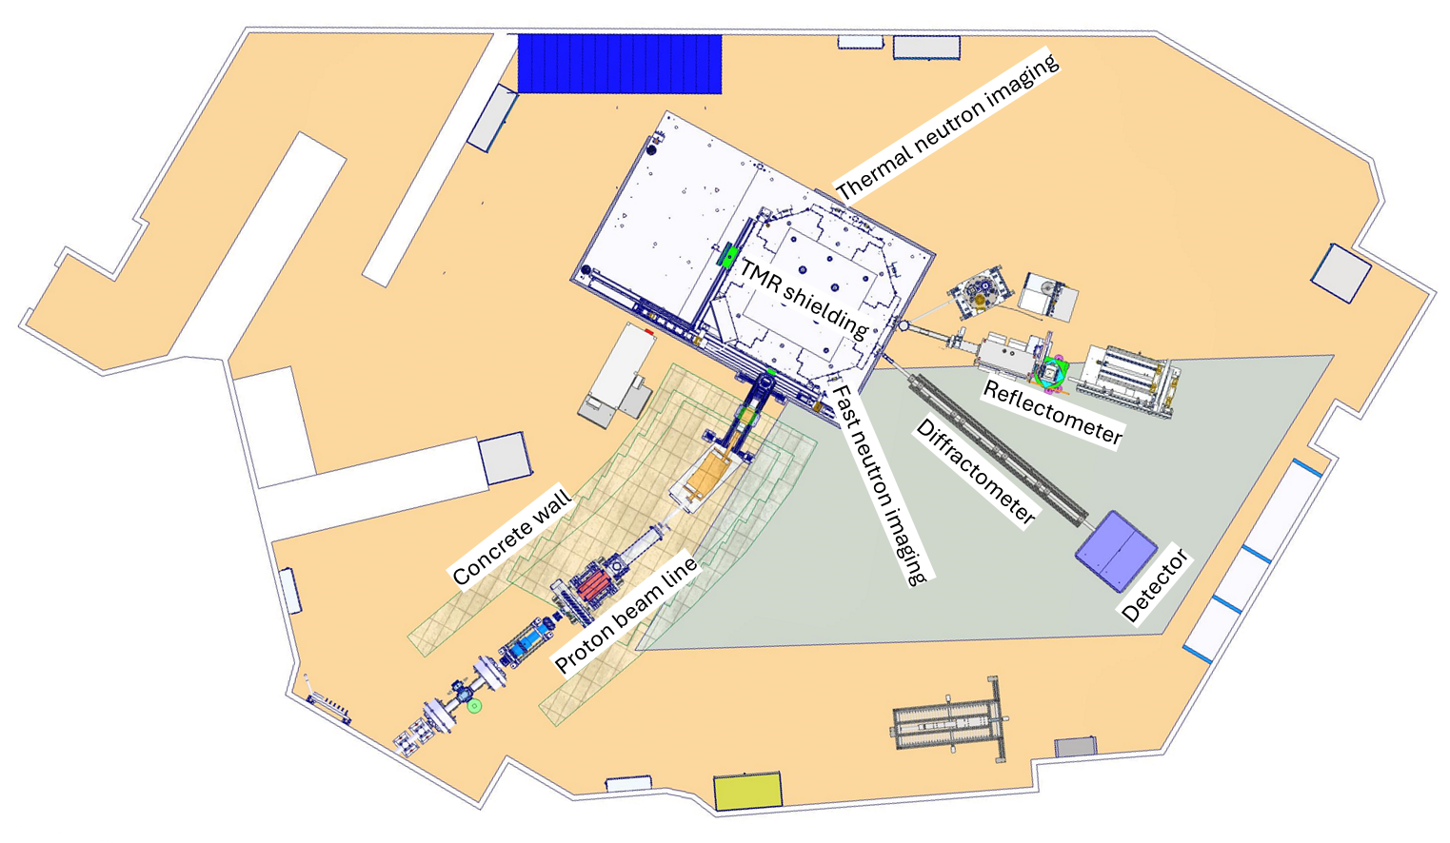
Measurement positions

Slide 10
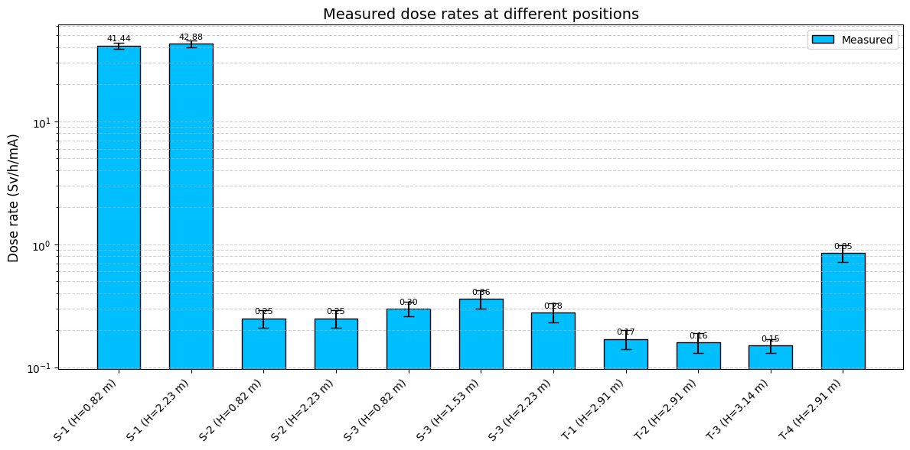
Measurement

Slide 11
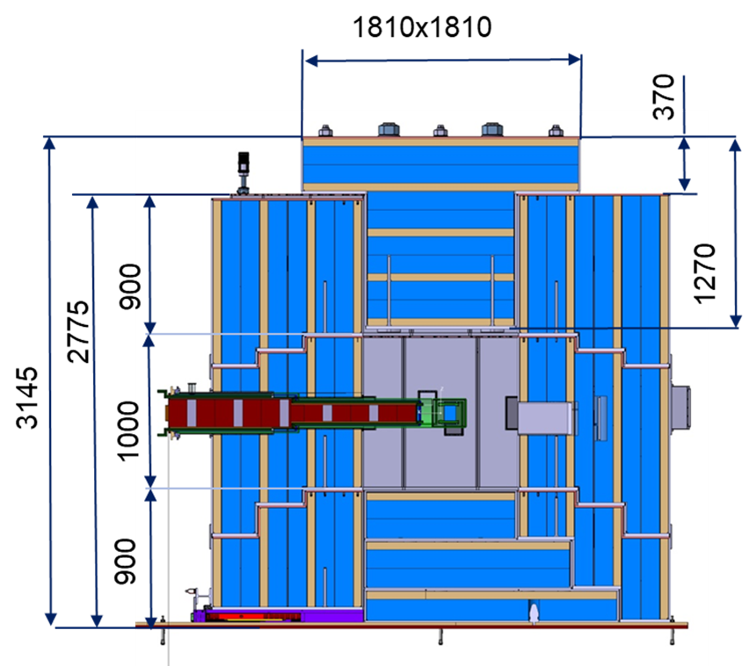
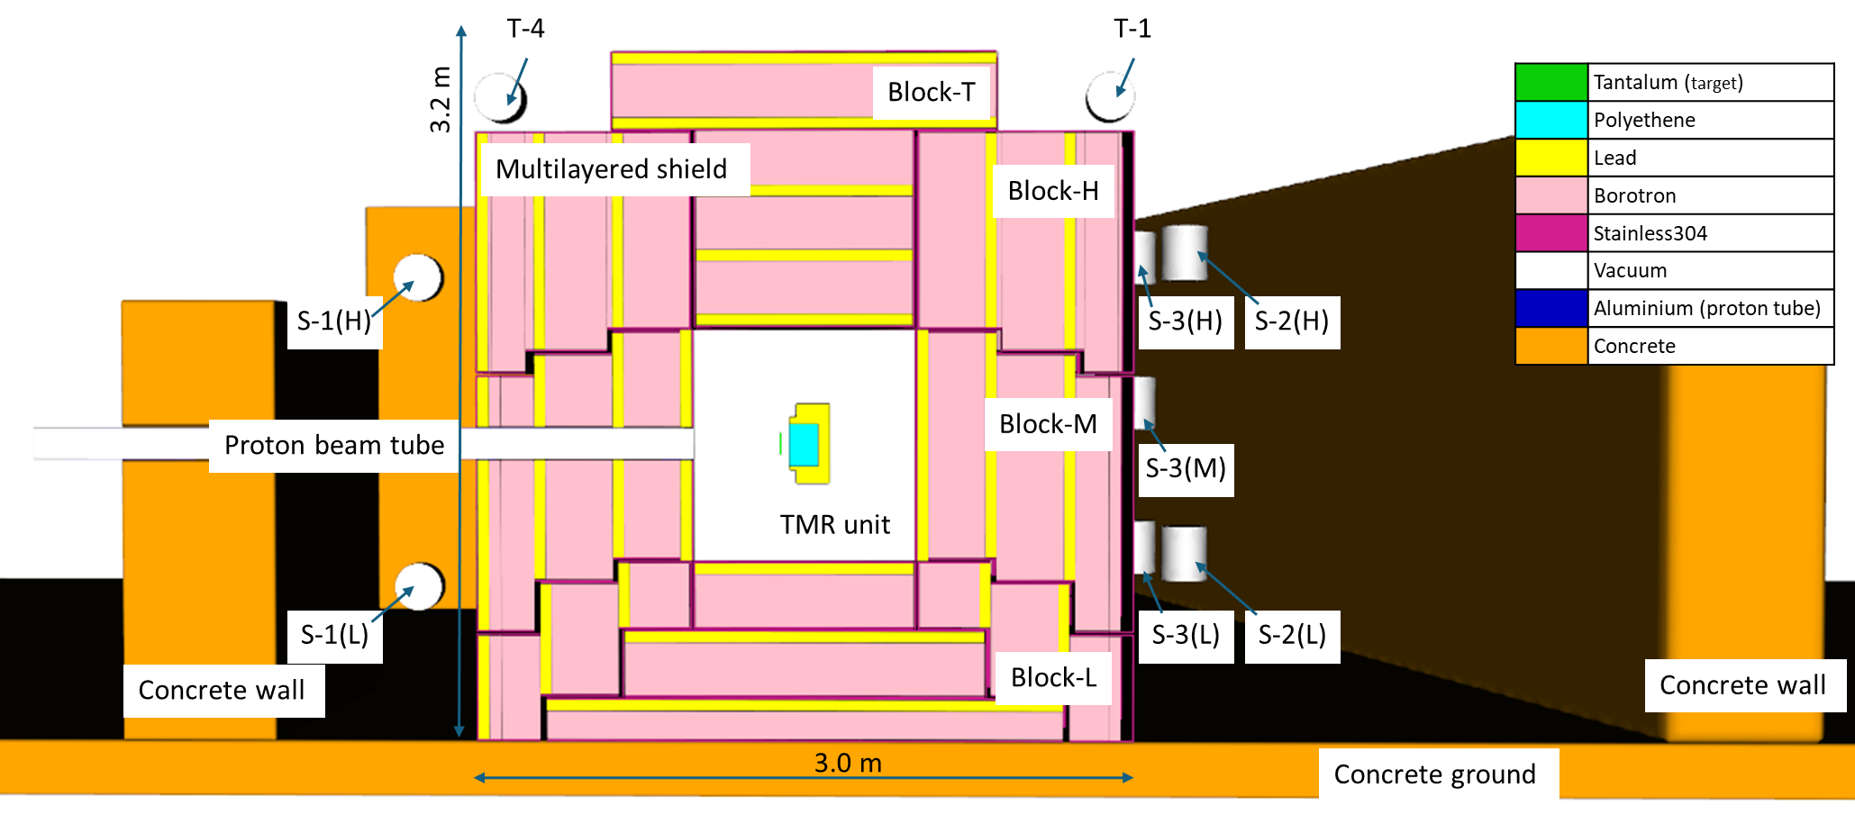
Simulation (PHITS (3.24), JENDL-4.0 (for e<20 MeV))
Extraction channels are not considered

Slide 12
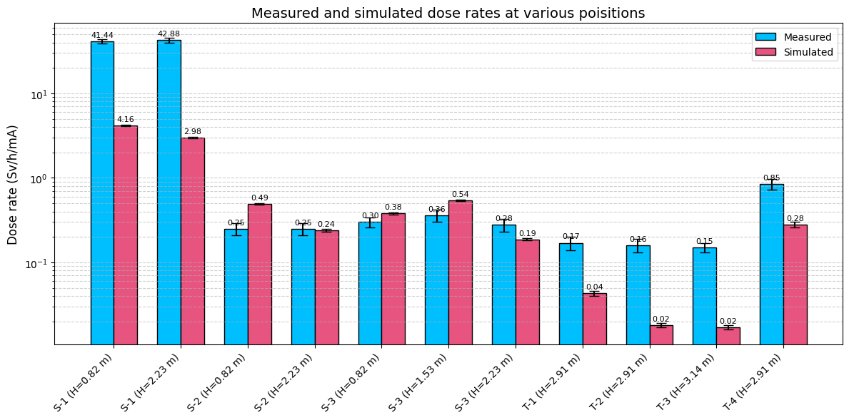
Comparison with the measured dose rate
Good overall agreement between measurement and simulation
Larger deviations
Strong influence of scattered neutrons in experimental hall
Better agreement
Dominated by shielding attenuation
More stable prediction

Slide 13
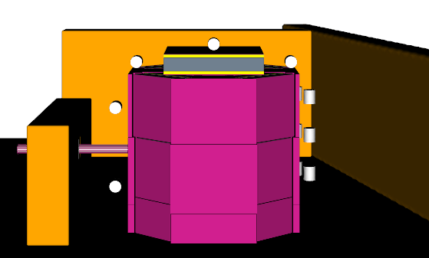
Comparison with the measured dose rate - 1
T-4
S-1(H)
S-1(L)
Uncertainty
Proton beam profile:
Small deviations → significant increase in dose rate
Beam losses can lead to higher-than-predicted values

Slide 14
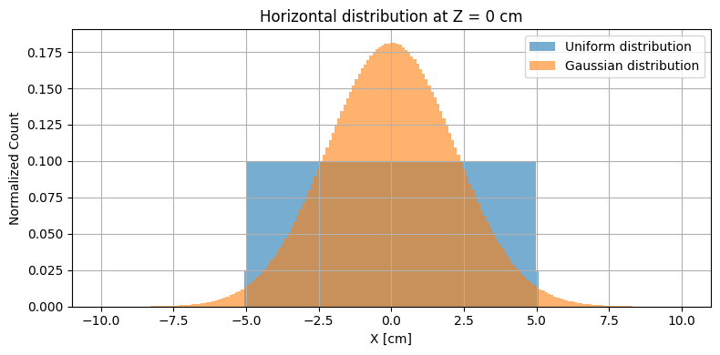
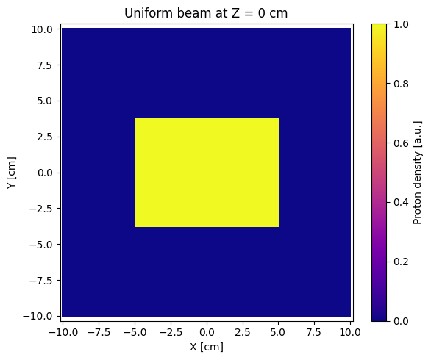
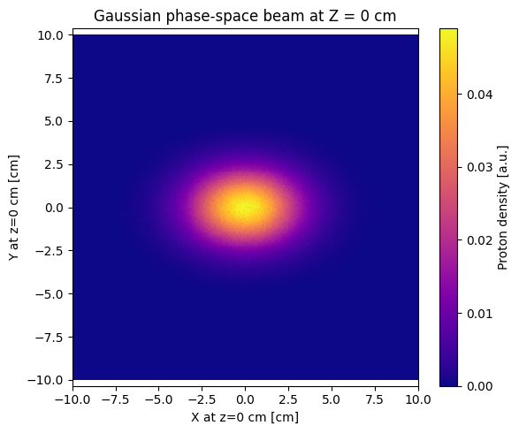
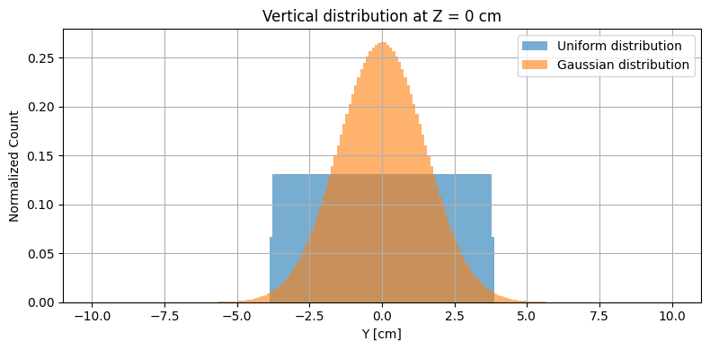
Analysis of deviations
- Beam profile with Gaussian distribution
 | Homogenous Beam | Assumed Gaussian Beam
Shape | Uniform rectangle | Gaussian distribution
Horizontal range
Vertical range
Angular spread | None (parallel)
Beam spill | 0% | ~2.45% outside ideal area

Slide 15
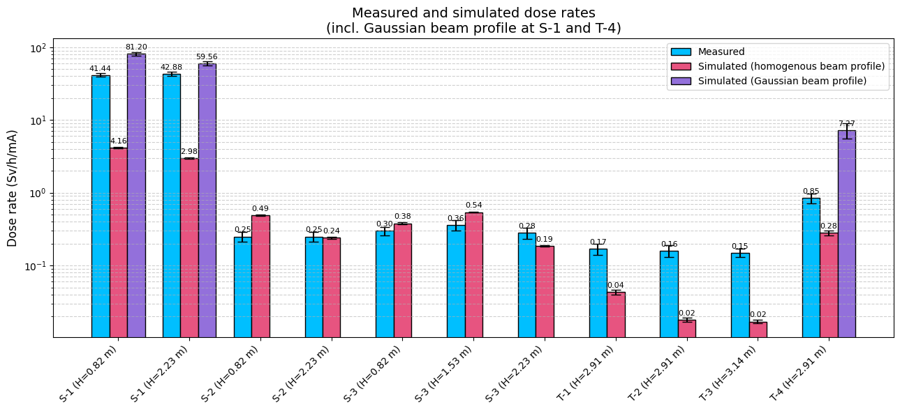
Comparison with the measured dose rate - 2
T-4
S-1(H)
S-1(L)

Slide 16
Conclusion and outlook
The neutron dose rate on the outer surface of the TMR shielding was measured during the 2023 beam time.
  Monte Carlo model successfully validated against measurements
  Agreement within experimental uncertainty range
  Scattered neutrons affect local dose rates
  Beam profile is dominant uncertainty source
  Shielding concept meets safety requirements
  Model can be used for further optimization

Slide 17
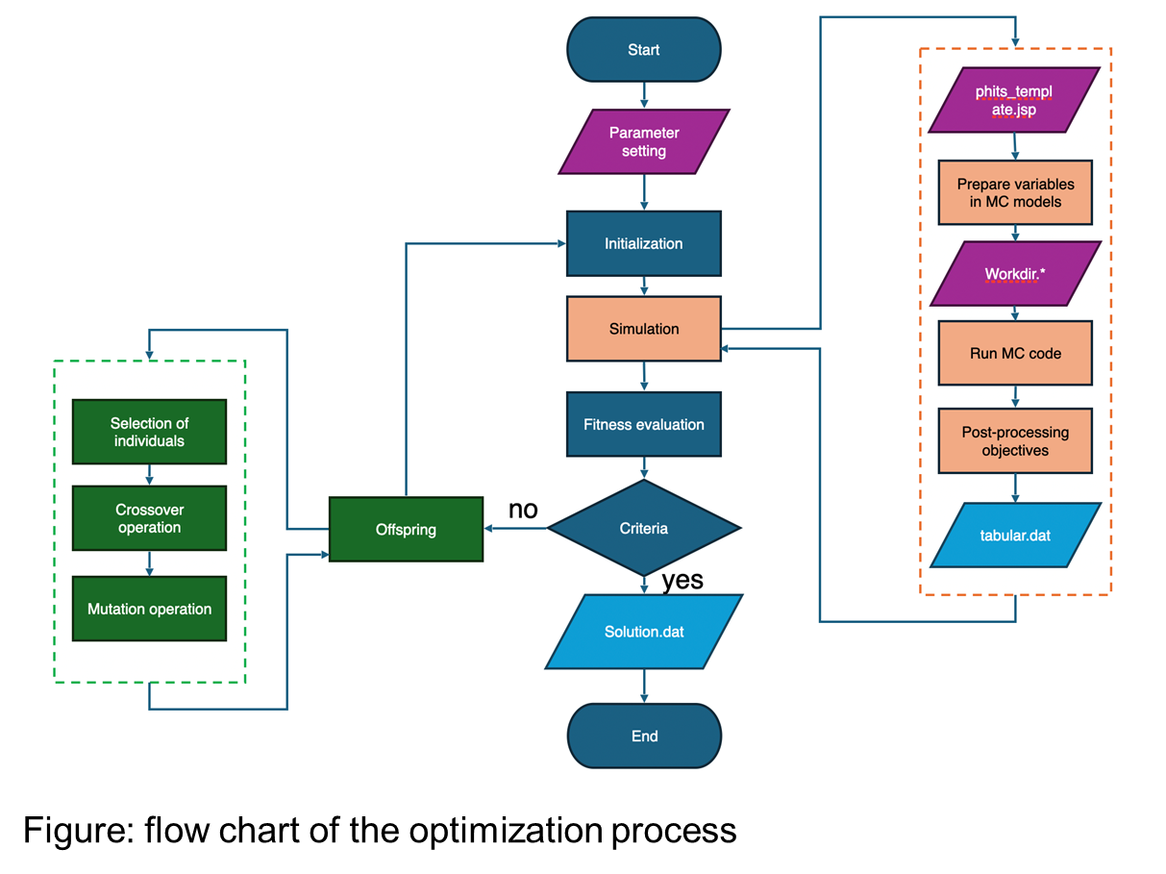
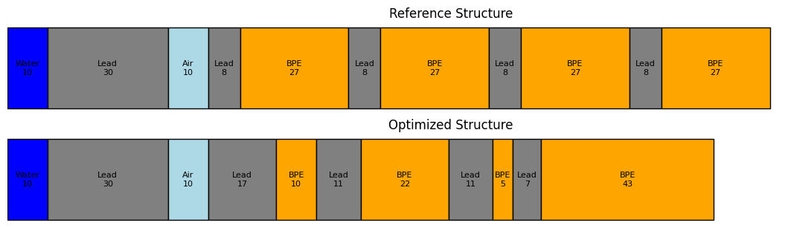
Conclusion and outlook
Further simulations and optimizations:
  Improved source term characterization
  Inclusion of additional geometry (e.g. extraction channels)
  Use multi-objective method to optimize the shielding geometry under the constraints.
    14 cm thickness reduction vs. 1D model → 10% weight reduction

Slide 18
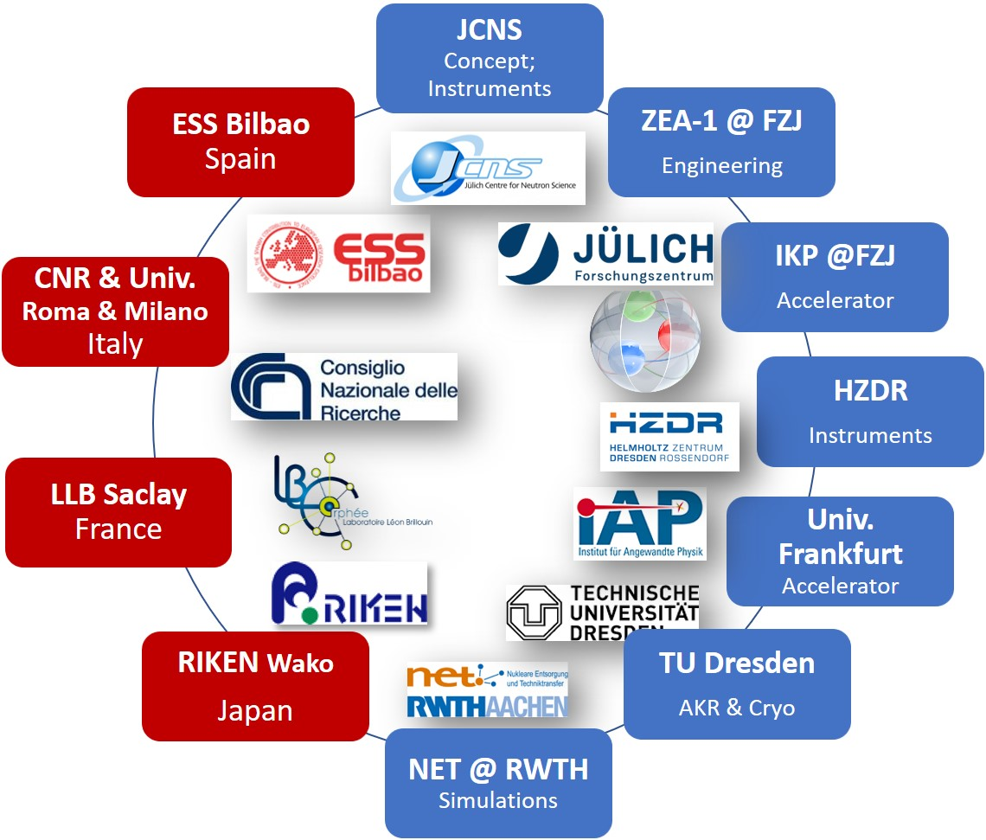






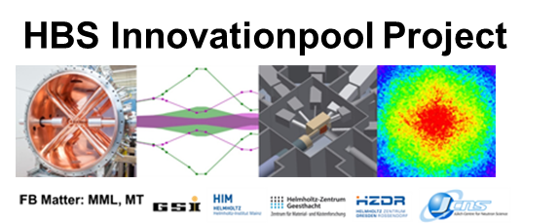



HBS Team
J. Baggemann
Th. Brückel
T. Claudio-Weber
T. Cronert (†)
T. Gutberlet
M. Hassan
J. Li
K. Lieutenant
E. Mauerhofer
D. Maharaj
M. Rahman
T. Randriamalala
U. Rücker
S. Sambamurthy
D. Shabani
J. Voigt
P. Zakalek
ITE-1:
Y. Bessler
R. Hanslik
R. Achten
T. El-Kordy
F. Löchte
E. Rosenthal
R. Rings
J. Wolters
- Engineering
IKP-4:
O. Felden
R. Gebel
A. Lehrach
- Nuclear physics
INM-5:
B. Neumaier
- Radio isotopes
C. Lange
T. Langnickel
Ch.Haberstroh
M. Klaus
S. Eisenhut
- AKR-2, liquid H₂
L. Zanini
J. I. Marquez
N. Rizzi
F. Ott
M. A. Paulin
H. Podlech
O. Meusel
- Accelerator
W. Barth
- Accelerator
G. Nowak
J. Plewka
C. Jacobsen
R. Kumar
J. Fenske
/ HIM
A. Lasko
A. Wolfertz
- JULIC Neutron
Platform Experiments
- Core team

