Slide 1


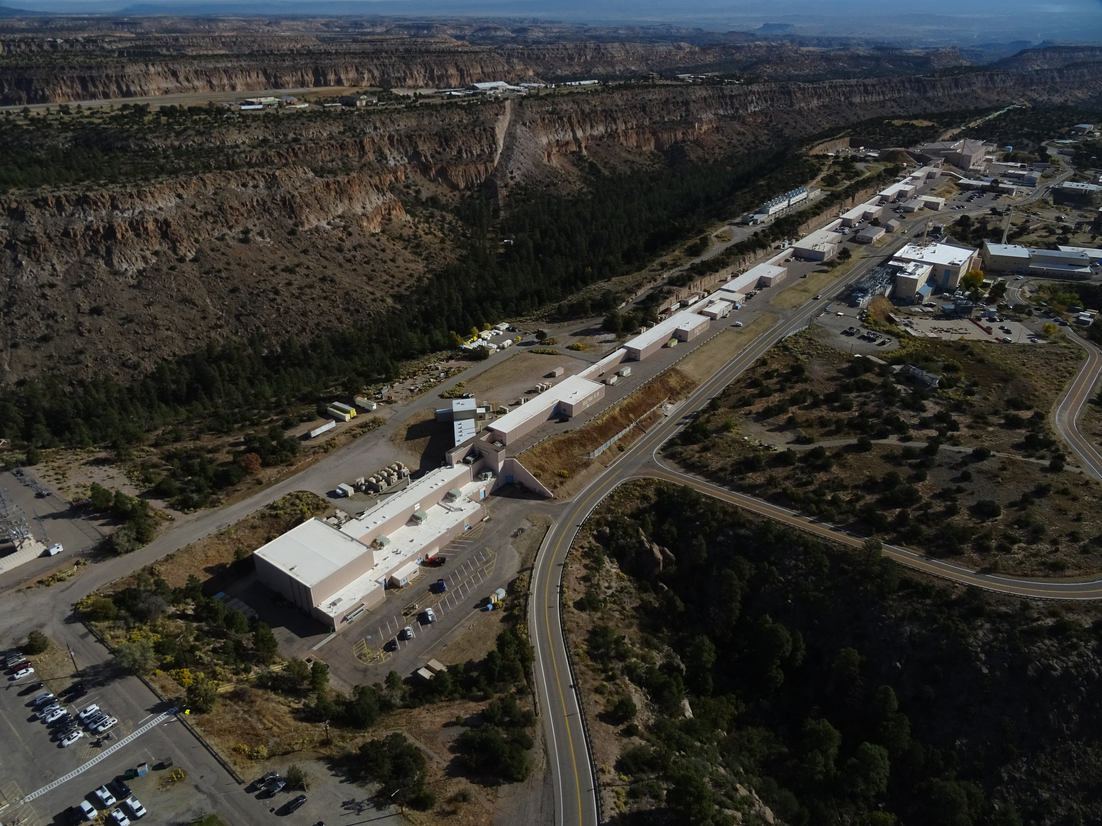

Operational Status of LANSCE
Eron Kerstiens
Accelerator Operations & Technology Division
Operations Group Leader
April 13, 2026
LA-UR-26-22890
Managed by Triad National Security, LLC., for the U.S. Department of Energy’s NNSA.

Slide 2
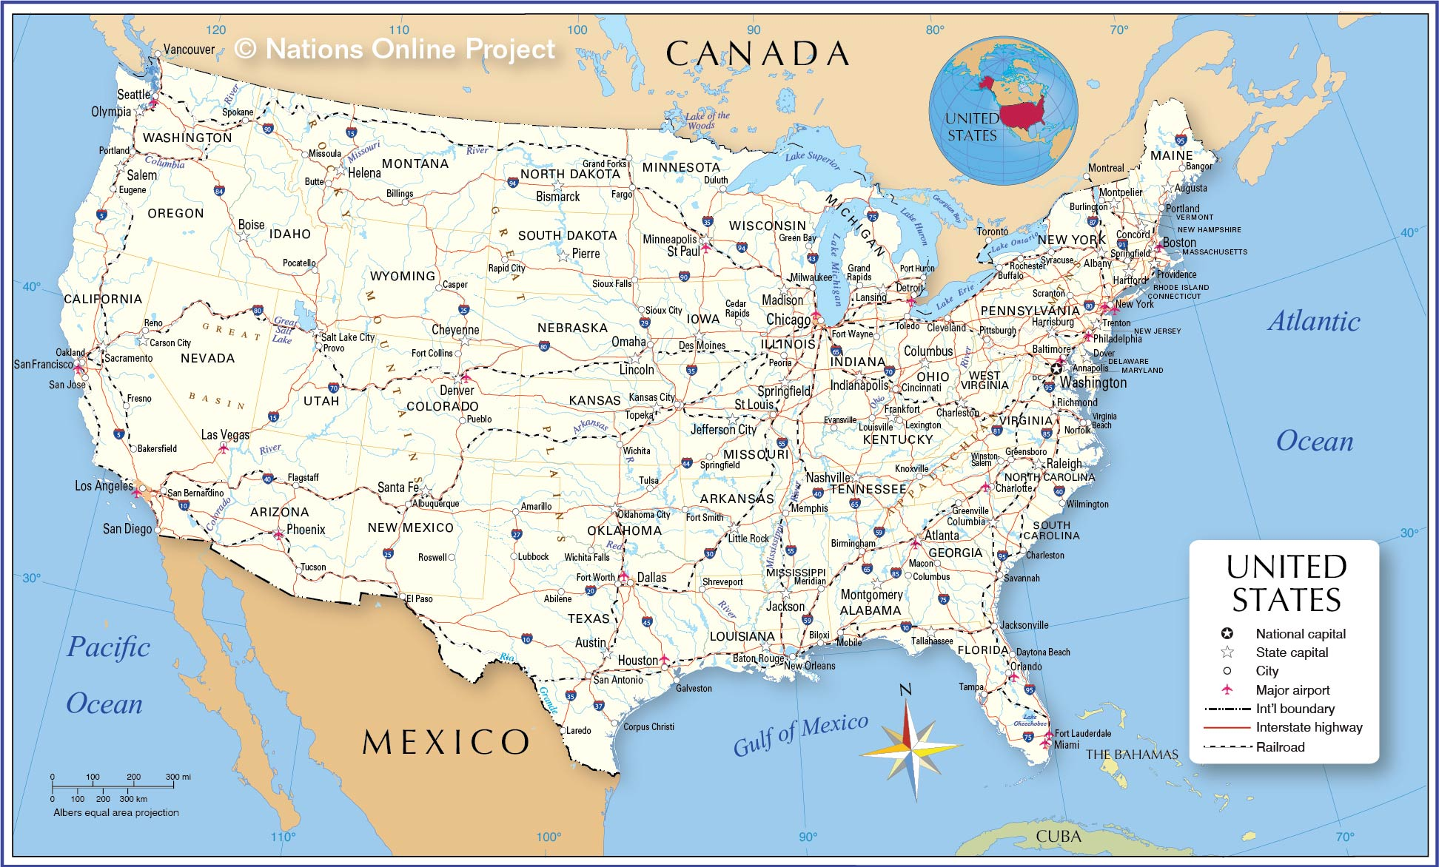

LANSCE is part of Los Alamos National Laboratory which is located in Los Alamos, New Mexico, USA
Los Alamos

Slide 3
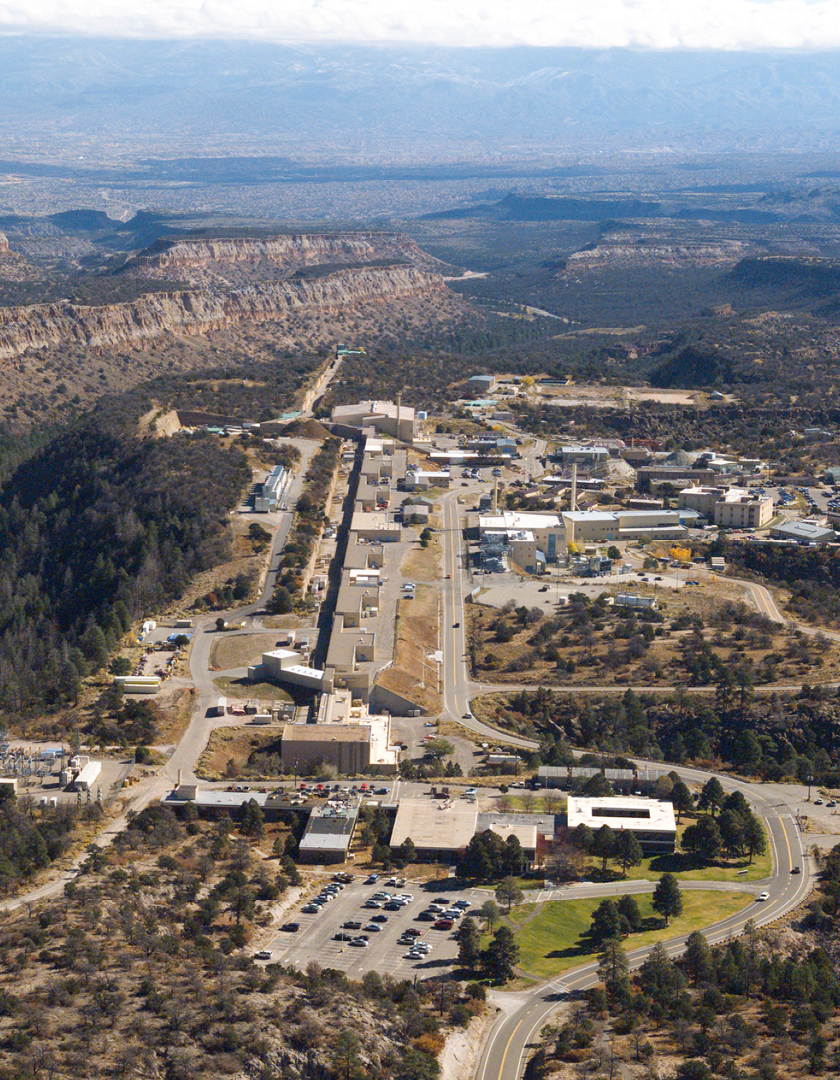

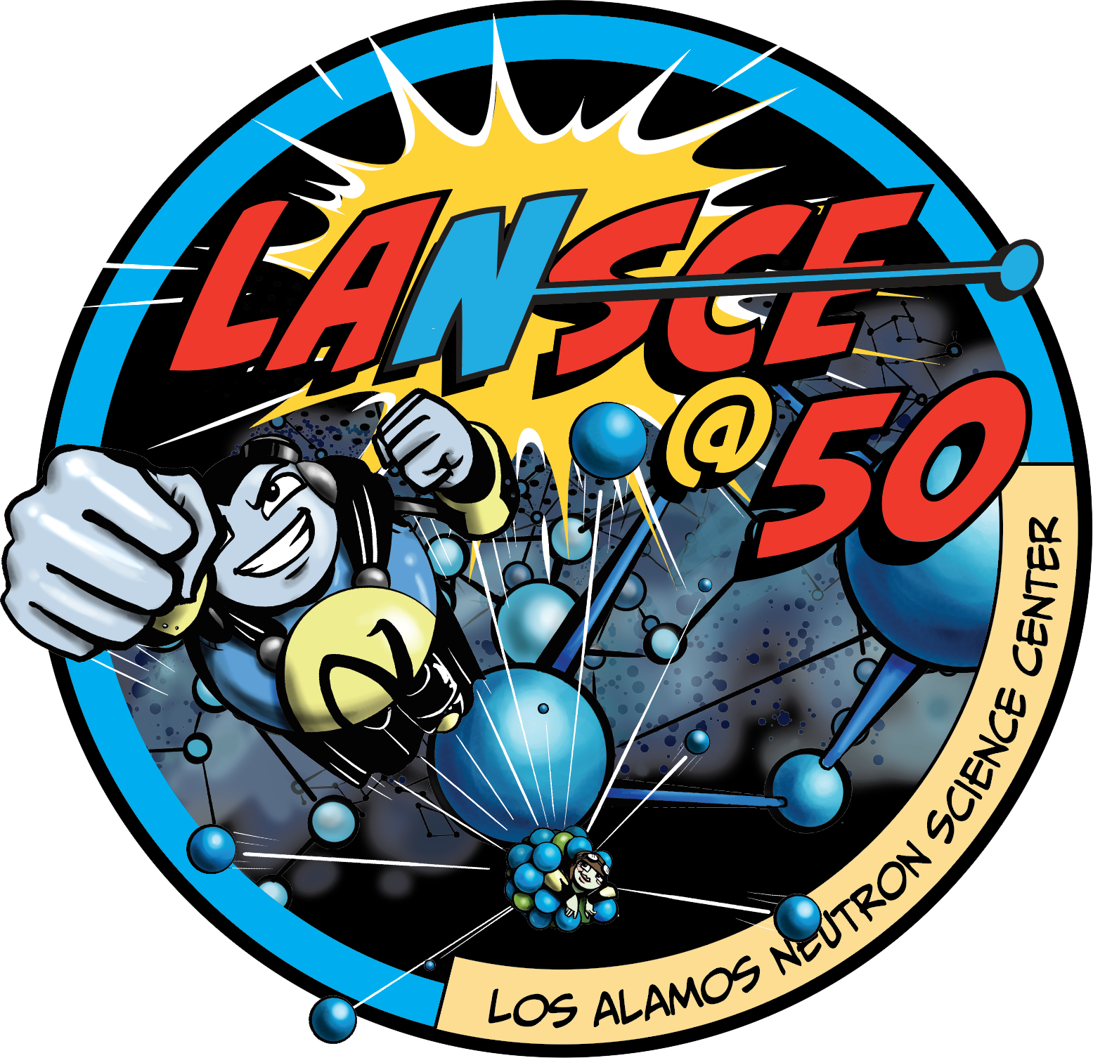
LANSCE’s five Experimental Facilities
support research in
Nuclear Physics & Materials Science, as well as
Fundamental Science and Medical Isotopes.
Until 1995 known as Los Alamos Meson Physics Facility
5
6
3
2
1960’s – design & construction started
1972 – LINAC achieved 800 MeV
1
1977 – Weapons Neutron Research (1)
1985 – Lujan Center (Neutron Scattering) (2)
4
1997 – pRAD (Proton Radiography) (3)
2004 – Isotope Production Facility (4)
2005 – Ultra Cold Neutron (UCN) Facility (5)
AREA - A orig. Facility not currently used (6)
2022 - 50th Anniversary

Slide 4
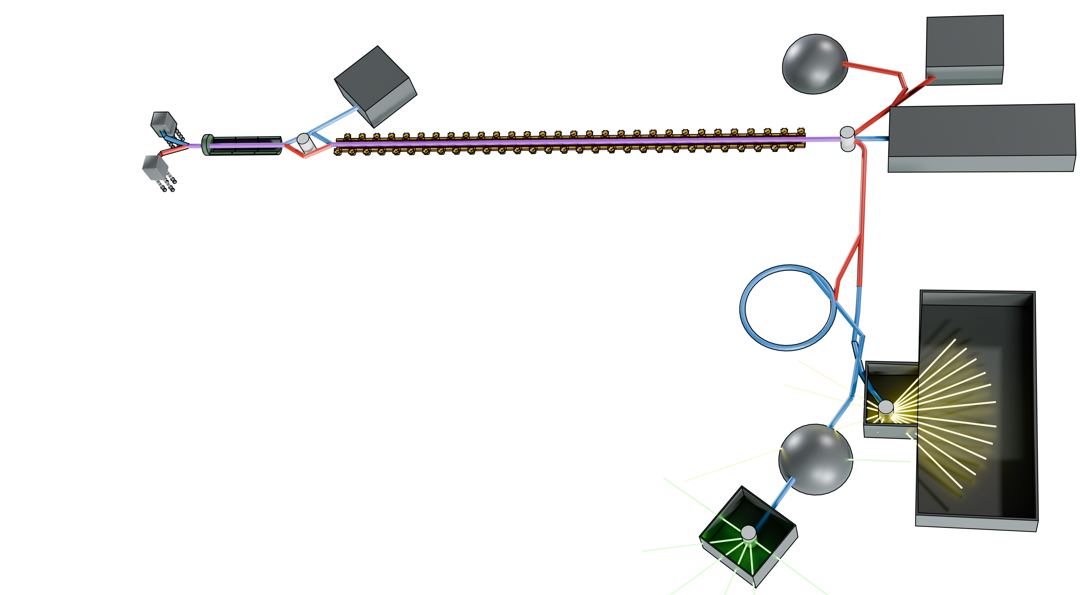
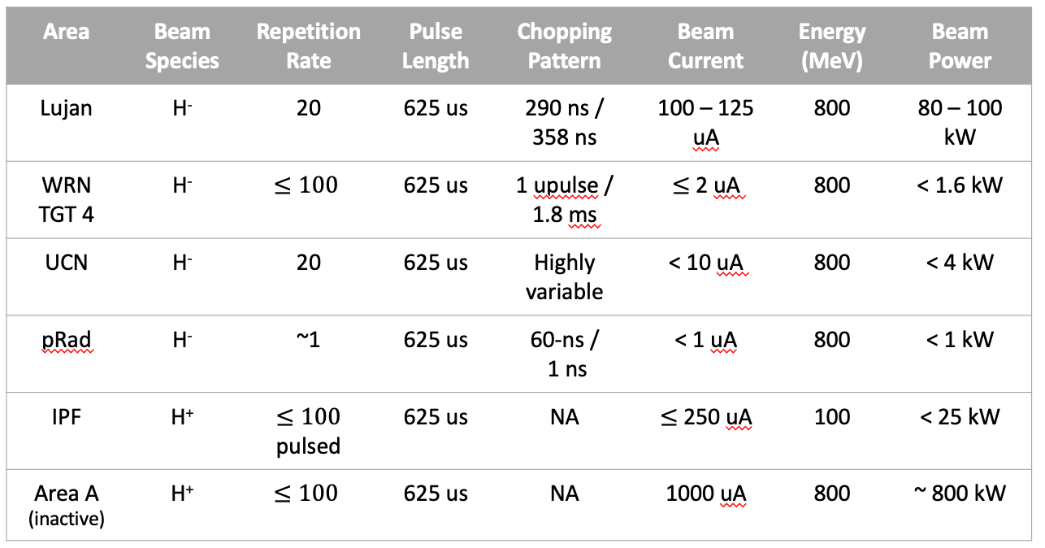
The LANSCE Complex
Isotope Production Facility
Ultra-Cold Neutron Facility
Proton Radiography Facility
H+ Source
201.25 MHz 100 MeV Drift Tube Linac
750—keV Cockcroft-Walton Injectors
805 MHz 800 MeV Coupled Cavity Linac
Area A (Currently Inactive)
H- Source
Proton Storage Ring
Lujan Neutron Scattering Facility
Target 2
Target 4
Weapons Neutron Research Facility

Slide 5
LANSCE - A Very Flexible and Diverse Facility
Distinctions
Highest power proton accelerator in the United States for defense programs research.
Highest energy proton radiography facility in the Unted States; also the birthplace of proton radiography.
Only proton accelerator in the United States with high explosives and plutonium capabilities.
Only dual-species proton accelerator in the world, both H+ and H-.
15 orders of magnitude neutron energy span (3x10⁻⁷ eV to 6x10⁸ eV).
Users
~700 users per year for material science, nuclear physics, particle physics, and national security.
~70 collaborating institutions, per year, from around the world
~ 4000 scheduled target operating hours per year

Slide 6
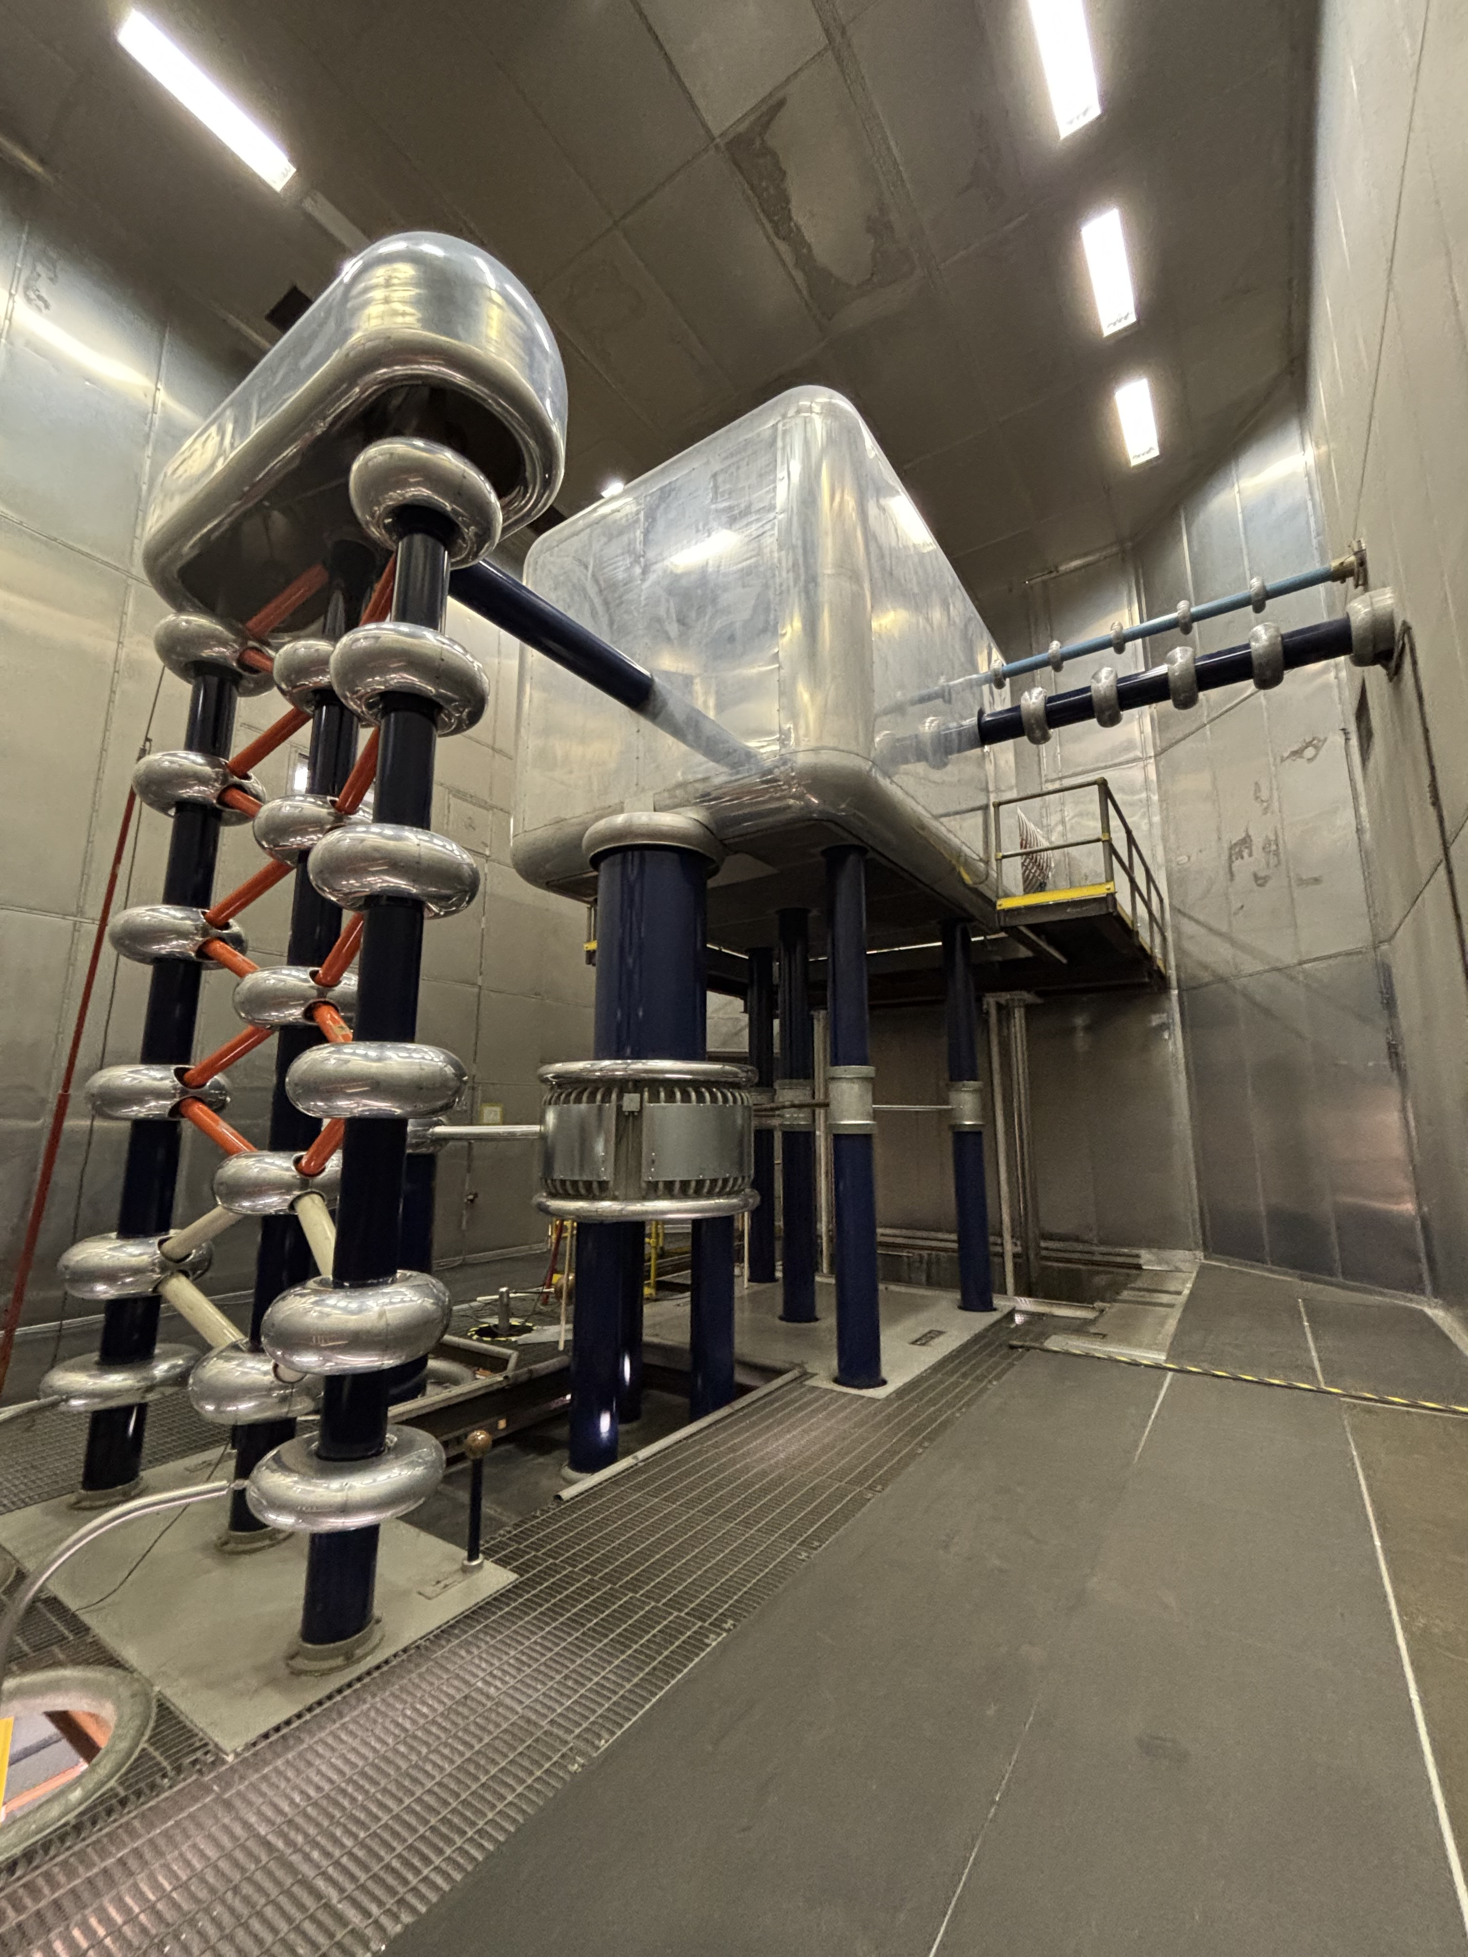
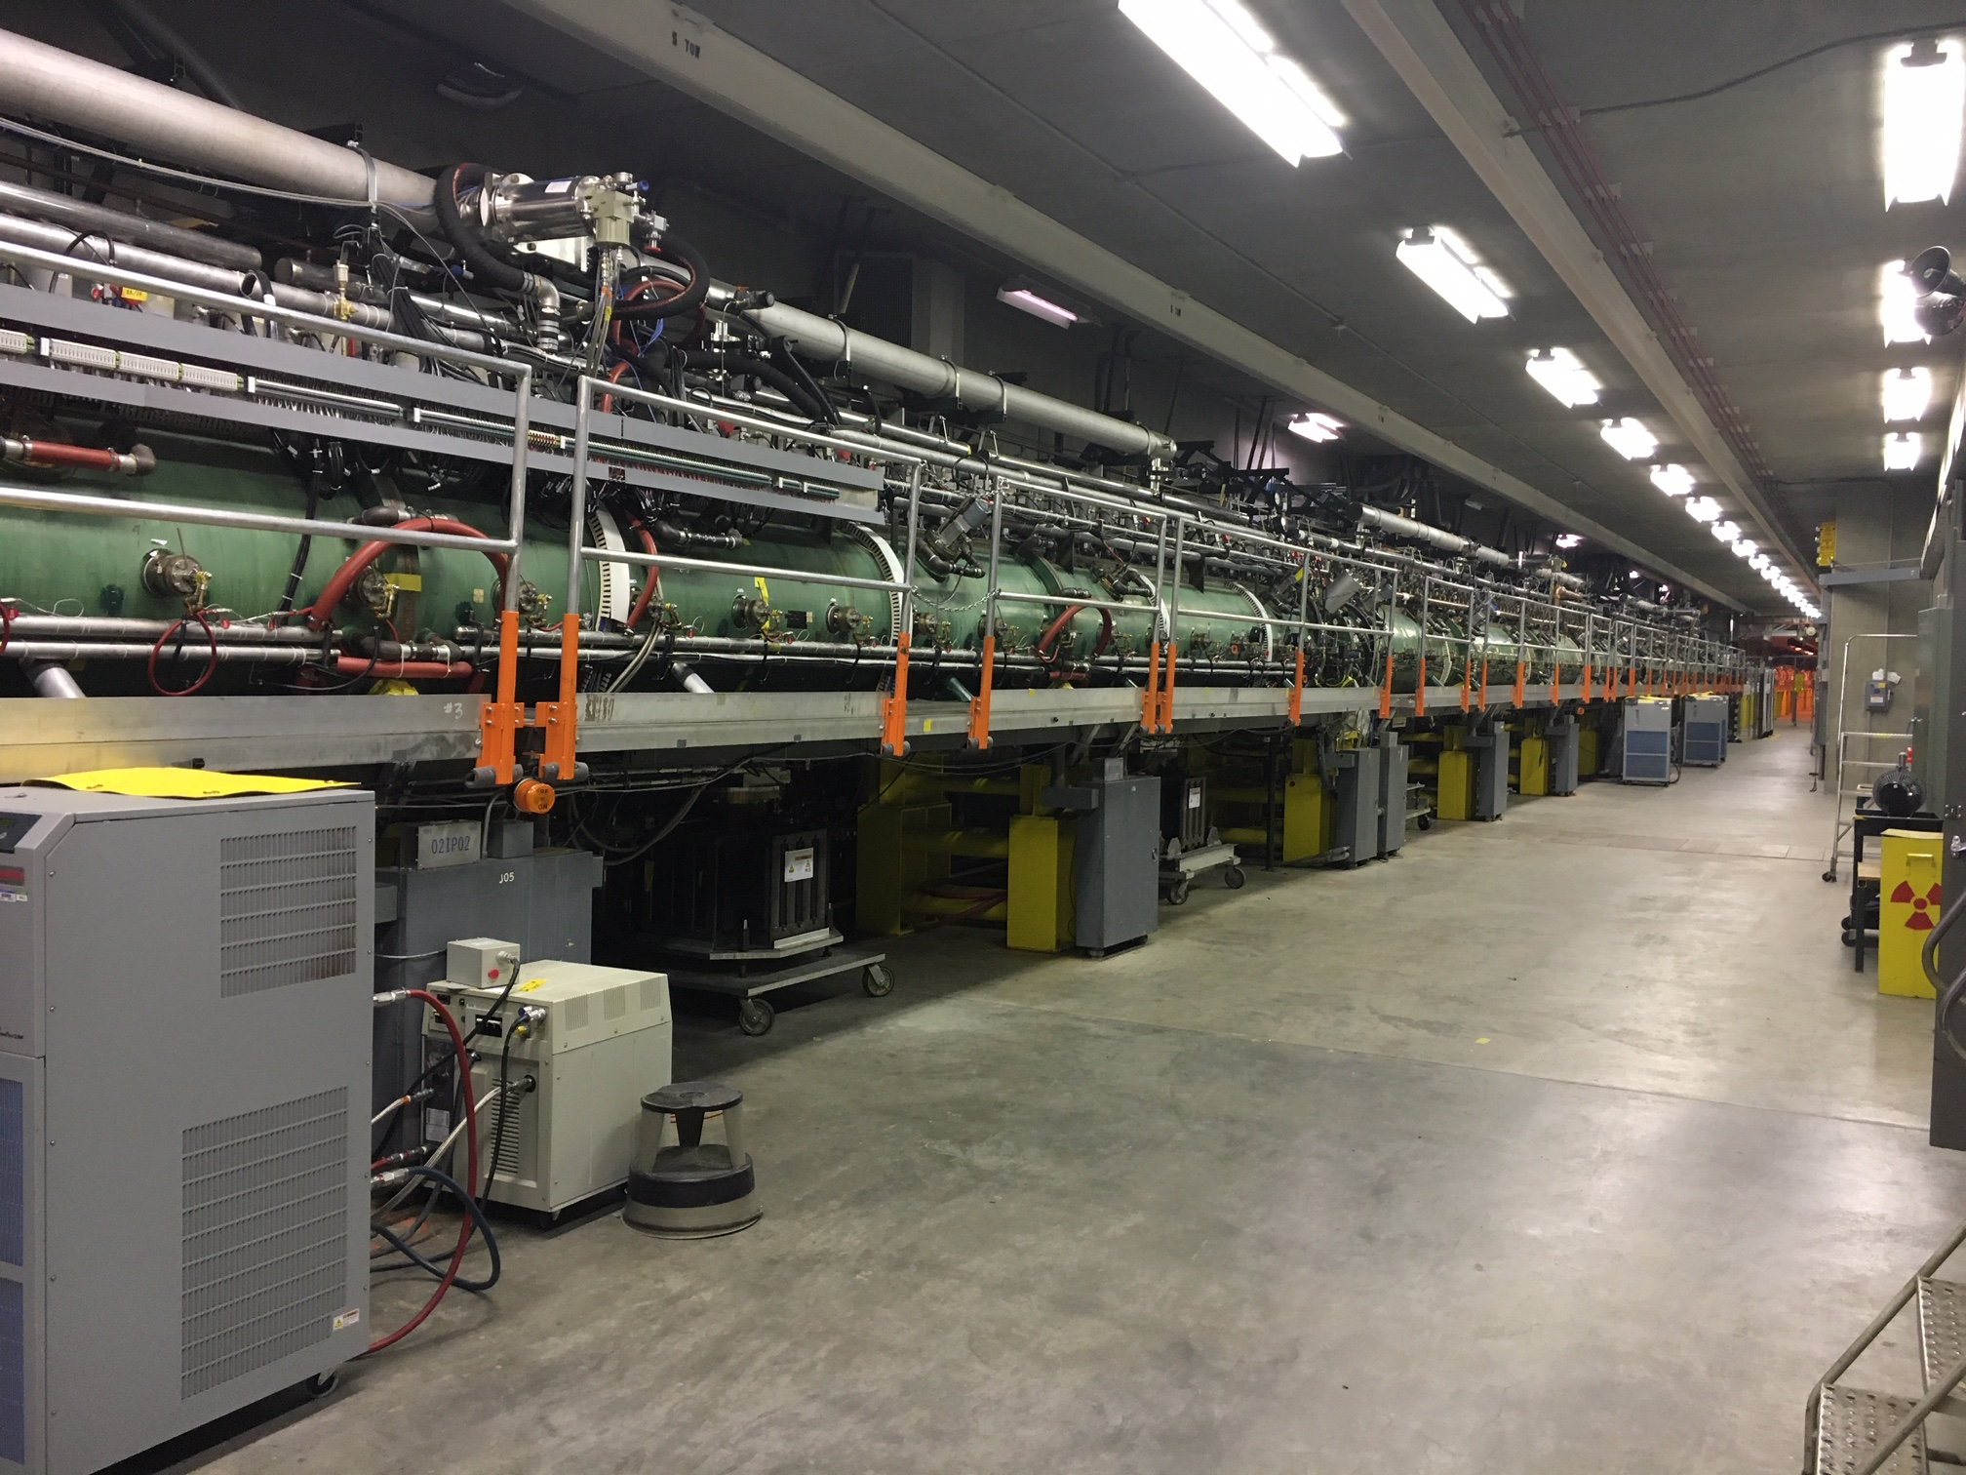
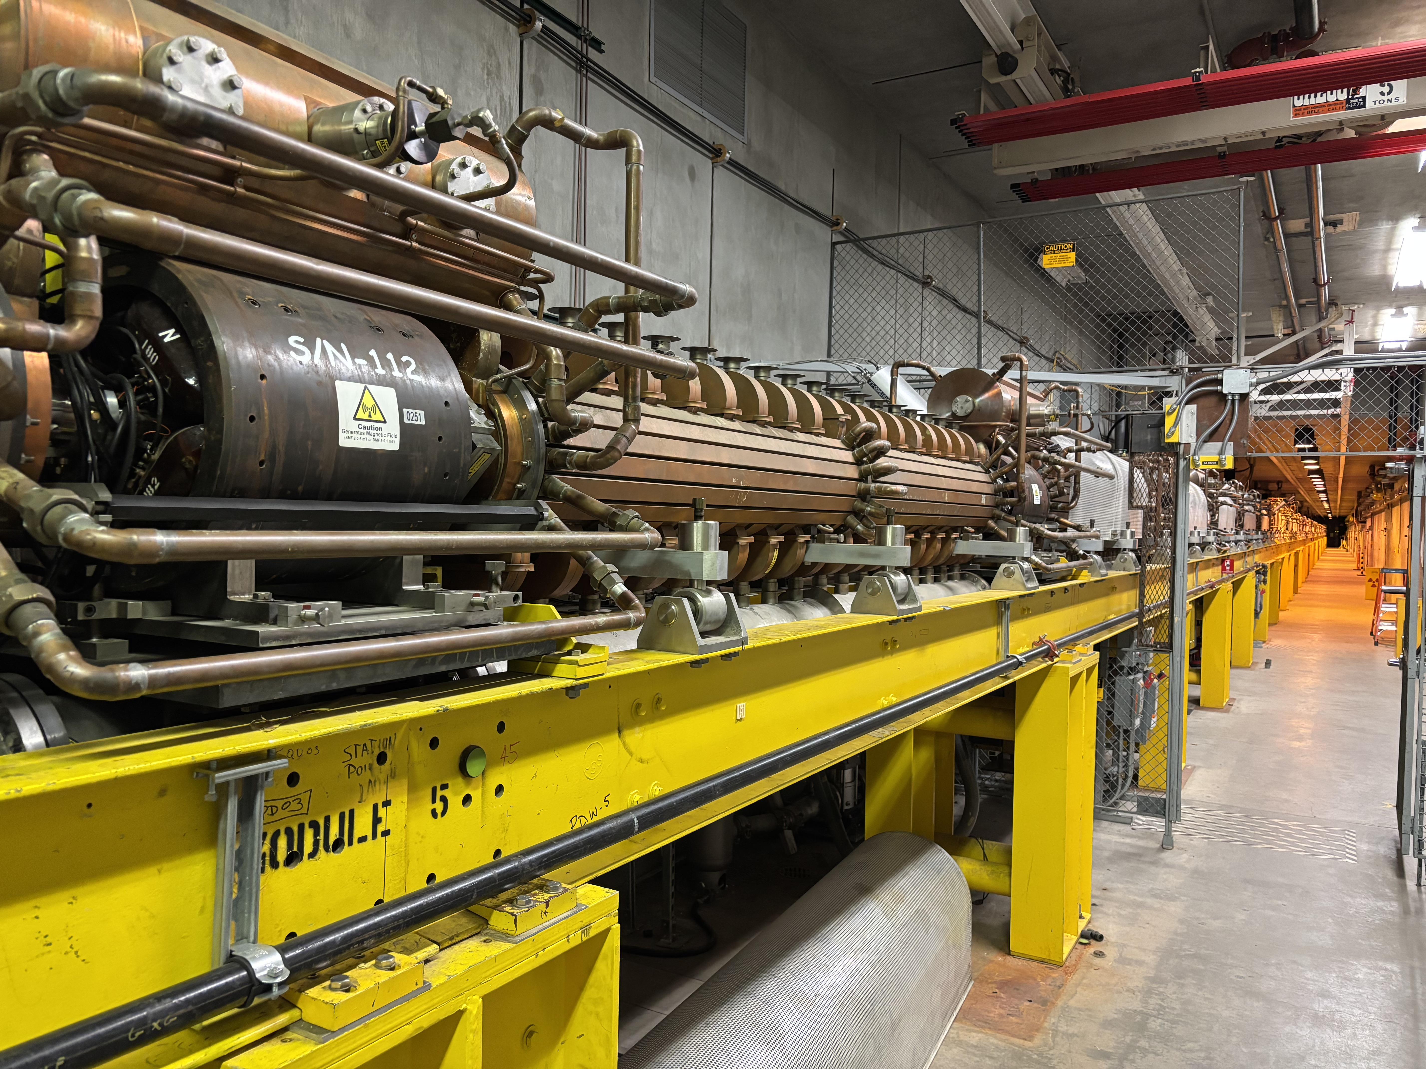
Accelerator (At a Glance)
750 keV H+ and H- Cockcroft-Walton Injectors – one of the last facilities in the world still using CWs.
100 MeV Drift Tube Linear Accelerator operating at 201.25 MHz.
800 MeV Cavity-Coupled Linear accelerator operating at 805 MHz.

Slide 7
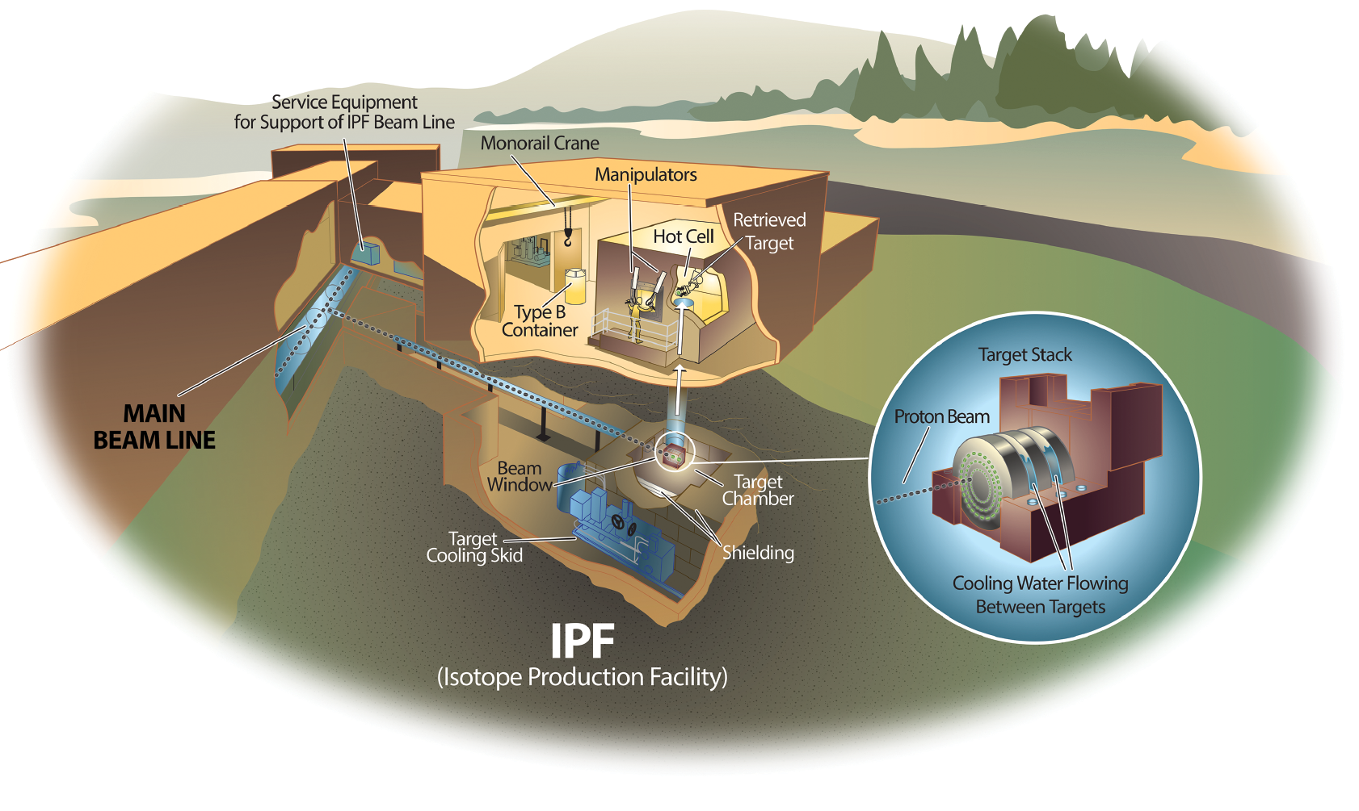
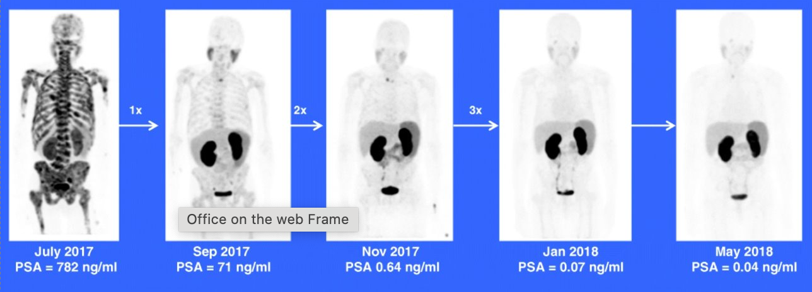
Isotope Production Facility
Commissioned in 2003 as a key facility of Department of Energy’s Isotope Program.
Excels in the basic science and applied engineering need to produce isotopes that can be used at scale in the marketplace.
We make a wide range of isotopes for medical, industrial, and research applications (30+).
Amerecium-241 for smoke detectors
Sodium-22 for PET scans
Arsenic-73 for environmental research
Actinium-225 to deliver high-energy radiation to cancer tumors without greatly affecting surrounding tissue.
Images of a patient with metastasized prostate cancer treated with Ac-225 PSMA
Sathekge, M., Bruchertseifer, F., Knoesen, O. et al. 225Ac-PSMA-617 in chemotherapy-naive patients with advanced prostate cancer: a pilot study. Eur J Nucl Med Mol Imaging 46, 129–138 (2019). https://doi.org/10.1007/s00259-018-4167-0

Slide 8
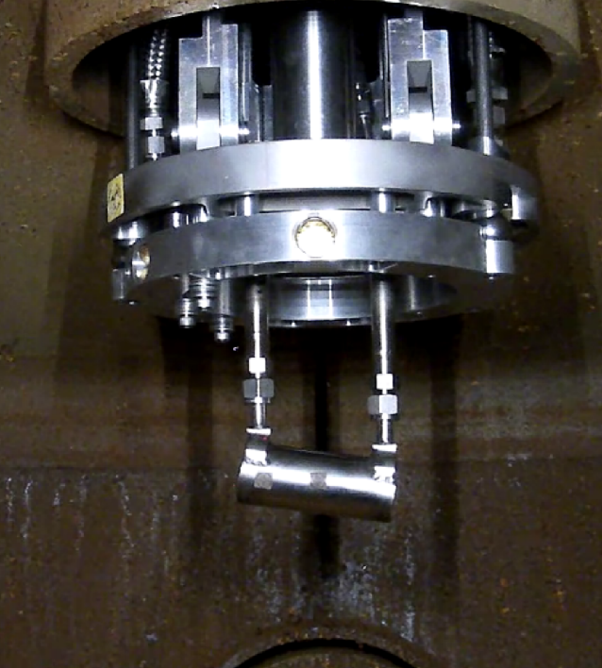




















Weapons Neutron Research Center
Unmoderated tungsten target
Small ~ 1” diameter
7 flight paths
Premier and only U.S. facility for electronics testing and certification using neutrons (neutron induced single event upsets).
Cosmic rays produce neutrons when they penetrate the atmosphere. These neutrons interact with silicon in electronics and can cause single event upsets.
Studies measurements for criticality.
Studies radiation effects on reactor components.

Slide 9
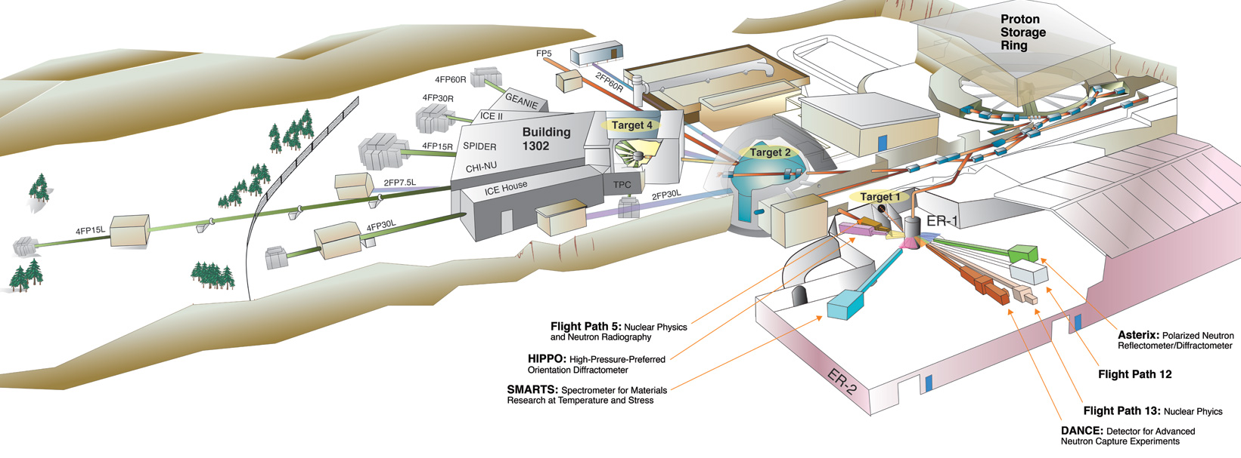
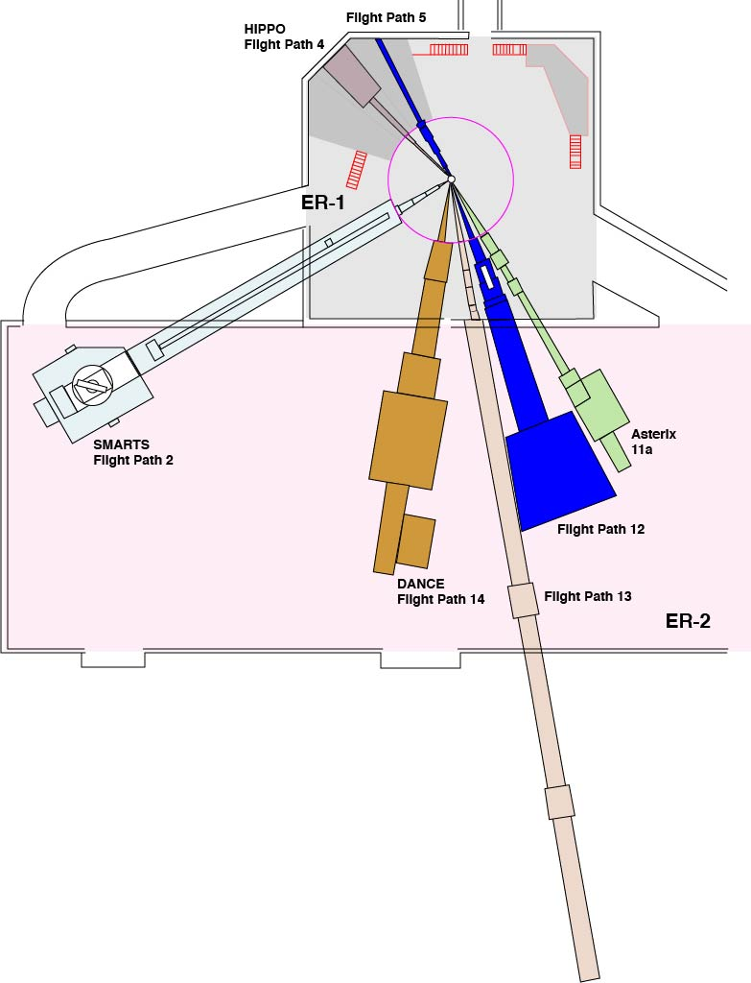
Manuel Lujan Neutron Scattering Center
Moderators: Liquid hydrogen, water and unmoderated flight paths provide cold, thermal, and intermediate energy neutrons.
7 operating flight paths
SMARTS and HIPPO – Neutron diffraction
ERNI – neutron radiography
ASTERIX – Cold neutron radiography and reflectometer
FP-12, DICER and DANCE – Nuclear physics

Slide 10
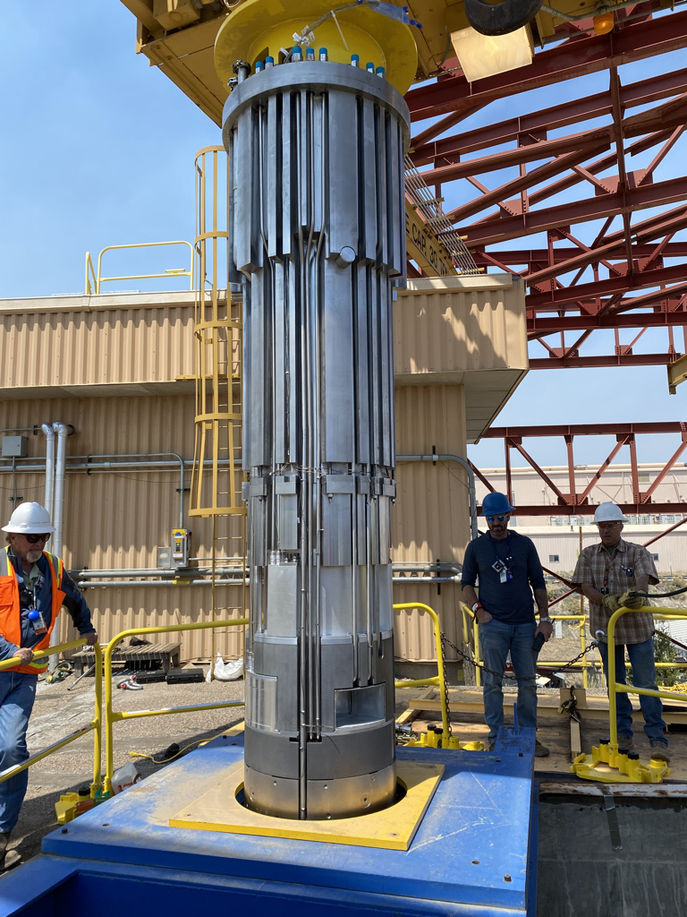
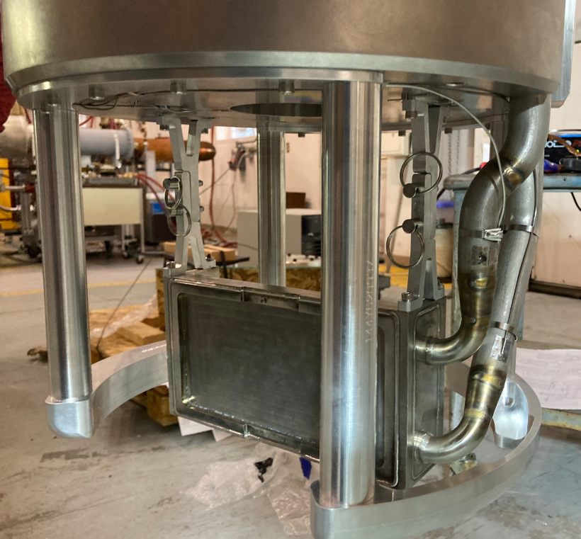
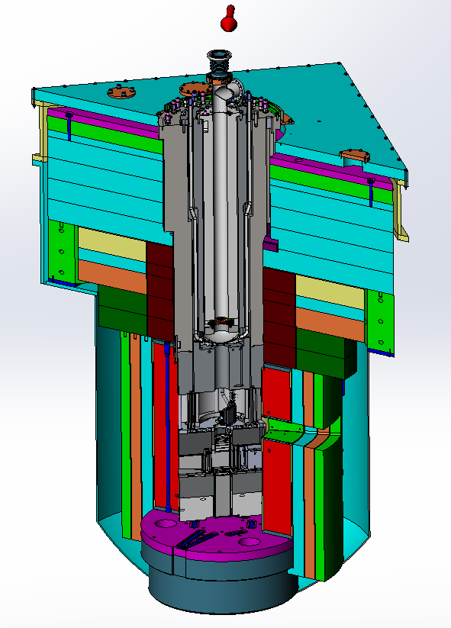
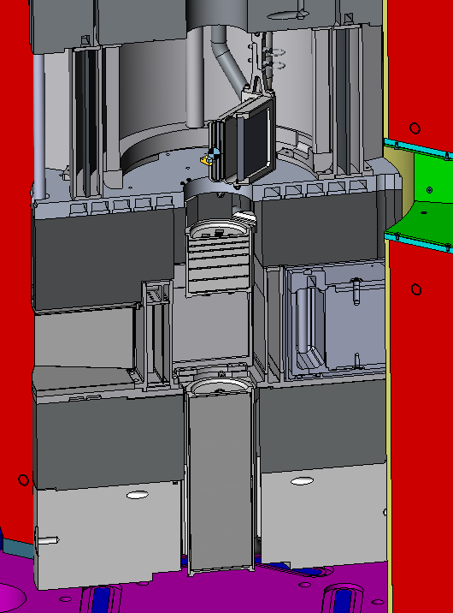
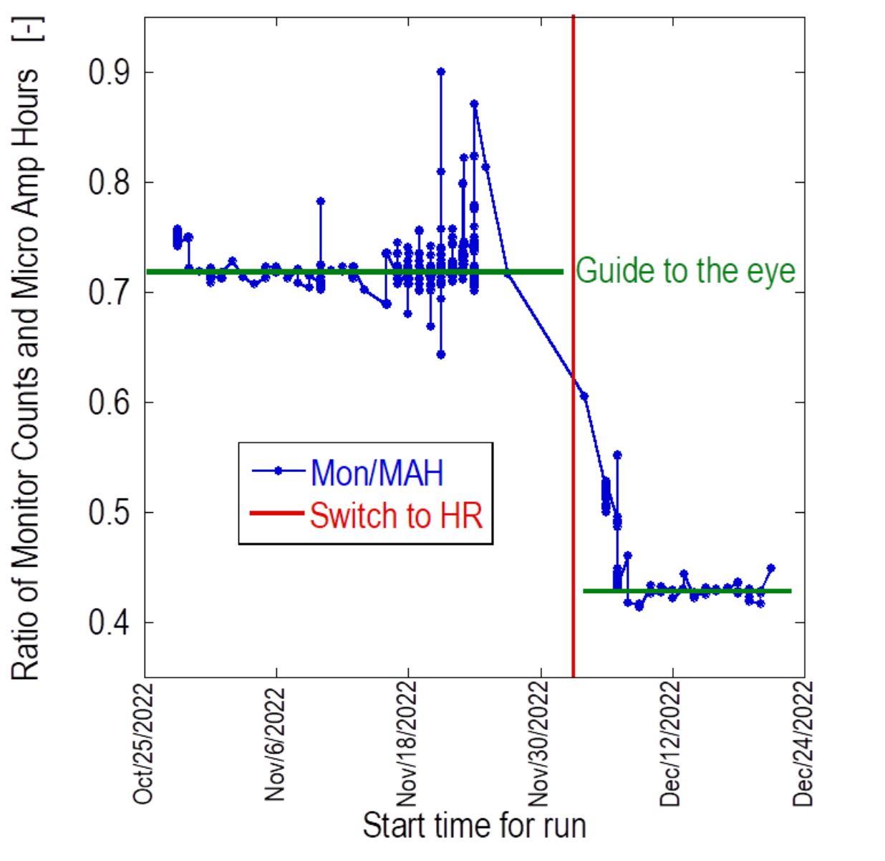
New Target Moderator Reflector System (TMRS) MKIV
TMRS
Upper Target
Installed in 2022.
Incorporated a third unmoderated tungsten target with direct line of sight to 3 flight paths to allow nuclear science studies using keV neutrons (FP-12, FP-13, FP14).
Tungsten targets are clad with .010” tantalum
Added a secondary water moderator for two flight paths that can be blown down to provide either high intensity (moderator filled with water) or high resolution (moderator blown down with helium).
TMRS
Upper Target
Middle Target
High Intensity to High Resolution Mode
Lower Target

Slide 11
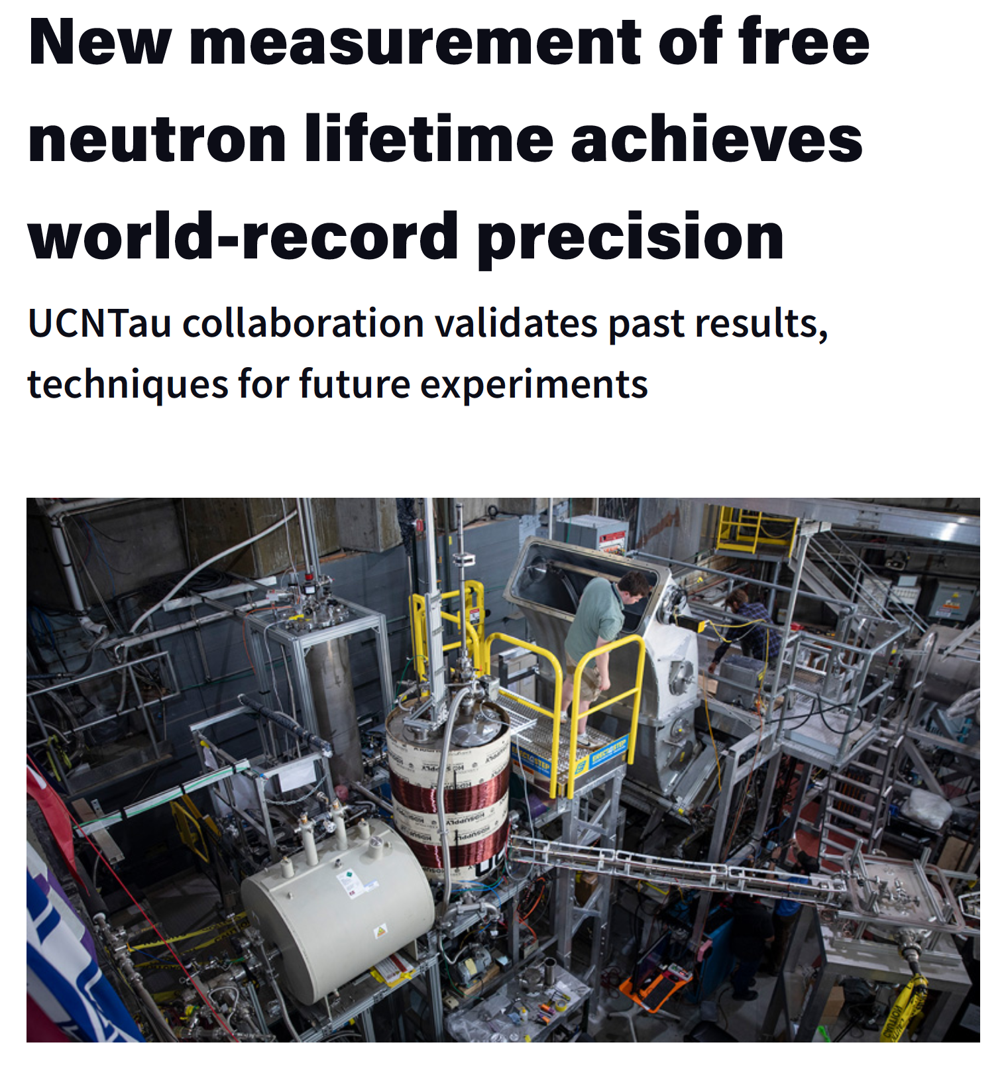
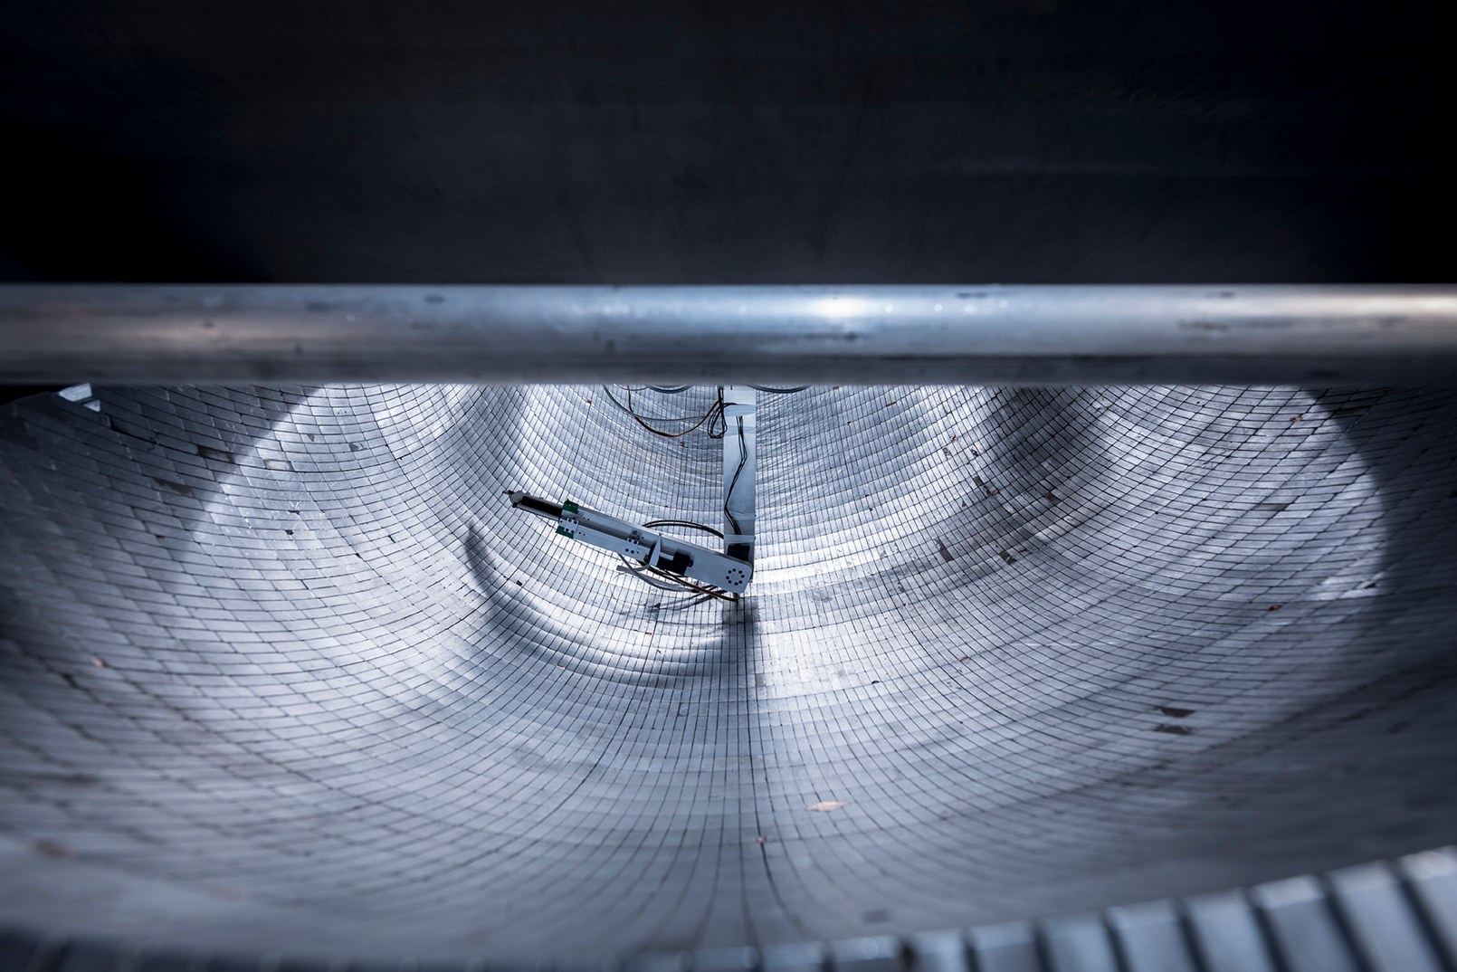
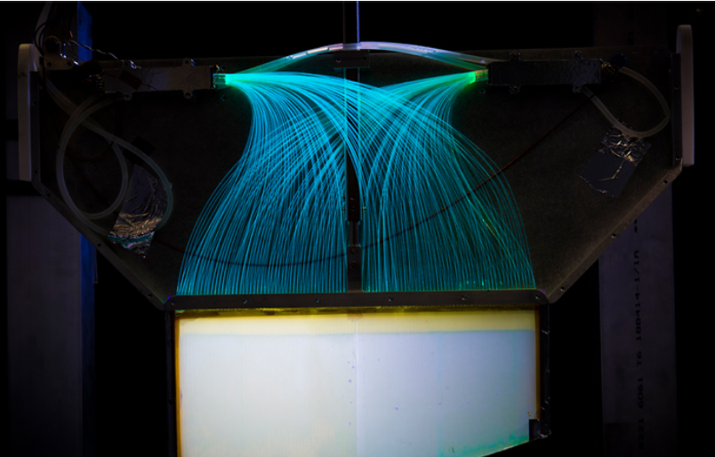
Ultra Cold Neutron Facility
Solid deuterium-based UCN source.
Unique probe for nuclear physics, possible defense program uses.
Most precise measurement of the neutron lifetime to date (877.83 seconds).
A view of the bowl-shaped array of permanent magnets as a robotic arm does magnetic field mapping.
A detector being lowered into the trap to count surviving ultracold neutrons; the camera flash is producing the glow.

Slide 12
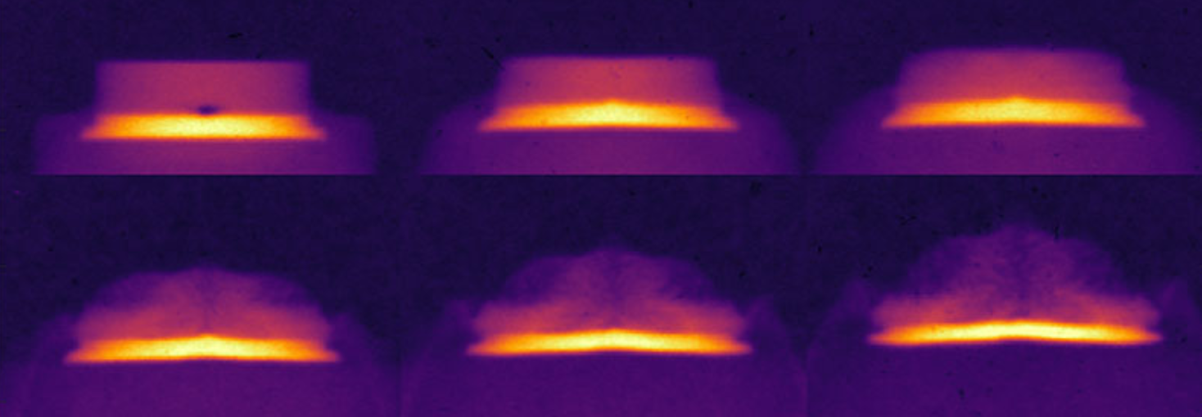
Proton Radiography Facility
A National User Facility Program
For both classified and unclassified experiments.
Used to diagnose high explosive properties and special nuclear material properties during dynamic events.
An image can be produced every 100-200 nanoseconds, 20-40 images per experiment.
These images are stitched together to make motion pictures.
2025 marked a return to plutonium-based experiments.
pRad makes fast movies through dense materials. Here, a metal coupon is shocked from below, where there is a divot in the interface. These six frames span 1.4 microseconds. The divot initiates an instability that evolves into a jet from the front interface, as the metal spalls — or breaks apart.

Slide 13
Our ability to maintain our nominal operations schedule has been degrading recently
Originally planned and approved 2023 Block Schedule
Key: Maintenance
Startup
Experimental operations
2019: DTL Tank 3 weld crack
2023: H+ C-W|HPRF|UCN Beam Window
2020: COVID
Final implemented 2023 Block Schedule
2024: 805 MHz klystron shortage
2021: SUS-J|IPF Window
2022: MKIV Target|HPRF
2025: Difficulties bringing 805 MHz system back up

Slide 14
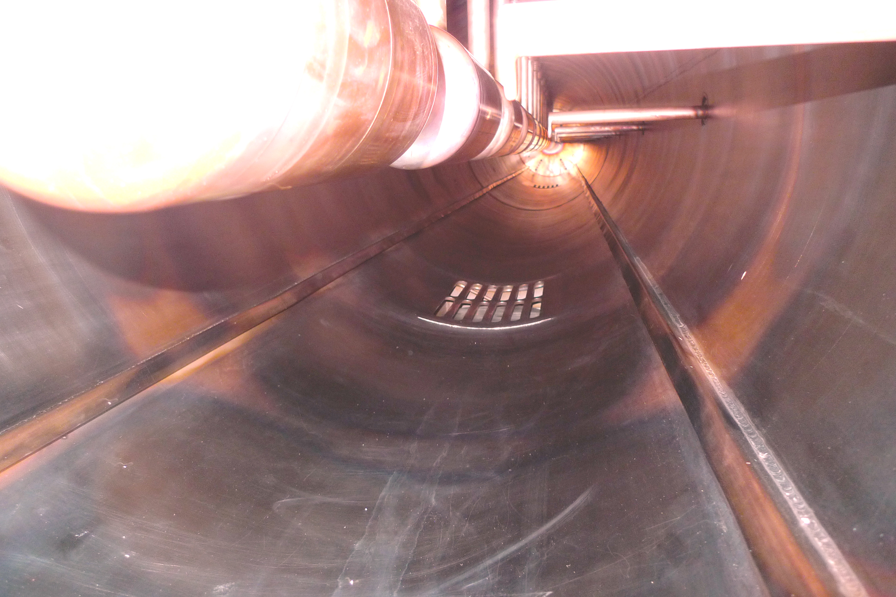
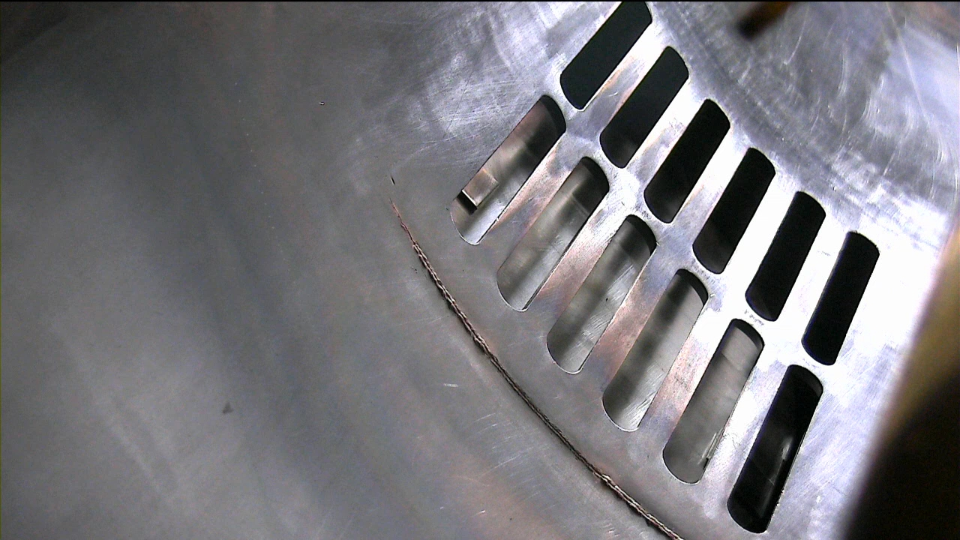
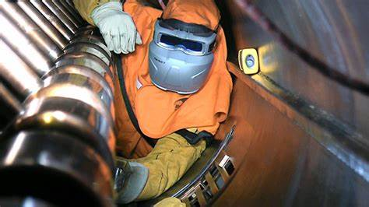
201 MHz RF Systems - DTL
All four 201 MHz RF systems were replaced between 2014-2021.
High reliability
The drift tube linac (DTL) has 15 vacuum grates that are welded into the inside of the tank. One braze failed and resulted in about 2 months of downtime to repair.
Required climbing into tank to copper weld – high hazard job
Recurring drift tube water leaks requiring repeated leak sealing.
DTL will be replaced in ~ 2032.

Slide 15
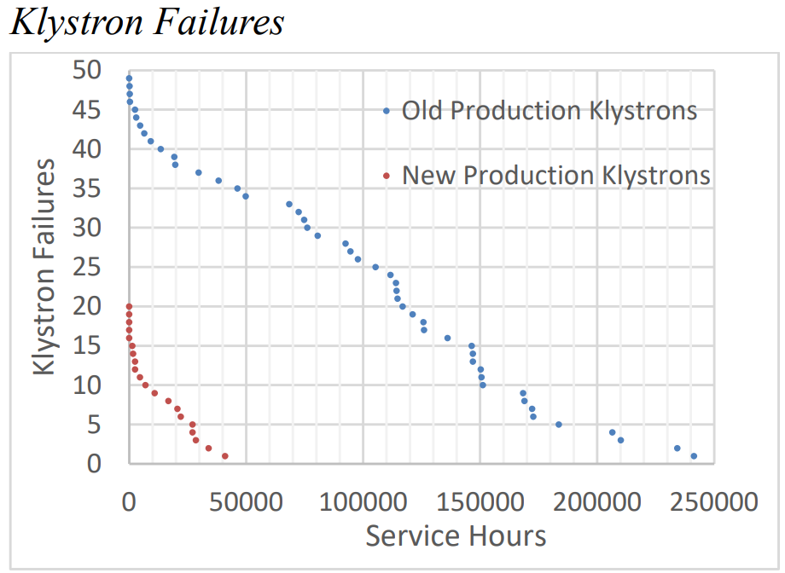
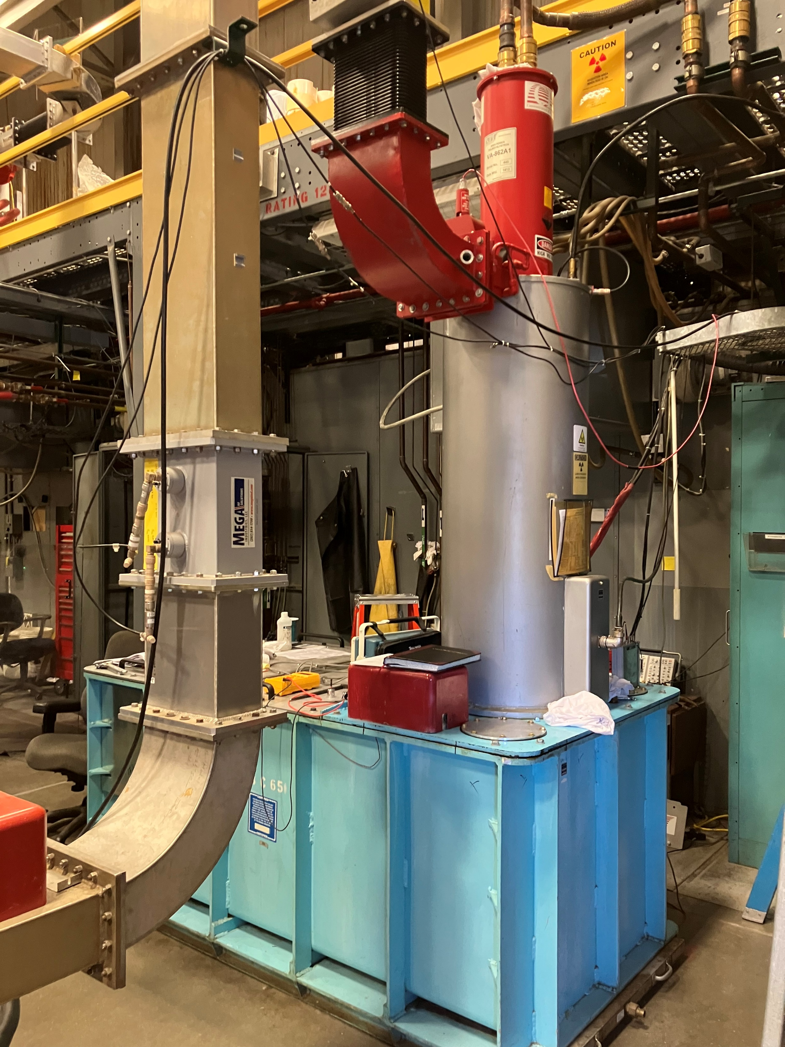
Coupled Cavity Linac and 805 MHz RF System
The coupled cavity accelerator structure remains reliable.
High failure rate and lack of spare klystrons continues to be an issue.
3-5 klystrons fail per run cycle - 2023 we depleted our spare inventory.
We didn’t operate at 800 MeV in 2024. We only operated at 100 MeV to IPF to conserve klystrons for high priority experiments in 2025.
It took about 2 years for our klystron vendor to ramp up production and provide a reliable stream of klystrons.
We will start the 2026 run cycle with 3 spare klystrons.
Analysis shows newer batches of klystrons sometimes fail earlier than older ones, with a notable number failing before accumulating typical service hours.
A klystron awaiting testing

Slide 16
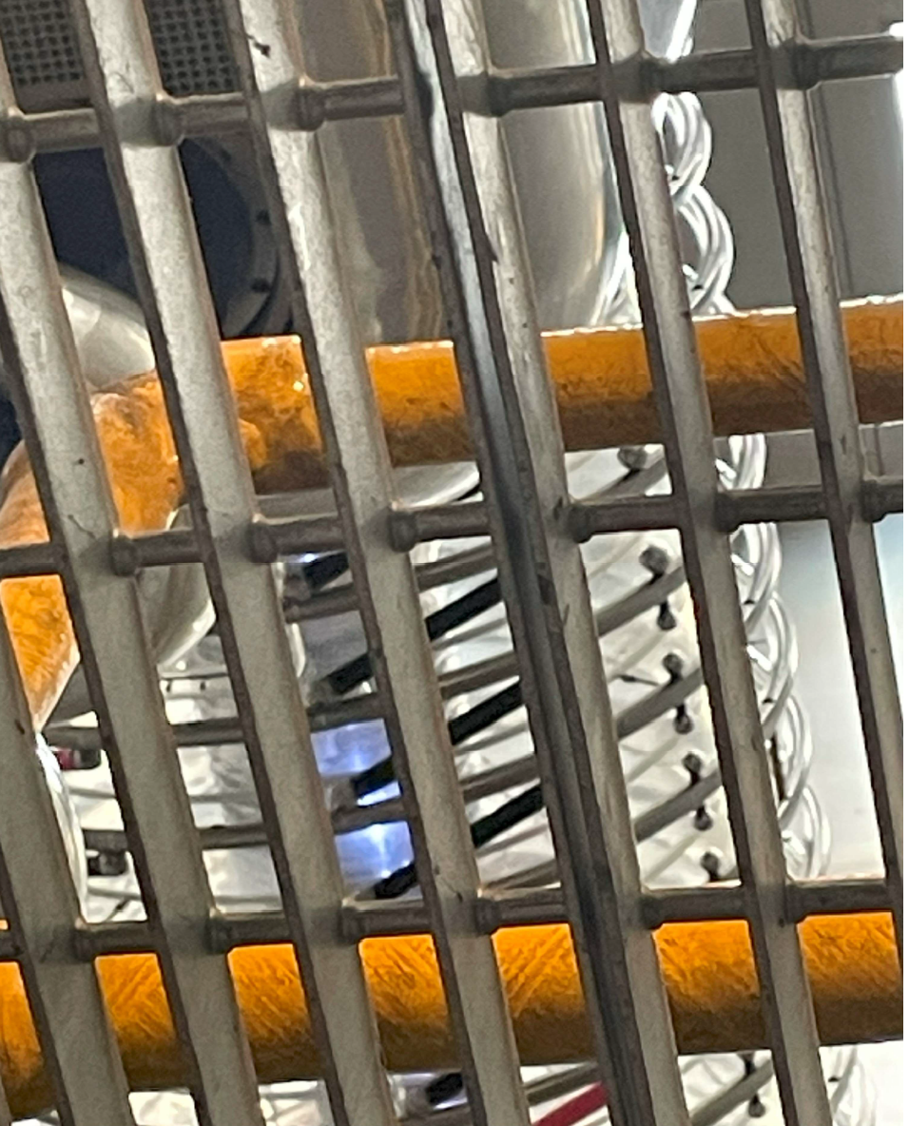
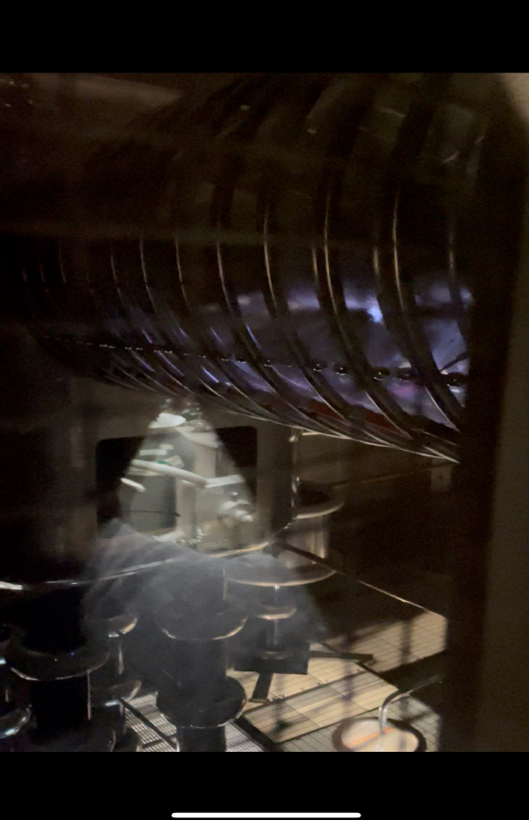
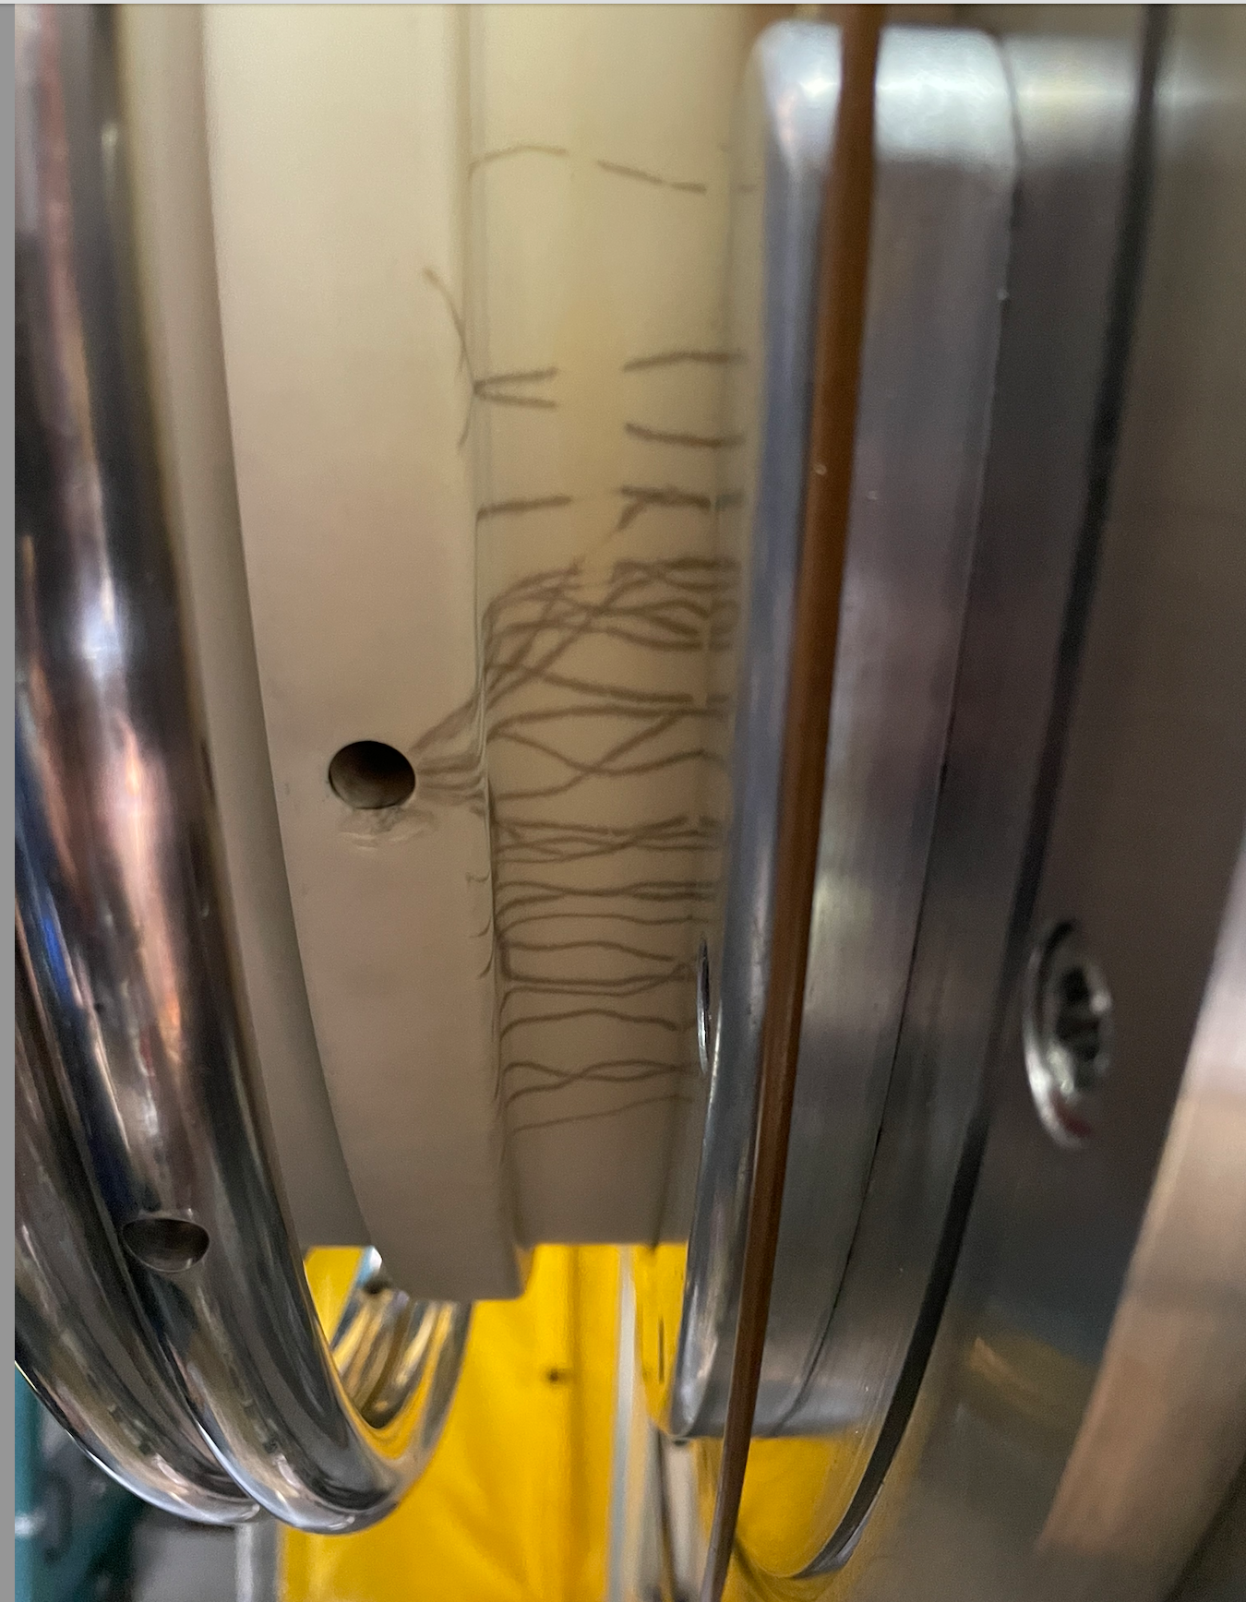
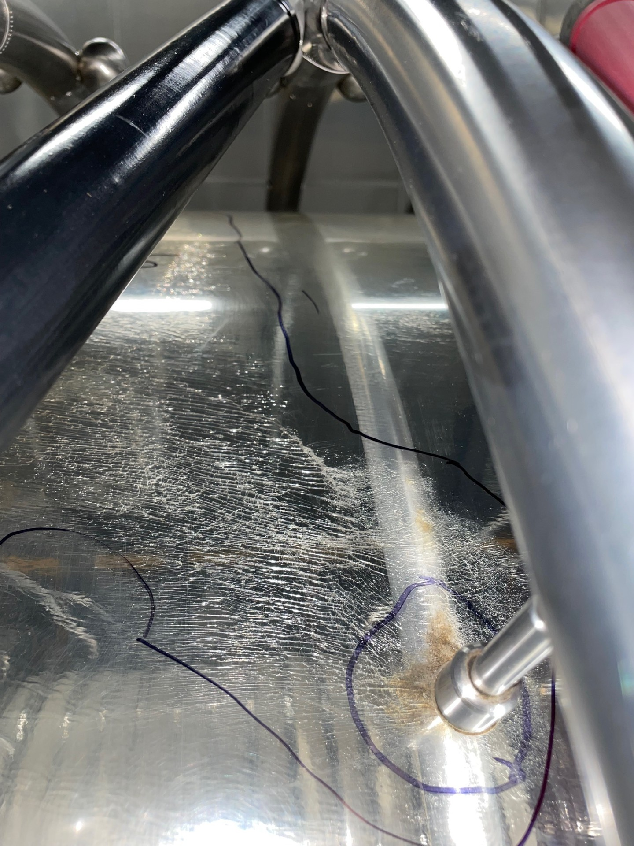
H+ Column Issues – Crazing, Arcing, Cleaning
Flashes of light are not good!
Arc marks on ceramic column.
During the 2026 outage, the column was removed for the 3rd time in two years for a deep polishing. We’re hoping that this resolves the problem!
Surface cracks on the inner surface of the LANSCE H+ High Voltage Jacket. The repair requires repolishing and takes multiple weeks.

Slide 17
Operating and maintaining a 50+ year old accelerator keeps us busy and provides some challenges
Our ability to maintain our nominal operating schedule has degraded over the past several years.
Components and systems continuously being replaced and upgraded.
Upgrades don’t always go as planned.
New and inexperienced employees
High turnover rates.
Perpetual training.
But more people allow us flexibility to to make process improvements.
Years of underfunding – but finally improving!
Now we have the money and are ramping up staffing – we just need some time to execute.

Slide 18
Process Improvements for the Future
LANSCE’s integrated Sustainment Strategy is built
on five interconnected plans
Asset
Mgmt.
Asset Management Plan
Risk Management Plan
Conduct of Engineering Plan
Training & Qualification Plan
Data Collection & Analysis Plan
Data Collection & Analysis
Risk
Mgmt.
10 Year Strategic Plan
Conduct of Engineering
Training & Qualification
Together, these plans create an integrated framework that ensures accelerator reliability, manages risk, upholds engineering standards, develops a skilled workforce, and delivers the performance insights needed to sustain and plan for safe, efficient, and mission-ready operations for decades to come.

