Slide 1
New Front-End Design Requirements for LANSCE Neutron Sources: LAMP’s Role in Sustaining High-Quality Beam to the Lujan 1L Target
Charles Taylor, representing the LAMP and LANE collaborations at the LANSCE facility
April 13st, 2026

Slide 2
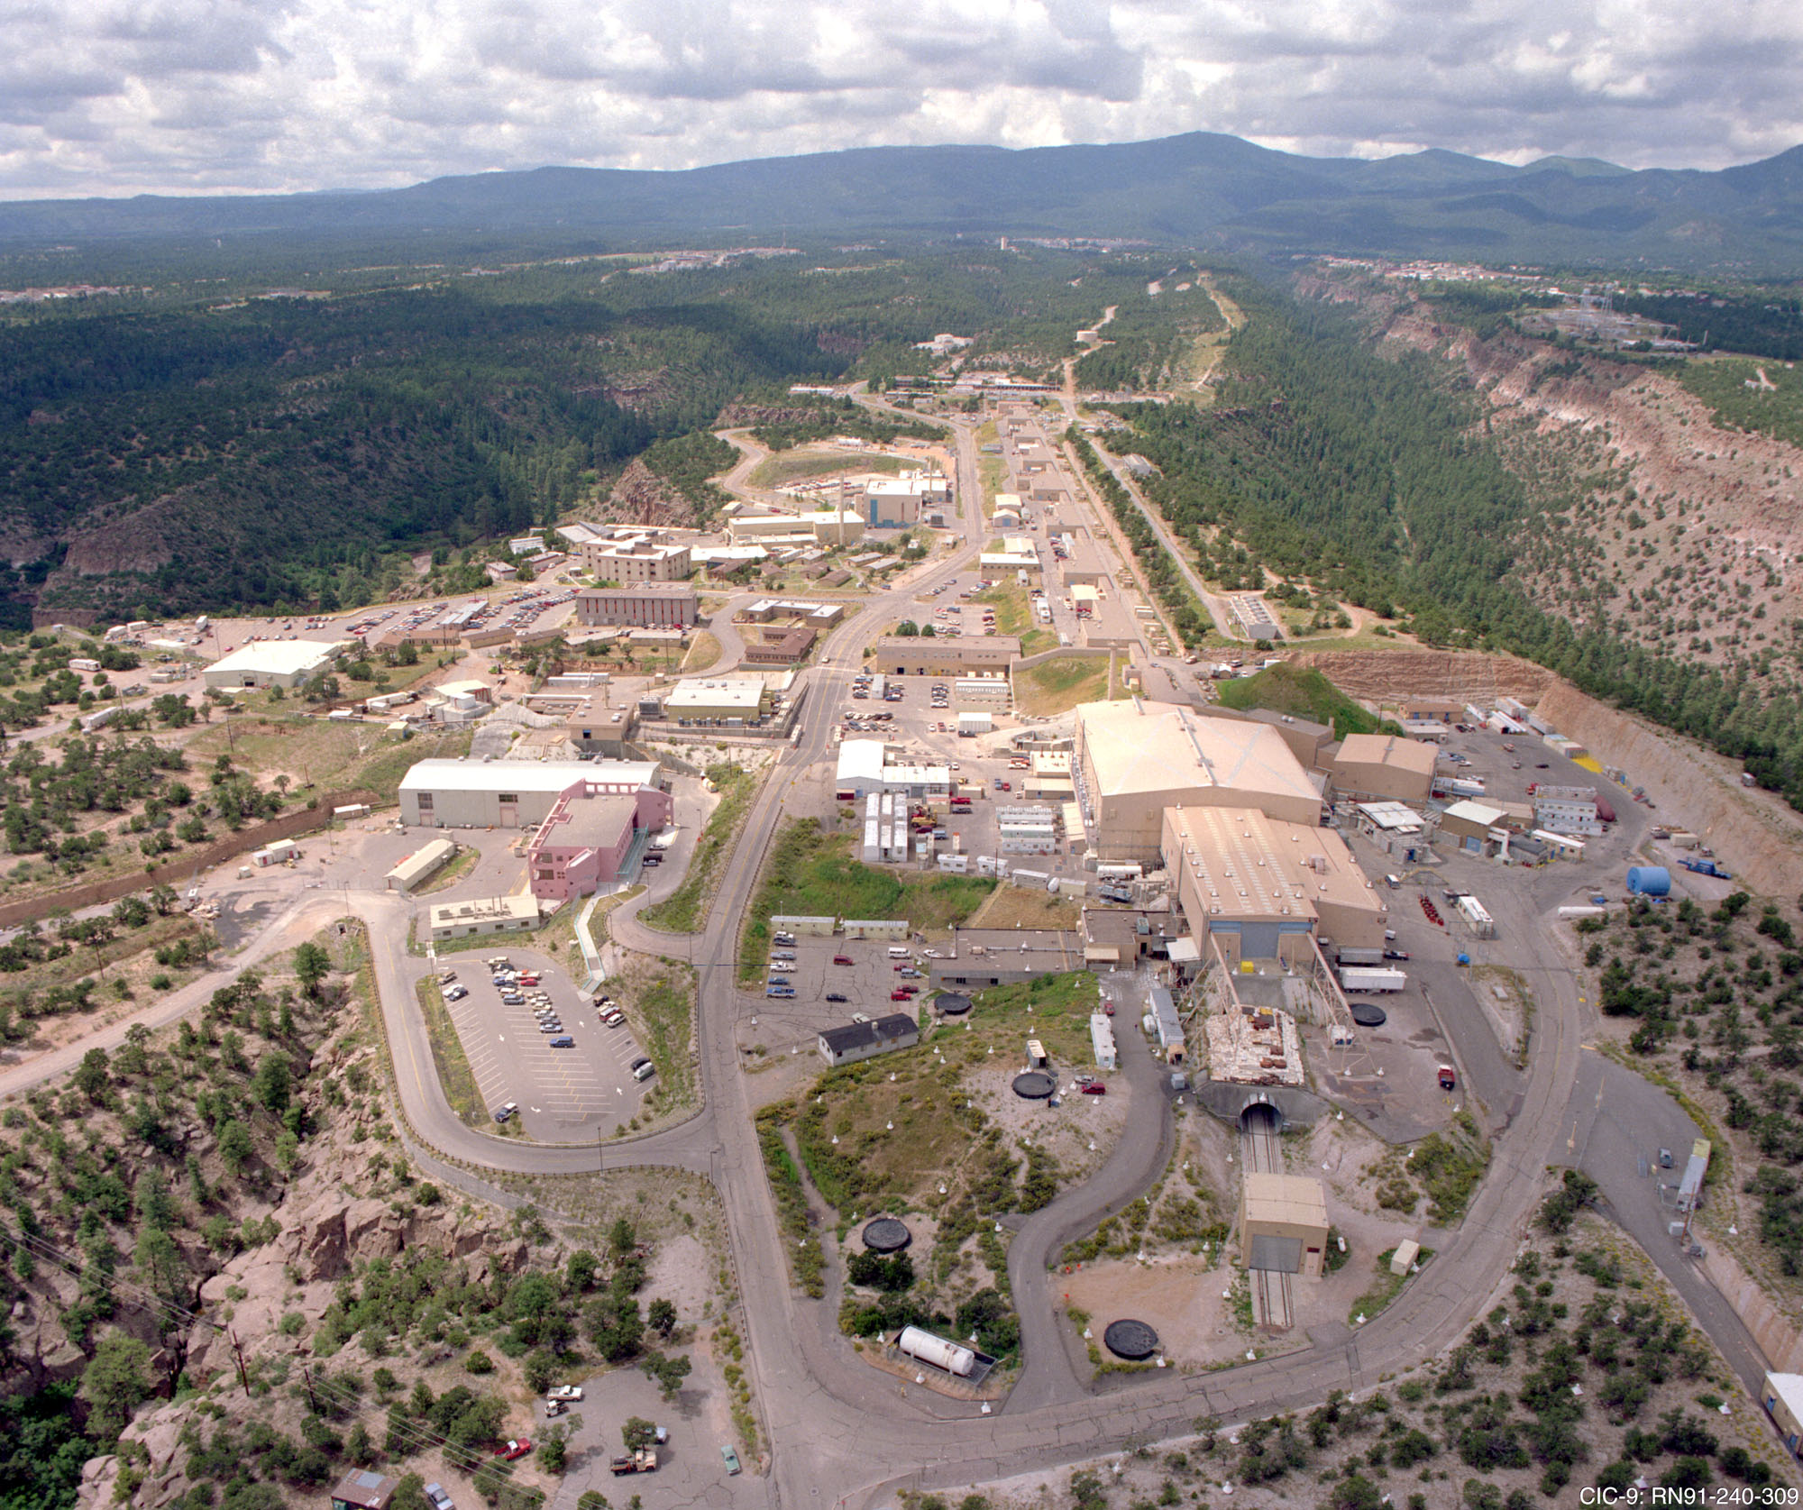
LANSCE Overview
The Los Alamos Neutron Science Center (LANSCE) accelerator facility has supported nation-wide science and technology programs for 50+ years
Historically delivers 800-MeV proton beams to six facilities simultaneously
Three major Department of Energy (DOE) Stakeholders:
Defense Programs (DP)
DOE Office of Science
Office of Nuclear Energy, Science and Technology (NE)
Studies at LANSCE include:
Nuclear weapons program
National security research
Radioisotope production
Basic science- (neutrino & dark matter searches)

Slide 3
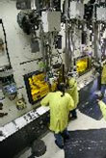
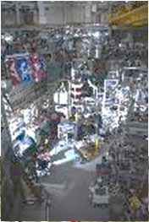
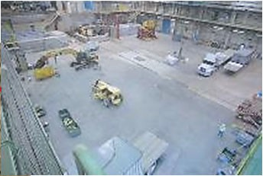
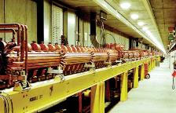
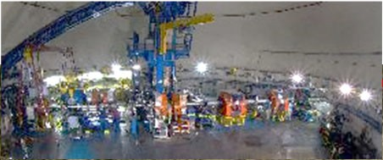
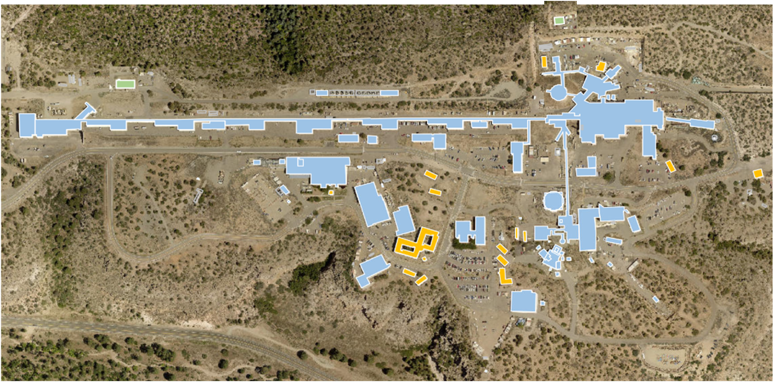
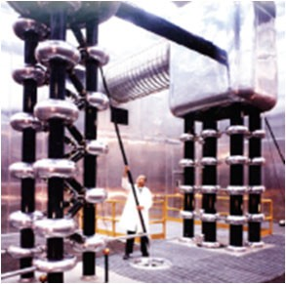
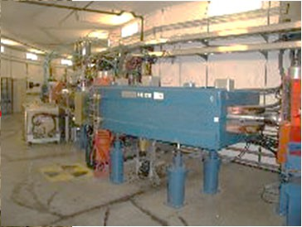
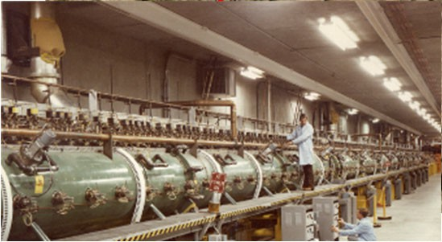
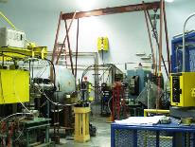
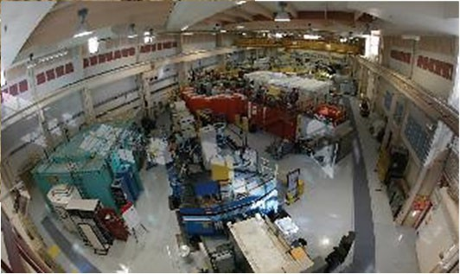
Ultracold Neutrons (DOE-SC-NP)
LANSCE overview and missions
Area A
Isotope Production (SC-IRDP, NA-11, -22, -ESH)
805-MHz Side-coupled linac (100-800 MeV)
Proton Radiography (NA-11, -12, -82)
~half-mile-long accelerator
Proton Storage Ring
H⁺, H⁻ injectors (750 kV)
Weapons Neutron Research (NA-11, -12, -82, -ESH, global
security, industry)
201.25-MHz Drift tube linac (to 100 MeV)
Lujan Center (NA-11, -19, -82, -ESH, DOE-NE, -SC-HEP)

Slide 4
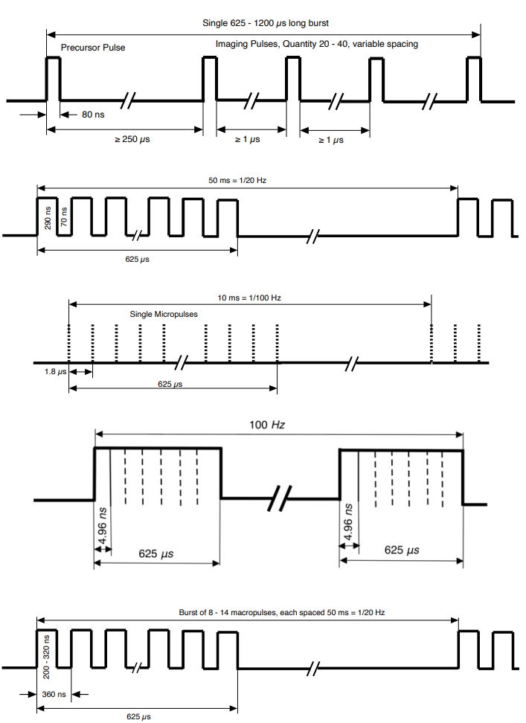
LANSCE has Unique Beam Capabilities for User Facilities
Simultaneous beam delivery to multiple user facilities
Dynamic beam sharing within a single accelerator cycle of 120 Hz operation
Dual-species operation (H⁺ and H⁻) with independent optimization
Flexible time structures: µs macropulses to ns bunches
Facility-specific beam tailoring (Lujan, WNR, pRad, IPF, UCN) Proton Storage Ring compresses pulses to 100–300 ns
Enables high-resolution neutron and radiography experiments
High flexibility comes with strong sensitivity to front-end performance
LANSCE’s uniqueness is not just beam power—it is the ability to deliver multiple, highly specialized beam formats at the same time.

Slide 5
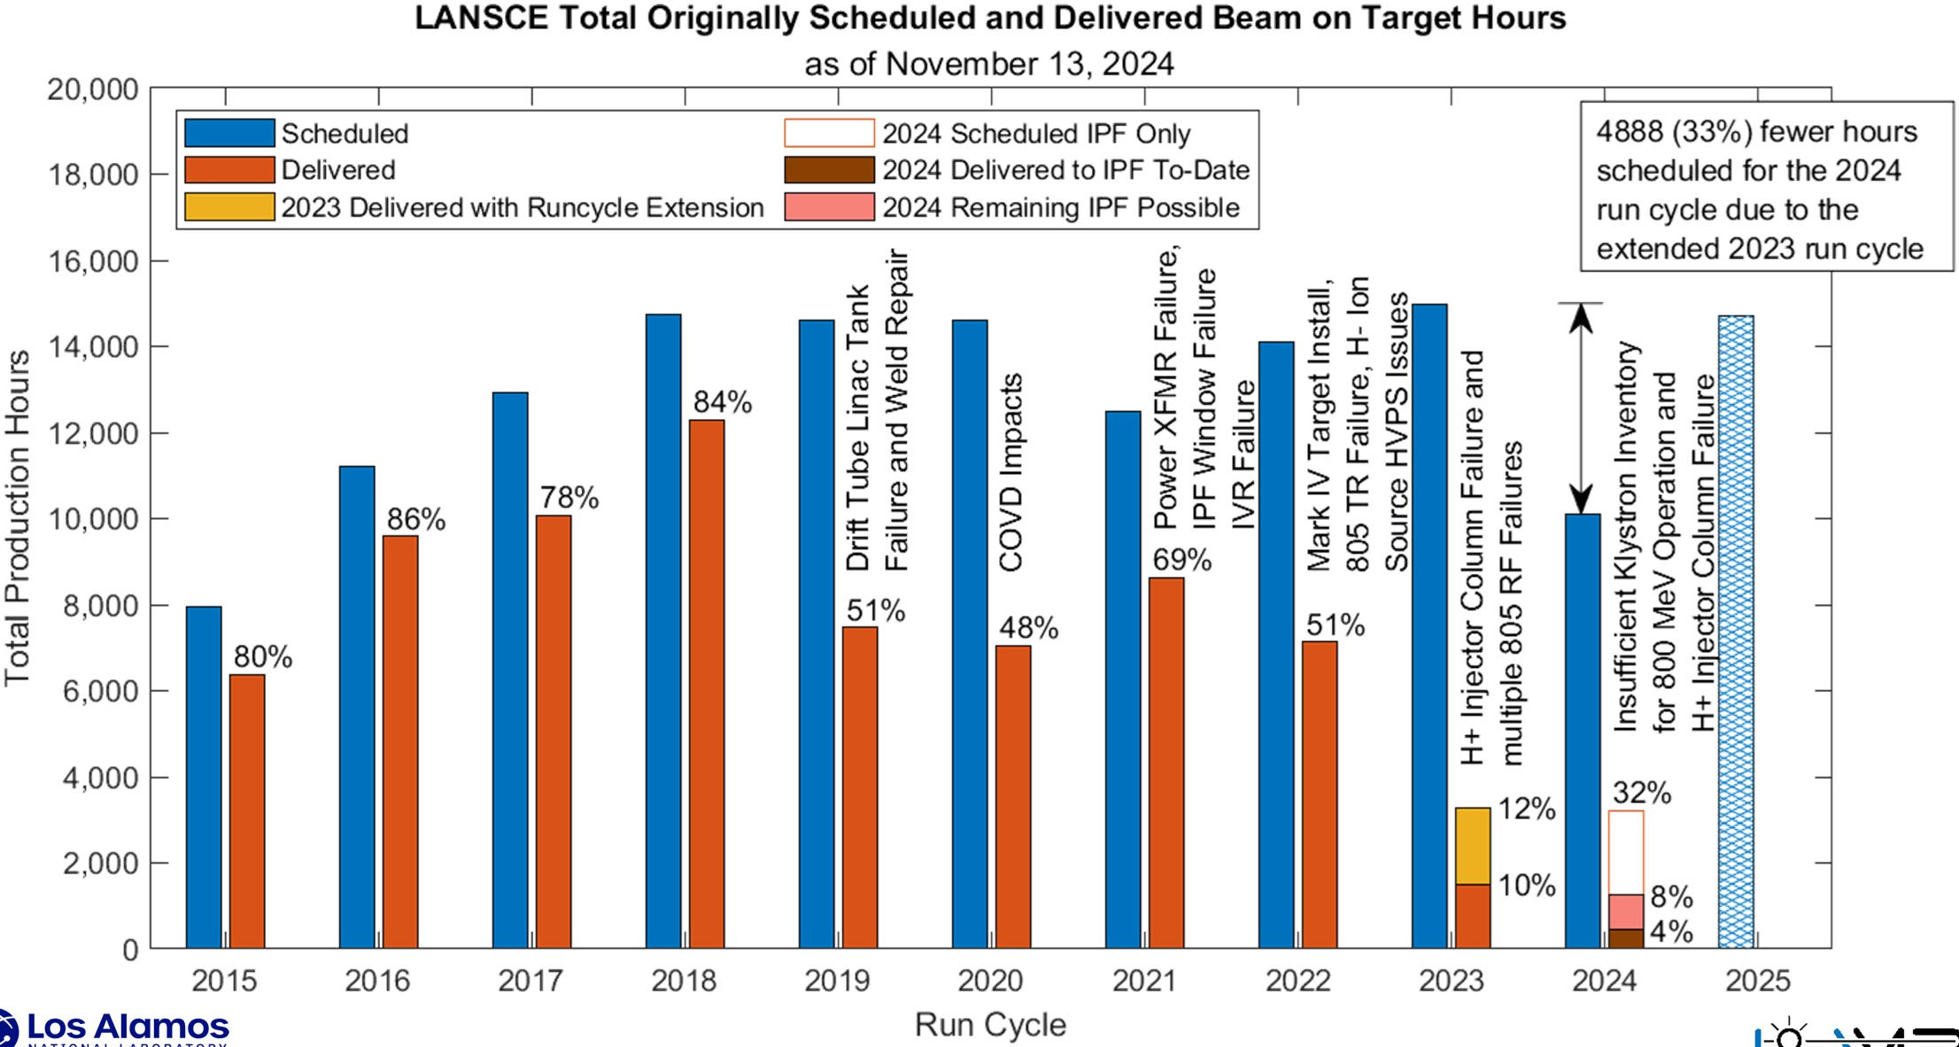
LANSCE Operational Challenges
Aging accelerator infrastructure
RF and klystron system failures
High Voltage Power Supply (HVPS) instability
Frequent beam trips and interruptions
Cooling water system leaks and inefficiencies
Vacuum system degradation
Run cycle inefficiencies
Obsolete components and spare parts shortages
Increasing operational risk
Reduced beam availability for users
Revision 0 of the Run Cycle

Slide 6
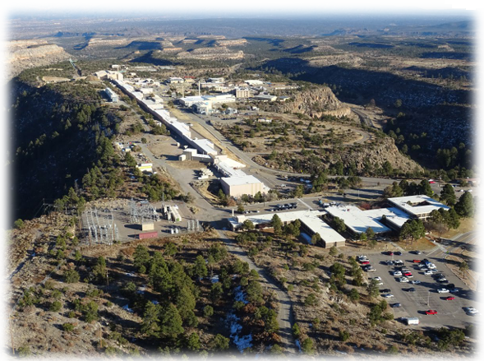
LANSCE Upgrades
LANSCE Upgrade Projects
LAMP: Modernizing the Foundation
Replaces aging front-end accelerator systems
Improves reliability and beam availability
Reduces single-point failures
Ensures operations through ~2050
Focused on sustaining existing mission capabilities
LAMP keeps LANSCE running for decades to come
LANE: Expanding the Mission Space
LANSCE Enhancements (LANE) initiative
Focused on advancing experimental capabilities
Driven by evolving NNSA mission needs
Potential expansion of:
Proton Radiography
Neutron science
Advanced materials diagnostics
Area A restoration
Positions LANSCE for next-generation national security challenges
LANE keeps LANSCE running for decades to come

Slide 7
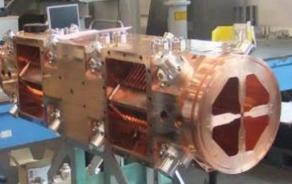
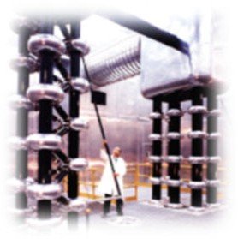
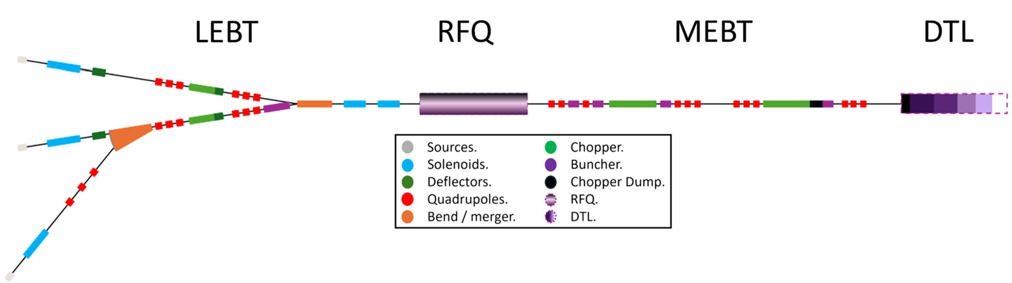
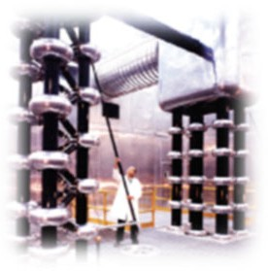
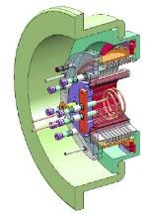
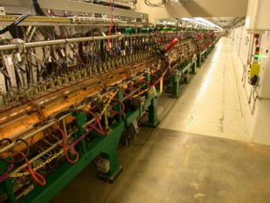


The project mandate is to keep the present machine capabilities with a modernized and more reliable front end
LANSCE Modernization Project (LAMP)
Radio Frequency Quadrupole (RFQ) 100 keV → 3 MeV
_{H}+
Existing Cockcroft-Waltons
35 keV → 750 keV
2 x (10 m x 15 m x 10 m)
_{H}-
Modern drift tube linac (SNS @ ORNL)
SNS H⁻ ion source
High reliability and uptime
High beam current
~ 250 mm Φ

Slide 8
LAMP Project Scope
Design & Technology Development
Front-end physics and engineering design spanning ion sources, LEBT, RFQ, MEBT, and DTL systems
Integration modeling to ensure beam delivery requirements are met for all user facilities (Lujan, WNR, UCN, IPF)
Technology maturation of critical systems including RFQ test stands, beam choppers, and diagnostics
Decommissioning (D&D) & Facility Preparation
Removal of legacy Cockcroft-Walton injectors and aging drift tube linac component
Digitization of the existing facility via large-scale point-cloud scanning to support removal and redesign
Conversion of scanned geometry into CAD models for installation planning and interference checks
Infrastructure preparation including integration with existing utilities, shielding, and facility constraints
Construction, Installation & Commissioning
Fabrication and installation of new RFQ-based injector and modern DTL systems
Integration of accelerator subsystems (RF, controls, diagnostics, vacuum, power)
Pre-installation verification testing and staged system validation prior to beam operations
Beam commissioning and ramp-up to meet operational requirements while maintaining existing mission capabilities

Slide 9
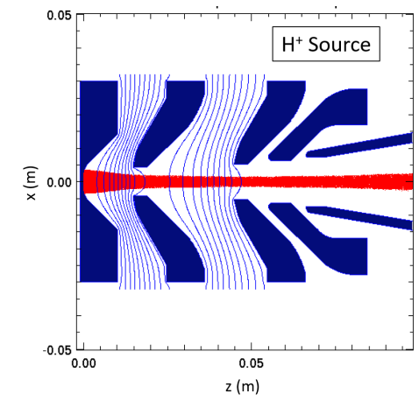
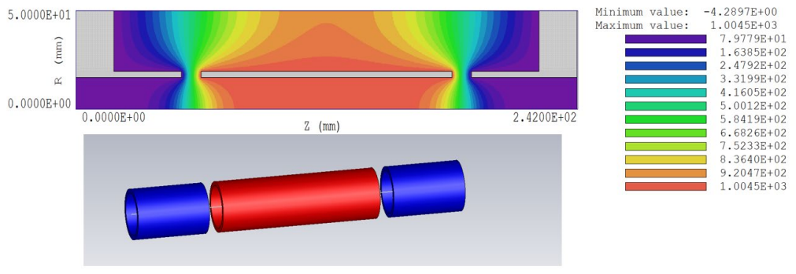
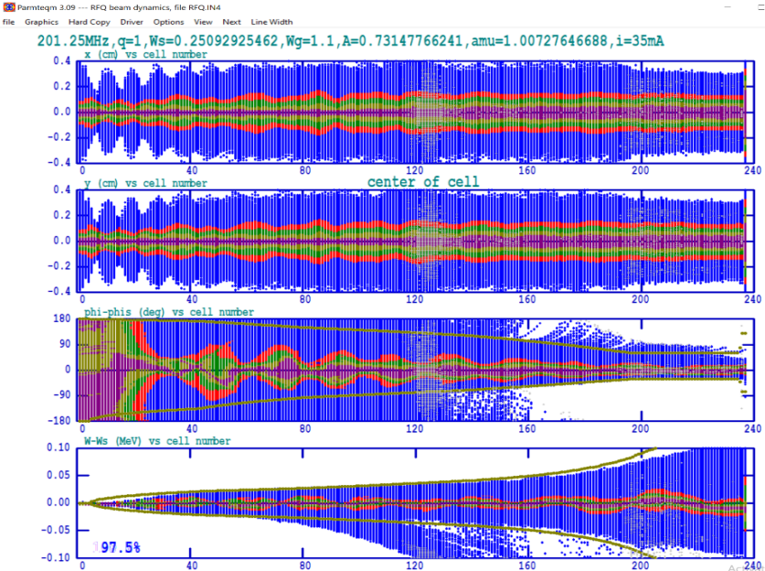
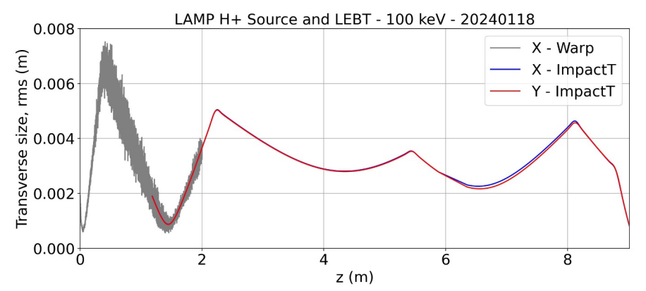
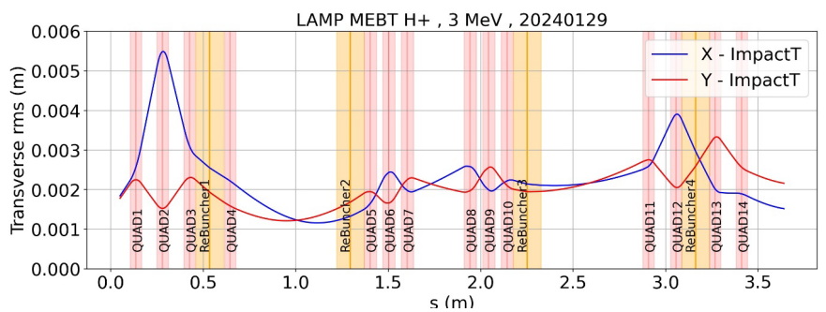
Preliminary Simulations of the LAMP Components
Model of low-frequency buncher for LAMP (16.67 MHz), re-designed for 100keV H- beam, [J. Upadhyay]
A transverse cut showcasing the model of the H+ source in Warp [S.I. Sosa Guitron]
The handshake between the RFQ and MEBT simulations. At the top, H+ beam at the end of the RFQ as calculated by Parmteq, at the bottom, the input beam read by Impact-T for the MEBT simulation. The RFQ was designed to output the same phase space distribution for both H+ and H- beams into the MEBT. This way, the MEBT can transport both species of beams
shows the longitudinal rms size as the initial beam is compressed with the LFB at z= 4.2 meters for MPEG-like beam [S.I. Sosa Guitron]
Transverse dynamics in the MEBT with H- beam [S.I. Sosa Guitron]
Simulation work presented in DOI:https://doi.org/10.2172/2315684 [LA-UR-24-21709]

Slide 10
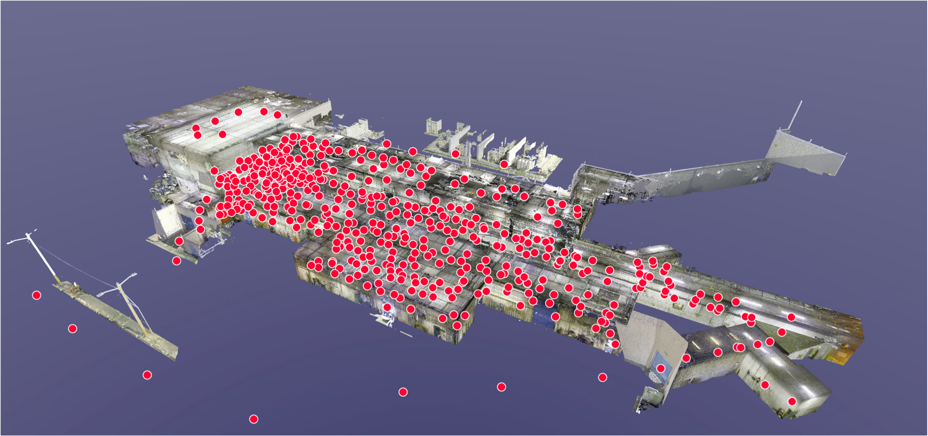
Published Point Cloud – 500 Scan Locations
Digitization of Existing Facility
Measurement of the facility and it sub-systems has been digitized
New point-cloud models are being used for D&D and upgrade model designs

Slide 11
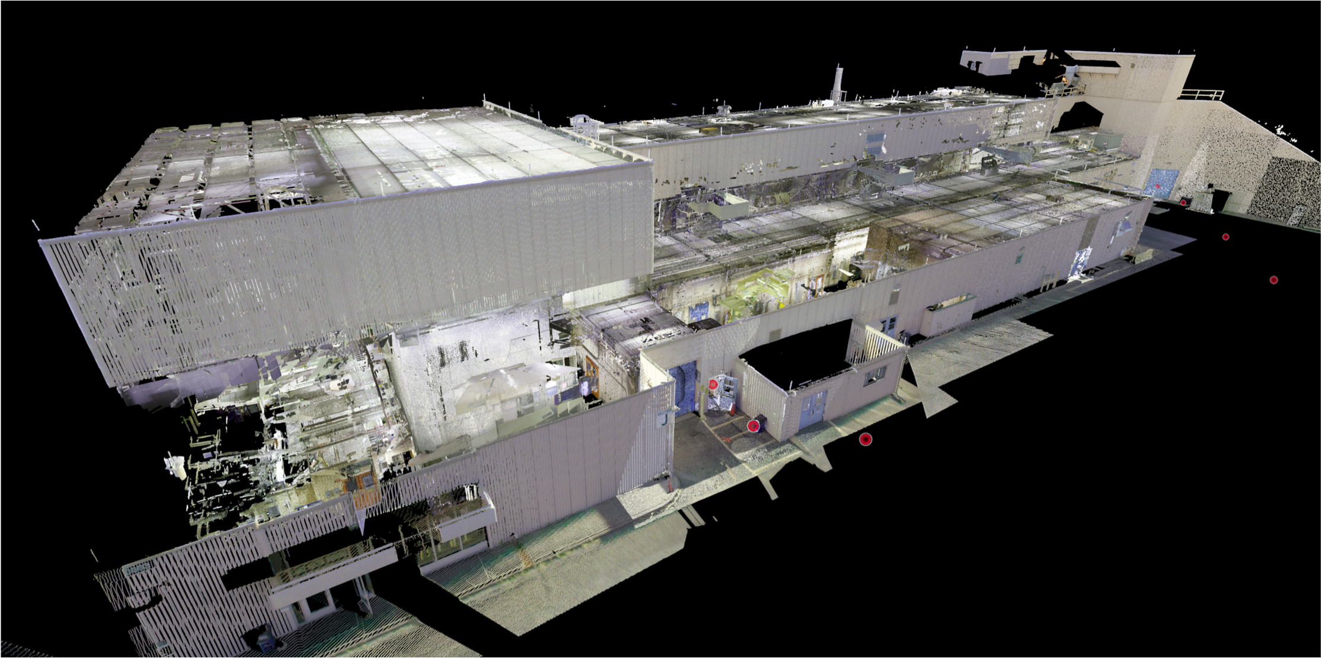
Published Point Cloud – LANSCE Front End
Nearly the entire facility has been scanned
Conversion to CAD models is underway
From LA-UR-25-31512

Slide 12
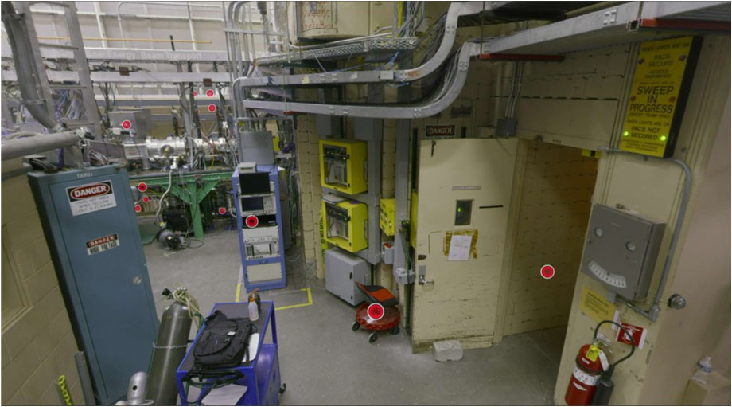
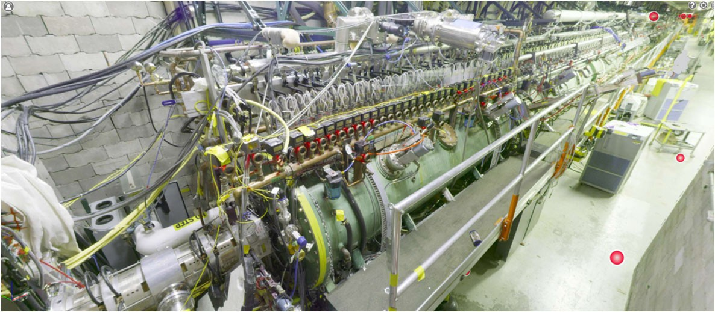
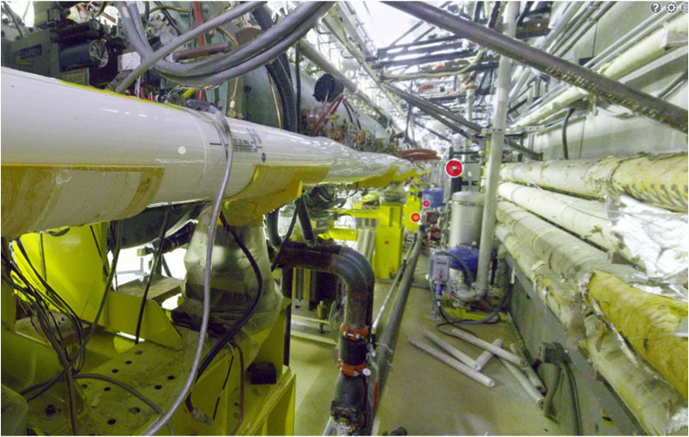
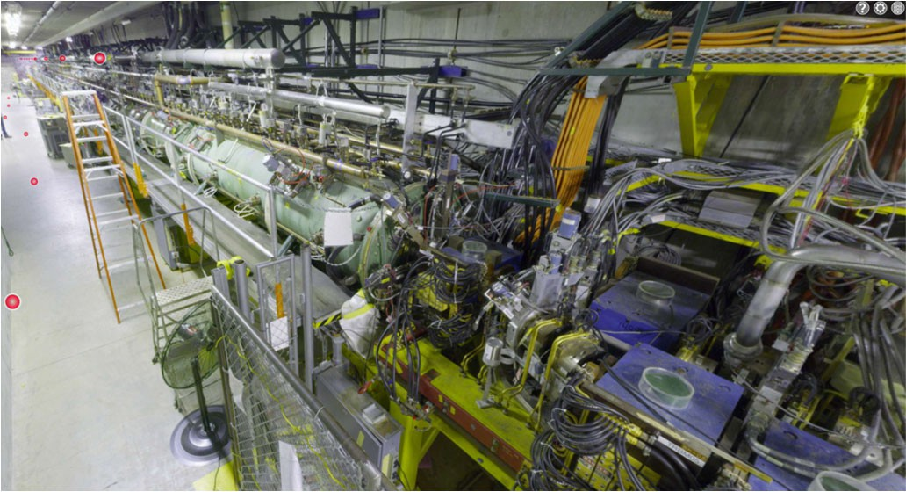

Recreated Beam Areas

Slide 13
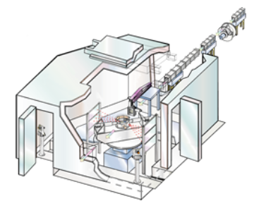
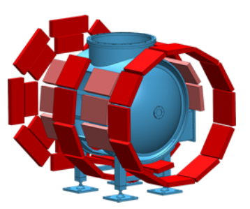
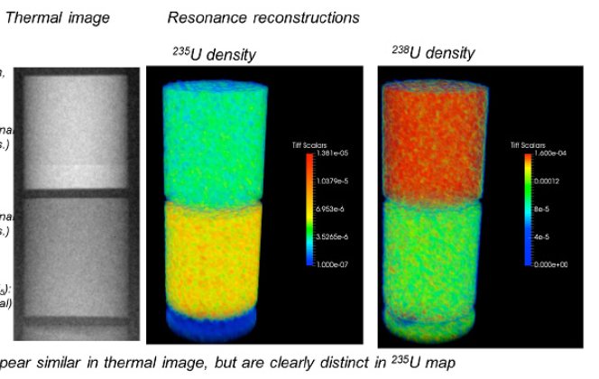
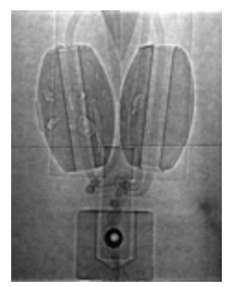
Lujan Requirement
High-Pressure-Preferred Orientation (HIPPO)
AP.25: Lujan1 (LBEG/PSR) Mpulse freq: 20 Hz |  | 100 µA at end station #µp/Mp: 102k
location | charge | cur(5ns) | assumed trans.
1L target | 49 pC | 9.8 mA | foil->end | 0.95
PSR.foil | 52 pC | 10.3 mA | TR->foil | 0.98
TR.entrance | 53 pC | 10.5 mA | DTL | 0.80
DTL.entrance | 66 pC | 13.2 mA | MEBT | 0.97
 |  |  | RFQ
MEBT.entrance | 68 pC | 13.6 mA | [Q/Q] | 0.95
 |  |  | LFB
RFQ.entrance | 72 pC | 14.3 mA | bonus | 1.00
LFB.entrance | 72 pC | 14.3 mA | LEBT | 0.98
H– source | 73 pC | 14.6 mA
Spectrometer for Materials Research at Temperature and Stress (SMARTS)
*transmission assumptions based on experimental measurements or simulations
LAMP design shall provide a H- beam at the Lujan Center 1L target with the following characteristics: 100 µA average beam current, structured as 120-nsec (FWHM) pulses at 20 Hz.
Energy Resolved Neutron Imaging (ERNI)
Asterix

Slide 14
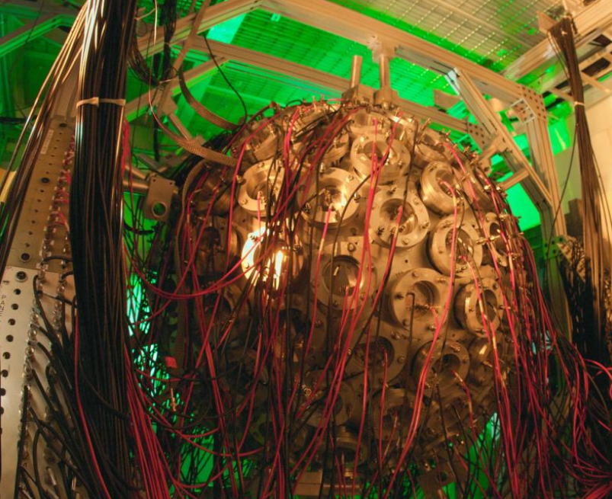
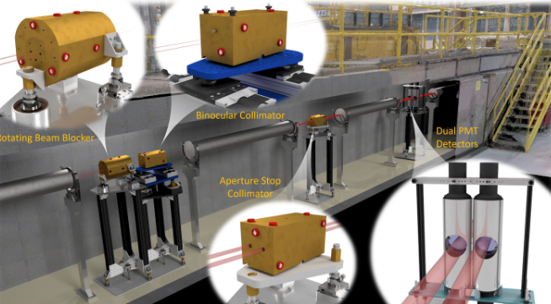
WNR Requirement
AP.35: WNR1 (MPEG) Mpulse freq: 100 Hz |  | 4 µA at end station #µp/Mp: 347
location | charge | cur(5ns) | assumed trans.
Target 4 | 115 pC | 23.0 mA | TR->end | 0.90
TR.entrance | 128 pC | 25.6 mA | DTL | 0.80
DTL.entrance | 160 pC | 32.0 mA | MEBT | 0.90
 |  |  | RFQ
MEBT.entrance | 178 pC | 35.6 mA | [Q/Q] | 0.70
 |  |  | LFB
RFQ.entrance | 254 pC | 50.8 mA | bonus | 1.70
LFB.entrance | 149 pC | 29.9 mA | LEBT | 0.98
H– source | 152 pC | 30.5 mA
Detector for Advanced Neutron Capture Experiments (DANCE)
LAMP design shall provide a H- beam at the WNR target 4 with the following characteristics: 4 µA average beam current, structured as 625-µsec (FWHM) trains of individual pulses separated by 1.8 µsec.
Device for Indirect Capture Experiments on Radionuclides (DICER)

Slide 15
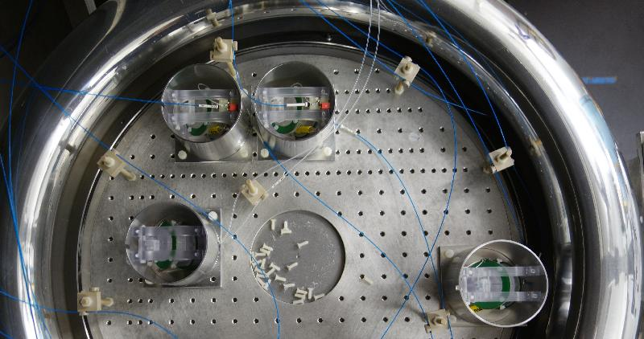
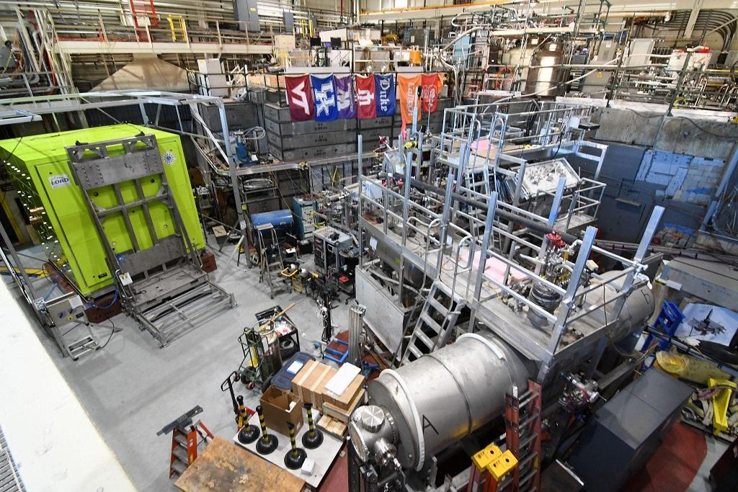
UCN Requirement
AP.50: UCN #Mpulse/5sec: | 10 | 10 µA at end station #µp/Mp 126k
location | charge | cur(5ns) | assumed trans.
Target | 40 pC | 8.0 mA | TR->end | 0.97
TR.entrance | 41 pC | 8.2 mA | DTL | 0.80
DTL.entrance | 51 pC | 10.2 mA | MEBT | 0.97
 |  |  | RFQ
MEBT.entrance | 53 pC | 10.6 mA | [Q/Q] | 0.95
 |  |  | LFB
RFQ.entrance | 56 pC | 11.1 mA | bonus | 1.00
LFB.entrance | 56 pC | 11.1 mA | LEBT | 0.98
H– source | 57 pC | 11.3 mA
LAMP design shall provide a H- beam to LANSCE line B, UCN facility, with the following characteristics: 10 µA average beam current, nominally 9–11 pulses of 625-µsec width, at 20 Hz every 5 seconds.

Slide 16
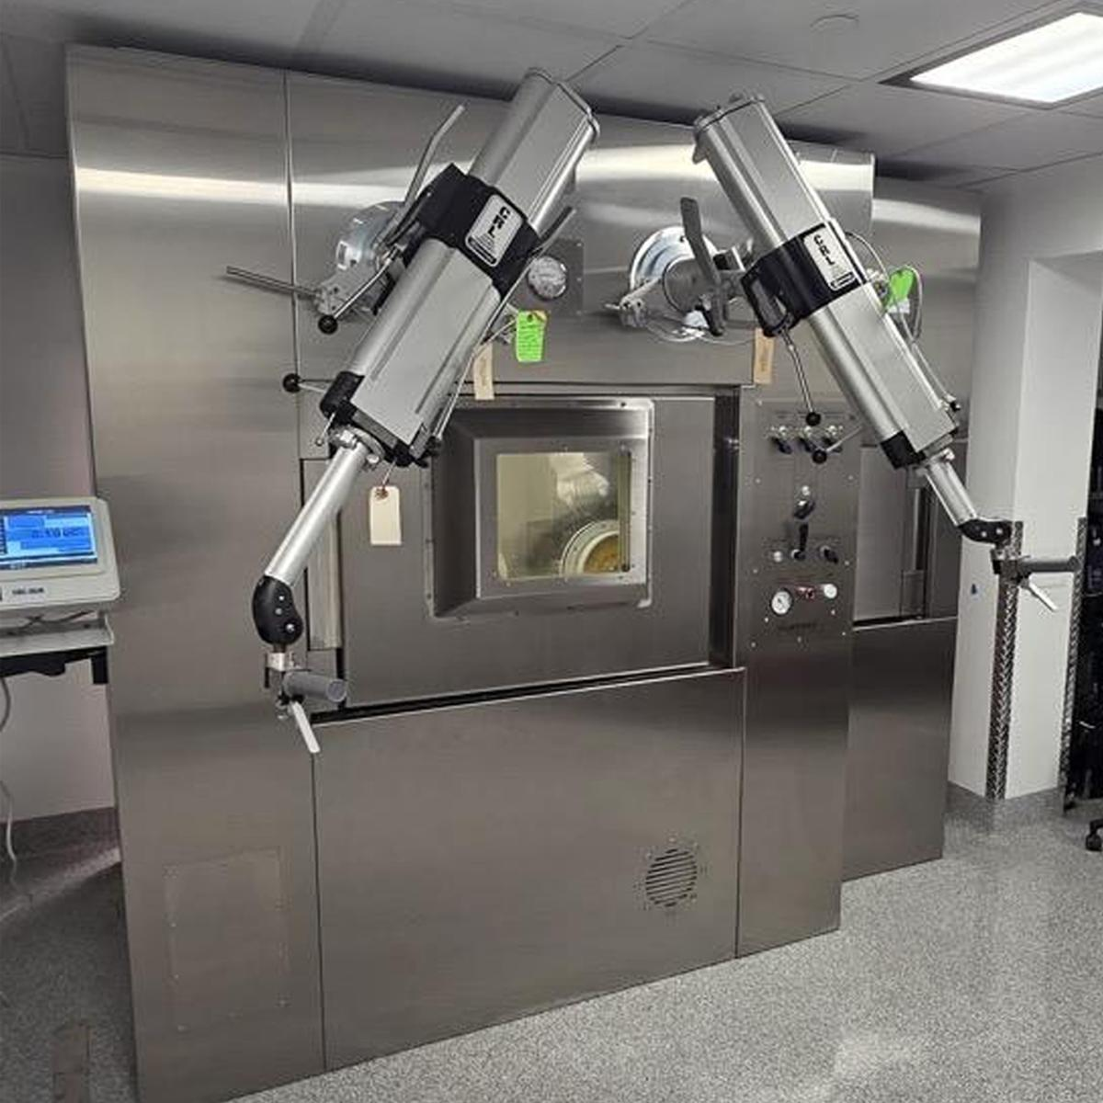
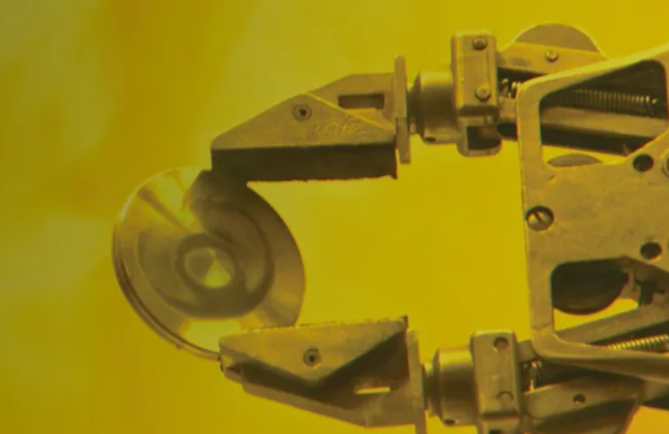
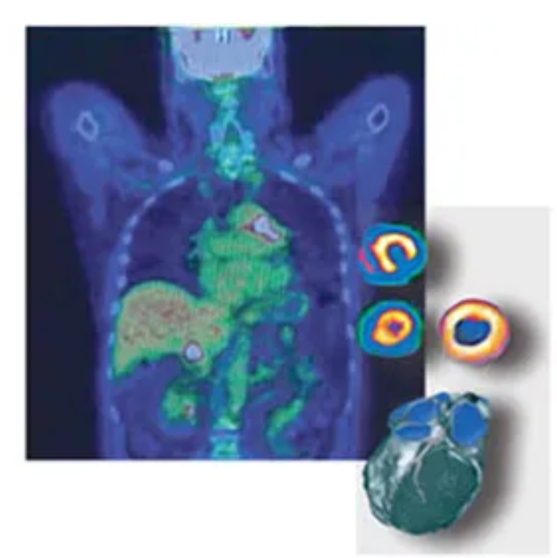
IPF Requirement
AP.60: IPF Mpulse freq: | 100 Hz | 250 µA at end station #µp/Mp: |  | 102k
location | charge | cur(5ns) | assumed trans.
end station | 25 pC | 4.9 mA | TR->end | 0.95
TR.entrance | 25 pC | 5.2 mA | DTL | 0.97
DTL.entrance | 26 pC | 5.3 mA | MEBT | 0.97
MEBT.entrance | 27 pC | 5.5 mA | RFQ [Q/Q] | 0.95
RFQ.entrance | 29 pC | 5.8 mA | LFB bonus | 1.00
LFB.entrance | 29 pC | 5.8 mA | LEBT | 0.98
H– source | 29 pC | 5.9 mA
LAMP design shall provide a H+ beam to IPF (Isotope Production Facility), with the following characteristics: 250 µA average beam current, structured as 625-µsec pulses.
H+ is its own source, and consistently lower emittance than H–. We adopted LBEG transport for much of H+ design work.

Slide 17
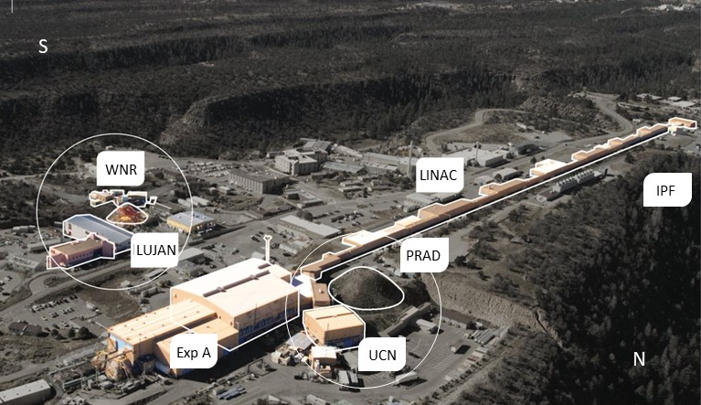
LANSCE Upgrades
LANE proposes to update LANSCE capability to enhance alignment with NNSA future directions
Proton Radiography (pRad Facility)
Dynamic imaging providing focused weapons physics data for models & simulations
Lujan Neutron Scattering Center (Lujan Center)
Materials characterization supporting aging, manufacturing, and performance as well as nuclear energy
Nuclear physics for defense programs
Weapons Neutron Research Facility (WNR)
Nuclear physics serving weapons assessments, counterproliferation, and criticality safety
Electronics testing for industry and global security
Isotope Production Facility (IPF)
Medical and other isotopes for the isotope program
Short-lived isotopes for defense programs, non-/counterproliferation, and criticality safety
Ultra-Cold Neutron Facility (UCN)
Unique probe for nuclear physics, possible future defense program uses
LANSCE
NNSA work
Key program drivers
100-800 MeV proton energies
Six target stations (three neutron spallation targets)
Sixteen beam lines (including future capability expansion in Area A)
LINAC = “Linear Accelerator”
17

Slide 18

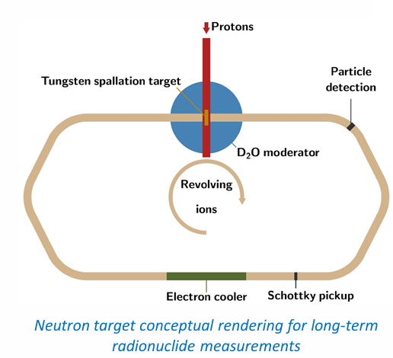
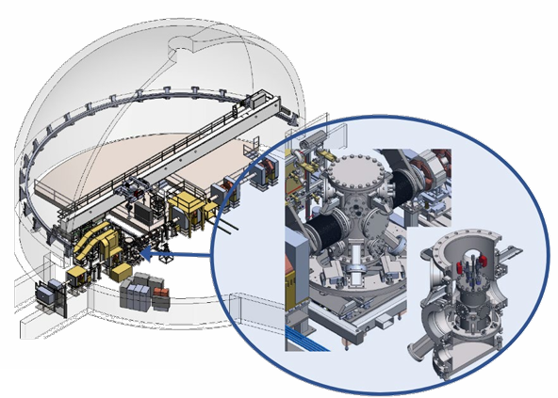
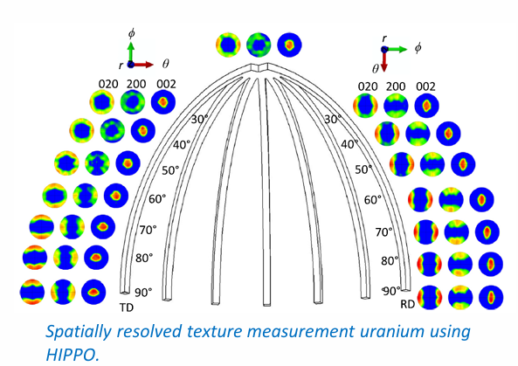
LANE Project Scope
Dynamic Imaging
Multi-pulse x-ray source for pRad
Additional proton radiography beamline in LANSCE Area A
Additional drivers and diagnostics
pRad energy upgrade
Materials Characterization
Dedicated beam line for classified experiments
New multi-probe flight path for imaging and bulk characterization
Compact x-ray source for small scale, hazardous, classified experiments.
Materials Characterization
Expanded WNR capabilities for radioactive targets
Partnering with Isotope Production Facility for improved targetry
A neutron target facility to measure short-lived isotopes

Slide 19
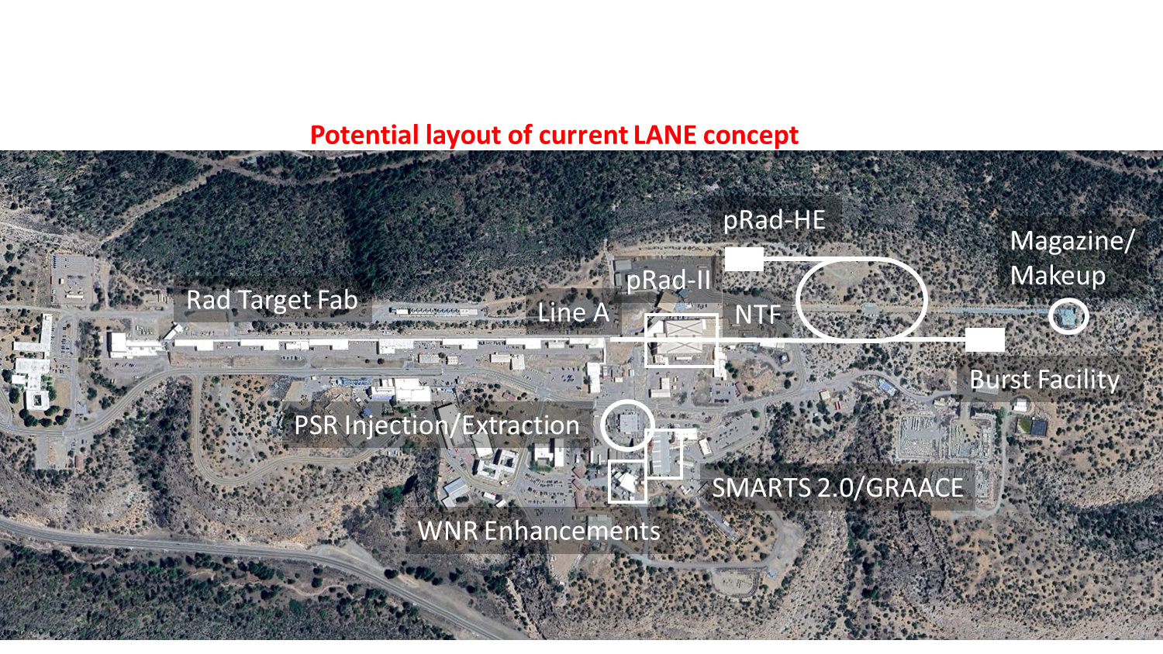
LANSCE Upgrades
LANE would add NNSA mission driven capabilities

Slide 20
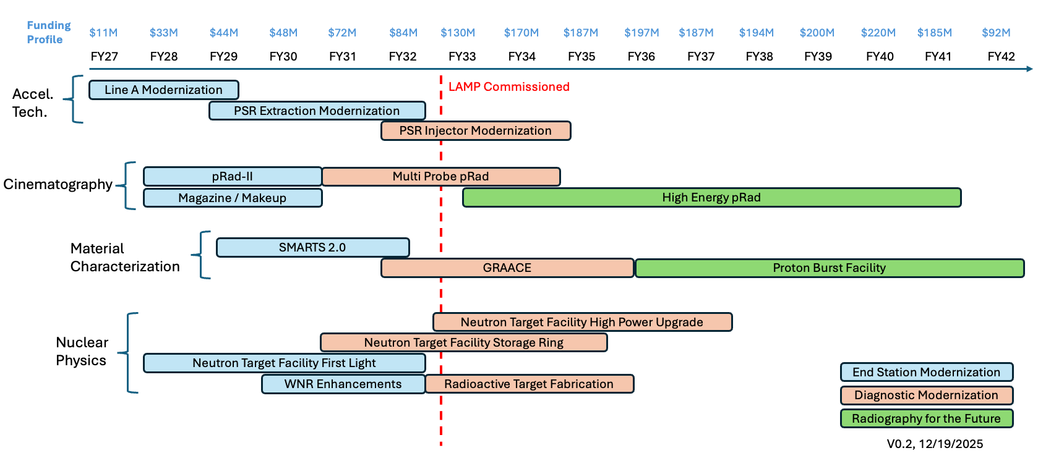
LANSCE Upgrades
LANE uses a phased approach to implement upgrades
Potential enhancements in current LANE concept

Slide 21
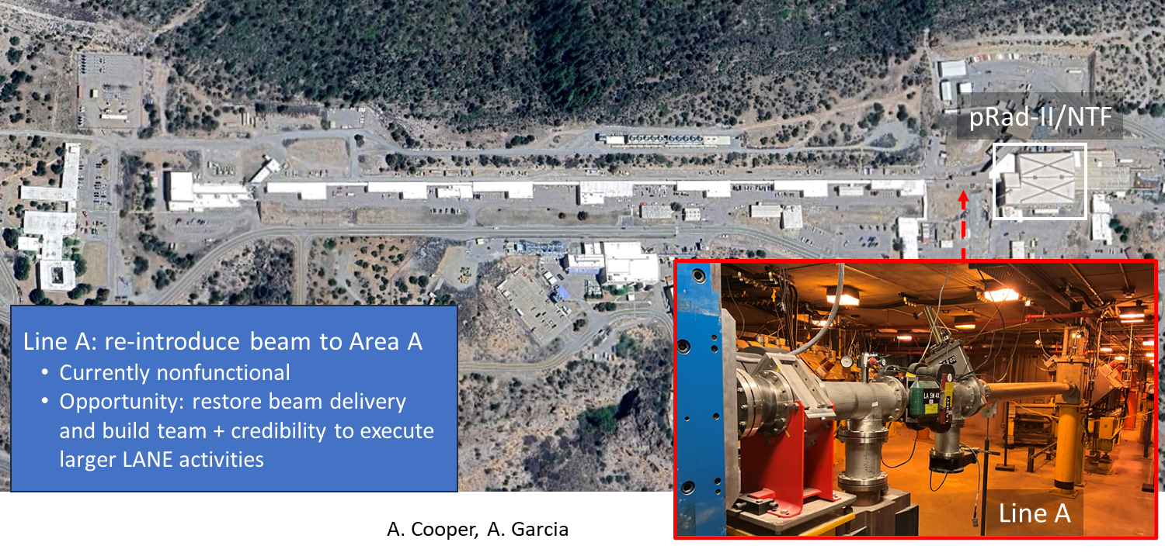
LANSCE Upgrades
Line A Modernization paves the way for LANE activities

Slide 22
Summary
LAMP Objective Requirements are to achieve the desired operational conditions
Replaces aging front-end systems to reduce failures, downtime, and operational risk
Establishes a modern RFQ-based injector and upgraded DTL for improved beam quality and stability
Eliminates single-point failures and addresses obsolescence in critical infrastructure
Enables consistent delivery of complex beam structures required by Lujan, WNR, UCN, IPF, and pRad
Supports ~5,300 annual beam hours with improved reliability and maintainability
Preserves current mission capabilities while extending operational lifetime through ~2050Provides a stable foundation for future upgrades and integration with LANE enhancements
LANE Objectives are Currently be Scoped this Fiscal Year
Expands LANSCE experimental capabilities by enabling next-generation beamlines, diagnostics, and user facilities aligned with evolving NNSA mission needs
Positions LANSCE for future mission growth through enhanced performance, flexibility, and restoration/expansion of experimental areas such as Area A

Slide 23
Questions?

Slide 24
Backup Slides

Slide 25

The LANSCE Complex
Ultra-Cold Neutrons
N
Isotope Production Facility
H⁺
201.25-MHz 100-MeV Drift Tube Linac
Proton Radiography
750-keV Cockcroft-Walton Injectors
Chopper
Kicker
Transition Region
80—MHz 800-MeV Coupled Cavity Linac
Area A
(currently inactive)
H⁻
Isotope Production Facility (IPF)
High-current (100 MeV H⁺) beam for medical and national security isotope production
Emphasis on reliability and sustained beam current
Proton Radiography (pRad)
High-energy proton imaging for dynamic experiments (e.g., hydrodynamics)
Requires precisely structured burst-mode beam delivery
Ultra-Cold Neutron (UCN) Facility
Fundamental physics experiments using moderated neutron beams
Requires specialized low-duty-factor beam delivery
Lujan Neutron Scattering Center (1L target focus)
Pulsed spallation neutron source for materials science, nuclear energy, and weapons-relevant studies
Requires high-quality, well-defined pulse structure and stable beam delivery
Weapons Neutron Research (WNR)
Operates with micropulse structures (µs spacing) and flexible timing modes
Broad-spectrum neutron source for nuclear data, cross sections, and radiation effects
Lujan Center
Proton Storage Ring
ER-1
Target 2
Target 1
Target 4
A. L. Cooper et al., High-intensity, low-energy heavy ion source for a neutron target proof-of-principle experiment at LANSCE, LA-UR-23-31433 (2024).

