Slide 1



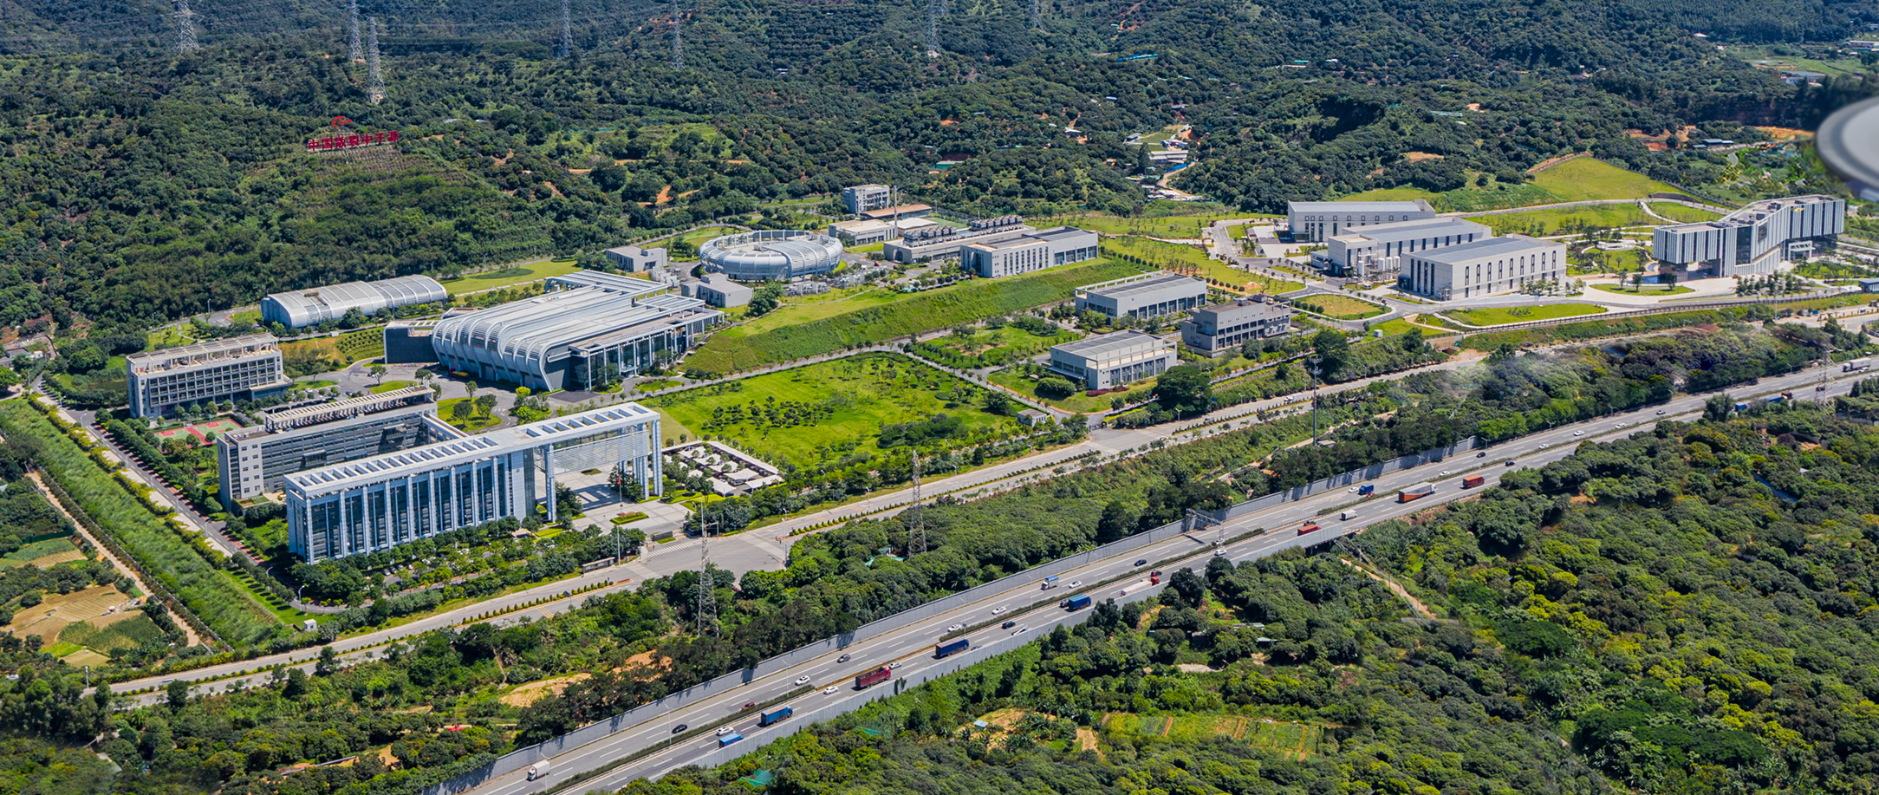
Status of CSNS Neutron Instruments
Tianjiao Liang
China Spallation Neutron Source (CSNS)
Institute of High Energy Physics， Chinese Academy of Sciences
ICANS XXV meeting, Malmö, Sweden, Apr. 13, 2026

Slide 2
Outline
CSNS Instrument Suite
Powder & single crystal diffractometers
Large scale instruments
Inelastic spectrometers
Industry application and nuclear technique
Summary

Slide 3
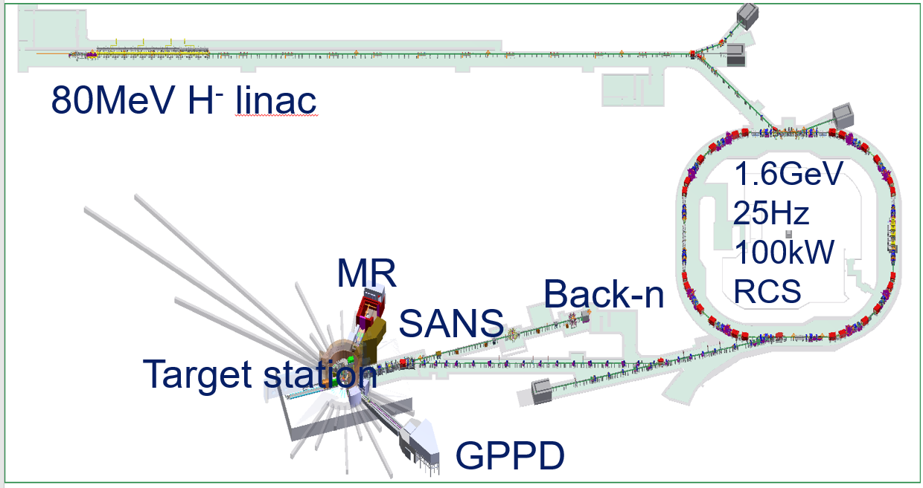
China Spallation Neutron Source
Layout of CSNS-I
CSNS-I (2011-2018)：Accelerator and target station 100kW, 3 instruments.
CSNS-CI (2018-2025)：8 instruments，trial or open to user.
CSNS-II (2024-2029)：Accelerator and target station 500kW, 11 instruments & station.
3

Slide 4
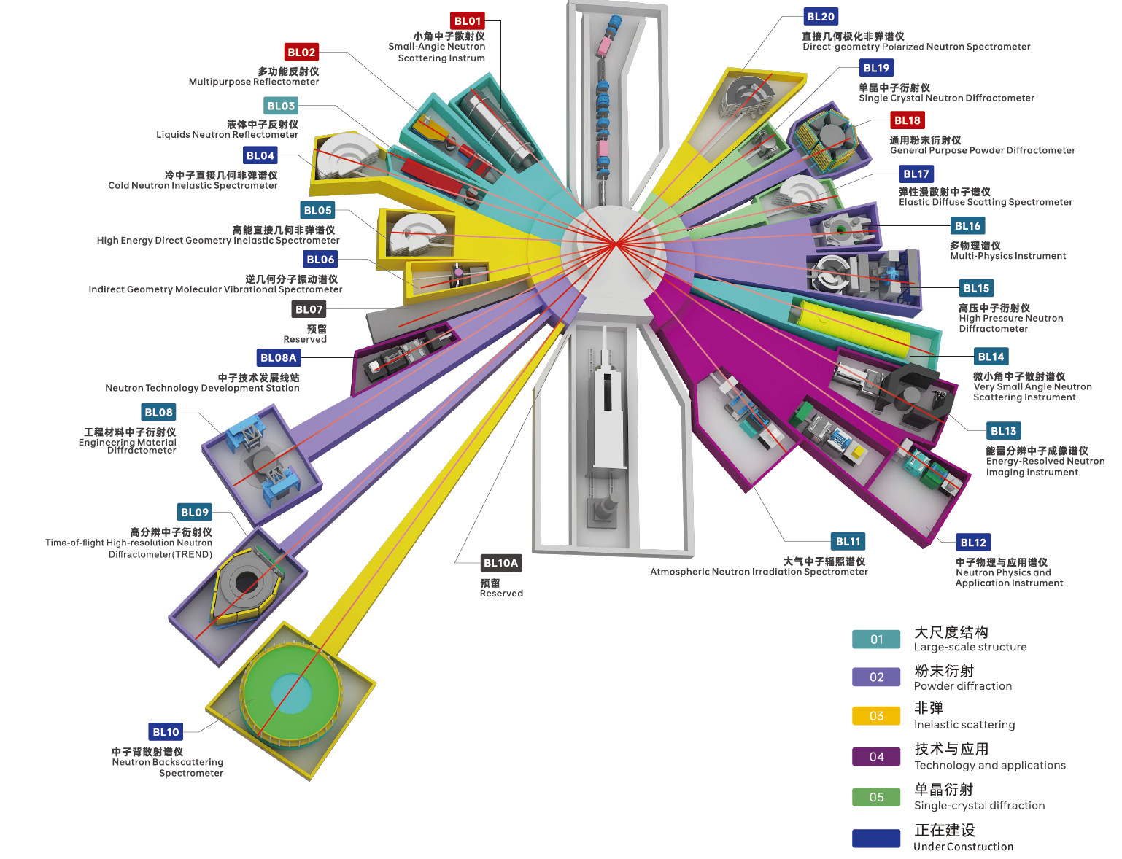
CSNS Instrument Suite
Powder Diffractometer | General Purpose Powder Diffractometer (GPPD)
 | Multi Physics Instrument (MPI)
 | High-resolution Powder Diffractometer (TREND)
 | High pressure diffractometer (HP)
Large Scale | Small Angle Neutron Scattering instrument (SANS)
 | Very Small Angle Neutron Scattering (VSANS)
 | Multi-Purpose Reflectometer (MR)
 | Liquid Neutron Reflectometer (LNR)
Industry Application | Engineering Material Diffractometer (EMD)
 | Energy Resolved Neutron Imaging (ERNI)
 | Atmosphere Neutron Irradiation (ANIS)
Direct Geometry Spectrometer | High energy inelastic spectrometer (HD)
 | Cold Neutron Inelastic Spectrometer (CNIS)
 | Polarized Neutron Spectrometer (PAINTER)
Indirect Geometry Spectrometer | Molecular Vibration Spectrometer (iMovies)
 | Neutron Backscattering Spectrometer (NuBS)
Single Crystal | Elastic Diffuse Scattering Spectrometer (EDS)
 | Single Crystal Neutron Diffractometer (SCND)
Nuclear physics & technique | Back-streaming white neutrons (Back-n)
 | Neutron Technology Develop Station (NTDS)
 | Neutron Physics & Application Instrument (NPAI)
 | High-energy Proton Experimental Station（HPES）
 | Muon station（MELODY）
Couple Hydrogen Mod. BL01-04
DPHM. BL18-20
DWM. BL15-17
DWM. BL05-07
Couple Hydrogen Mod. BL12-14
DPHM. BL8-10
CSNS-I CSNS-CI CSNS-II
4

Slide 5
Operating Instruments
2017 |  |  |  | 2018 |  |  |  | 2019 |  |  |  | 2020 |  |  |  | 2021 |  |  |  | 2022 |  |  |  | 2023 |  |  |  | 2024 |  |  |  | 2025 |  |  |  | 2026
3 | 6 | 9 | 12 | 3 | 6 | 9 | 12 | 3 | 6 | 9 | 12 | 3 | 6 | 9 | 12 | 3 | 6 | 9 | 12 | 3 | 6 | 9 | 12 | 3 | 6 | 9 | 12 | 3 | 6 | 9 | 12 | 3 | 6 | 9 | 12 | 3 | 6 | 9 | 12
Powder Diffractometer | GPPD
 | MPI
 | HRD
 | HPND
Large scale | SANS
 | MR
 | VSANS
Industry application | EMD
 | ERNI
 | ANIS
Inelastic | HD
2017.11
2018.9
Open to user
Commissioning
2018.9
2021.7
2021.11
Open to user
Design
Construction & Installation
Commissioning
2020.1
2021.7
2024.7
2025.2
Design
Construction & Installation
Commissioning
Trial operation
2018.5
2020.7
2024.7
2025.2
Design
Construction & Installation
Commissioning
Trial operation
2017.11
Open to user
Commissioning
2017.11
Open to user
Commissioning
2018.7
2020.7
2023.1
2024.3
Open to user
Design
2020.7
Construction & Installation
Commissioning
2018.5
2022.12
2023.10
Open to user
Design
Construction & Installation
Commissioning
Trial operation
2018.7
2020.7
2023.1
2024.3
Open to user
Design
Construction & Installation
Commissioning
2017.9
2020.7
2022.4
2022.10
Design
Construction & Installation
Commissioning
Trial operation
2019.7
2020.7
2023.1
2024.10
Open to user
Design
Construction & Installation
Commissioning
Trial operation
5

Slide 6
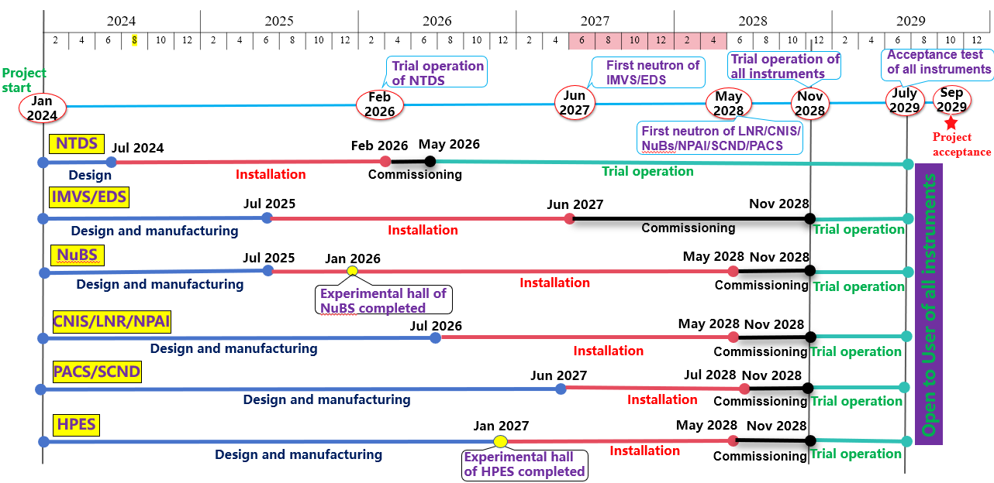
Schedule of CSNS II Instrument
6

Slide 7
Outline
CSNS Instrument Suite
Powder & single crystal diffractometers
Large scale instruments
Inelastic spectrometers
Industry application and nuclear technique
Summary

Slide 8
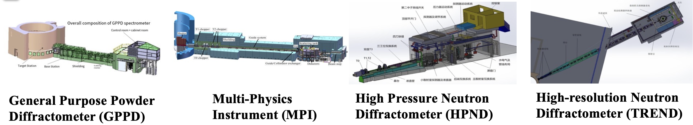
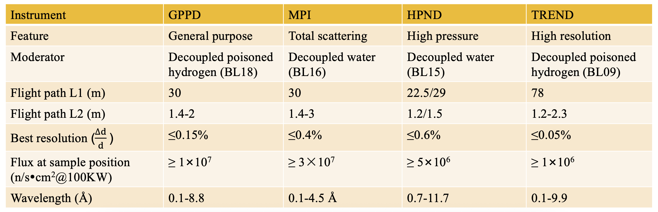
Overview of Powder Diffractometer
Phase I: Mar 2018
Coorperation: Oct 2021
Coorperation: Jul 2024
Coorperation: Jul 2024
8

Slide 9
Overview of Powder Diffractometer
Resolution
0.0003
TREND
GPPD
0.0015
MPI
0.004
HPND
0.006
1x10⁶
1x10⁷
4x10⁷
5x10⁷
Flux
9

Slide 10
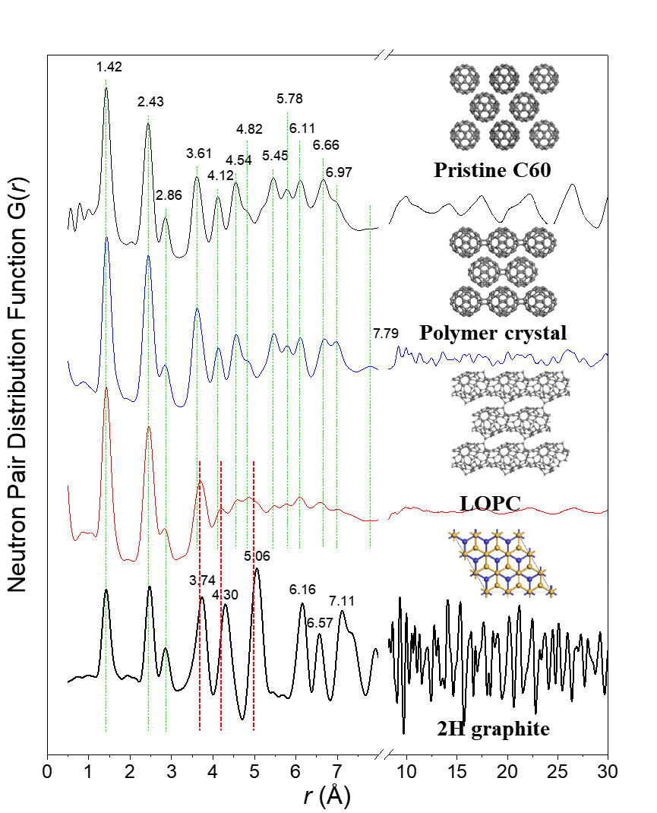

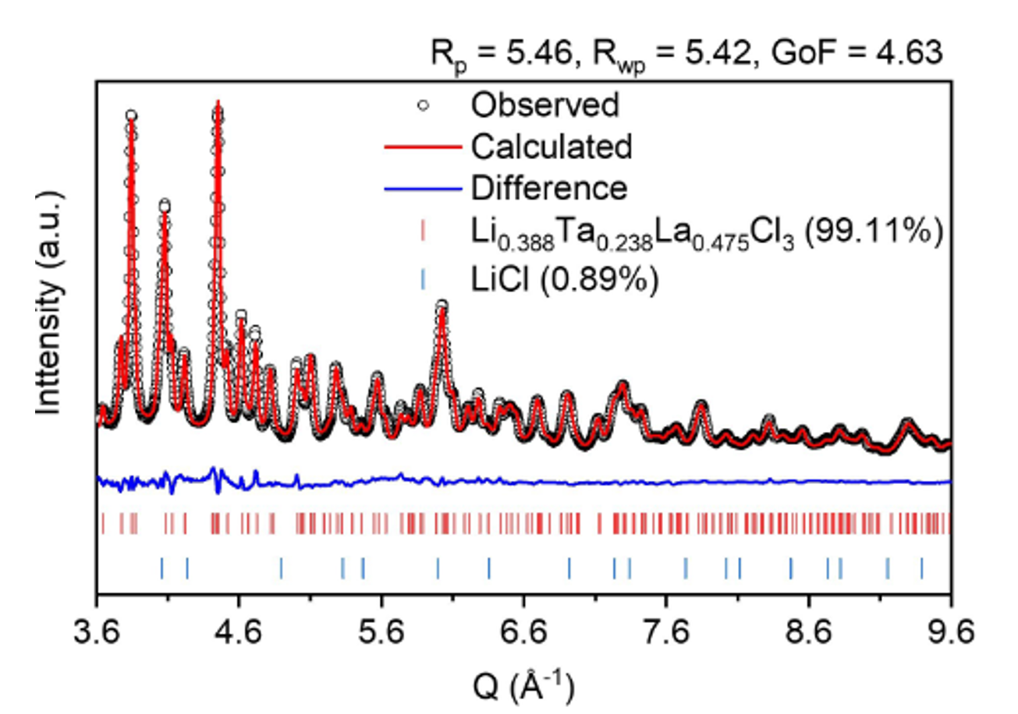
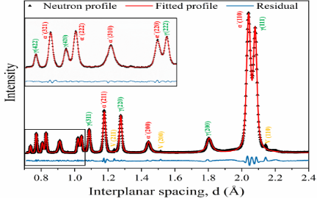
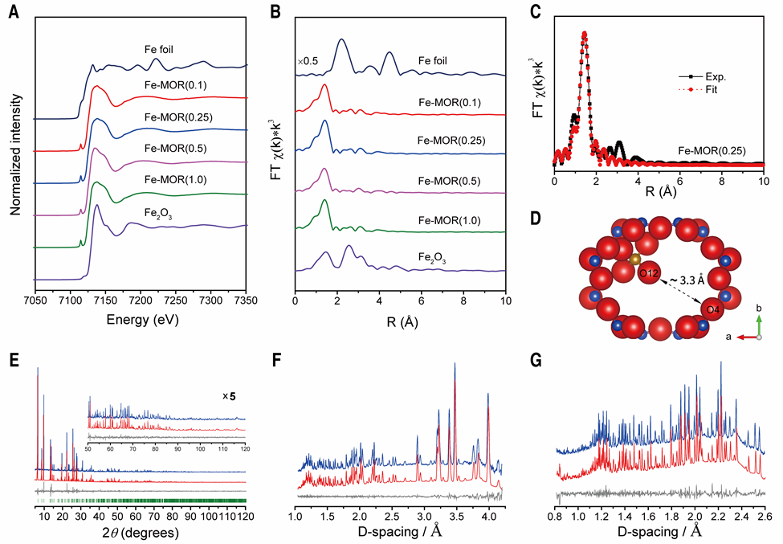
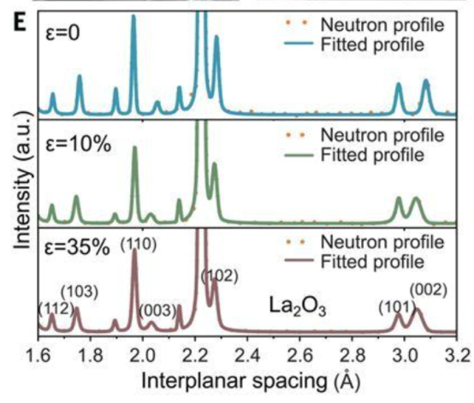
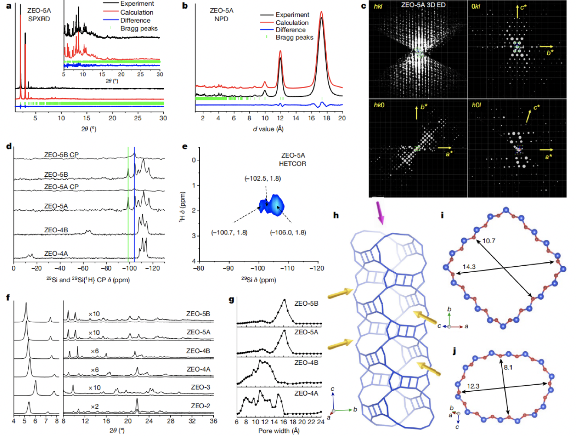
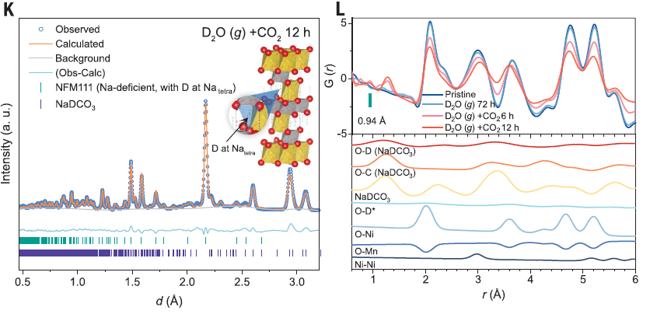
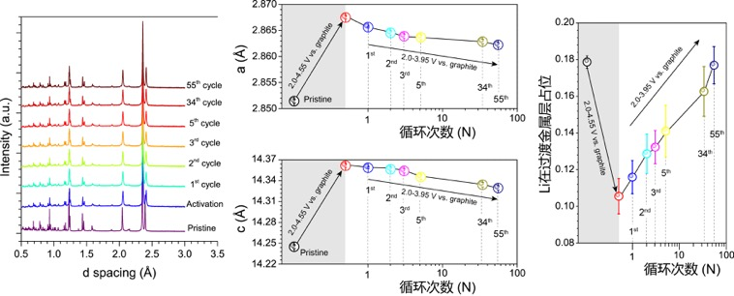
Scientific Highlight
Ultrastrong Steel
Iron-containing Mordenite
Long-range ordered porous carbon crystal
Lanthanide all solid-state electrolyte material
Science 368 (2020) 1347–1352 Science 373(2021) 315–320 Nature 614 (2023) 95-101 Nature 616 (2023) 77-83
Enhancement of Plasticity in Ceramics
Air Sensitivity of Na-layered Oxides
Zeolites with Extra-large Pores
Negative thermal expansion and
oxygen-redox electrochemistry
Science 385 (2024) 422–427 Science 385(2024) 744–752 Nature 628 (2024) 99-103 Nature 640 (2025) 941-946
10

Slide 11
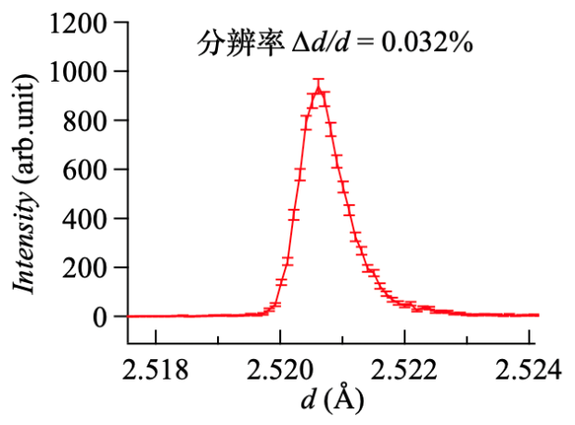
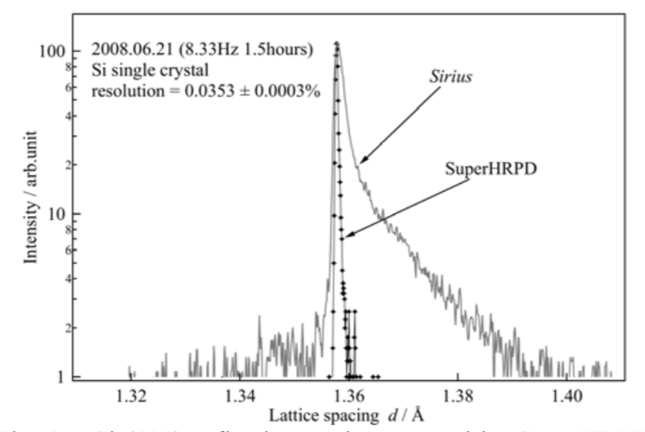
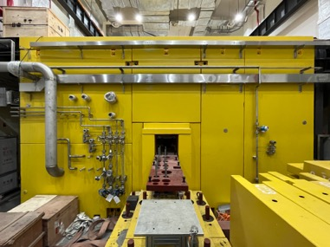
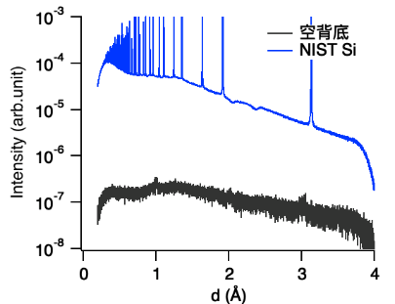
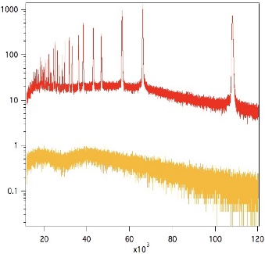
High-Resolution Diffractometer (TREND, BL09)
Detecting tiny structural distortion or critical behavior in condensed matter physics
Determination of complex crystal/magnetic structures of functional materials
In-situ measurements for energy materials in material science
Resolution@SuperHRPD
J. Phys. Soc. Jpn. 80 (2011) SB020
Resolution@TREND
NIST Si
Empty
Best resolution: <0.05%
d-range:0.1-25Å@6.25 Hz
Background@SuperHRPD
KENS_REPORT XX, P185 (2021)
Background@TREND
The background level is about one order of magnitude lower than SuperHRPD.
11

Slide 12
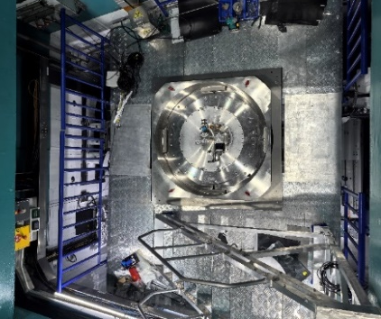
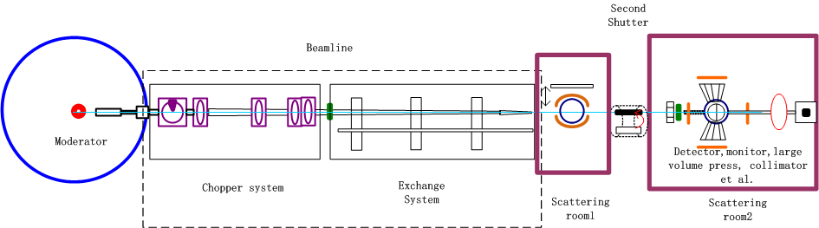
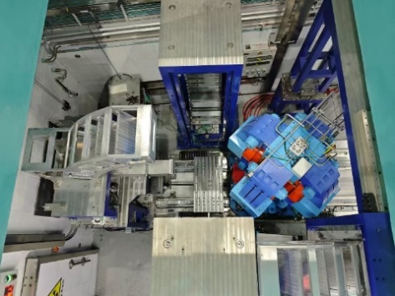

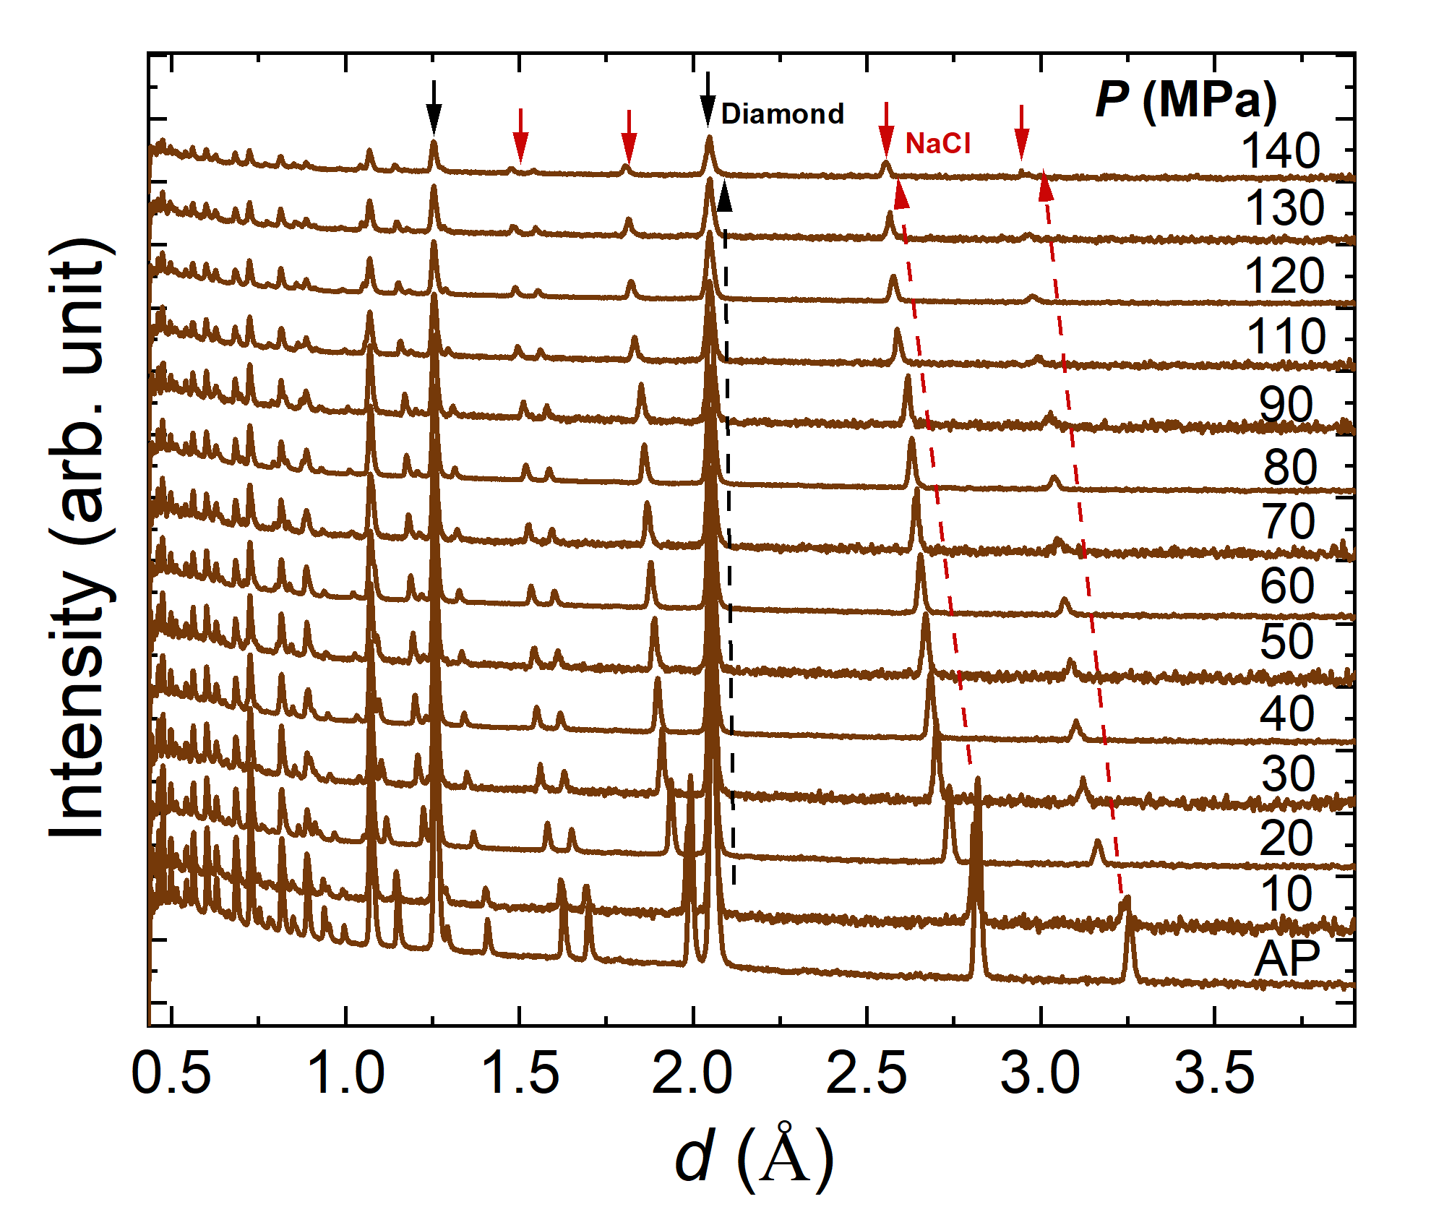
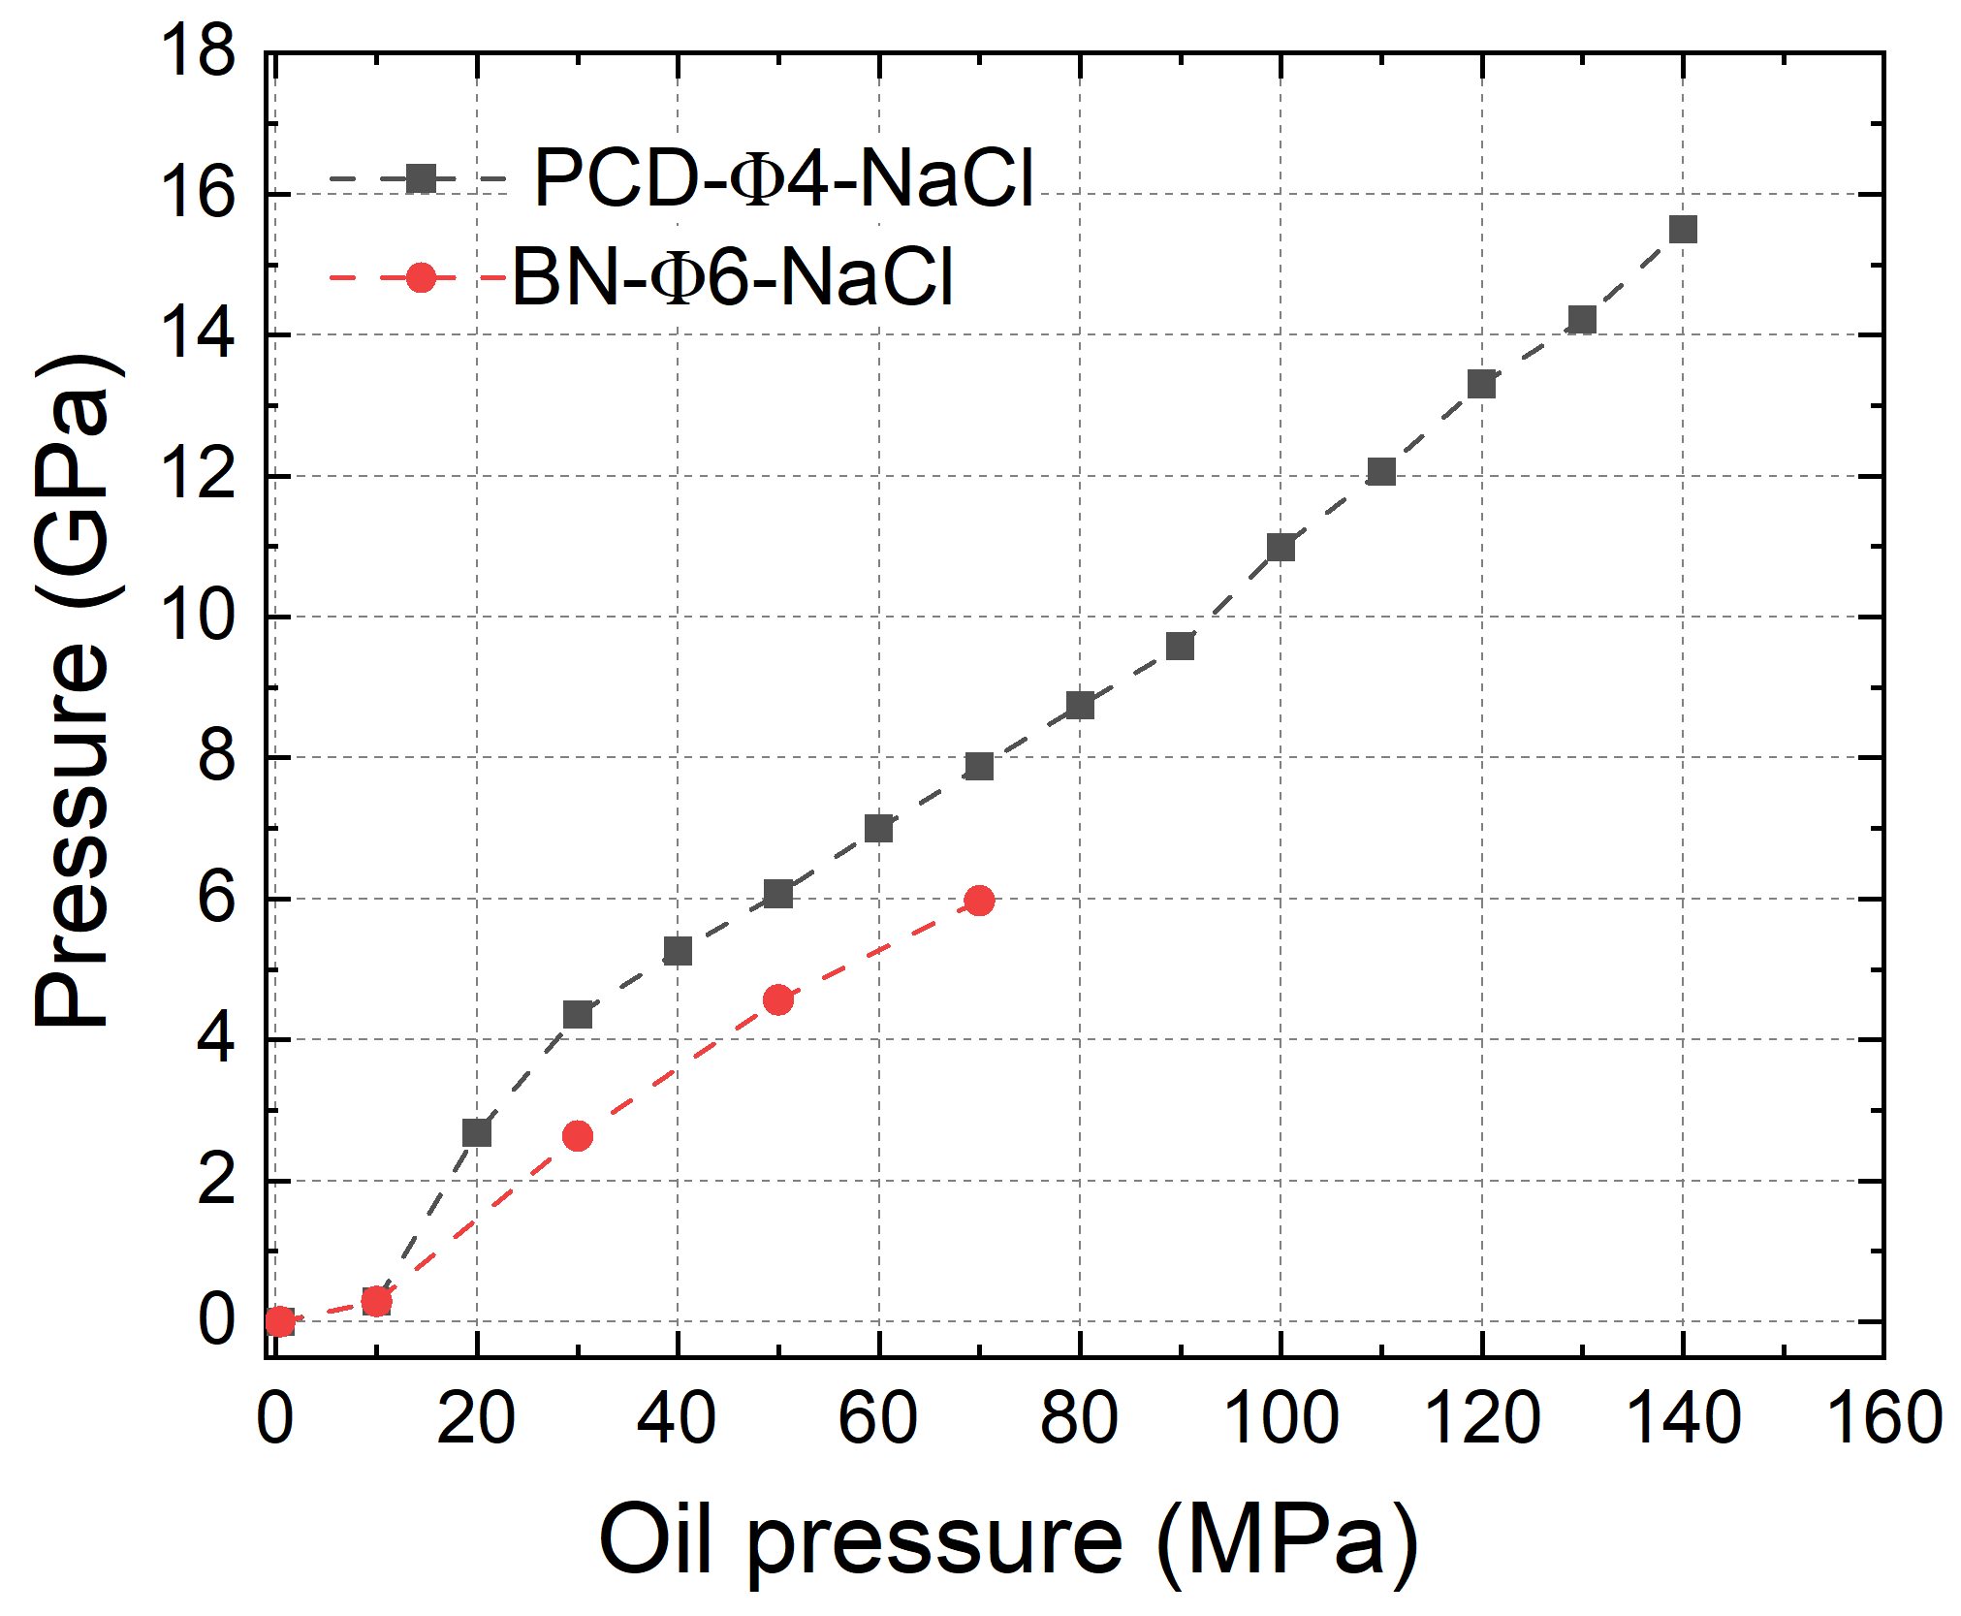
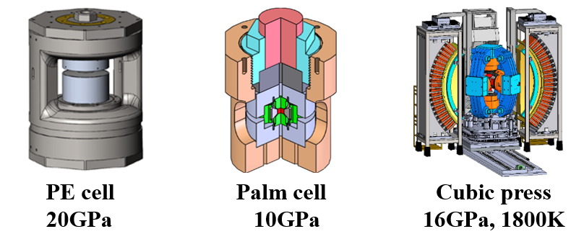
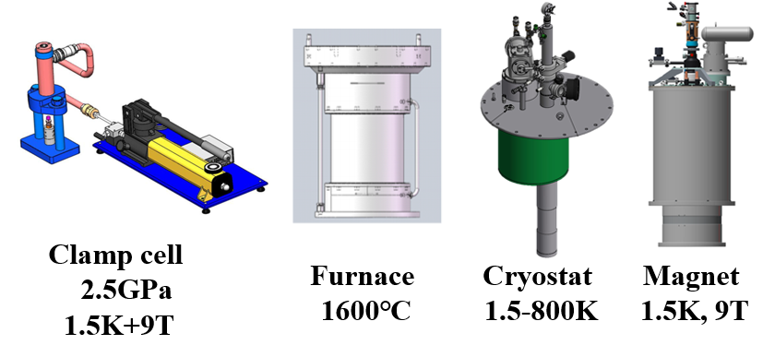
High Pressure Neutron Diffractometer (HPND)
Two hutches for different HP devices, the second in-situ neutron diffraction cubic press in the world.
Combining diffraction and imaging to analyze the relationship between structure and properties.
Hutch 1
Hutch 2
Hutch 1
Hutch 2
The PE cell can achieve a pressure of 15.5 GPa.
12

Slide 13
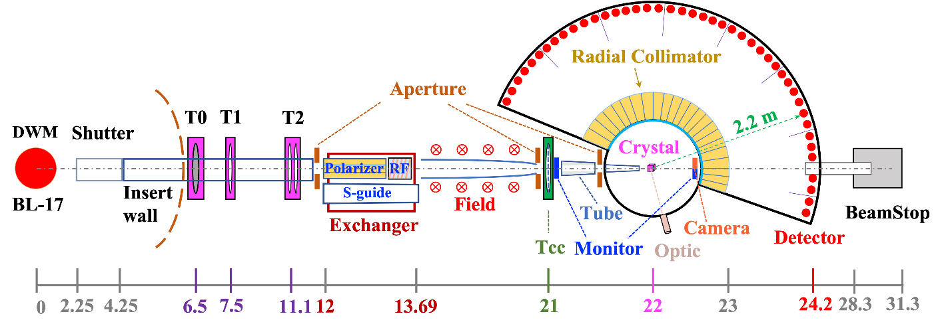
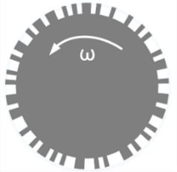
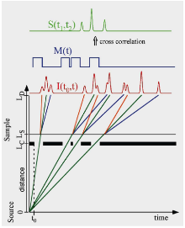
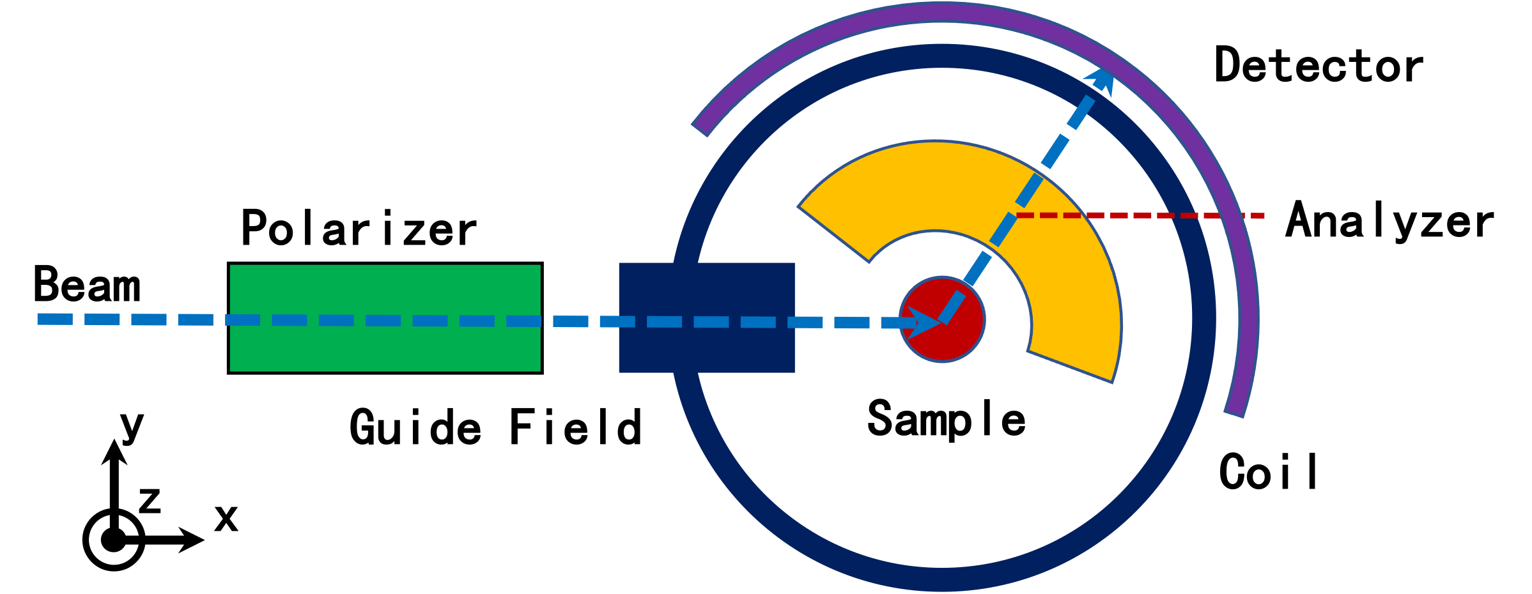
Elastic Diffuse Scattering Spectrometer (BL17)
Study the complex disorder and short-range correlation of spins, vacancies and atomic displacement in single-crystal sample.
Dr. Erxi Feng
Frustrated magnets, Quantum magnets, Critical phenomena, Superconductivity, Mulitferric, Ionic conductor, Molecular , Quasi-crystallography
Correlation chopper T_{cc}:Seperation of elastic and inelastic scattering signal.
Decoupled water moderator (DWM)
Flight length: L₁ = 22 m；L₂ = 2.2 m
Wavelength: 0.5~6.5 Å,
1.5~4.5 Å (polarized)
Detector: He3 PSD
Coverage: -35˚ ~ +145˚ (horizental)
-30˚ ~ +30˚ (vertical)
Q-range: 0.25 ~ 18 Å⁻¹
Q-resolution: < 1.0%
Polarized Neutron option:Seperation of nuclear, magnetic and spin-incoherent scattering.
13

Slide 14
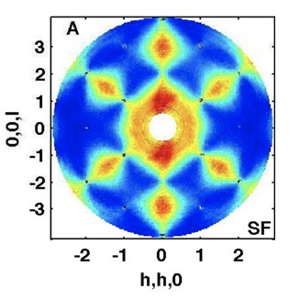
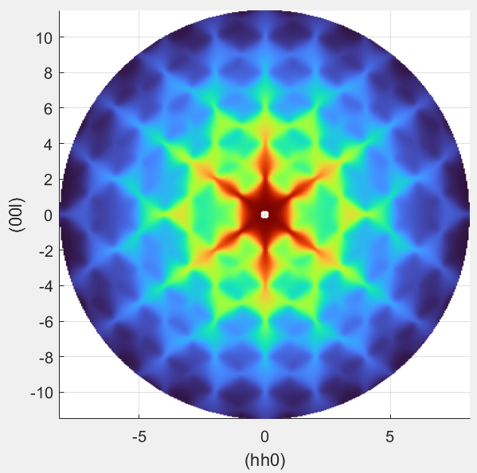
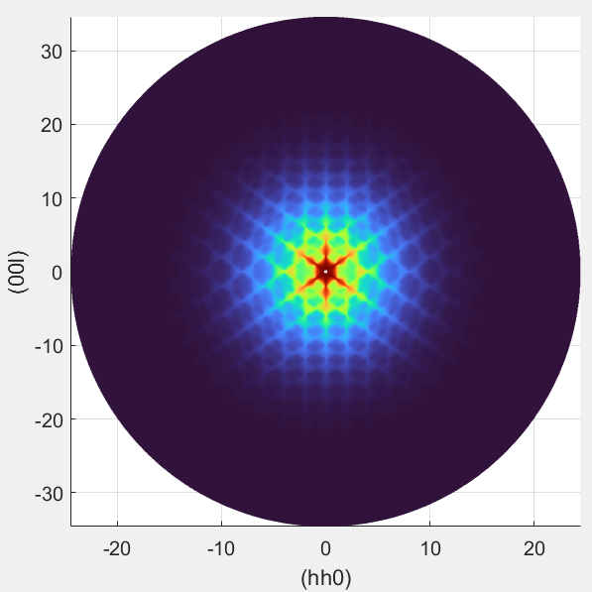
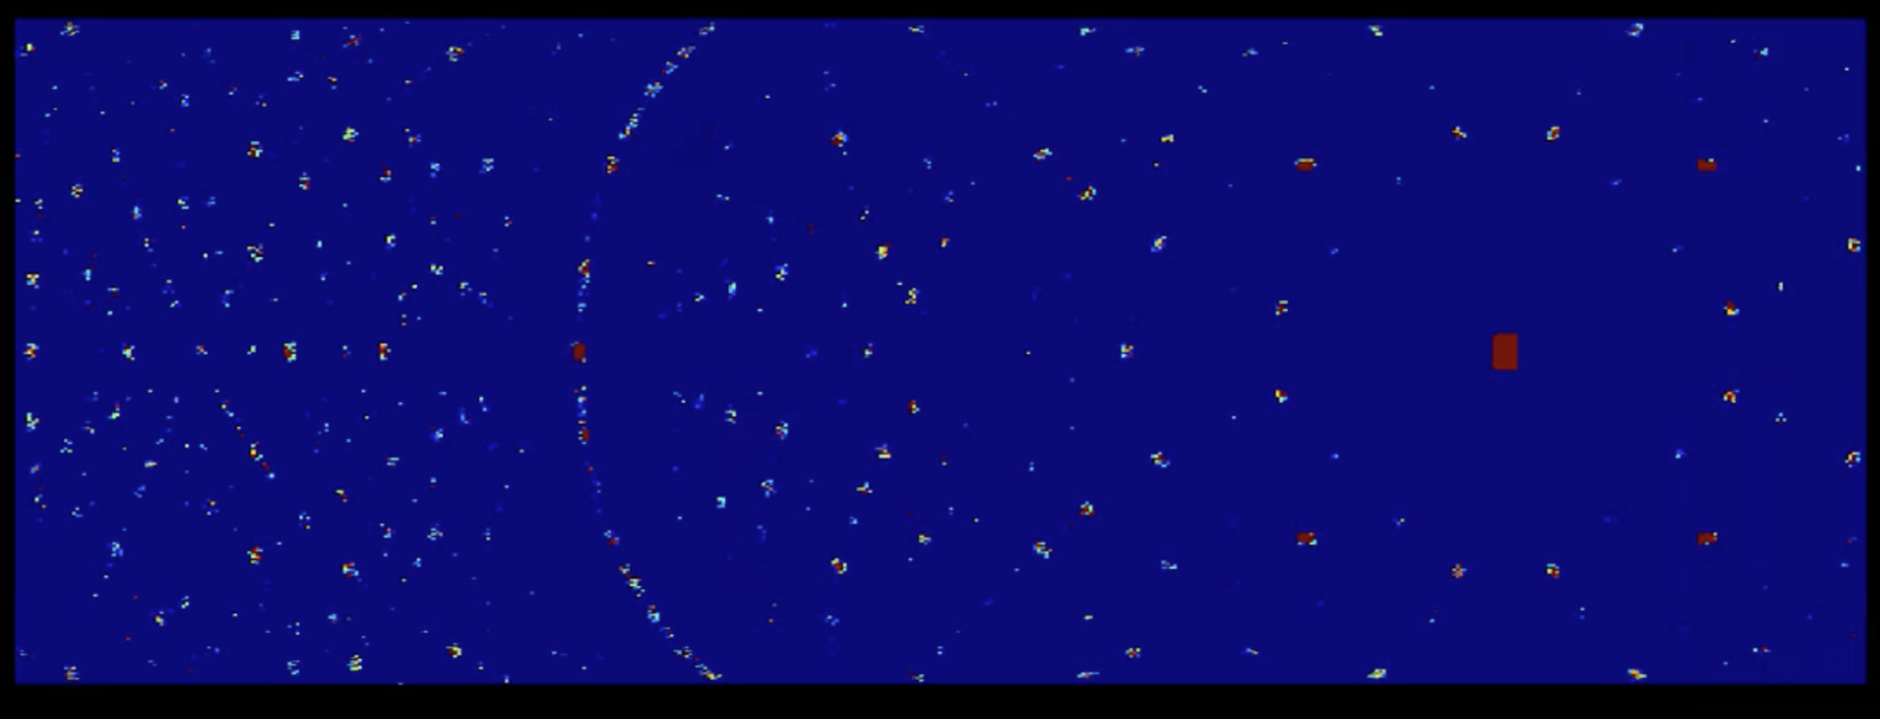
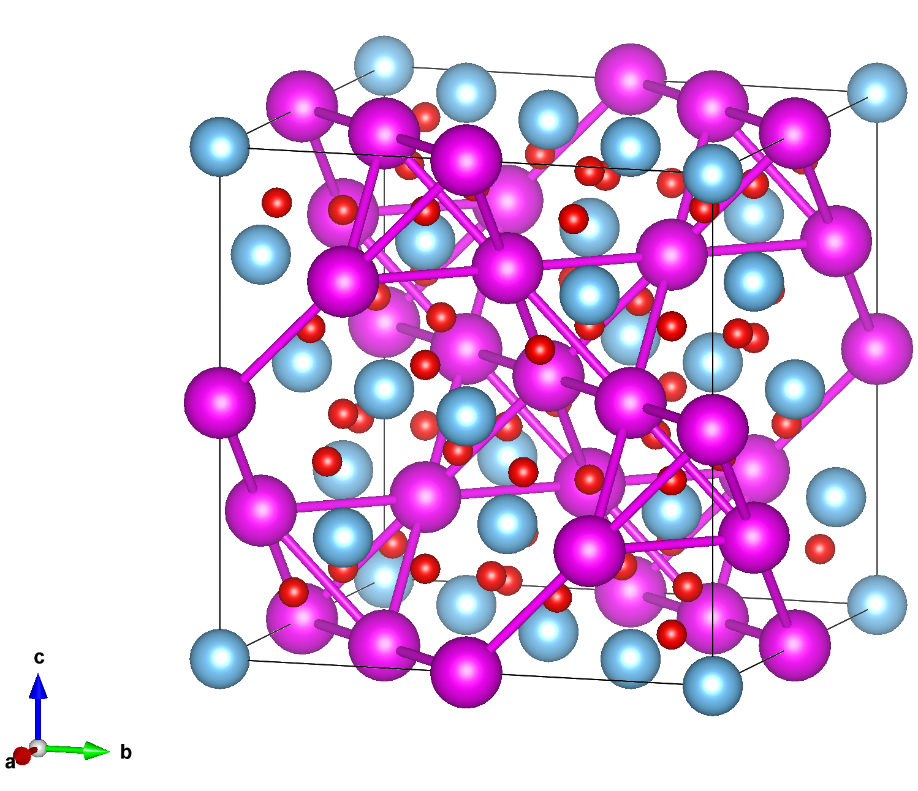
Elastic Diffuse Scattering Spectrometer (BL17)
Expected Performance（Mcstas simulation of Ho₂Ti₂O₇）
Magnetic Diffuse（Spin Ice）
Single-crystal diffraction（HK0）
Science 326 415 (2009)
D7 (polarized)
Flux ~ 2×10⁶ n/cm²/s
Q_{max} ~ 2.6 Å⁻¹
EDS 1.5~4.5 Å Flux ~ 1×10⁷ n/cm²/s Q_{max} ~ 7.5 Å⁻¹
EDS 0.5~6.5 Å Flux ~ 3×10⁷ n/cm²/s Q_{max} ~ 23.5 Å⁻¹
Large Q coverage enables magnetic and nuclear diffuse scattering observation simultaneously
Fine Q-resolution allows nuclear and magnetic structure analysis under extreme conditions.
Instrument lifecycle
n
2023
2024
2025
2026
2027
2028
2029
20??
CSNS-II
Sep. 2024:
Physical design completed
July. 2025:
Installation
Mid. 2028:
Commissioning & Operation
14

Slide 15
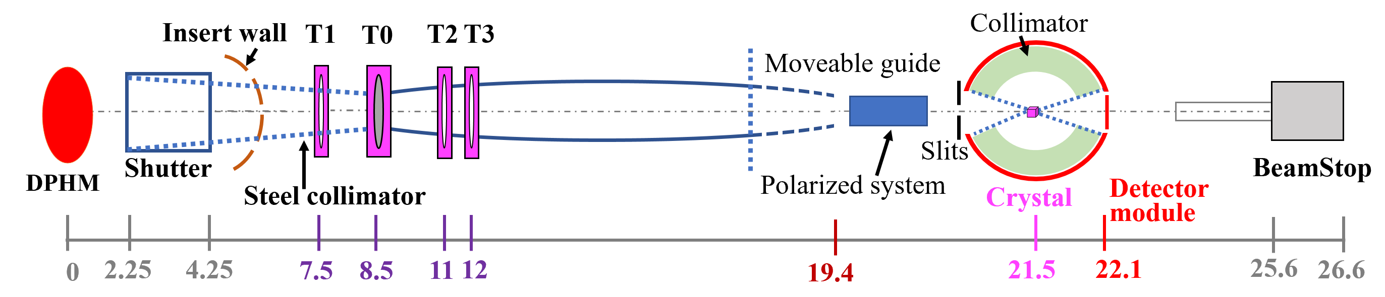
Single Crystal Neutron Diffractometer (BL19)
High-resolution single-crystal diffractometer using wavelength-resolved Laue techniques to address crystallographic and magnetic structural problems in solid-state physics, chemistry, biology materials science, engineering, etc.
Dr. Sihao Deng
Crystallography
Magnetic Structure
Phase Transition
Isotope
H-Atom and H-Bond
Protein
Features
1. High-resolution: d-resolution (∆d/d) < 0.3 %
2. Dual-Mode Optics: HR/HF switch
3. SiPM Detector: Spatial resolution 1 mm，
Best coverage (under evaluation) ~5.55 Ster. (~ 44%)
4. Polarized & Multi-Fields:³He sys, ≥7T, 0.1-2000K
5. Intelligent Beamline: Auto-align & online process
6. Accommodating medium-sized biomolecules up to 100Å cell
15

Slide 16
Outline
CSNS Instrument Suite
Powder & single crystal diffractometers
Large scale instruments
Inelastic spectrometers
Industry application and nuclear technique
Summary

Slide 17
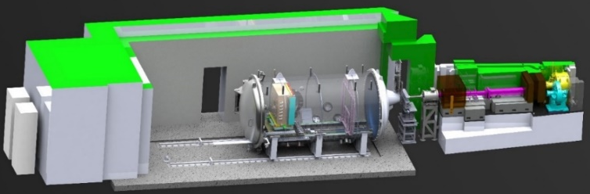
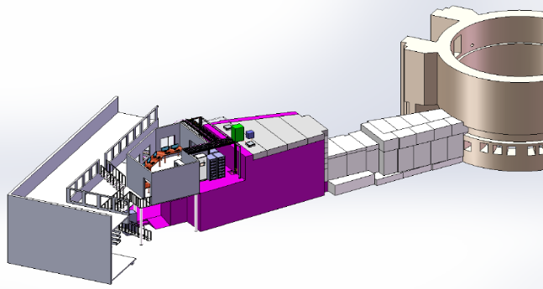
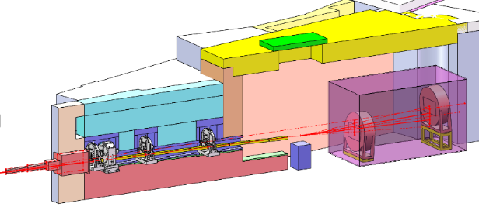
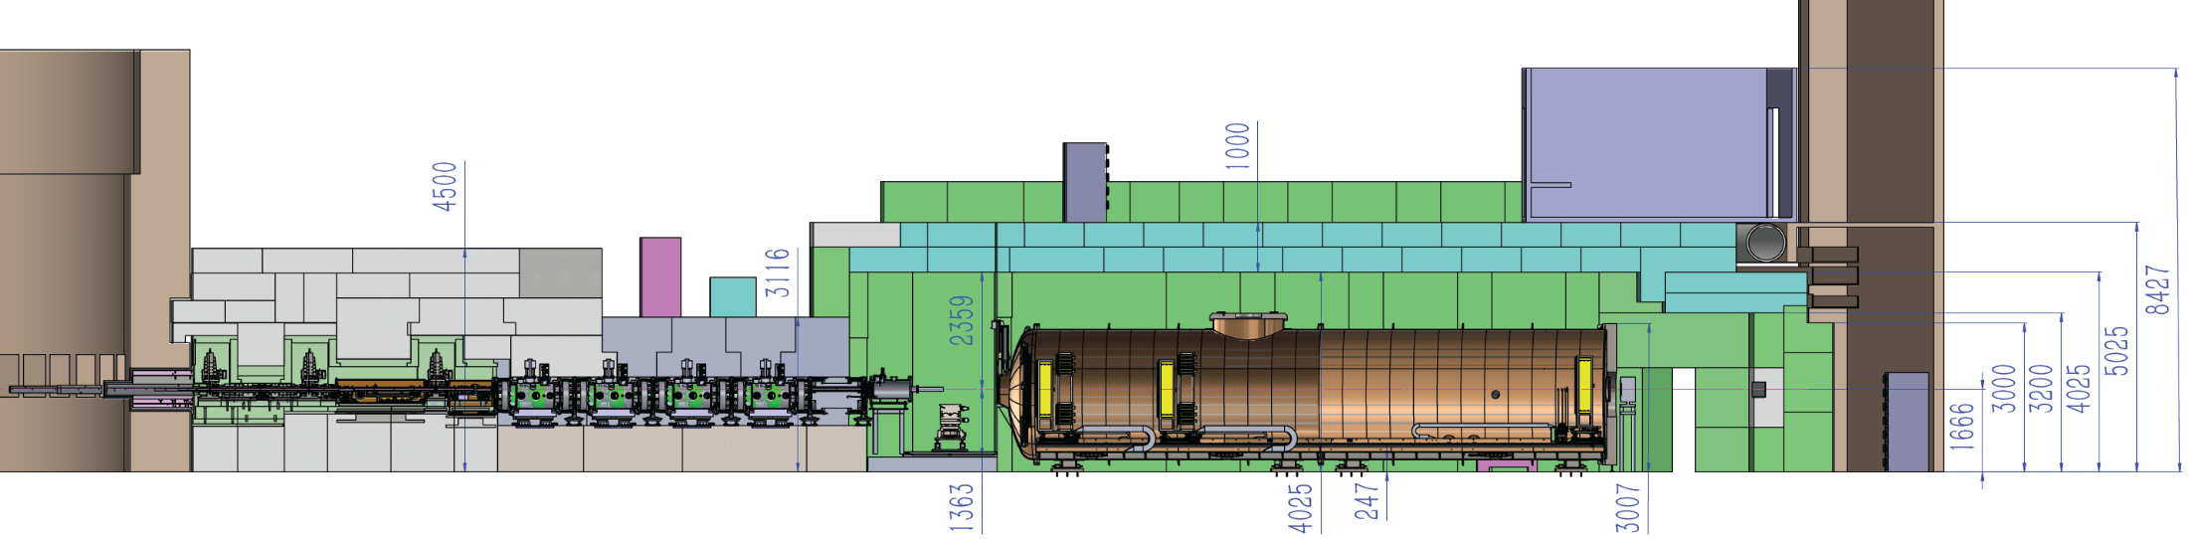
Large-Scale Instruments of CSNS
BL01-Small angle neutron scattering (18m)
BL02-Multi-purpose reflectometer（vertical）
2018-01 commissioning of SANS & MR
2018-09
users program
2023~2024 Upgrade and commissioning of SANS（120kW）
BL14-Very small-angle neutron scattering (35m)
BL03- Liquid reflectometer (horizontal)
2023-03 Fully commissioning of VSANS (100kW)
（under construction）
2024-03 users program
2024-10 Start design of LNR
2028-5 commissioning
（300kW）
Sponsored by Cantonese Government
17

Slide 18
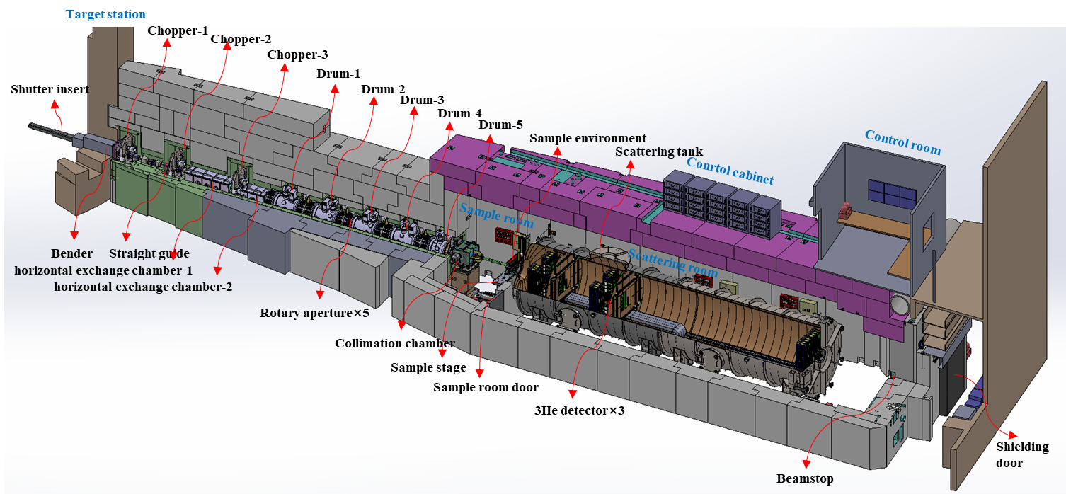
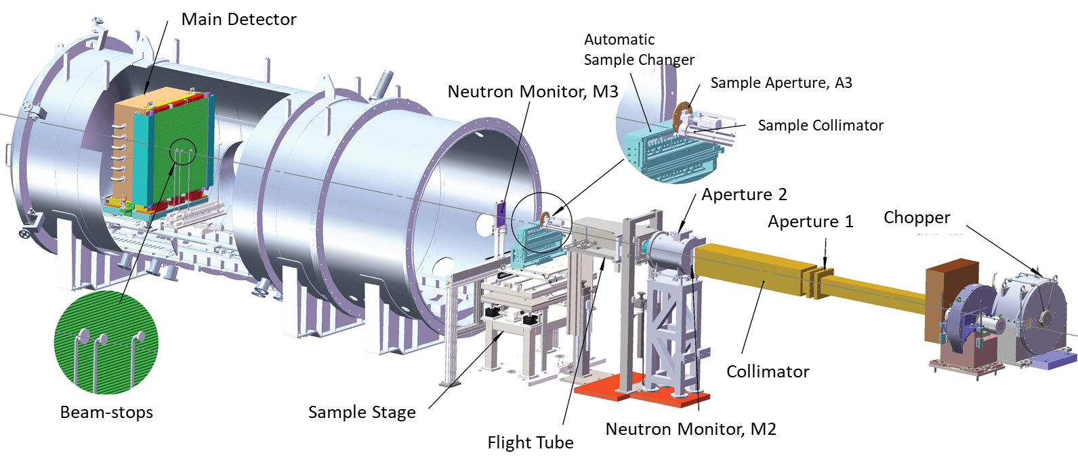
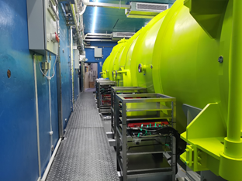
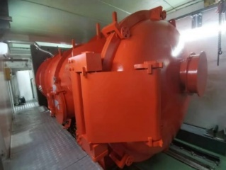
Small-Angle Neutron Scattering
SANS
VSANS
Instruments | SANS-18m（BL-01） |  | VSANS-35m（BL-14）
 | Before 2023 | 2024 - now
Moderator | CHM (20K) |  | CHM (20K)
Detector resolution | 8*8.5mm (³He PSD) | 5*8.5mm (³He PSD) | 3 ~1㎡ He-3 PSD 8mm resolution 1210×210 mm² GEM PSD 2 mm resolution
Wavelength range | 1-10.9 Å | 1 - 12 Å | 2.2－6.7 Å； 6－10.5 Å
Q-range | 0.005 Å⁻¹ - 1Å⁻¹ （SDD：2~4m） | 0.003 Å⁻¹ - 1.77 Å⁻¹ （SDD：2.2~5.2m） | SANS: 0.0016 － 1.8 Å⁻¹ VSANS: 0.00028-0.008 Å⁻¹
Q-resolution | 3.5% @ 0.1 Å⁻¹ | 2.8% @ 0.1 Å⁻¹ | 2.1% @ 0.1 Å⁻¹ for SDD=12.75m
flux @sample pos | 5*10⁶ n/cm²/s@100kW | ~7*10⁶ n/cm²/s@ 170kW | @2.49m, 2.6×10⁷ ； @5.15 m, 9.0×10⁶ @12.75m, 1.6×10⁶； VSANS, 1.3×10⁵
Beam-size @sample pos | 6mm（default），4mm | 8mm（default） 6mm，4mm | SANS: 6, 8, and 15 mm; VSANS: 15×30 mm²
18
18

Slide 19
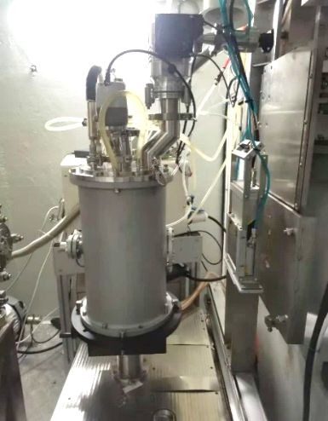
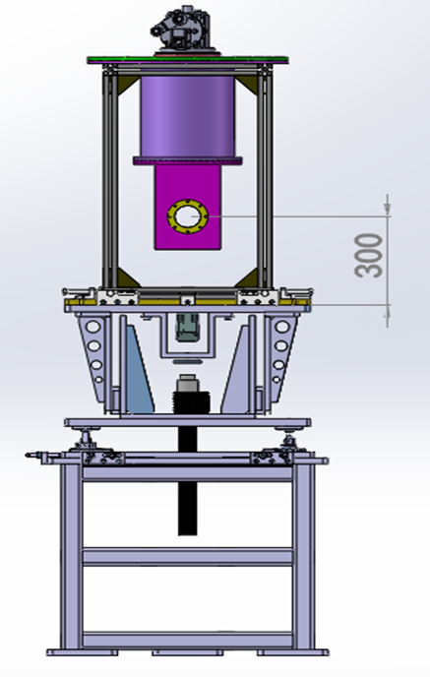
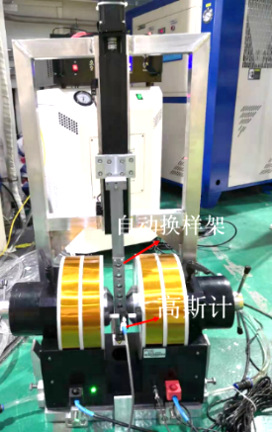
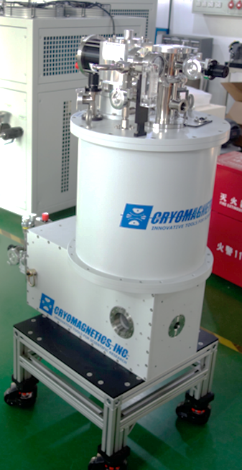
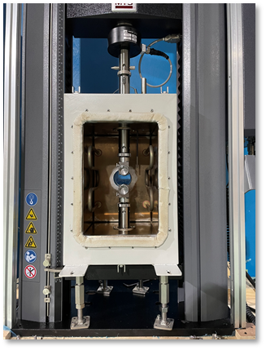
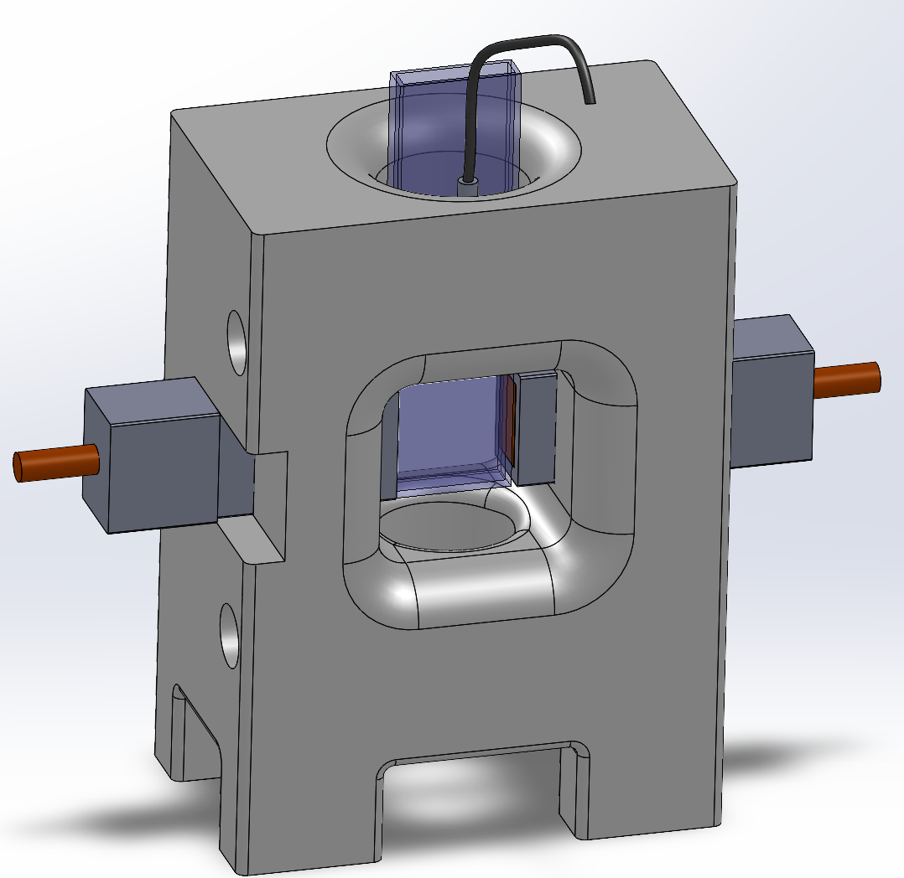






Sample environments of SANS & VSANS
Temp control devices
Magnetic devices
Stress-temp
In-situ electrical field
Furnace
(RT~1200℃)
Cryostat
(6~500K)
H_{max}：1.7T
Temp：RT
H_{max}：3 T
Temp：2-700K
load: 10 kN
Temp: -90~400℃
RT~1000℃
Voltage: 2.5kV
Temperature: RT~100 °C
40 positions sample changer
Simultaneous DSC
Rheo-SANS
Laser emission
Temp:-150~500℃
19

Slide 20



Multi-Purpose Reflectometer (BL02)
Magnetic nano-surface/interface (vertical)
NR
Magnetic Antiskyrmions possess alternating Bloch- and Néel-type spin spirals
Net Magnetization in AFM
Adv. Mater. 37, 2413700 (2025)
Nature Comm. 15, 4734 ( 2024)
20

Slide 21

Liquid Neutron Reflectometer (BL03)
Parameters | Design value
Moderator | CHM
Wavelength Range | 1~12 Å
Q-range | 0.003~0.6 Å⁻¹
Minimum reflectivity | ~10⁻⁶
Resolution（ΔQ/Q） | 2%~10 %
Flux @ Sample | 5×10⁷ (n/cm²/s)
Sample geometry | Horizontal
Experimental Modes | reflection+ GISANS
Detector Efficiency | ≥ 70 % @ 6 Å
Detector resolution | 2mm*2mm
Applications
behaviors of biological membranes proteins at interface
stability of colloidal systems and ions / molecules transport between two liquid phases
electrochemical/chemical reaction at liquid-liquid interfaces
reactions at Liquid-Solid Interfaces During Friction and Corrosion
characteristics and innovations
Rapid switching between reflection and GI-SANS experimental modes enabling the 3D interfacial structure measurement
Prof. Yubin Ke
21

Slide 22
Outline
CSNS Instrument Suite
Powder & single crystal diffractometers
Large scale instruments
Inelastic spectrometers
Industry application and nuclear technique
Summary

Slide 23

Scientific Goals of Spectrometers
Physics:
lattice dynamics,
spin dynamics,
molecular vibrations,
ion diffusion/reorientation,
nuclear spin excitation, etc.
Materials:
magnetic materials,
high-temperature superconductors,
energy materials,
Catalyst
life science materials, etc.
HD
Medium-High E_{i}
Medium E-Resolution
PAINTER
Medium-Low E_{i}
Medium E-Resolution
Polarization Analysis
CNIS
Low E_{i}
High E-Resolution
iMovies
Medium E_{i}
High E-Resolution
NuBS
Low E_{i}
High E-Resolution
23

Slide 24



High energy inelastic spectrometer (BL05)
Name | Parameters
Moderator | Decoupled Water
Energy and Resolution | 10meV~1500 meV: 3%~10%
Flux | 10~1500meV: 4.98*10⁷n/s/cm²@185kW
Beam size（sample） | MAX：5cm×5cm
Detector coverage | horizontal：-30˚～+60˚ vertical：-30˚～+30˚
Sample to moderator | 18m
Fermi to sample | 2m
Sample to detector | 2.5m
Sample environment | CCR（5K~800K） Superconducting magnet（～7T）
24

Slide 25












Cold Neutron Inelastic Spectrometer (BL04)
The Cold Neutron Inelastic Spectrometer (CNIS) is designed to be a high resolution inelastic spectrometer, which will focus on efficiently detecting low energy signals such as magnetic excitations, phonons, and quasi-elastic signals using cold neutron.
Prof. Xing Tong
Dr. Yu Feng
Incident energy：1- 75 meV
Energy resolution: 2.5% (~1% at high resolution mode)
Horizontal
Schematic Diagram of Spectrometer Structure and Key Component Layout
Vertical
Combination of multiple choppers allows switching to high resolution mode freely and enables multiple incident energy modes
Guides are being manufactured at MirrorTron and planed to be installed in this summer. It uses 50 cm straight sections to approximate the curved and elliptical shape
Sample chamber is made of low magnetic permeability materials for magnets. The end guide can be switched to a strong-focusing guide and a polarization system
An oscillating radial collimator is installed in the sample chamber to prevent scattering from the sample environment
Vanes are installed between detector banks to prevent stray scattering
³He detector banks use an “ air box” solution
25

Slide 26



Direct Geometry Polarized Neutron Spectrometer (PAINTER, BL20)
Preliminary Design： In the light of the low flux but sharp pulse width of the decoupled poisoned hydrogen moderator, PAINTER will incorporate the capabilities of both polarized inelastic neutron scattering and polarized neutron diffraction. The performance of beamline is optimized to a balanced point between a diffractometer and a spectrometer.
Polarized neutrons: λ ≥ 2 Å (E_{i} ≤ 20 meV)
(Polarization scheme has not been fully finalized）
detector
polarizer
analyzer
beam
incident guide field
sample
scattering
guide field
Moderator | Decoupled hydrogen
Best energy resolution | ΔE/E ≤ 5%
Neutron flux | ≥1×10⁷ n/scm²
Neutron polarizability | ≥90% @5 meV
Polarizer | Polarized supermirrors
Analyzer | Wide-angle polarization ³He
Incident energy | 1 meV~80 meV
Moderator-to-monochromator L₁=23 m
Monochromator-to-sample L₂=2.5 m
Sample-to-detector L₃=2 m
Detector size: 8mm ³He tubes
3 frame overlap disc choppers
2 high-speed disc choppers (pulse removal & monochromator)

Slide 27



Indirect geometry Molecular Vibrational Spectrometer (BL06)
Indirect geometry molecular vibration spectrometer (iMovies) is an inelastic neutron scattering instrument for neutron vibrational spectrum (NVS) . The optimum energy resolution (ΔE/E) is 1.5%.
Dr. Chunyong He
obtain molecular vibration spectra of materials
catalysts,
hydrogen storage materials
hydrogen bonded systems
hydrous minerals
MOF, zeolites,
biological samples such as drugs and biomolecules.
Time and energy double focused secondary spectrometer with large curved HOPG analyzer;
Large solid angle analyzer coverage, high flux, high energy resolution;
The neutron vibrational spectrum (NVS) and diffraction spectrum of the material are obtained simultaneously;
A variety of sample environments, such as dedicated closed-cycle refrigerator (CCR), high pressure, gas flow cells and gas manifold, in-situ Raman.
Large solid angle (≥4.5 sr) analyzer coverage, with a total of 14 modules
27

Slide 28


















Progress of iMovies
Most of the major equipment will be completed for processing and installation by the end of this year.
iMovies 2026.4.10
Open to users
2024.5-2025.9
2025.10
2026.3-
Commissioning
2024.4
2025.9
2026.3-
2026.8
Physical design review
Construction and installation of chopper and guides
Analyzer prototyping
Transmission test of Be filter
Analyzer tile assembly
Design and construction of Be filter
2027.4
2028.11
2029.7
scattering chamber installation
Day-one experiment
28

Slide 29




Neutron Backscattering Spectrometer (BL10)
Provide very fine energy resolution, <3.0µeV, good for probing dynamic processes in various systems on the ps-ns time scale.
Dr. Hongyu Guo
V sample (3cm)，2.2μeV
29
bent silicon crystals for analyzer

Slide 30











Progress of NuBS
Energy resolution < 3 μeV
2024.01
Start CSNS II
2024.10
construction
2027.03
Scattering chamber
2029.04
first experiment
2024.04
design
2025.07
Installation of 30m
2026.07
Accept of Hall
2028.04
First neutron
g
2029.09
End CSNS II
2025.05
2025.10
2025.08
2025.08
Physical design published
2025.07
2025.10
2025.10
2025.07
2025.08
Instrument hall > 99%;
Engineering design
30 m finished;
Analyzer design finished
User meeting
30

Slide 31
Outline
CSNS Instrument Suite
Powder & single crystal diffractometers
Large scale instruments
Inelastic spectrometers
Industry application and nuclear technique
Summary

Slide 32


Engineering Material Diffractometer (BL08)
Built for Residual stress Analysis, Texture Analysis, Micromechanical behaviour of metals, Industrial metallurgy and manufacturing process simulation.
Neutron wavelength 0.5-6.0Å
resolution Δ d/d ~ 0.25 %
Gauge volume 2, 3, 4, 6mm
sample table 1.8x1.8m, 2ton
First beam： Dec.29 2022，Under commissioning.
32

Slide 33




Atmosphere Neutron Irradiation (BL11)
Aim to neutron single event effect test for semiconductors, electronic devices and integrated equipment used in aviation and ground.
Experiment of Board Level ICs
The first neutron obtained April，2022
Good spectra shape with JEDEC
flux range:10³-10⁷ n/cm²/s (>10MeV)
Collimated beam (1-10cm) and extended beam (80cmx80cm)
Thyristor Irradiation Experiment
33
Notes:
Neutron single event effect test for semiconductors, electronic devices and integrated equipment used in aviation and ground

Slide 34




Energy resolved neutron imaging (BL13)
Conventional neutron imaging
Bragg edge imaging
Grating imaging
Neutron diffraction
Spatial resolution 50 μm
Δd/d ~ 0.5 %
View field 200 x 200 mm²
Adv. Funnct. Mat. 2024, 34, 2404495
First beam： Jan. 05 2023.
34
34

Slide 35





















Industry Application Highlight
More than 8% beamtime for industry application
35

Slide 36





Neutron Physics and application instrument (BL12)
NPAI ：Split-beam design, two beamlines;
Application Beamline : PGNAA and NDP
PGNAA： Exchanger for beam size and background adjustment; Attenuator for flux adjustment;
NDP：High rate mode by multiple detectors; NDP/NI system, 3D mapping mode by scanning sample;
Physics Beamline: UCN
UCN：Build China's first ultracold neutron source; A compact, SFHe4-based and high storage time UCN source .
PGNAA
NDP
UCN
Ultra Cold Neutrons（UCN）
NDP

Slide 37








Neutron Physics and application instrument (BL12)
Design and Progress of the Engineering
Finish the design of shielding, guide and chopper;
Shielding will be installed this year;
Guide and chopper will be installed next year;
The first neutron beam will be obtained in 2028.
PGNAA and NDP
The engineering design is in progress;
The production will be carried out in the second half of this year.
UCN Guide
Entire fabrication process development;
Surface roughness RMS: ~ 0.55 nm;
Density: ~ 93% bulk density.
UCN convertor (CYTOP)
Spin coating on silicon wafer;
Thickness: 95.5 nm;
Optical potential: 111.4 neV;
Currently attempting: Dip coating.
UCN cryostat
A 0.5 K @ 100 mW ³He refrigerator cools ultrapure ;
⁴He to ≤ 0.7 K via a ³He/⁴He heat exchanger;
Finalized cryostat process and design;
Finished initial superleak tests (³He/⁴He ≈10⁻¹⁰).

Slide 38

Neutron Technology Development Station （BL 08A）
Test and development of neutron detectors, polarization, optics, single crystal orientation etc.
Support the construction and operation of the neutron instruments
Development of novel experimental methods using pulsed neutrons
Prof. Ping Wang
Design highlights
1. Versatile functions: three terminals
2. Lower background: Bender + T0 chopper
3. Higher beamtime utilization efficiency: automatic technology
Terminal 2
Neutron reflectivity measurement
Terminal 3 Device testing
Terminal 1
Orientation of single crystals
38

Slide 39




Neutron Technology Development Station （BL 08A）
Preliminary testing completed
1. Neutron beam characteristics
2. Chopper system performance
3. Detectors, DAQ, control, Data Analysis
4. Neutron reflectivity terminal commissioning
NTDS successfully achieved its first neutron beam on March 5, 2026
The neutron flux: 4.2*10⁶ n/(cm²*s)
at 0.5 ~ 5.9 Å
2025.9.8

Slide 40
Summary
The operation of CSNS goes well with high efficiency, eight Instruments fully open to users. three instruments under trial operation.
The CSNS-II instruments finished physical design. There are still many challenges of engineering design, key technology，manufacture, installation and commissioning.
Close collaboration with international colleagues are expected !
40

Slide 41

Thank you ！

