Slide 1
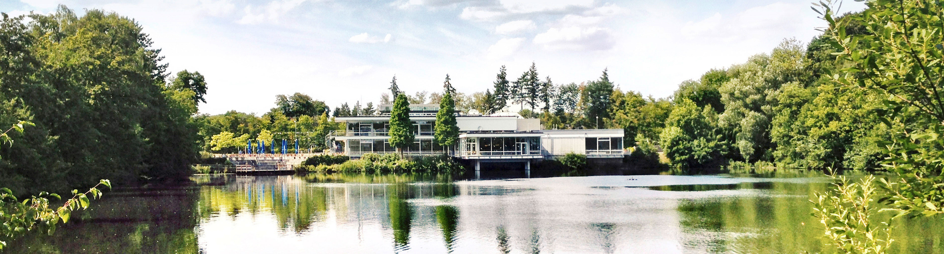
Advances in Neutron Instrument Simulations with VITESS
Release of versions 3.7 and 3.8
13.04.2026 I NicolÒ ViolinI
F. Beule, J. Robledo, J. Voigt, K. Lieutenant, N. Schmidt, T. Randriamalala
Notes:
Hello everyone and thank you for the opportunity to present.
Today I will give an overview of recent developments in the neutron instrument simulation package VITESS, focusing on version 3.7 and ongoing work towards version 3.8, which we have recently described in a journal publication.”

Slide 2
Key LearningS from user experience
From an instrument design tool to a platform to support virtual experiments
Need to connect:
moderator simulations, beamline optics, sample & detector
Emerging trend:
virtual experiments, digital twins
Instrument design at modern sources is increasingly complex
Notes:
“Monte Carlo simulations are a central tool in the design and optimisation of neutron scattering instruments at modern neutron sources.
Traditionally, these simulations focused on instrument performance — for example flux at the sample or resolution.
However, current developments go beyond that.
There is an increasing need to connect:
moderator simulations,
beamline transport,
and full experimental configurations.
This is driven by emerging concepts such as virtual experiments and digital twins, where simulations are used not only for design, but also for experiment planning and data interpretation

Slide 3
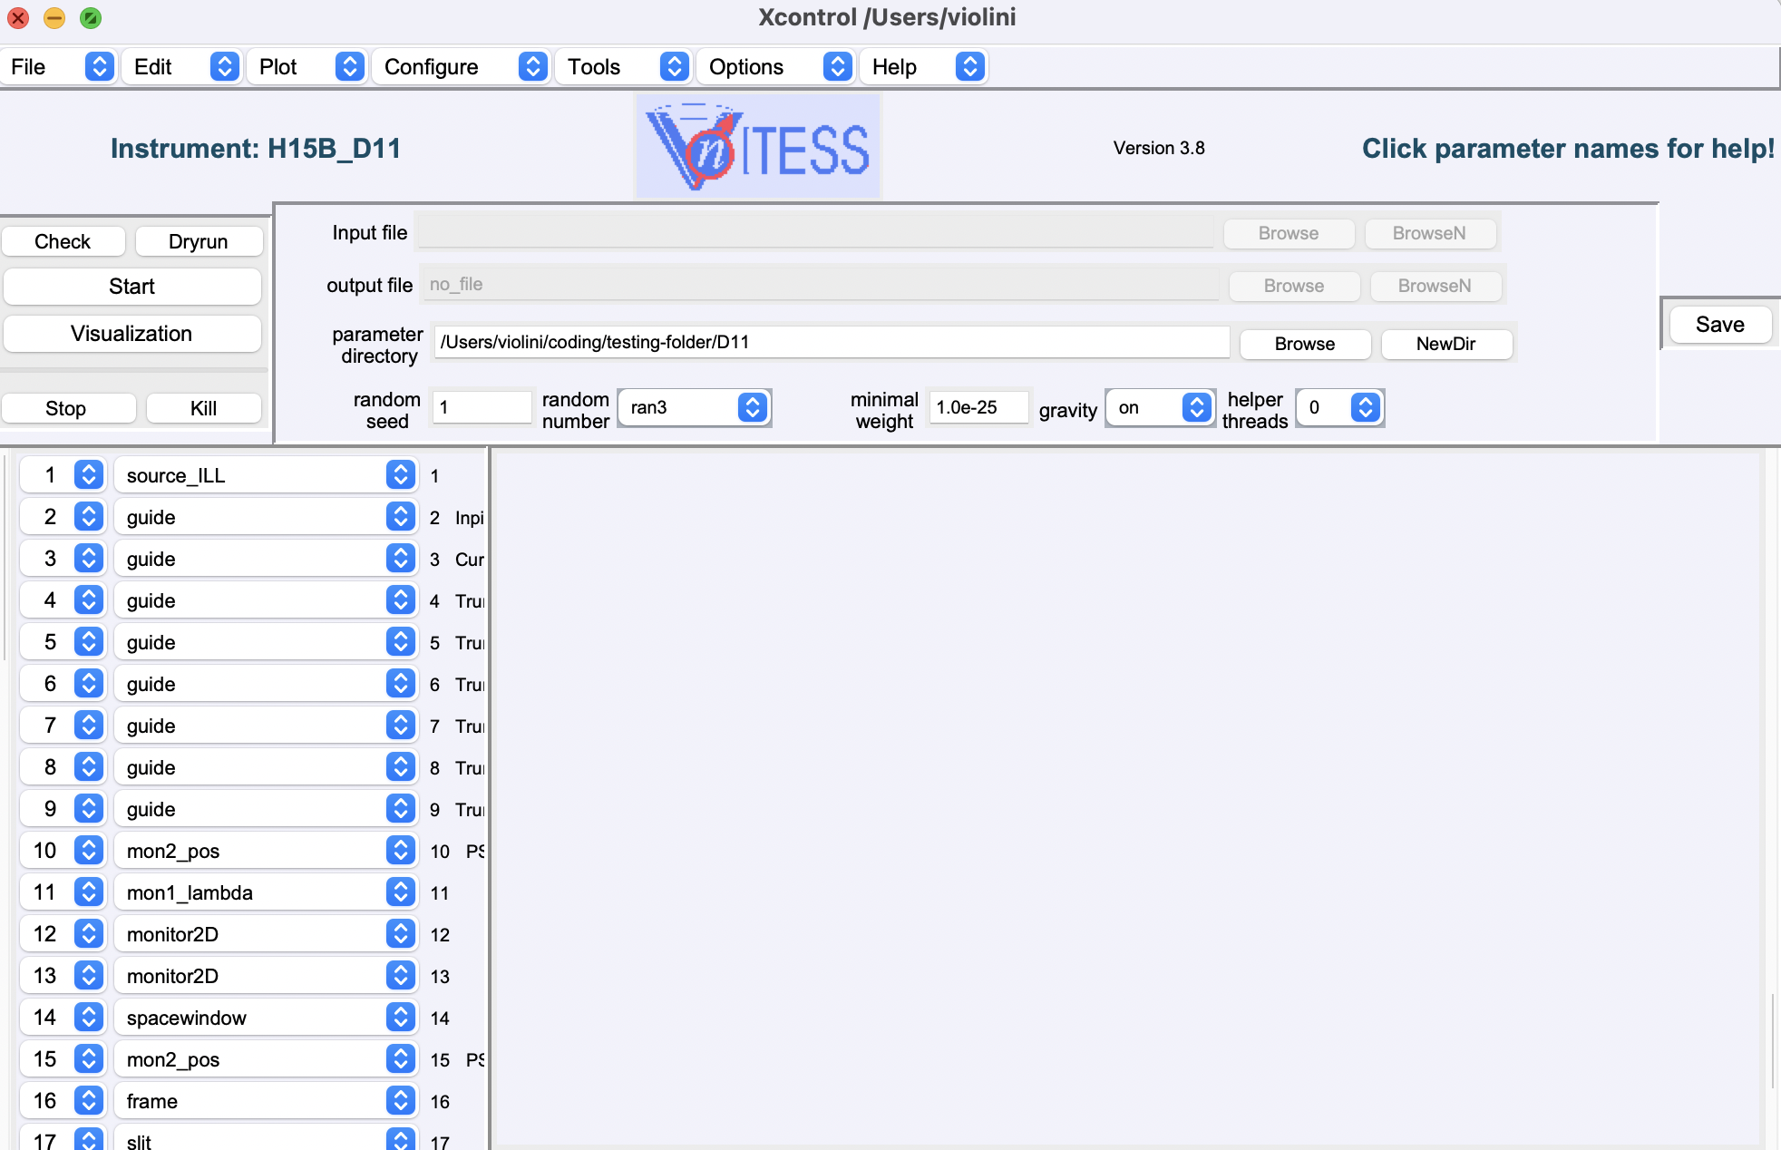
What is vitess
Latest released version is 3.8
Monte Carlo neutron transport
Modular instrument simulation
Used for design & optimisation
Notes:
VITESS is a modular Monte Carlo ray-tracing simulation package for neutron scattering instruments.
Neutrons are represented as rays characterized by position, direction, wavelength, and spin, and are propagated through a sequence of instrument components such as guides, choppers, samples, and detectors.
This modular structure allows flexible construction of virtual instruments and supports both instrument optimisation and virtual experiments.

Slide 4
Vitess
Release Roadmap
Release Version 3.7
Prism
Ncrystal
AI Source
KD Source
Spin-dependent scattering
2025
Q1-2026
Q2-2026
Q3-2026
Q4-2026
2027
Notes:
“In this talk, I will focus on:
the main developments introduced in VITESS 3.7,
In particular, I will highlight improvements in:
source modelling,
physical realism,
and simulation workflows.”

Slide 5
Vitess
Release Roadmap
Release Version 3.7
Prism
Ncrystal
AI Source
KD Source
Spin-dependent scattering
2025
Q1-2026
Q2-2026
Q3-2026
Q4-2026
2027
Release Version 3.8
Reduce technical debt
Update dependencies, compilation on Windows
Update of Monochromator
Notes:
And for what concenrns version 3.8, I’ll give some more details later

Slide 6
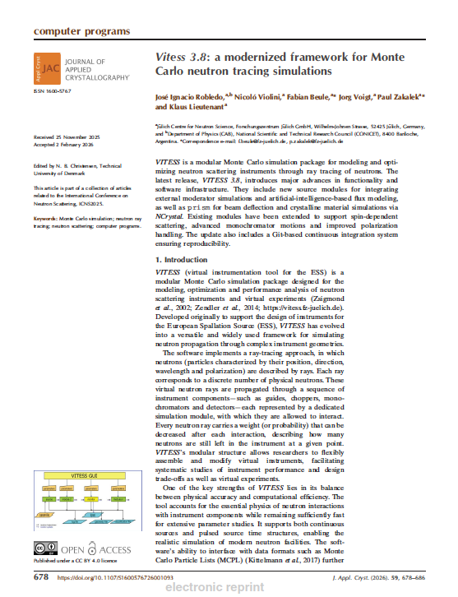
Vitess
J. Appl. Cryst. (2026) 59, 678–686
Release Roadmap
Release Version 3.7
Prism
Ncrystal
AI Source
KD Source
Spin-dependent scattering
2025
Q1-2026
Q2-2026
Q3-2026
Q4-2026
Release Version 3.8
Reduce technical debt
Update dependencies, compilation on Windows
Update of Monochromator
Notes:
This work has been described in more details in the paper that was very recently published in JAC

Slide 7
Vitess
Release Roadmap
Release Version 3.7
Prism
Ncrystal
AI Source
KD Source
Spin-dependent scattering
Version 4
New GUI (PyQt)
New Python library to work with instruments in py scripts
LiveMode for Digital Twins
2025
Q1-2026
Q2-2026
Q3-2026
Q4-2026
2027
Release Version 3.8
Reduce technical debt
Update dependencies, compilation on Windows
Update of Monochromator
Notes:
And I will talk about some ongoing work towards future versions.

Slide 8
Vitess
Release Roadmap
Release Version 3.7
Prism
Ncrystal
AI Source
KD Source
Spin-dependent scattering
Version 4
New GUI (PyQt)
New Python library to work with instruments in py scripts
LiveMode for Digital Twins
2025
Q1-2026
Q2-2026
Q3-2026
Q4-2026
2027
Release Version 3.8
Reduce technical debt
Update dependencies
Compilation on Windows
Update of Monochromator
Version 5
Modernize and port to C++
Large library of reusable code
Some modules running on GPUs

Slide 9
Vitess 3.7
Overview
  AI-Source
  KD-Source
Improved coupling between moderator simulations and instrument modelling, use of MCPL based input
  Ncrystal integration
  Spin-dependent scattering
New physics capabilities
Extended ability to work with neutron spin
  Prism
  Moving monochromator
Neutron refraction
Ability to simulate more complex cases such as Doppler, rotating crystals, Phase Space Transformer
Notes:
Version 3.7 introduces several important developments, which can be grouped into three main areas:
improved coupling between moderator simulations and instrument modelling,
extended physics capabilities,
and new instrument components.
These developments are largely driven by the need for more realistic and flexible simulations.

Slide 10
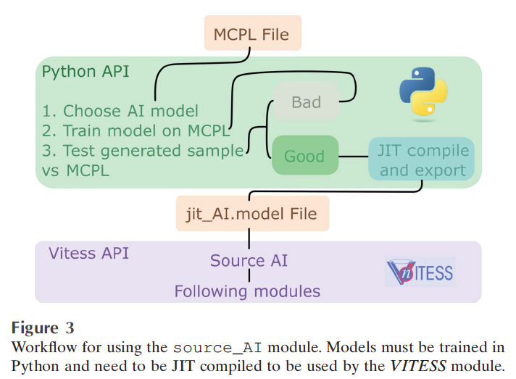
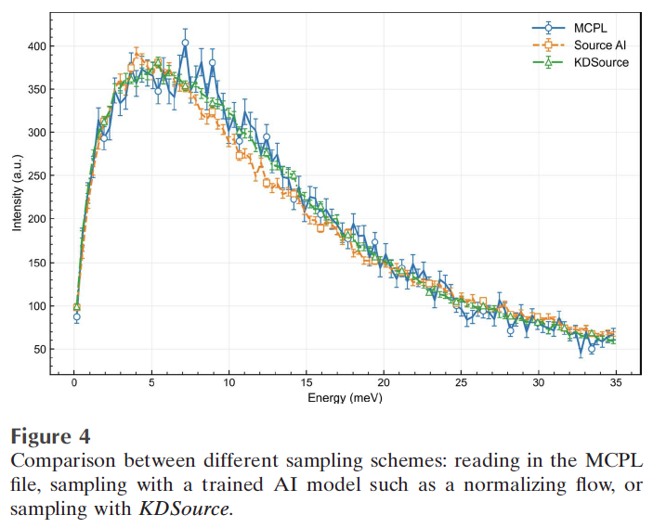
Vitess 3.7
KD Source (trajectory module) & Source AI (source module)
Notes:
This is one of the most relevant developments for neutron source facilities.
A key challenge is how to efficiently use detailed neutron distributions from moderator simulations, for example from MCNP or PHITS.
Two approaches have been introduced:
First, KDSource, which uses kernel density estimation to sample neutron phase space and generate additional trajectories from existing datasets. This allows improved statistical accuracy without rerunning expensive simulations.
Second, the source_AI module, which uses generative models trained on Monte Carlo particle lists to reproduce the full multidimensional neutron phase space.
These models can then be used to efficiently generate new neutrons, enabling repeated simulations or parameter studies without reusing large input datasets.
Together, these approaches significantly improve the coupling between moderator simulations and instrument modelling.

Slide 11
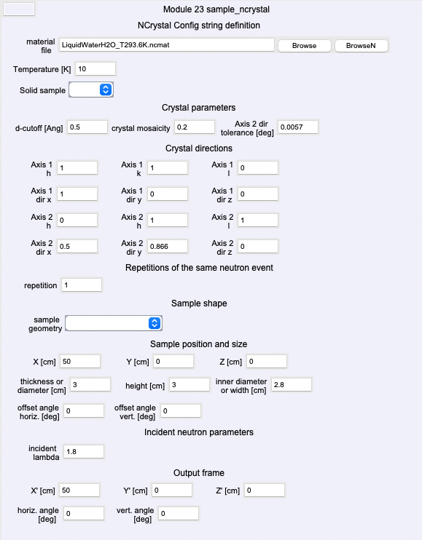
Vitess 3.7
Ncrystal integration
Required input
Material file
T
Solid sample: y/n
Crystal paramters: d-cutfoff, mosaic, axis2 tolerance
Crystal axes directions (h,k,l) (x,y,z)
Sample shape: hollow-cyl, cyl, sphere, cuboid
Sample pos and size
Incident neutron wavelength
Output frame
Notes:
In addition to source modelling, VITESS 3.7 extends the physical realism of simulations.
The integration of the NCrystal library enables detailed modelling of neutron interactions in crystalline materials, including coherent and incoherent scattering processes.

Slide 12
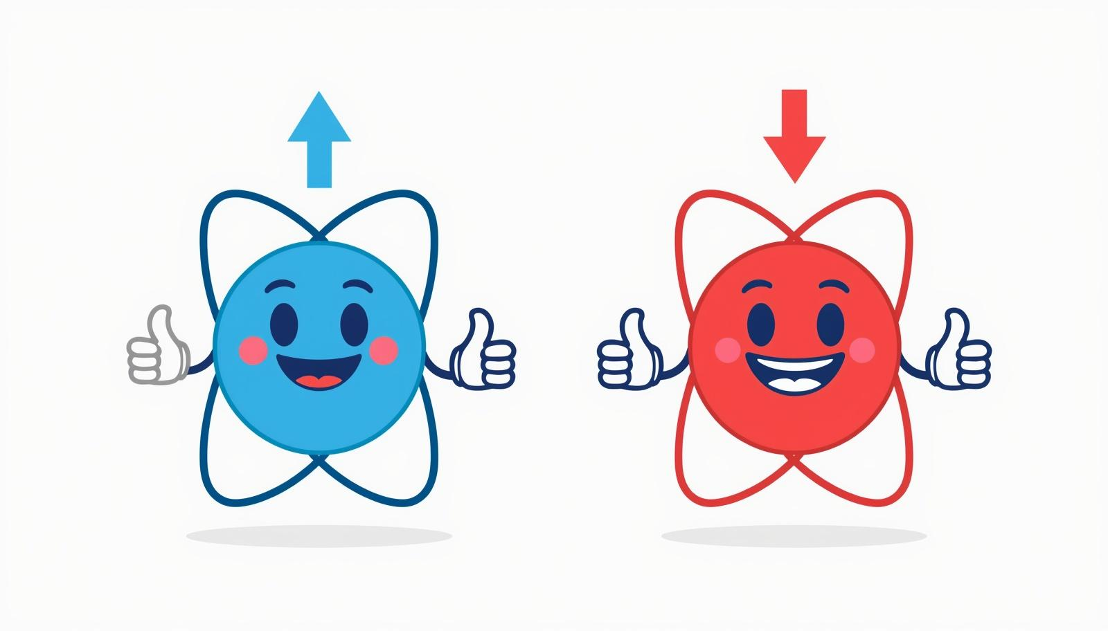
Vitess 3.7
Spin dependent scattering
Spin manipulation was found faulty and fixed in the following modules:
  polariser_he3
  polariser_sm
  pol_mirror
  flipper_coil
Recommendation to our users:
Please download the latest VITESS version and check any polarisation device
Notes:
Spin manipulation was found faulty in some modules and fixed.
Spin-dependent scattering is now supported in inelastic simulations, allowing polarization effects to be treated consistently.
The kernel function Sqw enables the option to add nuclear incoherent scattering to the already existing coherent scattering around a specific dispersion relation.
The typical spin-flip 1/3 2/3 probability is implemented.
To be able to treat the data correctly, the spin option was also added to the eval_inelast and the detector modules.

Slide 13
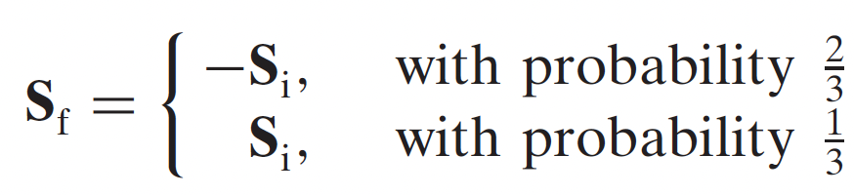

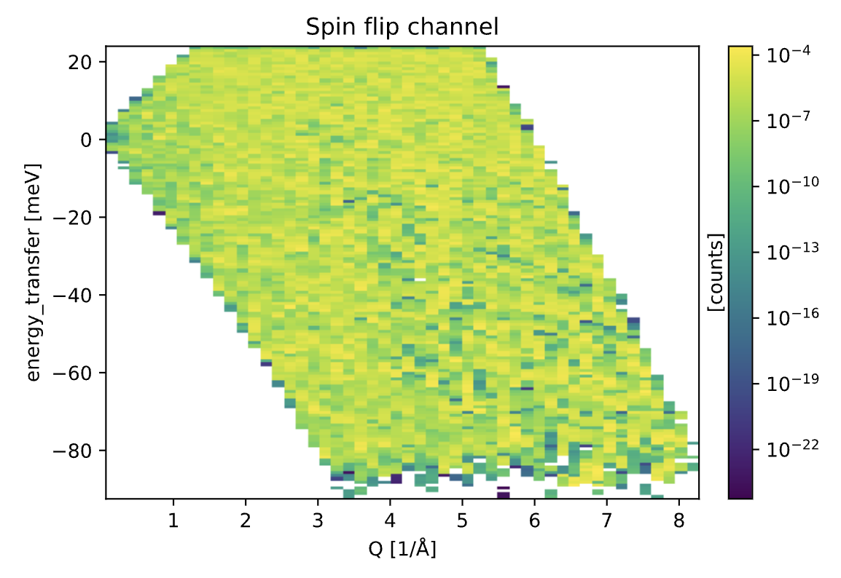
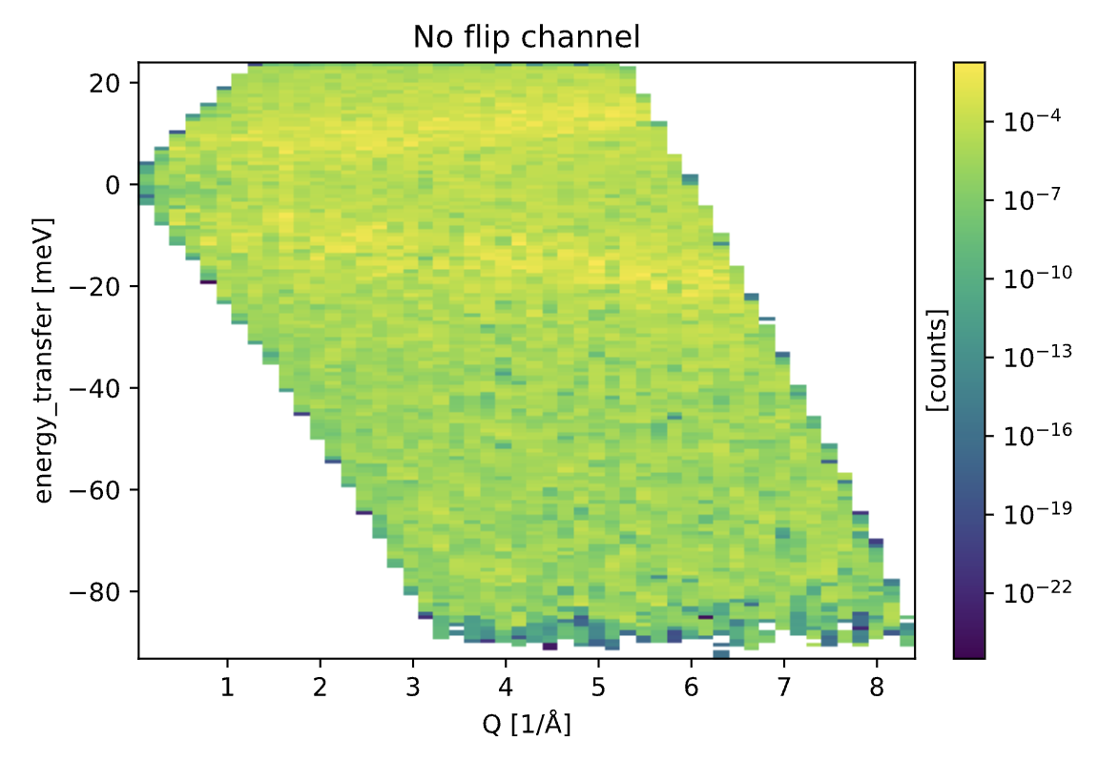
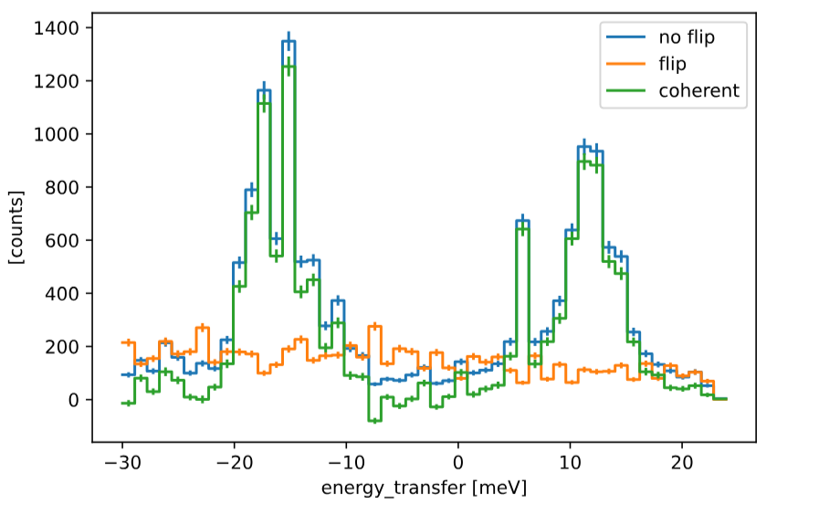
Vitess 3.7
Spin dependent scattering
Spin-dependent inelastic scattering: the spin option added to the following modules:
  sample_inelast
  eval_inelast
  detector
Fixed-Q slice
Notes:
Spin manipulation was found faulty in some modules and fixed.
Spin-dependent scattering is now supported in inelastic simulations, allowing polarization effects to be treated consistently.
The kernel function Sqw enables the option to add nuclear incoherent scattering to the already existing coherent scattering around a specific dispersion relation.
The typical spin-flip 1/3 2/3 probability is implemented.
To be able to treat the data correctly, the spin option was also added to the eval_inelast and the detector modules.

Slide 14
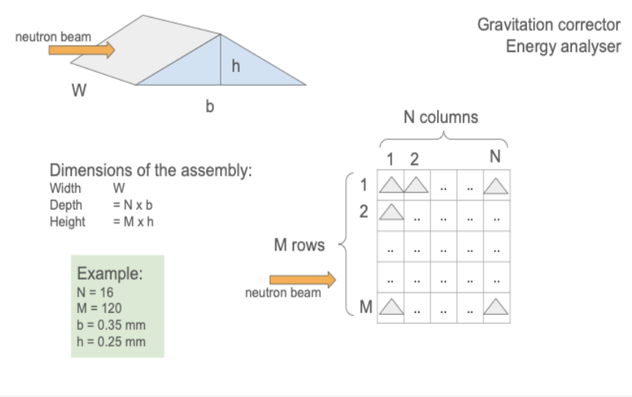
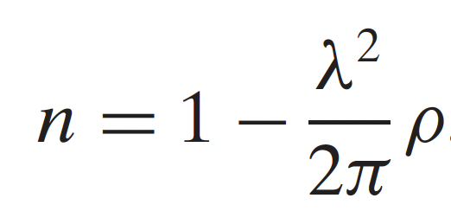
Vitess 3.7
Prism – developed from the original contribution by T. Krist (NOB)
Simulates neutron refraction by a prism or a stack of prisms
Notes:
A new feature we added to Vitess is the prism module.
This is able to reproduce an assembly of NxM prisms
The purpose is correction of gravity effects on long lambdas

Slide 15
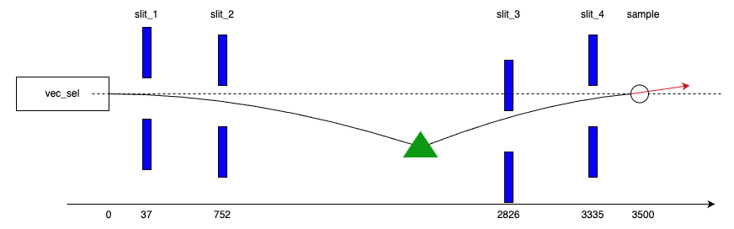
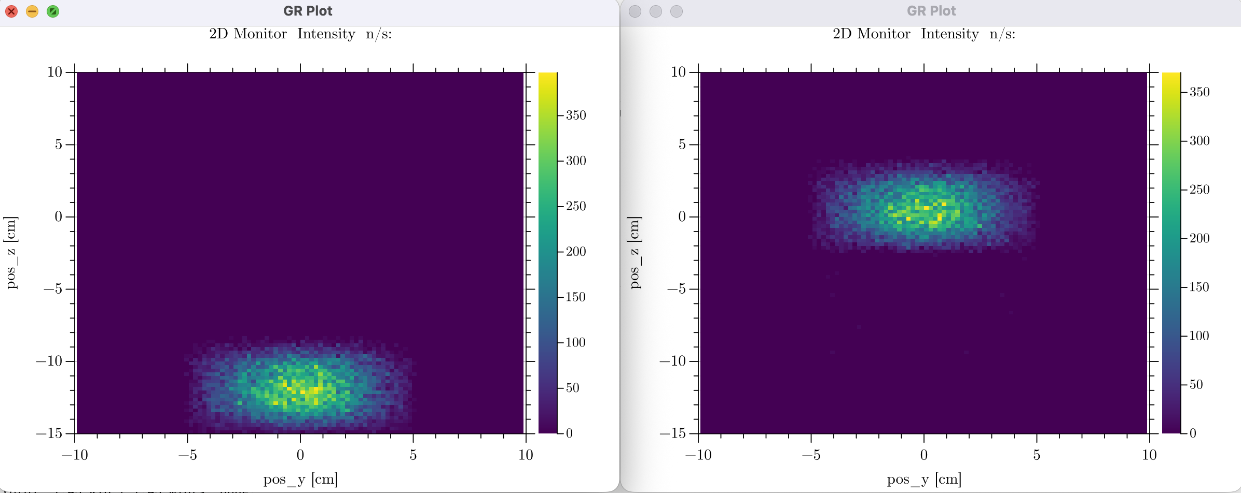
Vitess 3.7
Prism
Simulates neutron refraction by a prism or a stack of prisms
Example: D11 @ ILL
Neutron wavelenght: 20 Å
prism-sample distance: 17.5m
Without prism
With prism
2D pos monitor at sample
Notes:
Here you can see a study case we’re currently working on for the SANS instrument D11 @ ILL
You can see the effect of the prism is to deflect the entire neutron beam back into z=0 at the sample position.
We are validating the impact on chromatic aberrations as we speak.

Slide 16
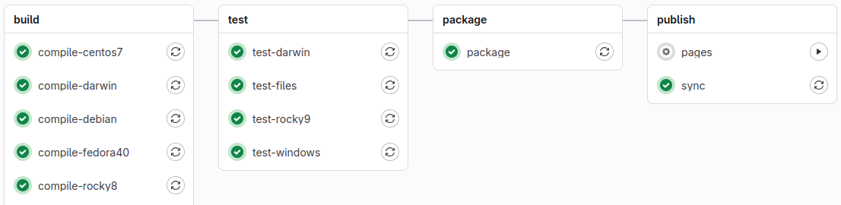
Vitess 3.8
Overview
automated module testing for regression, memory leaks, and undefined behaviour
230 automated tests
Notes:
The recent release of version 3.8 focuses on improving the codebase: more robust, improved reproducibility, and usability.
This includes:
automated testing of modules at the level of individual neutron trajectories,
integration of continuous integration workflows,

Slide 17
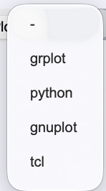
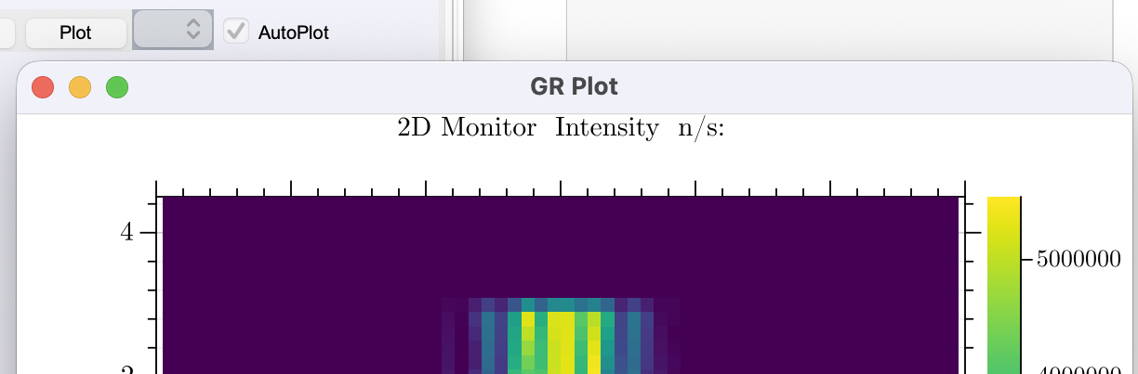
Vitess 3.8
Overview
automated module testing for regression, memory leaks, and undefined behaviour,
improvements in the graphical interface and plotting tools
Notes:
3.8 includes also improvements in the graphical interface and visualization, as now the default option is Grplot, that is integrated in the package

Slide 18
Vitess 3.8
Overview
automated module testing for regression, memory leaks, and undefined behaviour,
improvements in the graphical interface and plotting tools,
better cross-platform support (ex. KDSource on Windows and Source_AI on MacOS)
various fixes in modules such as monochromators and monitors.
Notes:
and better cross-platform support.
These developments ensure that the simulation results are reliable and reproducible after a new deployment, which is essential for instrument design studies.

Slide 19
Vitess
Outlook – upcoming versions
Qt will be used for the next graphical interface
Instrument files will be written in .yaml format
Python library to enable programmatic instrument definition and integration with python-based workflows
Port the code to C++ and GPUs
design tool
a platform for comprehensive
neutron experiment simulation
from a
towards
Notes:
Looking ahead, development continues towards future versions of VITESS.
This includes:
a new graphical interface,
Python-based workflows for instrument definition,
and further developments towards digital twin capabilities.
Overall, VITESS is evolving from a tool for instrument design towards a more comprehensive framework for neutron experiment simulation.

Slide 20
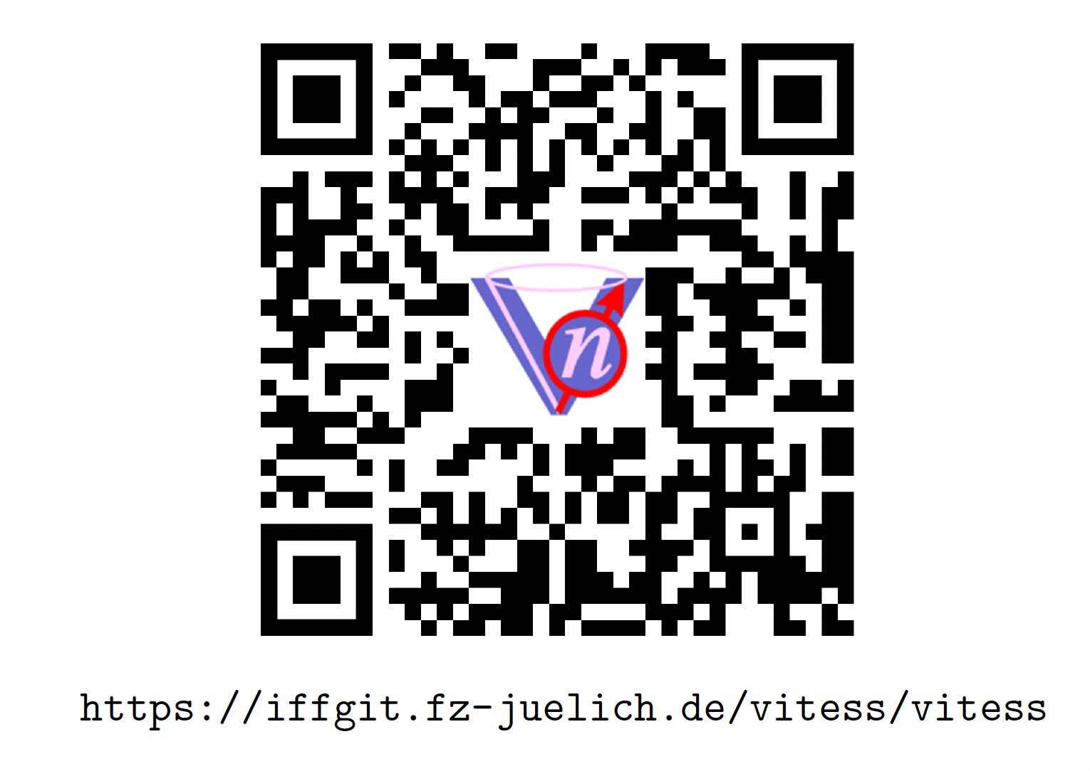
Vitess
Conclusions
VITESS 3.7 introduces significant advances in source modelling and physics capabilities, enabling improved coupling between moderator simulations and instrument modelling
VITESS 3.8 focuses on robustness and usability
VITESS 4 and 5 will enable more comprehensive virtual experiments and digital twins
Scan the QR-code
and
download the latest version!
Visit the website https://vitess.fz-juelich.de
Notes:
To conclude:
VITESS 3.7 introduces major advances in source modelling and physics capabilities,
enabling improved coupling between moderator simulations and instrument modelling,
VITESS 3.8 focuses on robustness and reproducibility,
and ongoing developments support the transition towards virtual experiments and digital twins.

Slide 21
Thank you for your attention!
We thank the VITESS user community for their
contributions, feature requests and feedback,
which directly drive the development of the code.

