Slide 2
Beam-on-Target Instrumentation: Tuning, Monitoring, and Beyond
Presented by Cyrille Thomas

Slide 3
Outline
Beam on target properties
Instrumentation suite
Focus on IMG
Data collection and applications

Slide 4
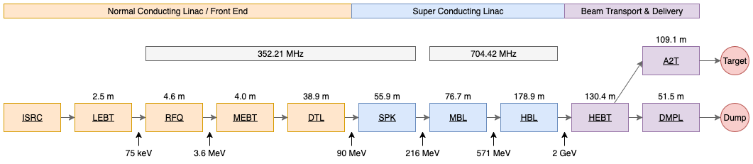
Beam Properties – ESS accelerator
Tunning:
Current: 1mA - 62.5mA
Pulse: 5µs - 2.86ms
Frequency: 1Hz - 14Hz
Energy: 216MeV - 2GeV
Peak power: 216kW - 125MW
Average power: 216mW - 5MW
Production:
Current: 62.5mA
Pulse: 2.86ms
Frequency: 14Hz
Energy: 2GeV
Peak power: 125MW
Average power: 5MW
Average beam size: 3mm

Slide 5
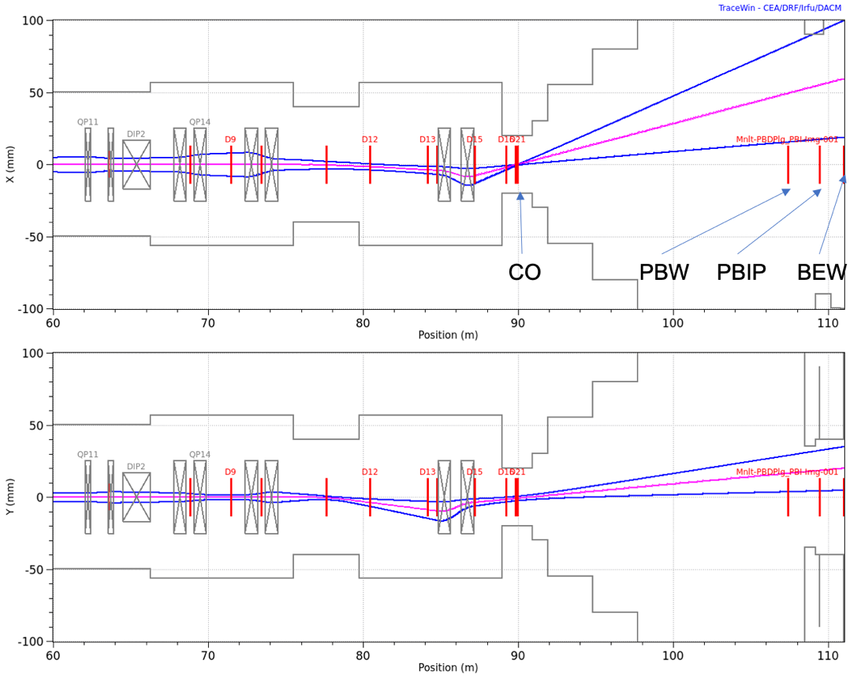
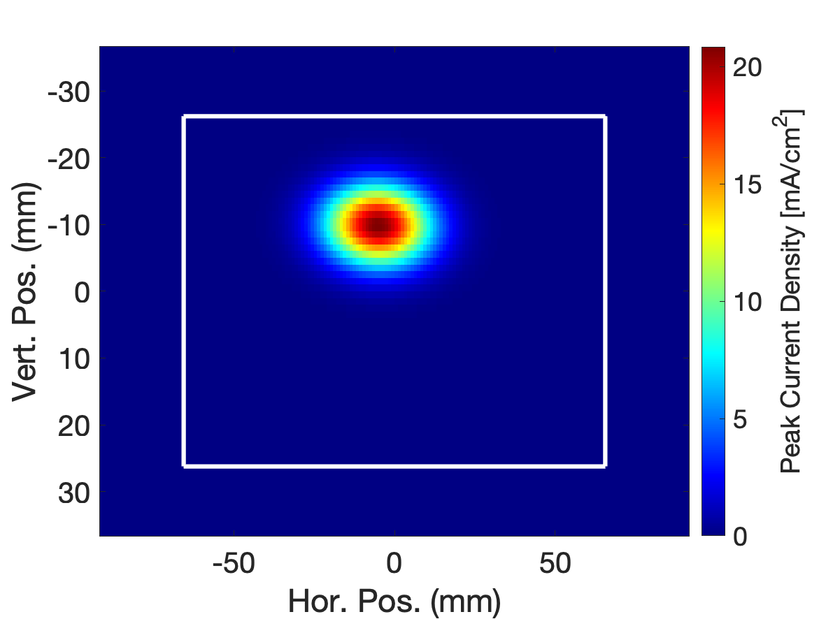
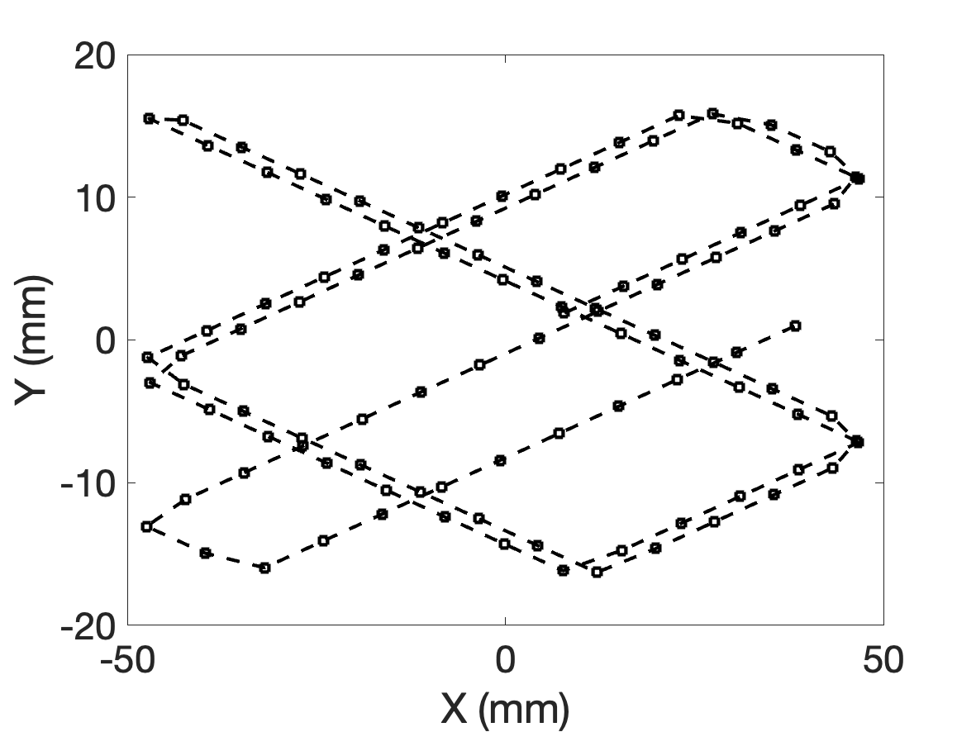
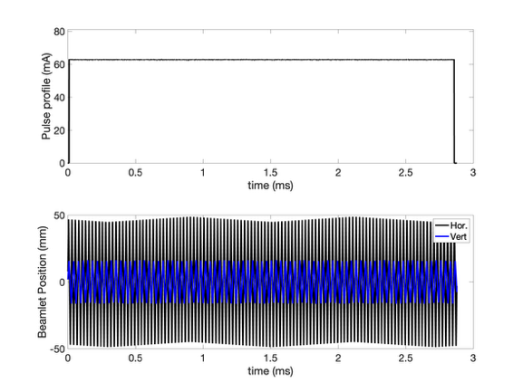
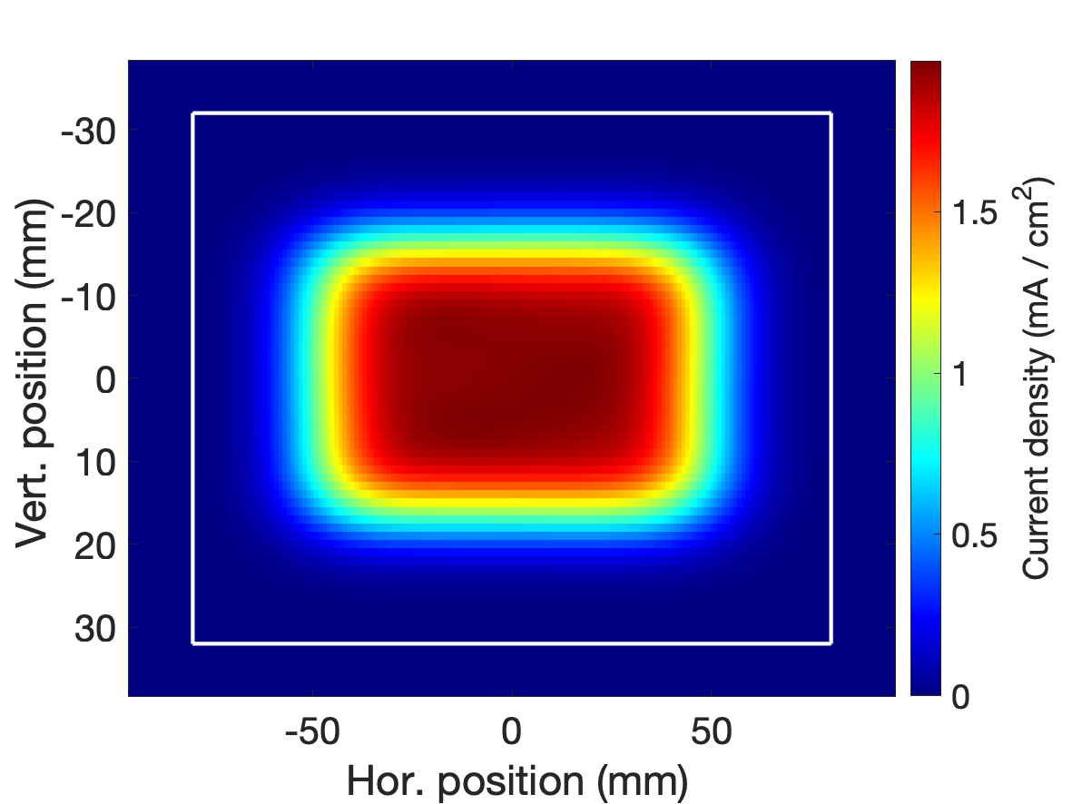
Beam Properties on ESS Target
courtesy from Y. Levinsen
pulse
62.5mA
2.86ms
Energy & current known (BPM & BCM)
Tuning:
Centre the beam: H ± 5mm, V ± 3mm
Set the lattice: beam size: H 13.5±1.4mm, V 5±0.5mm
Set the raster magnets: deflection amplitude H 60±6mm, V 20±2mm
Beamlet current and position
62.5mA x 2GeV = 125MW

Slide 6
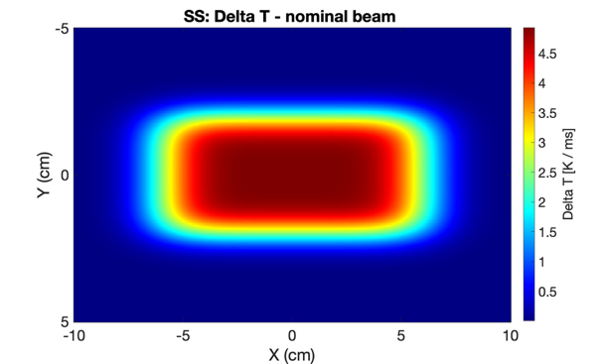
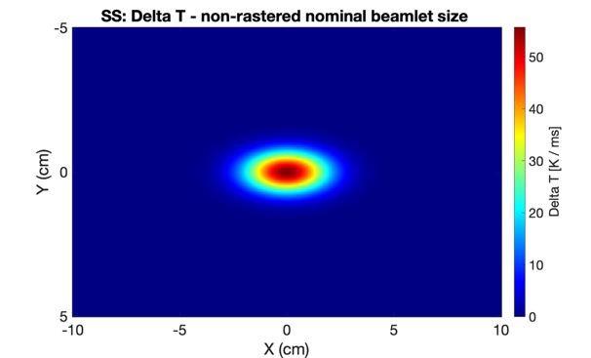
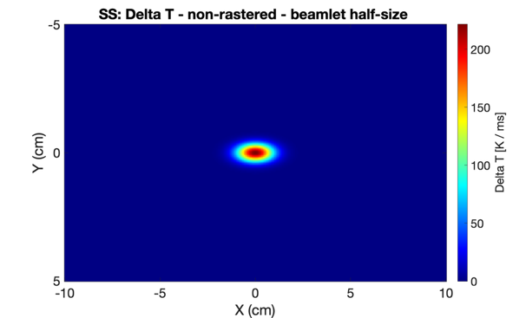
High Power Proton Beam
From tuning to production:
1.3cm x 0.5cm
0.65cm x 0.25cm
W to MW beam power
increasing pulse length, frequency and current
Potential beam damage
Melting
Thermo-mechanical stress, fatigue
Example: 570MeV, 62mA
ΔT [ K / ms ] for materials
Risk of single pulse damage exist
Most condition leads to damage in many pulses
Material | Nominal beam | Static, nominal beamlet size | Static, half nominal beamlet size
SS | 5 | 56 | 222
Al | 3 | 34 | 134
W | 14 | 155 | 620
Required:
Control beamlet size
Control raster beam
Interlock within one pulse period (71ms)
ΔT [ K ] for Aluminium
Mode | Nominal beam | Static, nominal beamlet size | Static, half nominal beamlet size
Slow Tuning (50µs) | 0.15 | 1.7 | 7
Production (2.86ms) | 8 | 94 | 375

Slide 7
Diagnostics Suites
Complementary diagnostics: permits rapid and trustable verification
Redundancy: permits high availability and reliability
Fast and accurate online measurement supporting tuning, production and machine protection
IMG TW: 2D profile
GRID PBIP: 1D profile H and V
APTM PBIP: Halo, beam loss
IMG PBW: 2D profile
APTM PBW: Halo, beam loss

Slide 8
Diagnostics complementarity and redundancy
 | IMG | GRD | APTM
Beam position
Beam size
Edges positions
Current Density Distribution
Beamlet position
Beamlet size
Beam loss and halo
Raster pattern
Online systems
Supports:
Beam tuning: set beam properties
Beam operation: detect errant beam condition
Direct observation
All instruments in the suite play an important role, but let's focus on IMG
Indirect observation

Slide 9
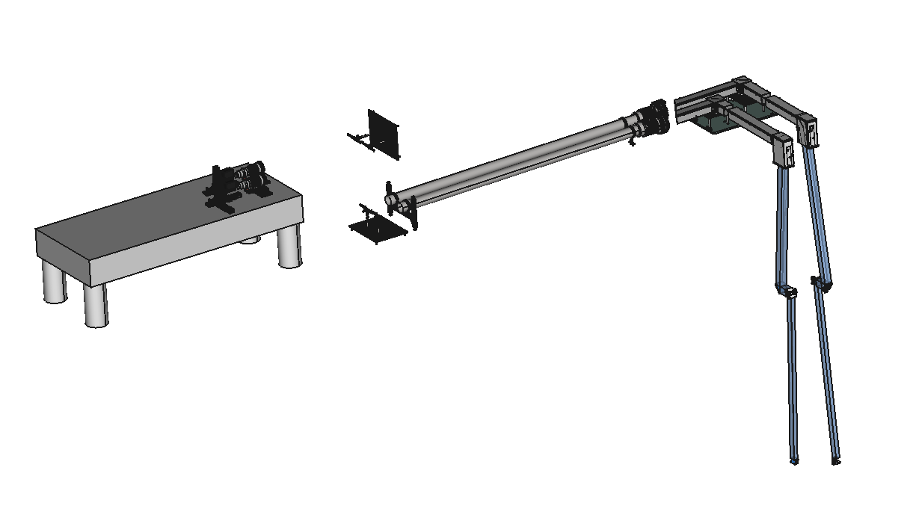
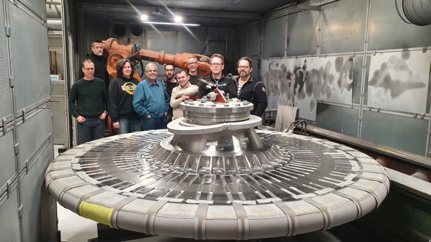
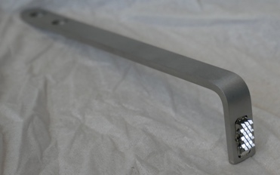
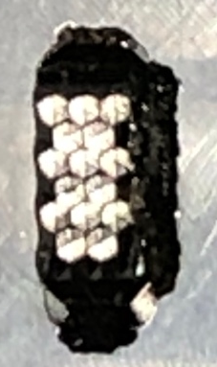
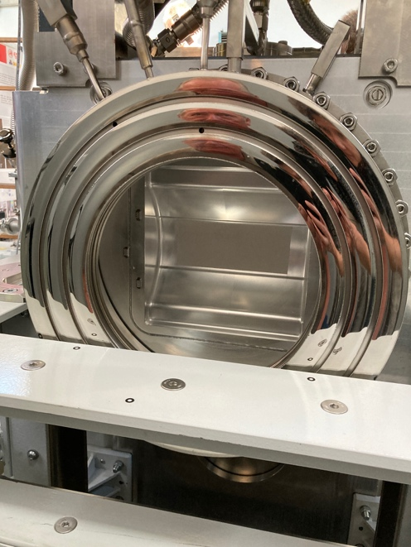
T-IMG
System overview
optics
TW coating
M5
Camera
+
FPGA based image processing
real time analysis and interlock
lenses
M7
M4
M6
M3
M2
TW retro-reflector
TW
PBW coating
PBW retro-reflector
M1
beam
PBW
Luminescent coating
Source: luminescent material

Slide 10
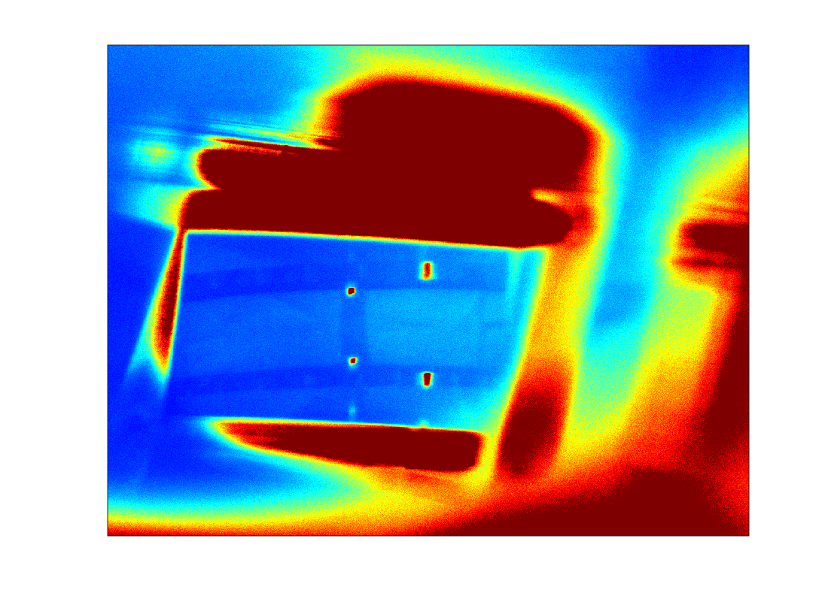
After:
alignment of the mirrors, camera, lighting system,
focussing right
set the TW on the reference position
TW RR positions: reference
10º
dz
dx = phase
sector 1
sector 36
RR
0º
synchronisation: 10º / 14Hz period
beam
M1
RR on moderator (missing)

Slide 11
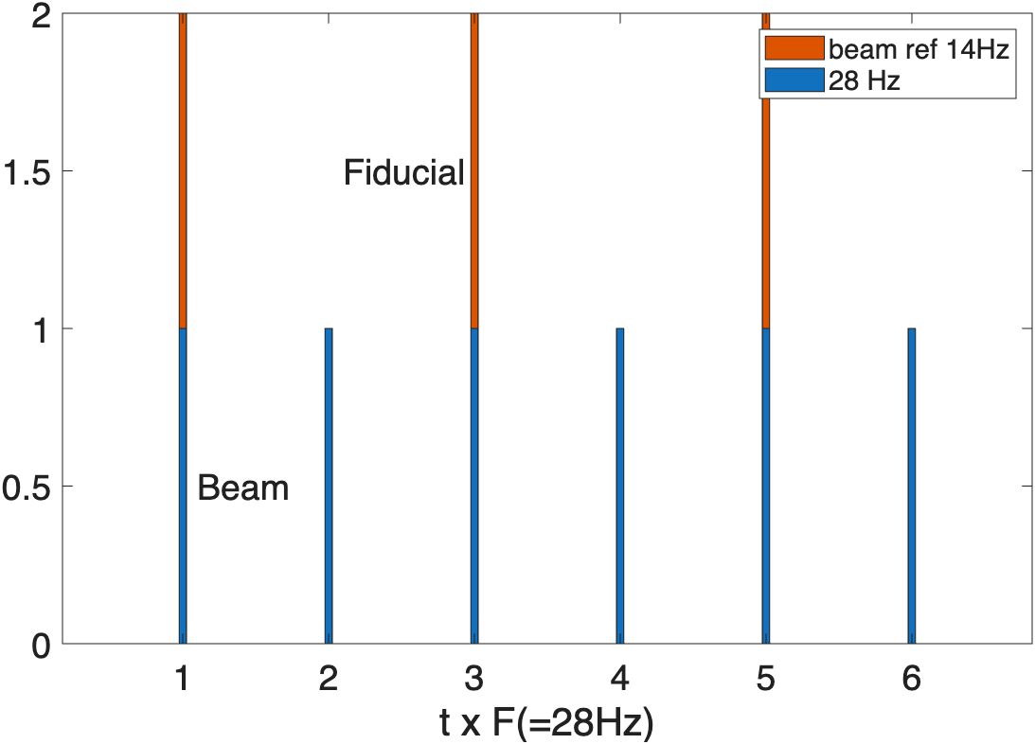
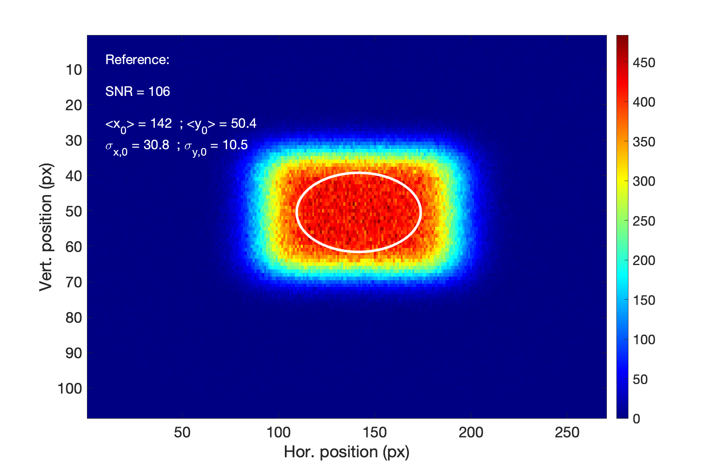
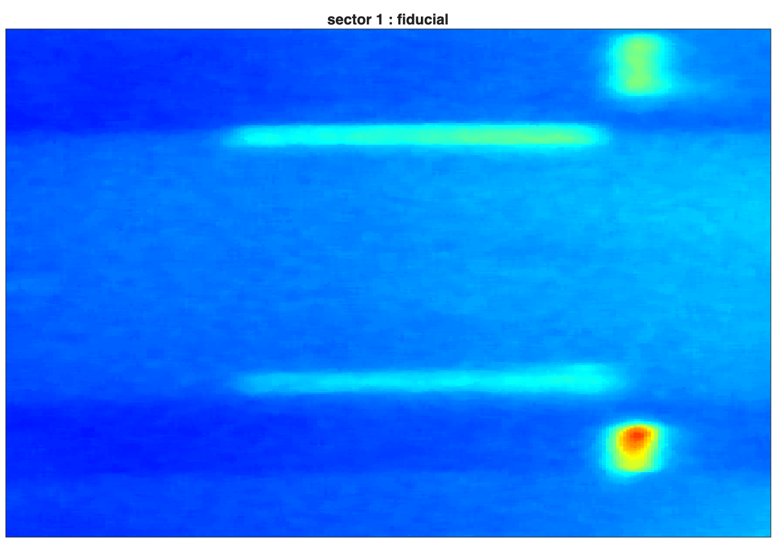
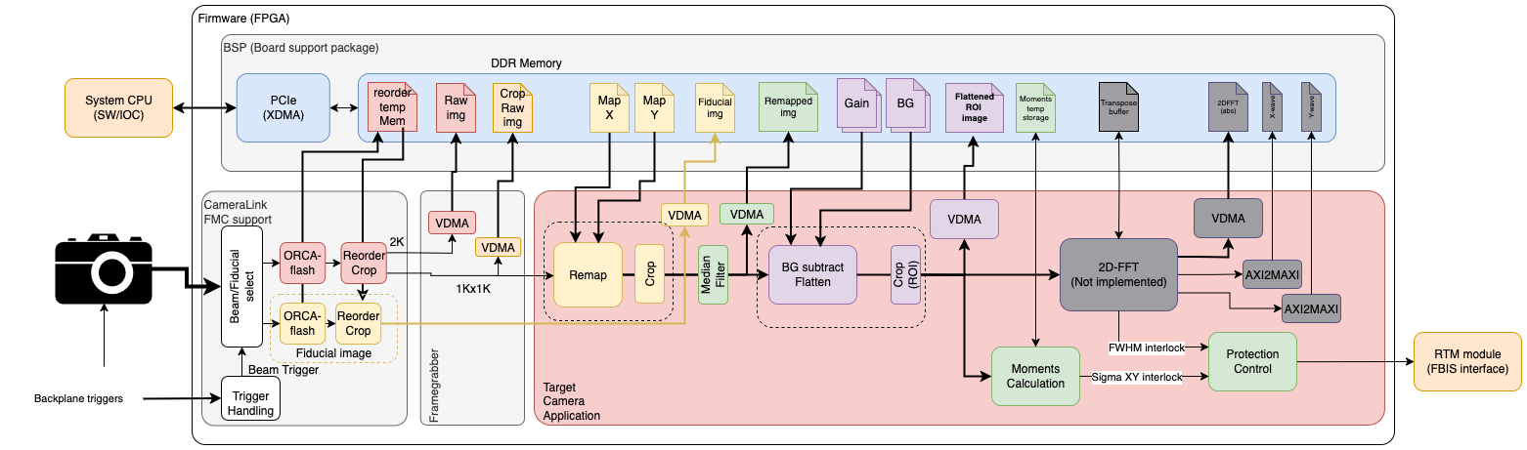
FPGA processing
Beam image
Fid. image
SW: FPGA control settings and displays
28Hz
triggers
14Hz
Beam timing ref
Aberration correction
Pre-conditioning
Errant condition check

Slide 12

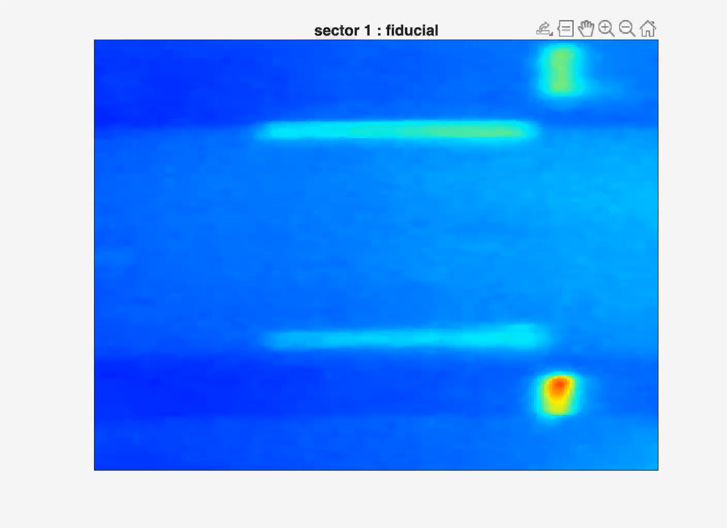
Camera speed is 28 fps:
one frames shows the beam
the other shows the RR fiducials when synchronously illuminated
2 turns, synchronous speed 28 frames/s
1 turns, 2 frames / s
RR fid. on sectors 1, 15, 26

Slide 13
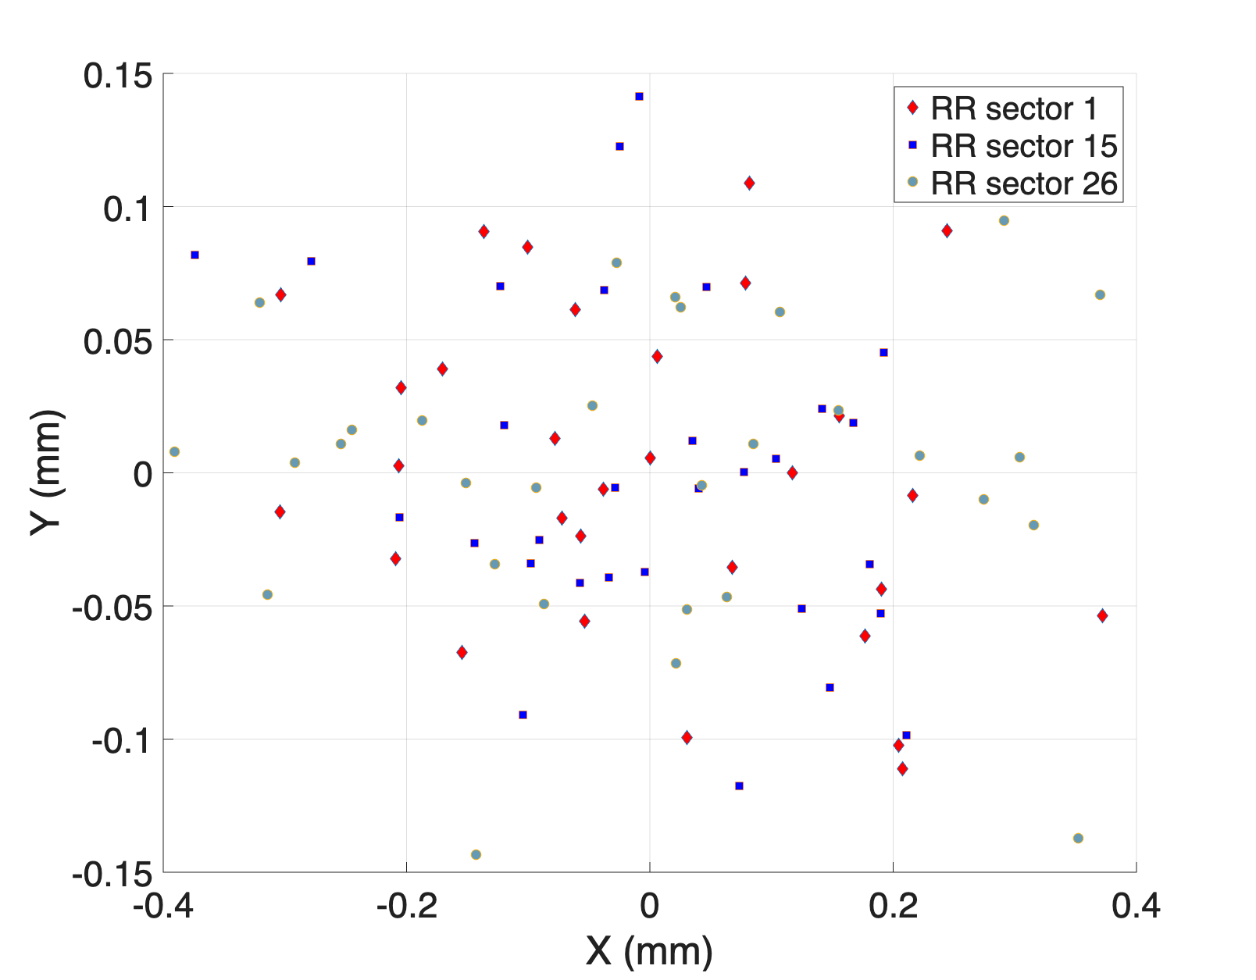
Early checks!
correction for geometrical aberration needed
System magnification
L =83.3mm ± 0.57
Magnification: 0.0114 ± 0.7%
L = 60.439 ± 0.57
Relative position for each RR fiducials
Standard deviation position | Value
vert. top RR | 0.061 mm
hor. top RR | 0.173 mm
L = 61.6mm – from TW diameter
error: 2%

Slide 14
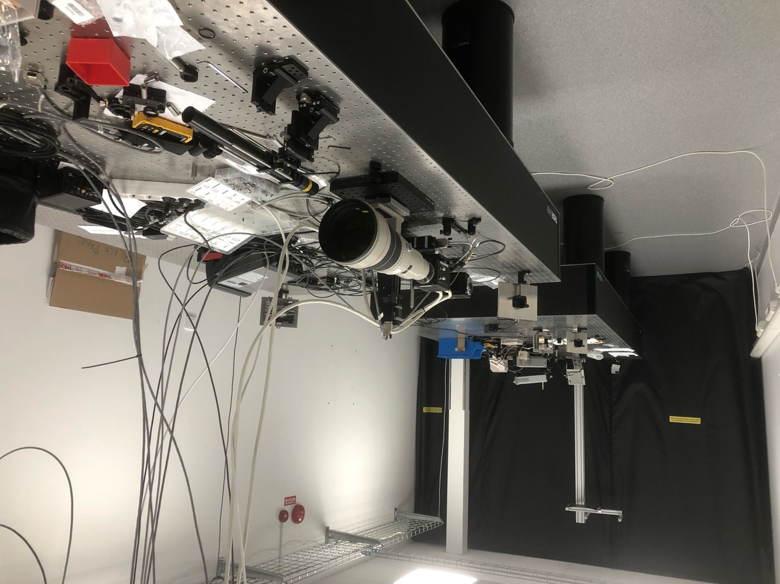
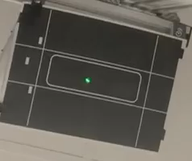
Lab system
Full replica of TW or PBW design
Laser raster system develop and deployed
Verify:
RR fiducial performance and lightning
Alignment procedure
Focussing procedure
Full vertical integration and performance
Lab setup for development
PBW
Laser -raster
M1
M3
M5
M2
M4
Camera
Lens
LED
X: 3Hz -> 10kHz -> 30kHz
Y: 3Hz -> 10kHz -> 32kHz

Slide 15
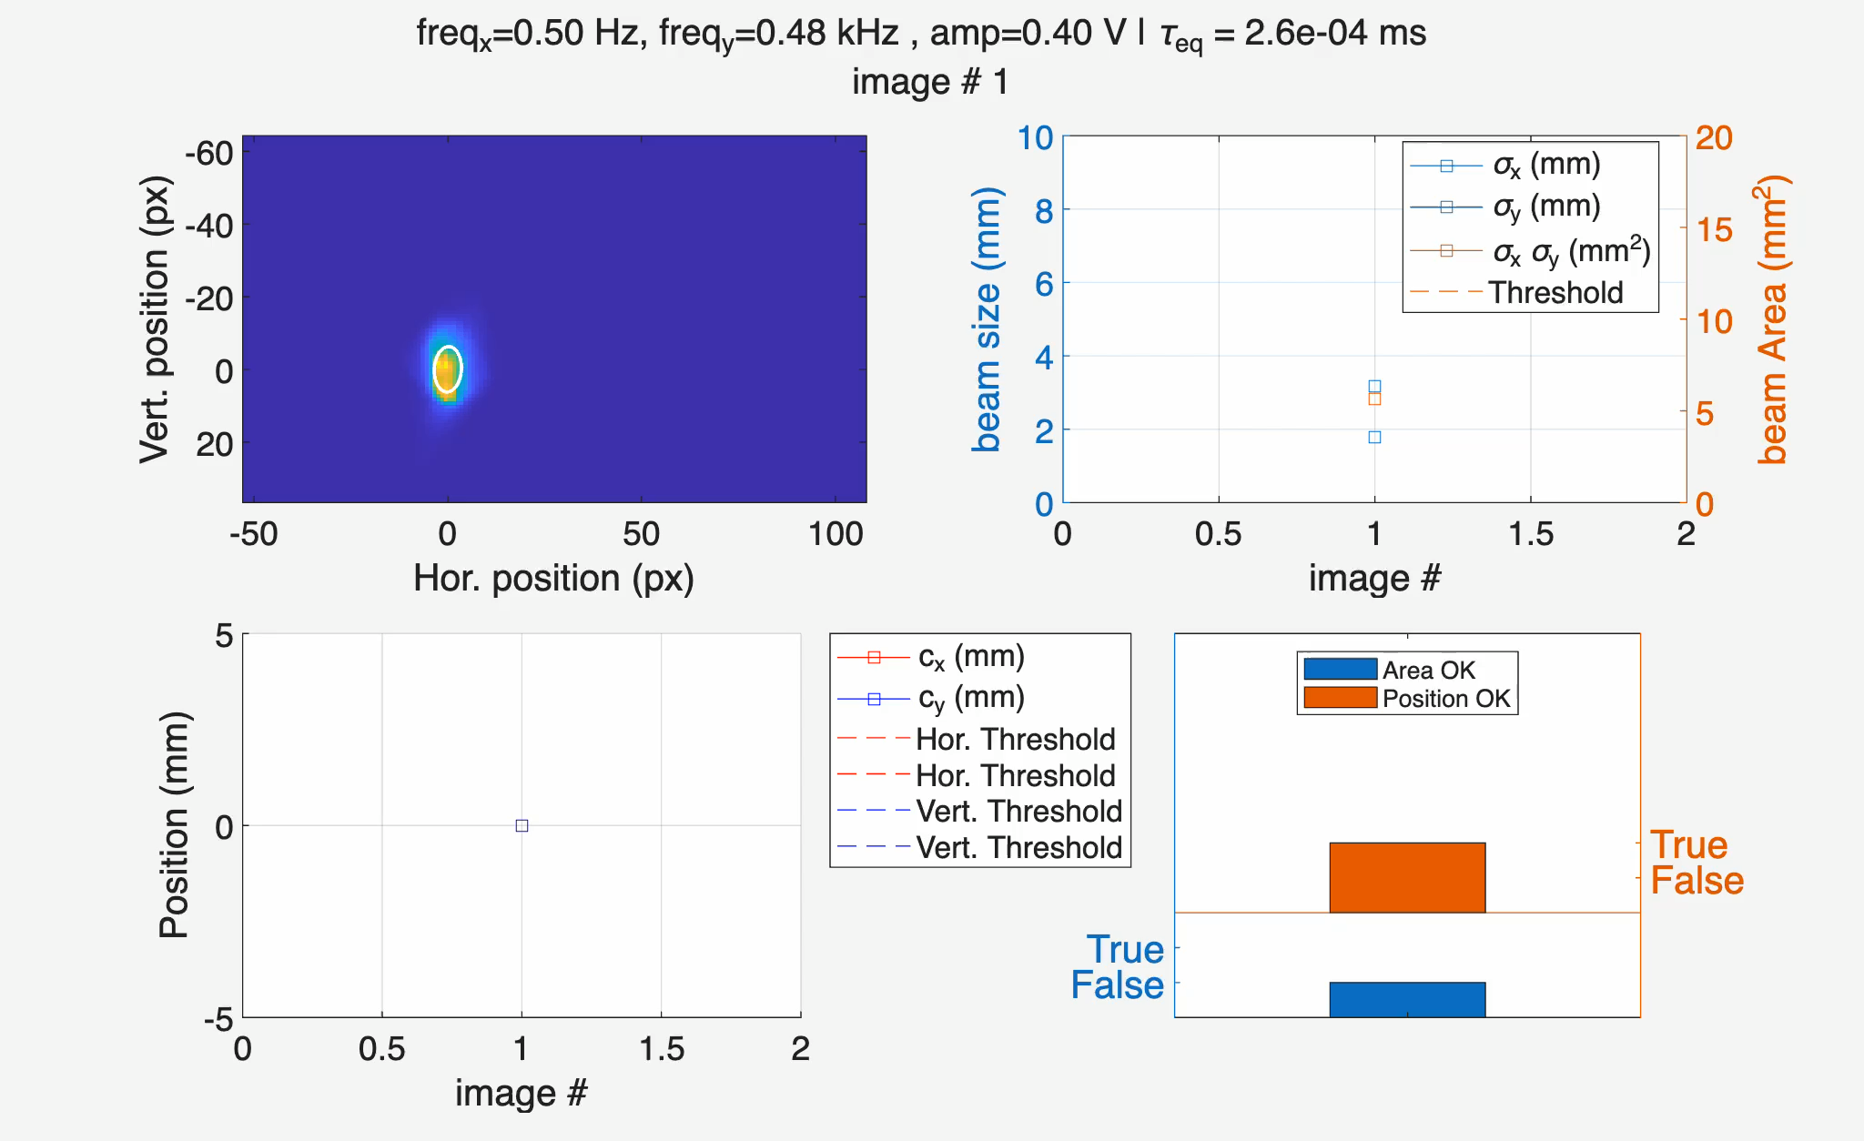
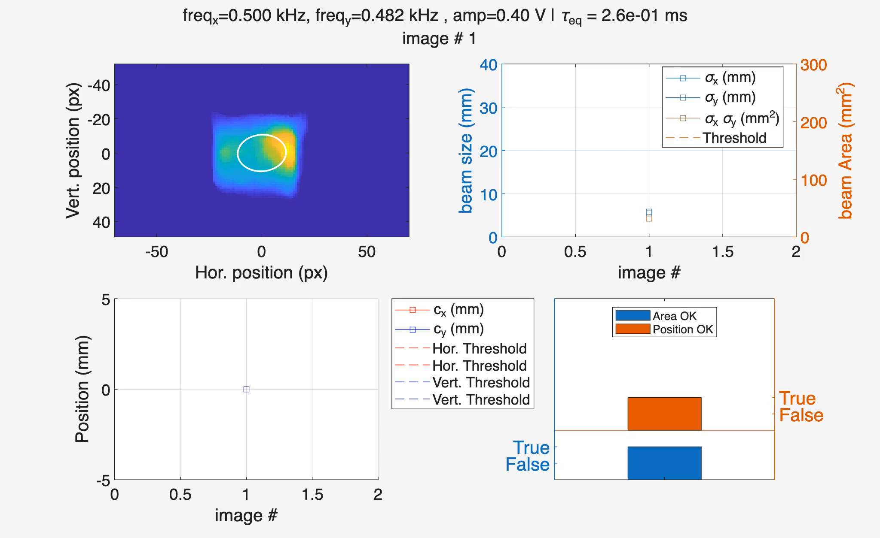
System test and verification
FPGA processing:
Raster frequency: fx =0.5Hz, fx =0.48Hz
Raster amplitude: ax = 24m, ay = 29mm
Camera exposure: 20ms
Short pulse equivalent: 0.26µs
Note: strong vertical jitter, due to screen vibration
Image moments:
centre c_{x}, c_{y}
rms sizes σ_{x}, σ_{y}
Check conditions for FBIS interlock
σ_{x} x σ_{y} > A_{th}
|c_{x}| <c_{x,max} & |c_{y}| <c_{y,max}
Expected beam: small, oscillating driven by raster
-> FBIS interlock: stop beam production.
Raster frequency: fx =500Hz, fx =482Hz
Raster amplitude: ax = 24m, ay = 29mm
Camera exposure: 20ms
Pulse equivalent: 0.26ms
Fid. position compensation
Expected beam: large, stable

Slide 16
… and beyond
Collection of data to build a database:
per pulse
current (BCM: current monitor)
total charge (BCM : current monitor)
position (IMG)
size (IMG / GRD)
2D image profile (IMG)
Raster centre of mass (GRD)
Beamlet size (GRD / IMG post analysis)
Post irradiation analysis
all components in the target area are prone to be irradiated and subject to PIE -> invaluable data fully supporting analysis
Incident analysis
in case of damage of a component, knowing the irradiation history is critical
Machine Learning
new tools available bringing new angle in operation of the machine, data for ML training
commensurate data input for modelling the neutron source

Slide 17
Concluding Remarks
In summary, beam-on-target instrumentation is essential not only for beam tuning but for ensuring safe and reliable operation at high power.
The combination of complementary diagnostics such as IMG, GRID, and APTM provides the necessary redundancy and accuracy to monitor beam properties in real time.
In particular, IMG enables direct 2D observation of beam position, size, and stability, supporting both operation and machine protection.
Finally, the systematic collection of beam data opens new opportunities for post-irradiation analysis, incident investigation, and the development of machine learning tools for future optimization.

Slide 18
Thanks to all collaborators in this project, from ESS and from collaborating institutes.
E. Adli, H. Gjersdal, K. Sjobak - and other collaborators from University of Oslo, Norway
K. Michel, N. Weisend, M. Hartl, H. Kocevar, R.Kuriakose, M. Mohammednezhad, K. Rosengren, S. Ghatnekar Nilsson, R. Baron, M. Dominiak-Sumila, F. Nilen, A. Takibayev, and other collaborators from European Spallation Source ERIC
S. Joshi, S. Bjorklund - University West, Sweden
P. Jatczak and other collaborators from Institute of Electronic Systems, Warsaw University of Technology

Slide 19
Thank you for your attention!

Slide 20
Complementary slides

Slide 21
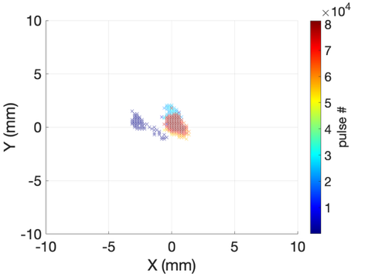
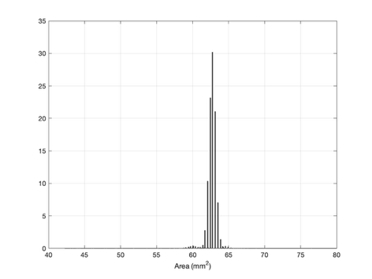
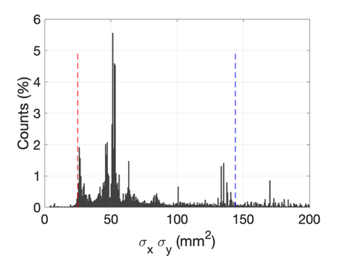
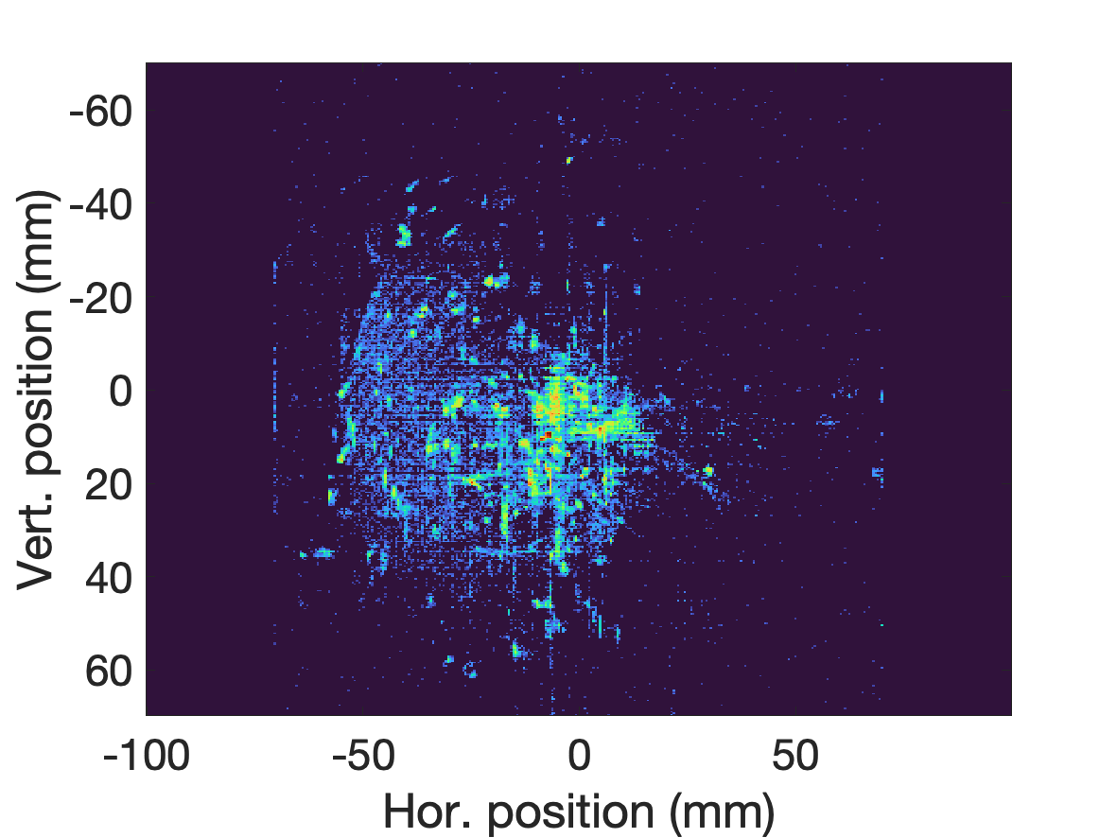
Beam properties statistics over the commissioning
IMG02
Period from April to June
Stability run
Beam area:
Range: 1-200mm²
Some peaks: most prominent at 50mm²
Can be below 25mm²
1.8% of the total pulses are below the lowest limit
The interlock status is changed to NOK for all these events
Beam position
Beam area
Beam position:
Covers the left part of the screen
Notes:
Cavity tuning can only be done with armless beam (ESS probe beam mode)
Once tuned, stable condition can be found.
Mostly close to the centre
Note: position interlock is for BPMs, and BLMs

Slide 22
Beam modes
Beam Mode | Current (mA) | Pulse Length (µs) | Frequency (Hz) | Average Power (kW) @ 2GeV | IMG |  | GRID |  | APTM
 |  |  |  |  | Tuning | MPS | Tuning | MPS | Tuning | MPS
Probe(low-low-low) | 6 | 5 | 1 | 0.06 | ✔︎ | ✗ | ✗ | ✗︎ | ✔︎ | ✗︎
Fast commissioning (low-low-high) | 6 | 5 | 14 | 0.84 | ✔︎ | ✗ | ✗ | ✗︎ | ✔︎ | ✗︎
RF test (low-high-low) | 6 | 50 | 1 | 0.60 | ✔︎ | ✗ | ✗ | ✗︎ | ✔︎ | ✗︎
Stability test (low-high-high) | 6 | 50 | 14 | 8.40 | ✔︎ | ✗ | ✗ | ✗︎ | ✔︎ | ✗︎
Slow commissioning (high-low-low ) | 62.5 | 5 | 1 | 0.625 | ✔︎ | ✗ | ✔︎ | ✗︎ | ✔︎ | ✗︎
Fast tuning (high-low-high) | 62.5 | 5 | 14 | 8.75 | ✔︎ | ✗︎ | ✔︎ | ✗︎ | ✔︎ | ✗︎
Slow tuning (high-high-low) | 62.5 | 50 | 1 | 6.25 | ✔︎ | ✗ | ✔︎ | ✔︎ | ✔︎ | ✗︎
Long pulse verification | 62.5 | 2860 | 0.033 | 11.92 | ✔ | ✔ | ✔ | ✔ | ✔ | ✔
Production | 62.5 | 2860 | 14 | 5005 | ✔ | ✔ | ✔ | ✔ | ✔︎ | ✔
From Slow tuning to Production
All Tuning modes
Commission instrumentation
Increase pulse length
Increase frequency
increase current
Production:
Raster monitoring required for beam permit

Slide 23
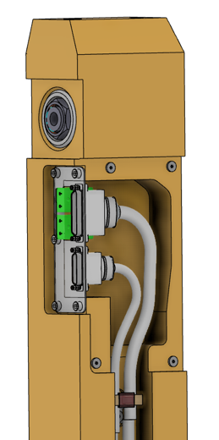
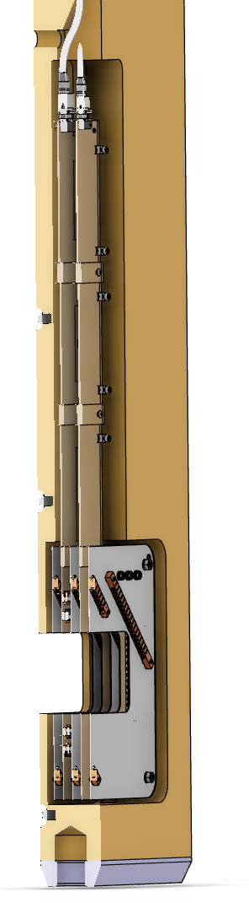
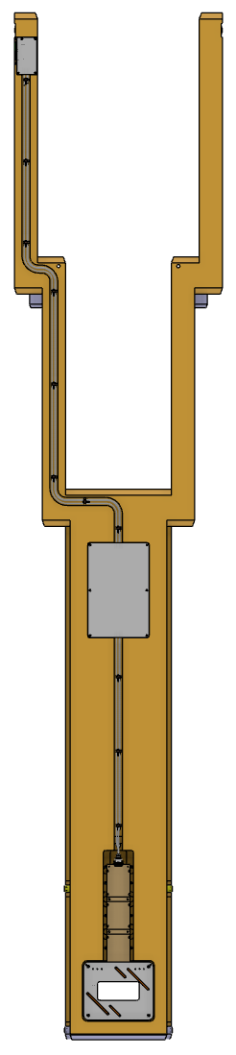
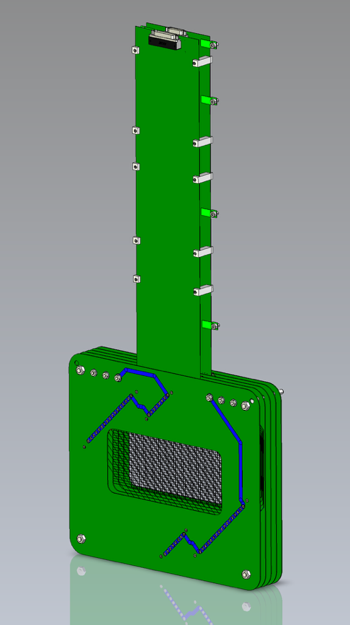
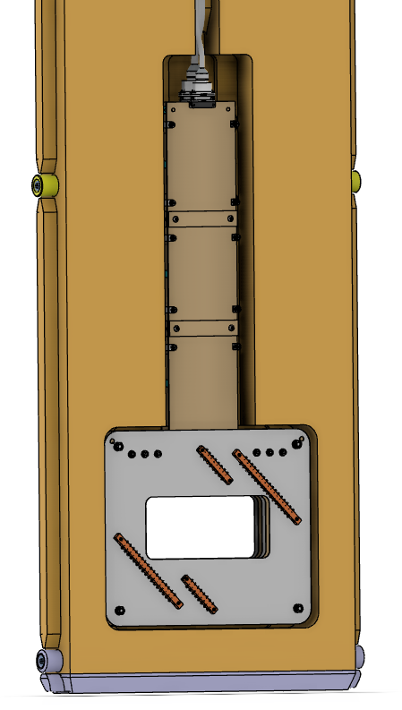
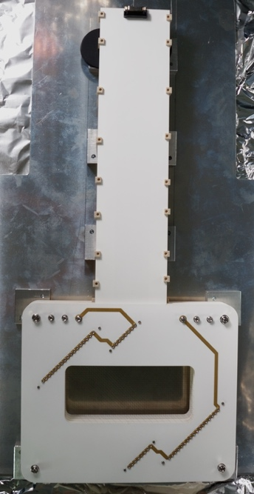
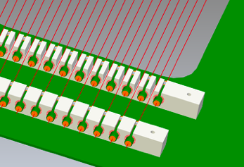
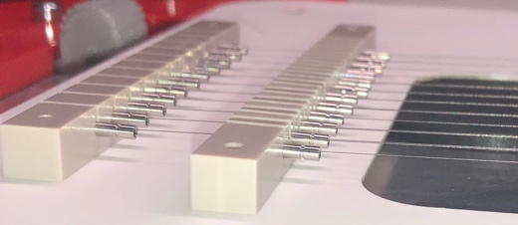
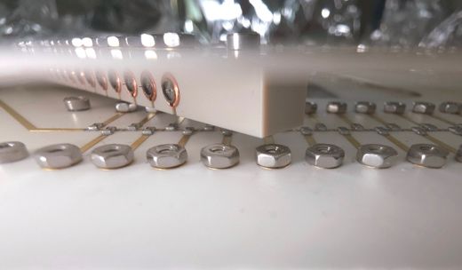
GRID
3x Bias harps
1 Vert. harp: reads hor. profile
1 Hor. harp : reads vert. profile
Wire-clamps:
clamp
electrical contact
maintain tension
PBIP GRID slice

Slide 24
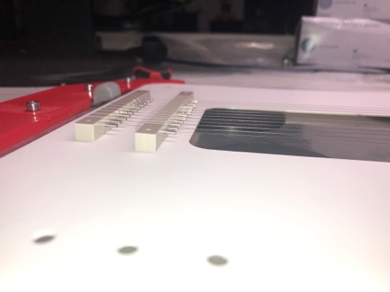
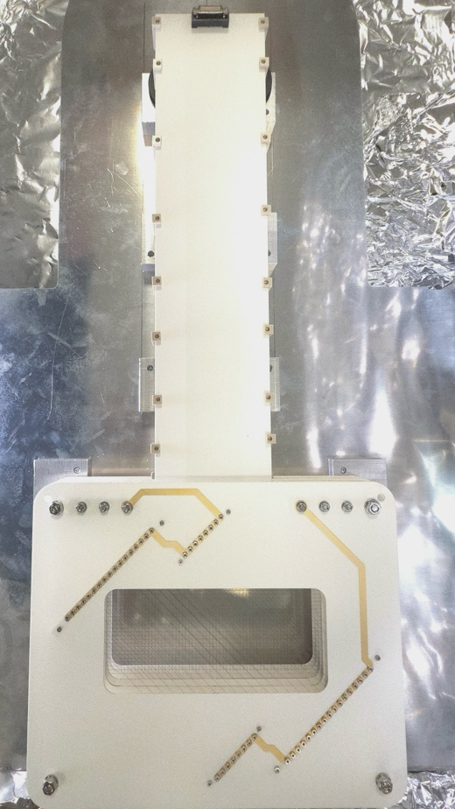
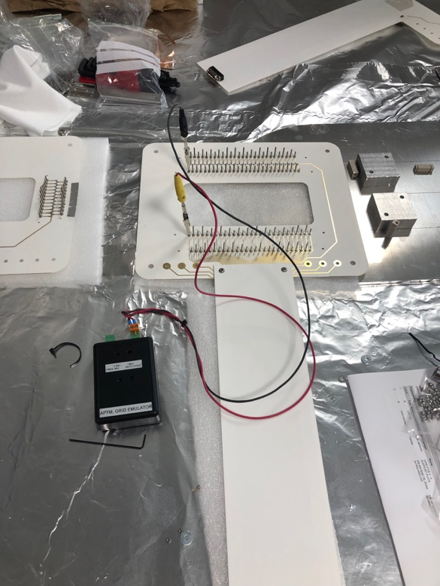
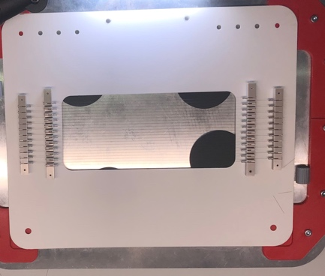
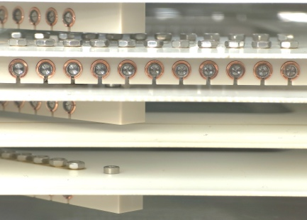
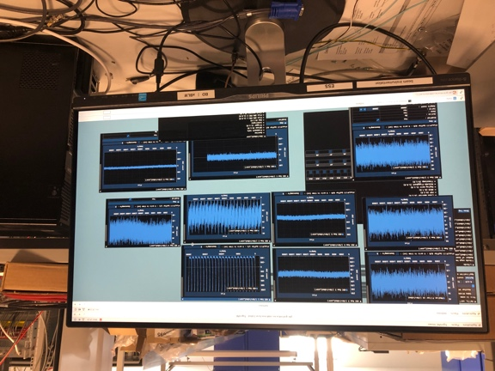
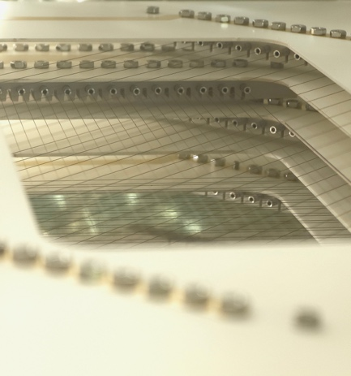
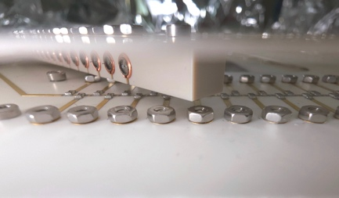
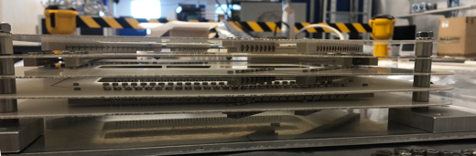
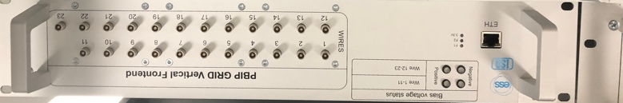
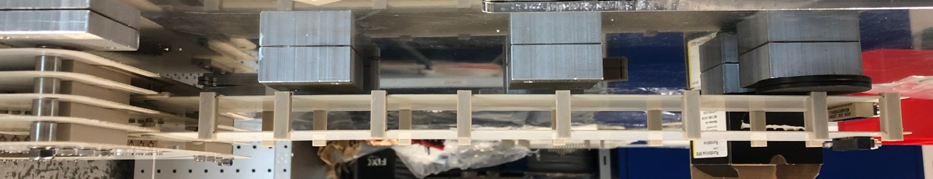
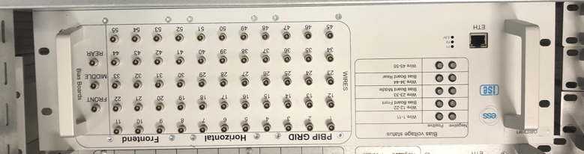
GRID
Assembled and under testing
Full vertical integration
wire clamps and support
Hor. wires for Vert. profile
FE, signal and bias

Slide 25


GRID
Control and sampling electronic
Firmware implementation
Based on (matlab) model of the instrument
Verified showing a stable and robust design
mTCA crate, timing, power, control
10 AMC board DAMCFMC2ZUP1 (CAEN ELS)
20 FMC-PICO-1M4-C
Readout 78 signals from wires
All channels individually process with FPGA
All signals transferred to concentrator FPGA board for real time processing of beamlet size and position
Interlock: evaluation every 1µs, delay 3µs

Slide 26



GRID Model
Wire current sampling, 1MS/s
All samples synchronized
beamlet size
Tunning support: beamlet size and raster amplitude
beam centre: motion detection
Beam abort if:
Beamlet size small than threshold values
No displacement detected
High current value detected on aperture edges
aperture limit
Fast interlock: ~10µs
Operation range: Current > 30 mA

Slide 27
Beam Diagnostics
Missions:
Support beam tuning
Support machine protection
in numbers:
Beam position: 100
Beam current : 21
Beam loss: 348
Beam profiles : 37
Beam emittance: 2
Destination stations: Faraday cups / beam stops: 6
Tunning Dump and Target diagnostics instruments: 10
Total instrumentation: ~520 systems instances
Beam shaping: pulse choppers

Slide 28

APTM
Measure beam outside defined aperture
e
p
Metallic plate
Secondary electron emission
p
Material
Heat load

Slide 29








APTM
PBIP APTM
Fully verified, pre-aligned to specs (±0.5mm)
Installed in PBIP in monolith vessel
PBW APTM
Pre-assembled, fully verified and pre-aligned to specs (±0.5mm)
Installed in the PBW assembly
Metrology Survey

Slide 30




APTM
RCC1466 + Piggyback RTM
Control and sampling electronic
Machine Protection
FBIS
mTCA crate, timing, power, control
Control software layer:
Control
Signal processing
Interlock
Archive
Display
1µs sampling
3-6µs sustained condition to trigger FBIS
AMC board DAMCFMC2ZUP1 (CAEN ELS)
FPGA: real time signal processing
TCs:
Beckhoff ECAT modules: EL3314-0002
3ms sampling
1ms trigger signal
FMC-PICO-1M4-C

Slide 31





APTM
TCs steady state vs. beam offset
TCs ∂T after each pulse
Blades
TCs
Proportional to current
Interlock within 10µs
Proportional to current density
Interlock within 10ms
APTM Model
Blade signal vs. beam position
Blade signal during operation

Slide 32




DumpL APTM
2
3
4
Conceptual and final design (2018-2021)
BI, collaborations (Lund University, ESS Mechanical, WUT)
Prototypes (2018, 2019 and 2020)
BI, testing at JPARC, ESS support (mechanical, logistics …)
Manufacturing, assembling, installation (2019-2023)
BI, ESS support (mechanical, vacuum, linac group Target group, procurement, rigging, …
Control system (2023-2026), Firmware, FPGA, low level software, EPICS: BI, ICS
Commissioning (now): BI, ICS, BP, Ops
Verify instrument performance
Verify protection function
Conditions
controlled beam: current, pulse, energy, size, position!
1
5
12
6
11
7
10
9
8
First signal and milestone reached!
IMG
APTM
Dump
at ~9m
Control
FE
Electronics:
sampling
signal processing
FBIS interface
APTM
Long-haul cables
signal
BL component

