Slide 1
VESPA, the Neutron Vibrational Spectrometer at the ESS
Status & update on the finalised design
Adrien Perrichon / Monika Hartl
ICANS XXV aPRIL 2026 – MalmÖ

Slide 2
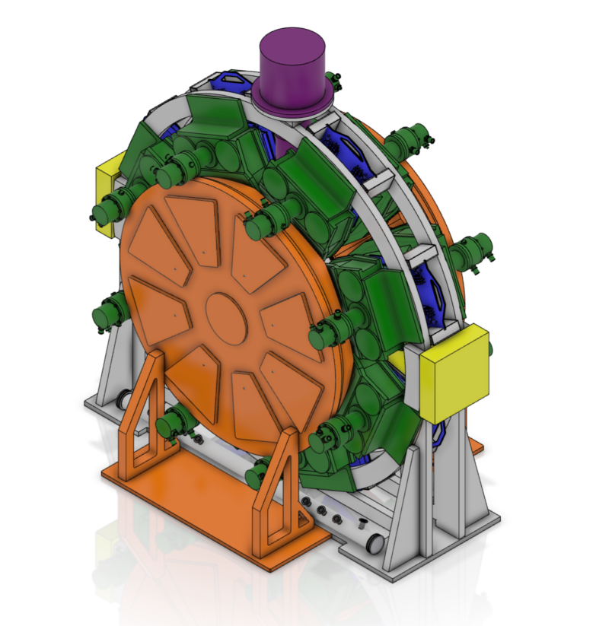
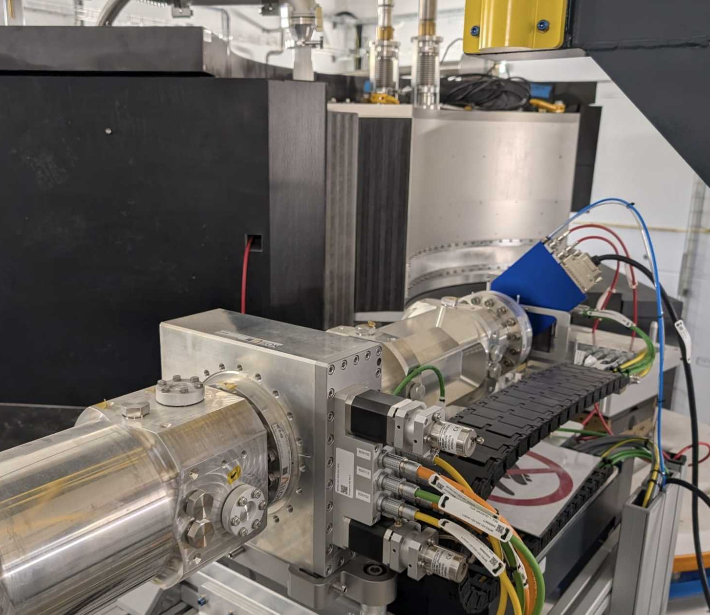
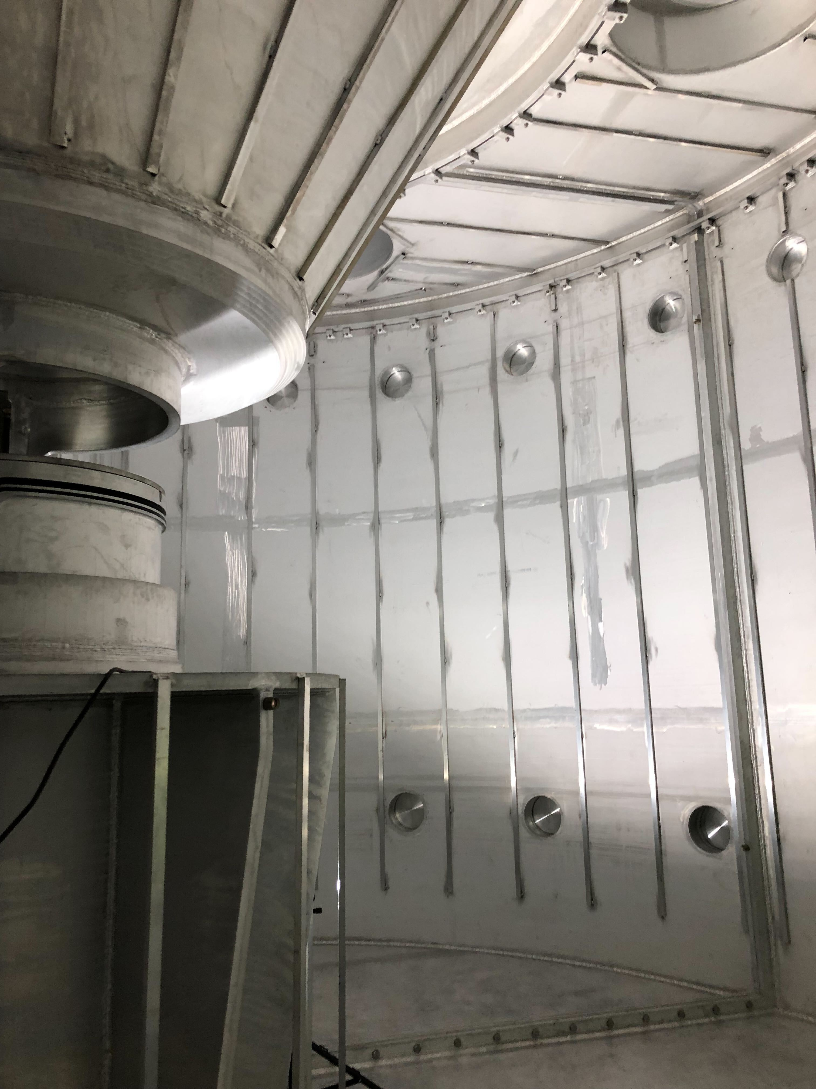
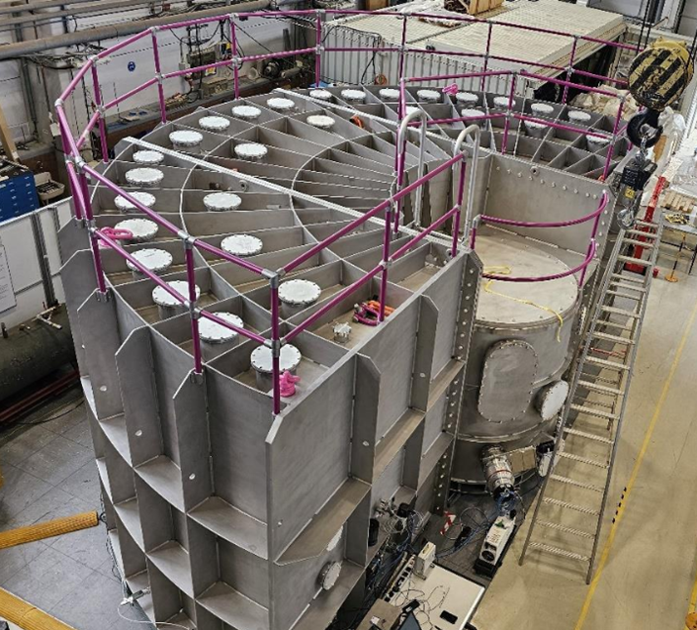
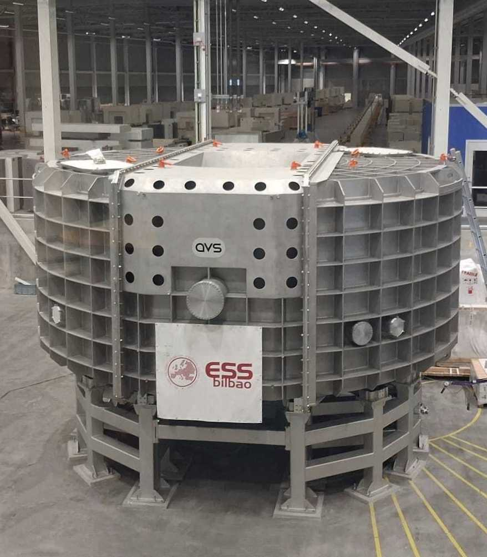
Neutron Spectroscopy at the ESS
A suite of 5 neutron spectrometers
BIFROST
Indirect Geometry
Cold Neutrons
INS (magnetism)
Completed
CSPEC
Direct Geometry
Cold Neutrons
All-purpose
Q3 2027
TREX
Direct Geometry
Bi-spectral
All-purpose
Q4 2027
MIRACLES
Indirect Geometry
Cold Neutrons
QENS
Q3 2027
VESPA
Indirect Geometry
Thermal Neutrons
INS (incoherent)
Q1 2029
Neutron Vibrational
Spectroscopy

Slide 3
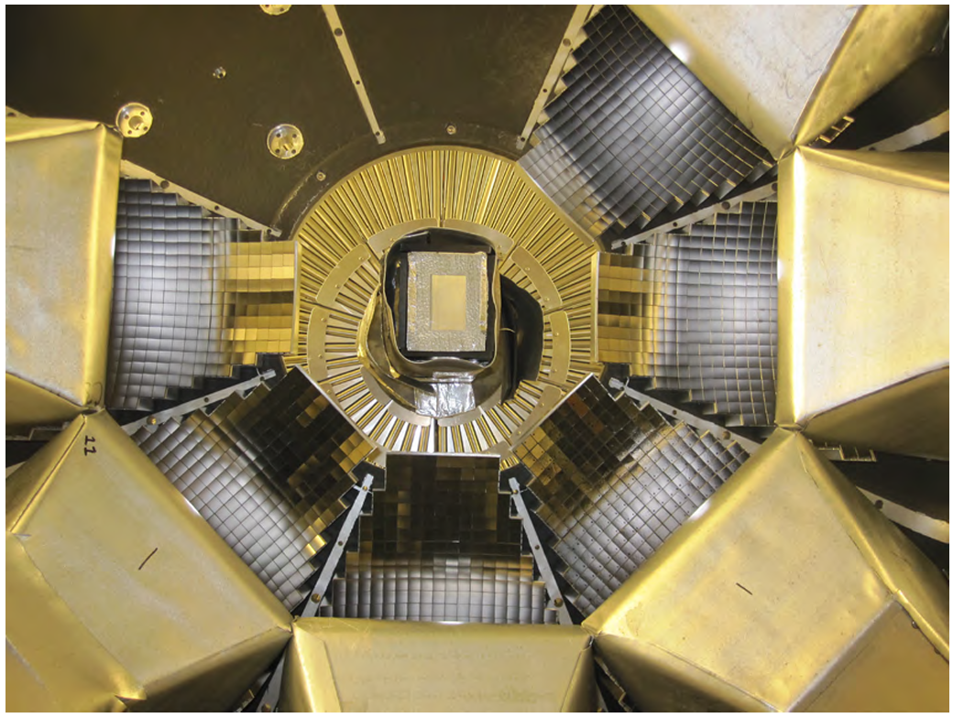
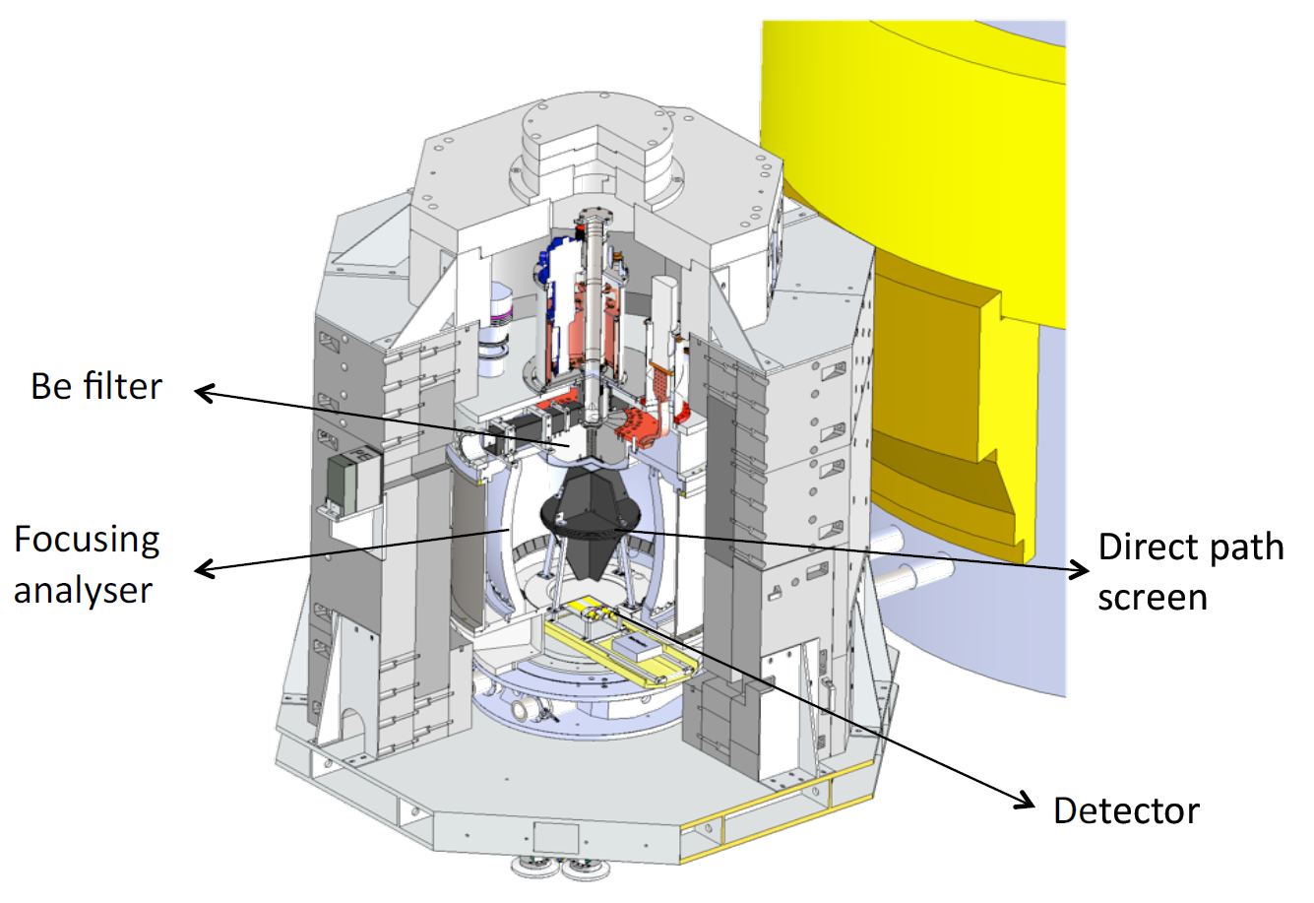
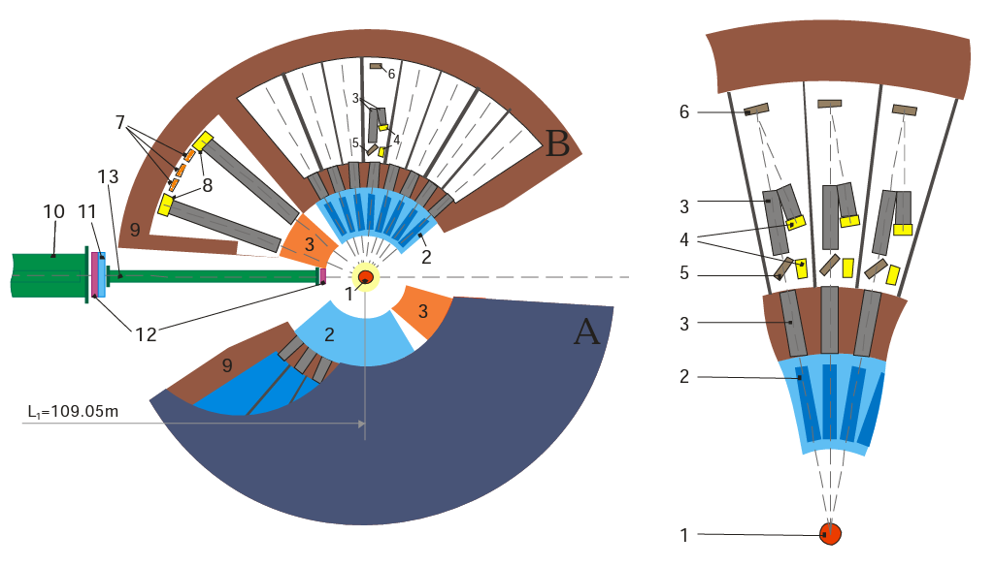
Neutron Vibrational Spectrometers
International landscape of NVS instruments
Operational instruments
  TOSCA @ISIS, UK
  VISION @SNS, TN, USA
  Lagrange @ILL, France
  FANS @NIST, MD, USA
  NERA @FLNP, Russia
Upcoming instruments & upgrades
  VESPA @ESS, Sweden
  TOSCA+ @ISIS, UK
  iMovies @CSNS, China
  BJN @FLNP, Russia
  IN8(?) @ILL, France
  B-WAVES(?) @STS, TN, USA
VISION, https://neutrons.ornl.gov/vision
Seeger et al., Nucl. Instrum. Methods Phys. Res. A. 604 (2009) 719
LAGRANGE, Jiménez-Ruiz et al., J. Phys. Conf. Ser. 549 (2014) 012004
NERA, Natkaniec et al., J. Phys. Conf. Ser. 554 (2014) 012002

Slide 4
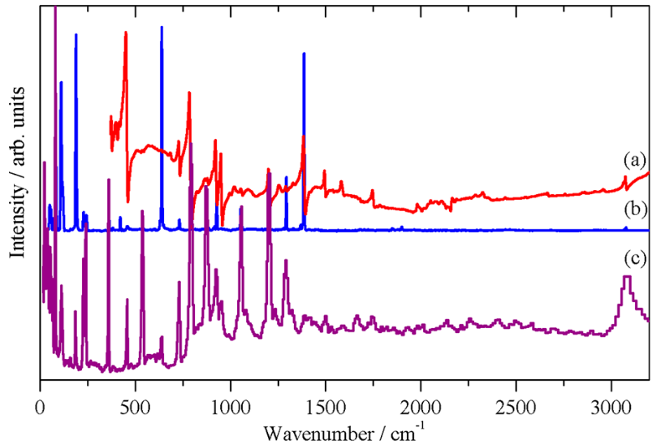
Neutron Vibrational Spectroscopy (NVS)
Or Incoherent INS =Neutron analogue to optical spectroscopy (FT-infrared/Raman)
  Sensitivity to hydrogen
  No selection rules
  Non-destructive (no energy deposition)
  Penetrability of neutrons through many materials (complex sample environments possible, probing bulk sample)
  Quantitative method: simplicity of neutron-nucleus interaction allows calculation of intensities
  Access to the “fingerprint” region: 480 – 1800 cm⁻¹ (60 – 220 meV)
  Poor resolution (1-3% of ΔE) compared to optical spectroscopies
  Requires large amount of sample compared to optical spectroscopies (0.1-1g, depends on σ_{total})
  Low temperature measurements (intensity quickly drops with T due to Debye-Waller factor)
Parker et al. JPCC 121 (2017) 12636
2,5-diiodothiophene
IR Raman NVS

Slide 5
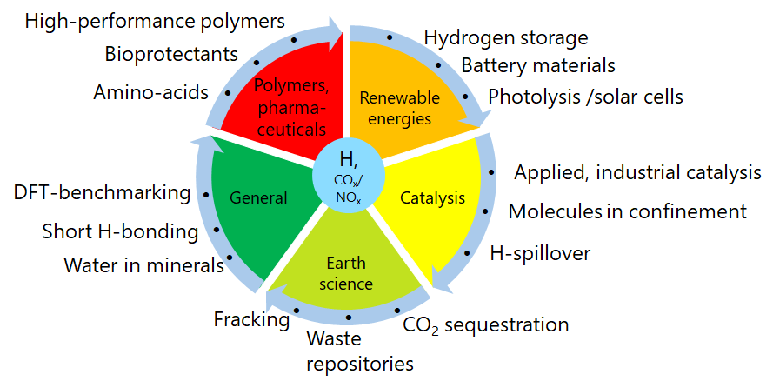
VESPA, the NVS spectrometer at the ESS
VESPA’s science case
  Broad science case in chemistry, focus on catalysis & energy materials
  90% of measurements at base temperature (<10K) = fast cooling CCR always installed
  90% of measurements <20 minutes in standard cans = high-capacity sample changer
Electrochemistry cell & potentiostat (impedance)
Illumination cells & optical stick
Raman stick & spectrometer
Mass spectrometry & RGA
Ortho/para H2 convertor
Pump & probe
Catalysis rig
Pressure cells & high-pressure gas handling panel & gas intensifier
Gas flow cells & gas handling panel (200 bar)

Slide 6
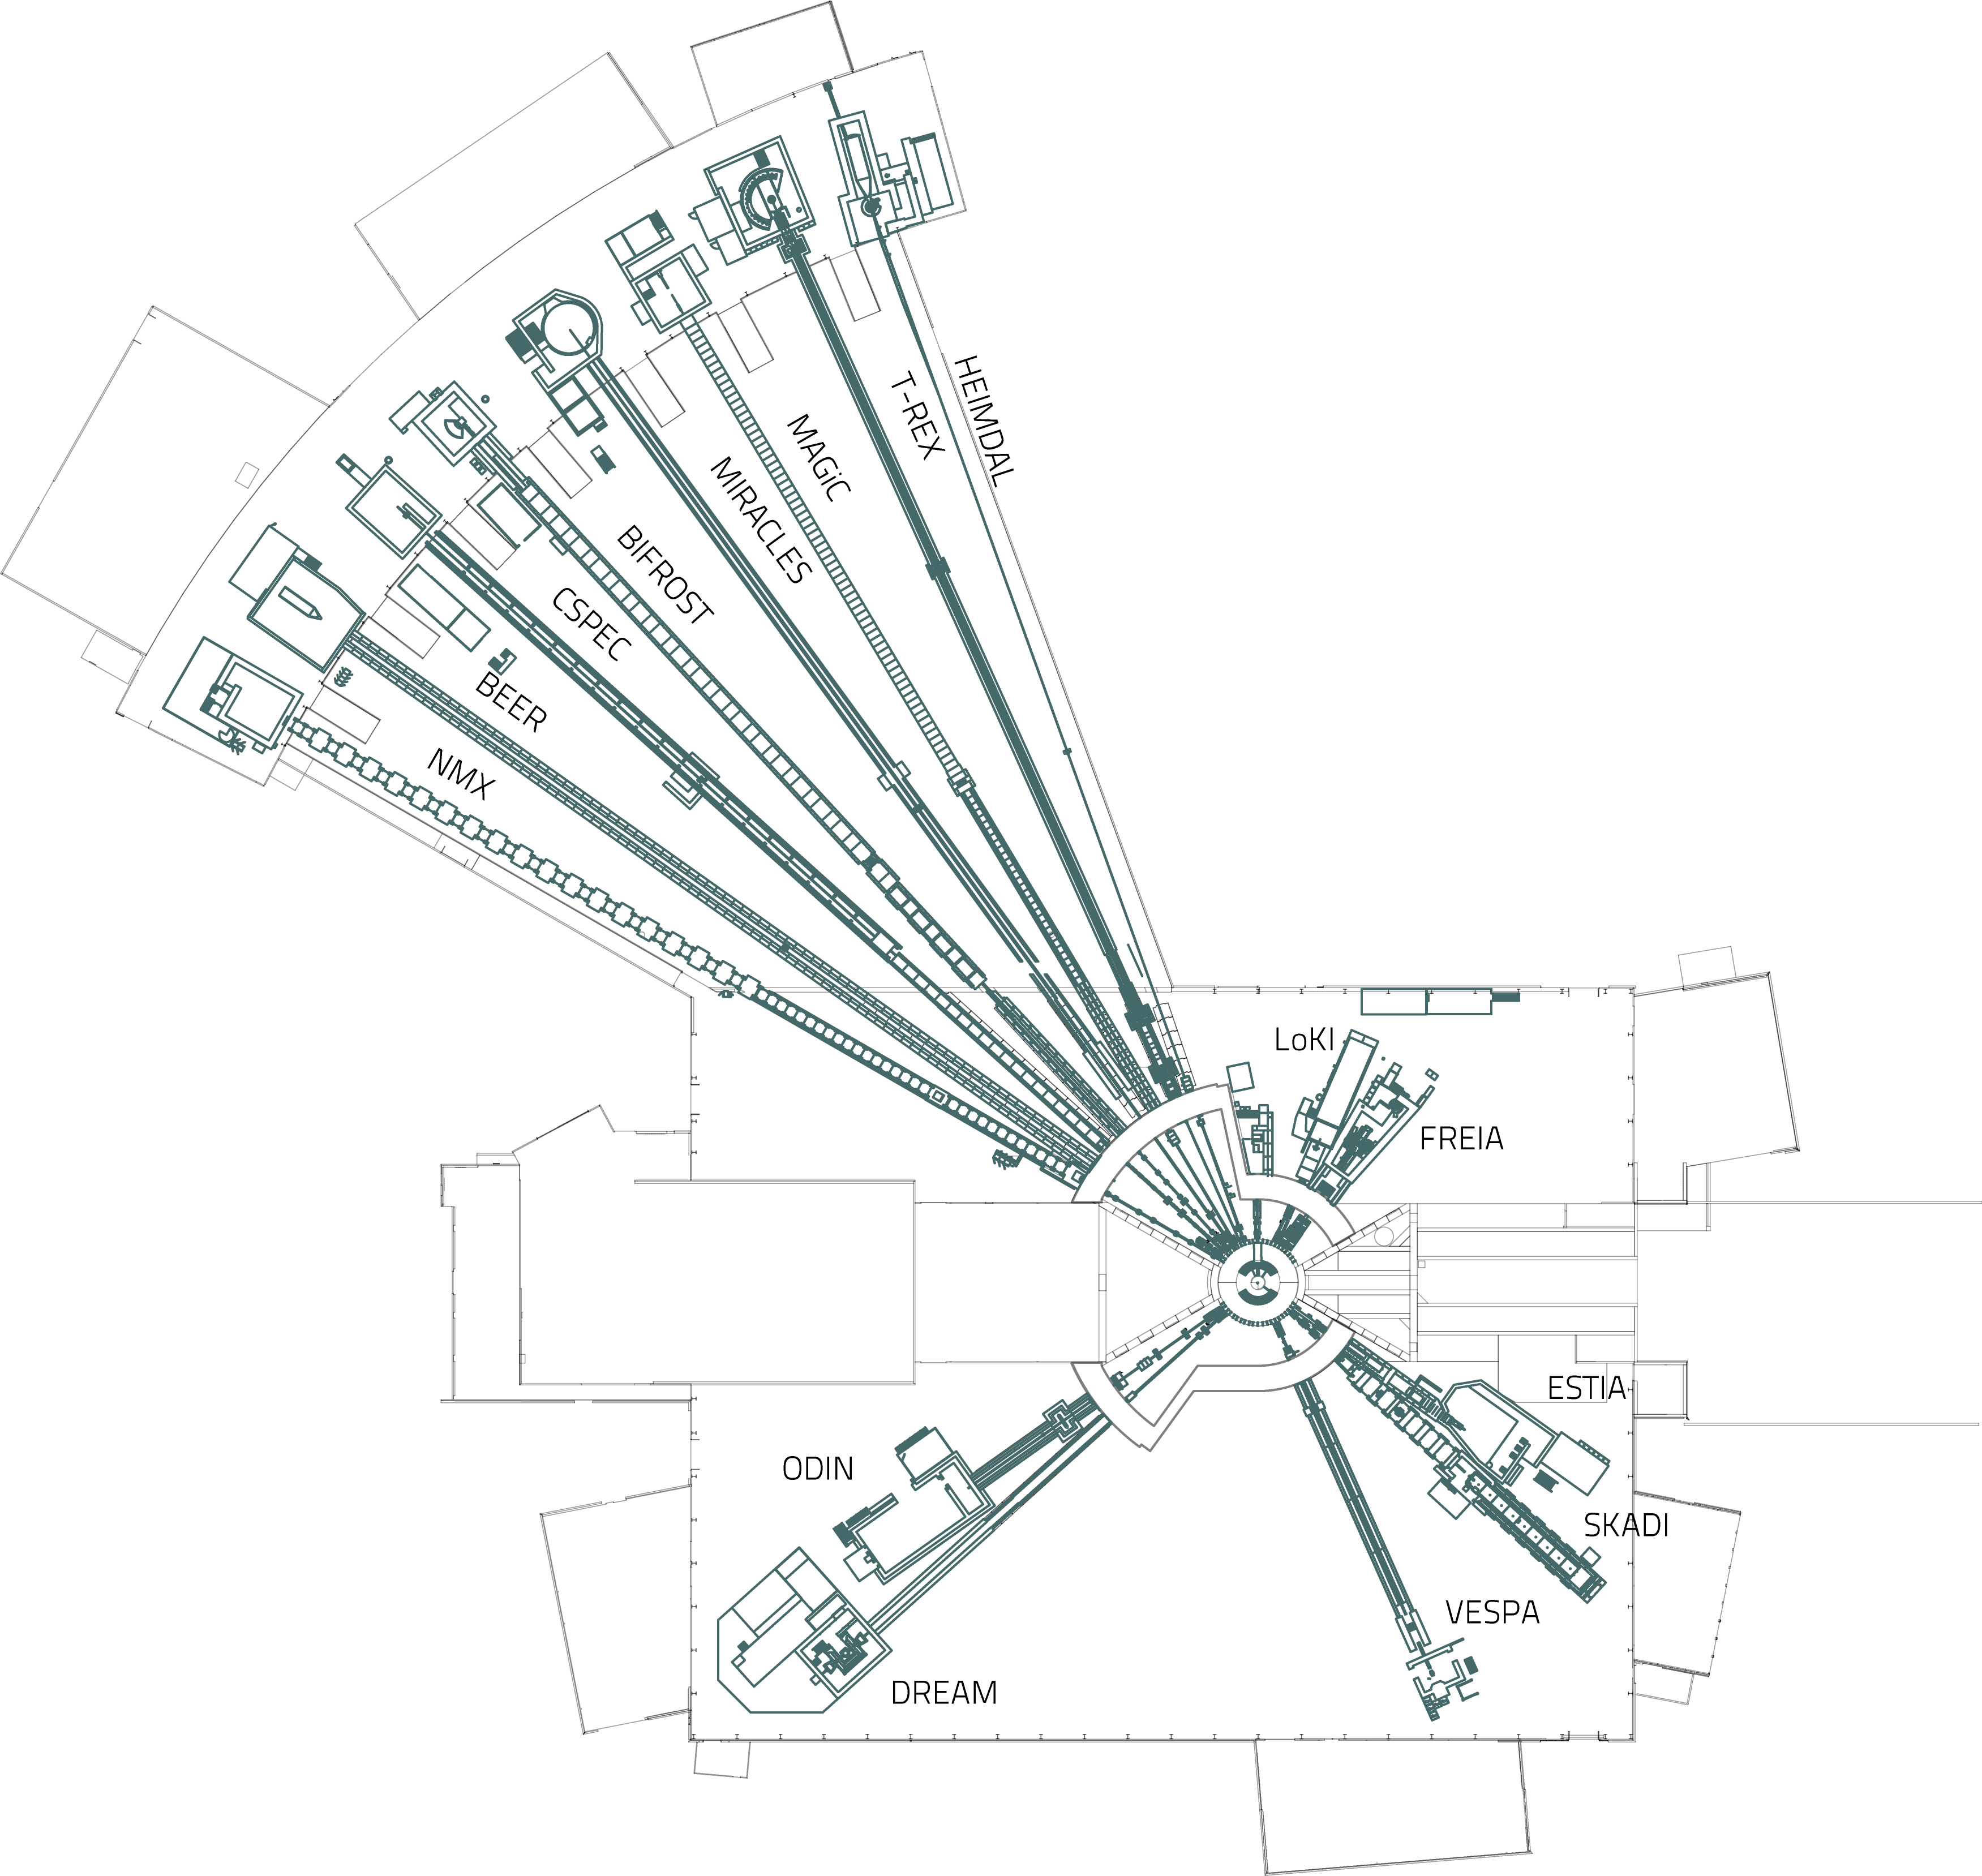
VESPA, the NVS spectrometer at the ESS
VESPA’s quick facts
  E7 beam port with direct view of the thermal moderator
  59 m long instrument with a high-m elliptic supermirror guide
  Complex chopper cascade to achieve 3 subframes and variable resolution
  Broad band, Ei = 3–1200 meV
  Indirect-geometry crystal-analyser
  Complex and compact secondary spectrometer: 13000 HOPG crystals, 280 kg of cryo-cooled Be, 600 ³He tubes, in <2 m³ footprint

Slide 7
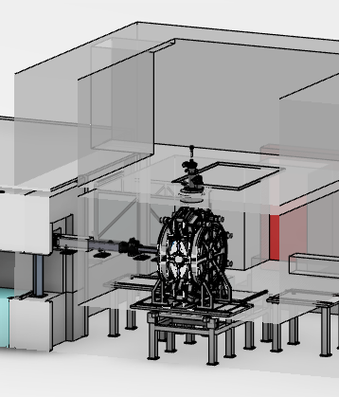
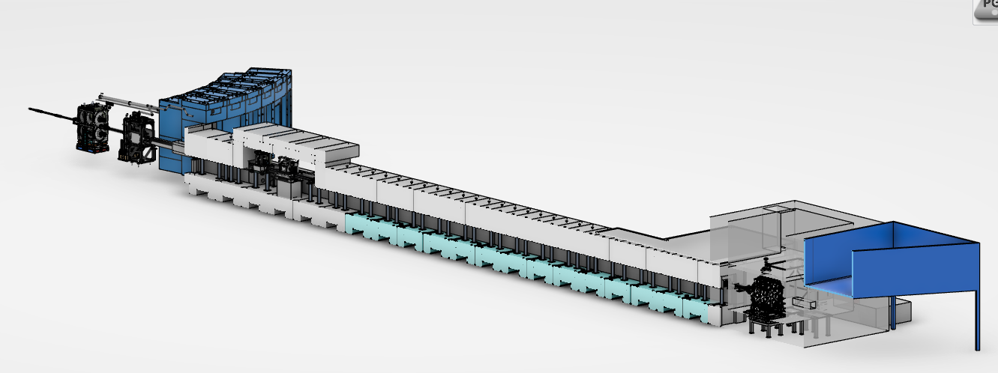
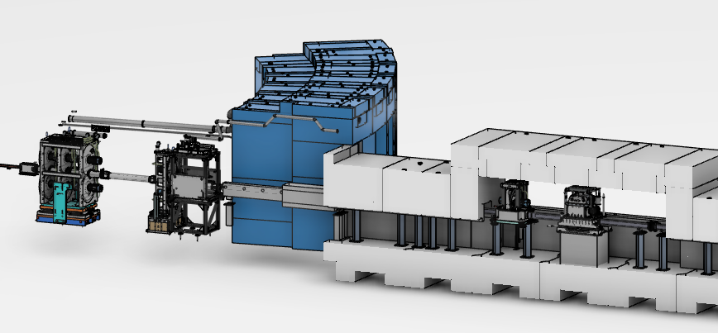
VESPA, the NVS spectrometer at the ESS
VESPA’s beamline layout
cryostat
spectrometer
slit system
PSC1, PSC2, PSC3
experimental (upper) cave
sample prep. area
heavy shutter
FOC
BM5
sFOC
T0
BM4
BM3
spectrometer (lower) cave
control
hutch
GLT & beam stop
BM1
BM2

Slide 8
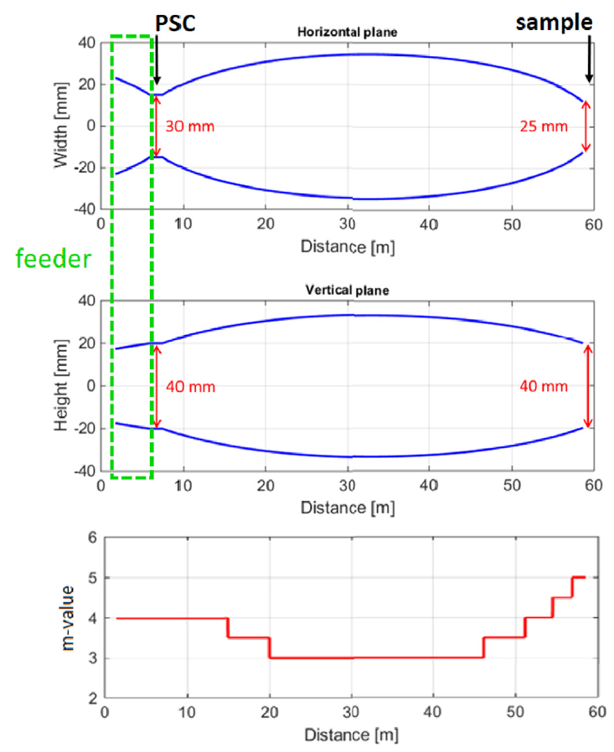
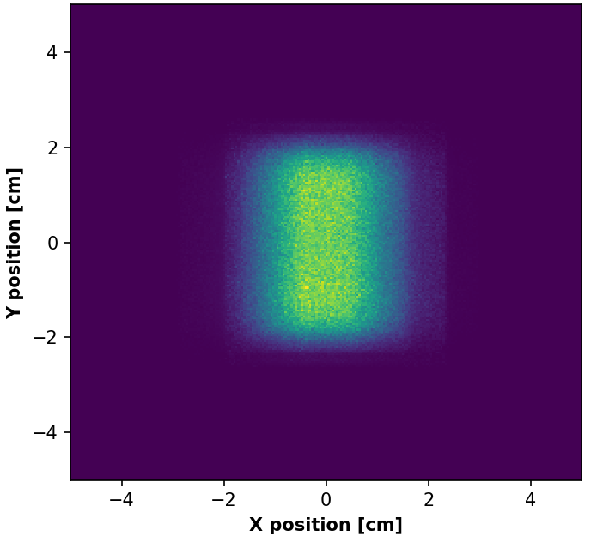
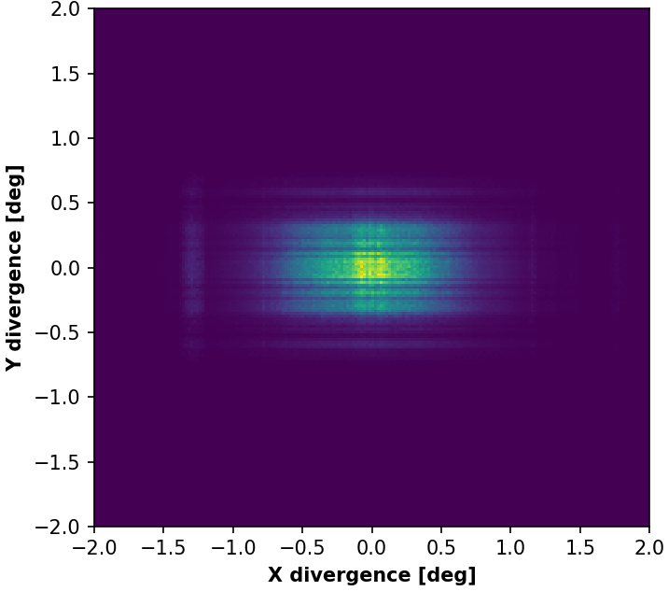
VESPA’s primary spectrometer
Supermirror guide
59 m long instrument
  14 Hz ESS
  Min Ei = 3 meV
  Max Ei = 1200 meV
Beam profile
  Beam spot 30 × 40 mm²
  Divergence 2°
High-m supermirror guide with elliptic profile, elliptic feeder, and straight section for the pulse-shaping choppers
Zanetti et al., Phys. B 562 (2019) 107

Slide 9
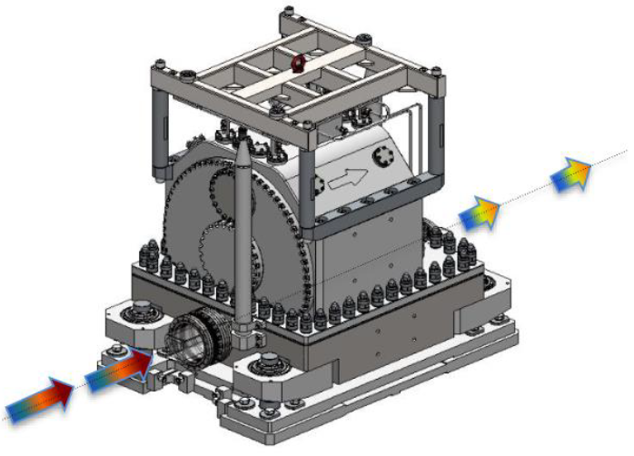
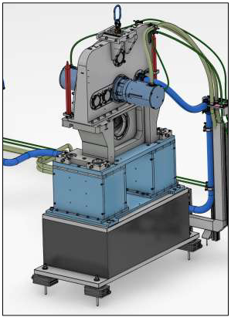
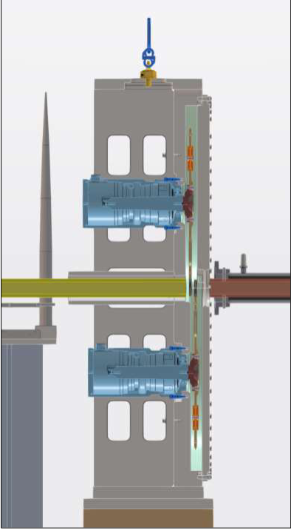
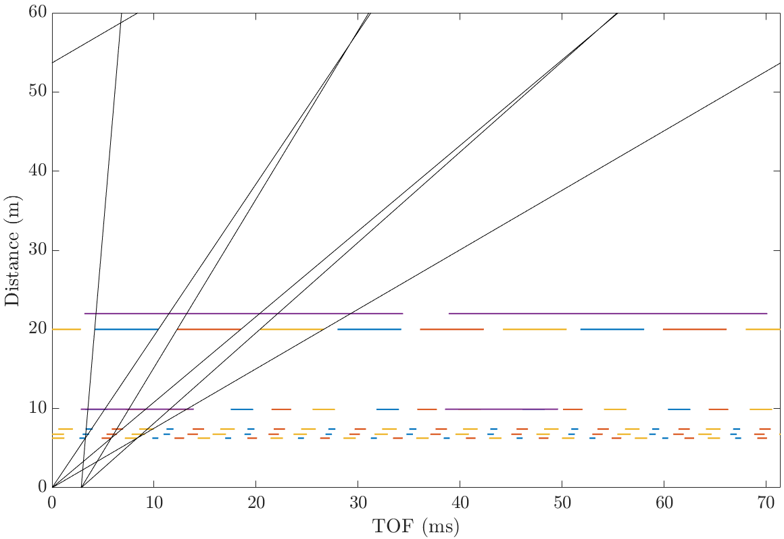
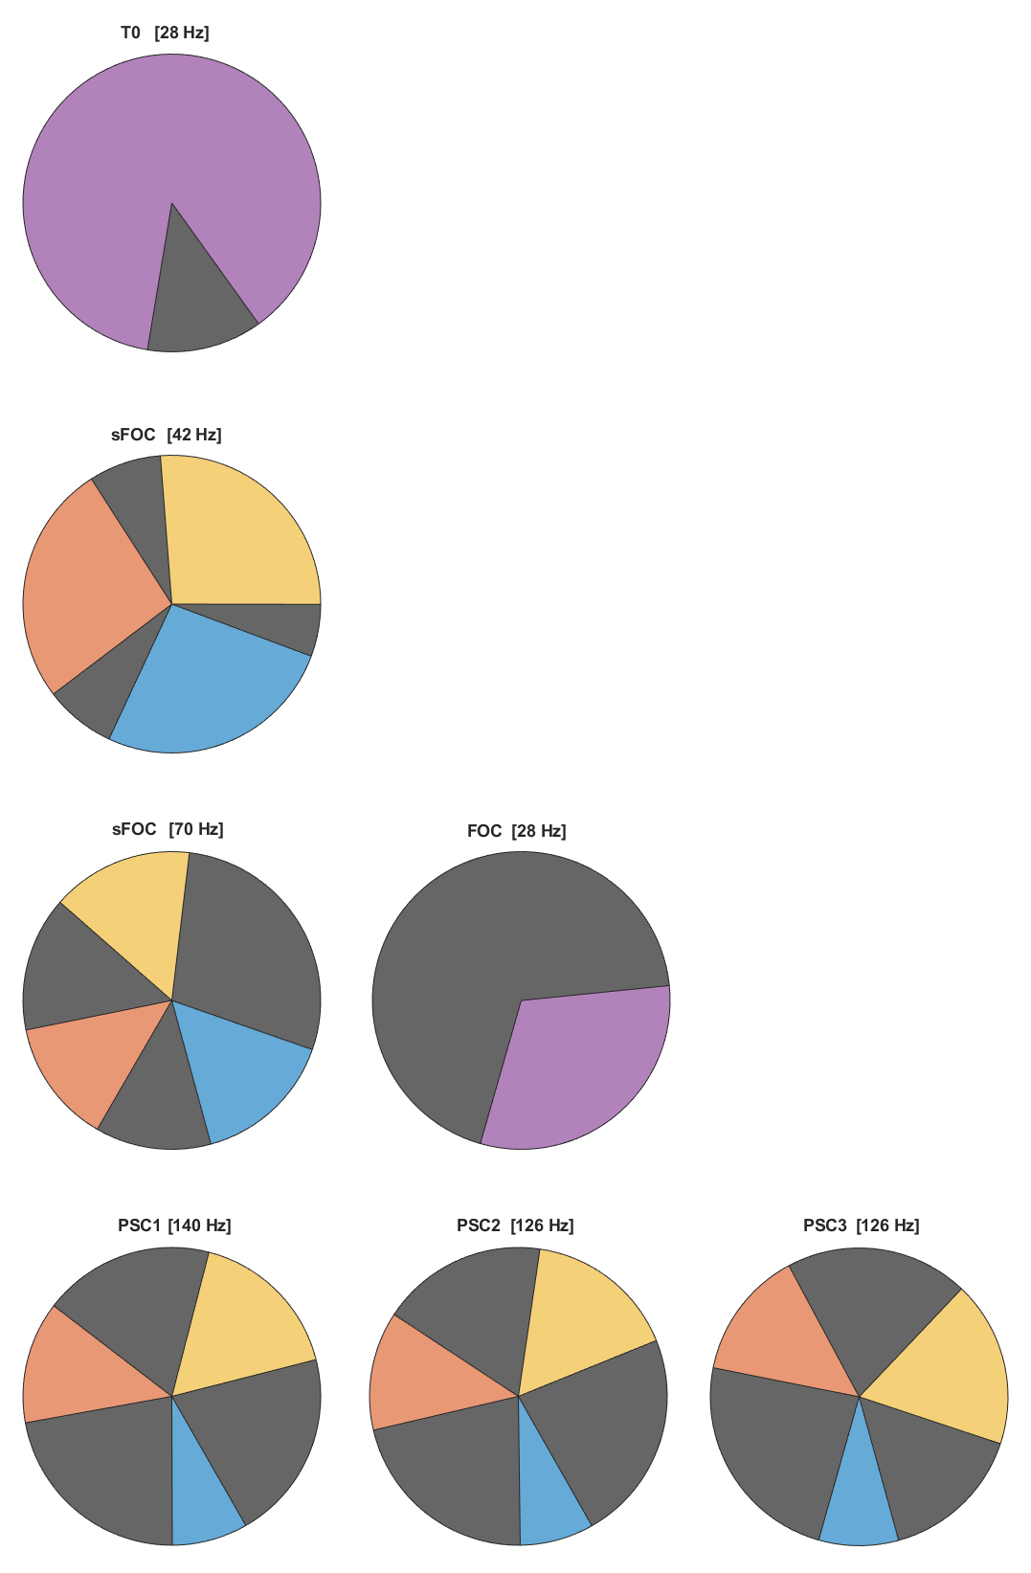
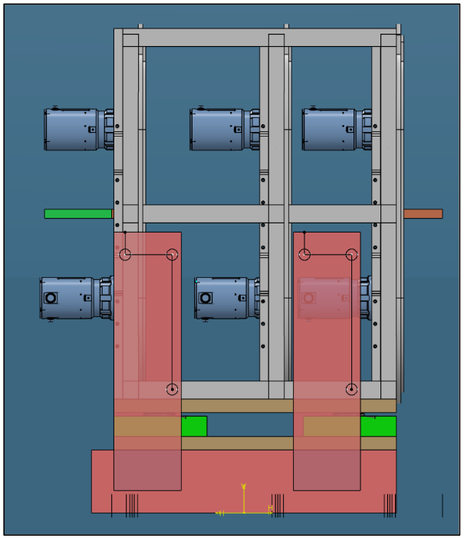
VESPA’s primary spectrometer
Chopper cascade
  Easy to define subframes with flexible time-resolution (3 PSC)
  Difficult to minimize background (3 FOC and T0 chopper)
2.9 meV
1200 meV
6.1 meV
19.3 meV
6.8 meV
23.6 meV

Slide 10
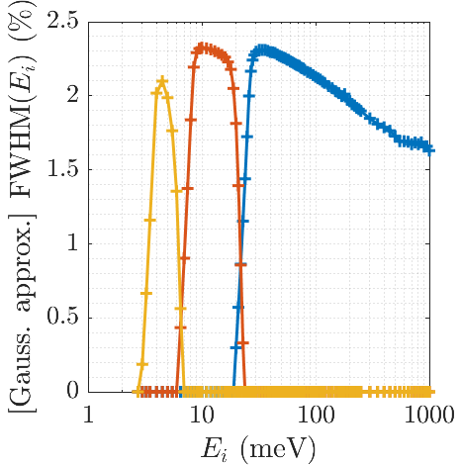
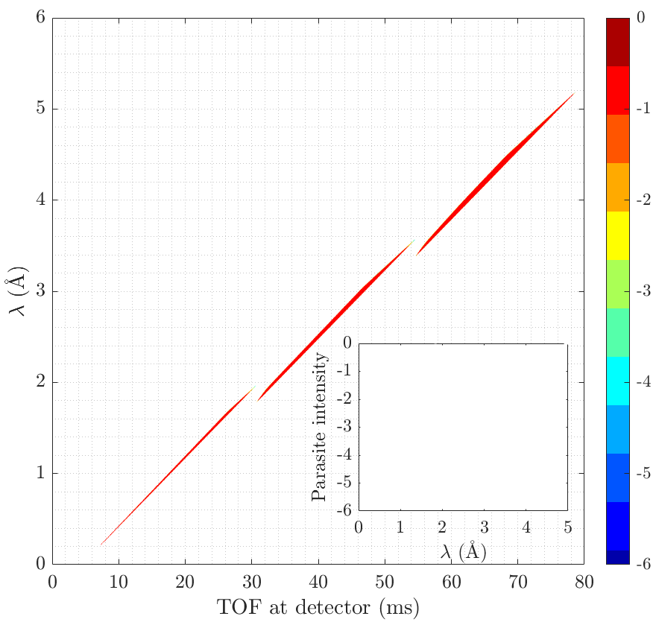
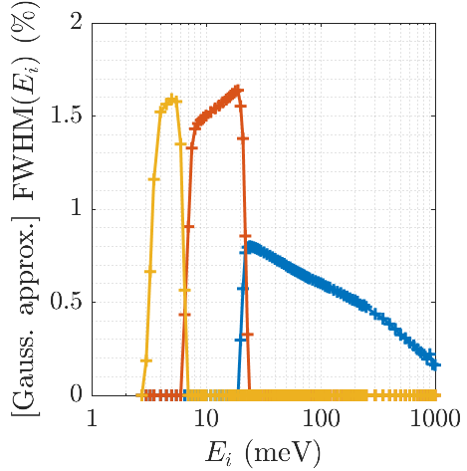
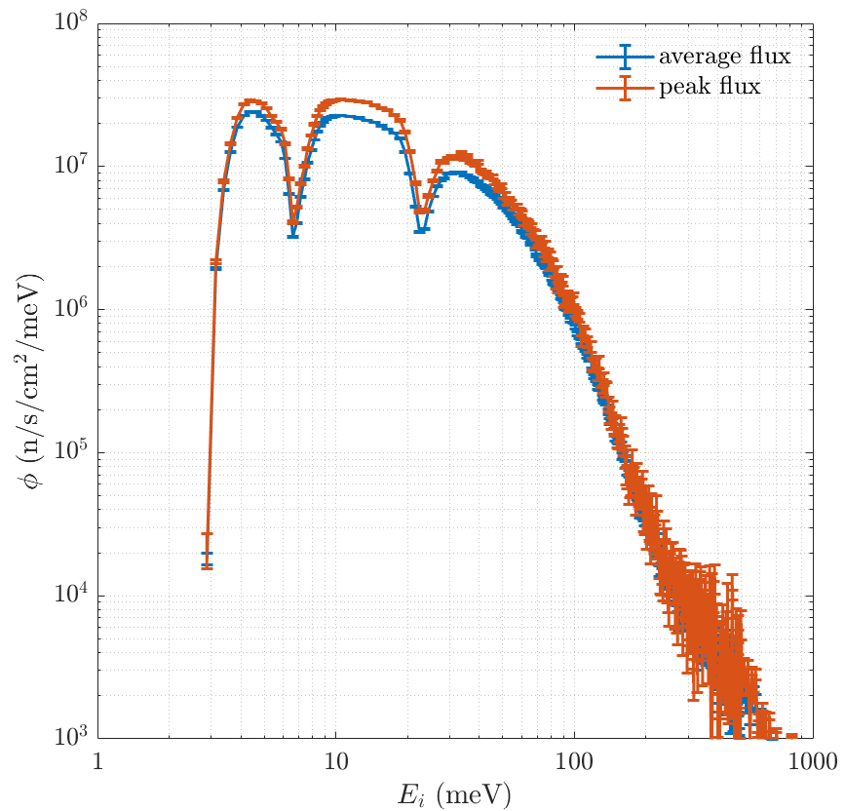
VESPA’s primary spectrometer
Resolution & flux at sample position
  Resolution of subframe 1 flexible from 0.8%Ei to 2.35%Ei, controlled through the PSC phases (<30s switch)
  Parasitic streams strictly suppressed
  High flux over the fingerprint (FP) region, 60-220 meV, and at low energy
Φ in n/s/cm² | FP | <85 meV
VESPA HF 2.0MW | 19 e5 | 33 e8
VESPA HR 2.0MW | 4.7 e5 | 18 e8
VISION 2.0 MW | 9.1 e5 | 10 e8
VISION 1.4MW | 6.4 e5 | 7.1 e8
TOSCA | 3.7 e5 | 4.5 e8

Slide 11
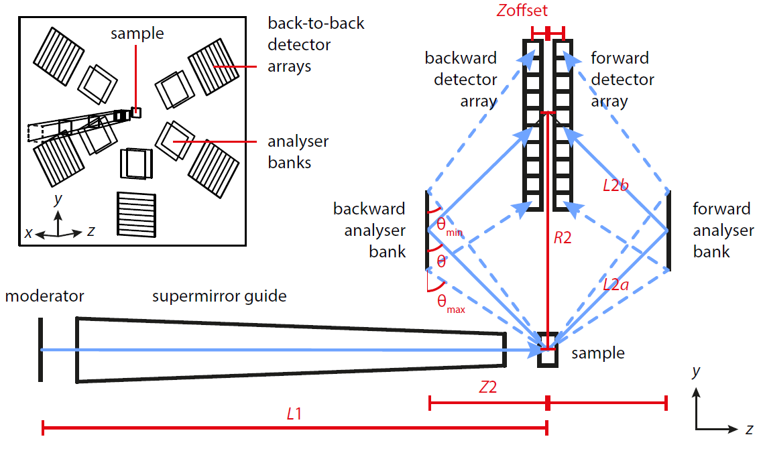
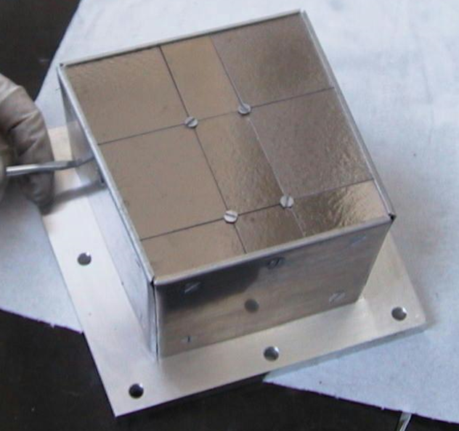
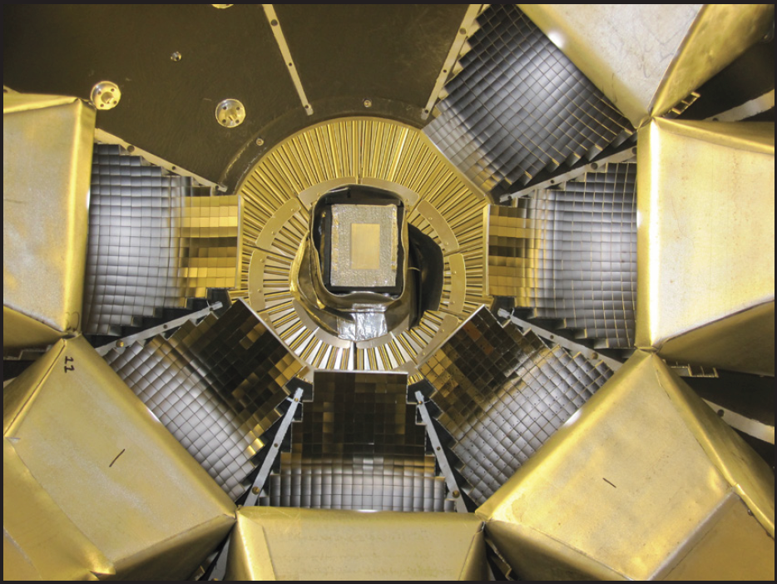
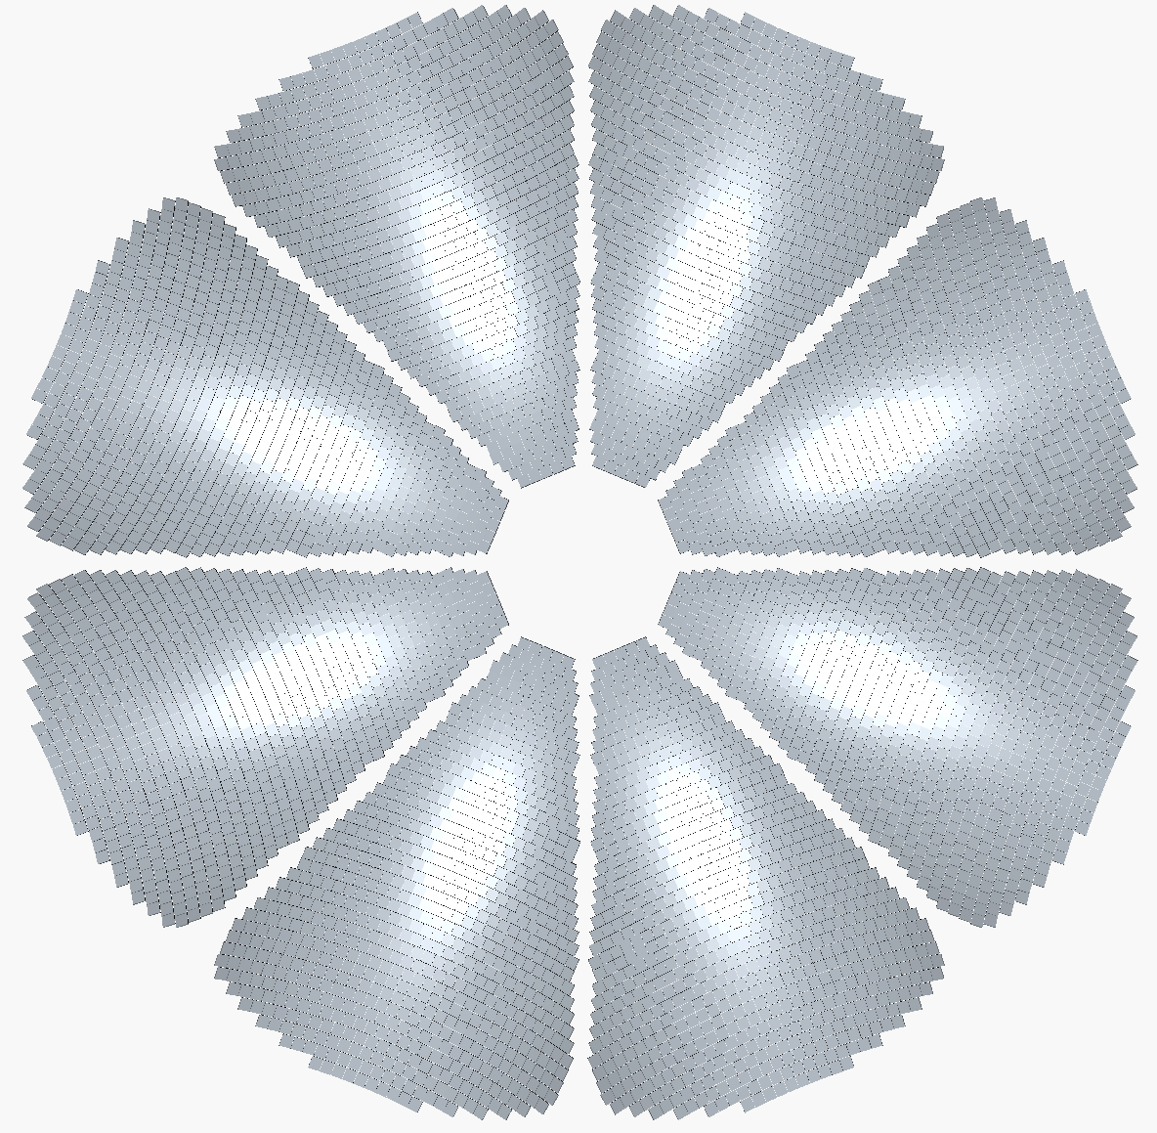
Wheel analyser design optimisation
Taking TOSCA’s ideal wheel geometry toward a 3rd generation
Time-focusing & energy-focusing geometry
TOSCA
Defocusing
(flat)
= 1.0 sr
ΔE_{th.} = 0.7% Ei
VISION
Focusing
(∼elliptical)
= 3.5 sr
ΔE = 1.5% Ei
VESPA Focusing
(∼parabolic)
= 7.0 sr
ΔE_{th.} = 0.8% Ei
Perrichon, Nucl. Instrum. Methods Phys. Res. A. 1041 (2022) 167401
Design goal to maximise the solid angle Ω while keeping the resolution close to the theoretical limit
Design goal to achieve a signal-to-noise ratio SNR>10⁴

Slide 12
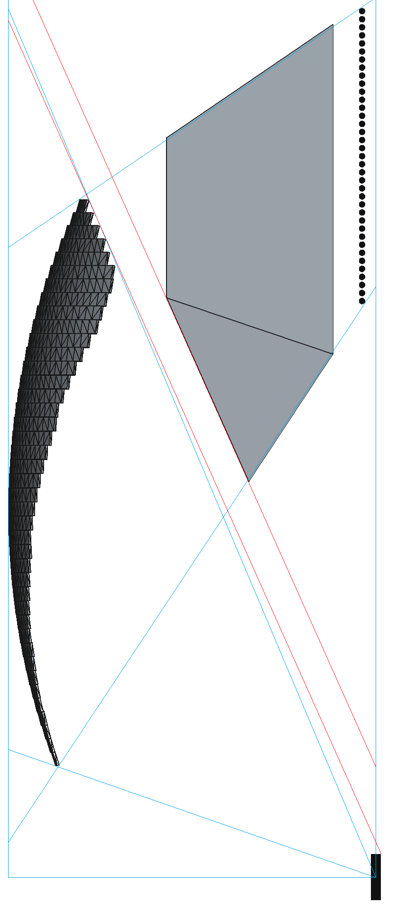
Wheel analyser design optimisation
Beryllium filter envelope
line-of-sight
Fit into the wedge space between detector and analyser
Scientific requirements:
  Minimum path length 14 cm (VISION)
  Optimally 16 (CAMEA) to 20 cm (BIFROST)
  No line-of-sight from analysers to detectors without going through Be or significant shielding
  No or minimal shadowing
  Engineering requests:
  Parallel illumination and filter planes
  Minimise the number of Be faces
  Specific gaps to accommodate frame and vessel
filter plane
line-of-sight
illumination
solid angle
solid angle
focal circle radius

Slide 13
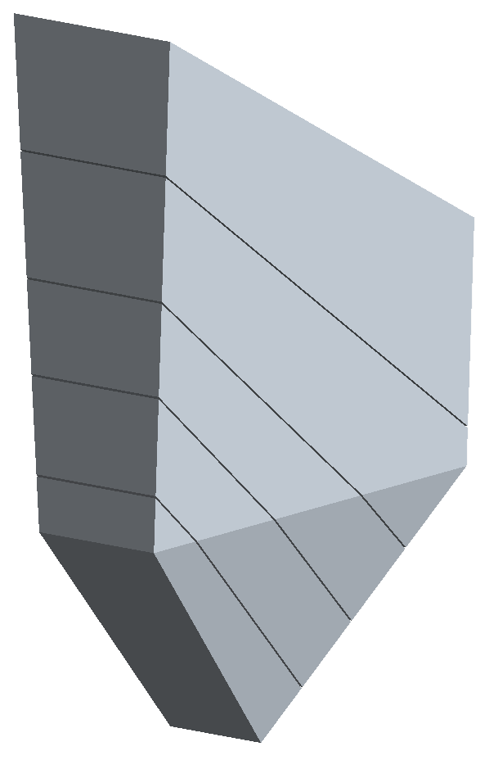
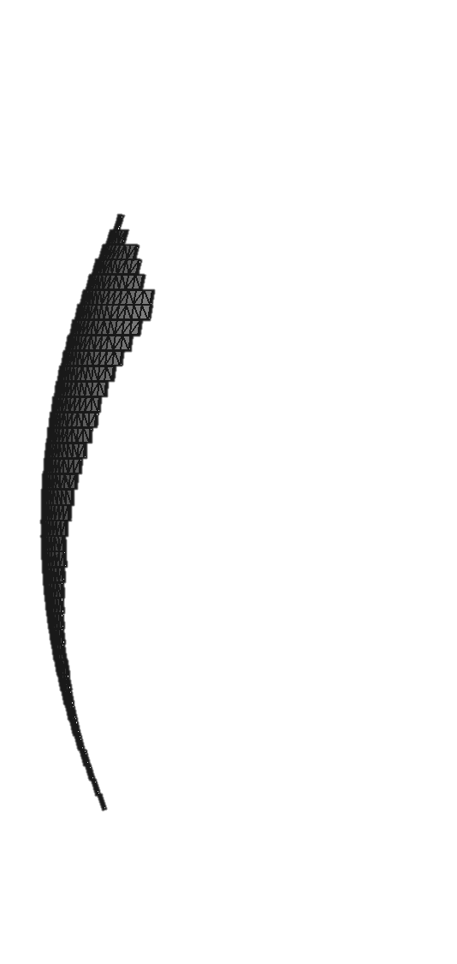
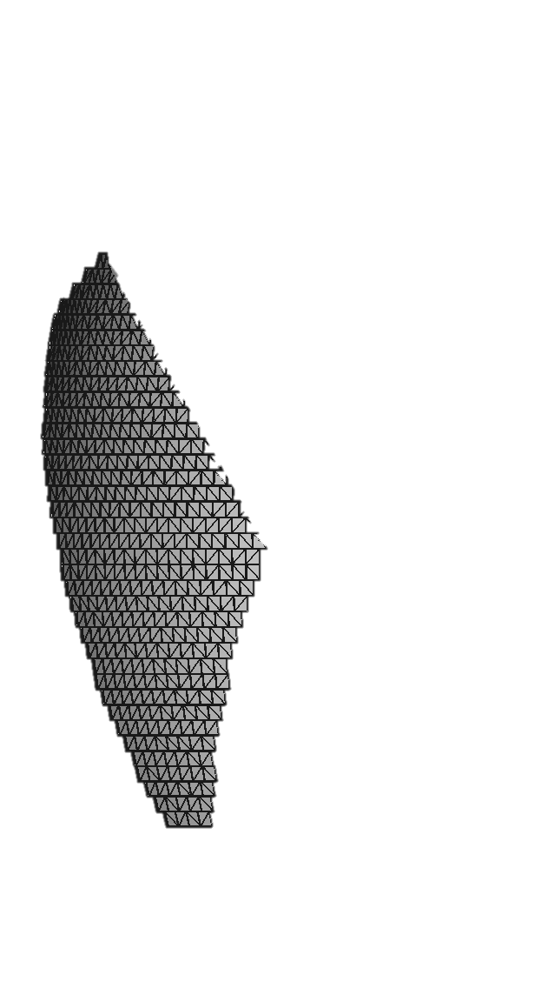
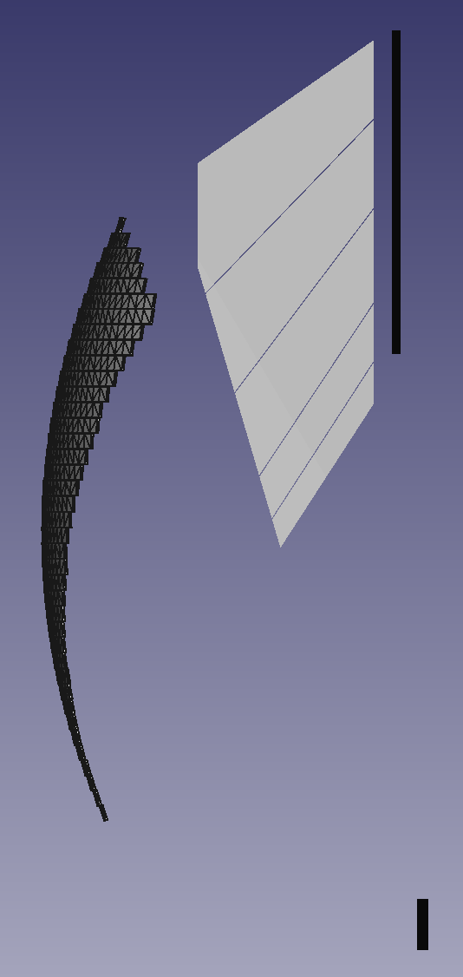
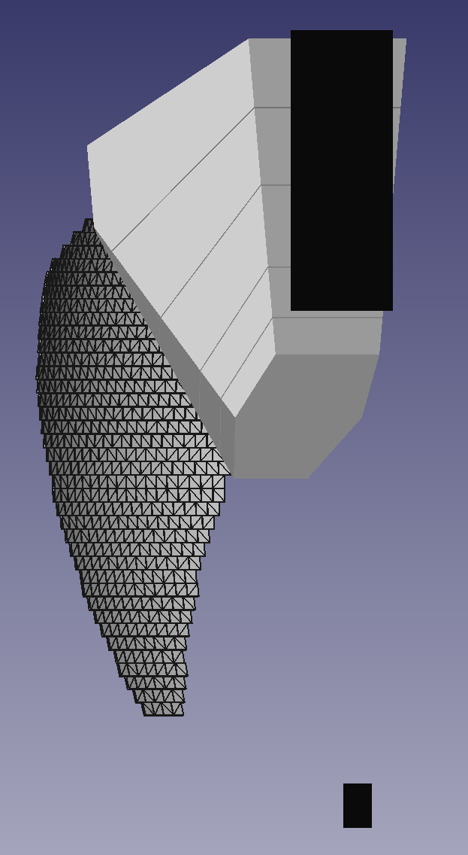
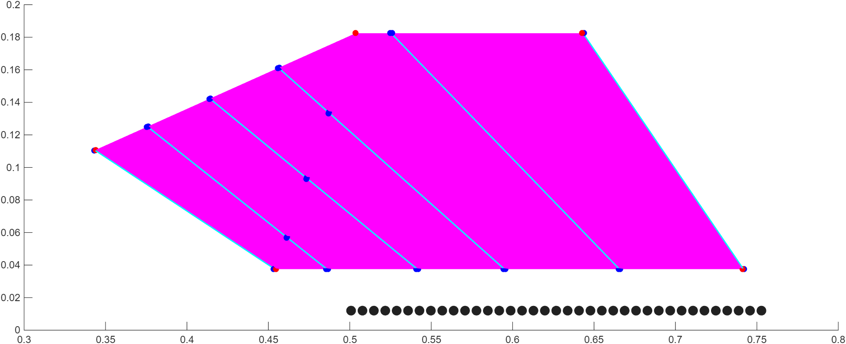
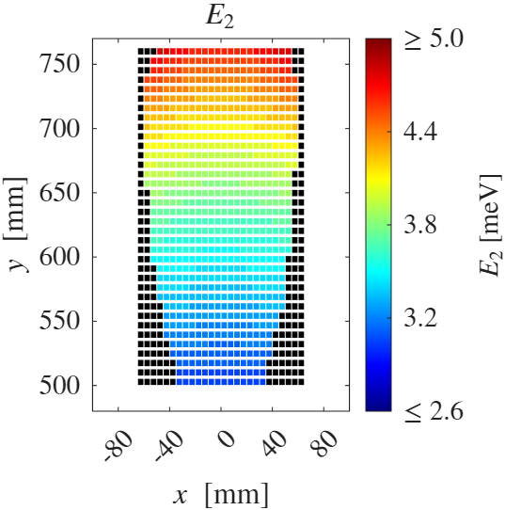
VESPA’s wheel analyser
Beryllium filter assembly
Assembly of Be wedges and Cd blades
Transmission (E<5 meV) 78.8 %
Transmission (E>5 meV) <1e-4
760mm
118 mm
175 mm
128 mm
2026-04-14

Slide 14
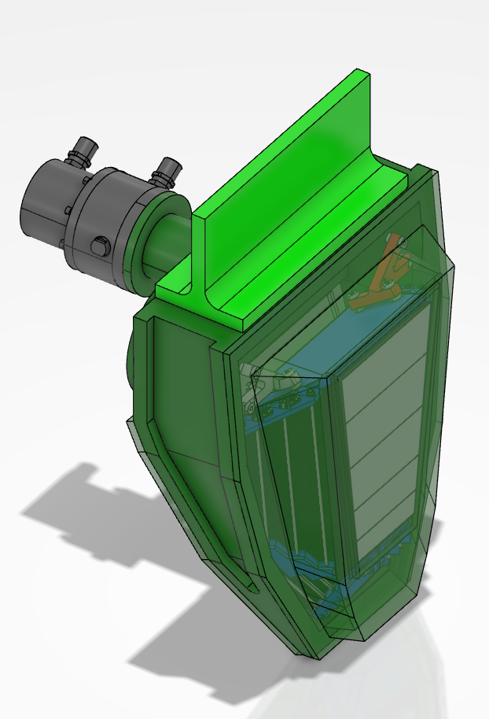
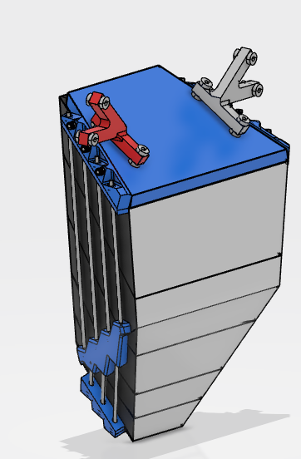
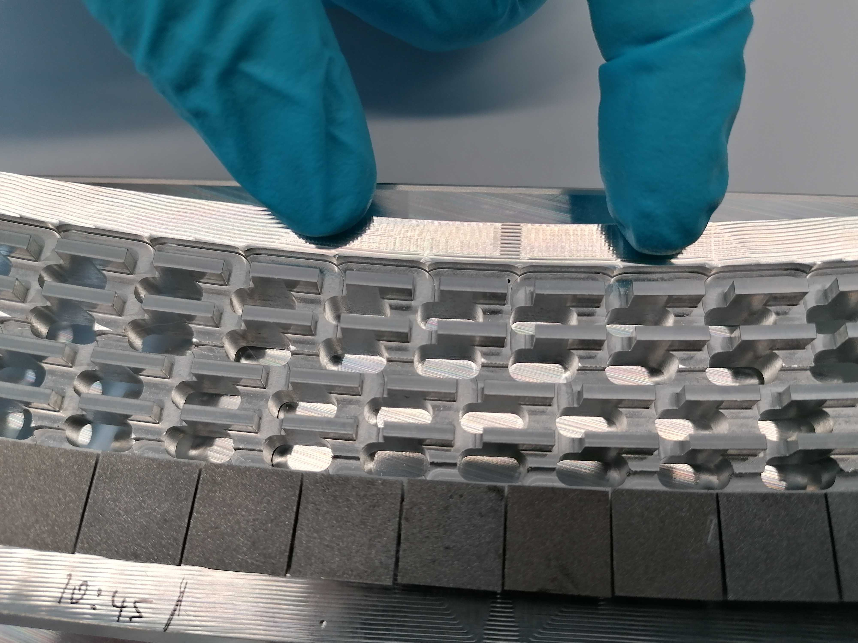
Engineering highlights
From scientific design to engineering design
Strong focus on access and maintainability:
  Translation stage from in-beam to maintenance position
  Translation of the gas boxes
  All detector cartridges can be pulled out of the structure
  All cold heads easily accessible
  Each module can be isolated
  Feasibility of the entire system is confirmed, prototyping is ongoing, procurement to start shortly
Cryostat
Spectroscopy
detectors
Beryllium filters
∅ 2m
Lateral diffraction detectors
n
Gas box & analysers
Core structure
~1.4m

Slide 15
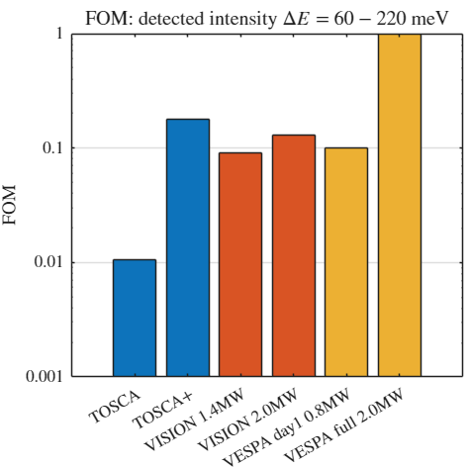
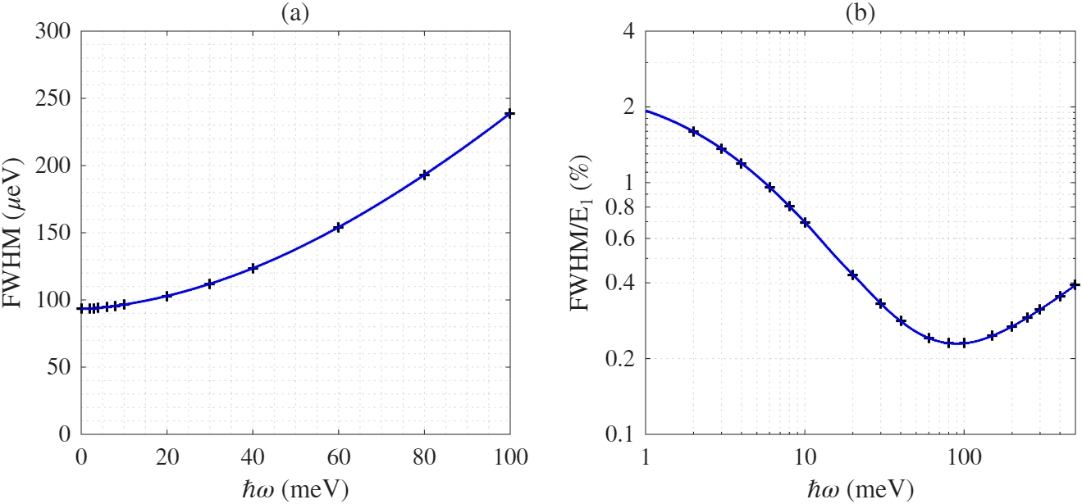
VESPA’s predicted performance
Detected intensity figure-of-merit & other metrics
Detected intensity FOM
  VESPA day 1 (4 out of 16 modules, ESS at 0.8 MW): comparable to state-of-the-art instruments
  Completed VESPA at nominal 2.0 MW: ~1 order of magnitude more intensity
  Flexible energy resolution (0.8-2.5%Ei)
  Excellent signal-to-noise >1e4 (HOPG limit)
  Beyond NVS, VESPA will also provide
  Absolute normalisation of intensity
  Medium resolution diffractogram and PDF
  Low-resolution (5x5 mm) imaging
secondary only
10 x 10 mm² sample

Slide 16
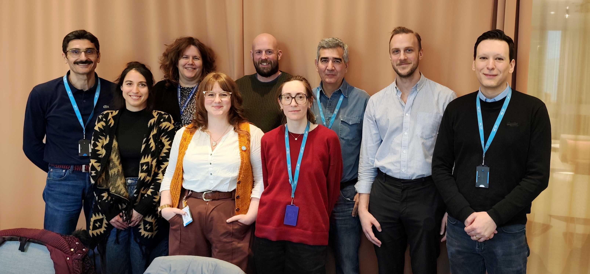
Acknowledgments
Lorenzo Di Fresco (CNR)
Monika Hartl (ESS)
Liam Whitelegg (ESS)
Roberto Senesi (CNR)
Alexander Johansson(ESS)
VESPA commissioning & First Science Experiments
  Q2-Q3 2029
  Start of User Program
  Q4 2029
  Thank you for your attention!
  Any questions?
  adrien.perrichon@ess.eu
  monika.hartl@ess.eu
  vespa@ess.eu
Amalia
Chambon
(DTU)
Helen Popland
(ESS)
Rosa Camilleri (ESS)
Sam Lambrick (CNR/ISIS)

Slide 18
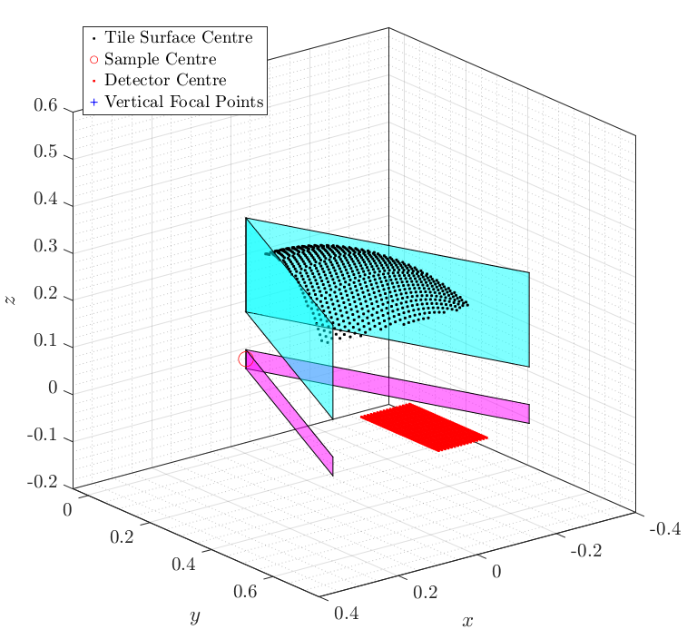
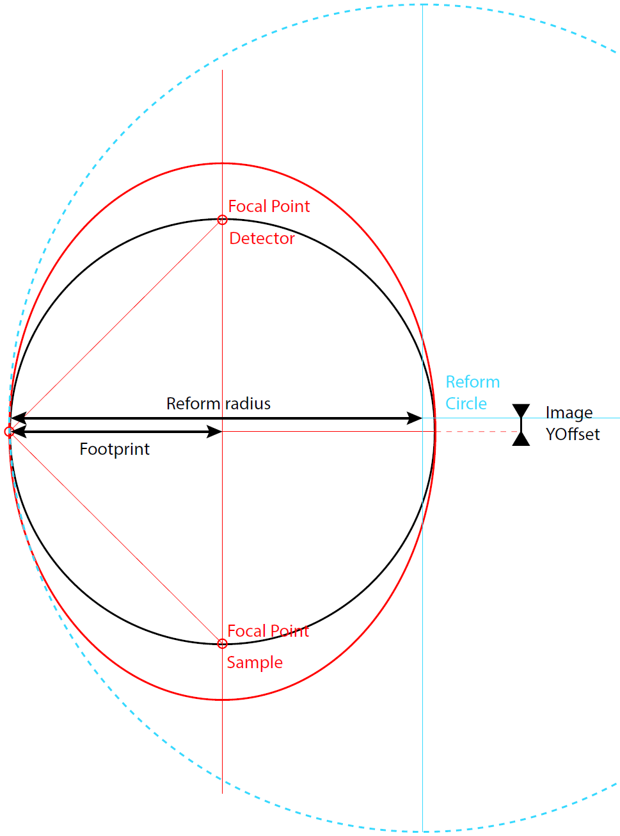
Wheel analyser design optimisation
Numerical optimisation of 13 parameters (incl. 3 fixed)
Footprint = 320 mm
Point-to-point (elliptic) focusing defined by:
  ϕmin & ϕmax (solid angle of analyser)
  Detector position, pitch, number of tubes
Vertical profile optimisation
  Ellipse focal points by sample (y and z)
  Ellipse focal points by detector (y and z)
Horizontal profile optimisation
  Horizontal focusing radius
  Ellipse focal point by sample (z)
  Ellipse focal point by detector (z)
  Collimator envelope is fixed to radial

Slide 19
Neutron Vibrational Spectrometers
International landscape of NVS instruments
Instrument | Institut, Country | Status / Est. op. | Geometry | Ω (sr) | Resolution (% E_{i}) ∗
NERA | FLNP, Russia | Operational | 2θ cylindrical | 0.2 | 1.5-3, depends on scattering angle θ
TOSCA | ISIS, UK | Operational | wheel | 1.0 | 1.5, depends on sample thickness
FANS | NIST, USA | Operational | 2θ cylindrical | 1.1 | 2-5 (Cu220), 2-7 (Cu311), depends on collimation
Lagrange | ILL, France | Operational | single barrel | 2.5 | 2-3 (Cu220), 1.5-2 (Cu331), depends on sample volume/height and collimation
VISION | SNS, USA | Operational | wheel | 3.5 | 1.5, depends on sample thickness
BWAVES | STS, USA | ? | 2θ cylindrical | 1.3 | 3
BJN | FLNP, Russia | ? | double barrel | 5.8 | 4
iMovies | CSNS, China | 2028 | wheel | 4 | 1.5, TBC
TOSCA+ | ISIS, UK | >2030 | wheel | 6.3 | 1.1 (0.8) depends on sample thickness
VESPA | ESS, Sweden | 2029 | wheel | 7.0 | 2.5 (HF), 0.8 (HR) depends on sample thickness
  Trend to maximise Ω (incoherent scattering, limited Q info)
  Development of the “wheel” geometry at spallation source
∗ Resolutions in the fingerprint region (50-150 meV), at the resolution plateau if applicable, else at 100 meV

Slide 20
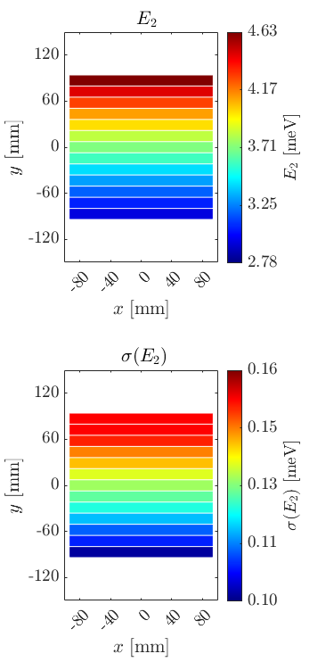
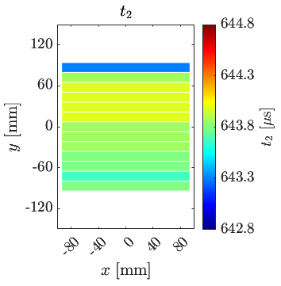
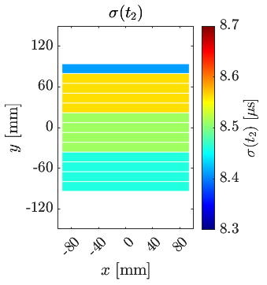
Wheel analyser design optimisation
TOSCA’s ideal wheel geometry
Final energy (E₂) at detector
Time-focusing & energy-focusing geometry
Secondary TOF (t₂) at detector
Perrichon, Nucl. Instrum. Methods Phys. Res. A. 1041 (2022) 167401

Slide 21
Wheel analyser design optimisation
Toward a 3rd generation of the wheel geometry concept design
Design goal to maximise the solid angle Ω while keeping the resolution close to the theoretical limit
Design goal to achieve a signal-to-noise ratio SNR>10⁴
TOSCA
Defocusing (flat)
= 1.0 sr
ΔE_{th.} = 0.7% Ei
VISION
Focusing (∼elliptical)
= 3.5 sr
ΔE = 1.5% Ei
VESPA Focusing (∼parabolic)
= 7.0 sr
ΔE_{th.} = 0.8% Ei

Slide 22


VESPA’s wheel analyser
Predicted (McStas) “per pixel” properties (37 PSD tubes with 5 mm pixel length)
Parameter | Value
Detector coverage | 93.2%
Detector capture | 95.6%
Filter transmission | 78.8%
E2 (min – max) | 2.95 – 4.74 meV
E2 (average) | 3.89 meV
Resolution at 150 meV | 0.32% (*)
(*) Missing contributions from tile thickness and detector electronics, approx. 0.5% total

Slide 23




VESPA’s wheel analyser
2θ
E2
Q-dependency, coverage & resolution
n

Slide 24


VESPA’s wheel analyser
Predicted beryllium filter performance
Assembly of Be wedges and Cd blades
Blades aligned on vertical divergence
Transmission (E<5 meV) 78.8 %
Transmission (E>5 meV) <1e-4
~3e-5
~7e-5
~5e-5
~1e-4
118 mm
~3e-4
175 mm
128 mm

Slide 25

Engineering highlights
From scientific design to engineering design
760mm

