Slide 2
Cooling the ESS rotating tungsten target with high-temperature helium
From design to operational readiness
PRESENTED BY Naja de la Cour on behalf of the team:
Jaroslaw Fydrych, Mikael Olsson, Tomas Labuda, Kennet Lindström, Lóránt Horváth, Jimmy Lindahl, Jaime Arriagada, Sven Jönsson, Lennart Åström et. Al.

Slide 3
Content
Basic design concept of the Target Helium Cooling System (THCS)
Design evolution implementing the screw compressor
Installation in occupied areas
Testing and commissioning experience with the screw compressor
Readiness for beam on target with the screw compressor

Slide 4
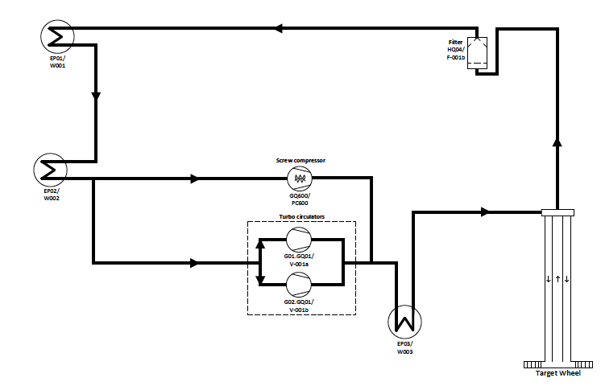
Main Layout
Target Helium Cooling System
KEY DATA
Media: Helium
Mass flow: 1.8-2.7 kg/s
Temperature: 40-240℃
Pressure: 7 – 11 bar(a)
Volume 16-18 m³
Heat load: 3 MW
Future installation
Design Installation Testing Challenges Success!
Notes:
Not to be confused with a cryogenically cooled system
Trivia: at full mass flow; 2.7 kg/s, and given pressure, the full system volume is circulated every 8-9 seconds

Slide 5
Design evolution
Implementing the screw compressor
As a redundancy to the turbo compressors, it was decided to implement an oil-free* screw compressor at a late stage in the project.
The original design was adapted for operation with the turbo-circulator only, and the implementation of an additional compressor with support systems heavily impacted several installed systems.
The compressor is of a standard design but customised for helium use and was chosen for reliability and for diversifying of the system.
*Compression is oil free, gear-box is lubricated
Design Installation Testing Challenges Success!
Notes:
Trivia: the density of air at atmospheric conditions is approximately the same as helium at 8 bar (a)

Slide 6
Backup circulator background
Turbo Circulators
Backup Circulator
Cooling water
Oil Separation system
Controls
Additional power supply
Radioactive waste handling
Electrical
Physical interface
Oil detection system
Design Installation Testing Challenges Success!

Slide 7
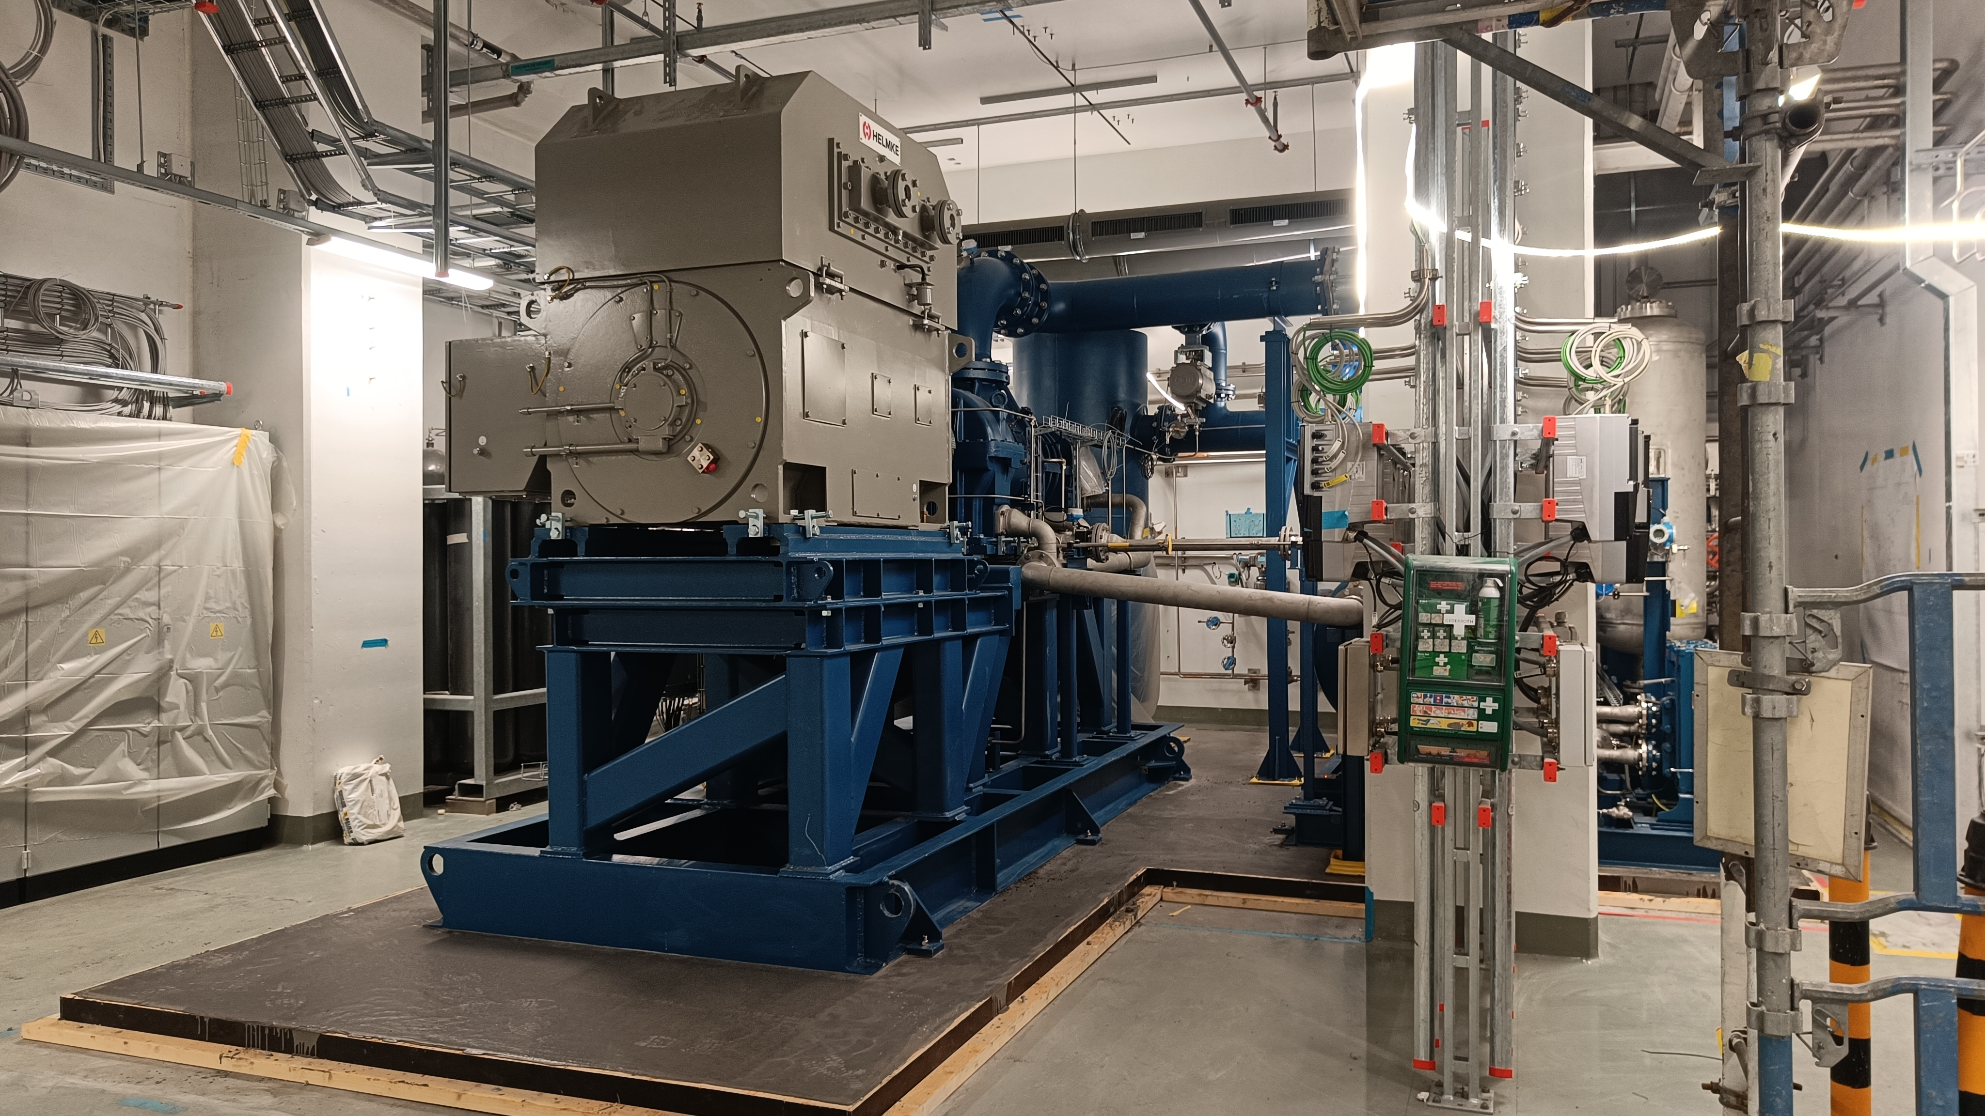
Installation
Design Installation Testing Challenges Success!

Slide 8
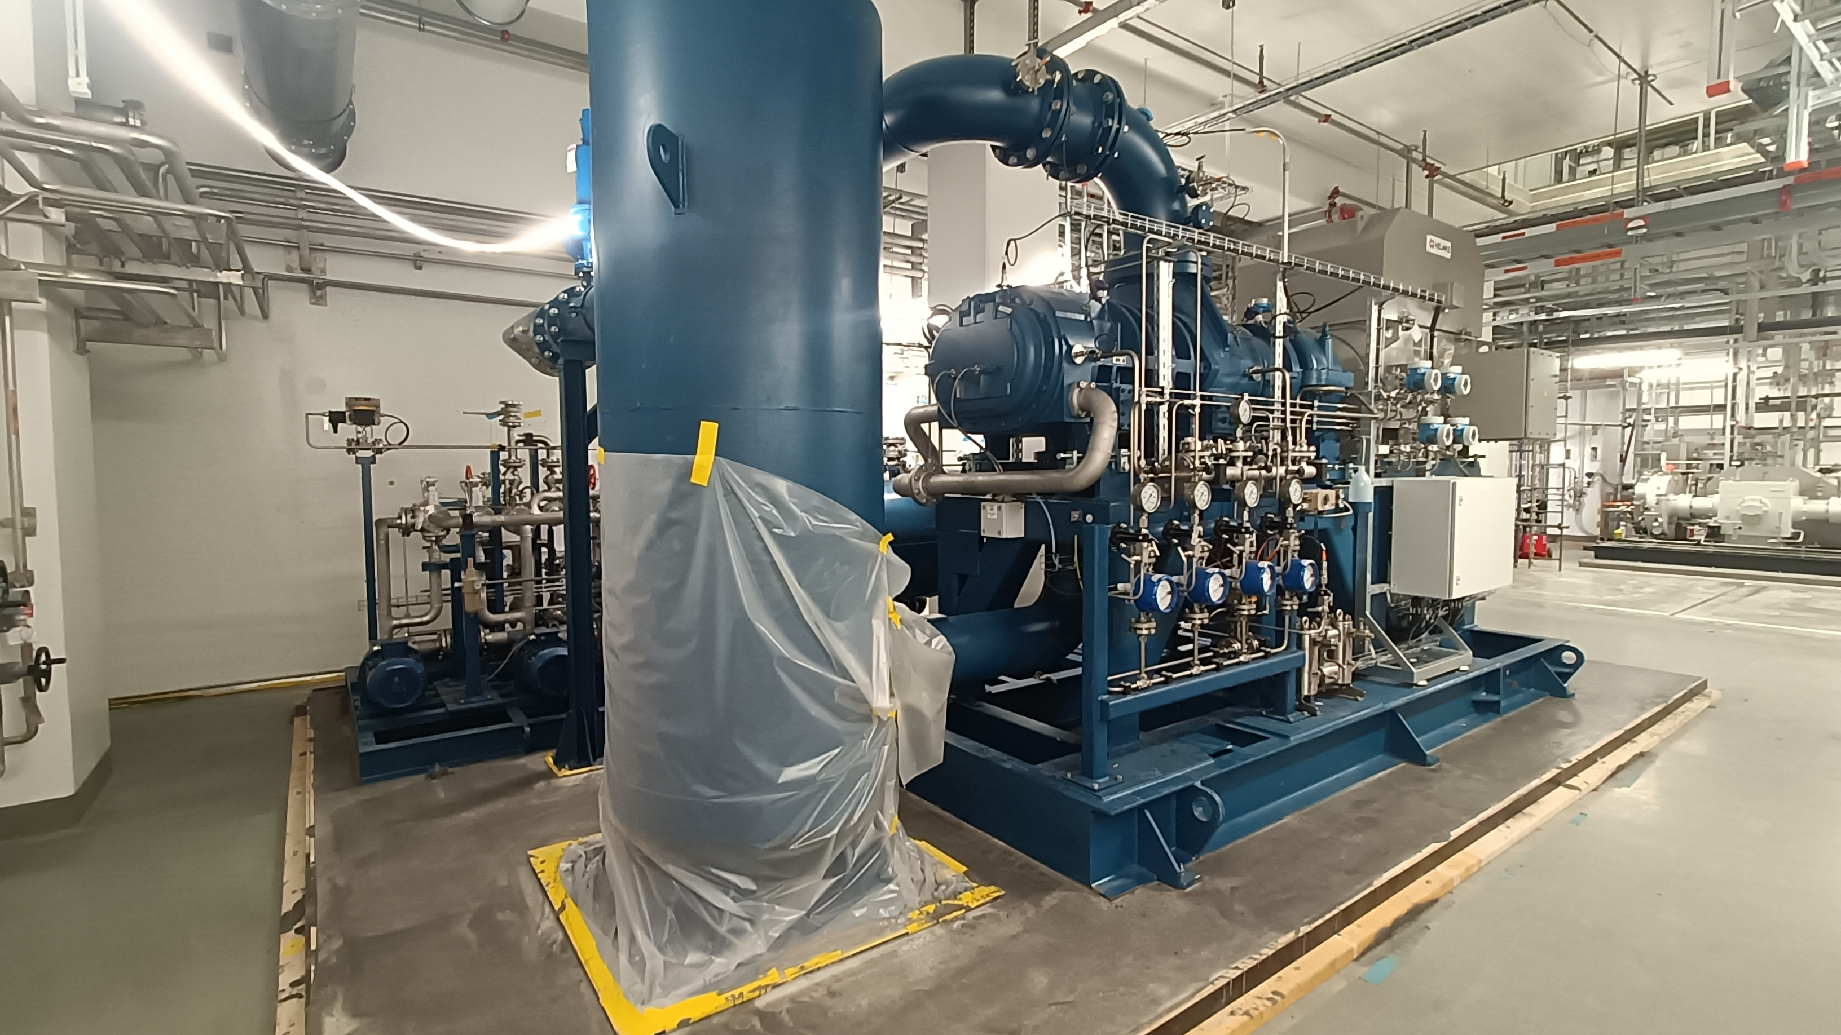
Compressor and oil skid
Design Installation Testing Challenges Success!

Slide 9
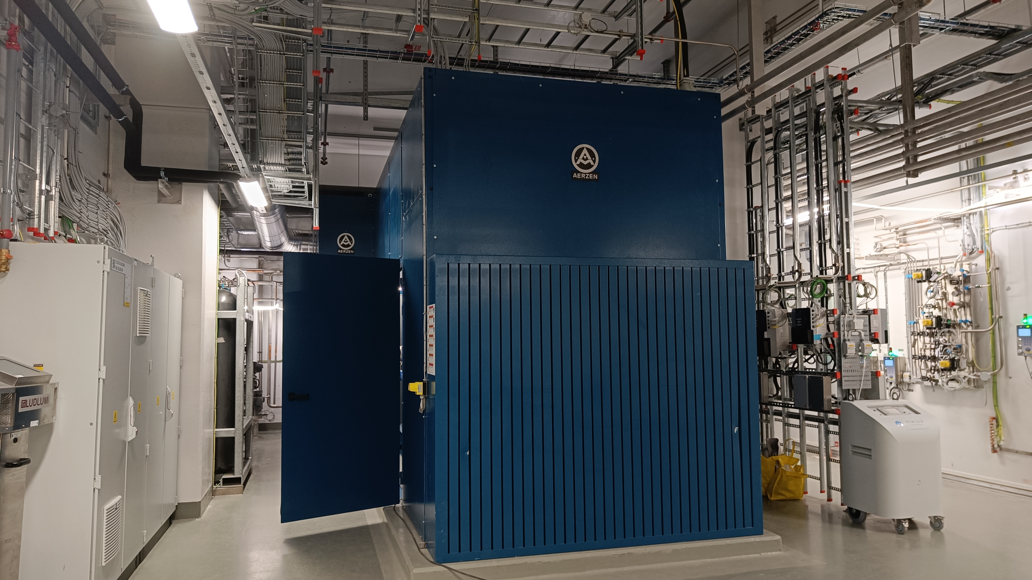
Sound hood
Design Installation Testing Challenges Success!

Slide 10
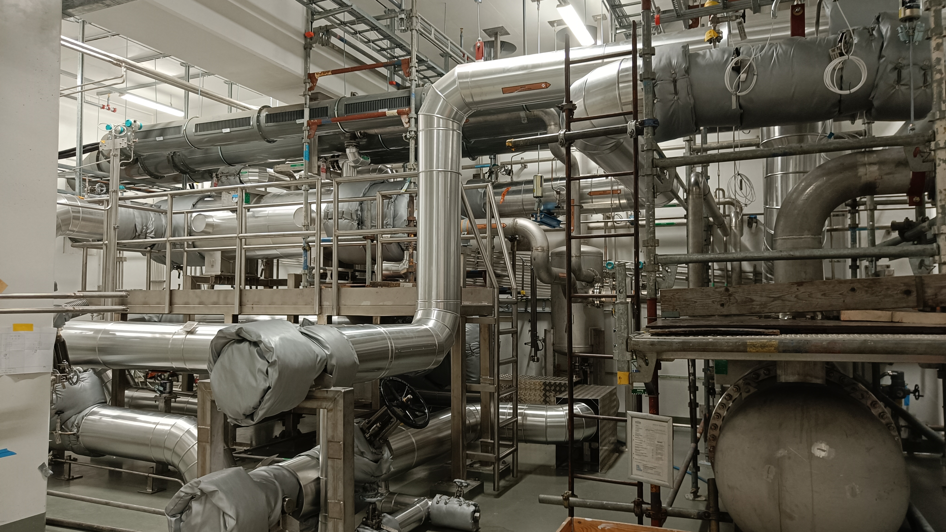
Target Helium Cooling System
Design Installation Testing Challenges Success!

Slide 11
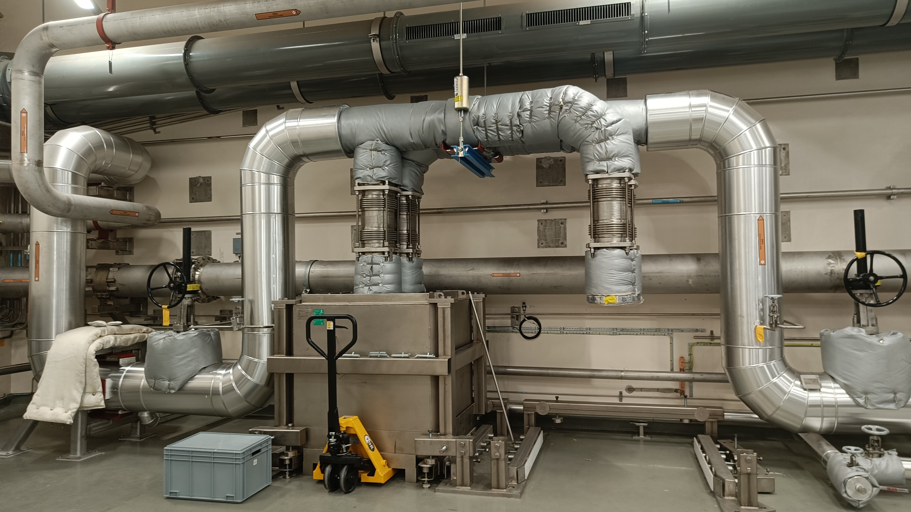
Main loop filter
Design Installation Testing Challenges Success!

Slide 12
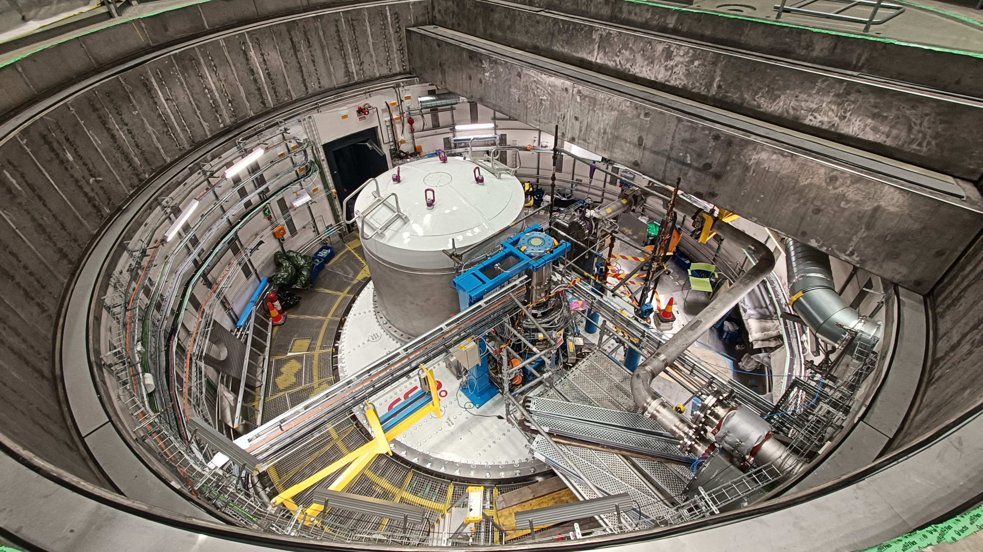
Target Wheel connection
Design Installation Testing Challenges Success!

Slide 13
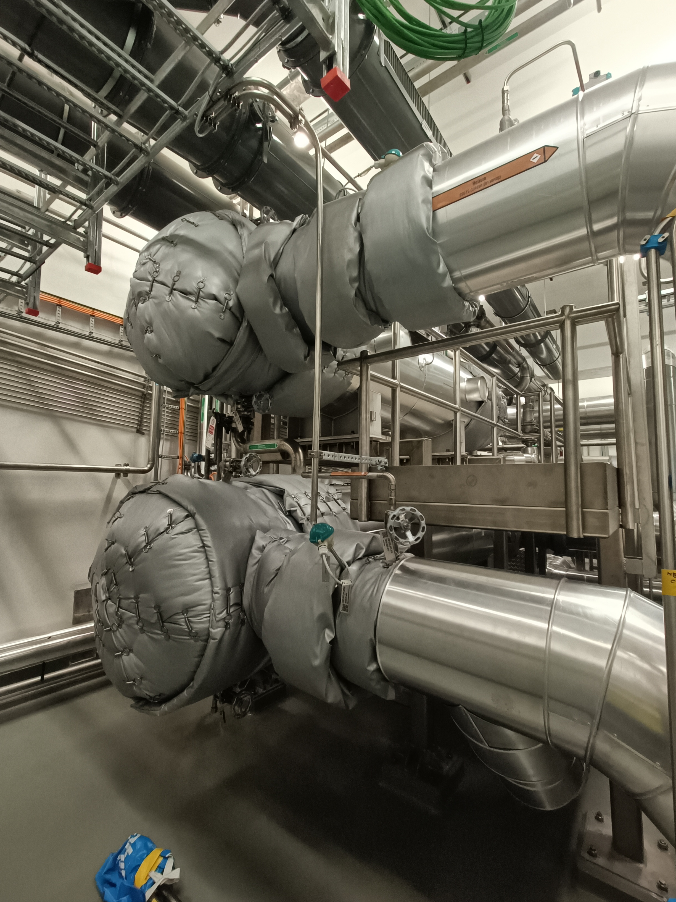
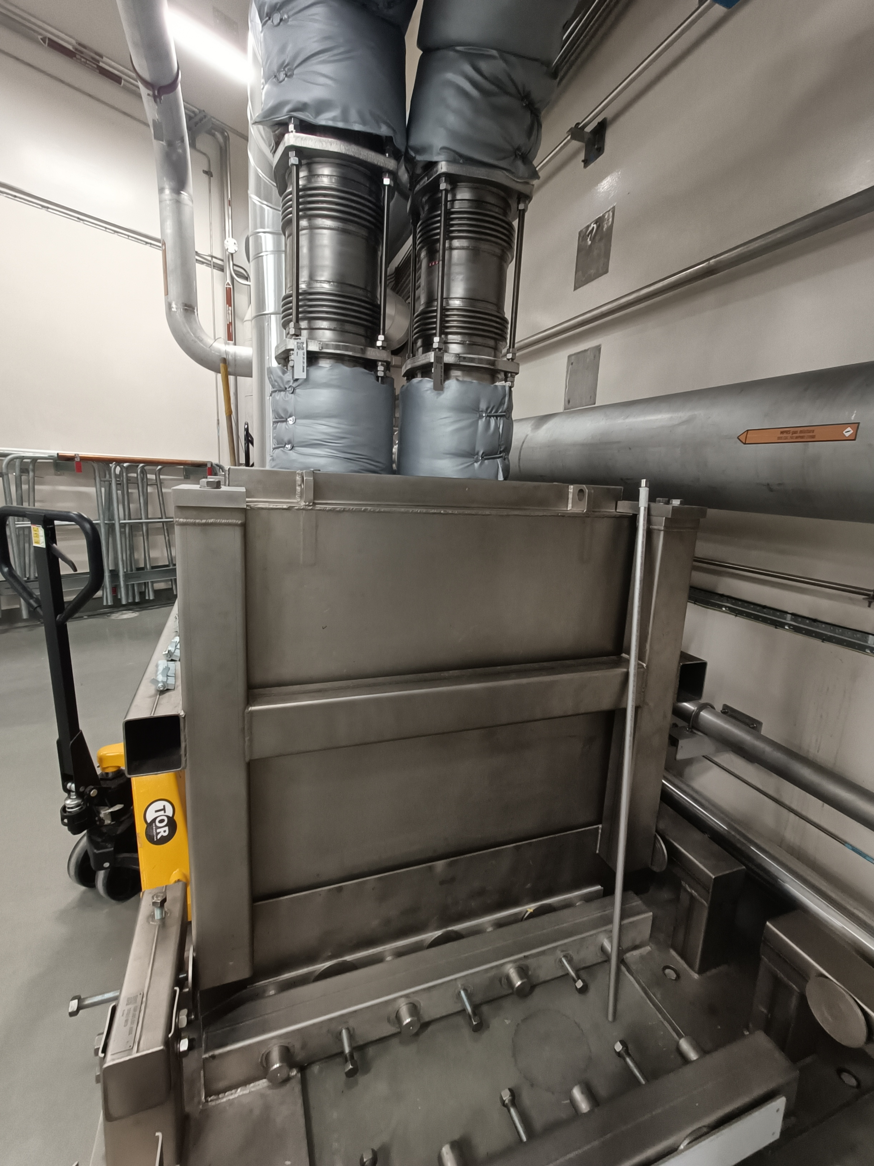
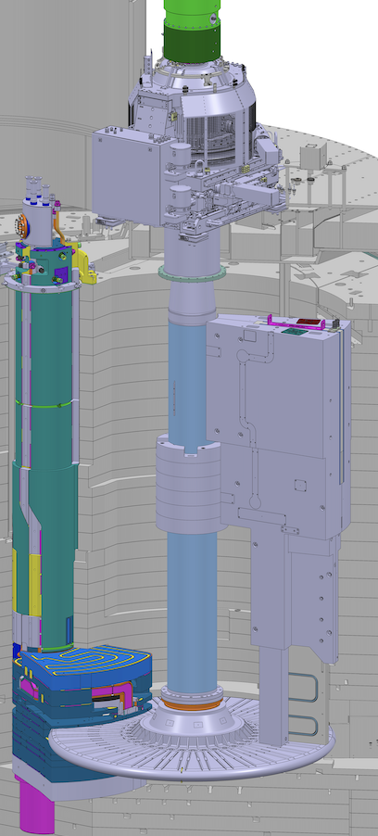
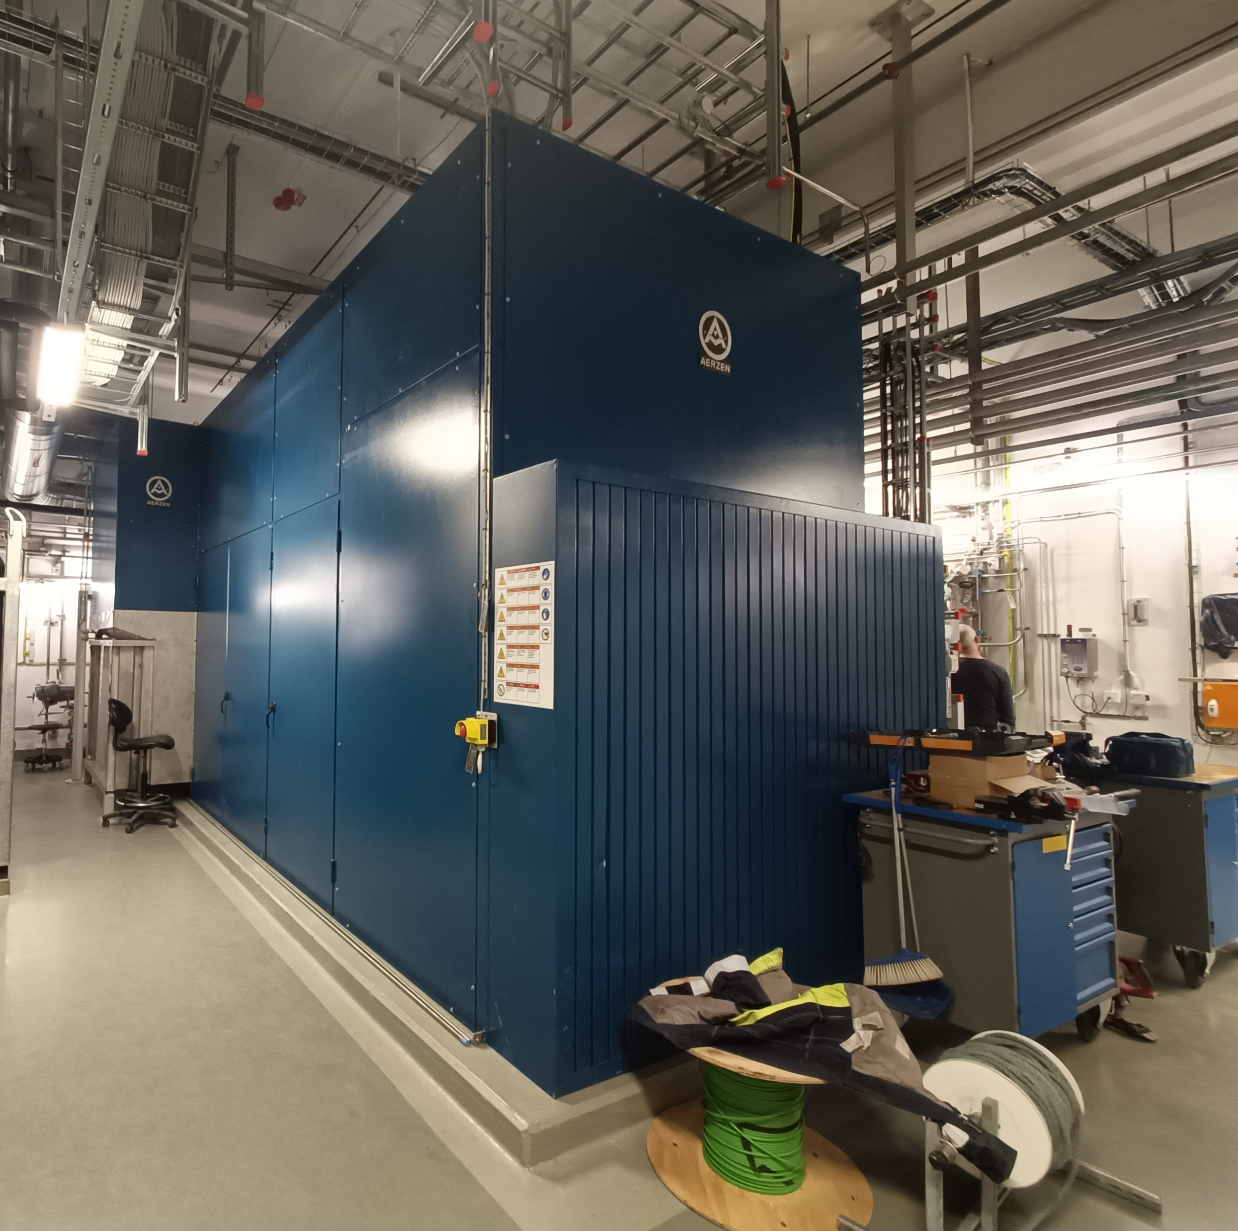
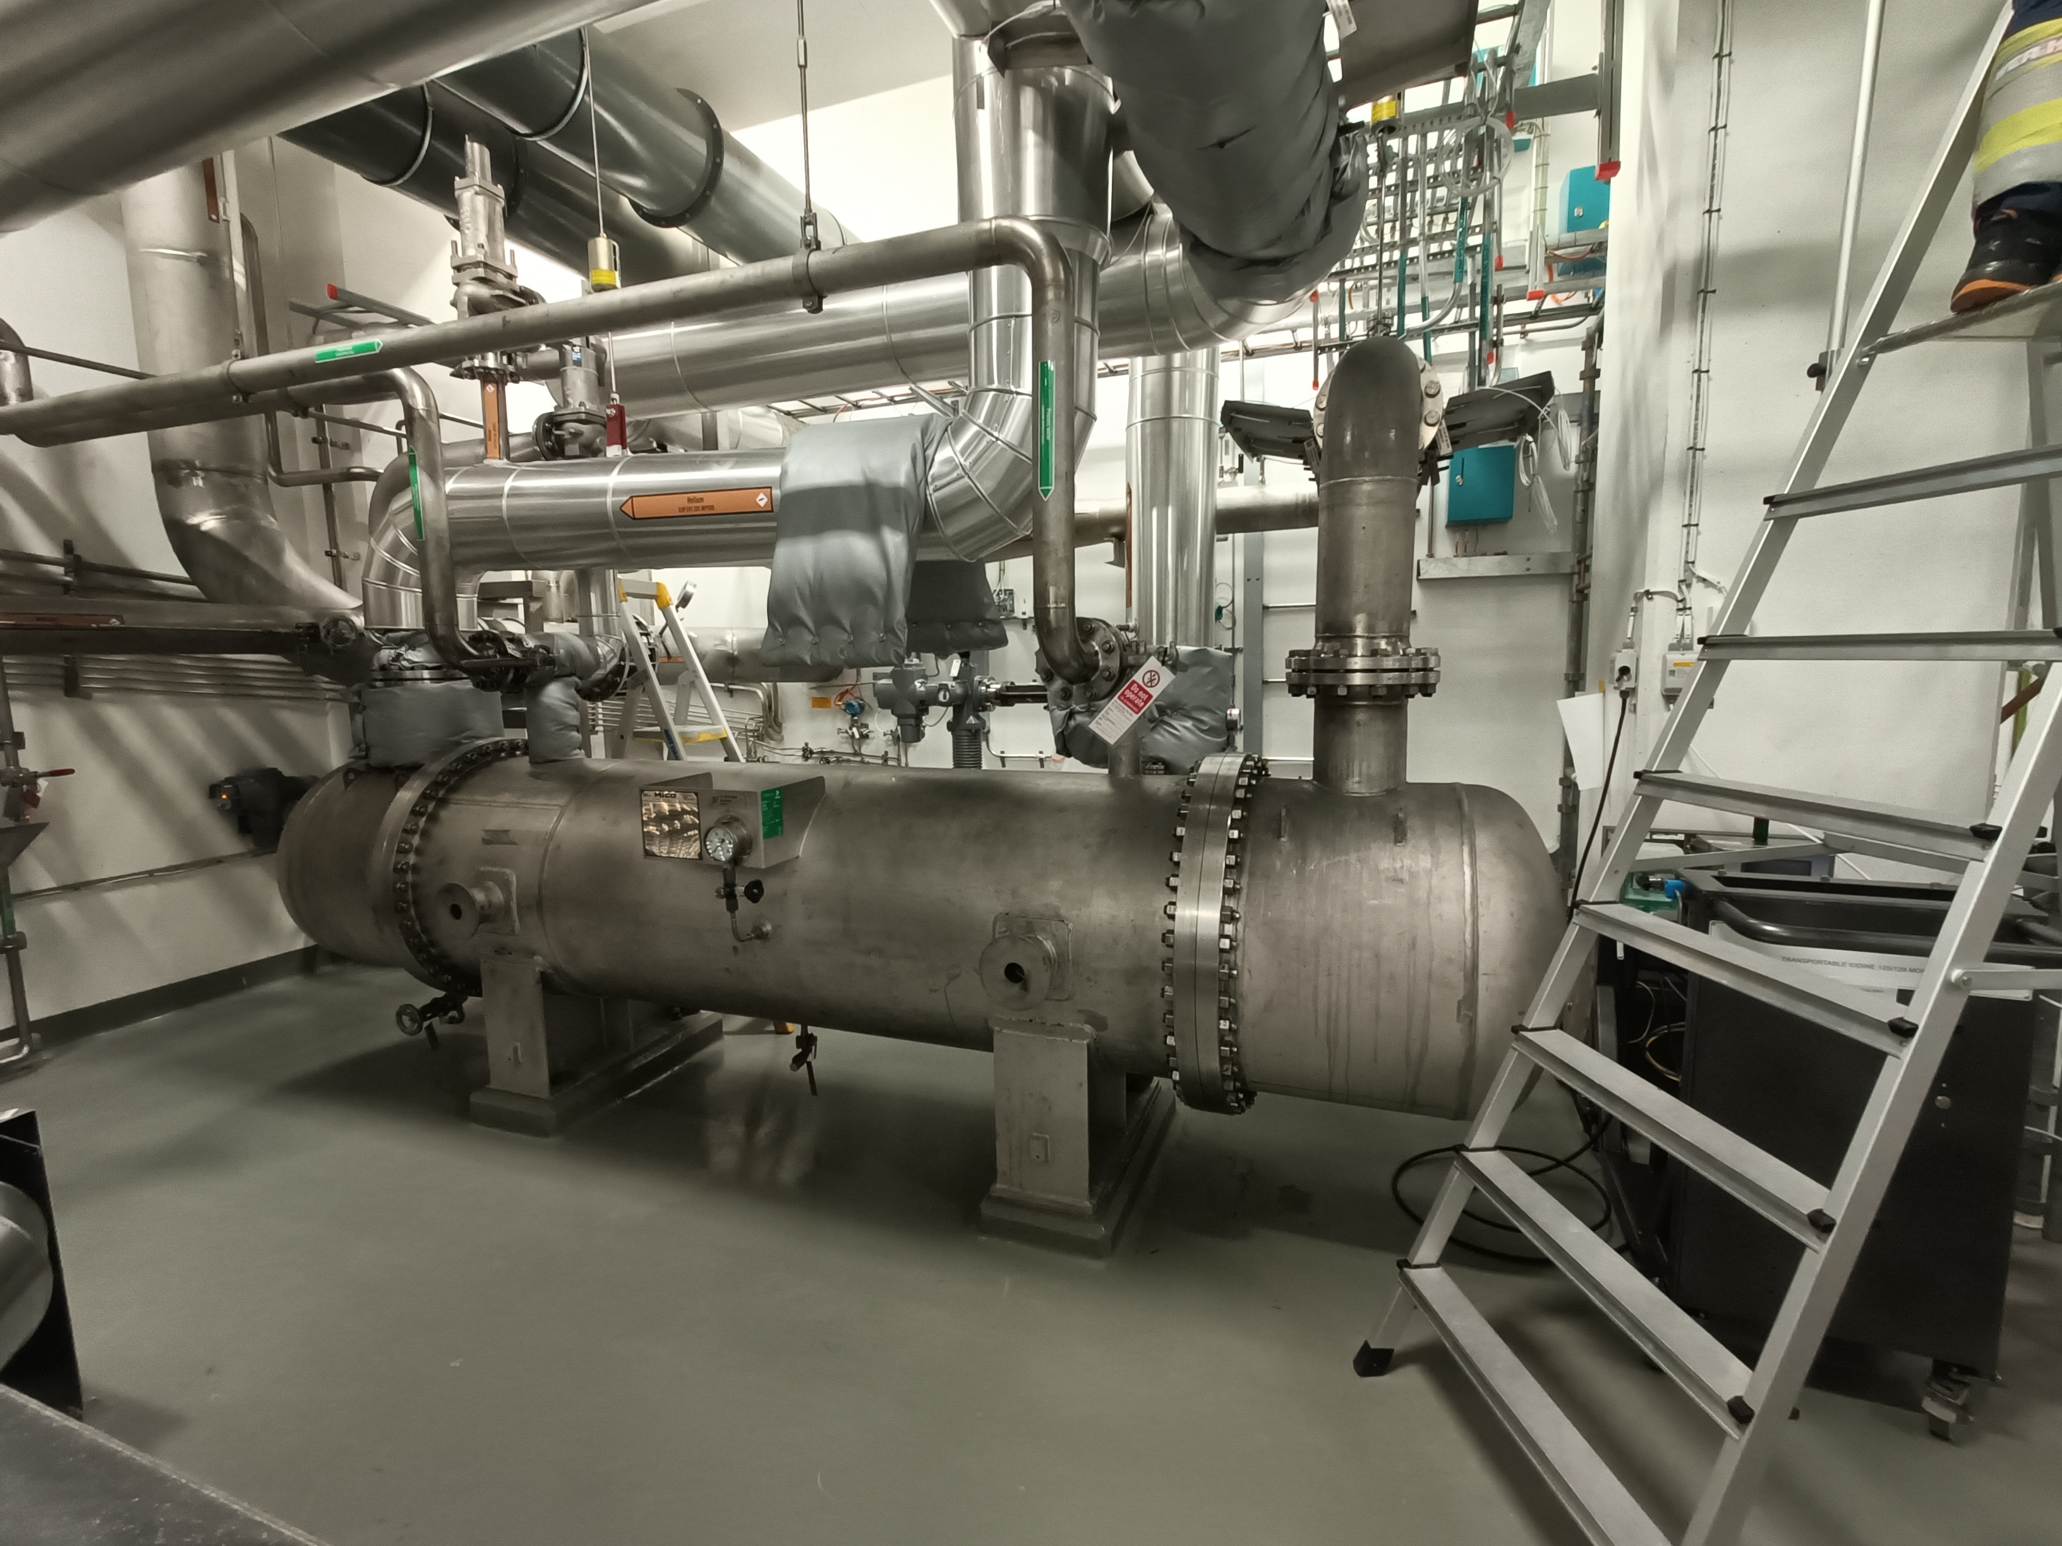
Main Layout
Target Helium Cooling System
Future installation
Design Installation Testing Challenges Success!

Slide 14
Testing and Commissioning
September 2025
Functions and interactions verified together with all supporting systems:
    Pressure control system
    Helium Injection System
    Helium Purification System
    Water Cooling Systems
    Safety Systems
  Operation worked well up to the helium design flow for 5 MW beam power; 2,7 kg/s.
Design Installation Testing Challenges Success!

Slide 15
Testing and Commissioning findings
Understanding the personality of the system
  Sensitive to variations in operating parameters
    pressure losses, flow-induced effects and vibration phenomena
  Largest outcome - to adjust conditions to be able to minimise impact from vibrations, leading to future installations and improvements
  Initially unstable until the main critical vibrations were identified and a running of the system where those vibrations were passed quickly, was defined.
Design Installation Testing Challenges Success!

Slide 16
Vibrations
Media density, volume and heat
  Media density impact – Helium 95% vs Helium 4.6 (99.996%)
  Running in bypass vs. through the target wheel
  Commissioning with beam – upcoming challenges
Design Installation Testing Challenges Success!
Notes:
When the density of the media changes, the critical vibrations move as well.
To save on helium, Helium 95% was initially used until the system was more stable and leak tight. Further testing made use of Helium 4.6 (99.996% He)
The air content of the Helium 95% had a huge impact on the density and was approximately 32% heavier than He 4.6 due to the air content.
Another vibrational impact was found when running the system in bypass instead of through the target wheel as the system volume was different.
When commissioning with beam, the vibrations will move again, but the team is prepared and the strategy and method is defined.

Slide 17
Pressure drop
Turbo vs screw compressor needs
The main THCS Target Helium Cooling System is designed to minimise pressure drops.
The screw compressor requires a pressure drop over the system. This is not expected to be needed when running with the turbo machines.
Solution: restrict the flow to a valve feeding the compressor
Design Installation Testing Challenges Success!

Slide 18
Operational modes
Filling vs running the system
The pressure control system is designed for filling and emptying the system quickly
Additionally, the pressure retention compressor is designed to handle maximum flow.
Solution: implement a bypass design with smaller valves to ensure a more stable flow and complement the system with an additional pressure retention compressor for normal operation conditions.
Design Installation Testing Challenges Success!

Slide 19
Status: Successfully commissioned under cold operational conditions
Improvement possibilities identified:
  Introducing a regulating valve for pressure drop
  Adding bypasses to streamline the system for operation
  An additional smaller pressure retention compressor – more suitable for operational needs
Design Installation Testing Challenges Success!

Slide 20
Ready for Beam On Target (BOT)
Readiness for operation
  Target Helium Cooling System is ready for operation
  The team is preparing for additional challenges and learning opportunities for when the system is being subjected to heat and with the added volume of the turbo circulators
  Several design improvements have been identified and will be implemented during ordinary maintenance periods, streamlining the design for optimal operation without impacting BOT
Design Installation Testing Challenges Success!

Slide 21

Key takeaways
Include all modes of operation during design
Get to know your media
Don’t underestimate the importance of testing
Expect to make future upgrades
It’s not a problem, it’s a challenge

